Slide 1



Session 1: Intro to Wealth Creation
September 12, 2025

Slide 2

Objectives
Get to know each other.
Review the cohort timeline
Understand the wealth creation principles
Notes:
Melissa

Slide 3
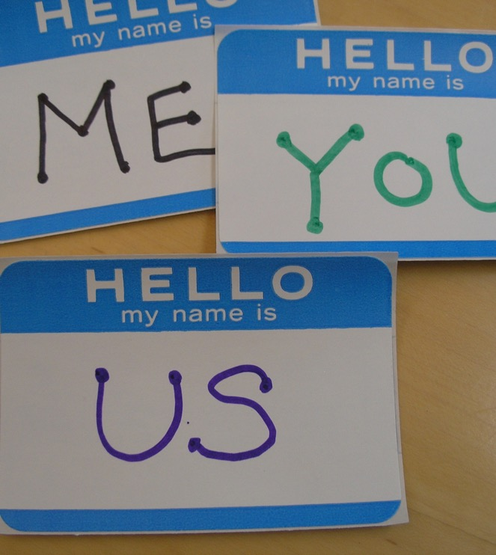

Introductions
Name
Organization
Favorite fall food

Slide 4
Introduction to WealthWorks: Key Concepts
History
Intent
Principles
Forms of Wealth
Stocks versus Flows
Notes:
Shanna
We are going to be offering you a good deal of content in the next few minutes. Take in what you can. Don’t worry if you feel a bit at sea. That’s normal. Be assured you are not alone. Wealthworks is not business as usual and it generally takes more than one exposure to some of the key concepts to understand what it’s about. Holli can point you to additional resources. If you have a clarifying question as we go along, please raise your hand and we will do our best to answer it.

Slide 5
History of WealthWorks
Development began in 2006 – the search for a new and more effective framework for meaningful rural development.
Ten years of testing in the field in the poorest parts of the U.S. (Deep South, Central Appalachia, Lower Rio Grande Valley)
Success! Even during a national recession.
Adopted by USDA, National Association of Development Organizations, Action Aid International and others.
WealthWorks is a framework, not a cookie-cutter approach. It is adapted to each new opportunity.
I’m here help you get started adapting it to your place.
Notes:
Shanna

Slide 6

Intent
WealthWorks intends to change the way rural development is practiced in the US from attraction, extraction, and supply-based approaches to a demand-driven wealth-based approach. Wealth-based development helps low-wealth rural areas overcome their isolation and integrate into regional economies in ways that increase their ownership and influence over various kinds of wealth and lead to improved and sustainable livelihoods.
Notes:
Shanna.

Slide 7
Guiding Principles
1. Wealth creation is demand driven.
2. Wealth creation is intentionally inclusive.
3. Wealth is generated by WealthWorks value chains.
4. Measurement is integrated into the entire process as a tool for planning & adaptive management.
5. Wealth sticks in places through attention to structures of ownership and control.
6. The wealth creation approach is strategically flexible while doing no harm.
Notes:
Shanna.
Today we will explore principle #1 and #3 in some depth.

Slide 8
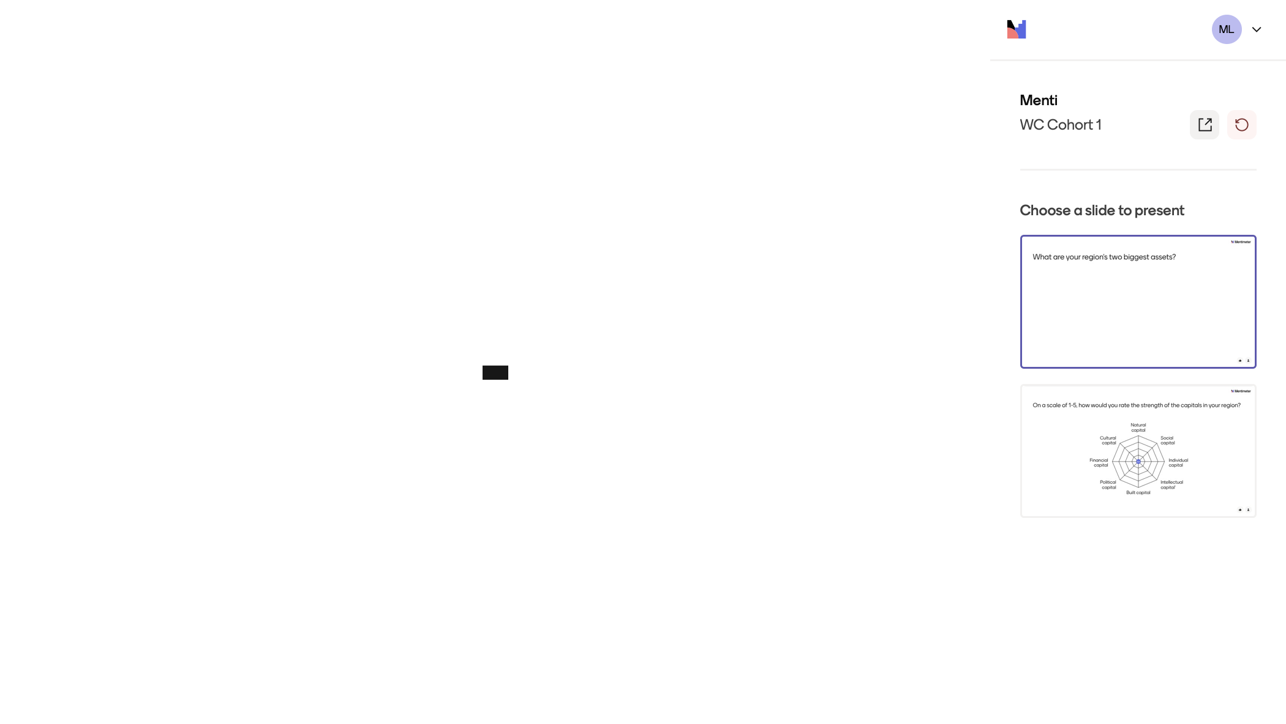

Slide 9

Exercise:
What Makes a Community Great?
E
What are the positive assets in your community? What would land your place on a “Top 10 Places to Live” list?
These are the assets you can build upon.
Take a few minutes to ponder this.
Either unmute and tell us two of your place’s top assets or write them in the chat.

Slide 10

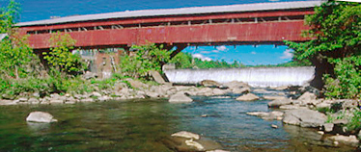
Wealth creation is an approach to economic development
connects a region’s assets to market demand in ways that build rooted wealth for local people, places and firms.
brings together a range of public, private and non-profit sector partners who have self-interest in the outcomes and an openness to discovering shared or common interests.
focuses on building a sector rather than individual and unrelated businesses.
Notes:
Goal: Advance a region’s prosperity by building wealth that sticks
WealthWorks is a bridge between community development (voice, empowerment, organizing) and economic development (attraction, retention, entrepreneurship).

Slide 11



Principles of Wealth Creation
#1 – Create wealth, broadly defined, and aspire to do no harm.
#2 – Root wealth in local people, places and firms through local ownership, control and influence.
#3 – Build lasting livelihoods by intentionally including people and firms on the economic margins.
Notes:
Wealth building framework has three critical goals:
Create wealth broadly defined – includes 8 capitals. Aspire to do no harm to any.
Root wealth in place – pay attention to who owns, controls and influences the wealth that’s created. Root wealth in local peoploe, places and firms through local ownership, control and influence.
Build lasting livelihoods especially for people and firms on the margins – intentionally including economically-marginalized residents.
Use a systems approach – Wealth Creation Value Chains – to build value in existing and emerging sectors.

Slide 12

#1: Investing in and Building 8 Capitals
Wealth is not just money.
Wealth is the reservoir of all assets that can contribute to the well-being of people, places or economies.
Every place has wealth.

Slide 13
t
Wealth Components: Eight Capitals
Key Concept
Intellectual
  Knowledge and innovation
Assessment
Design
Measurement
Individual
  Skills, education, health
Social
  Trust and relationships
Natural
  Natural resources
Built
  Infrastructure
Political
  Influence on decision makers and shapers
Financial
  Savings and investment
Cultural
  Traditions, customs and ways of doing
Notes:
Realize that you all are familiar with the triple bottom line. This isn’t really different … just unpacks the three capitals into greater detail… The other addition is that this approach focuses on both inventory and then investing in building our “stocks” of these capitals/assets. We recognize that without active investment, resources will depreciate.

Slide 14
WealthWorks builds stocks of wealth
Most projects focus on income (a flow)
instead of on building wealth (a stock).
INCOME
WEALTH
EXPENSE
Notes:
Shanna
Our current economy is based on overconsumption and underinvestment. Many of our stocks of wealth have dwindled or depreciated – natural resources, human health, infrastructure, intellectual capital, etc.

Slide 15
Stocks vs. Flows
Notes:
Shanna
All stocks of wealth depreciate over time. We must continually reinvest in them to maintain and grow them. The larger and healthier our stocks of wealth, the more “income’ they generate and the more we can consume while still having enough left to reinvest.

Slide 16
Exercise
Which form of wealth are you best at building? What is one example of how you have done that?
Notes:
Shanna
Teacher, health care worker, engineer, farmer, banker, etc. in a relationship,

Slide 17

#2: Wealth without Ownership isn’t Rooted
Capitals that are “owned” locally build wealth.
Ownership means you capture and control the flow of benefits from the capitals over time. It creates enduring, stable benefits.
Benefits – e.g., income, know-how, better technology – flowing from local ownership of capitals can be re-invested and re-circulated locally, enriching many.
Preserving local ownership or control over your capitals can increase the chances of preserving local jobs.
Local ownership is an anchor that helps wealth and change to stick.

Slide 18
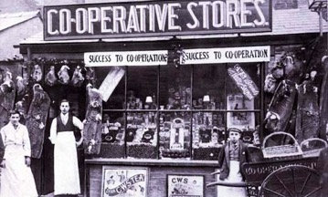
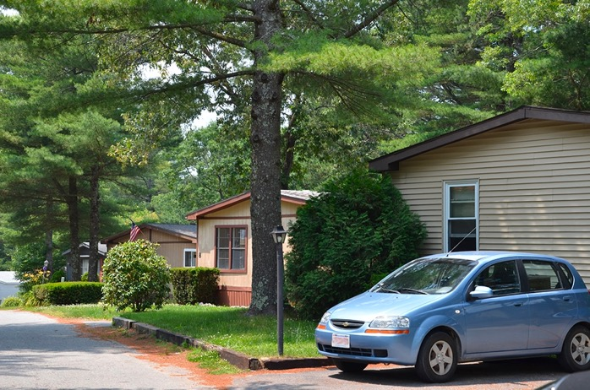
Making Wealth Stick: Local Ownership and Control
Cooperatives
Resident Owned Communities
Buy Local Campaigns
Regional branding
Notes:
Ownership and control looks like…
Many locally-owned businesses committed to the community
Local access to certificates or two-year degrees through the community college
Local endowment in the community foundation or affiliate
Other examples?

Slide 19

#3: Build Lasting Livelihoods
“Lasting livelihoods” means…
Ability to overcome vulnerability, maintain dignity and control, take risks to seize opportunities.
People at the margins are earning (and saving!) more.
They have improved skills to qualify for higher-paying jobs and to build their careers.
They are putting something aside for the future, e.g., building assets, so they are more resilient.
Notes:
Lasting livelihoods” means…
Low-income residents are doing better today, with improved skills to qualify for higher-paying jobs.
They are earning more and building careers.
They are putting something aside for the future, e.g., building assets, so they are more resilient.
They have better future prospects so they can give back their time, talent, and even treasure to the community.
Many places harbor underutilized assets ̶ people’s know-how and energy, natural resources, buildings, influence, connections… – that are not contributing to the broader economy.
Underutilized assets can be connected, developed, and linked to markets in ways that create wealth.
Economically-marginalized people and places are resources –and they (and everyone) will do better if they are connected to larger economies.
Need to include all, but too often economically-marginal are excluded

Slide 20
A Continuum for EDDs
Focus on Assets - CEDS
SWOT
Measuring outcomes
Sector-specific
Collaboration
Value chain development
Value chain mapping
Filling gaps in the chain
Coopetition
Notes:
It’s not one size fits all. The entry point is to use the discussion of capitals/assets in your CEDS planning.

Slide 21
Cohort Timeline
Session | Topic | Dates
1 | Intro to Wealth Creation | 9/12 and 24
2 | Wealth Creation & CEDS | 10/8 and 22
3 | Understanding Demand | 11/5 and 19
4 | Value Chain Selection/Identifying a Market Opp. | 12/3 and 17
5 | Mapping a Value Chain | 1/14 and 28
6 | Identifying Gaps, Bottlenecks, Underutilized Assets | 2/4 and 18
7 | What’s next? | 3/11

Slide 22
Homework
https://www.nado.org/training-materials-and-resources/

Slide 23
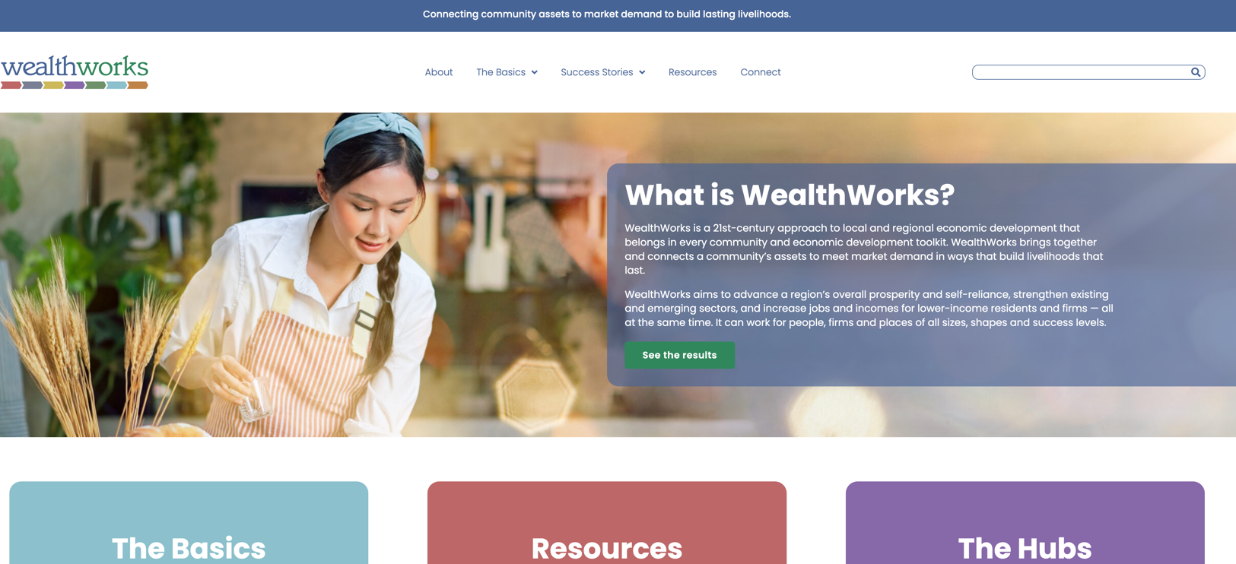
WealthWorks Website - www.wealthworks.org

Slide 24
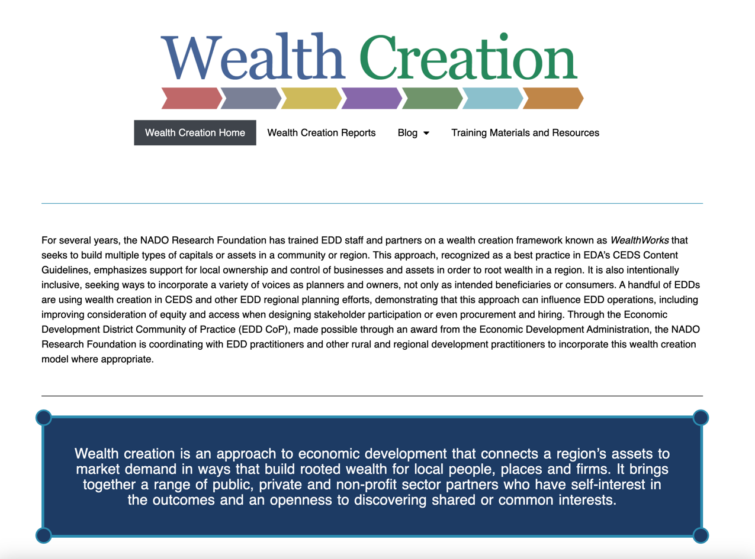
NADO Wealth Creation Website – www.nado.org/wealthcreation

Slide 25
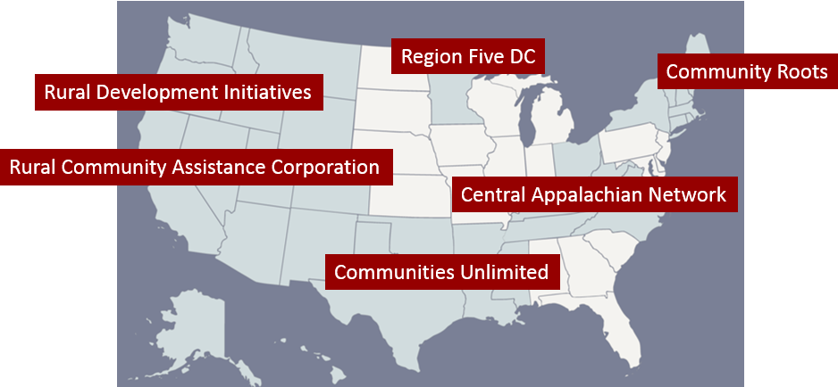
WealthWorks Regional Hubs
http://www.wealthworks.org/connect/hubs

Slide 26


Slide 27

For More Information
Melissa Levy
NADO
mlevy@nado.org
www.nado.org

