Slide 1
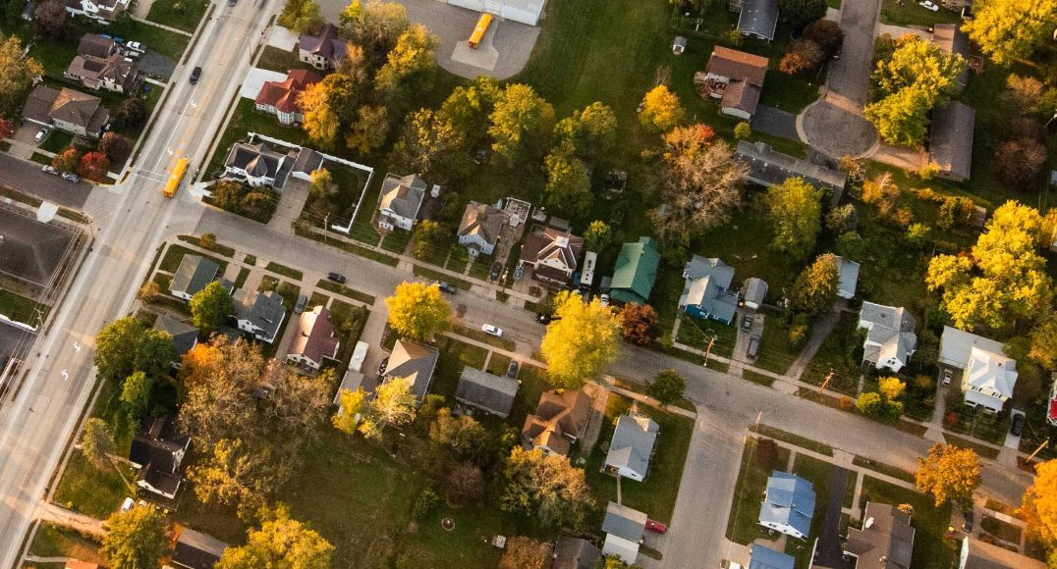
How to Create Bicycle/Pedestrian/Trails Plans in Small Towns in the Midwest
Credit: City of Viroqua

Slide 2
Towns Outside of MPO Areas
Town | Population | Plan/Study
Albert Lea, Northfield, Red Wing | 17,000 – 21,000 | Maintenance Planning for Pedestrian and Bicycle Facilities in Greater Minnesota
Amery, WI | 3,000 | Stower Seven Lakes Trail Plan
Avon, Dante, Geddes, Lake Andes, Platte, Tabor, Tyndall, Wagner (SD) | 100 – 1,500 | Tabor to Platte Rail to Trail Feasibility Study
Baxter, MN | 9,000 | Bicycle & Pedestrian Policy Study
Brookings, SD | 24,000 | Bicycle Plan
Vermillion, SD | 12,000 | Bicycle Plan
Viroqua, WI | 4,500 | Bicycle & Pedestrian Plan and SRTS Addendum
Winona, MN | 26,000 | Complete Streets Policy and Pedestrian and Bicycle Plan

Slide 3
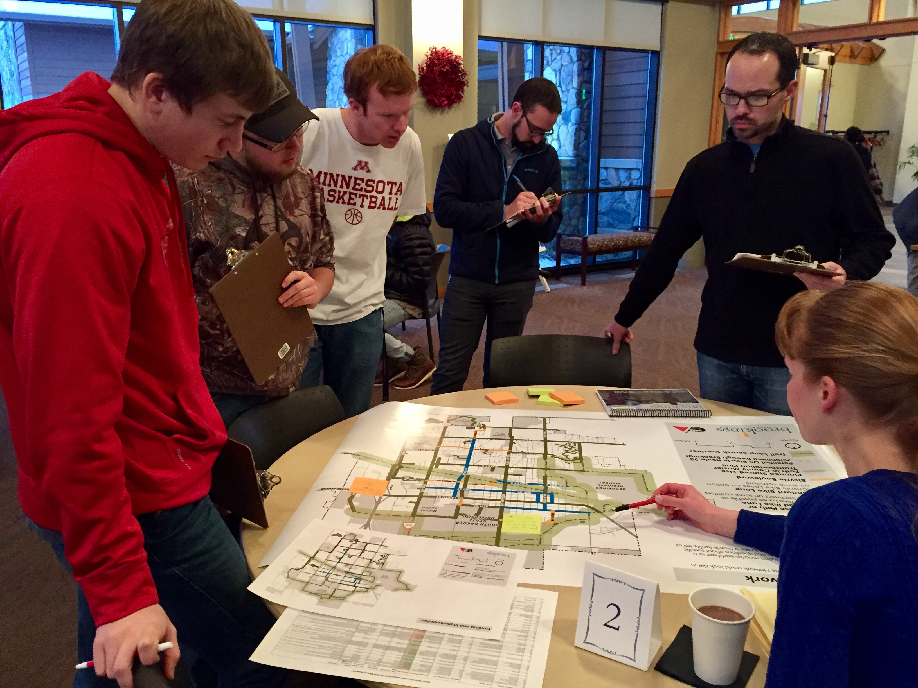
Questions
What are the community characteristics?
What are the goals of the plan or study?
Who are the stakeholders and what are their views?
What sort of engagement has taken place in the past?
What is the starting point for bicycling or walking?
What are the available resources for completing the plan or study?

Slide 4
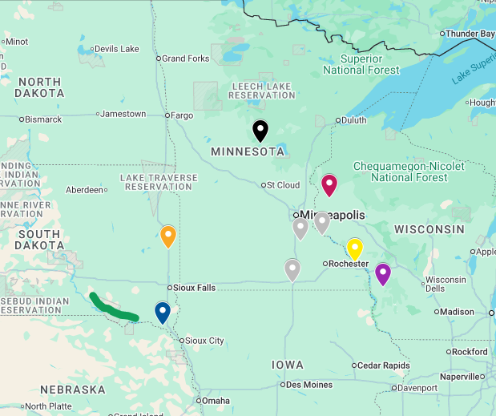
Albert Lea/Northfield/Red Wing, MN
Maintenance Planning
Question Category | Answer
Community characteristics | 3 mid-sized towns (17,000 – 21,000) in rural Minnesota, one with 2 colleges
Goals | Estimate the cost to maintain paths and sidewalks along state/federal highways
Stakeholders and their views | Higher level management at MnDOT (eager for information) and maintenance staff in 3 cities (open to helping with the hope of future aid)
Past engagement | None
Starting point | Each town has intermittent snow removal responsibilities along state/federal highways
Available resources | $140,000

Slide 5
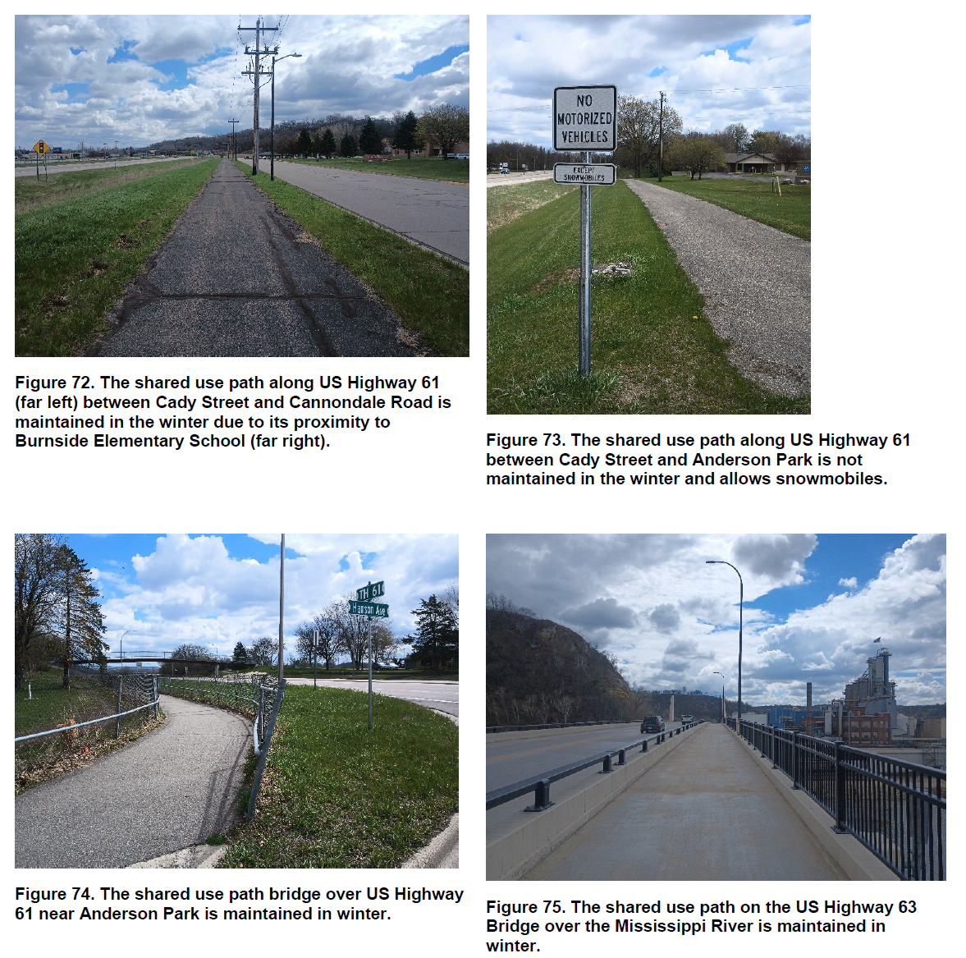
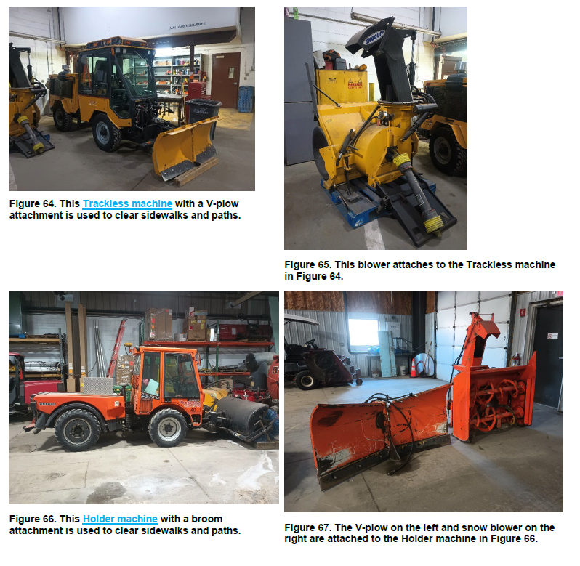
Red Wing, MN

Slide 6
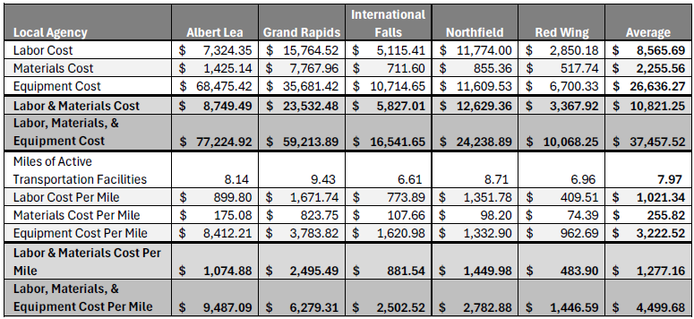
Annual Winter Maintenance Costs Per Mile

Slide 7
Amery, WI
Stower Seven Lakes Trail Plan
Question Category | Answer
Community characteristics | Small town in the northern lakes area with many existing regional biking, ATV, and snowmobile trails
Goals | Figure out of snowmobiles and horses should be allowed on the 14-mile rail trail
Stakeholders and their views | Friends of the Stower Trail and snowmobile club with opposite views
Past engagement | Public survey with 2,000 responses, public hearing with 200 attendees and 50 speakers
Starting point | One non-motorized state trail, one motorized state trail
Available resources | $30,000

Slide 8
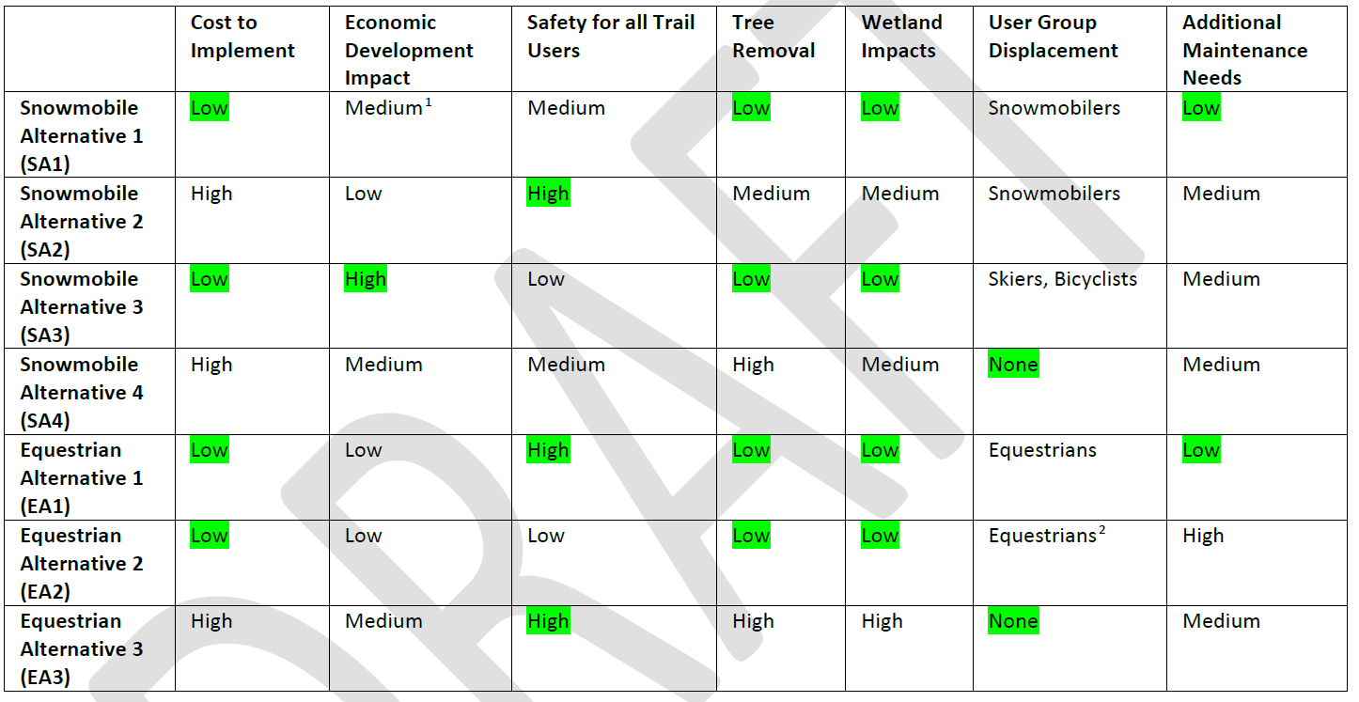
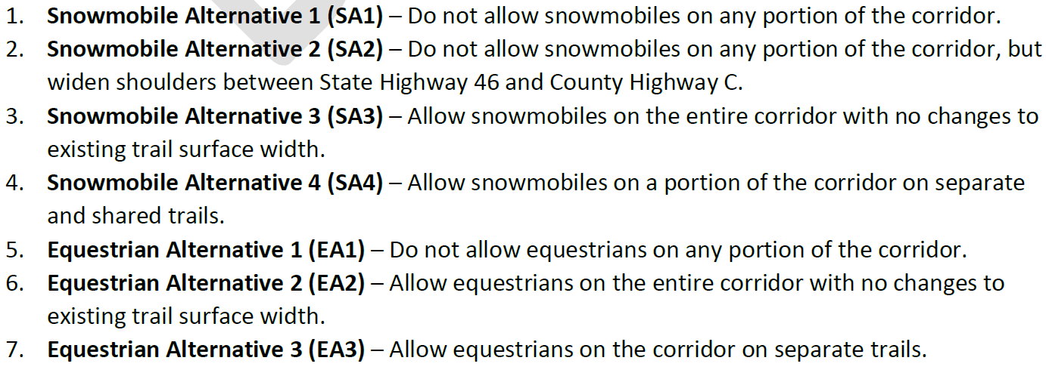
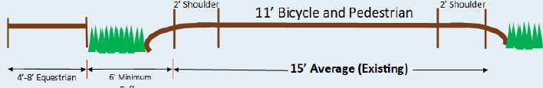
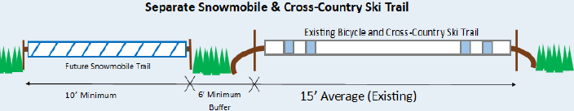
Alternatives Analysis

Slide 9
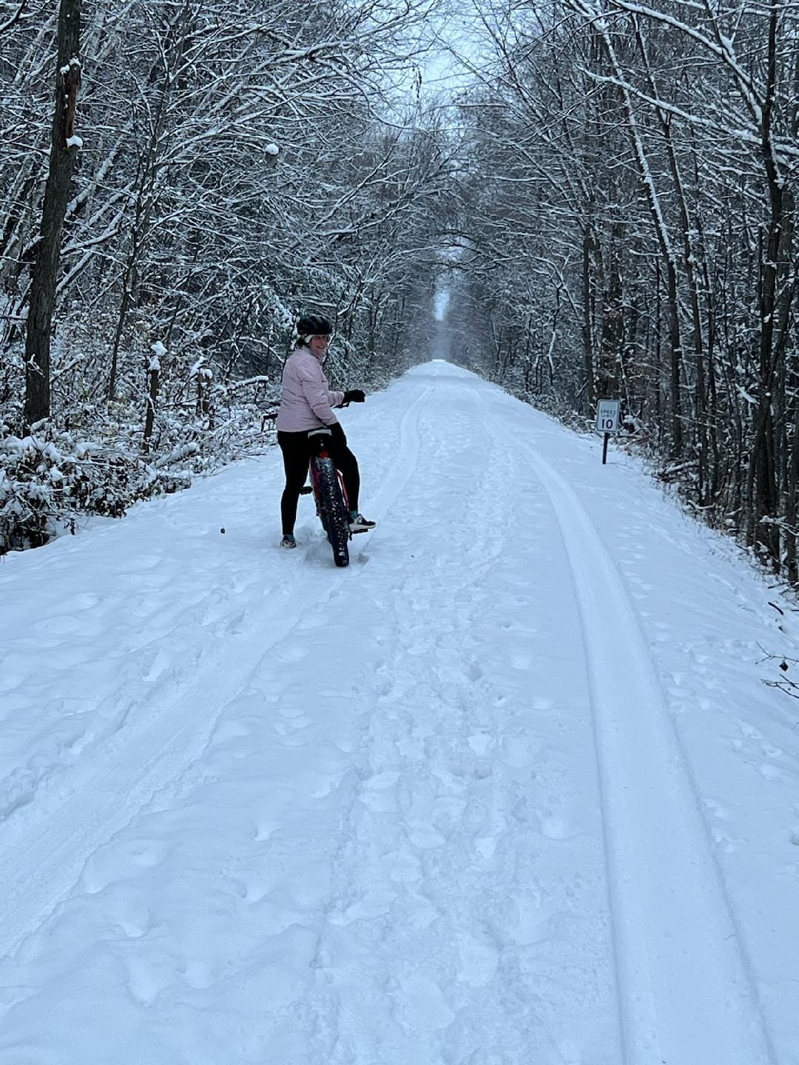
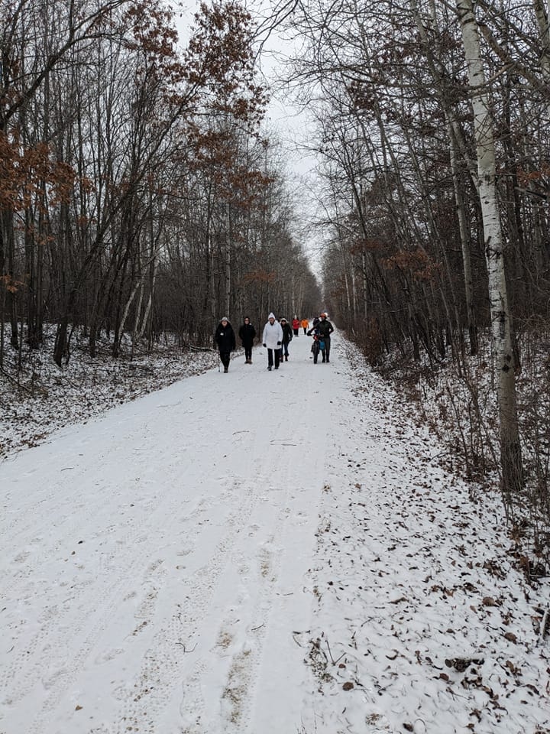
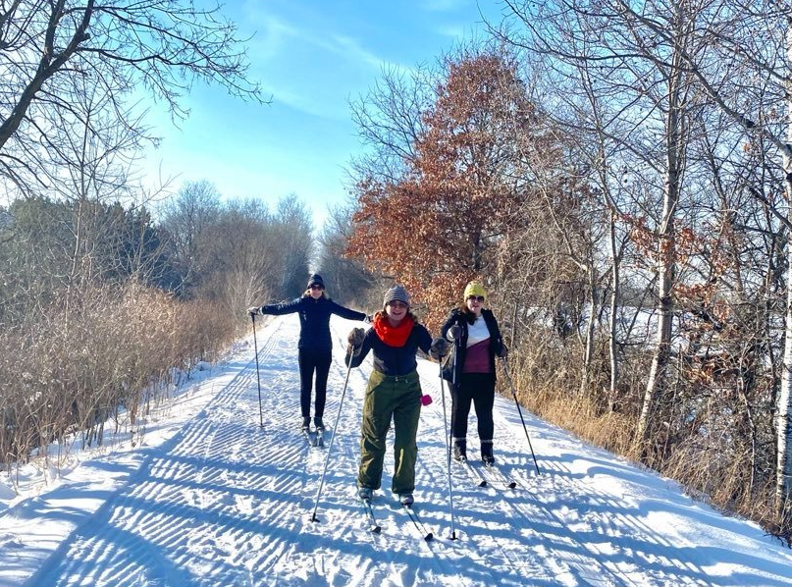
Credit: Friends of the Stower Seven Lakes Trail

Slide 10
Avon, Dante, Geddes, Lake Andes, Platte, Tabor, Tyndall, Wagner (SD)
Rail to Trail Feasibility Study
Question Category | Answer
Community characteristics | Very small agricultural towns near the Missouri River and through the Yankton Sioux Reservation
Goals | Determine the challenges and opportunities of converting a 70-mile state-owned unused rail corridor to a trail
Stakeholders and their views | Friends of the Rail Trail and property owners with opposite views, client is neutral
Past engagement | Led by Friends group with high public participation at previous South Dakota Rail Board meetings
Starting point | 1 out of 70 miles has been converted to a trail, remainder is an inactive rail line
Available resources | $250,000

Slide 11
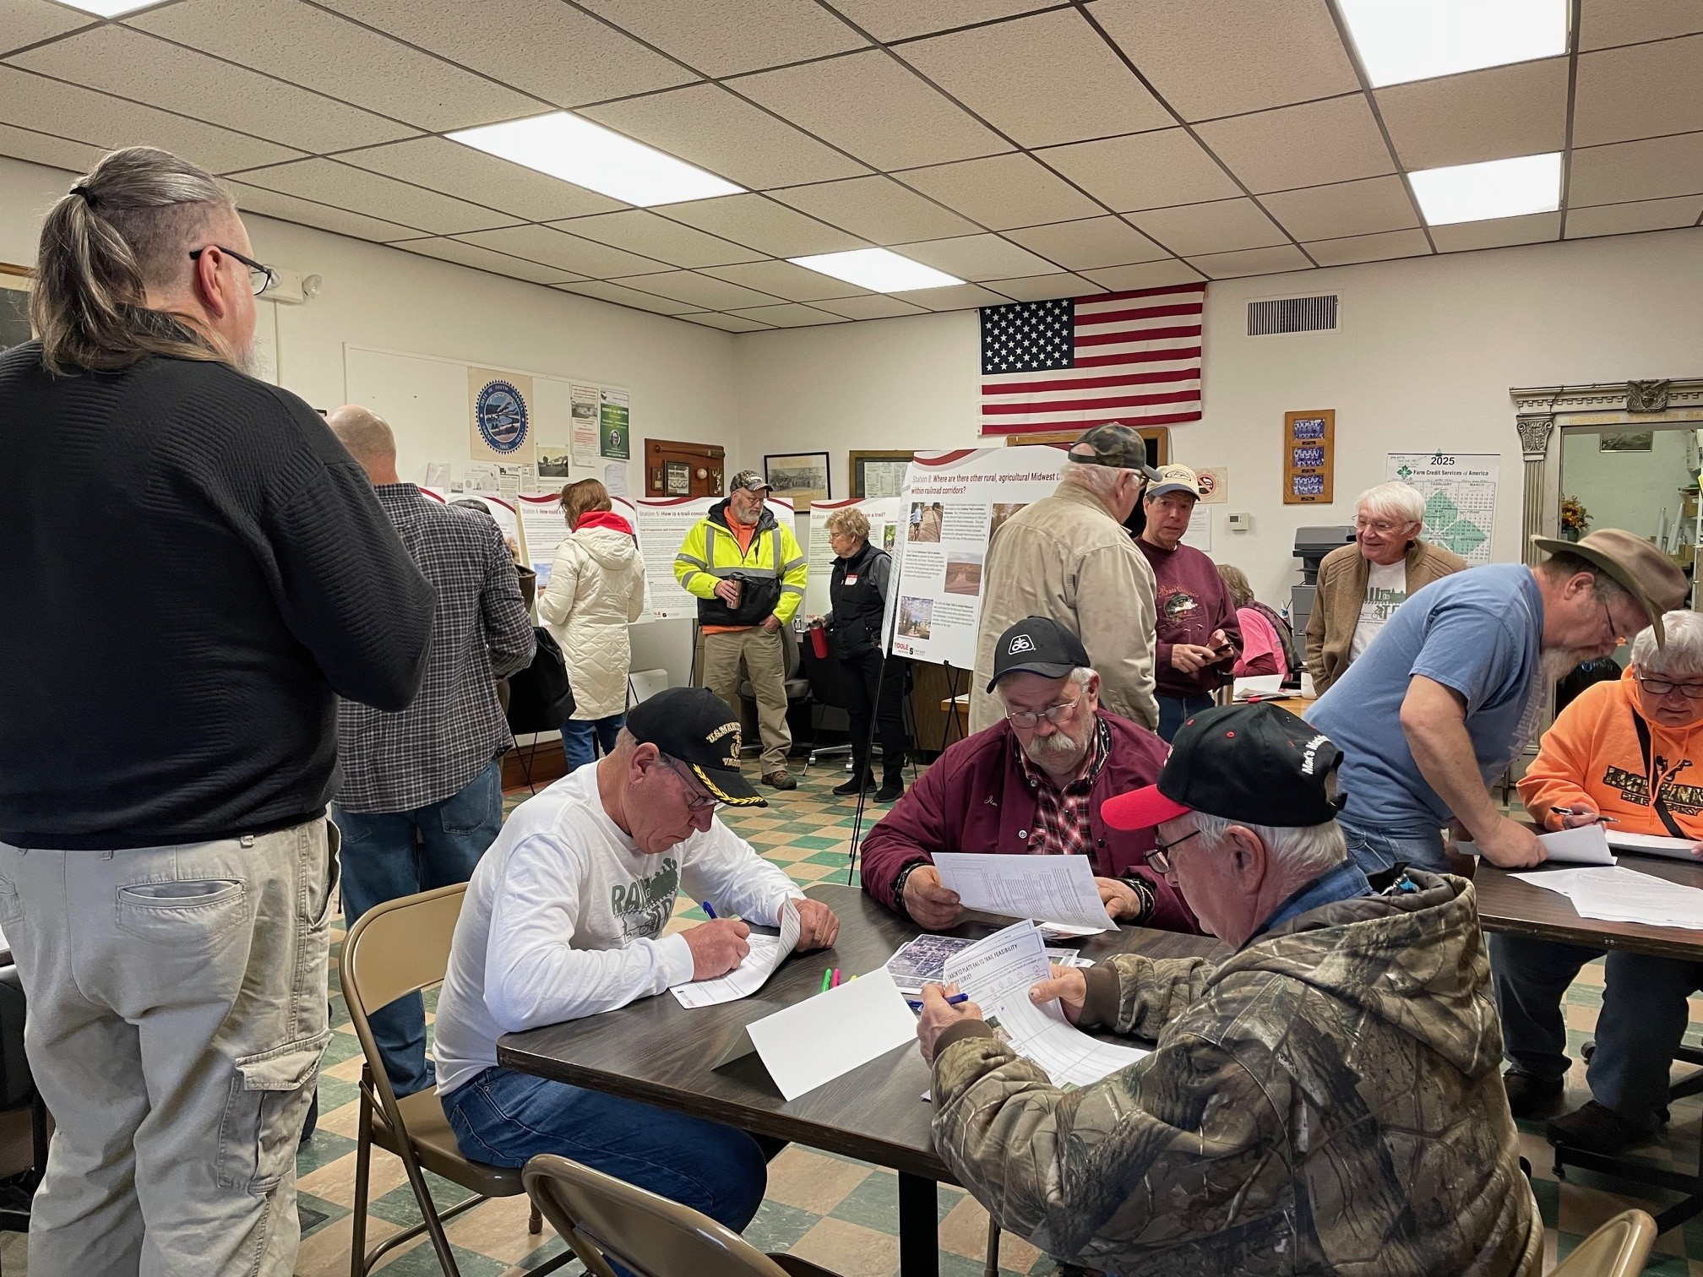
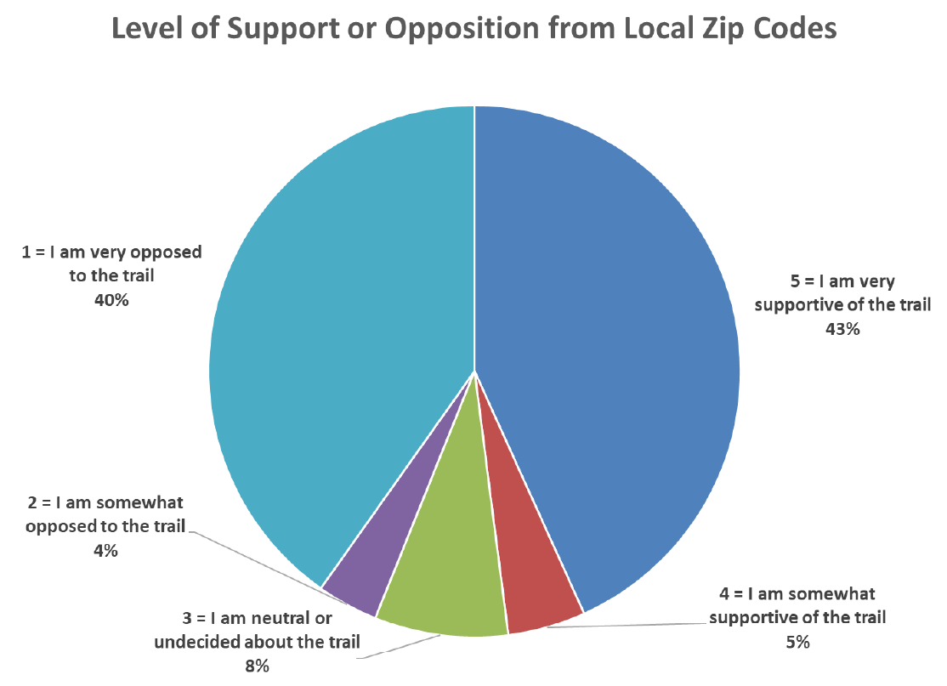

Slide 12
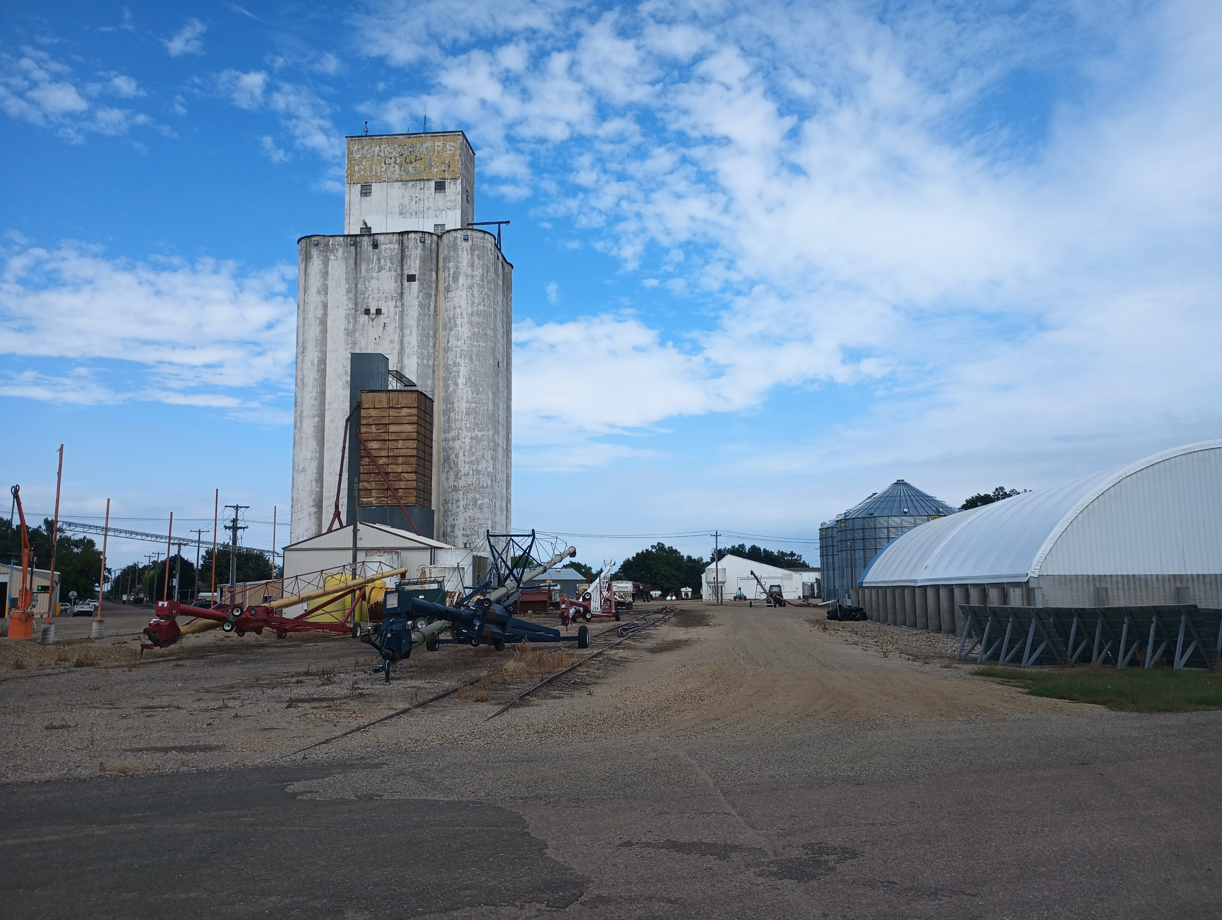
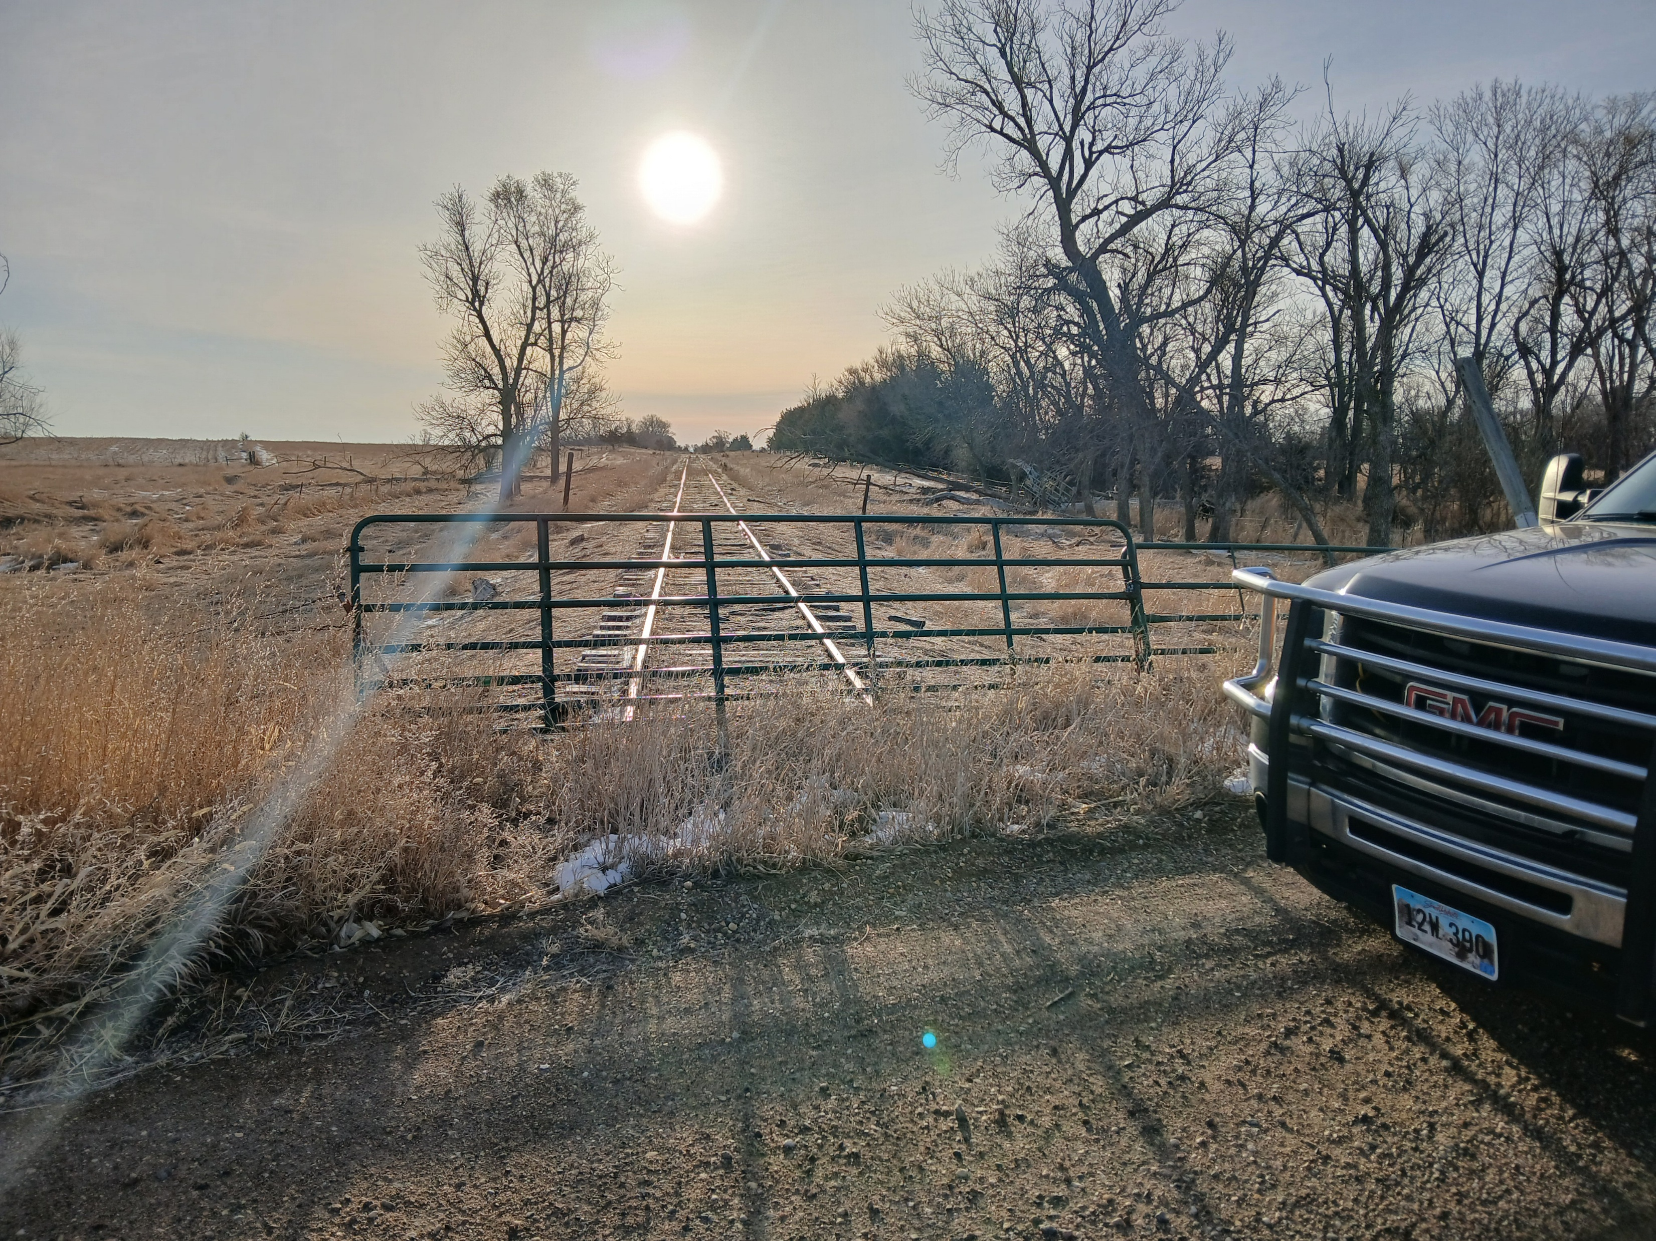

Slide 13
Baxter, MN Bike/Ped Policy Study
Question Category | Answer
Community characteristics | Suburban community (pop. 9,000) attached to larger community of Brainerd (pop. 15,000), at the southern end of the “Up North” vacation area
Goals | Determine which streets should have shared use paths.
Stakeholders and their views | 5-member City Council: favorable to the planning effort
Past engagement | None
Starting point | One state trail, disconnected paths, shoulders, no sidewalks
Available resources | $22,000

Slide 14
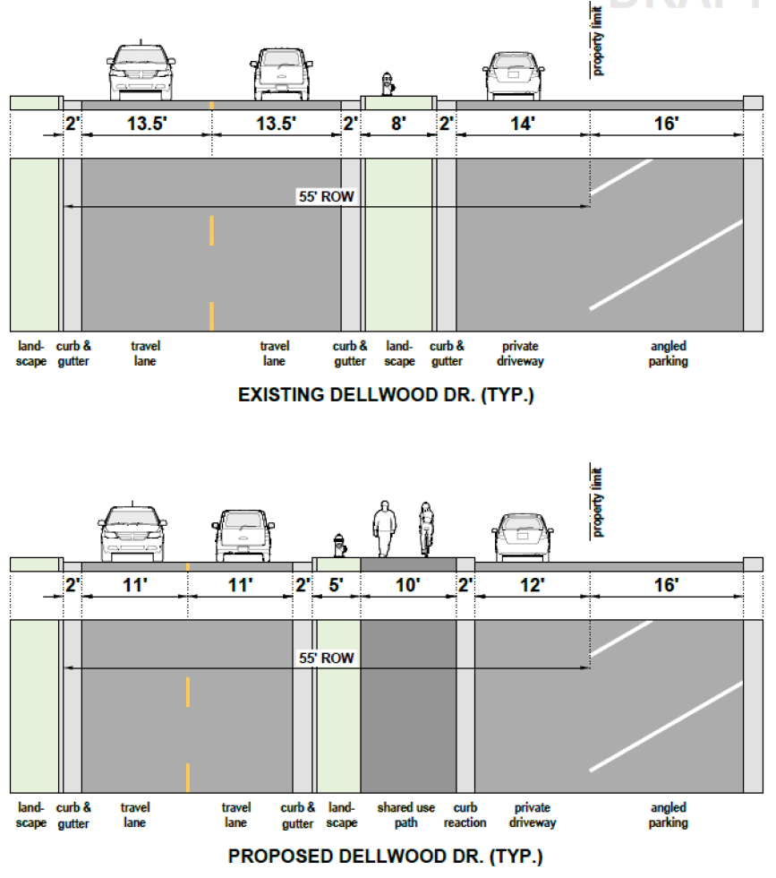
Conceptual
Cross Sections
6 challenging situations chosen by client
Researched right-of-way lines
Narrowed travel lanes to add shared use path

Slide 15
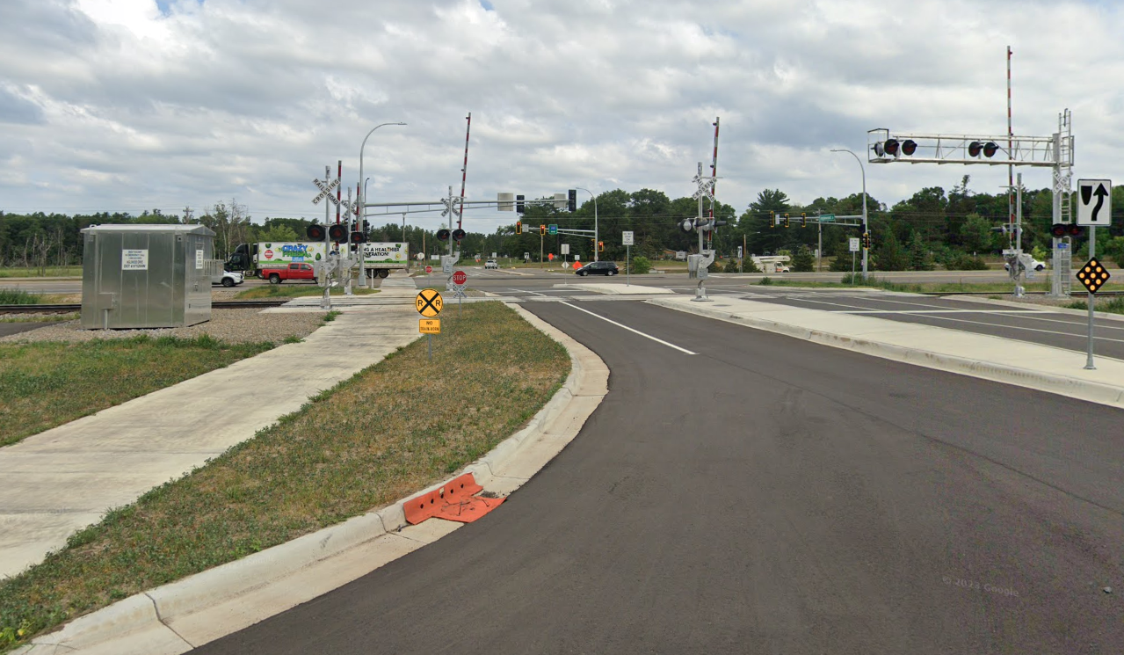
New Shared Use Path
Crosses major U.S. highway
Railroad crossing includes gates for path (on both side of tracks)

Slide 16
Brookings, SD Bicycle Plan
Question Category | Answer
Community characteristics | Rapidly growing college town (24,000)
Goals | Become a more bike friendly community
Stakeholders and their views | Bicycle Advisory Committee and a largely supportive public
Past engagement | None
Starting point | A half complete loop trail and several on-street bike lanes/routes
Available resources | $100,000

Slide 17
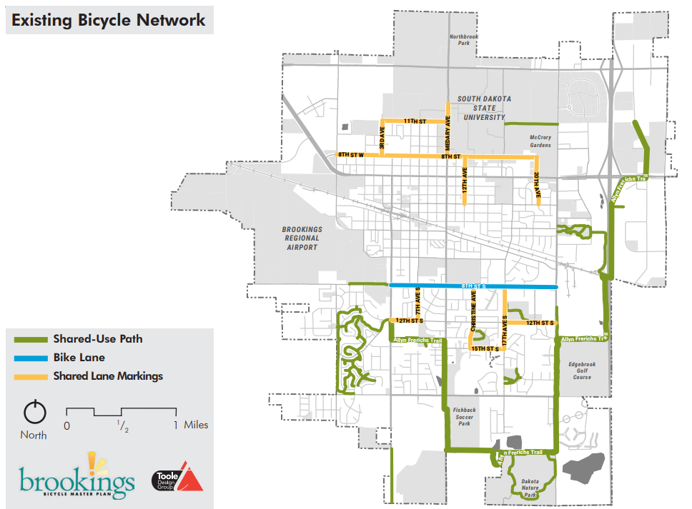
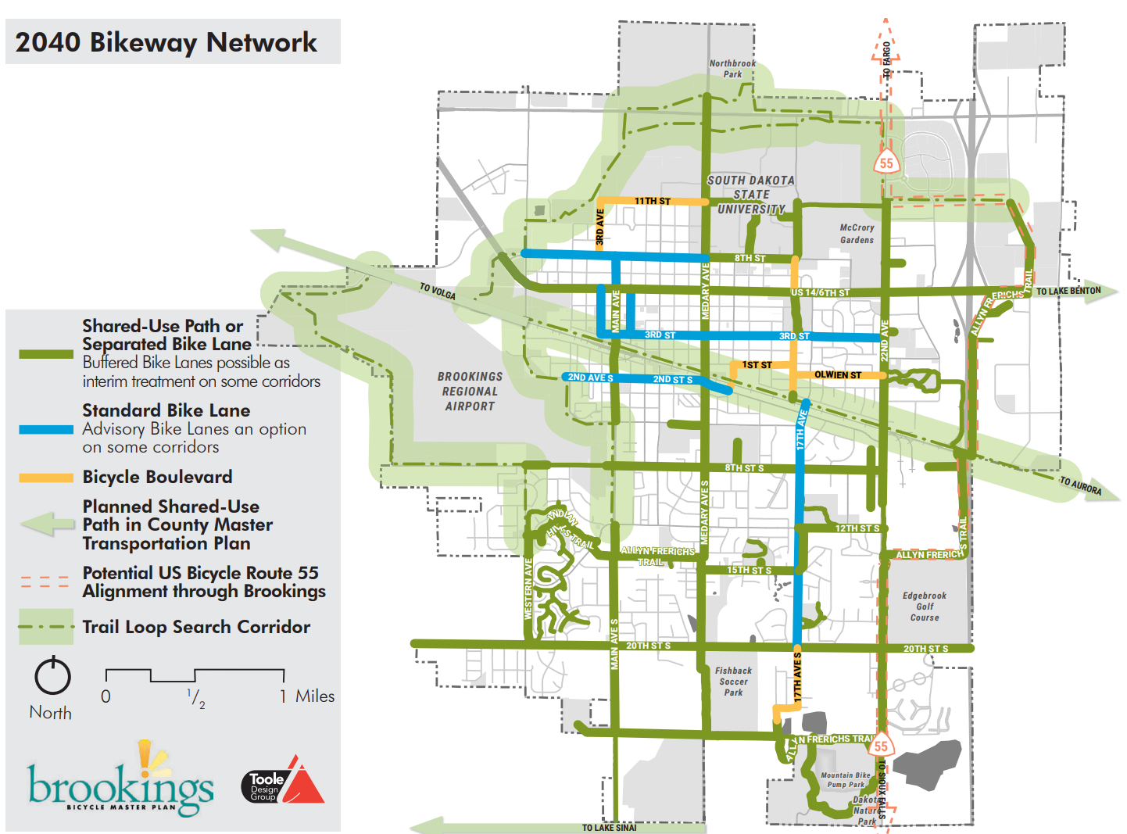

Slide 18
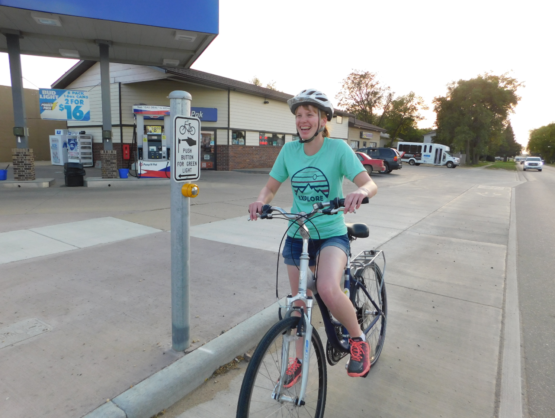
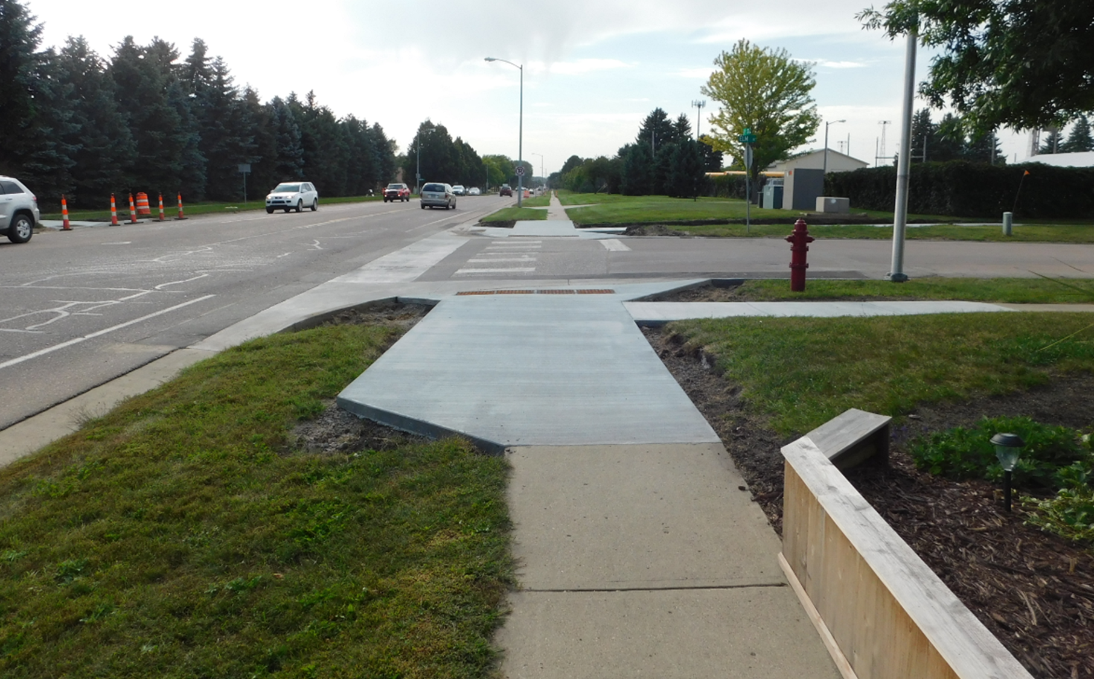

Slide 19
Vermillion, SD Bicycle Plan
Question Category | Answer
Community characteristics | Smaller college town (12,000)
Goals | Before installing a requested on-street bike facility, determine what the network should look like
Stakeholders and their views | A largely supportive public
Past engagement | None
Starting point | Short segment of river trail
Available resources | $125,000

Slide 20
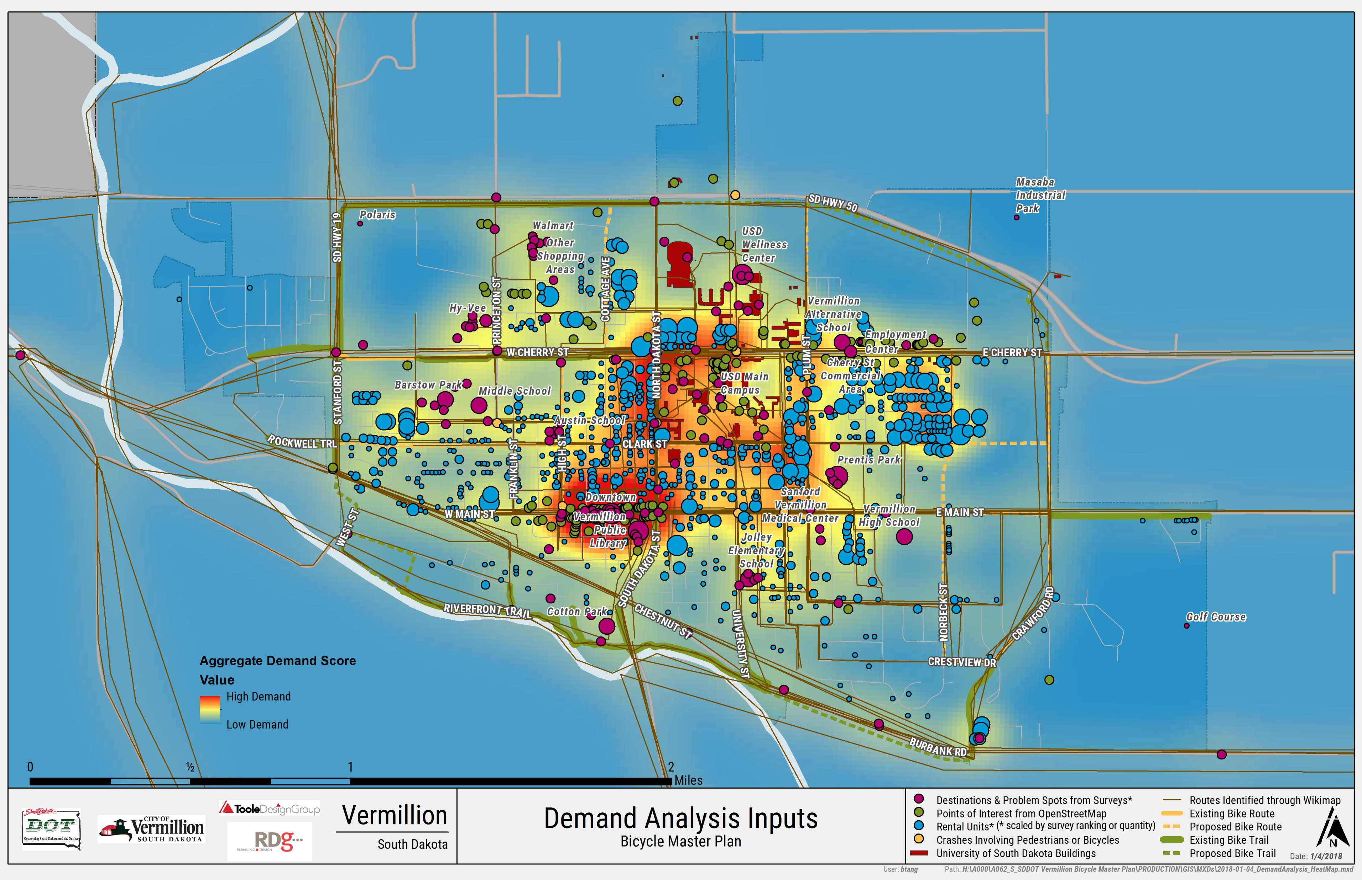

Slide 21
Viroqua, WI Bicycle & Pedestrian Plan and SRTS Addendum
Question Category | Answer
Community characteristics | Moderately small town (4,500)
Goals | Determine a network plan for bikes in street reconstruction projects + update old SRTS plan
Stakeholders and their views | A largely supportive public
Past engagement | None
Starting point | A few small segments of paths and standard bike lanes
Available resources | $50,000

Slide 22
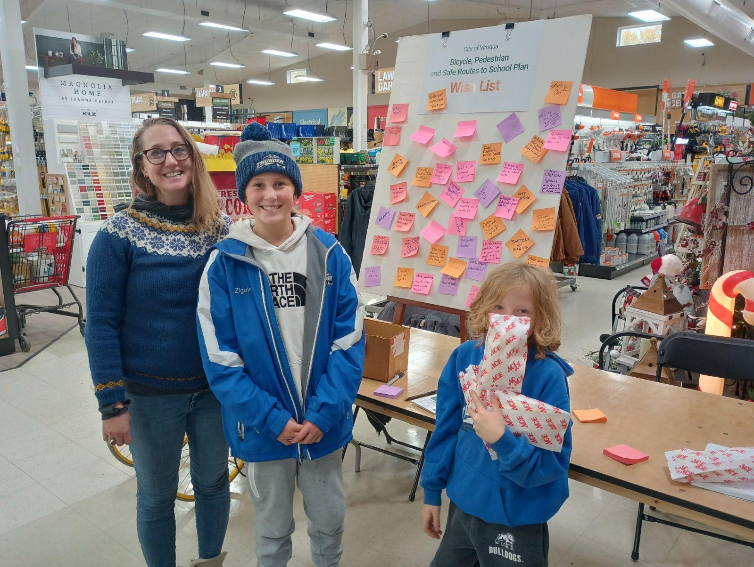
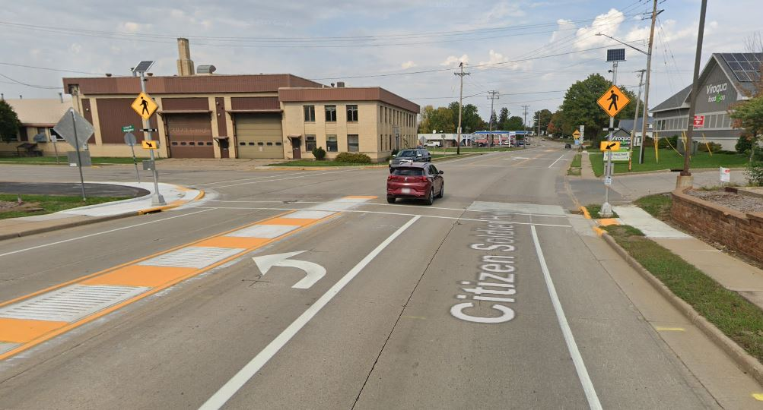

Slide 23
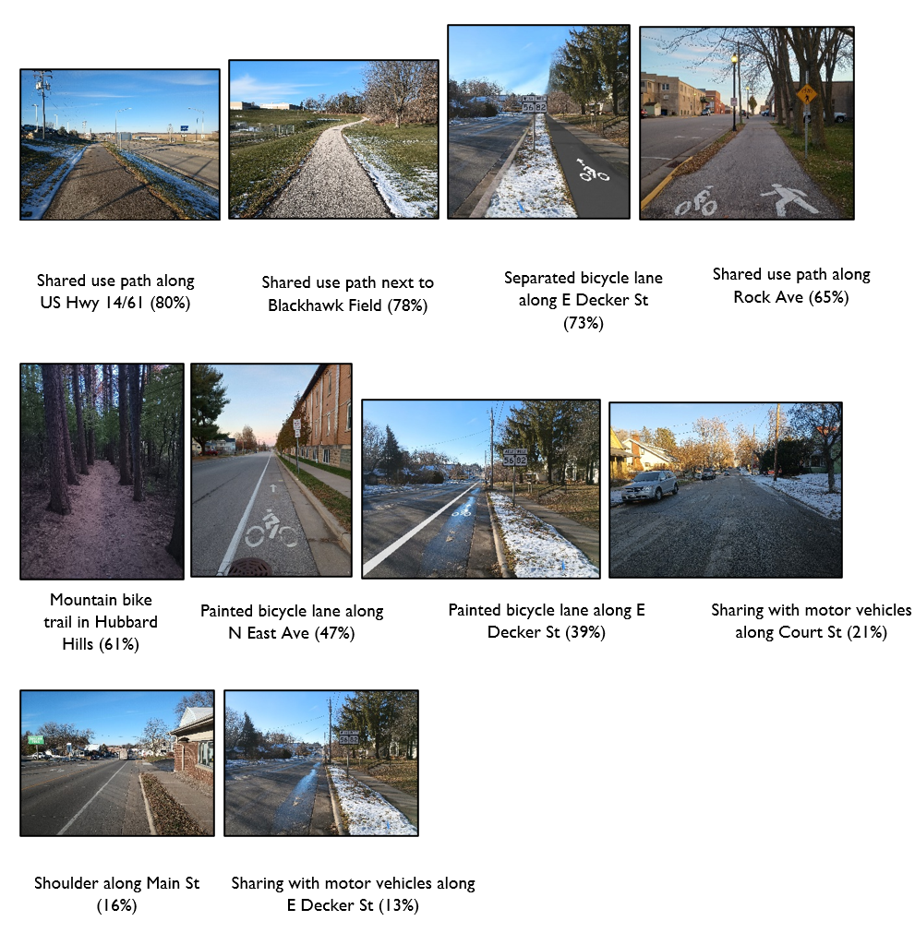
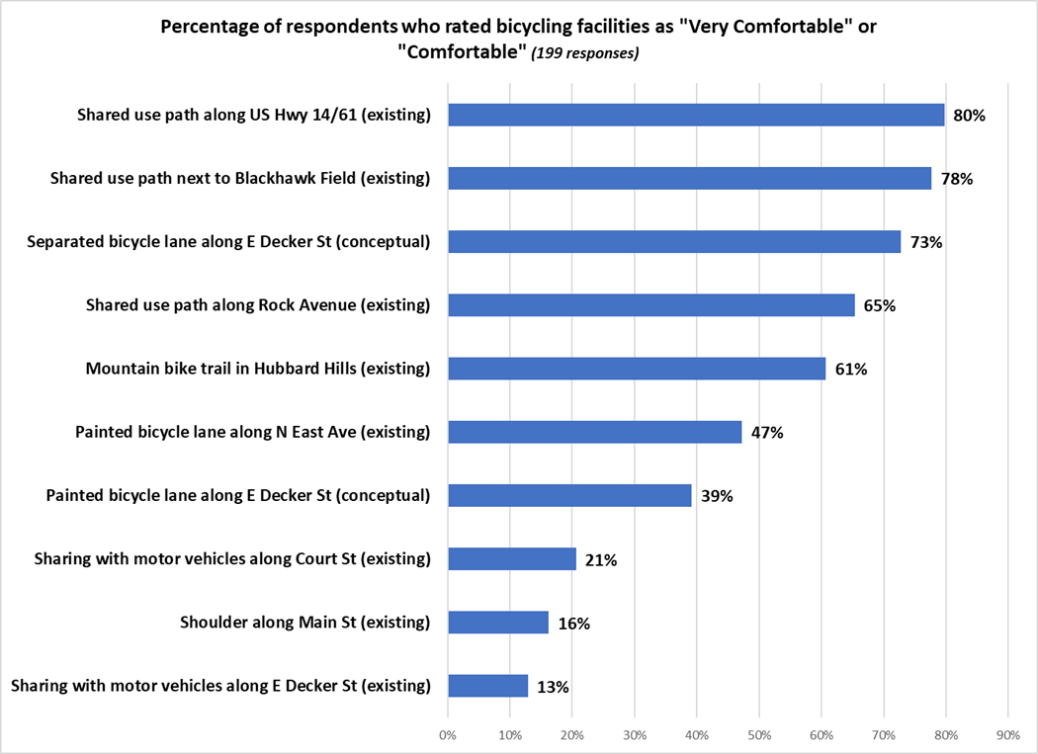

Slide 24
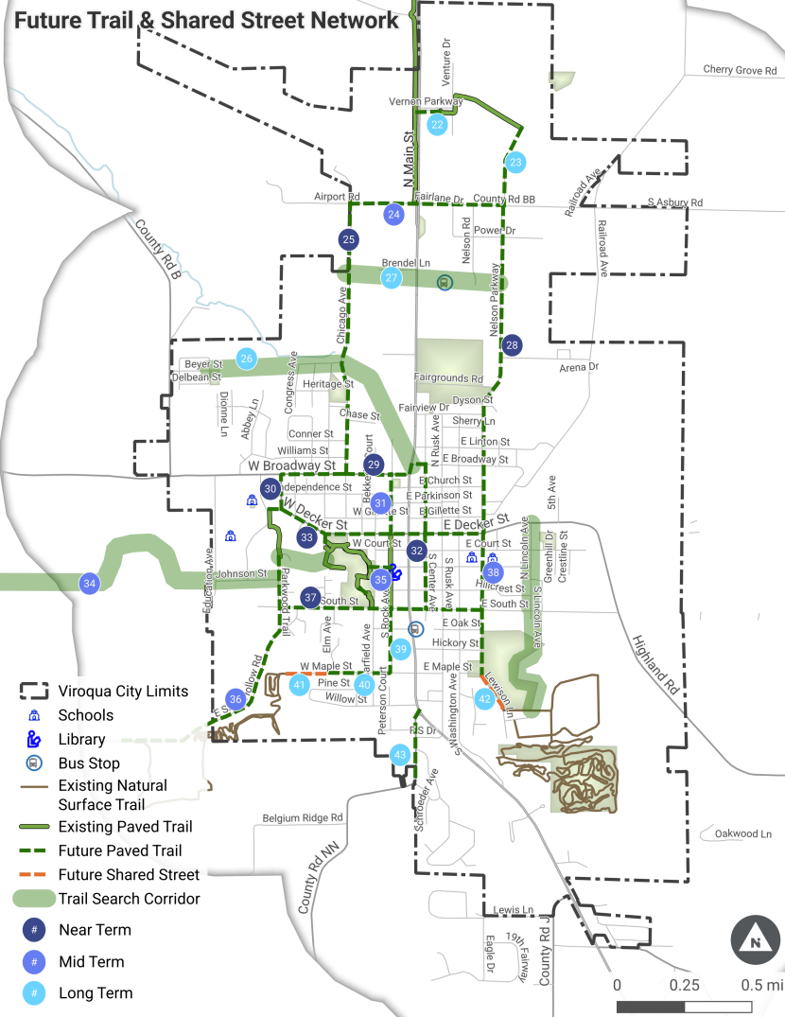
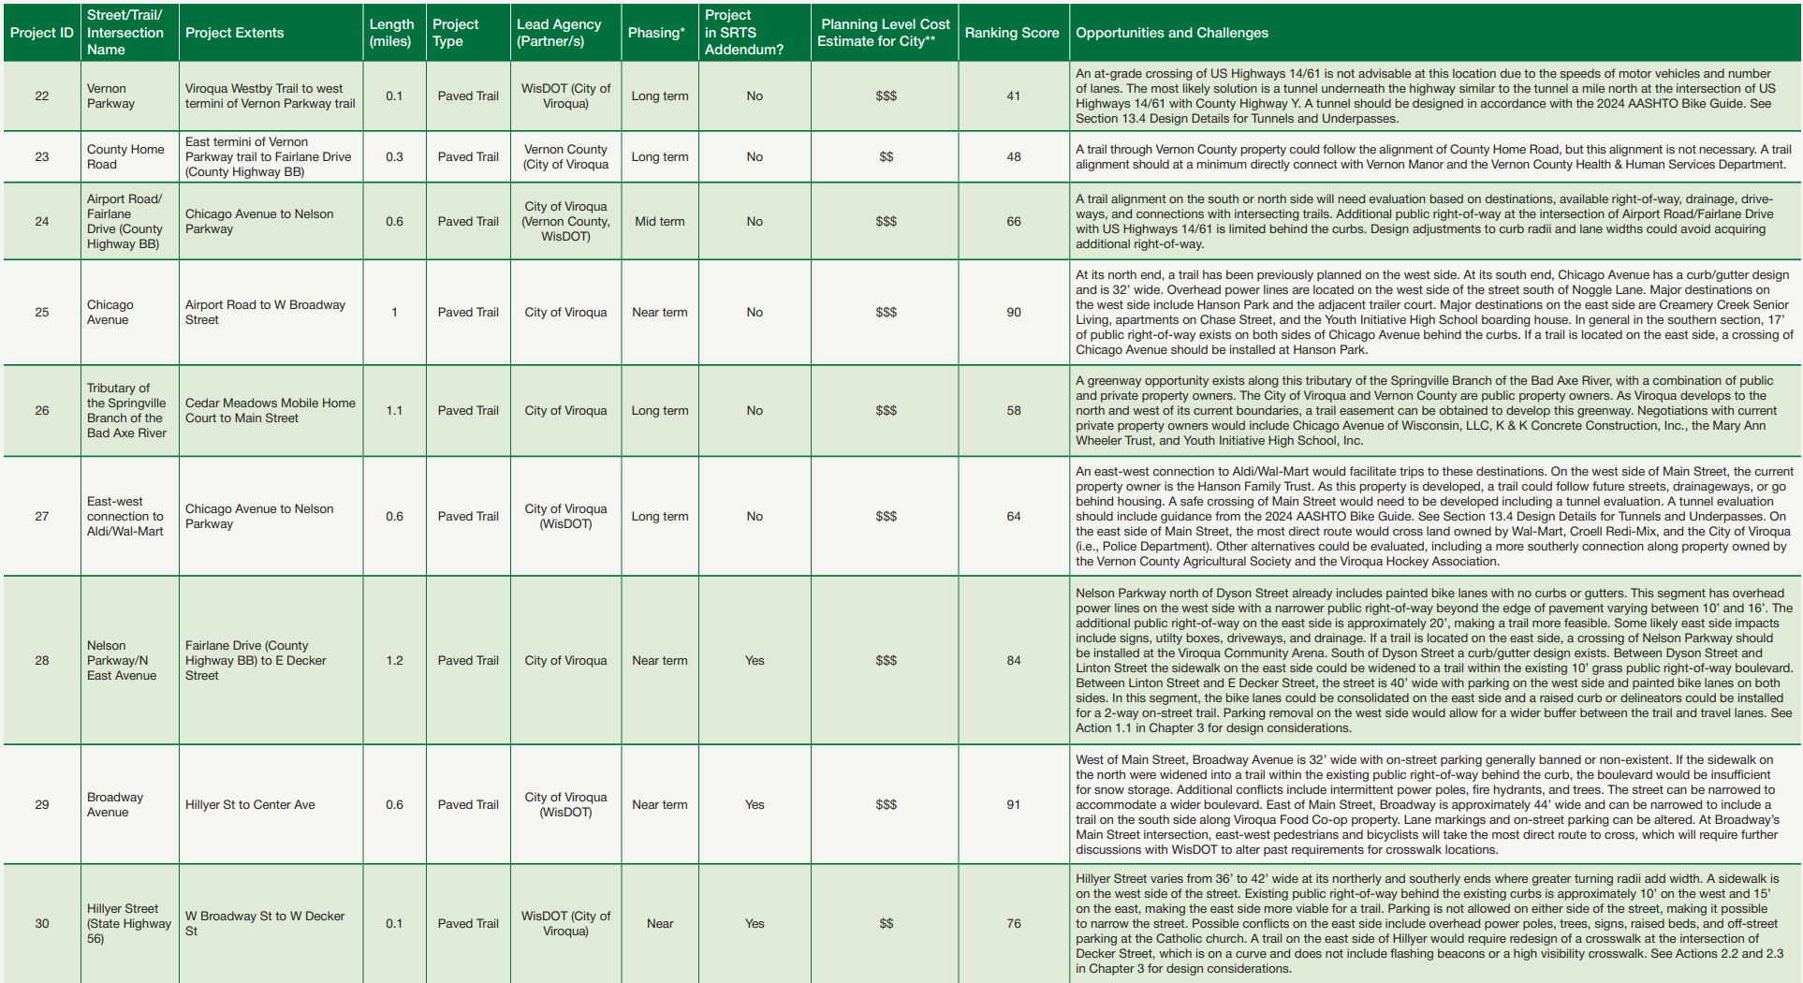

Slide 25
Winona, MN Complete Streets Policy and Pedestrian/Bike Plan
Question Category | Answer
Community characteristics | College town (26,000)
Goals | Adopt a complete streets policy and create a plan to go with it
Stakeholders and their views | A moderately supportive public
Past engagement | None
Starting point | A lake path and limited standard bike lanes
Available resources | $60,000

Slide 26
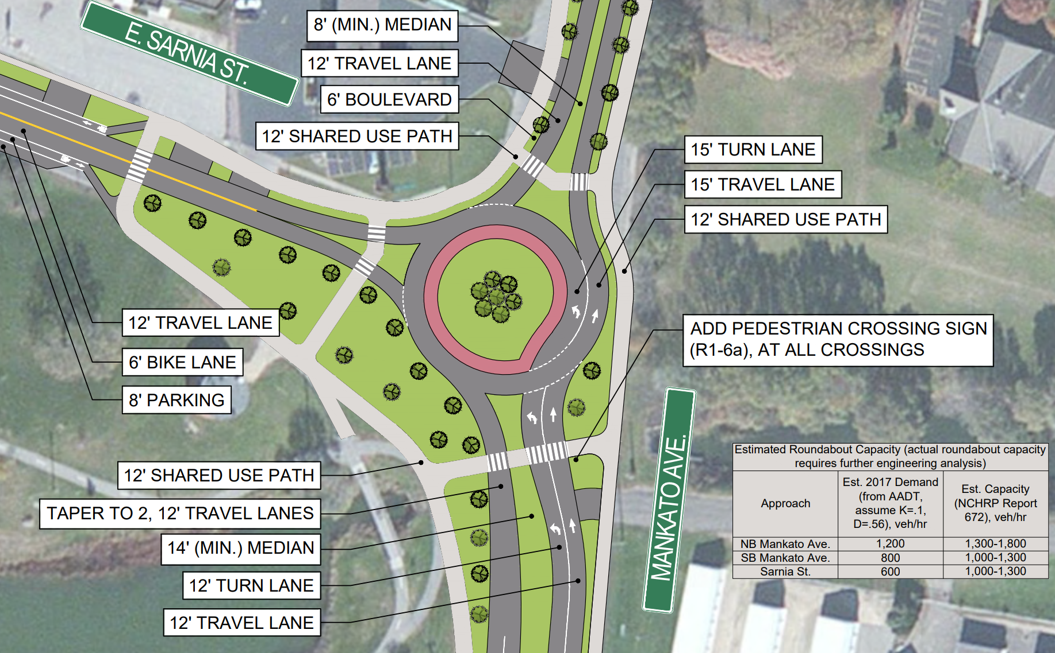

Slide 27
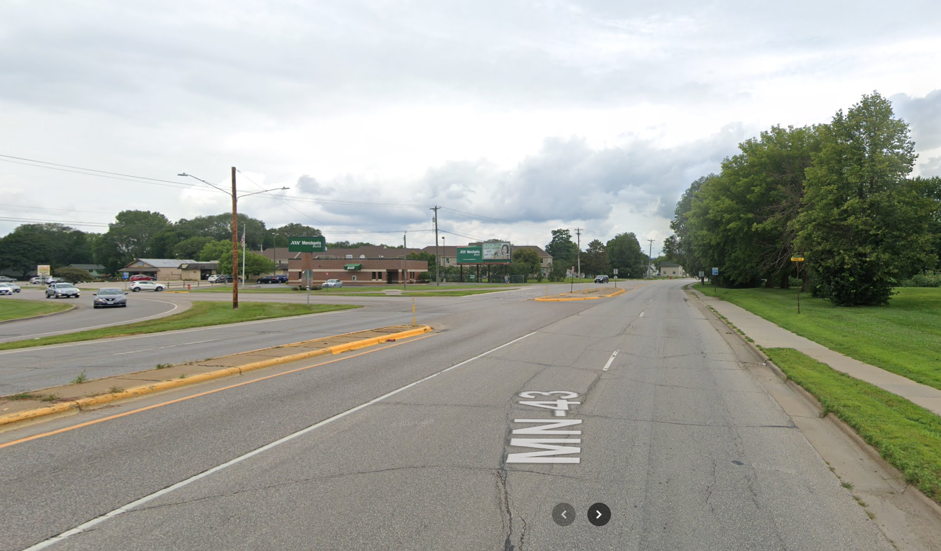

Slide 28
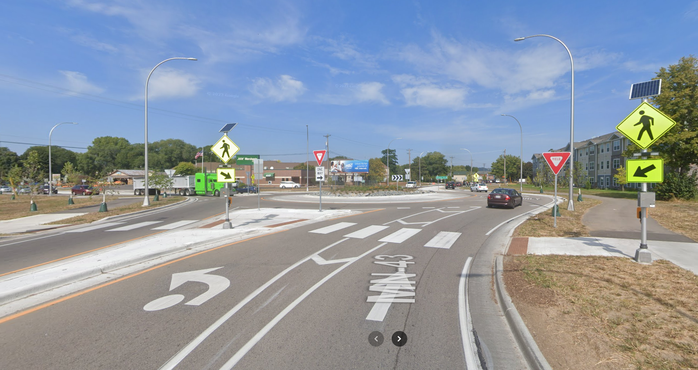

Slide 29
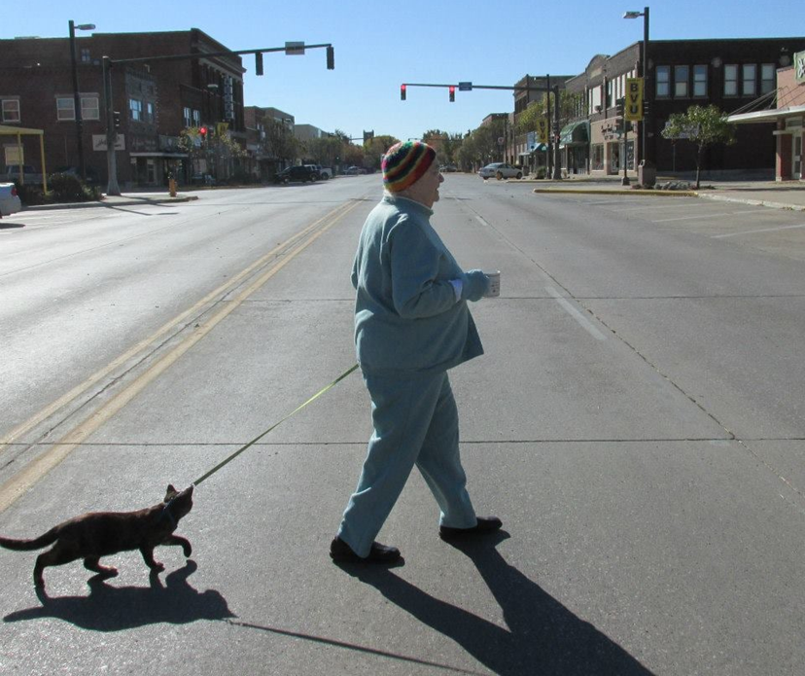
Walkable and bikeable communities = Improved lives for everyone (including Grandma)
Less disease
More happiness
Improved learning
Reduced health costs
Joan Lichter, 2014

Slide 30
Thank You!
Shaun Murphy-Lopez, Principal Planner
608.462.3715
smurphylopez@tooledesign.com

