Slide 1



RPAs in Iowa
History and State of the Program
3/2/2023

Slide 2

About me: Travis Halm
Education: B.S. Community Regional Planning, Iowa State, 2012
Work experience:
  MPO/RPA Coordinator, Iowa DOT (2023- present)
  Transportation Planner, MAPA MPO/RPA (2017-2023)
    Omaha/Council Bluffs and four-county region in Southwest Iowa
  Transportation Planner, Brazos Valley COG, TX (2015-2017)
    Bryan/College Station, TX and surrounding seven counties
  Planner, City of Lawrence, KS, (2013-2014)

Slide 3
History of RPAs in Iowa
3/2/2023

Slide 4
History
Originally formed to address federal funding changes that occurred in ISTEA (1991)
  STP Funding was created to replace dedicated urban/rural funding
Commission formally adopted RPA process in 1993
  Counties had a choice:
    Keep within existing Regional Transit Agency boundaries
      (COGs and RTAs generally, but not always, coincide, and some were recognized as Economic Development Districts through EDA)
    Join an adjacent RTA
    Form a new RPA all together
  Final product was 18 RPAs
    Some counties were against the model or wanted to join a new region
    Most counties stuck with their COG boundary (for board continuity)

Slide 5
History (cont.)
Iowa DOT provided structural framework:
  TPWP, TIP, LRTP, PPP and PTP processes
  Committee Structure
    Policy, Technical and modal-specific committees
    Encouraged fostering partnerships with conservation boards, resource agencies and transit agencies
STP funding was the guiding factor for entire process
  Initially, no sub-allocation was to be allowed
  After some debate, some regions retained regional competition, but some did not formally sub-allocate but generally kept a running tally of which counties received which funding amounts.
Ultimately, the goal was to improve local government coordination, public involvement, and have locally elected officials making transportation decisions

Slide 6
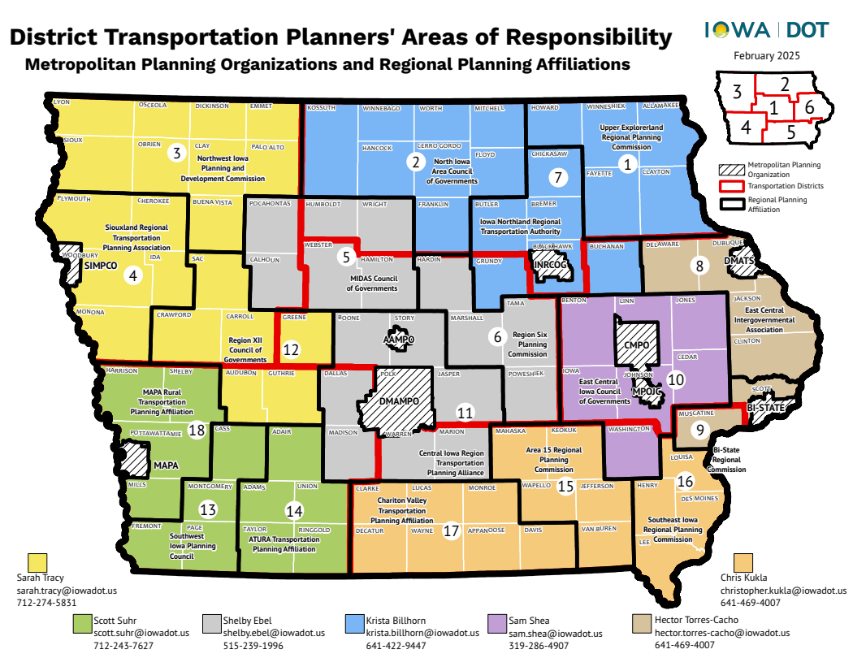

Slide 7
Committee structure (can vary)
Council of Governments board
  Sometimes serves as policy board
Policy Committee
  Approves final documents (Five acronyms) and other planning work
Technical Committee
  Steers completion of work tasks and recommends approval of final documents (5A) to Policy Committee
  Conducts calls for projects for Surface Transportation Block Grant (STBG) and Transp. Alternatives (TAP)
    Call for projects, inquiries, project selection, and eventual TIP creation and approval
Transportation Advisory Group
  Biannual (at minimum) advisory group for facilitating direct coordination between transit providers and human service agencies
  Serves as steering committee for PTP updates

Slide 8
Primary Work Functions
Short Term (Annual)
  Transportation Improvement Program (TIP)
    Program all projects within their jurisdiction that receives State or Federal Transportation dollars
    Administer STBG and TAP call for projects, project selection, and some administration
  Transportation Planning Work Program (TPWP)
    Prepares budget and tasks for upcoming FY work
    Provides a forum to solicit work or studies from boards or public
  Transportation Advisory Group
    Bi-annual meetings on passenger transportation – in conjunction with transit agency
Long Term (Every 4-5 years)
  Long Range Transp. Plan (LRTP)
    An update is required every five-years to the LRTP, which lays out an inventory and transportation vision for the region
  Public Participation Plan (PPP)
    Determines the agency’s public participation protocol for all planning products, boards and outreach.
  Passenger Transportation Plan (PTP)
    Modal-specific plan to public transit (geared mostly to health and human service transportation)

Slide 9
Other Work Functions
Long-range or corridor related studies
  Safe Streets For All – community action plans are common right now
  Trail planning
  Hazard mitigation and resilience planning
  Modal-specific plans (Freight, Transit)
Technical Assistance for counties and municipalities
  Pavement data collection
Discretionary grant assistance

Slide 10
Funding Planning Work
Funding to perform Planning Activities - $1,113,850 total
  FTA funding (5305e, 5311) totaling $593,216 statewide
  State Planning & Research (SPR) Funding matches that $593,216 ($520,634 utilized*)
    Agencies can carry over both funding sources up to 100% of an annual allocation of funding
    Agencies over 100% of an annual funding apportionment forego new funding
    Agencies must provide a 20% local match (80 fed/20 local split)
  Agencies can program regional STBG funding to planning activities
  Largest agency budget for RPA planning work in FY26: $320,016
  Smallest agency budget for RPA planning work in FY26: $56,406

Slide 11
Funding for Regional Projects
STBG (Surface Transportation Block Grant)
  Surface Transportation Block Grant - $52,683,747 total statewide for RPAs to program in FY26
    Agencies have between $1.3 and $4.6m depending upon size and population annually
  Intended for regionally-significant transportation projects
  Some agencies sub-allocate funding by population and other factors to member jurisdictions.
  Some have a set-aside for small communities, based upon population thresholds
TAP (Transportation Alternatives)
  Transportation Alternatives Program - $5,029,292 total statewide for RPAs to program
    Agencies have between $168,000 and $613,000 annually.
  Provides funding for trail projects of regional significance

Slide 12
RPA SWOT
Strengths and Opportunities
  Statewide coverage of the planning process
    Every inch of the state is covered by an MPO or RPA
  Local technical assistance and expertise can be housed semi-locally in places which would otherwise go without
  Transportation decisions are made by locally elected officials (RPA Policy and Technical Committee board members)
Weaknesses and Threats
  Hiring and staff retention issues
    More populated regions offering more money
    Inconsistencies in spending down planning dollars
    Some agencies receive the equivalent of one planner salary per agency
  “Is this an STBG selection committee or a regional planning committee?”
    Agency TIP processes don’t always allow for regionally-significant projects

Slide 13
Questions
3/2/2023

Slide 14
Thank you!
3/2/2023

