Slide 1
Managing Uncertainty with Scenario Planning
Haley Schultheis and Carrie Kissel
2025 National Regional Transportation Conference

Slide 2
Session Agenda
Introduction
Game time! Managing Uncertainty
Identifying the forces shaping our regions
Discussing changing conditions, consequences, and our reactions

Slide 3
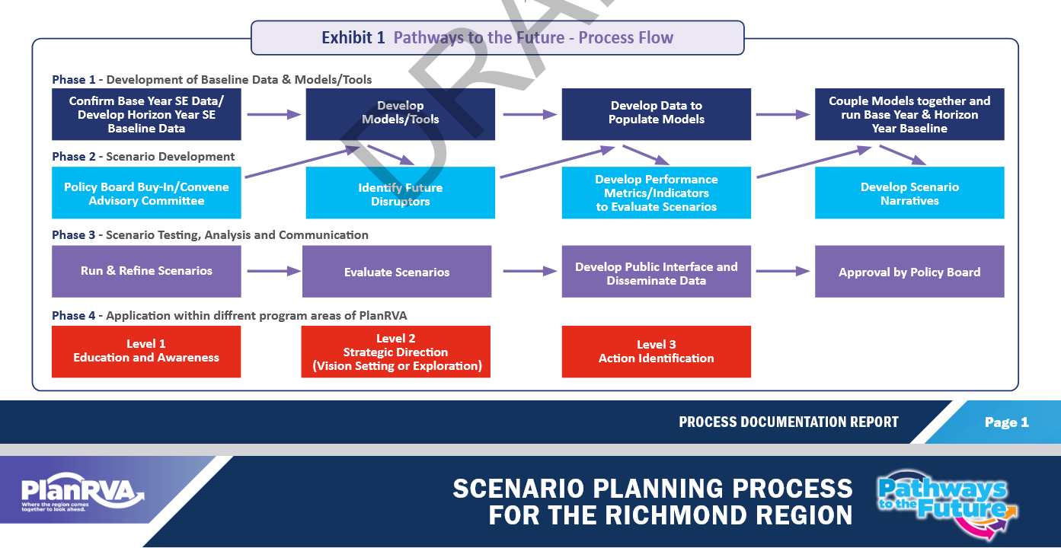
RDO Example: PlanRVA
Pathways to the Future

Slide 4
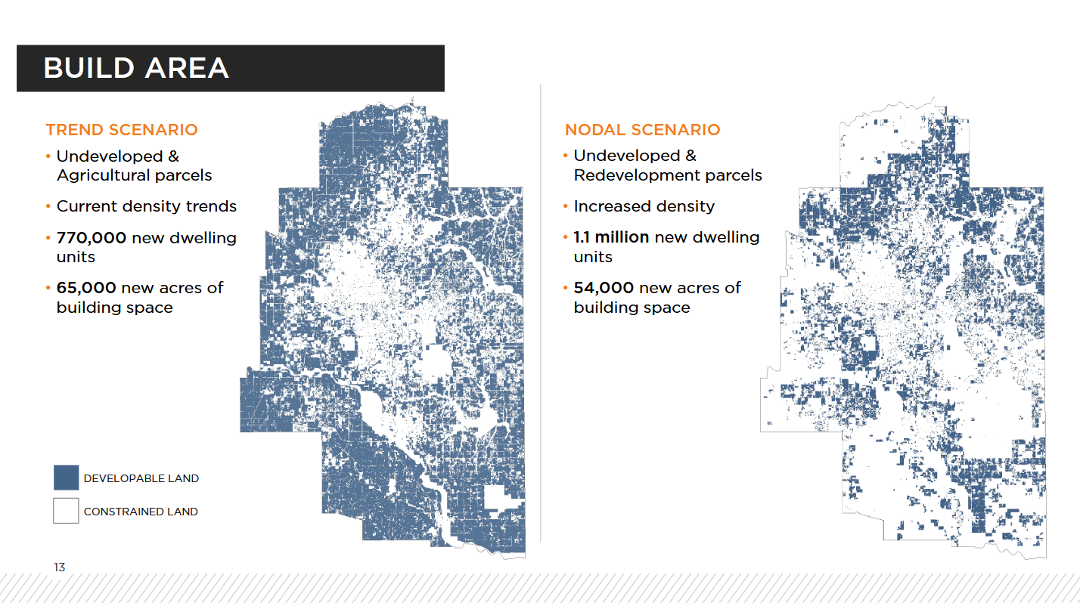
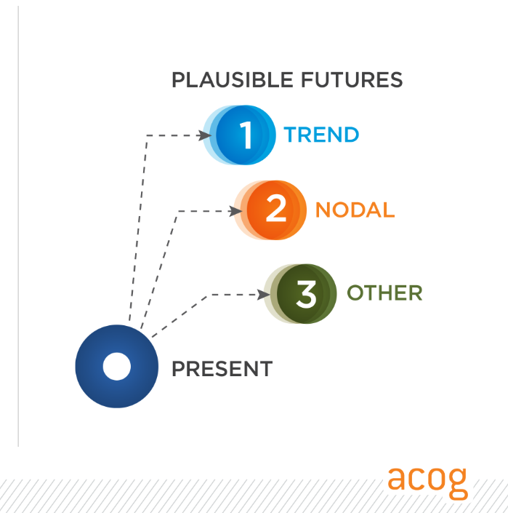
RDO Example: Assn of Central OK Govts
Encompass 2045
Scenarios
Build-out Analysis

Slide 5
Decisions for the Decade
A game about risk and
planning for uncertainty
(Game originally created by:
American Red Cross – Climate Centre)

Slide 6
This game will help us:
Think about ways to plan for future scenarios
Make decisions when there are unpredictable factors
Discuss various methodologies for decision making
Notes:
Take a note from Kevin's presentation and tell you why we are playing this game:

Slide 7
Imagine…you are a governor!
Your mission:
To build a prosperous environment and contribute to the success of your nation over the coming decades.
Notes:
So,

Slide 8


However, your mission faces challenges from natural disasters
Extreme Heat
Extreme Cold
Notes:
There's always a however...

Slide 9

And you must properly allocate your resources in order to avoid disaster!

Slide 10

Notes:
The dice will serve as your nation’s semi-predictable variable and will aid in your resource allocation planning process

Slide 11
Rules of the game:
Table = Nation; Each person = governor of individual province
Each governor will receive 10 resources (beads) and they must individually decide how to invest them
Investments made at the beginning of the decade cannot be changed
Scores will be evaluated for each table + each province

Slide 12
Here’s how we play:
Allocate resources based on the scientific data (to come)
Roll the dice 10 times (1 roll = 1 year)
# on dice determines weather event for that year
Will you have proper protection for an extreme event, have development resources available, or face a humanitarian crisis?
Once a governor faces 1 humanitarian crisis, they can no longer earn prosperity points
Notes:
Allocate resources based on the scientific data (to come)
Each nation has 1 dice that they will roll 10 times
1 roll = 1 year
The # on the dice will determine the weather event for that nation, for that particular year
Depending on how governors have invested their resources, they will either have proper protection for an extreme event, have development resources available, or face a humanitarian crisis
Once a governor faces 1 humanitarian crisis, they can no longer earn prosperity points

Slide 13
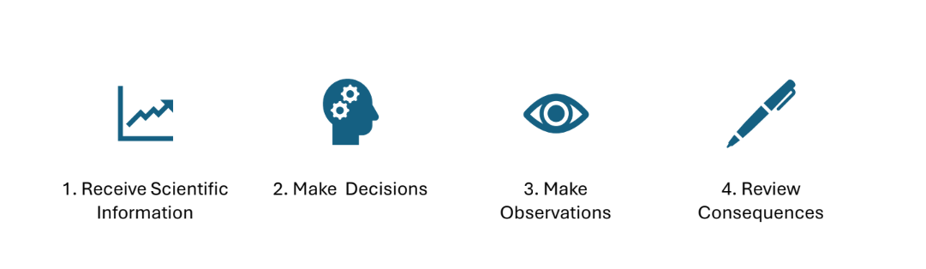
Scenario Planning Basics:

Slide 14
Step 1: Receive Scientific Information
= extreme cold snap
= prosperity!
= extreme heat wave

Slide 15
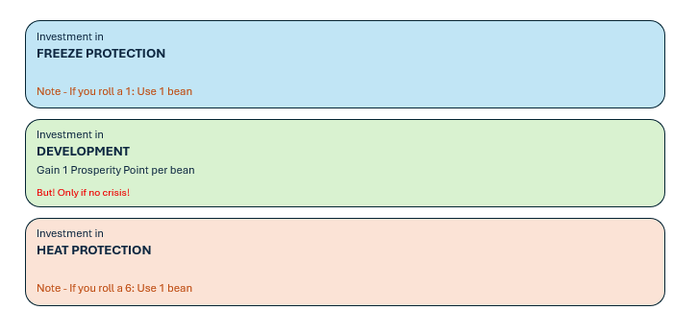
Step 2: Make Decisions
Allocate your 10 resources among the 3 investment areas – freeze protection, heat protection, or development

Slide 16
Step 3: Make Observations
Each table will roll the dice 10 times (1 roll = 1 year) to determine the potential weather conditions of the decade
If you roll a 1: remove 1 bead from freeze protection
If you roll a 6: remove 1 bead from heat protection
If you roll a 2, 3, 4, 5: you keep your beads till the next round
If you roll a 1 or a 6 with no resources remaining: you face a humanitarian crisis!

Slide 17
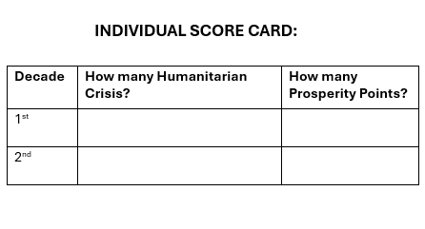
Step 4: Review Consequences

Slide 18
How to win… or lose
The table with the fewest collective humanitarian crisis will be the winning nation!
The governor with no humanitarian crisis + the most prosperity points will the winning governor!

Slide 19
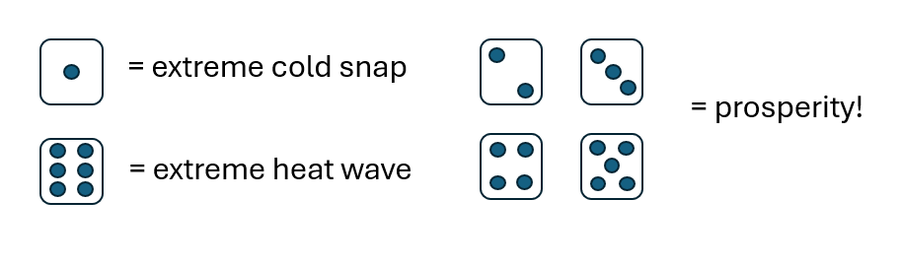
Now lets play! (Round 1)
Remember your scientific information
Allocate your resources
Roll the dice! 1 roll = 1 year
Make observations
Review consequences (individually and as a team)
Raise your hand with any questions – we can help!

Slide 20
What are your initial thoughts?
How was your scenario planning successful? or unsuccessful?

Slide 21
Round 2
with new information/offerings

Slide 22
Reminder of our process:

Slide 23
Step 1: Receive NEW Scientific Information
= extreme cold snap
= prosperity!
= extreme heat wave

Slide 24
Step 2: Make Decisions
Allocate your 10 resources among the 3 investment areas – freeze protection, development, heat protection

Slide 25
Step 3: Make Observations
Each table will roll the dice 10 times (1 roll = 1 year) to determine the potential weather conditions of the decade
If you roll a 1: remove 1 bead from freeze protection
If you roll a 5 or 6: remove 1 bead from heat protection
If you roll a 2, 3, 4: you keep your beads till the next round
If you roll a 1, 5, or 6 with no resources remaining: you face a humanitarian crisis!

Slide 26
Step 4: Review Consequences
INDIVIDUAL SCORE CARD:
Decade | How many Humanitarian Crisis? | How many Prosperity Points?
1st
2nd

Slide 27
A reminder on how to win!
The table with the fewest collective humanitarian crisis will be the winning nation!
The governor with no humanitarian crisis + the most prosperity points will the winning governor!

Slide 28
BUT WAIT!

Slide 29

Special Offer:
Receive a robust choice shield – no humanitarian crises!
Only 2 guaranteed prosperity points
All at the table must agree

Slide 30
Now lets play! (Round 2)
Remember your new scientific information
Allocate your resources
Roll the dice! 1 roll = 1 year or Robust Option?
Make observations
Review consequences (individually and as a team)
Raise your hand with any questions – we can help!

Slide 31
Lets discuss:
What did you realize about your planning style while playing?

Slide 32
How did your strategies differ across the nation? And how did that impact your planning and results?

Slide 33
Who chose the robust option and why?

Slide 34
How does this game relate to the state of transportation planning today?

Slide 35
Forces Shaping Our Regions
Drivers of change that are uncertain and can affect the future
Categories of changes:
  Social
  Technological
  Economic
  Environmental
  Political
Slide content courtesy Lincoln Institute of Land Policy

Slide 36
Activity: Identifying Forces
Use the sticky notes at your table to identify potential forces in the categories:
  Social
  Technological
  Economic
  Environmental
    Example: Extreme heat or extreme cold
  Political

Slide 37
Prioritizing for Planning and Response
Slide content courtesy
Lincoln Institute of Land Policy
High certainty
Key forces to
prepare plans for
Low impact
High impact
Black swan events
High uncertainty

Slide 38
Scenarios
Table exercise on scenarios:
  Negative Growth: Population decrease, steep drop in funding
  Fairly Stable: Population decreasing slowly, stable funding
  Grow, Grow, Grow! Population increasingly steeply, unpredictable funding levels
  Funding Flood: Population increasingly gradually, large increase in funding levels

Slide 39
If… Then… We will…
If:
  Conditions that might occur along with change in population and funding
Then:
  Consequences of those conditions for your agency or region
Our responses/actions will be:
  What your agency/community might do to manage, address, or mitigate consequences of those changing conditions

Slide 40
Next Steps
Identify driving forces that are likely to have the highest impact:
  For your region
  For your organization
What scenarios could occur?
Map out the ifs/thens/we wills
Identify low hanging fruit!
  Are there some “we wills” that occur in response to more than one scenario? Prioritize those actions!

Slide 41
Thank you for playing!
Carrie Kissel
  ckissel@nado.org
Haley Schultheis
  hschultheis@nado.org
www.NADO.org
www.RuralTransportation.org

