Slide 1
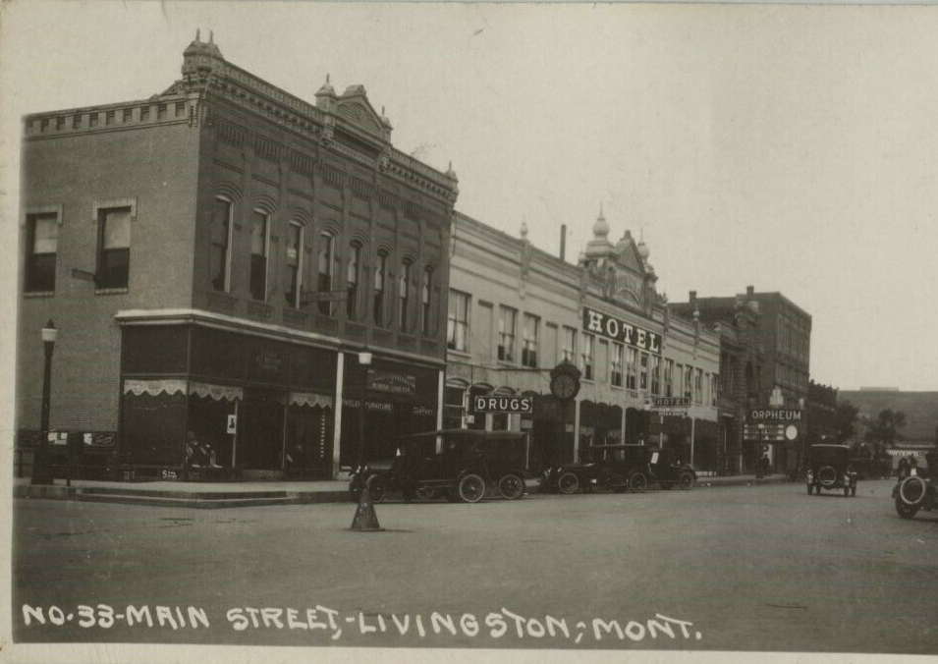
Prioritizing Active Transportation in Rural Montana
Pilot Test of Livingston Downtown Master Plan Priorities
Notes:
Introduce self and project

Slide 2
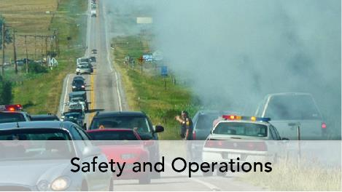
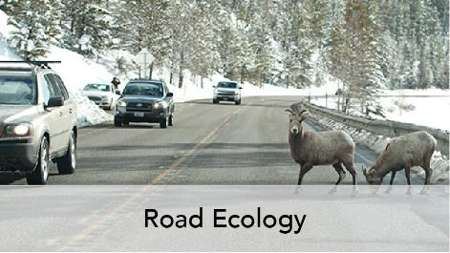
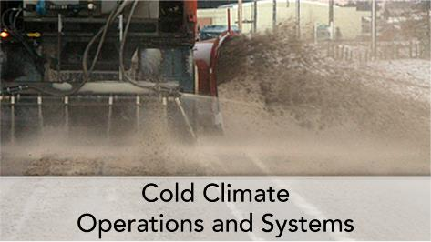
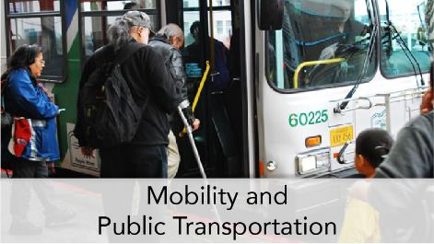
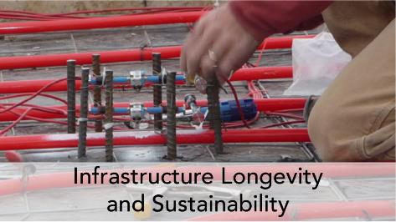


Research Expertise
Notes:
Introduce WTI

Slide 3
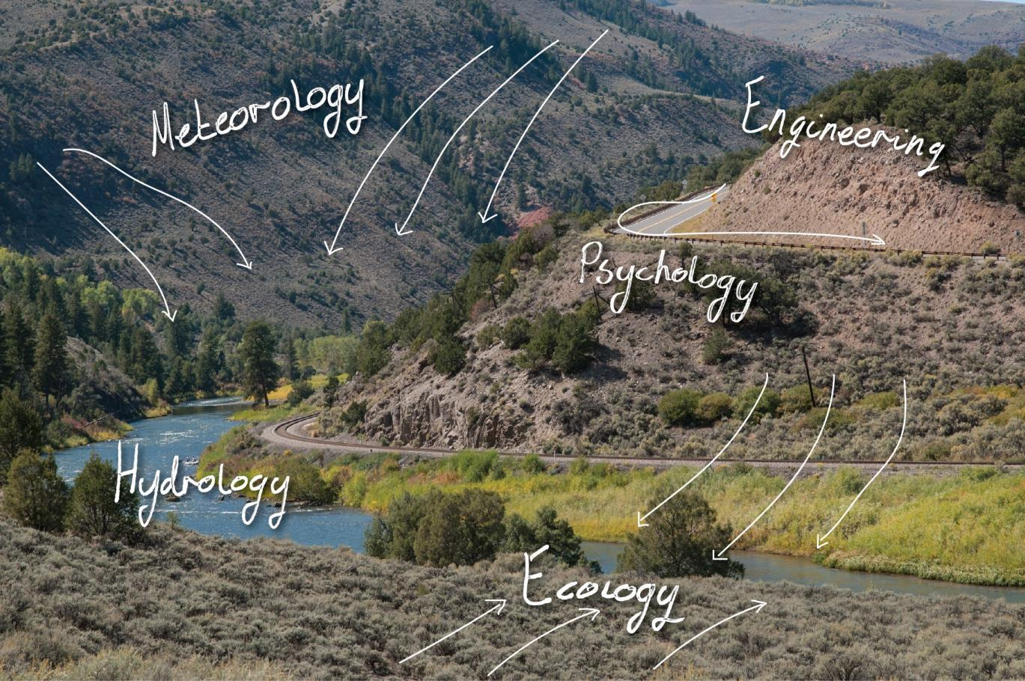
WTI Approach:
Multidisciplinary perspective
Within WTI:
  Ecologists
  Biologists
  Psychologists
  Planners
  Civil Engineers
  Corrosion Engineers
  Electrical Engineers
  Industrial Engineers
  Mechanical Engineers
  Aviation Management Specialists
Across Campus:
  Civil Engineering
  Mechanical Engineering
  Industrial Engineering
  Electrical Engineering
  Computer Science
  Ecology
  Fish and Wildlife
  Plant Sciences
  Land Resources
  Environmental Sciences
  Political Science
  Mathematics
  Physics
  Health Sciences/Community Health

Slide 4
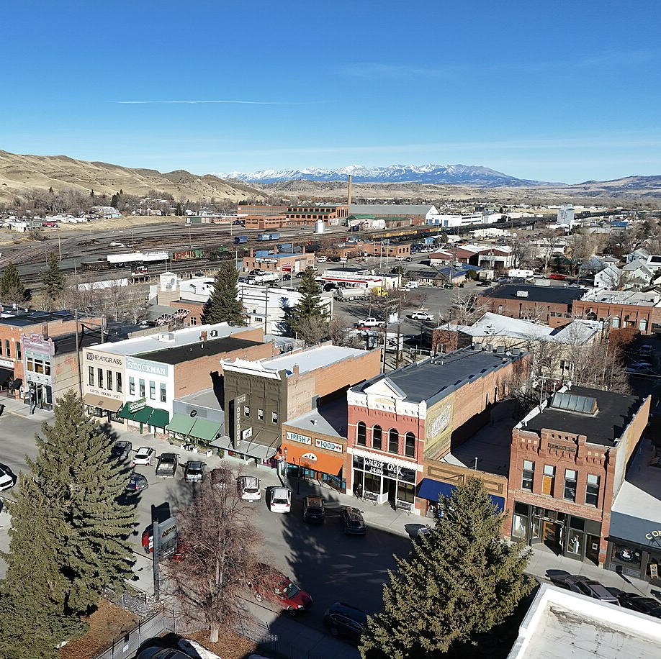
Livingston, Montana
Small rural community ~ 8,500 residents
Old railroad community
Tourism
Bedroom community to Bozeman
Gateway community to Yellowstone National Park
Old time “locals” vs new “transplants” and celebrities
By Quintin Soloviev - Own work, CC BY 4.0, https://commons.wikimedia.org/w/index.php?curid=156877873

Slide 5
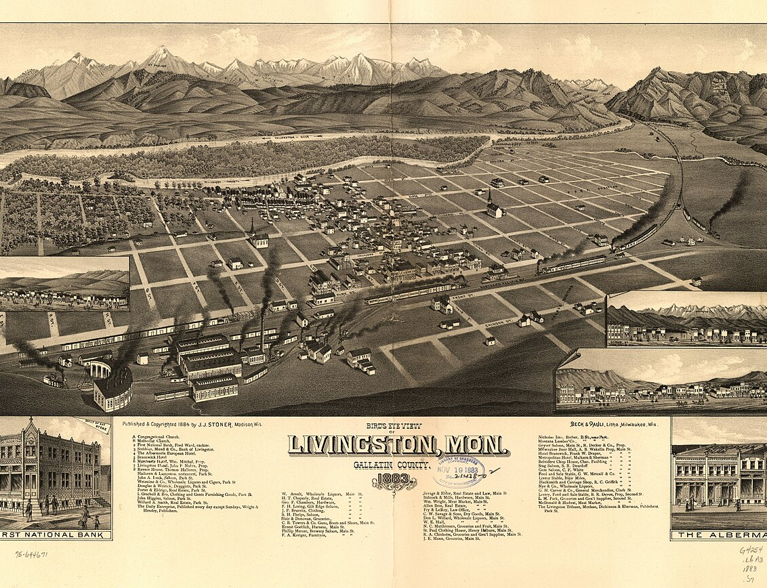
Walkable Communities
Enhanced business activity
Reduced transportation costs
Tourism and economic development
Efficient land use
Health benefits
Sustainability and environment
By Madison, Wis., J. J. Stoner, c1884. - Downloaded From U.S. Library of Congress: G4254.L6A3 1883 .S7, Public Domain, https://commons.wikimedia.org/w/index.php?curid=6032692
Notes:
Old representation from the 1800’s. Small, compact, able to be navigated by foot or bicycle.
Current growth is mostly rural sprawl into Paradise Valley

Slide 6
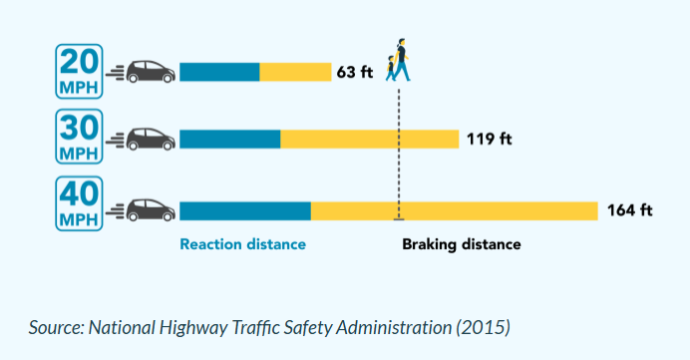
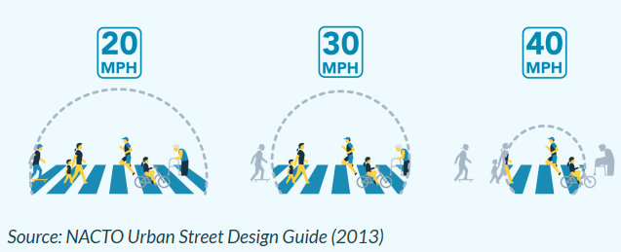
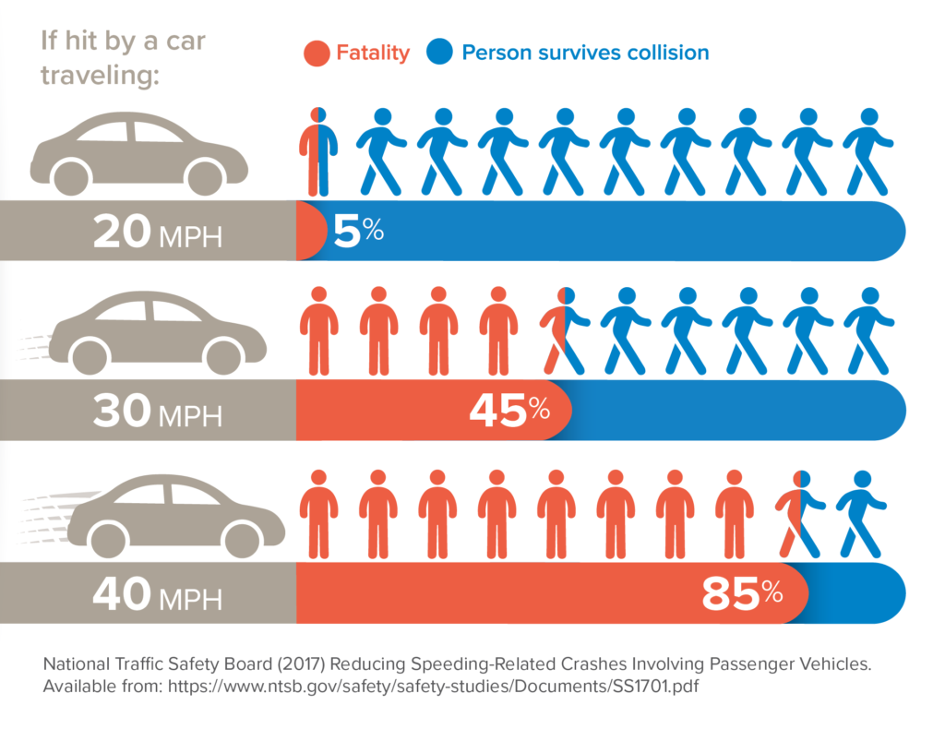
Safe Systems Approach
Safe Roads
Safe Speeds
Safe Road Users
Safe Vehicles
Post Crash Care
Notes:
Higher vehicle speeds significantly increase likelihood of death
Our bodies can only tolerate so much physical impact. Even small increases in vehicle speed significantly escalate risk of severe injuries and deaths. System designers and policymakers can use proven tools to encourage lower, safer speeds. Where there is a mix of people walking, biking and driving

Slide 7
Pop-up Traffic Calming
Improve safety
Respond to residents’ concerns in timely manner
Cost-effective
Changeable
Inform long-term infrastructure improvements
Leverage local knowledge
Engage community
Placemaking

Slide 8
Pop-up Project
Process
Walk Audit
Project Design & Sketches
Material Procurement
Public Communication
Evaluation
Community Need
Baseline Data Collection
Installation
Community Engagement
Notes:
The goals of pop-up traffic calming projects are defined by the community and allow for community input on design and implementation before construction begins on a long-term project
Data collection- typically speed and volume data- before/after. In some cases video data – for bike/ped volumes and pedestrian yielding rates. Houston radar simple way to collect speed/volume data.

Slide 9
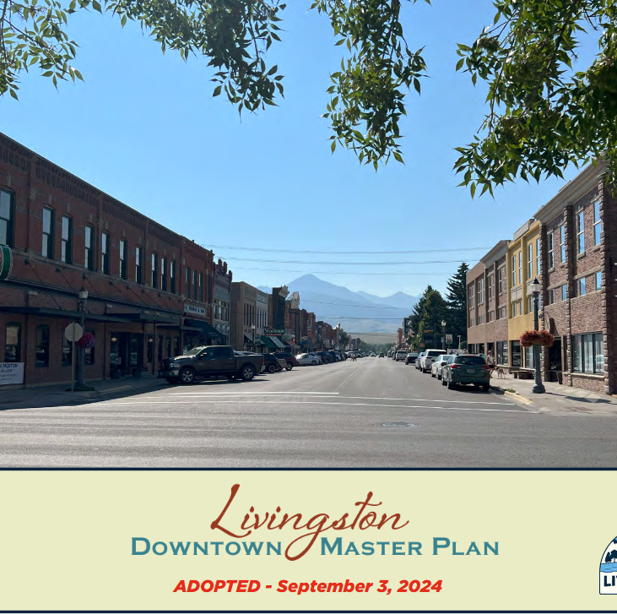
Community Need
“Pursue low-cost traffic calming measures as pilot projects to gauge community’s response to longer-term improvements”
“Prioritize curb extensions/bulb-outs to shorten the crossing distance for pedestrians…”
“Implement bike boulevard enhancements on priority bike connection corridors, and respond to safety evaluation outcomes”
“Study potential roadway changes – such as enhancements to, or better defined non-motorized trail connections…”

Slide 10
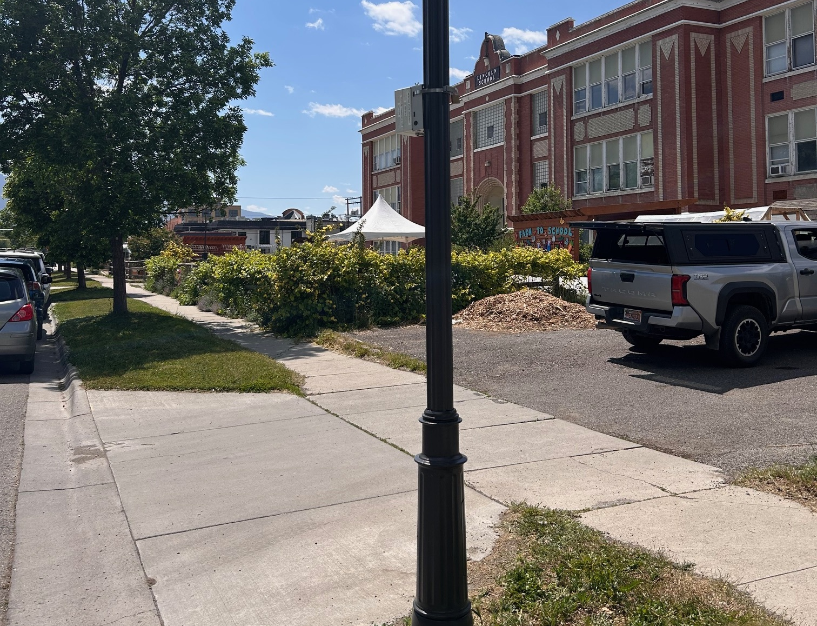
Baseline Data Collection
Previous planning document priorities
Speed Radar
Traffic Counts
Existing conditions of roadway, sidewalks, and intersections
Participant priorities from walk audit

Slide 11
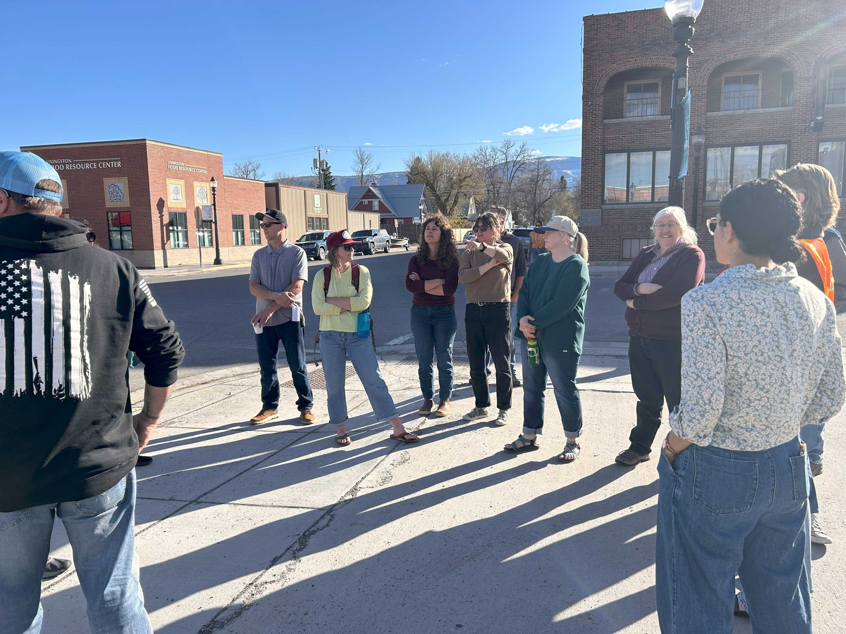
Walk Audit
Diverse Stakeholders
People who are part of Community Leadership
People who serve as police, fire, EMS
People who drive school bus
People involved in Planning, Community Development
People who own business or work in education
People who live or work nearby
People who are young
People Living with Disabilities
People who are older
Notes:
History
Viewshed, tourism photos
Historical context of traffic calming
Culture divide: old time residents vs new transplants, conservative vs liberal, rural vs urban, rhinestone cowboy, wealth vs poverty
More in common than we think.

Slide 12
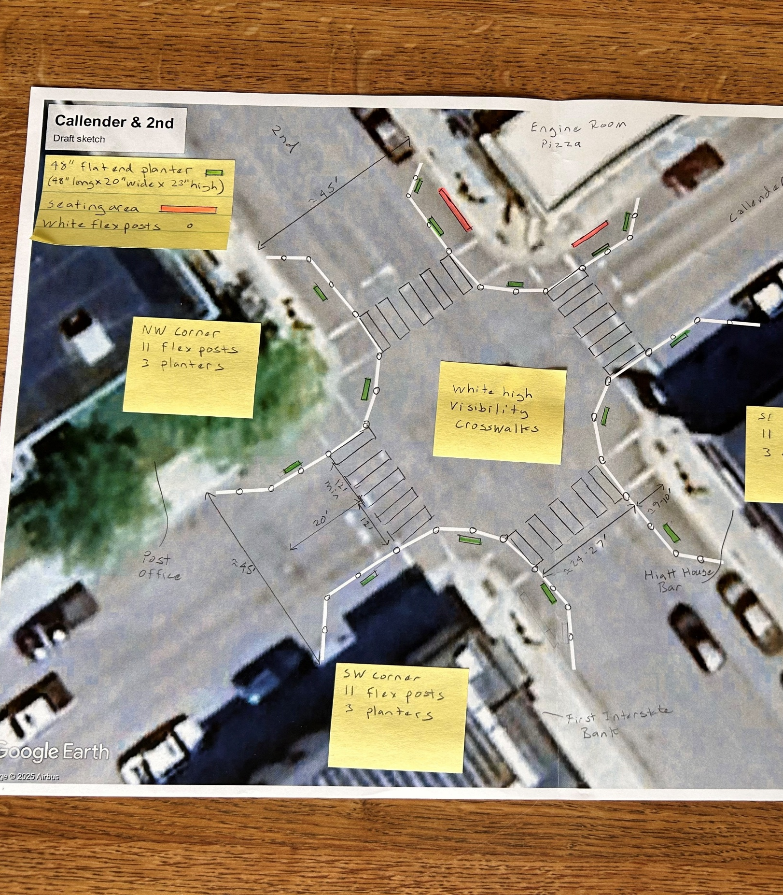
Downtown Project Design and Sketch
Maximum 25-30 mph speed limit
Iterative sketches with feedback from community
MUTCD and local regulation compliance
Durable materials & supplies
Encroachment permits
Timing of installation work

Slide 13
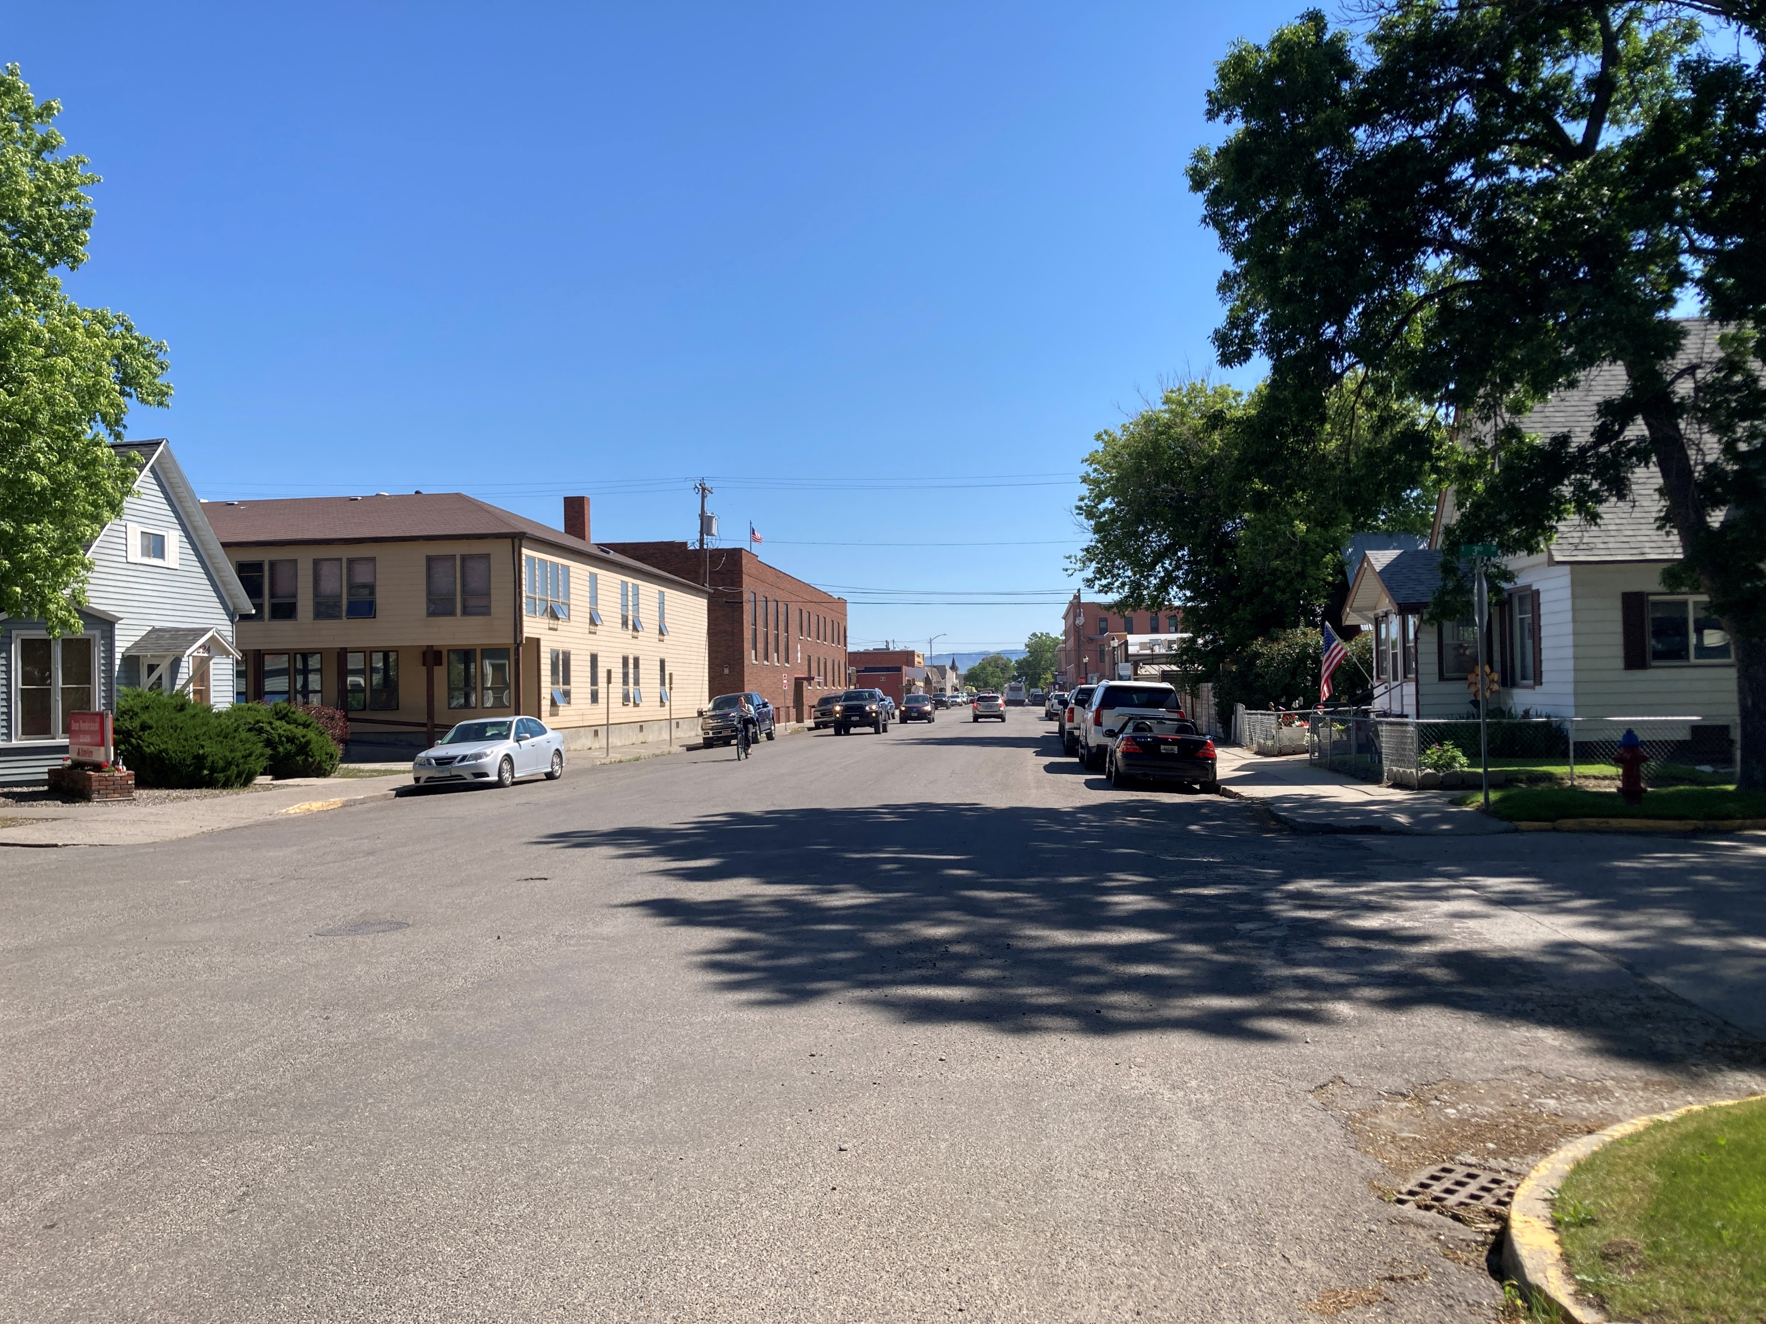
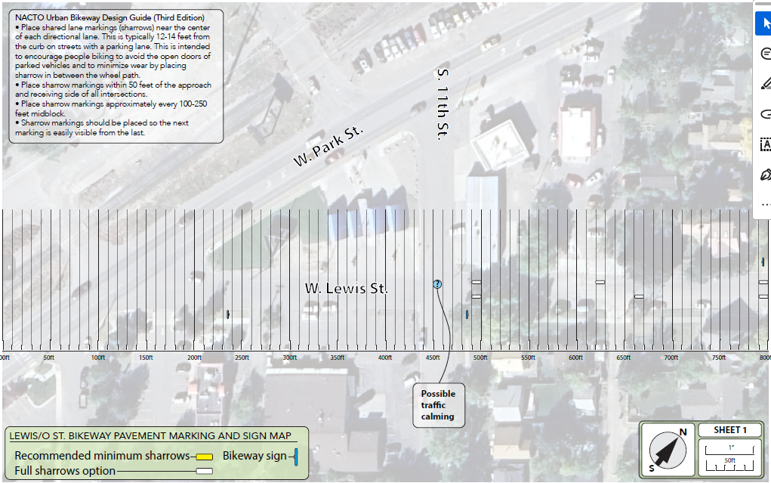
Bikeway Project Design and Sketch
Collect vehicle speed data to ensure ideal volume/speeds
Assist City of Livingston with identification of signage and pavement marking placement.
Use existing materials for quick build traffic calming in select locations.
Identify future improvements to corridor (ie: traffic circle, median island, gateway treatment)

Slide 14
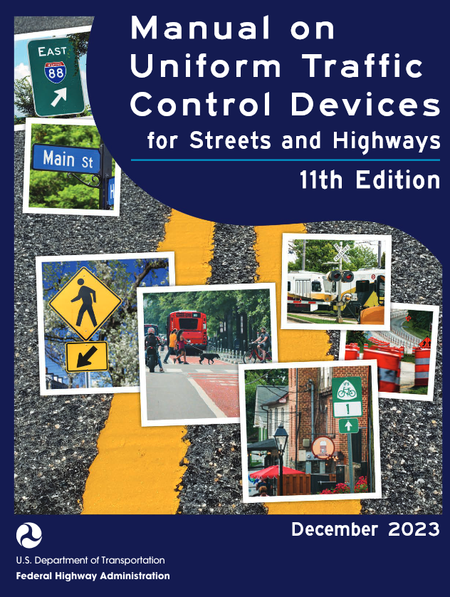





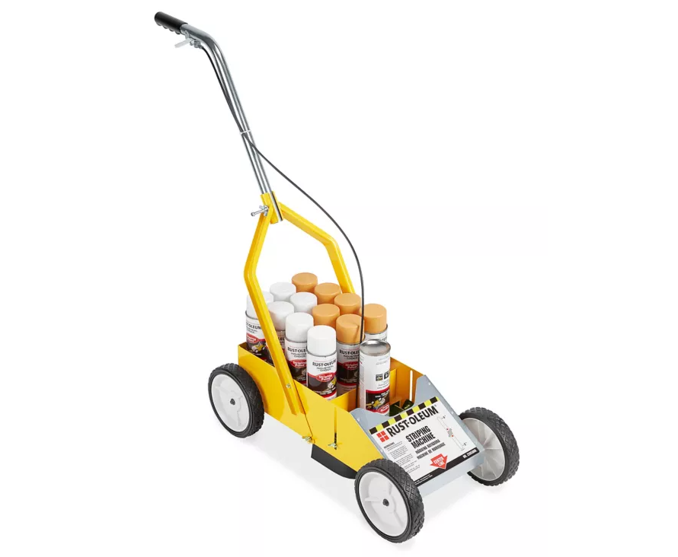
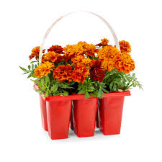

Material Procurement

Slide 15
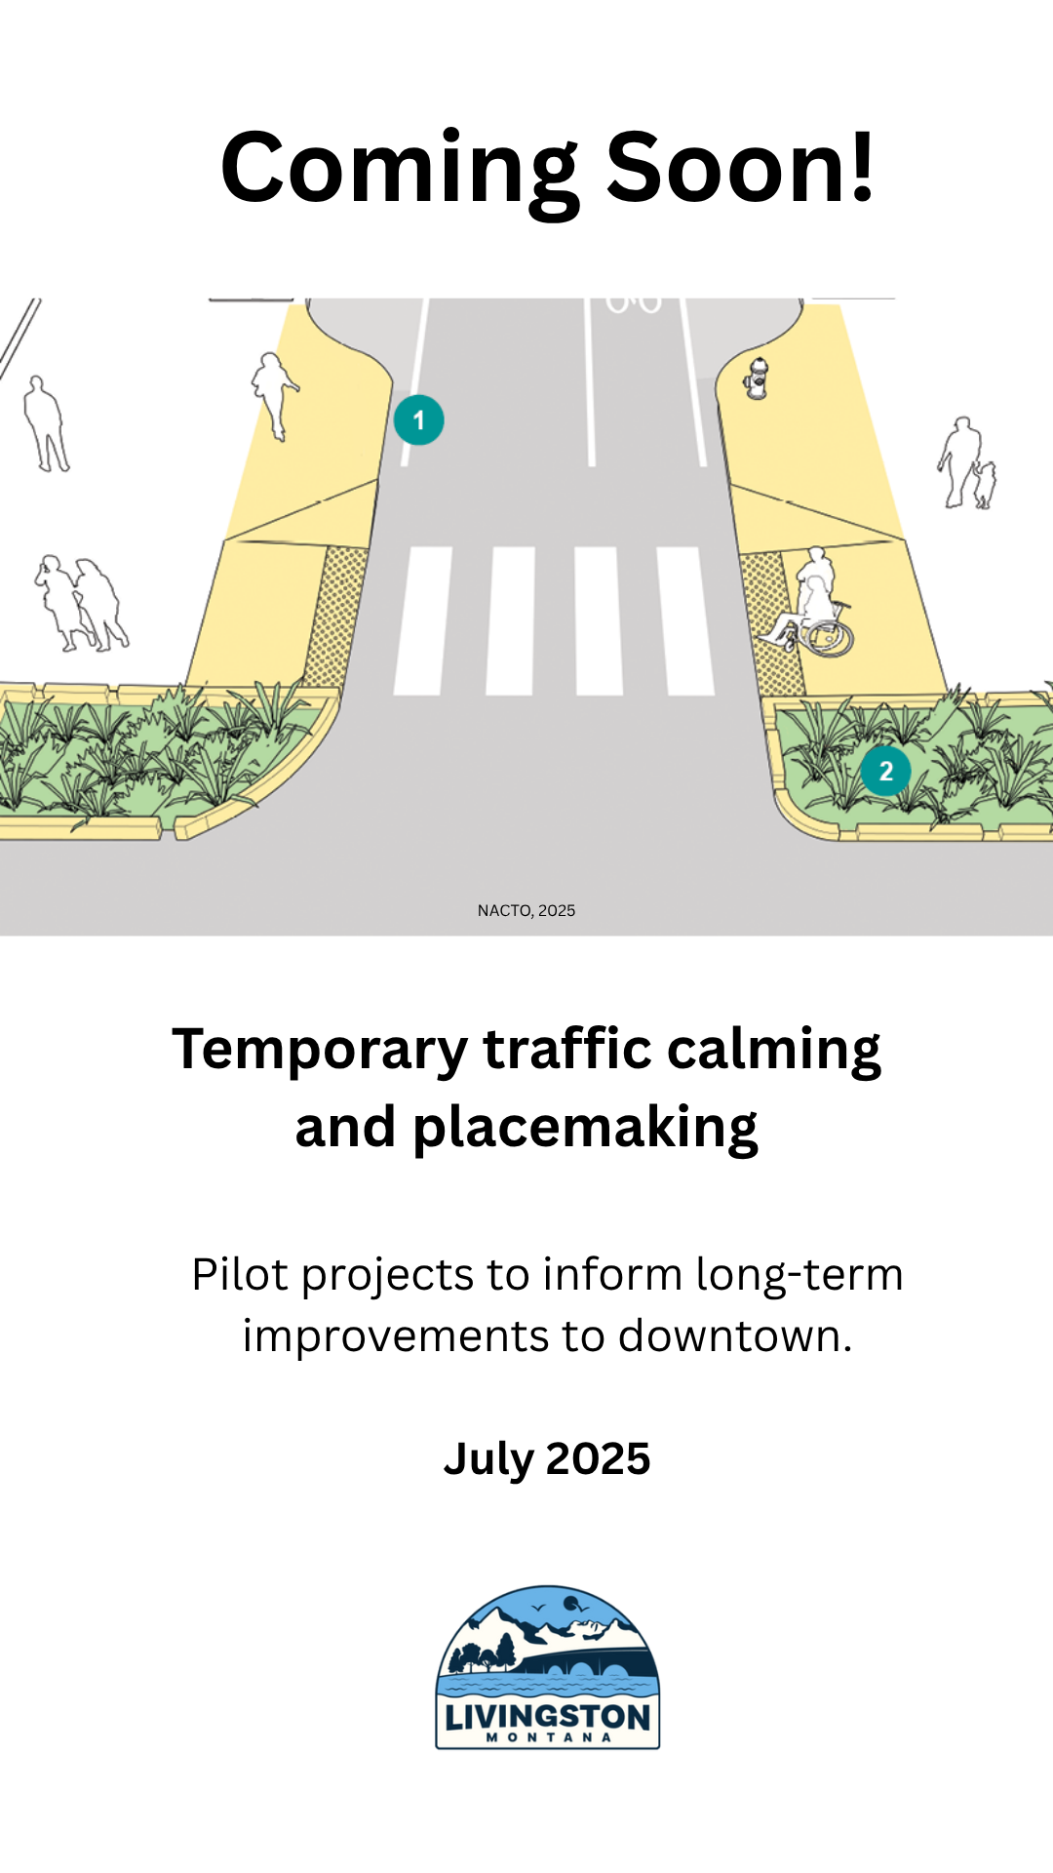
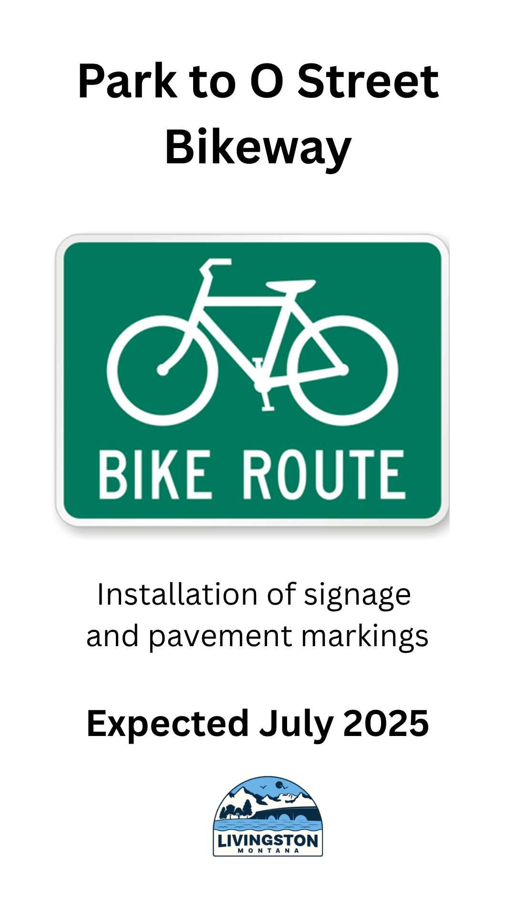
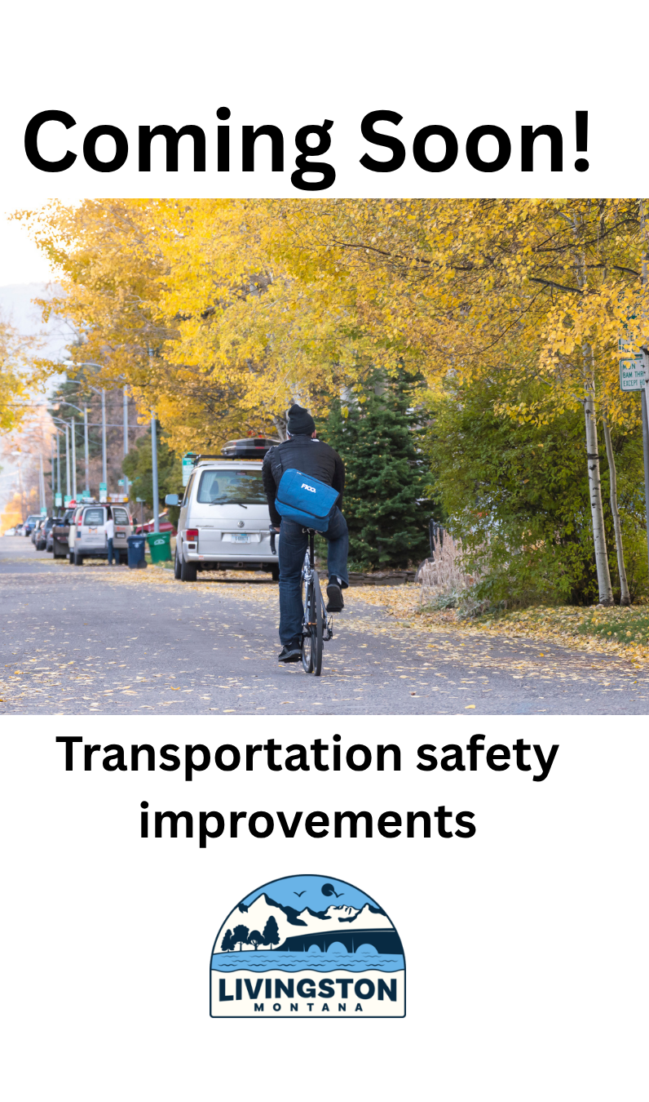
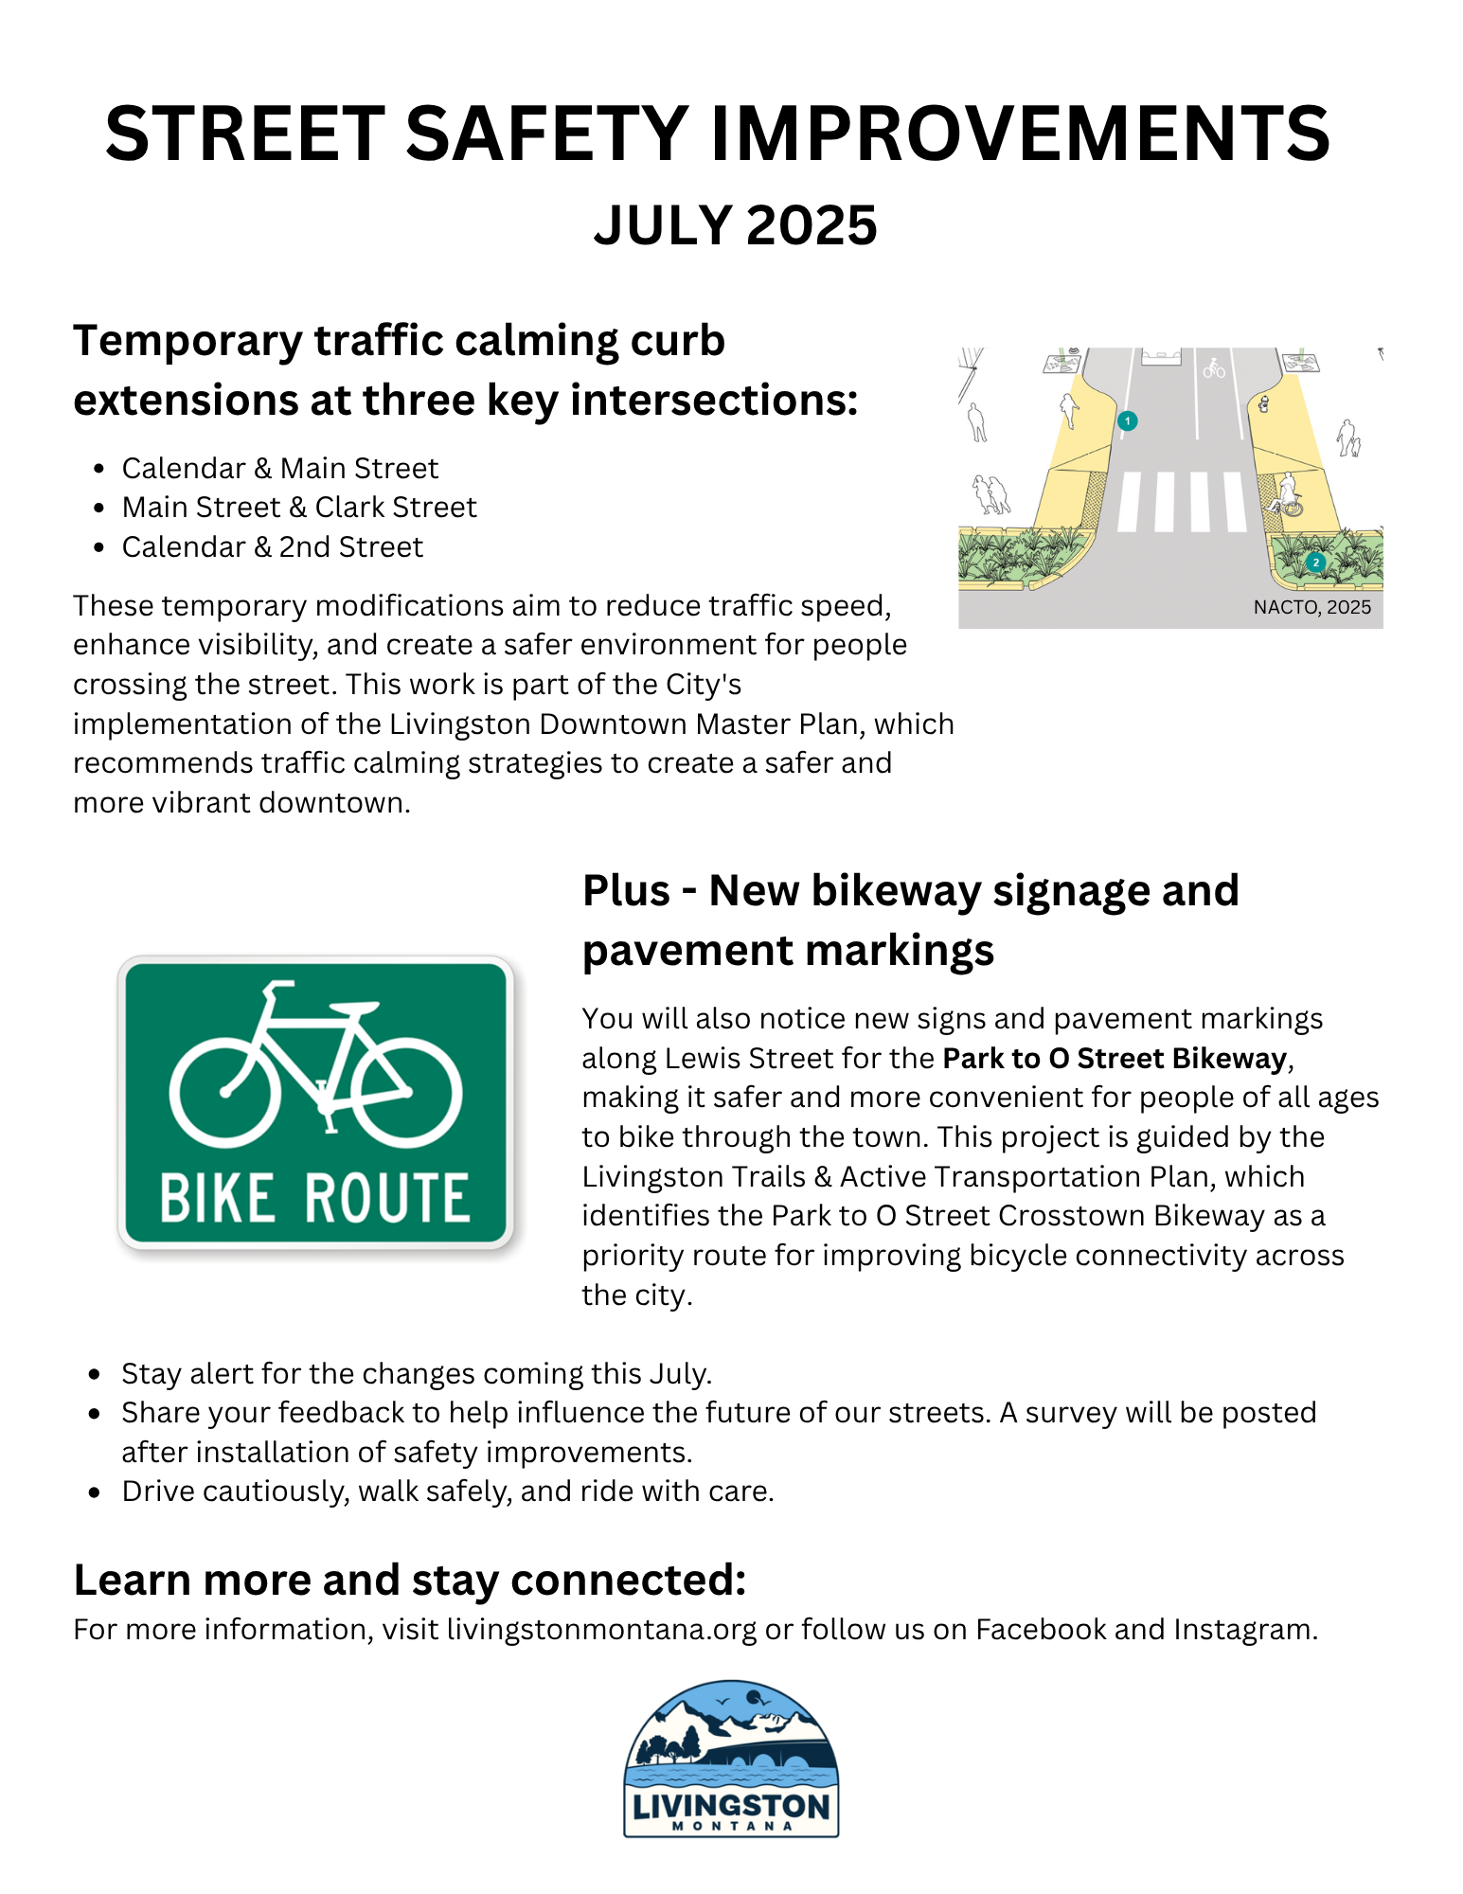
Public Communication
Social media
Newsletter
Newspaper
Flyers & Door hangers
Direct mailer
Radio
Other relevant channels

Slide 16
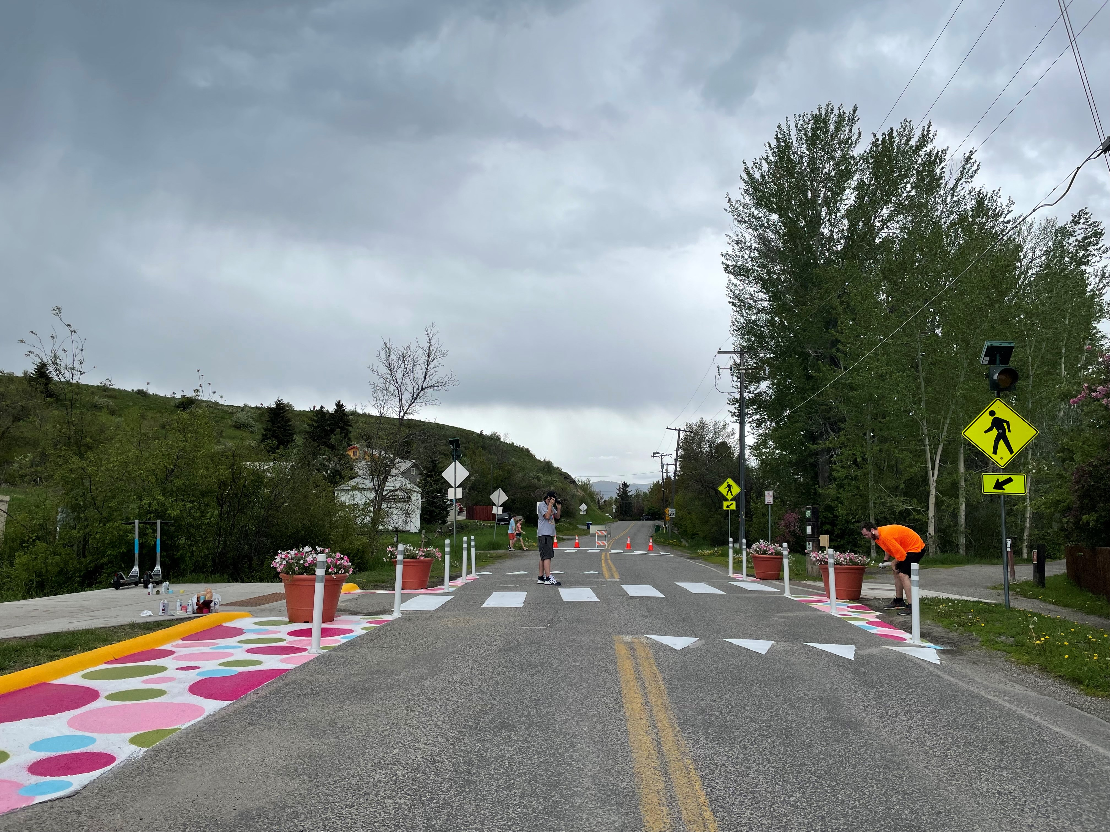
Installation
Volunteers' vs paid staff
Local artists, students
Downtown Curb Extensions:
  Bollards and paint installed July
  Wait until after parade
  Planters on back order
Bikeway:
  Utility locates for signage
  Expense vs durability: Sharrows, thermoplastic $$$ vs. paint $
  Suggested gateway treatment/ traffic calming

Slide 17
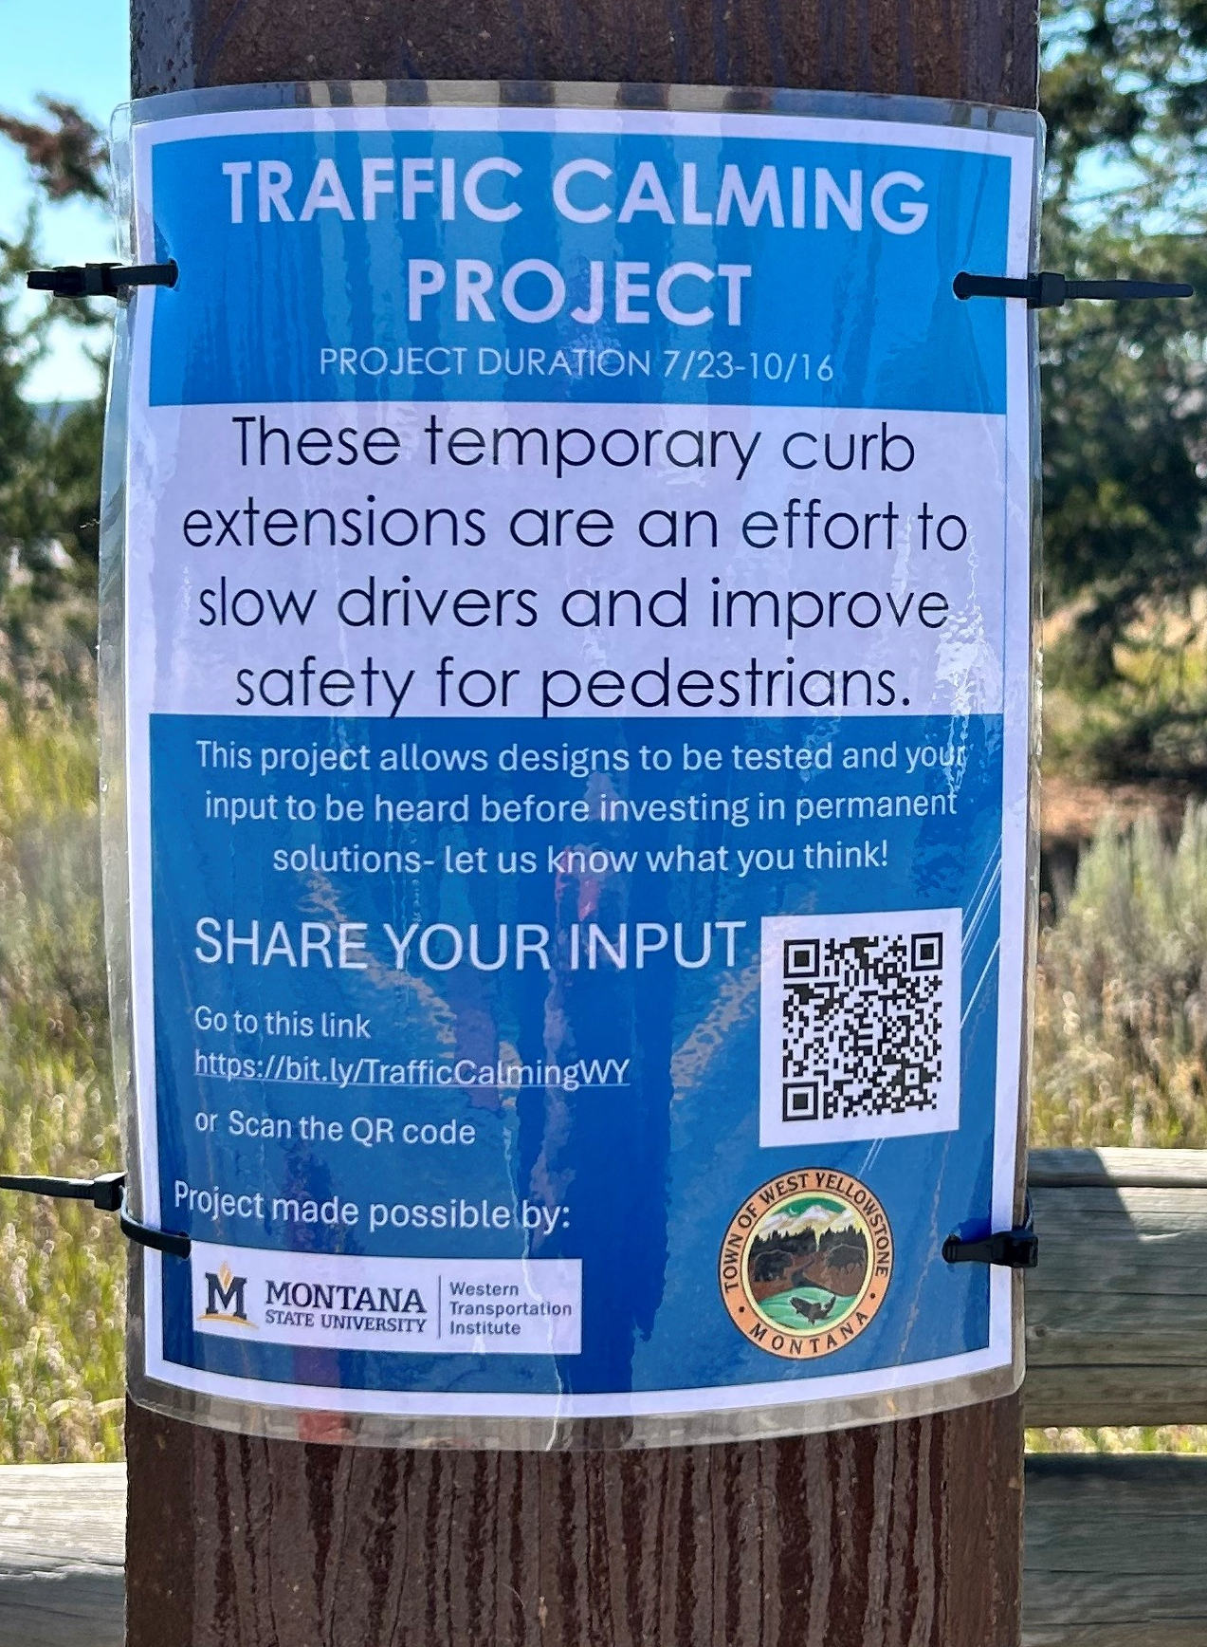
Evaluation
Speed
Volume
Yielding Rates
Survey Results
Other community feedback
“It works really well in slowing down traffic and making crossing safer. I like how it visually makes it seem more like a neighborhood installment, which says we’re here and we care. Thanks for doing this! It makes all of us more safe.”

Slide 18
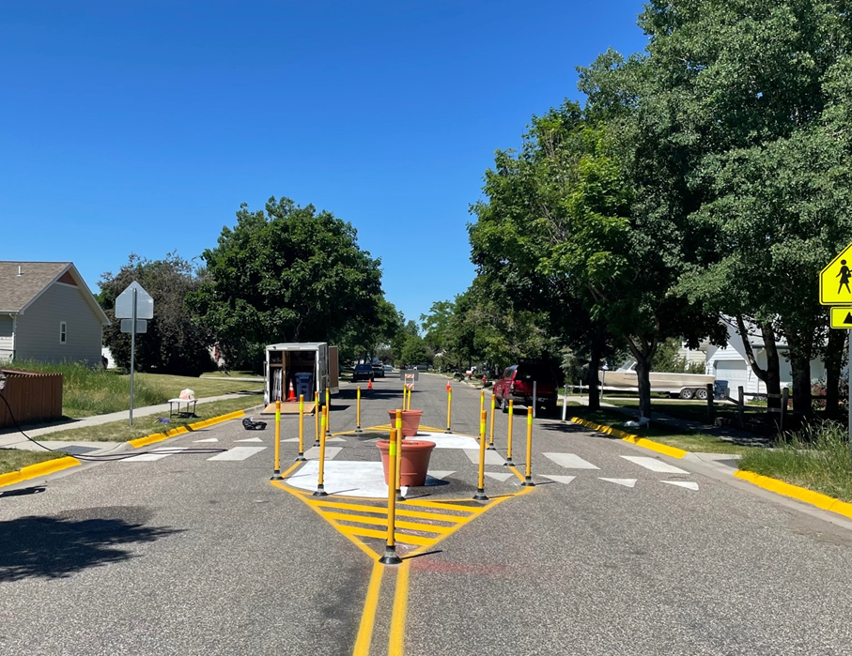
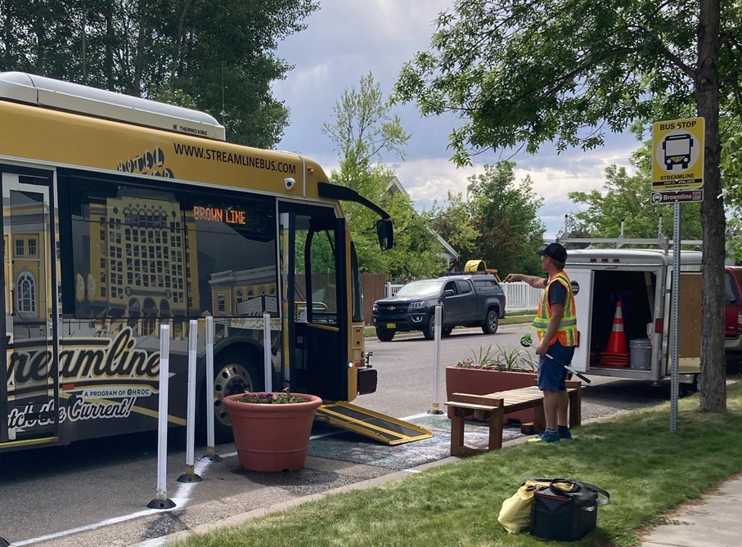
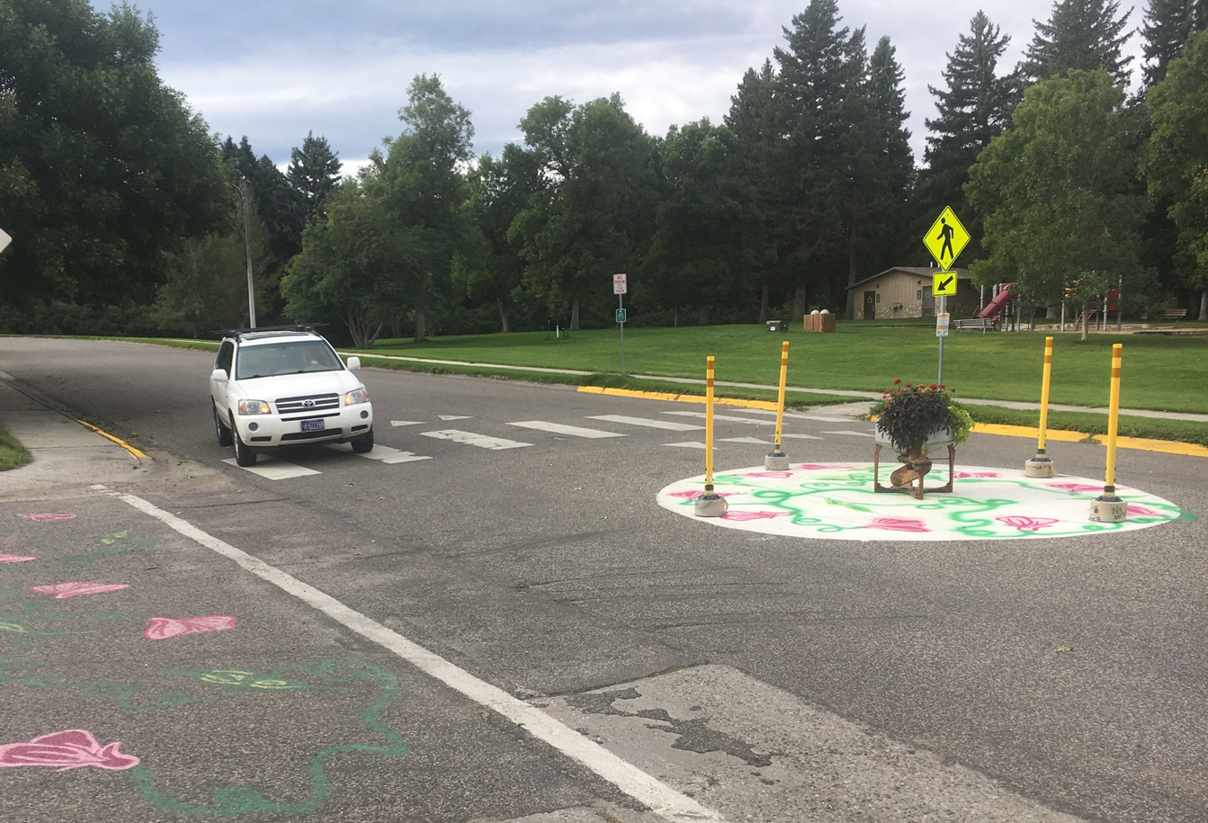
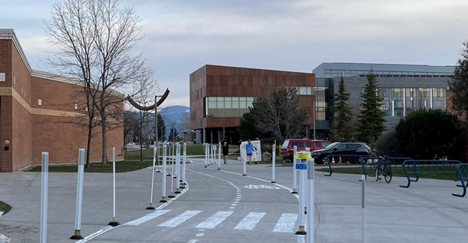
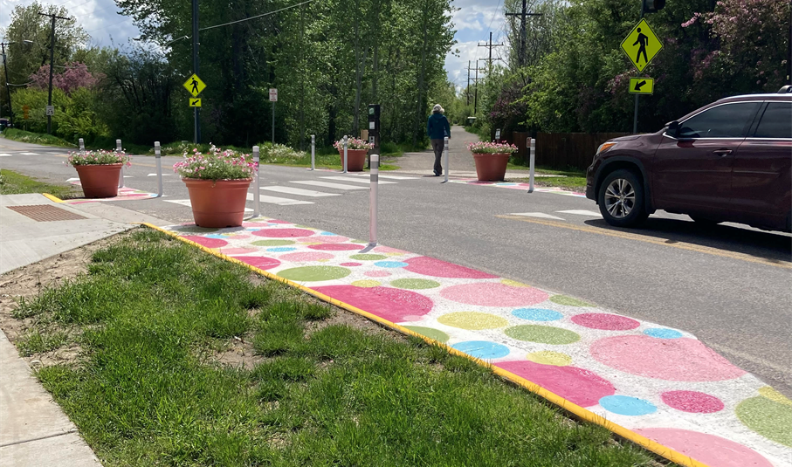
Other similar projects:
City of Bozeman: city wide TC program, Primer, Trailer/equip, youth engagement
Okolona Walk Audit and Community Engagement
West Yellowstone – Working with DOT
Hamilton
Big Sky

Slide 19
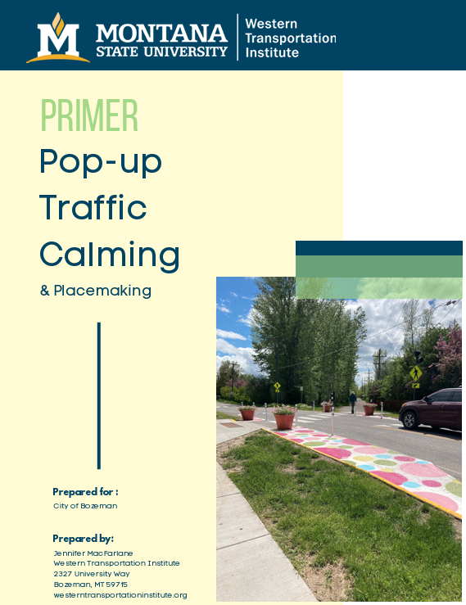
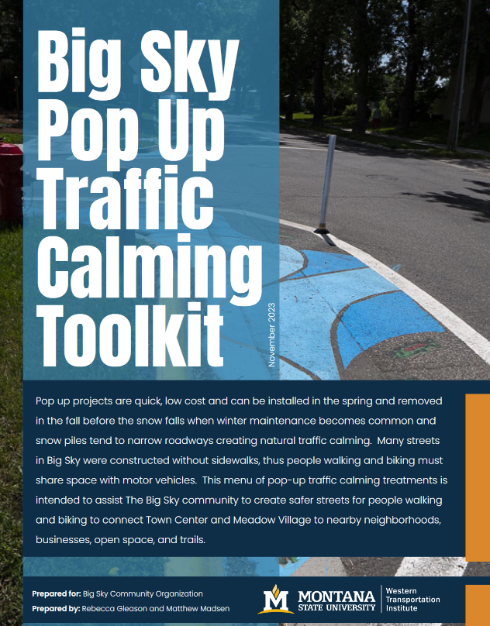
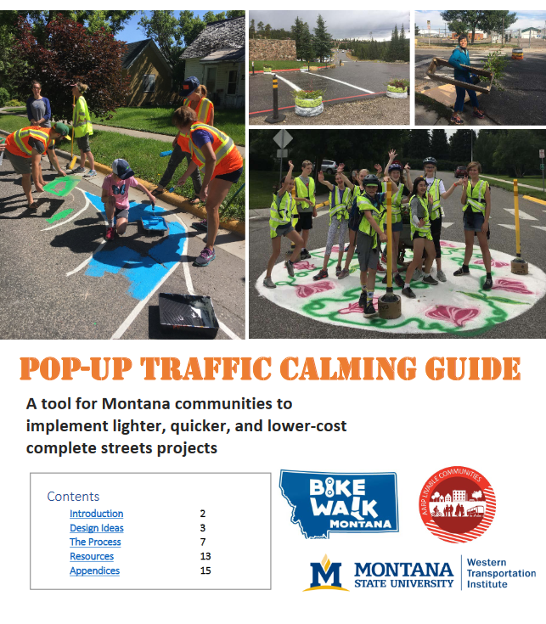

Resources
Montana Pop-up Traffic Calming Guide
Big Sky/ Rural Traffic Calming Toolkit
Burlington Public Works Quick Build Design + Materials Standards
Pop-up Traffic Calming & Placemaking Primer

Slide 20
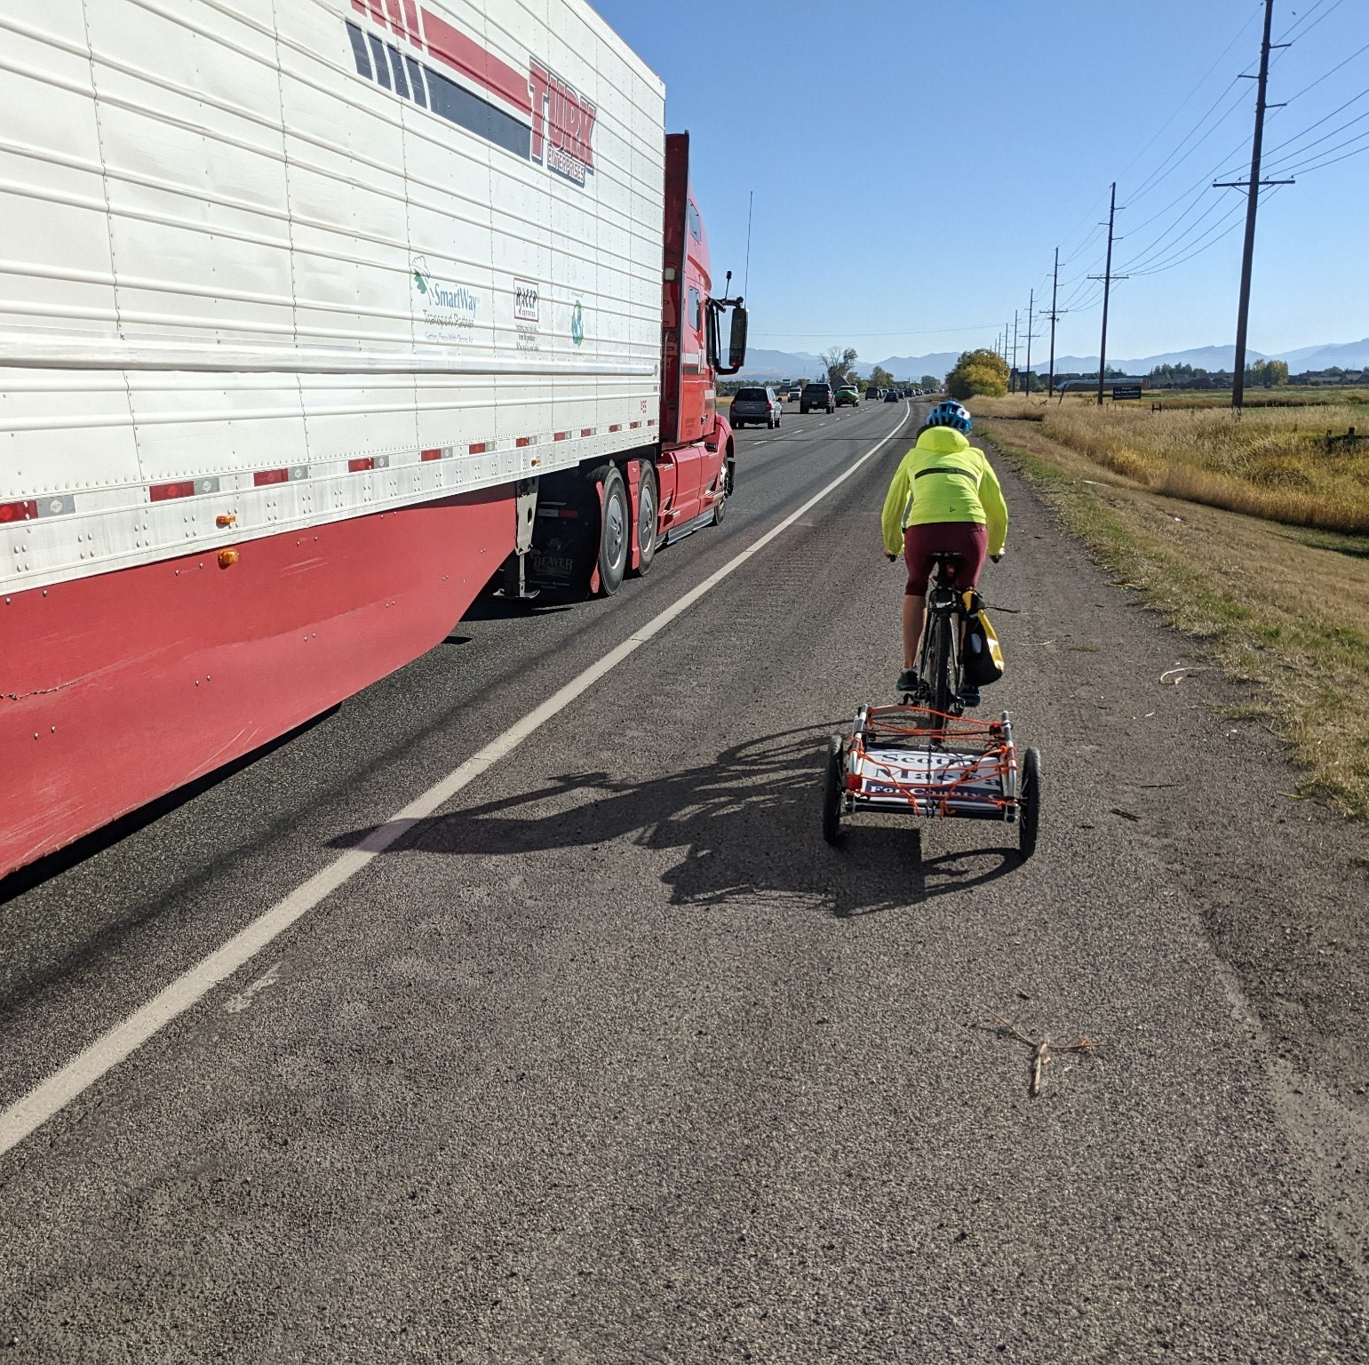
Contact
Western Transportation Institute
PO Box 174250
2327 University Way, Bozeman, MT 59715
(406) 589-7772
Jennifer.macfarlane@montana.edu

