Slide 1





Engagement in the
Rural Transportation Analysis
2024
Notes:
Include Holly's basic info, (sr) title, staff photo

Slide 2
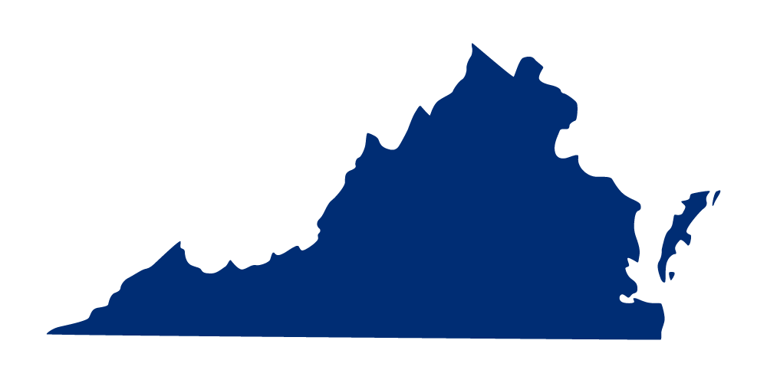
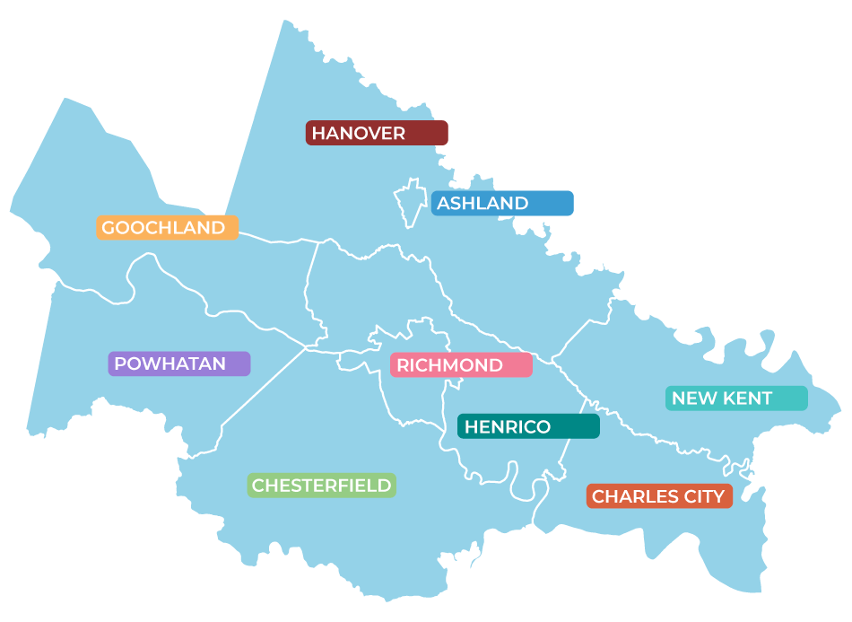
Richmond, VA Region
VIRGINIA
Notes:
Map and overview of PlanRVA region

Slide 3
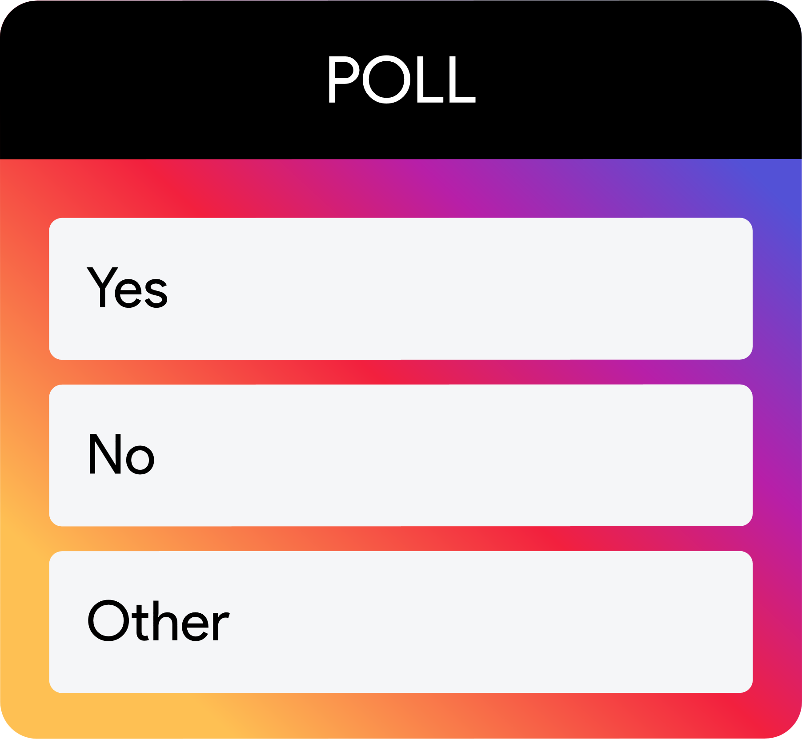
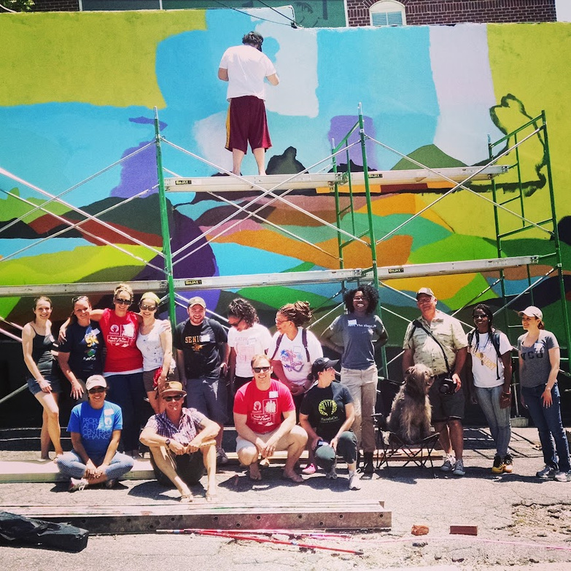

Slide 4
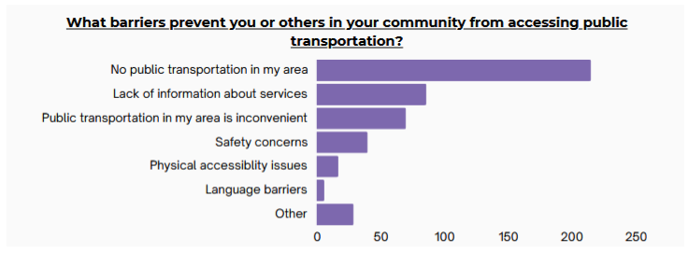
Richmond’s answers

Slide 5


WHAT WE HEARD
Challenges
for Rural Residents
-Long distances to essential services
-Limited or no access to public transit
-High costs of vehicle ownership
-Mobility barriers for older adults and people with disabilities
Interest in:
flexible, reliable, and affordable options

Slide 6
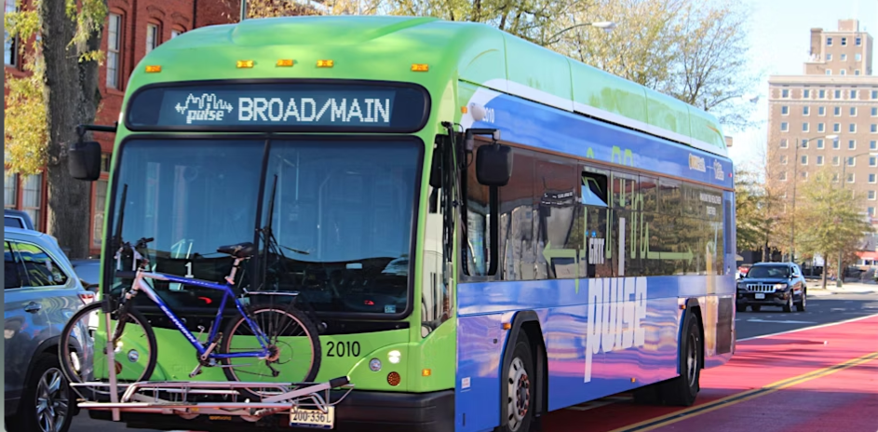


Approach
Identify stakeholders:
  Transportation operators (3)
  Locality staff and champions
  Community/nonprofits (health, seniors, business)
We asked them to:
  Invite us to or tell us about an event
  Fill out the survey
  Share the toolkit
What did we do?
  Go to where people were already gathering
  Show up at least twice in each of 5 counties

Slide 7


YOUTH SPOTLIGHT
Might be closer than it sounds—transit already offers fare-free rides, breaking down cost barriers and keeping people moving!
“Free rollercoasters that take you to other places”
–Liam, 9
A ridiculous thought is only that until we have the technology or the willpower to make it happen.

Slide 8
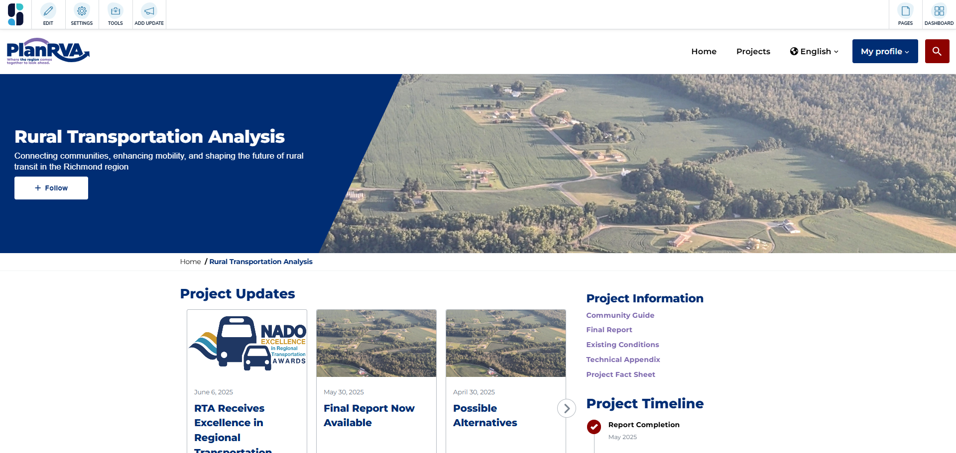
NEW TO US
engage.planrva.org
Input Tools:
-Online survey
-Online travel mapper
-In person events w/ paper survey
Notes:
"There is no public transportation in Goochland. If you do not have a car, you are either home bound or have to rely on others with vehicles to help you out."
"I love the current GRTC link in Hanover, and my kids have used it several times. I would love to see it extended and expanded"
"My kid wanted a summer job but could not get one do to lack of transportation."
" I live less than a mile from a park, the Y, the library, a pool and some restaurants but am forced to drive because there are NO SIDEWALKS. It would open up so many more options with this one simple addition in Hanover."
"I wish it was possible to get to rural village areas from the city without using a car"
"I can drive now but in a few years I may need assistance going to doctor appointments and groceries."
"I am a double amputee who goes to dialysis 3x per week. The facility is 15 minutes away and there is nothing in New Kent that would provide what I require to stay alive."
What did the Open Comments Say?
Sentiment Breakdown
Most feedback on rural transportation was positive (61.6%), with 26.7% expressing
negative views and the remainder being neutral or mixed.
Need for Expanded Transit Options
Residents emphasized the need for more sidewalks, bike paths, microtransit
services, and connections to essential destinations. Priorities included improving
transportation for seniors, low-income residents, and individuals with disabilities.
Barriers to Access
The lack of public transportation limits access to services, particularly for those
with mobility challenges. There is strong interest in more flexible transit options
to enhance accessibility across rural areas.
Opposition to Transit Expansion
Some community members expressed skepticism, viewing public transit as
underutilized and unnecessary for rural settings.
Community Engagement and Education
Education campaigns are essential to address misconceptions about public
transit and promote its benefits. Ongoing engagement with residents is crucial
to ensure solutions meet community needs.

Slide 9
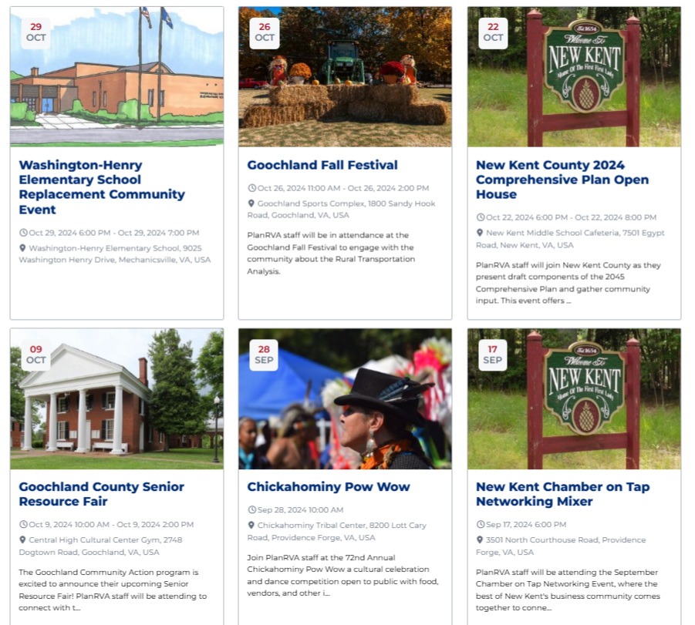
Why did this work for us?
  Test of new engagement site
(Simpler language)
  Tools and survey best practices
(Tribal location)
  Tee up to LRTP
  Rural counties felt heard
(Suburban county wanted in!)
  Shared data
(VDH)
  We were more powerful together

Slide 10
Community Perspectives
"I am a double amputee who goes to dialysis 3x per week. The facility is 15 minutes away and there is nothing [here] that would provide what I require to stay alive."
"I can drive now but in a few years I may need assistance going to doctor appointments and groceries."
Aging & future mobility needs
Critical medical transportation needs
Notes:
"There is no public transportation in Goochland. If you do not have a car, you are either home bound or have to rely on others with vehicles to help you out."
"I love the current GRTC link in Hanover, and my kids have used it several times. I would love to see it extended and expanded"
"My kid wanted a summer job but could not get one do to lack of transportation."
" I live less than a mile from a park, the Y, the library, a pool and some restaurants but am forced to drive because there are NO SIDEWALKS. It would open up so many more options with this one simple addition in Hanover."
"I wish it was possible to get to rural village areas from the city without using a car"
"I can drive now but in a few years I may need assistance going to doctor appointments and groceries."
"I am a double amputee who goes to dialysis 3x per week. The facility is 15 minutes away and there is nothing in New Kent that would provide what I require to stay alive."
What did the Open Comments Say?
Sentiment Breakdown
Most feedback on rural transportation was positive (61.6%), with 26.7% expressing
negative views and the remainder being neutral or mixed.
Need for Expanded Transit Options
Residents emphasized the need for more sidewalks, bike paths, microtransit
services, and connections to essential destinations. Priorities included improving
transportation for seniors, low-income residents, and individuals with disabilities.
Barriers to Access
The lack of public transportation limits access to services, particularly for those
with mobility challenges. There is strong interest in more flexible transit options
to enhance accessibility across rural areas.
Opposition to Transit Expansion
Some community members expressed skepticism, viewing public transit as
underutilized and unnecessary for rural settings.
Community Engagement and Education
Education campaigns are essential to address misconceptions about public
transit and promote its benefits. Ongoing engagement with residents is crucial
to ensure solutions meet community needs.

Slide 11
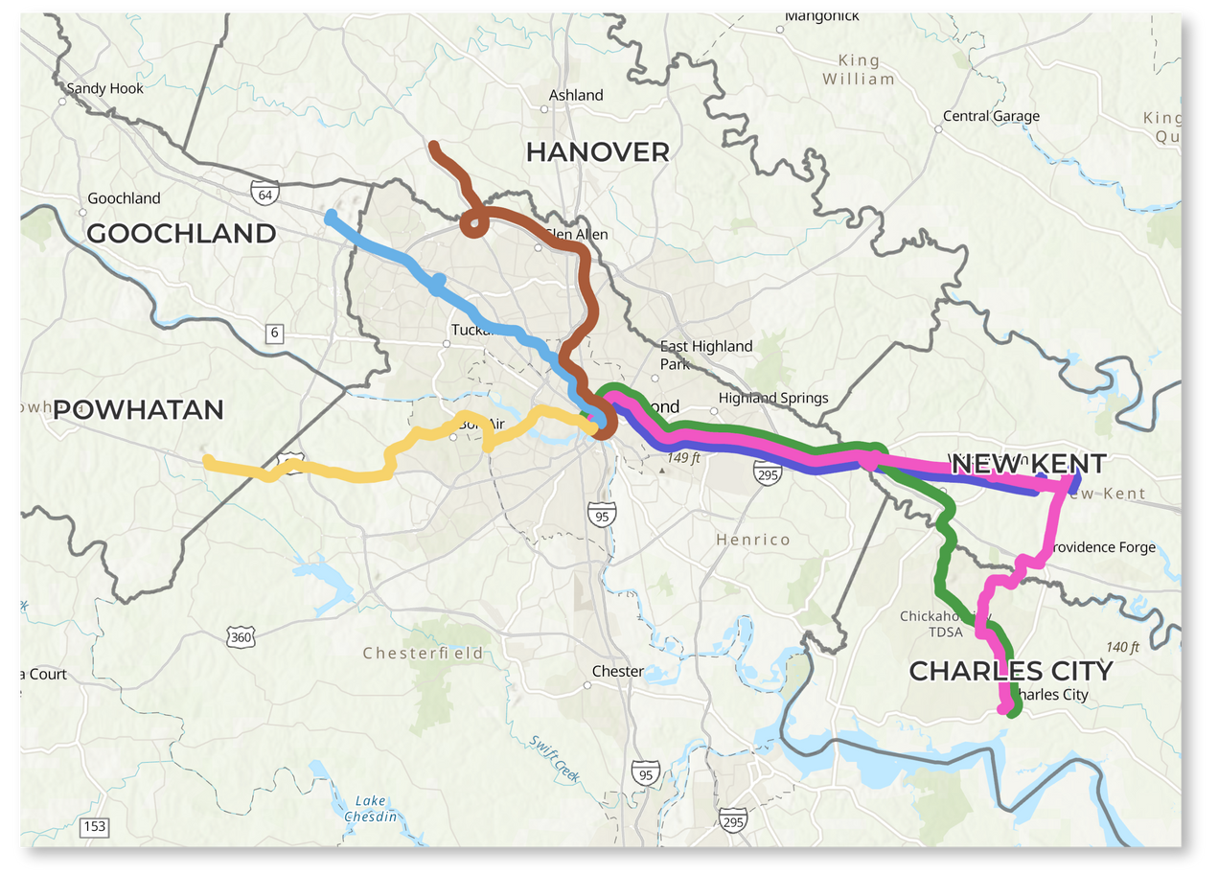
Project Recommendations
New Rural Transit Service
  New Express Services
    Fixed route from rural centers to downtown Richmond
  Expanded Microtransit Service
    GRTC LINK in more areas
  Expanded Demand Response Services
    In areas without fixed route or microtransit
  Coordinated Volunteer Services
    Centralize scheduling and coordination
Proposed Rural Express Services
Notes:
Possible solutions image, inc

Slide 12
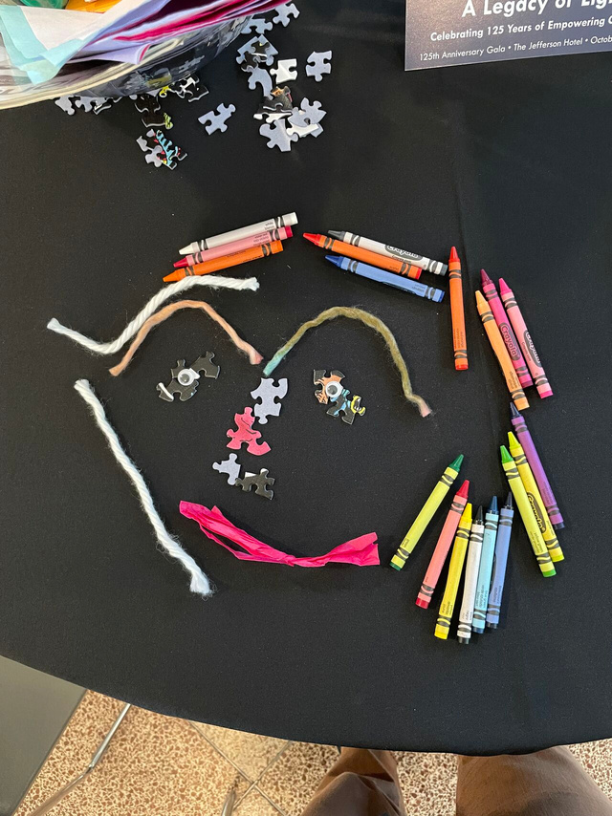
Activity at your tables
Group
  Get in a group at your table of 2-3 people
    (quickly and quietly)
  Think of an upcoming (or past) engagement opportunity at your org
Why Are We Doing This?
  Making is the first step in creative discovery
  Start with a small, achievable activity
  Working with your hands is a different way of thinking and gets different results
Notes:
Include Holly's basic info, (sr) title, staff photo

Slide 13
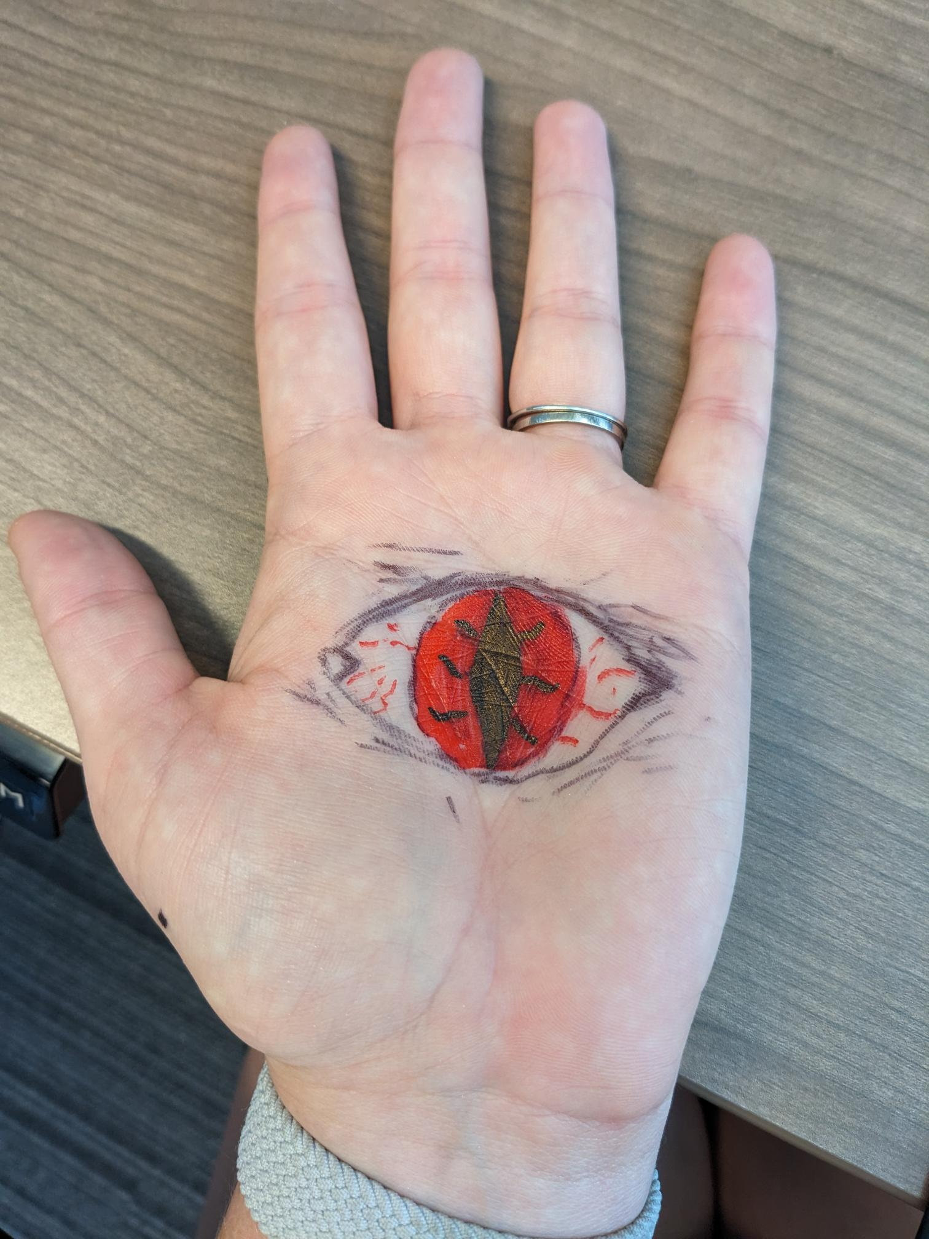
Make It
  Choose a card prompt
  Work together to make something AND—discuss how you could apply that to your engagement opportunity
  Example:
      Prompt: Make a hat for yourself or someone else
      Engagement Application: Invite the public to make and put on the hat of someone else—an elderly person or a transportation engineer.
      How would this new persona plan a future they want?
Timer is set for 7 minutes
Be weird, think big.
Notes:
Include Holly's basic info, (sr) title, staff photo

Slide 14

Reflect on it
  After timer dings, choose ONE reflection question:
  What did you like about the process of creating this?
  OR
  What is one way you could build on what you made?
  Discuss in your group
  Timer is set for 3 minutes
Notes:
Include Holly's basic info, (sr) title, staff photo

Slide 15

Share your creative ideas
After the session
and throughout the conference:
In the Whova App Community Board:
GET INSPIRED--Community Engagement
Take a photo before you leave
Share on Socials
Tag @planrva #NRTC2025

Slide 16

Staff Credits
Leads
Dan Motta, Transportation Planner
dmotta@planrva.org
Holly Gordon, Sr. Community Engagement Manager
hgordon@planrva.org
Contributors
Transportation Team:
Dorian Allen, Planner
Sulabh Aryal, AICP, PTP, Planning Manager
Myles Busching, Director of Transportation
Ansley Heller, Planner
Ken Lantz Jr, PE, Mobility Coordinator
Phil Riggan, Planner
Kerry Wagenhauser, AICP, Planner II
Data Team:
Sarin Adhikari, Principal Data Manager
Elizabeth Greenwell, Data Analyst
Engagement Team:
Kristin Hott, Engagement Coordinator
Take a photo of your creation
Share on Socials
Tag @planrva #NRTC2025
Notes:
Include Holly's basic info, (sr) title, staff photo

