Slide 1



All Things National RTAP
2025 National Regional
Transportation Conference
Des Moines, Iowa
July 15-17, 2025
U.S. Department of Transportation
Federal Transit Administration

Slide 2

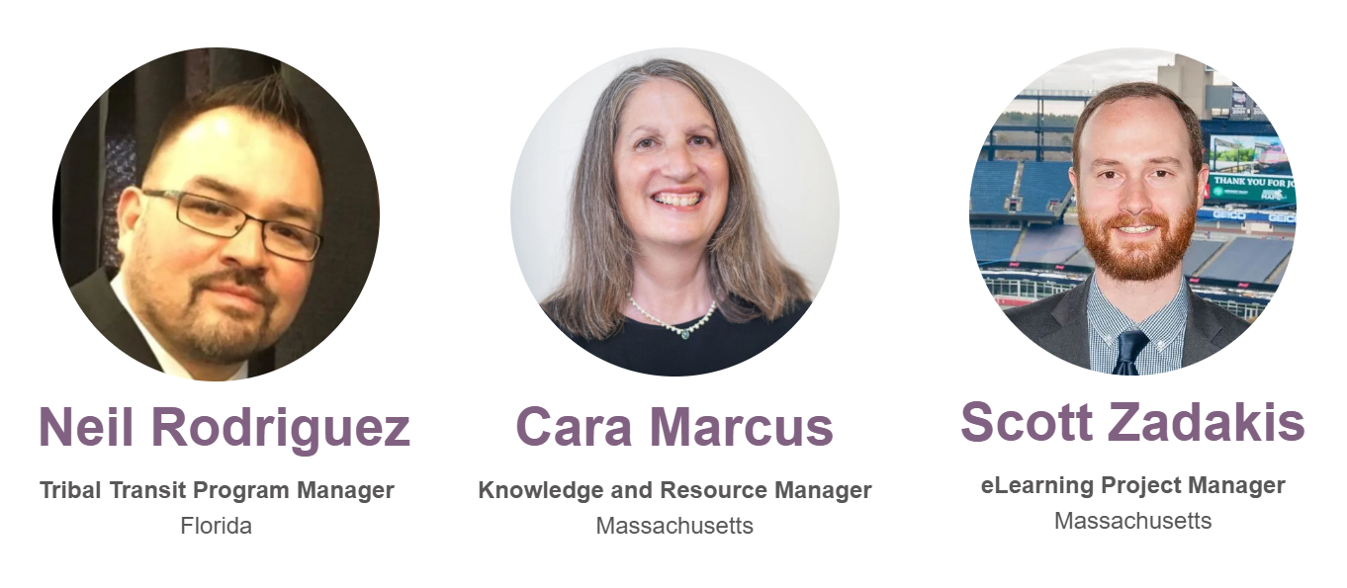


Meet our team of experts!
We are here to assist you with all of your rural transit and community needs!
U.S. Department of Transportation
Federal Transit Administration

Slide 3

Agenda
National RTAP Resources and Services Overview
Closer look at:
    National RTAP eLearning
    Transit Manager’s Toolkit
    Tribal Transit Program
    Technology Tools
    Mobility Management
Questions?
You can train on:
ADA training
Customer Service
Problem Passengers
Enhanced Tribal Program
Mobility Management

Slide 4
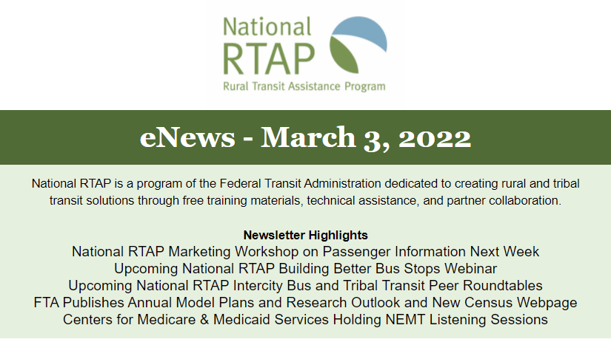
News you can use!
eNews - biweekly newsletter (email or online)
Pulls information and opportunities from nearly 200 sites and newsletters
National RTAP news, resources, events
Industry webinars, conferences, trainings
FTA and USDOT updates
Industry publications
Funding opportunities

Slide 5
Information Resources
Technical Briefs
  1-12 pages. Short guides to a topic, with case study examples and links to resources.
Best Practices Spotlight Articles
  Sharing Training with Agencies Coordinating Transportation
  Transportation to Scenic Destinations
  Social Media
Rural Integrated National Transit Database (iNTD)​
  Compare your state or system to peers and look at your efficiency and effectiveness measures
Biennial Surveys of Rural and Tribal Transit Agencies and State RTAPs​
  See national trends and use the Job Description and Salary Database
Notes:
Essential Spanish for Rural Transit Drivers​
AND 2 the Point in Spanish
Rural Integrated National Transit Database (iNTD)​
Compare your state or system to other states or like systems. Use this program to look at your efficiency and effectiveness measures
SURCOM Courses in National RTAP eLearning​
An other trainings including BOTL Human Trafficking, Braun Securement
Biennial surveys of Rural and Tribal Transit Agencies and State RTAPs​
This is where we get the info for the Position and salary spreadsheet, see national trends with technology
Recorded webinars offering valuable training and innovative best practices​
You may have missed it originally but you can see it now, or check out a subject area that you haven’t had time to explore
Tech Briefs are another great way to get a quick and thorough in depth take on a subject area.

Slide 6
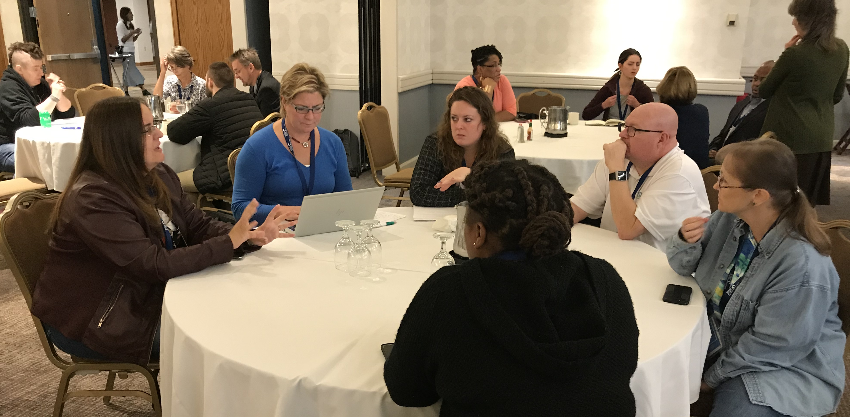
Technical Assistance
Reference services – for questions or a template
Peer Assistance
  Online Forums
  Roundtables on Zoom
  Twitter Chats
  Peer Mentoring
National RTAP Conferences
Participation in national, state, and regional conferences
Direct technical assistance – evaluated upon request

Slide 7
Closer look

Slide 8

TACL: The Transportation Technical Assistance Coordination Library
A sustainable methodology and platform to access transportation coordination resources from transportation technical assistance centers and the Federal Transit Administration (FTA).
The FTA-funded technical assistance centers participating:
  National Aging & Disability Transportation Center (NADTC)
  National Center for Applied Transit Technology (N-CATT)
  National Center for Mobility Management (NCMM)
  National Rural Transit Assistance Program (NRTAP)
  Shared-Use Mobility Center (SUMC)
http://transportation-tacl.org
Learn about TACL Webinar
August 11, 2022, 2:00-3:00 PM ET
www.nationalrtap.org/webinars

Slide 9
Accessing the Information You Need
Closer look at:
    National RTAP eLearning
      Training resource what, when, and where you need it
    Transit Manager’s Toolkit
      Reference Material that introduce you to the rules and invite you to learn more
    Technology Tools
    Streamline compliance, improve access, and manage data
    Mobility Management
      Facilitate serving your community, improve connectivity, build training capacity

Slide 10
National RTAP eLearning

Slide 11
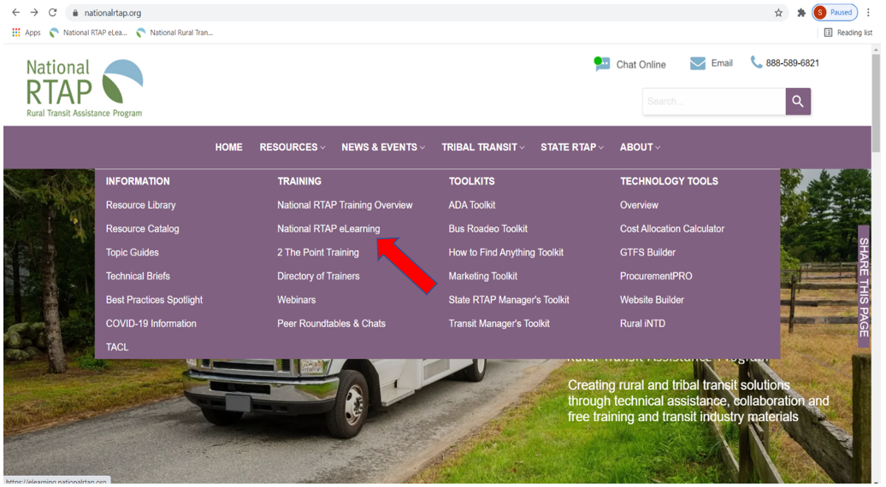
Navigate to eLearning

Slide 12
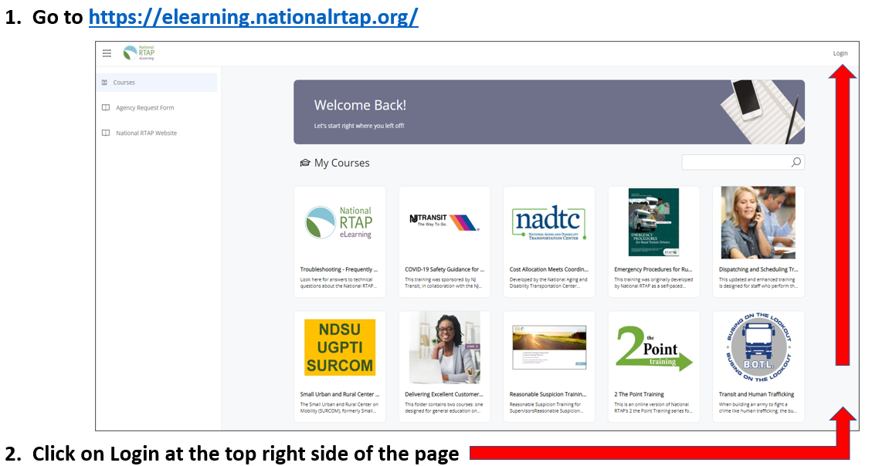
elearning.nationalrtap.org

Slide 13
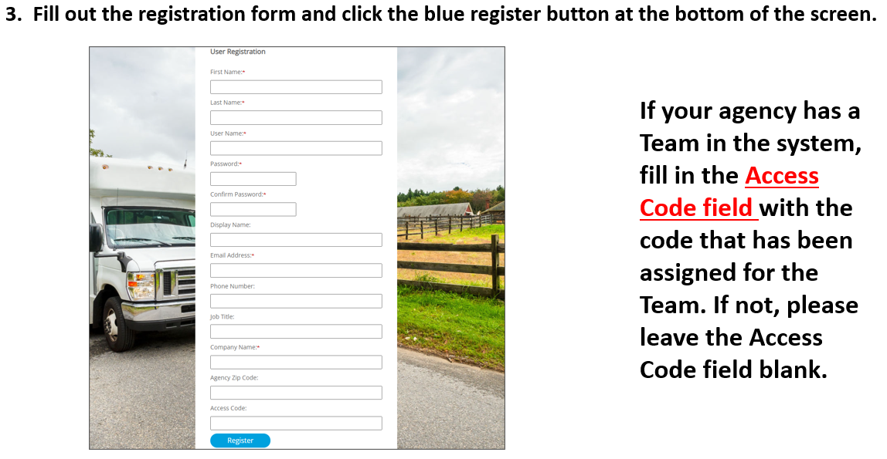
Registration

Slide 14
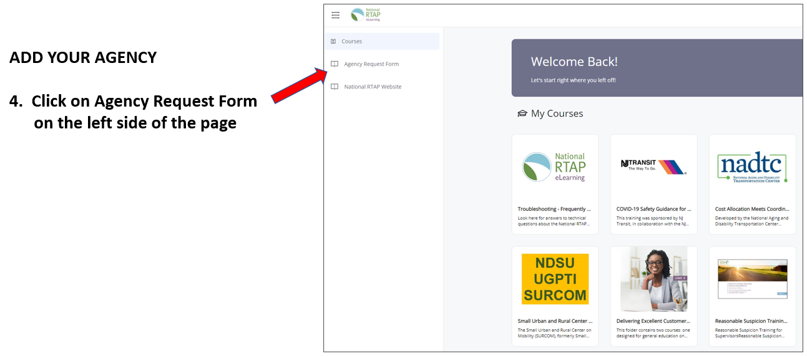
Managers – Add Your Agency

Slide 15
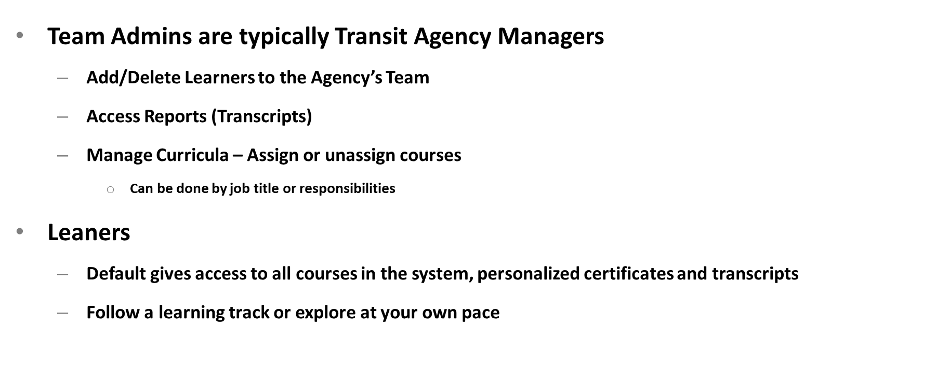
Team Admin and Learners
Learners

Slide 16
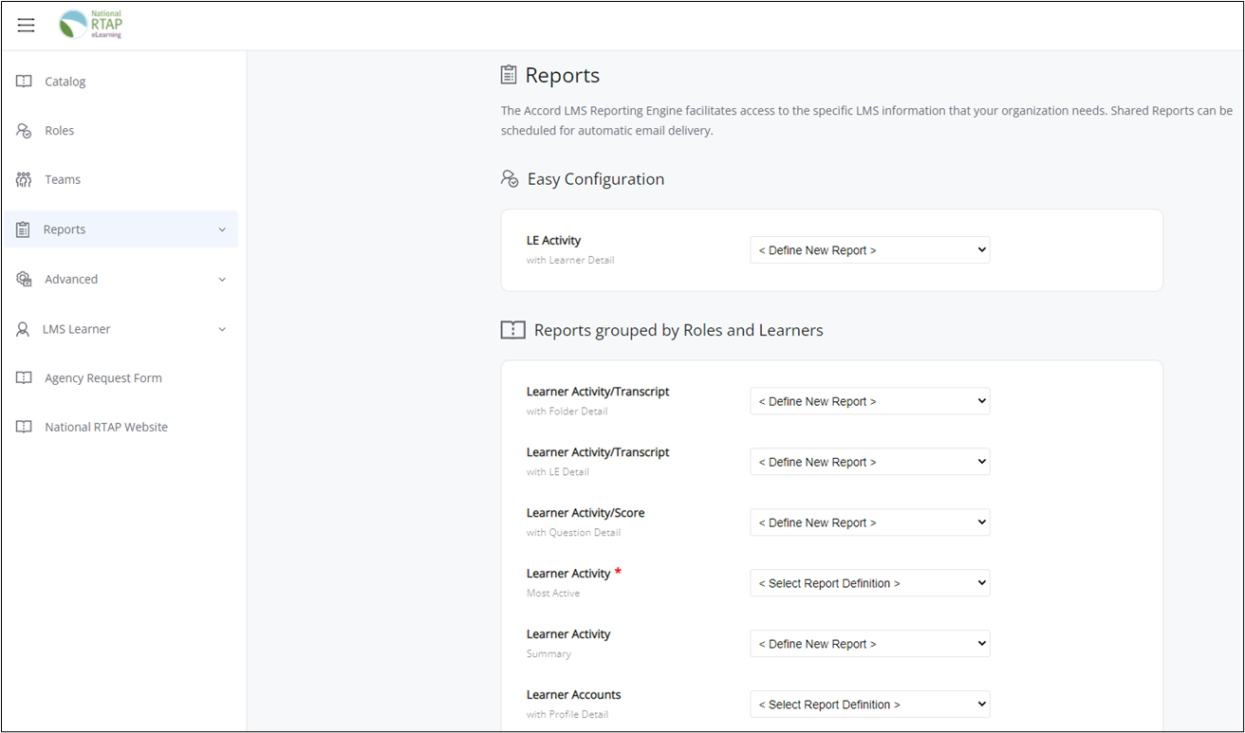
Reports

Slide 17
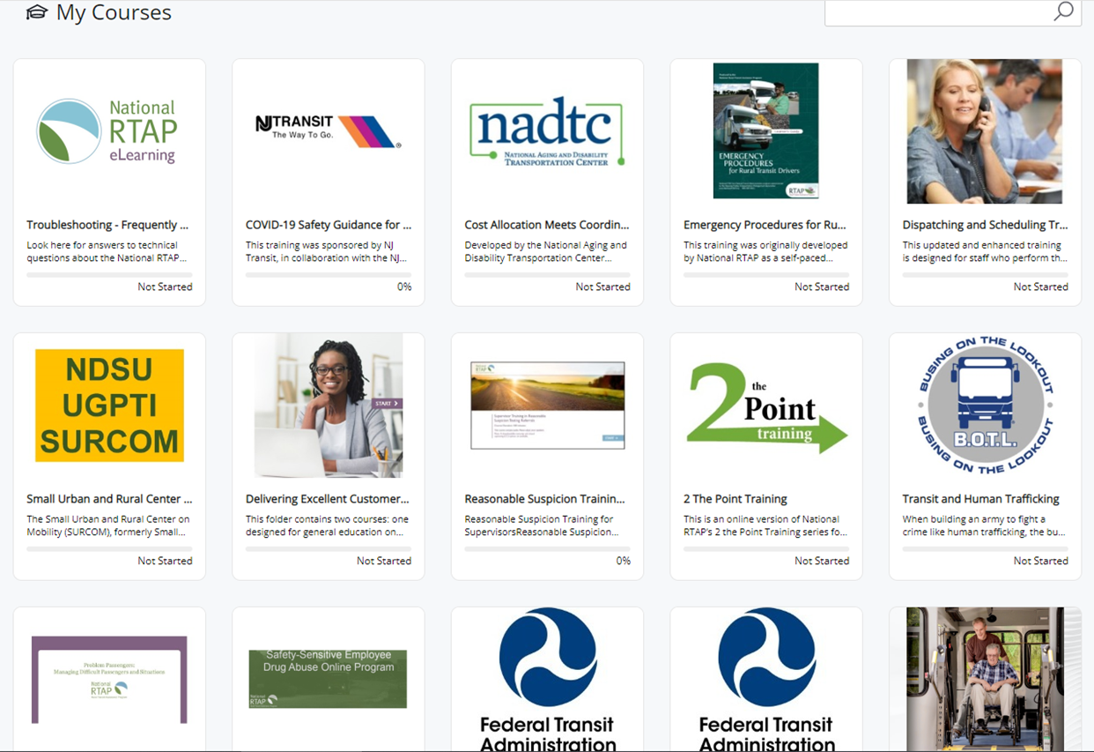
Courses/Homepage

Slide 18
Courses Available
National RTAP:
2 the Point Training
Dispatching and Scheduling
Emergency Procedures for Rural Transit Drivers
Problem Passengers: Managing Difficult Passengers & Situations
Reasonable Suspicion Training for Supervisors
START Online - Safety Training and Rural Transit
Substance Abuse Awareness Training for Safety
Sensitive Employees
Top Shops: Emergency Management in Maintenance Facilities
National Aging and Disability Transportation Center:
Cost Allocation Meets Coordination: A Mini-Course for Human Services Transportation Providers
Other Partner Organizations:
COVID-19 Safety for Frontline Transit Employees (NJ Transit)
FTA Title VI Program Requirements for FTA Grantees
Transit and Human Trafficking: Busing on the Lookout
Wheelchair Securement and Lifts Training Videos
Small Urban and Rural Center on Mobility:
Crisis Management for Rural and Tribal Transit Providers
Customer Service for Rural and Tribal Transit Providers
FTA 101: An Introduction to the Federal Transit Administration
Grant Writing for Rural and Tribal Transit Providers
Financial Management Short - The Basics
HR Training Shorts: Onboarding, Interview Questions, Performance Appraisals, Employee Recognition

Slide 19
Mobility Management

Slide 20
Maximizing Mobility Management Benefits
How do you define Mobility Management?
Mobility Managers
  On-site/Boots on the Ground
  Know staff
  Community Partnerships/Liaisons
Training Opportunities​
Identify the needs
  Can identify training resources​
  Provide in-person hybrid eLearning experience.​
  DIY Training

Slide 21
Maximizing Mobility Management Benefits
The Future of Mobility Management
New Training
Leadership in Mobility Management
Developing a Sustainable Rural Mobility Management Network
Mobility Management Handbook Workgroup
Partnerships between Tribal & Non-Tribal Mobility Management
Connecting the Dots: Steps to Coordination from Rural to Urban

Slide 22
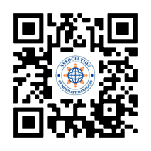
Maximizing Mobility Management Benefits
New Partnerships
Association of Mobility Managers (AMM)- https://associationofmobilitymanagers.com/
Association of Travel Instruction - https://www.travelinstruction.org/
Veterans Affairs (state levels)

Slide 23
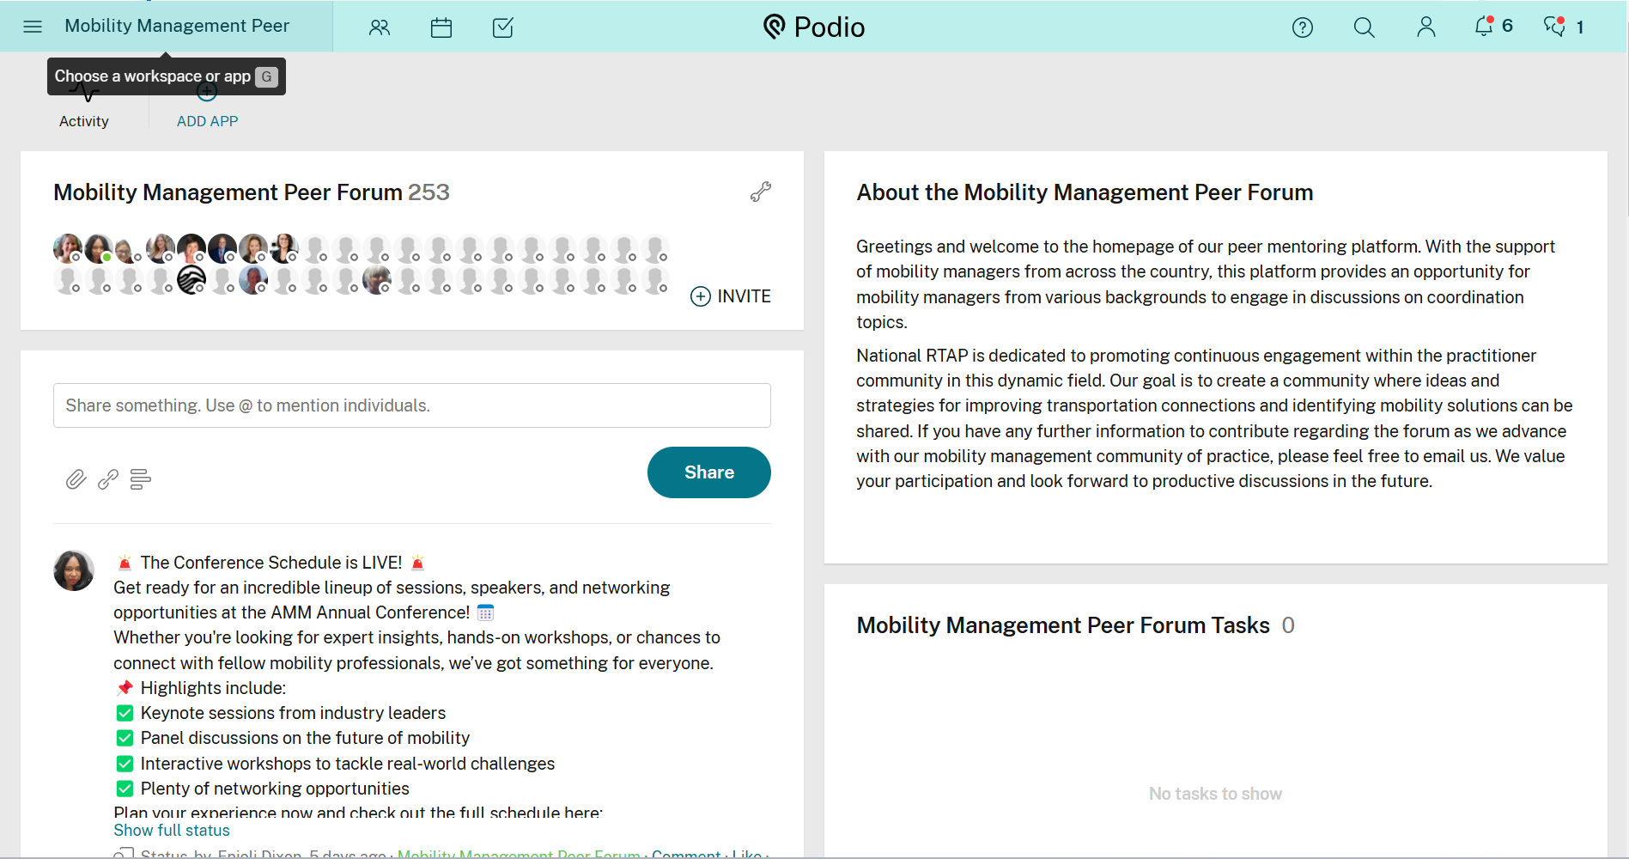
Maximizing Mobility Management Benefits
New Platform
Podio: Mobility Management Community of Practice

Slide 24
Community Rides Grant Program

Slide 25
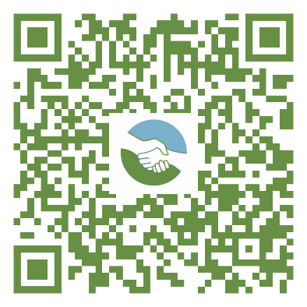
Community Rides Grant Program
Closer look at:
    Support local transportation solutions and partnerships
    Recipients and subrecipients of the Federal Transit Administration (FTA)'s Formula Grants for Rural Areas (Section 5311)
    Apply for grants of up to $100,000
    Up to 12-month project
    RFP deadline is August 29, 2025
    Projects that develop or strengthen transportation partnerships that improve transportation access in rural communities. www.nationalrtap.org/News/Community-Rides-Grants

Slide 26
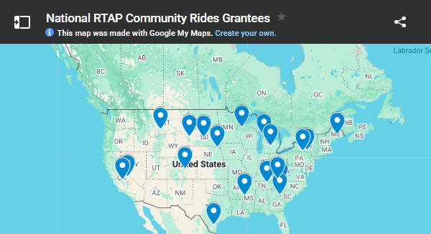
Community Rides Grant Program
19 Past Awarded Projects
Microtransit to technology solutions
Helped support projects that needed a little more funding to get off the ground
Local partnership building
Addressing a particular need (but available community wide)

Slide 27
Technology Tools

Slide 28
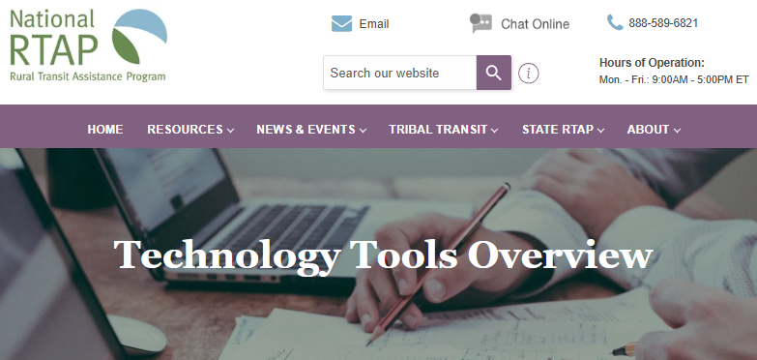
Technology Tools
Technology Tools (https://www.nationalrtap.org/Technology-Tools/Overview):
Full Suite of Technology Tools Supporting Rural Transit Agencies
    iNTD
    GTFS Builder
    ProcurementPRO
    Website Builder
    RideSheet
    Cost Allocation Calculator

Slide 29
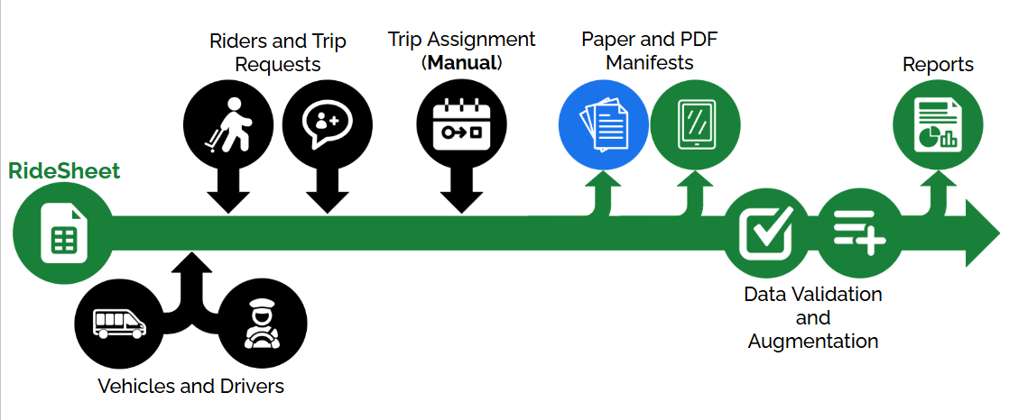
RideSheet
Moving from pen and paper scheduling
Google Sheets/Workspace
Built in reports + NTD reporting
10 or fewer Demand Response Transportation (DRT) vehicles
Piloted in several location throughout the US
Coordination built in via the transactional data specification (TDS)
Looking to pilot on a statewide level
Source: Full Path

Slide 30
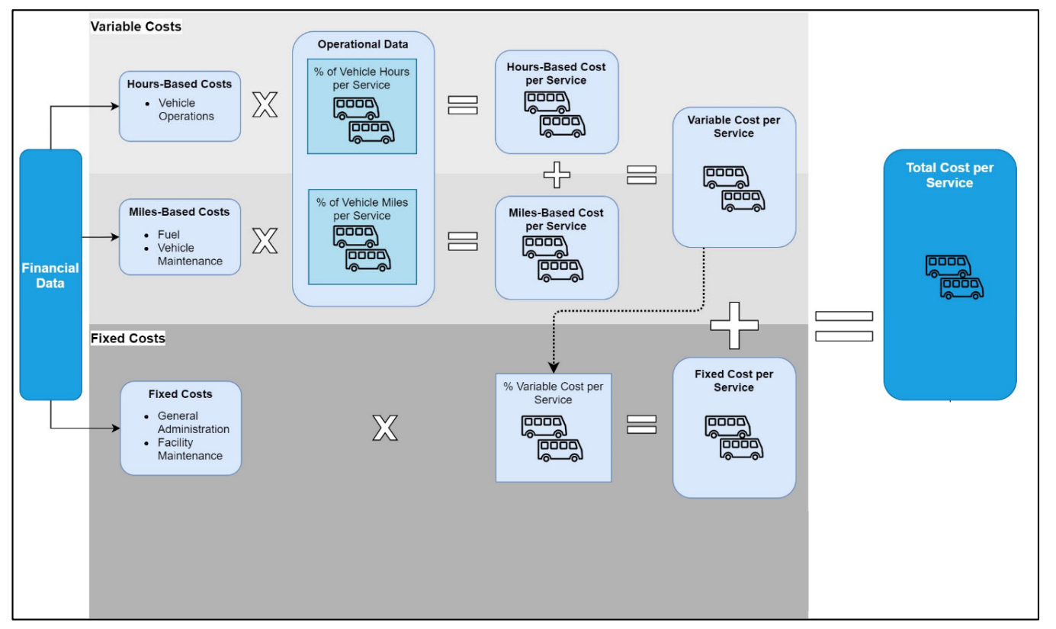
Cost Allocation Calculator
  Two Variable Cost Calculator: Time & Distance
  Supports National Transit Database (NTD) reporting
  Fully allocated cost by route/service, mode, service area, type of service, sponsored type, & funding source
  Generates performance measures
  Helps to understand the true cost of service – planning & operations

Slide 31
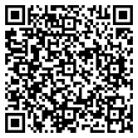
Maximizing Mobility Management Benefits
Upcoming Activities
Monthly webinars
ProcuremtPRO Tools and Tactics
Community Rides Grant RFP Informational Webinar
Quarterly Mobility Management Regional Meetings
National RTAP Conference – Mobility Management Track: December 2025
How can we help you?

Slide 32
DIY Training
Notes:
National RTAP in the Cloud hosts the four web applications:
GTFS Builder and Cost Allocation Calculator (both of which can be downloaded),
Procurement PRO and Website Builder (data stored on the our cloud).
The web apps are hosted on the National RTAP server and users can access the information and functionality from any device with internet service for free.

Slide 33
Who, What, Where, When, How
Who
Staff who enjoy teaching
Mobility Managers
Employees
What
ADA Driver Training
60 Minute Drug and Alcohol Awareness
START: 101 Driver training
  Before you go
  Defensive Driving
Customer Service
Problem Passengers
2 The Point: refreshers for all things driver.
When, Where, How
Breaks, at home, anywhere you
can use a phone
Wherever you are
National RTAP eLearning

Slide 34
New Products and Upcoming Events

Slide 35
What’s New in the Resource Library?
  ADA Driver Training eLearning and certification checklist
  Cybersecurity Topic Guide
  Customer Driven Service eLearning
  Dispatching & Scheduling eLearning and Manuals
  Active Shooter Training eLearning and Manuals
  School Bus & Rural Transit Coordination
  Electric Vehicle Maintenance Best Practices Article
  Rural iNTD - 2022-2023 NTD Data Added
  Updated Transit Marketing; Workshop Recordings
In progress:
ELDT Passenger Endorsement Training
GTFS eLearning
Financial Management eLearning
Webinars with USDA and FHWA on partnerships and grants
FTA 101 eLearning

Slide 36
Upcoming National RTAP MM Events
UPCOMING:
A Cost Allocation Tool You Can Use
March 19, 2024, 2:00-3:00 PM ET
Spring in to New National RTAP Resources March 20, 2025 2:00-3:00 PM ET
Technology Tools Office Hours
GTFS : Thursdays 1:00-1:30 PM ET
Website Builder: Tuesdays 1:00-1:30 PM ET
RECENT:
Transit Manager Peer Roundtables
Summaries available with valuable tips
Business Webinars: Risky Buisness III Insurance for Nonprofits and Small Transit Agencies providing NEMT January23,2025
GTFS: 3 Steps to Trip Planning
Go from reporting to improved customer service
October 2 &9, 2024
To register or to access recordings, slides, or summaries, go to:
nationalrtap.org/Training/Peer-Roundtables-and-Chats and nationalrtap.org/Webinars.

Slide 37



Thank You!
National Rural Transit Assistance Program
888-589-6821 | nationalrtap.org | info@nationalrtap.org
Find us on Facebook, Twitter, YouTube, LinkedIn & Instagram
U.S. Department of Transportation
Federal Transit Administration

