Slide 1

MOVE Safe Michiana: Safety Planning and
Tools to Implement Safety Improvements Quickly
Dustin New, LCI, Active Transportation Planner,
Michiana Area Council of Governments

Slide 2

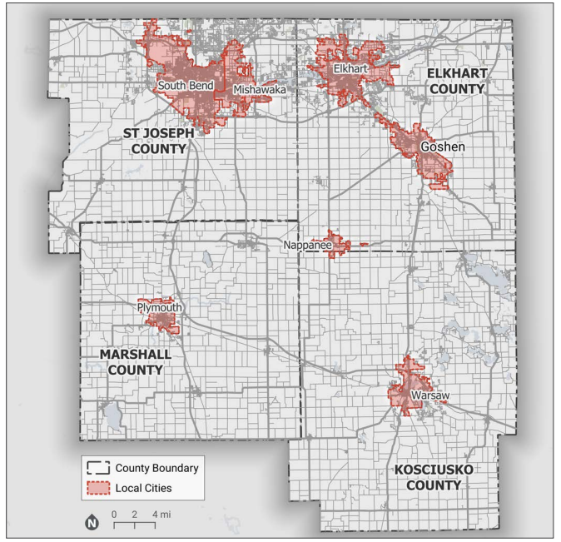
The MACOG Region
  North-Central Indiana
  Four Counties
  Six Cities, 35 Towns
  Two “Urbanized Areas”
    South Bend – Mishawaka
    Elkhart - Goshen
  Total Population: Approximately 600,000
  80% Rural – 20% Urban

Slide 3



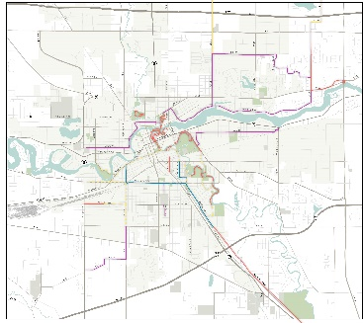
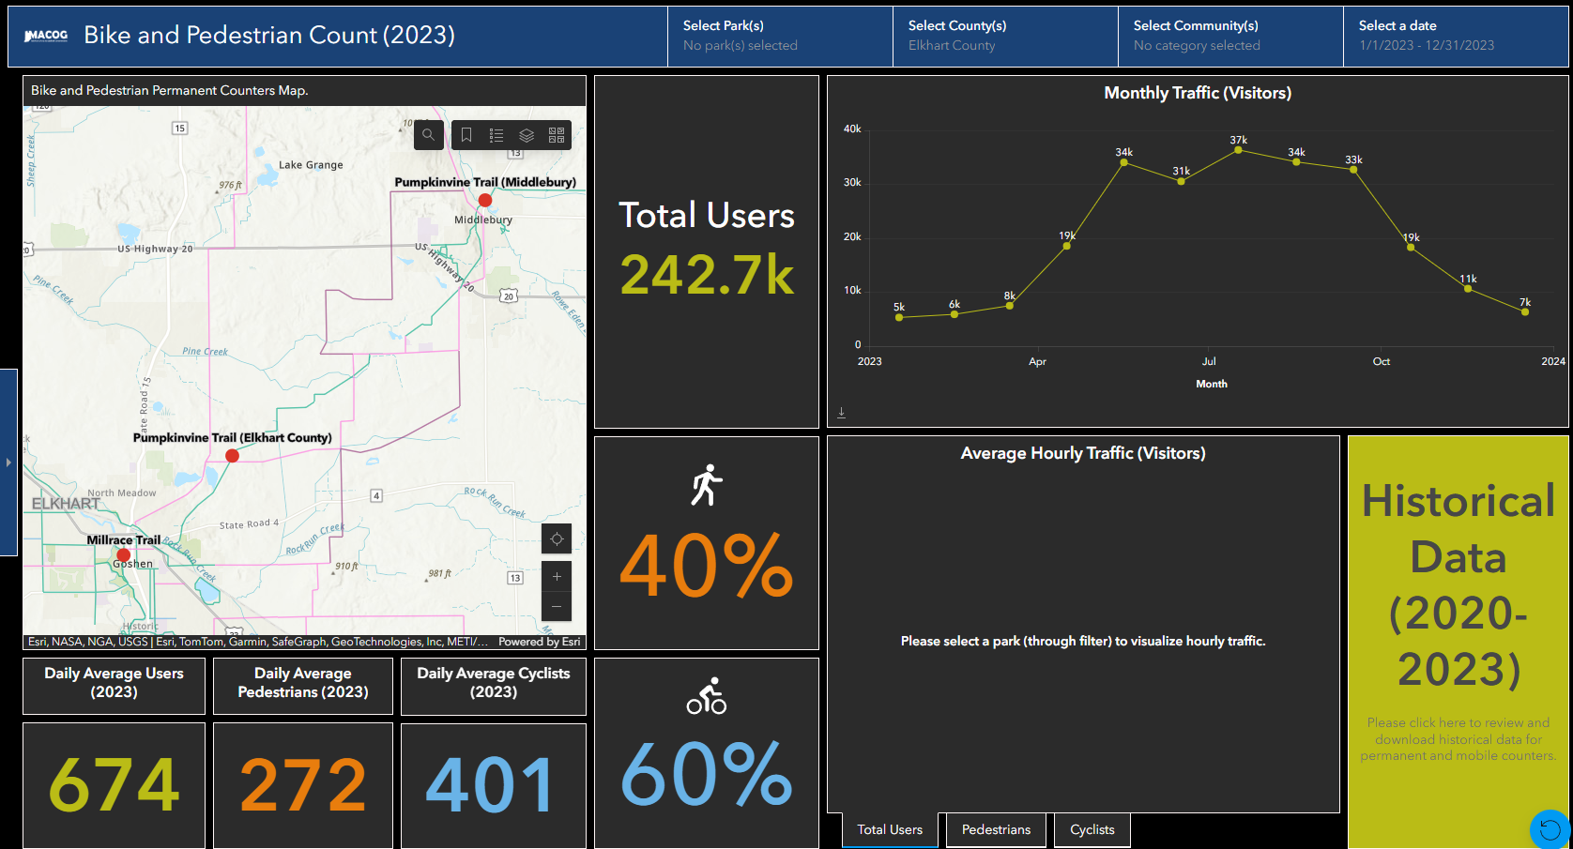
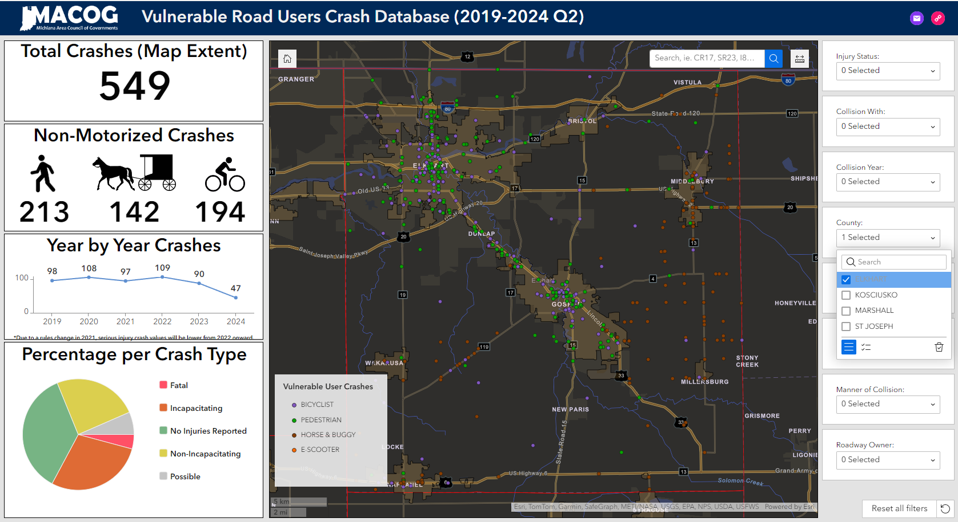
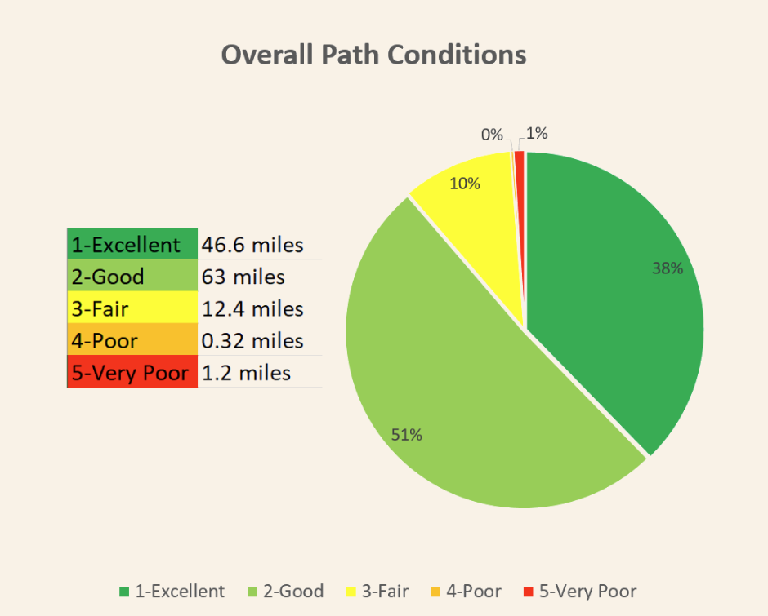
How does MACOG promote active
transportation?
  Crossway Trails
    Coordinated Signage throughout region
  Crossway Tales (newsletter)
  Bike2fun.com
  Regional Trails Map
    Electronic coming soon!
  Trail counters and Dashboards
    Bike & Pedestrian Counts
    Vulnerable Road User Crashes
  Qualitative Trails inventory (data bike)

Slide 4
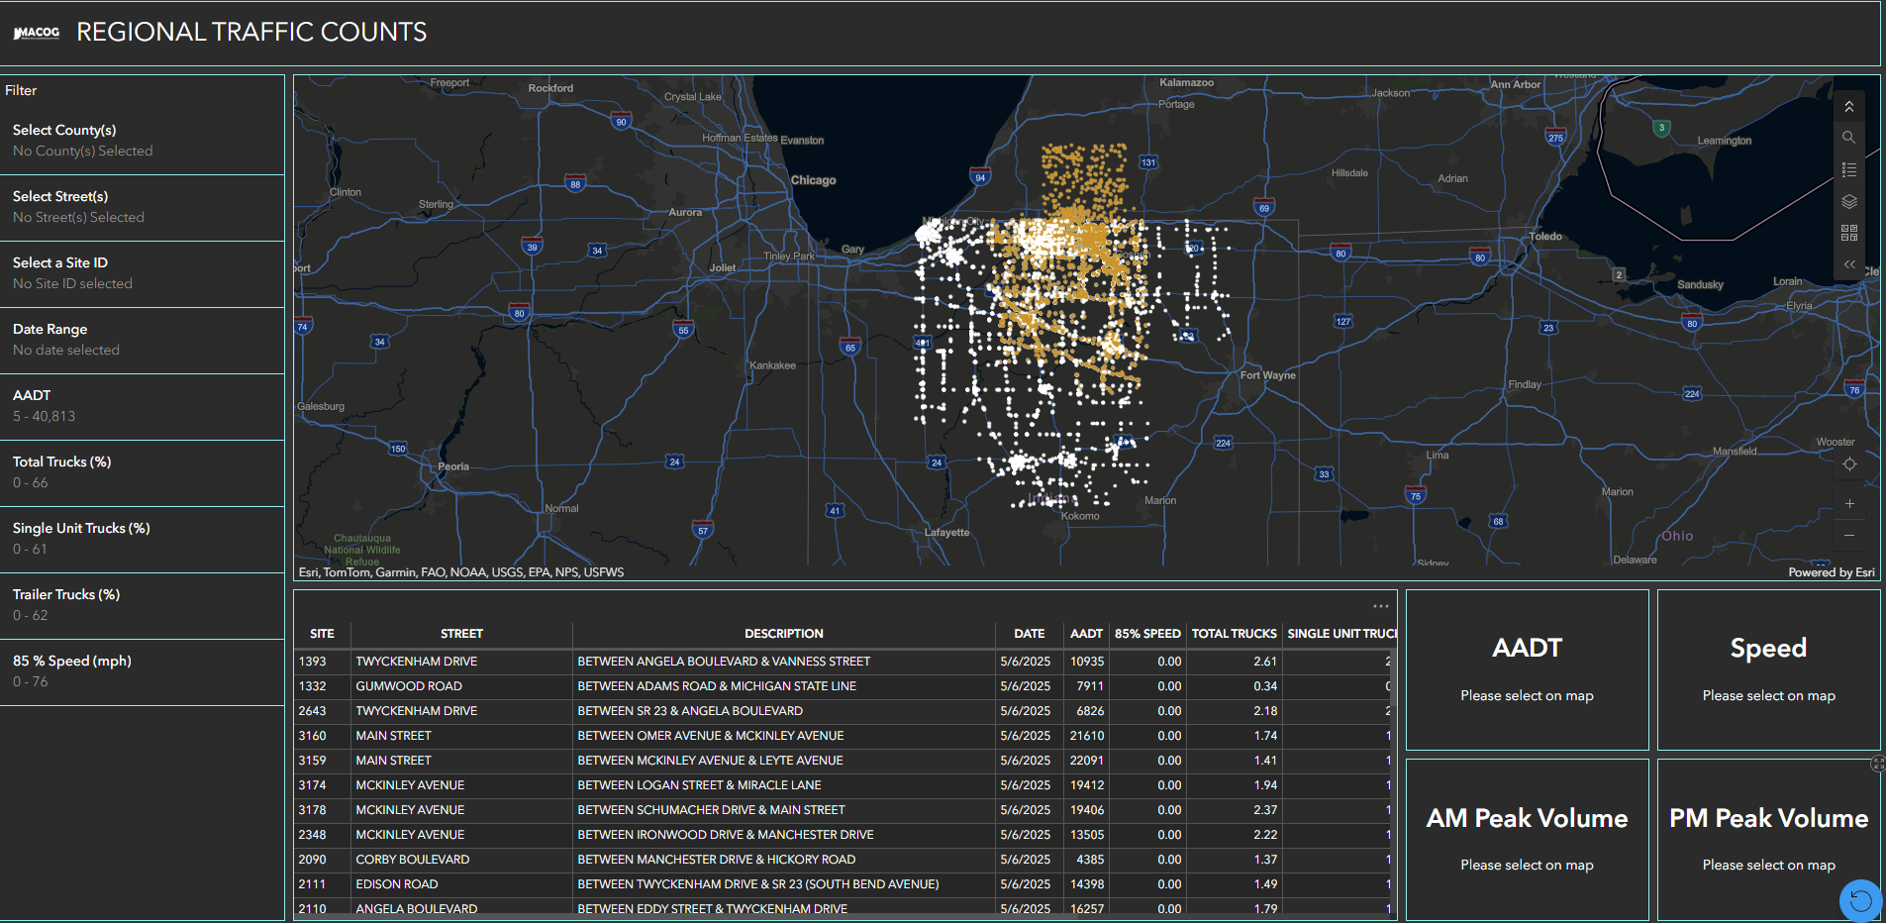
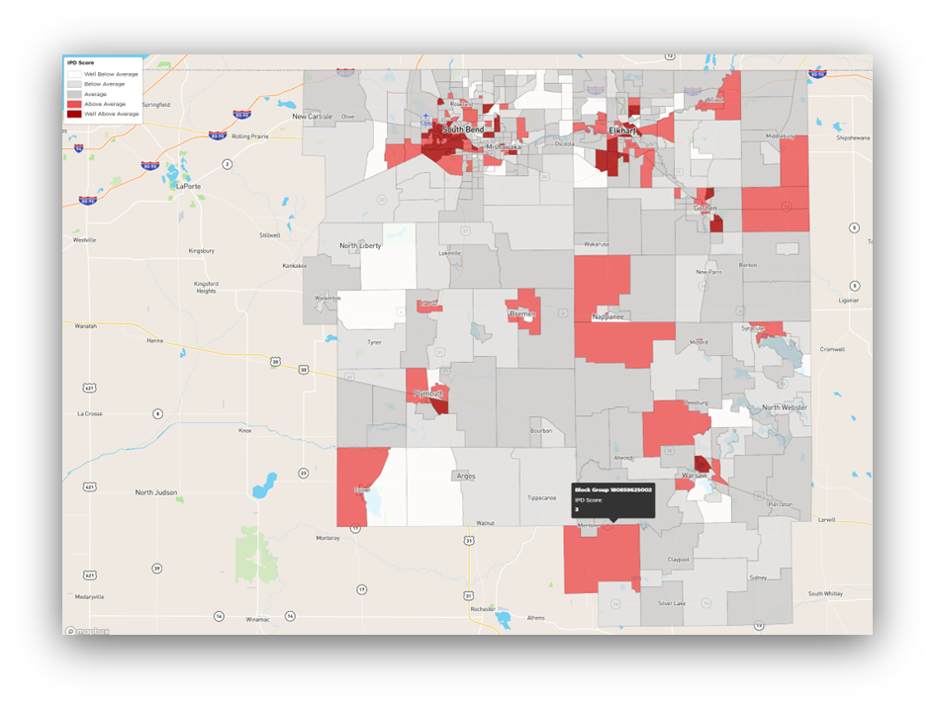
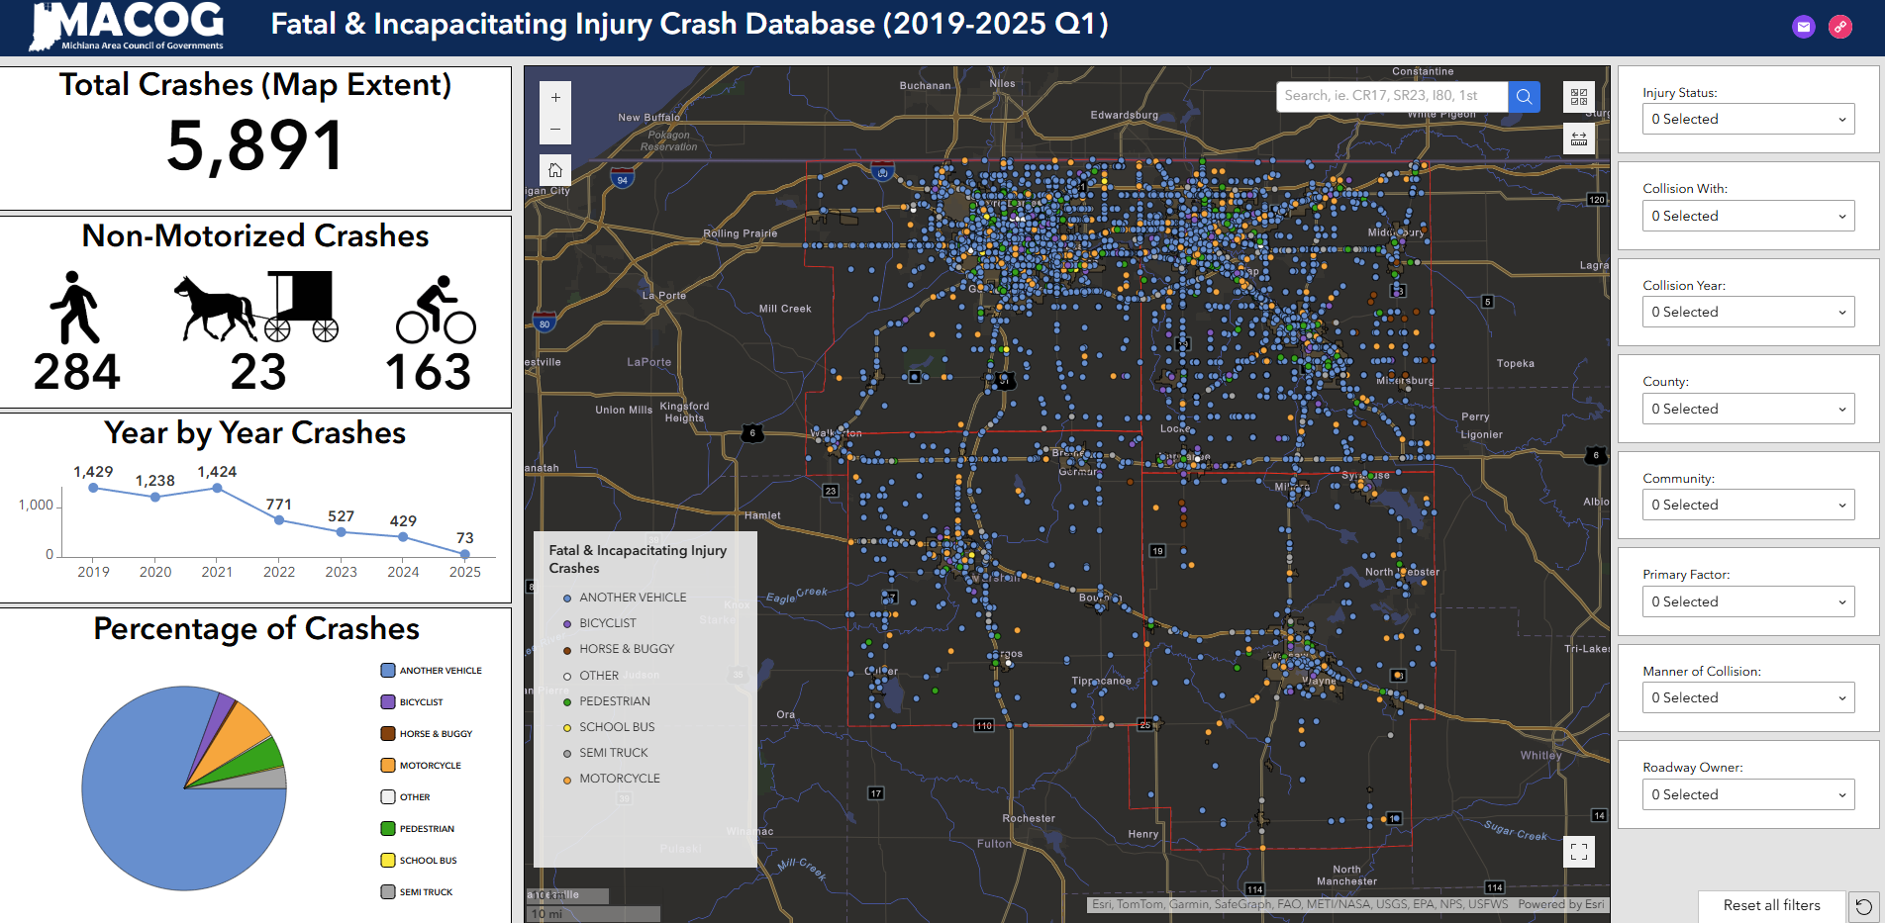
Interactive Dashboards

Slide 5

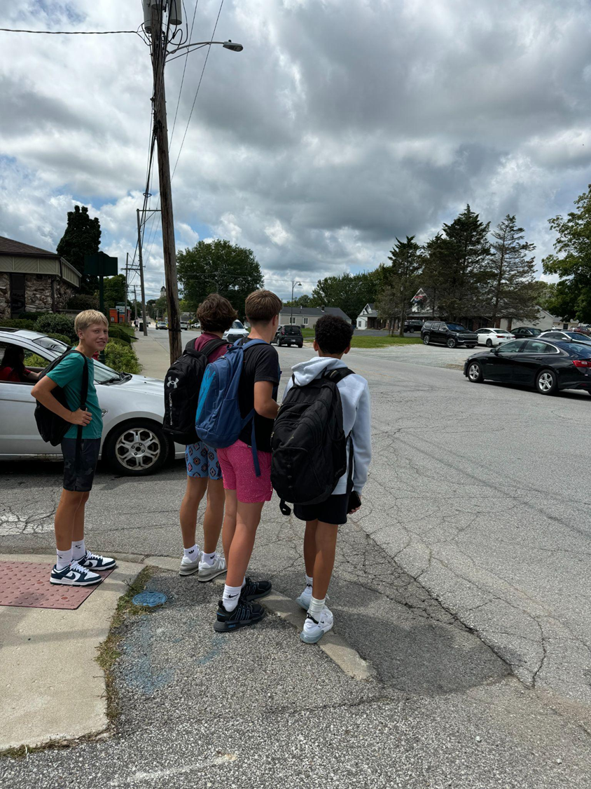
5,389 people in the region experienced a life
altering crash between 2019 and 2023
The Plan includes a regional commitment to
working toward zero roadway fatalities and
serious injuries by 2050
Safety is a shared responsibility

Slide 6
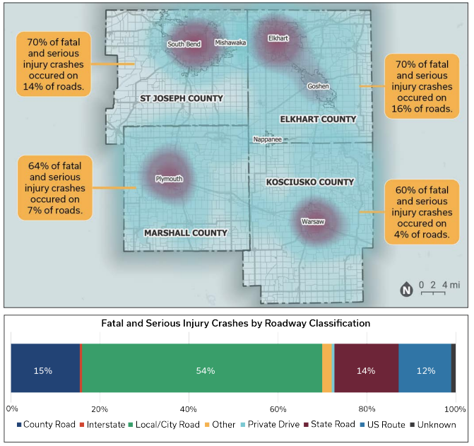
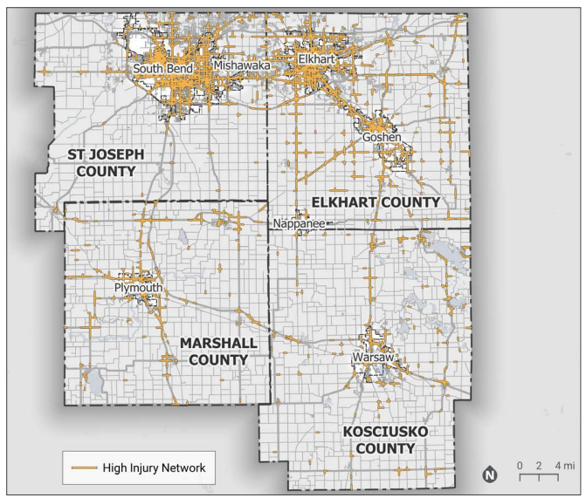

Slide 7
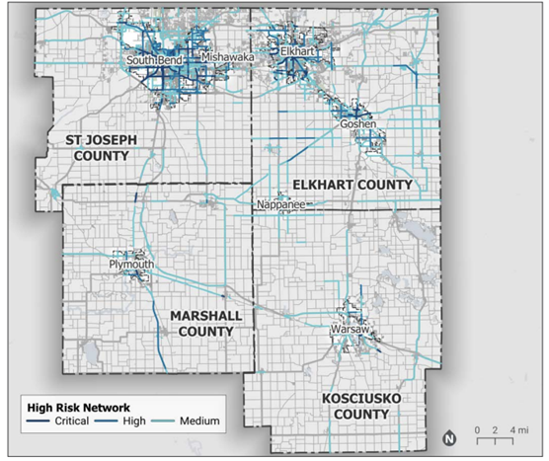
Note the inclusion of State facilities

Slide 8
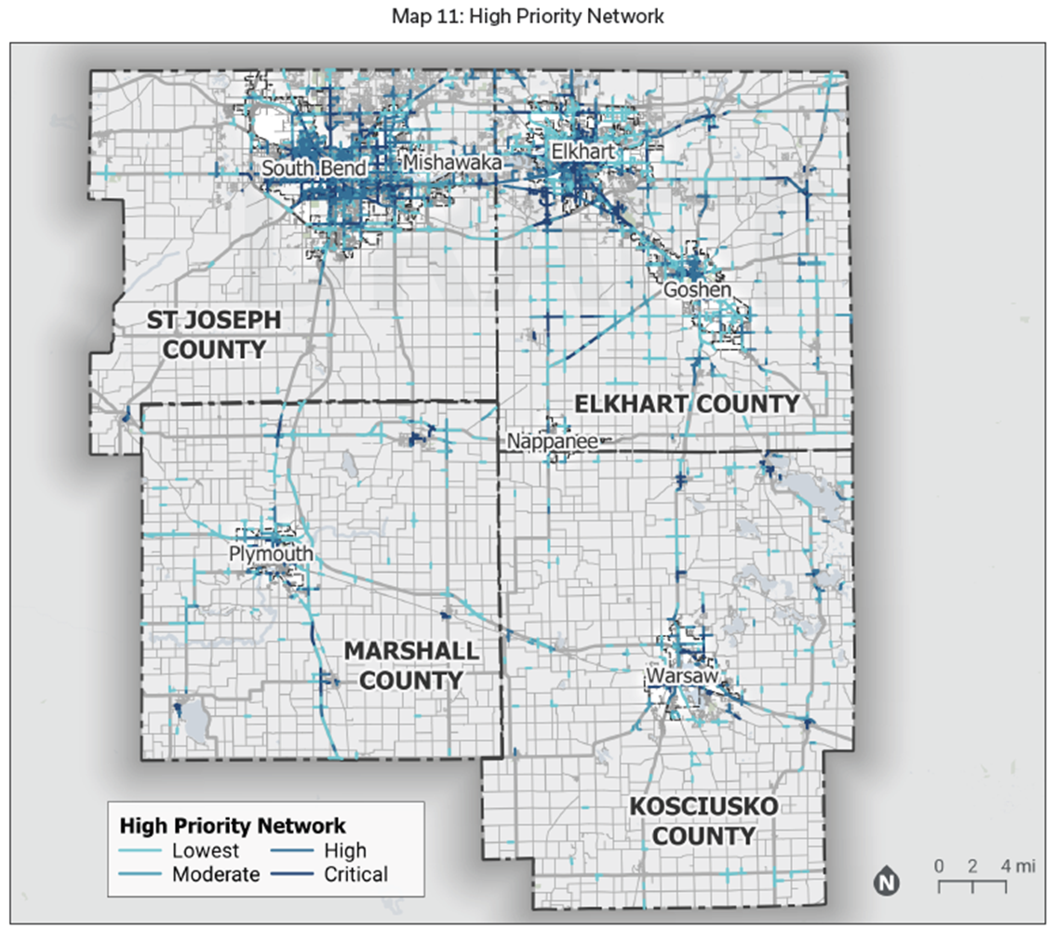

Slide 9
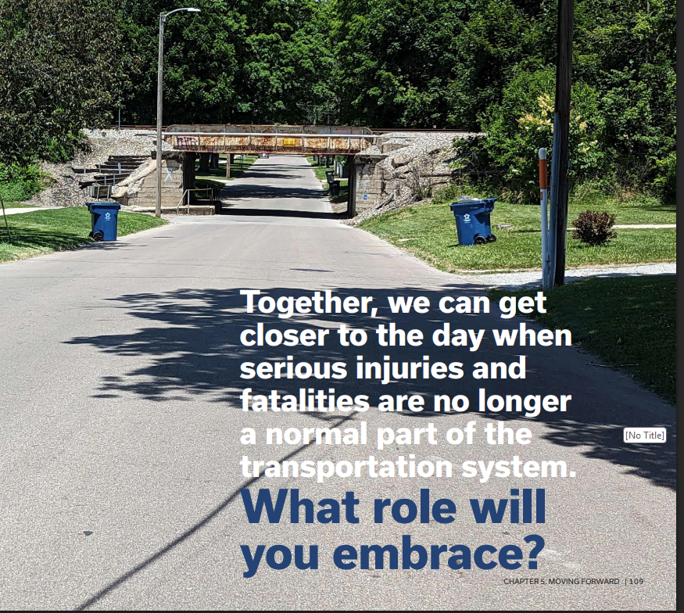
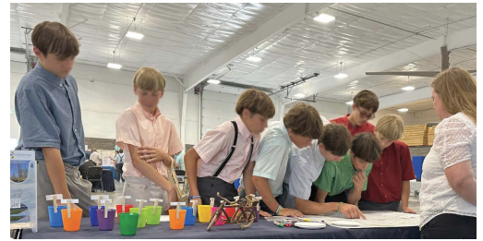
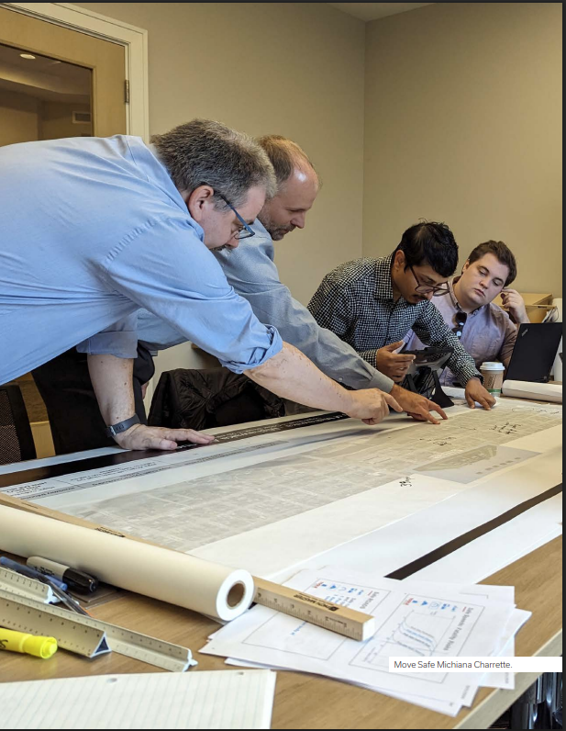
TIMELINE
  Began March 2024
  Bike tours with stakeholders
  Charrettes during planning
  Community Candidate Projects
  Policy Board Approval
  June 2025
ONGOING
  Applications for Funding
    Warsaw, Plymouth,
    South Bend, Regional,
    INDOT
  Further Prioritization
  TTAC Review Committee

Slide 10
PAVEMENT PLAYBOOK

Slide 11
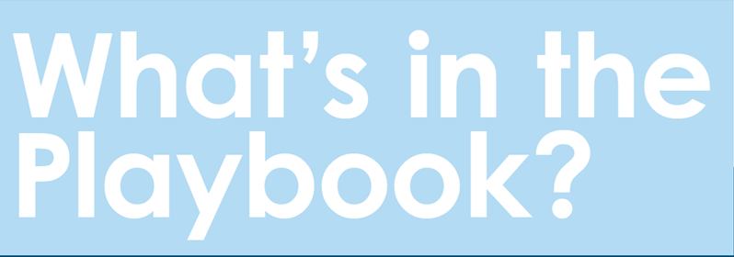

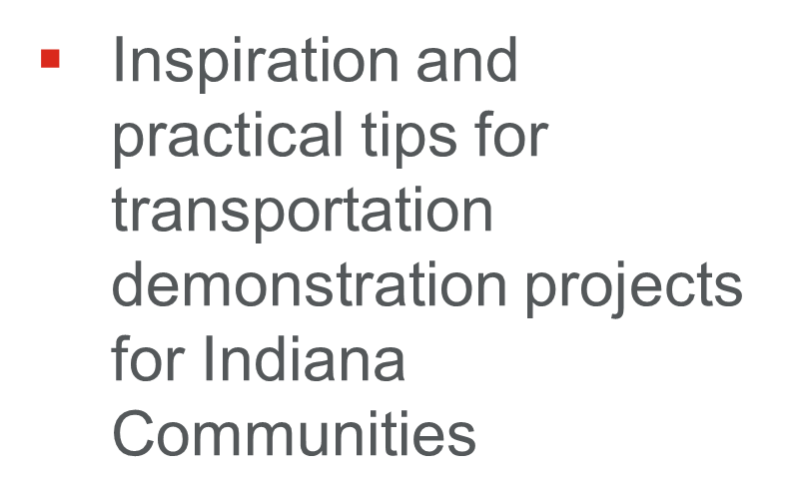

Slide 12
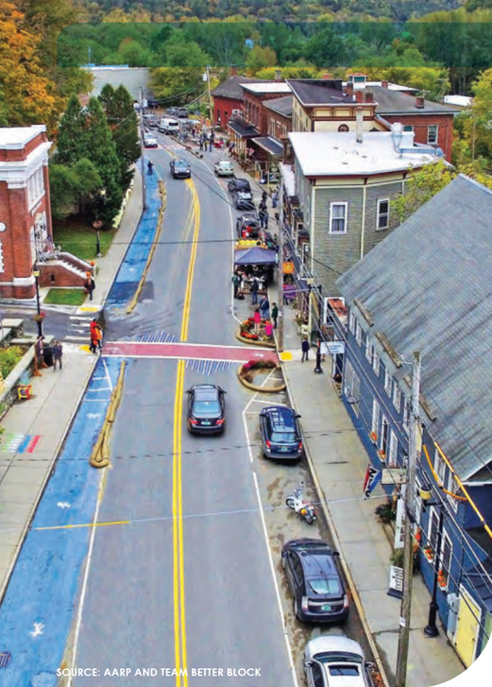
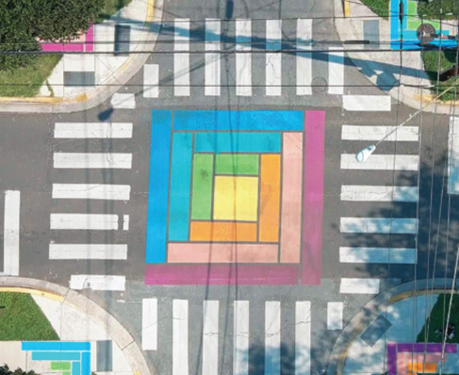
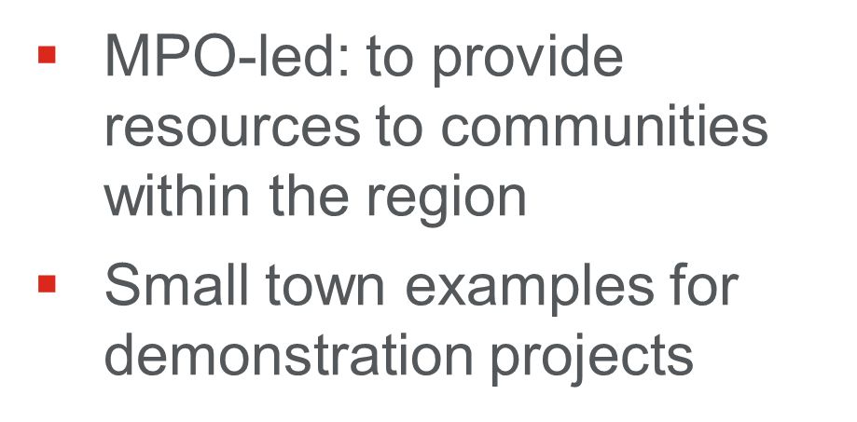
What makes the Pavement Playbook a Unique Resource?

Slide 13

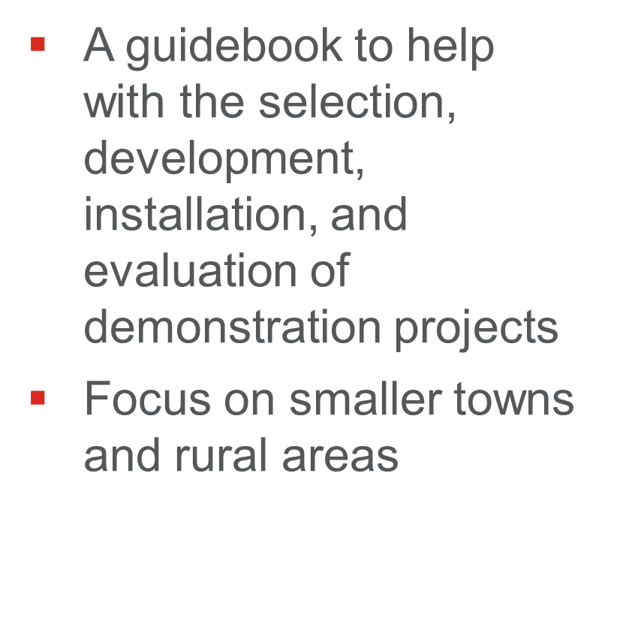

Slide 14
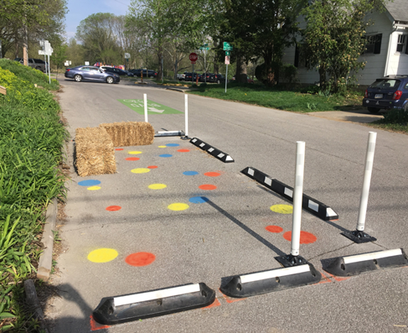
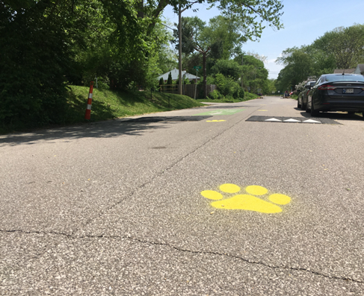
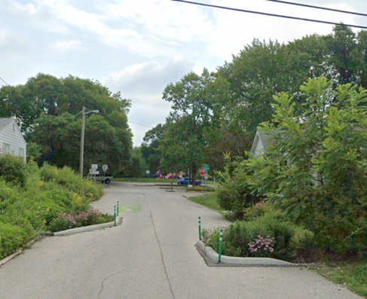
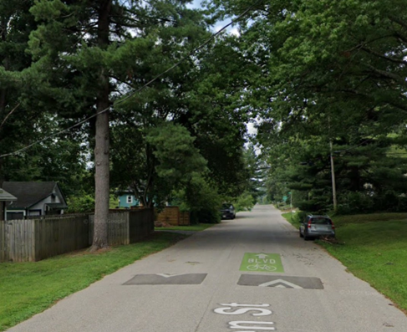


Why was the Pavement Playbook Developed? Why use temporary installations?
Speed control
Aesthetics
Test ideas
Temporary can be YEARS!
TEMPORARY LEADS TO PERMANENT
Allen Street Neighborhood, Bloomington, Indiana

Slide 15
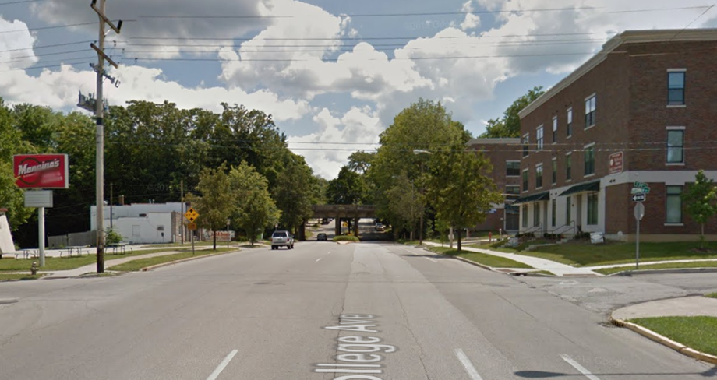
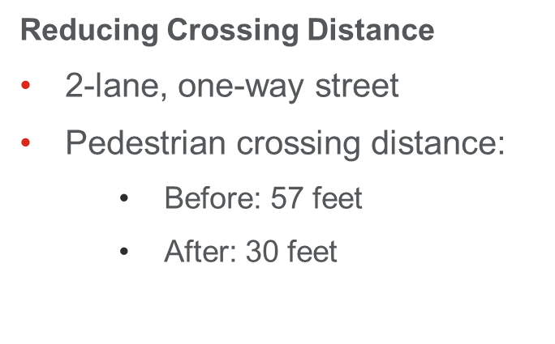
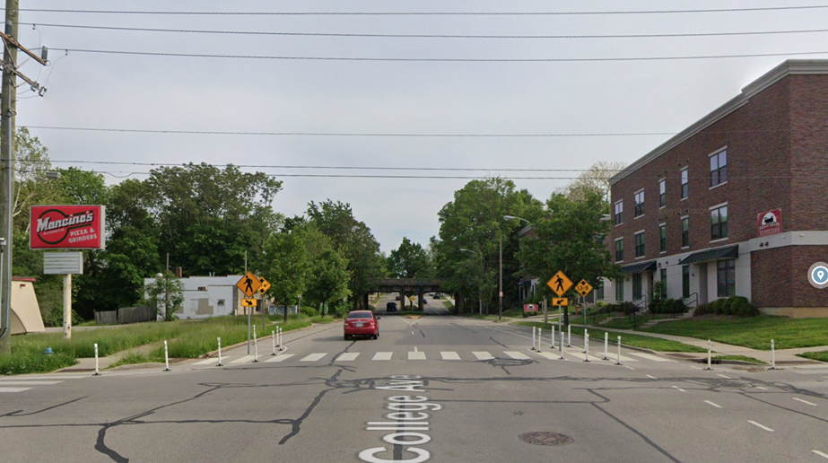

Improve Safety NOW!

Slide 16
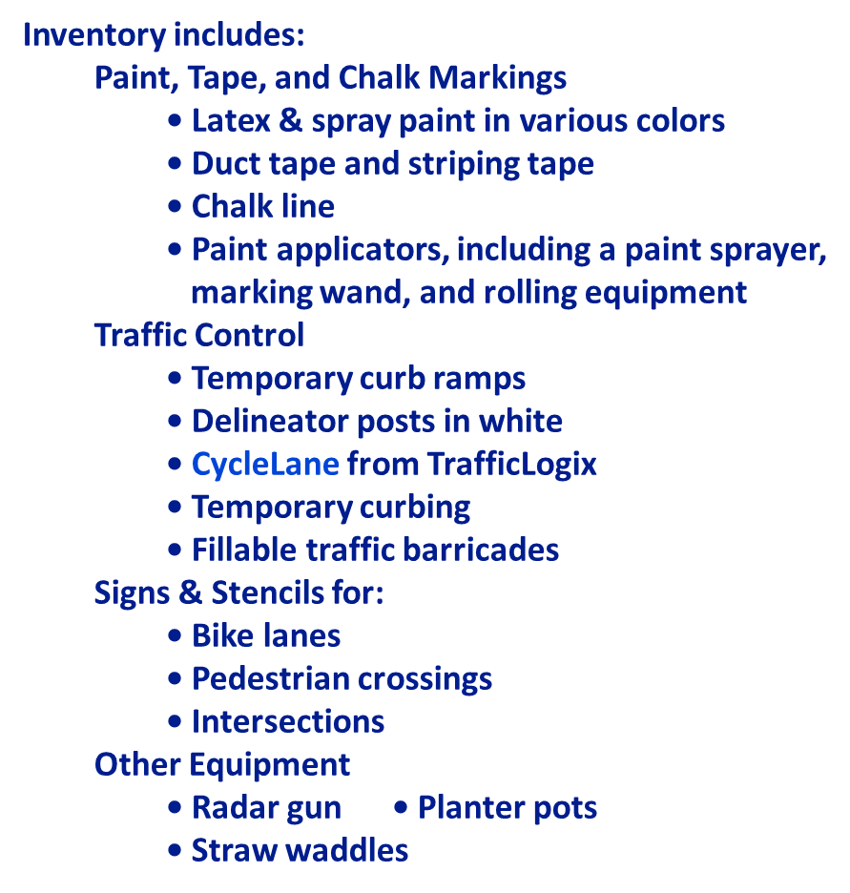
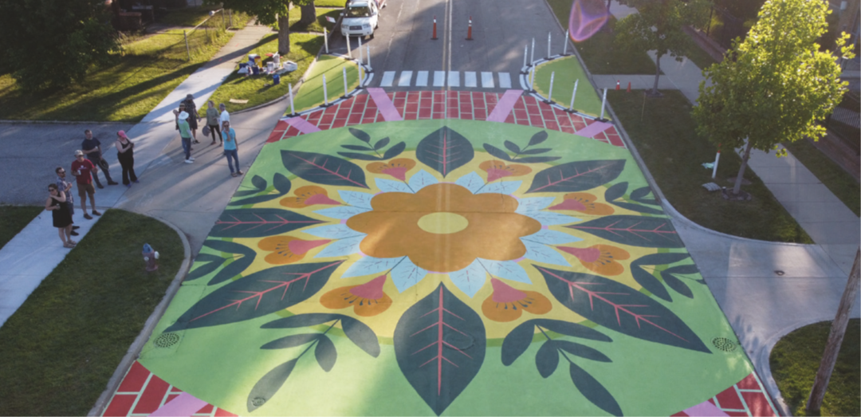
MACOG Safe Streets
Lending Library

Slide 17


Slide 18
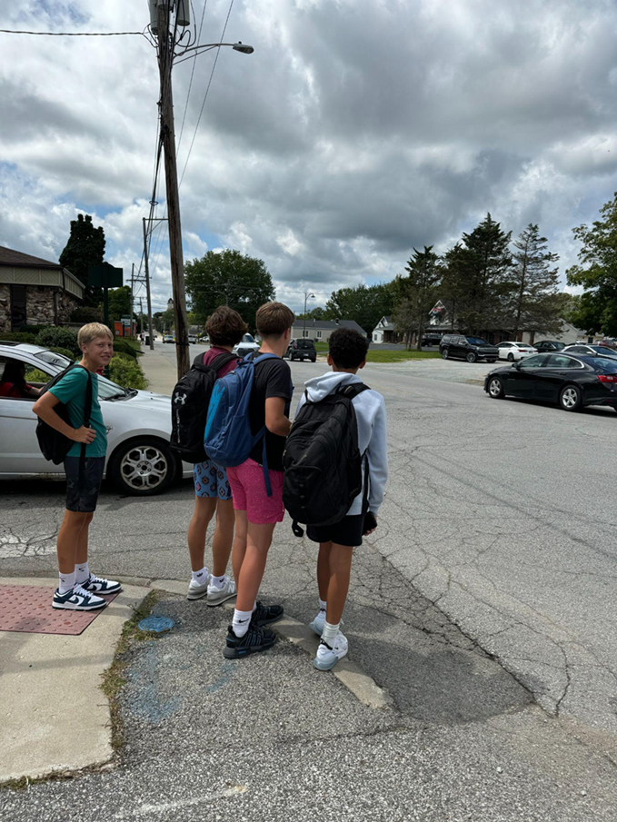
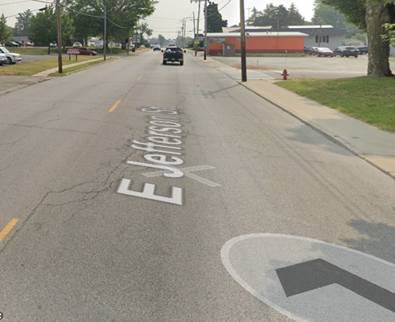

Slide 19
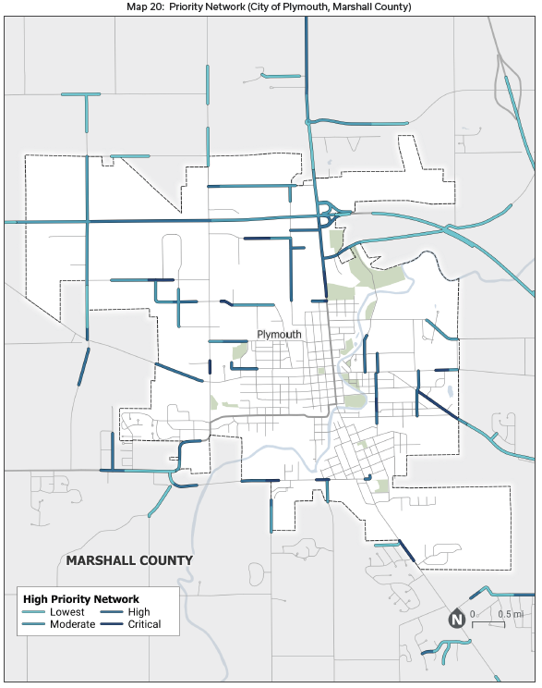
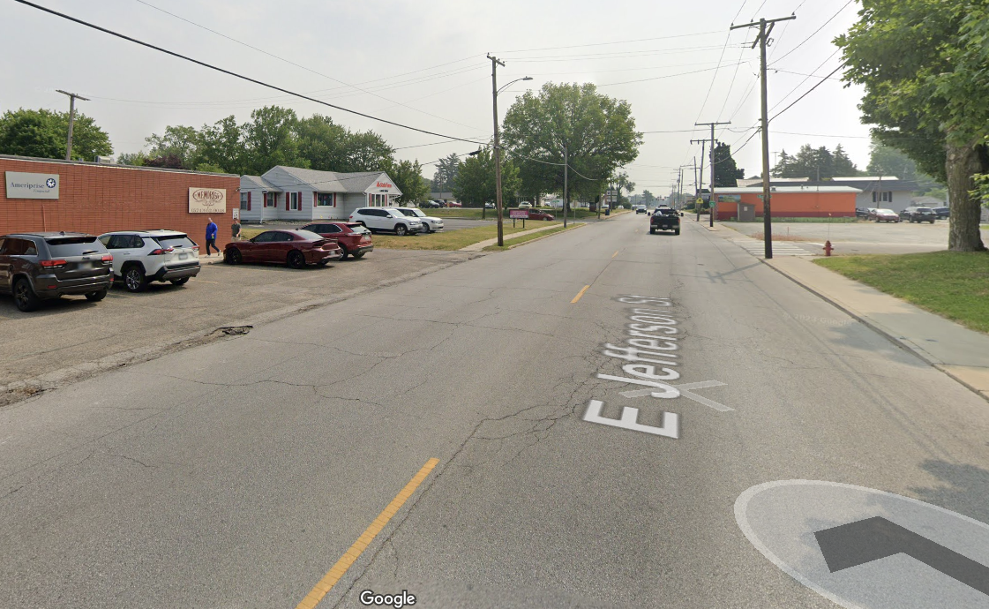
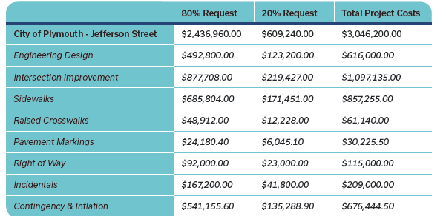
Plymouth, Indiana, Demonstration

Slide 20
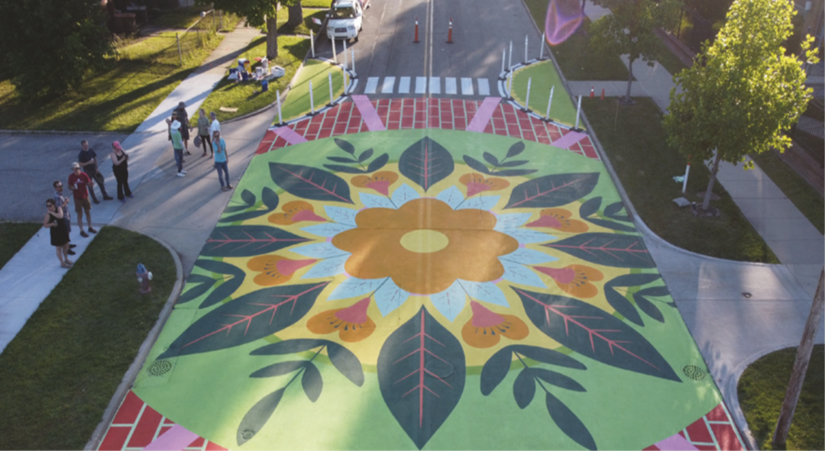

Slide 21
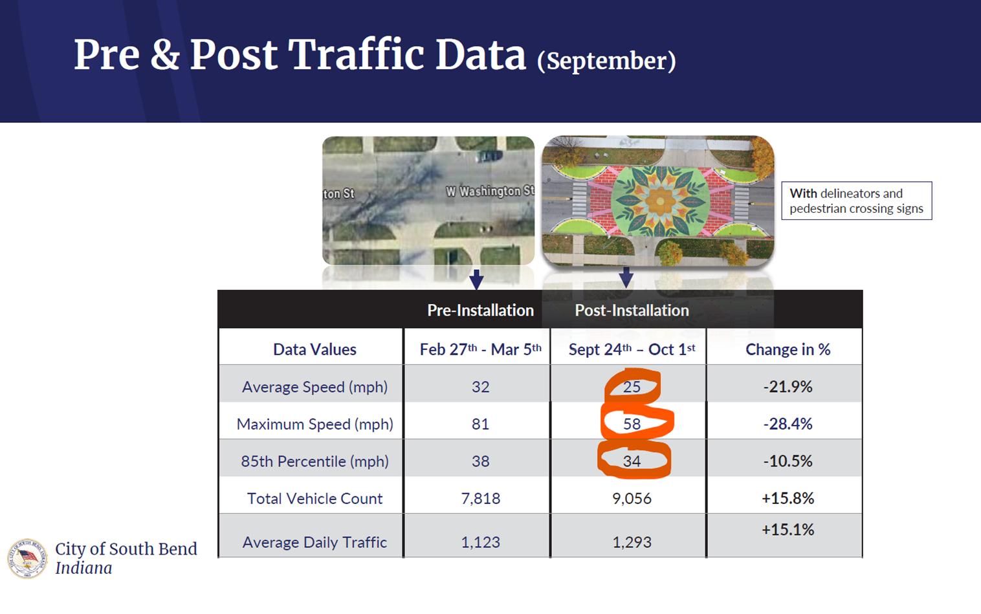

Slide 22

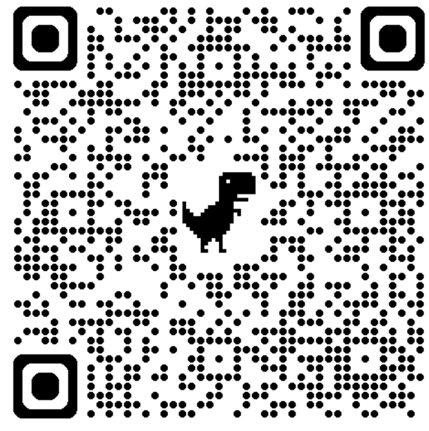

Slide 23
Thank you!
Dustin New
Active Transportation Planner
Michiana Area Council of Governments
dnew@macog.com
574.287.1829 x502

