Slide 1

HIRTA Health Connector
A Mobility Experience from Beginning to End
Notes:
HIRTA’s Health Connector is designed to meet the needs of various populations, especially those in underserved communities, in accessing healthcare services. Its goal is to streamline the process of scheduling healthcare appointments and arranging transportation, ensuring that every resident has enhanced and equitable access to healthcare. HIRTA provides transit service for anyone for any reason, but Health Connector provides an emphasis on groups such as individuals with disabilities, people with low-income, older adults, veterans, and those with limited English proficiency.
The Health Connector reflects HIRTA’s mission of ensuring that no one is left behind in accessing essential services. It’s exciting to broaden the impact of Health Connector and make a tangible difference in the lives of those who need it most, and to help achieve HIRTA’s aim of empowering individuals to navigate their healthcare needs with greater independence.

Slide 2
Notes:
If you’re unfamiliar with HIRTA, the Heart of Iowa Regional Transit Agency was established in 1981 under state law and serves anyone for any reason in Boone, Dallas, Jasper, Madison, Marion, Story, and Warren counties here in central Iowa. This seven-country service area basically is the ring of counties surrounding Polk County and the city of Des Moines.

Slide 3
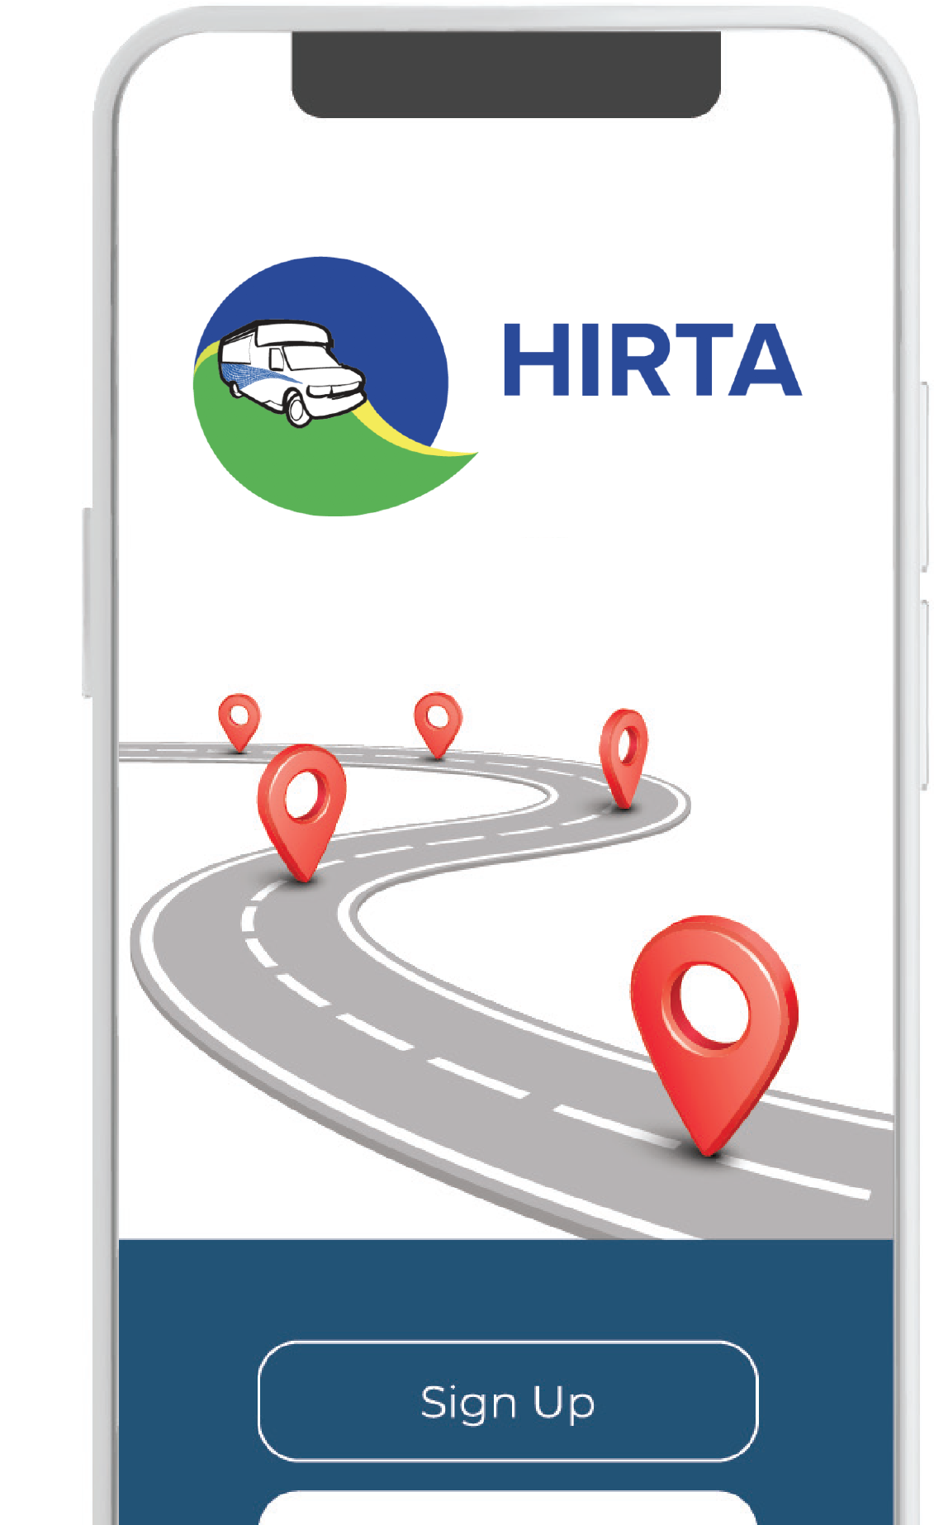
Purpose of
Health Connector
Schedule and manage medical appointments and transportation services at the same time
Notes:
The Health Connector was made possible through a cooperative agreement between HIRTA and the Federal Highway Administration, as part of the “ITS4US” initiative of the US DOT’s ITS Joint Program Office. Its focus is on improved transportation to healthcare for residents of Dallas County, Iowa. In this effort, HIRTA is supported by a project team that includes Flexlynqs, Capture Management Solutions, Iowa State University’s Institute for Transportation, and the Community Transportation Association of America (CTAA).

Slide 4
The Issue We Face
39%
of survey respondents cited missing at least one healthcare appointment due to the lack of available transportation options
Notes:
Our team honed in on transit access to healthcare because that was a recurring finding in the county’s community health assessments and Community Health Improvement Plans. As I’m sure you can imagine, transportation always comes up as a major barrier in accessing healthcare. In a survey conducted of Dallas County residents, 39% of respondents said they missed at least one appointment due to lack of transportation. HIRTA’s a transportation agency; with the right tools, this problem could be solved.
We focused on integrating several components, most of which were practically “off the shelf.” These included designing a kiosk interface for use in hospitals or other healthcare facilities, deploying accessible wayfinding tools on the transit vehicles and at major healthcare destinations, and creating a HIPAA-compliant connection between HIRTA’s trip requesting and scheduling system and the patient scheduling components of medical facilities’ electronic health records system. We also broadened the linguistic accessibility of HIRTA’s customer-facing systems to better fit the language profile of Dallas County, and opened up these systems to become available to Health Connector passengers’ family members, caregivers and other trusted third parties.

Slide 5
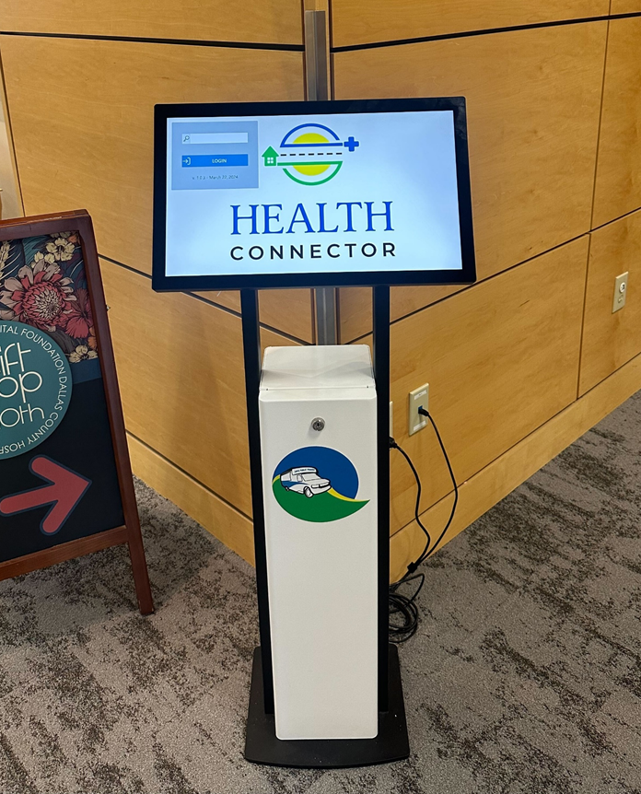
Equipment and Facility Requirements
Kiosk allows riders to self schedule
Great for people who lack data, smart phone, need return ride home etc.
Notes:
As part of our collaboration with Dallas County Hospital, we introduced this dedicated kiosk within the hospital. It offers a convenient and accessible way for individuals to book their Health Connector trips. Eligible users still have the option to schedule trips using the HIRTA On Demand app or the web portal. However, for those who may not have mobile data or are already at the hospital and need a ride home, the kiosk provides an efficient option.

Slide 6
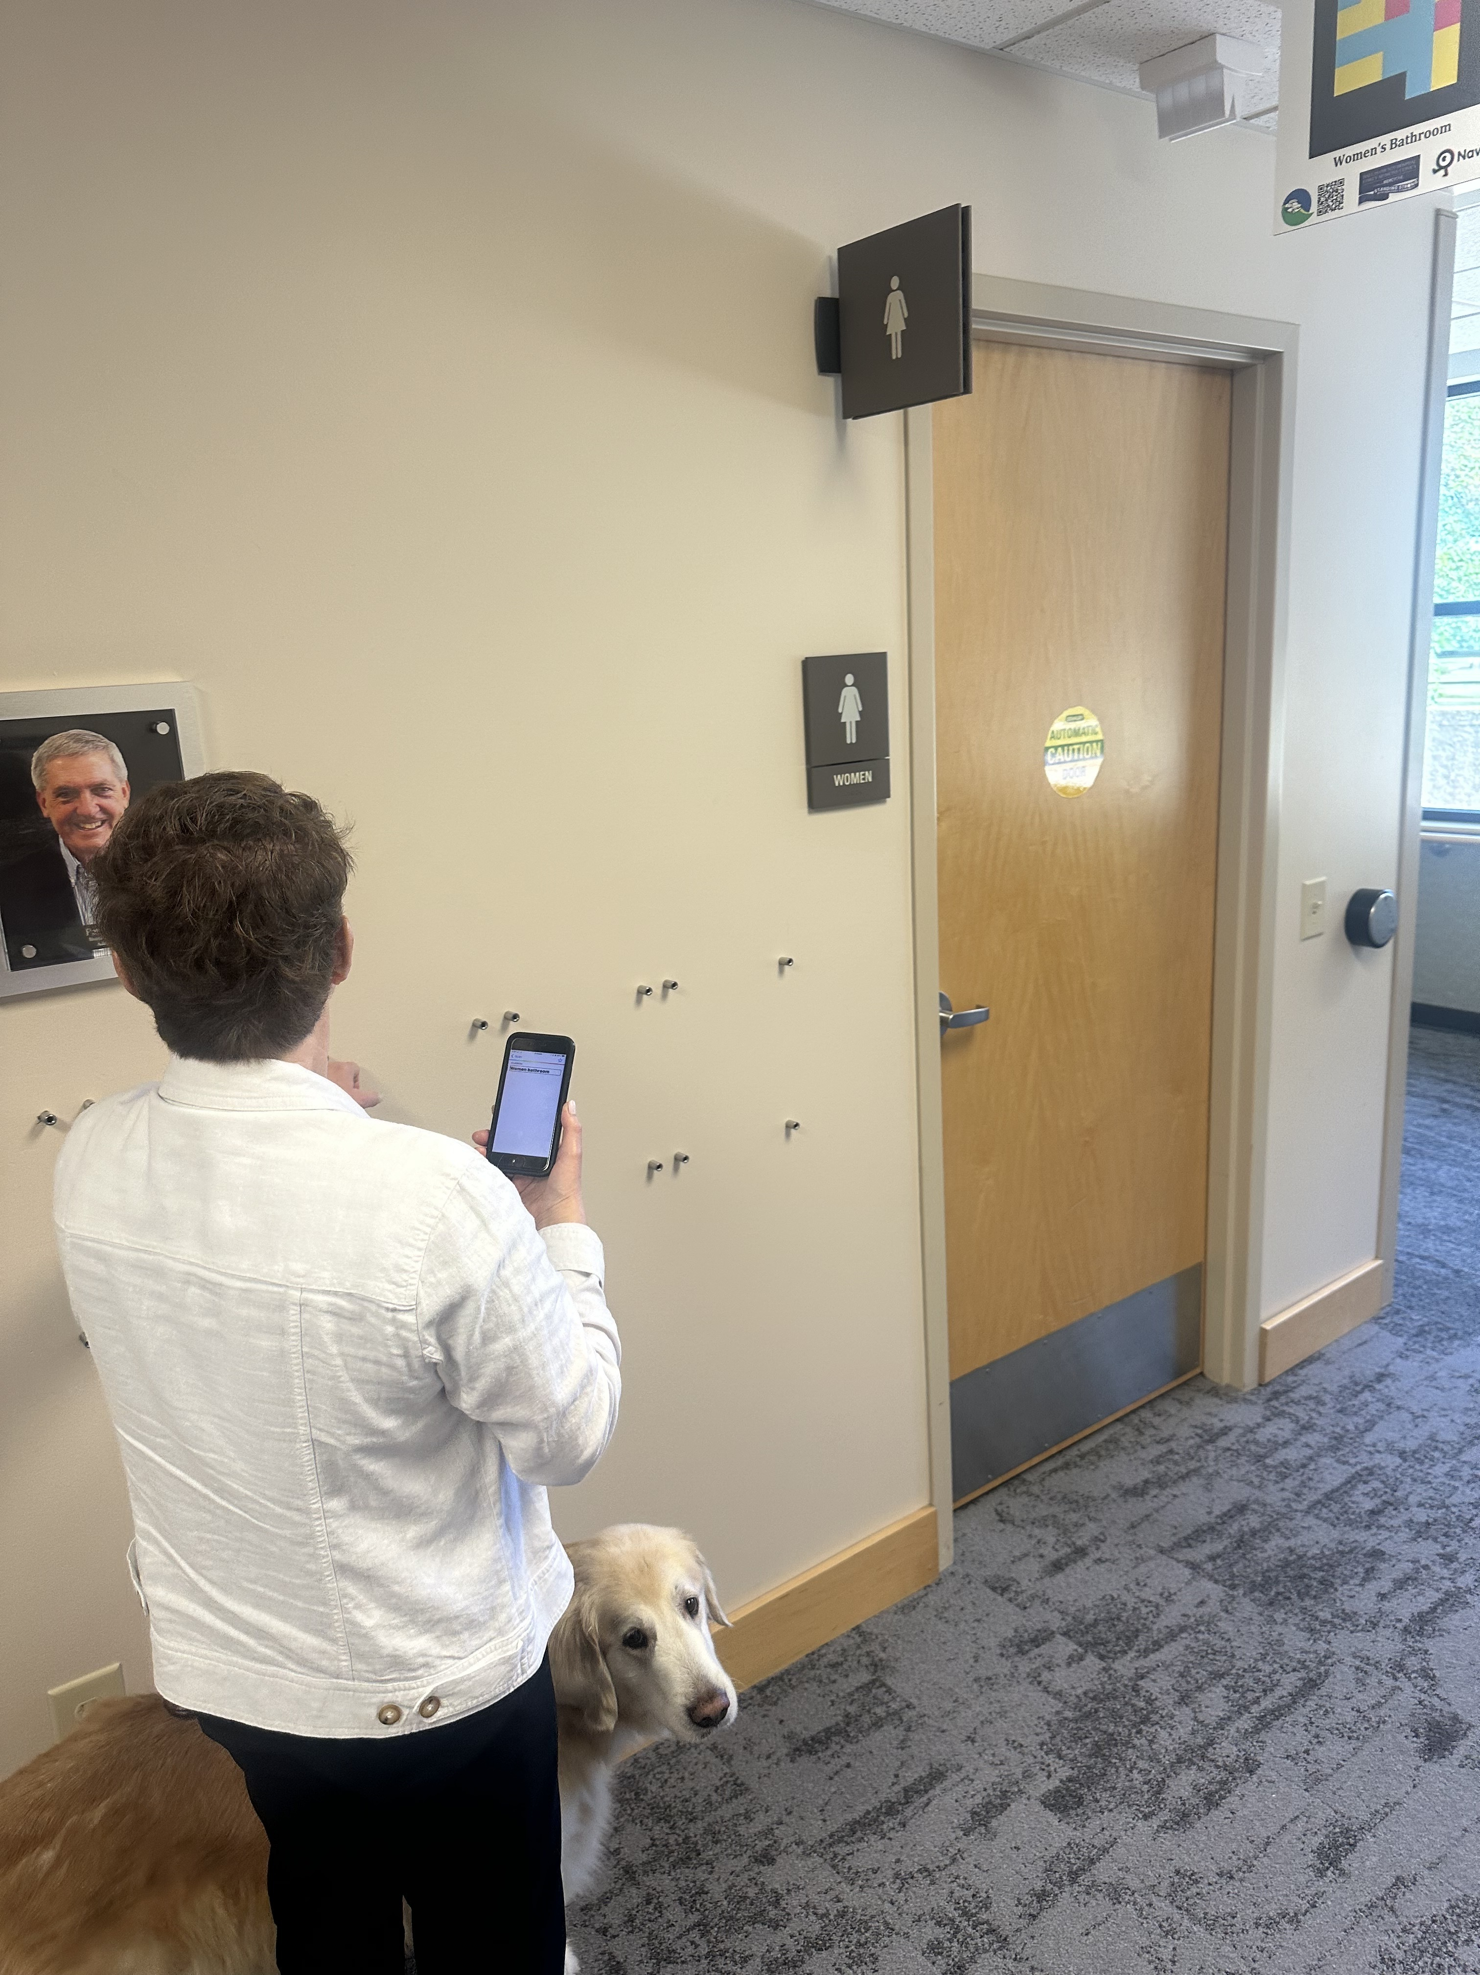
Wayfinding
Notes:
There are numerous wayfinding technologies out there. We went with NaviLens, which uses a form of QR code that can be scanned at distances of up to 60 feet and within a 160-degree angle of view. The NaviLens system is app-based, using 508-compliant smartphone apps. Unlike conventional QR codes, the NaviLens targets do not require focusing precision on the user’s part, and are accessible even to smartphone users with visual impairments, as the left-hand photograph with one of HIRTA’s passengers illustrates in real life.

Slide 7
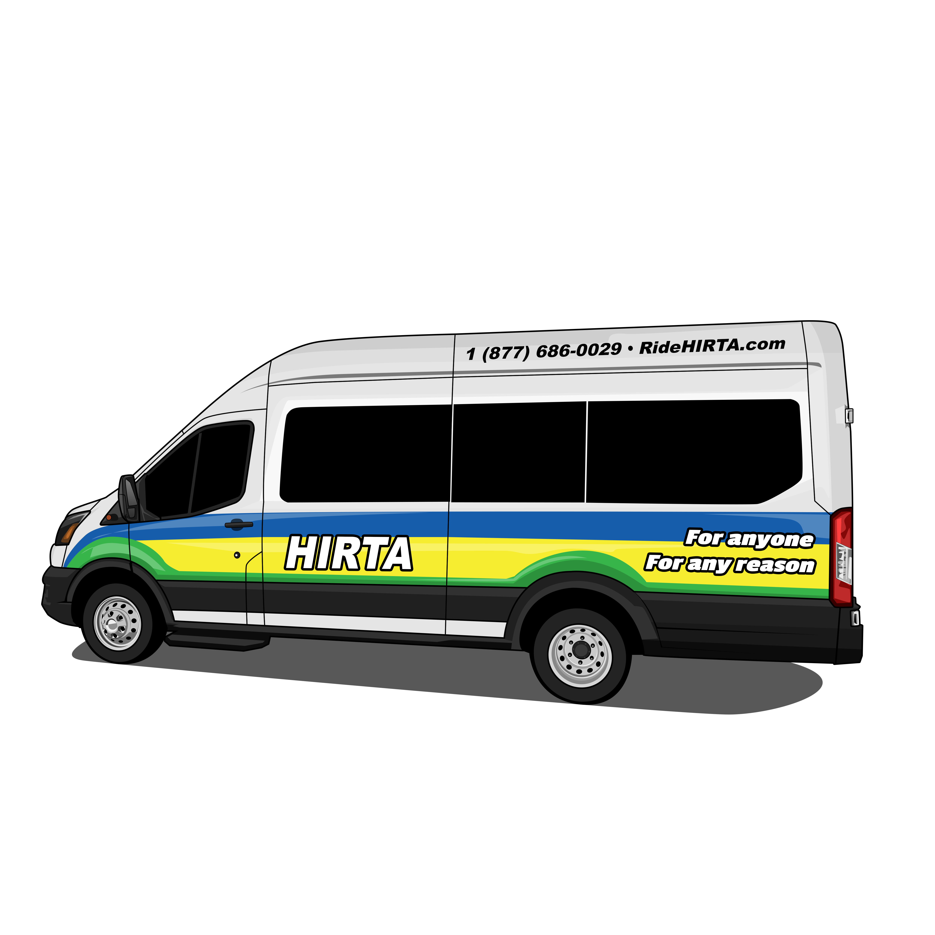
Notes:
HIRTA uses paid NaviLens codes on its buses so riders can scan the code and receive real-time information about their ride.
For example, the code on the screen reads out “This is HIRTA bus 2237.” If you’re a Health Connector passenger, this code can open additional information about your ride, and how you’ll navigate away from the bus at your destination.

Slide 8
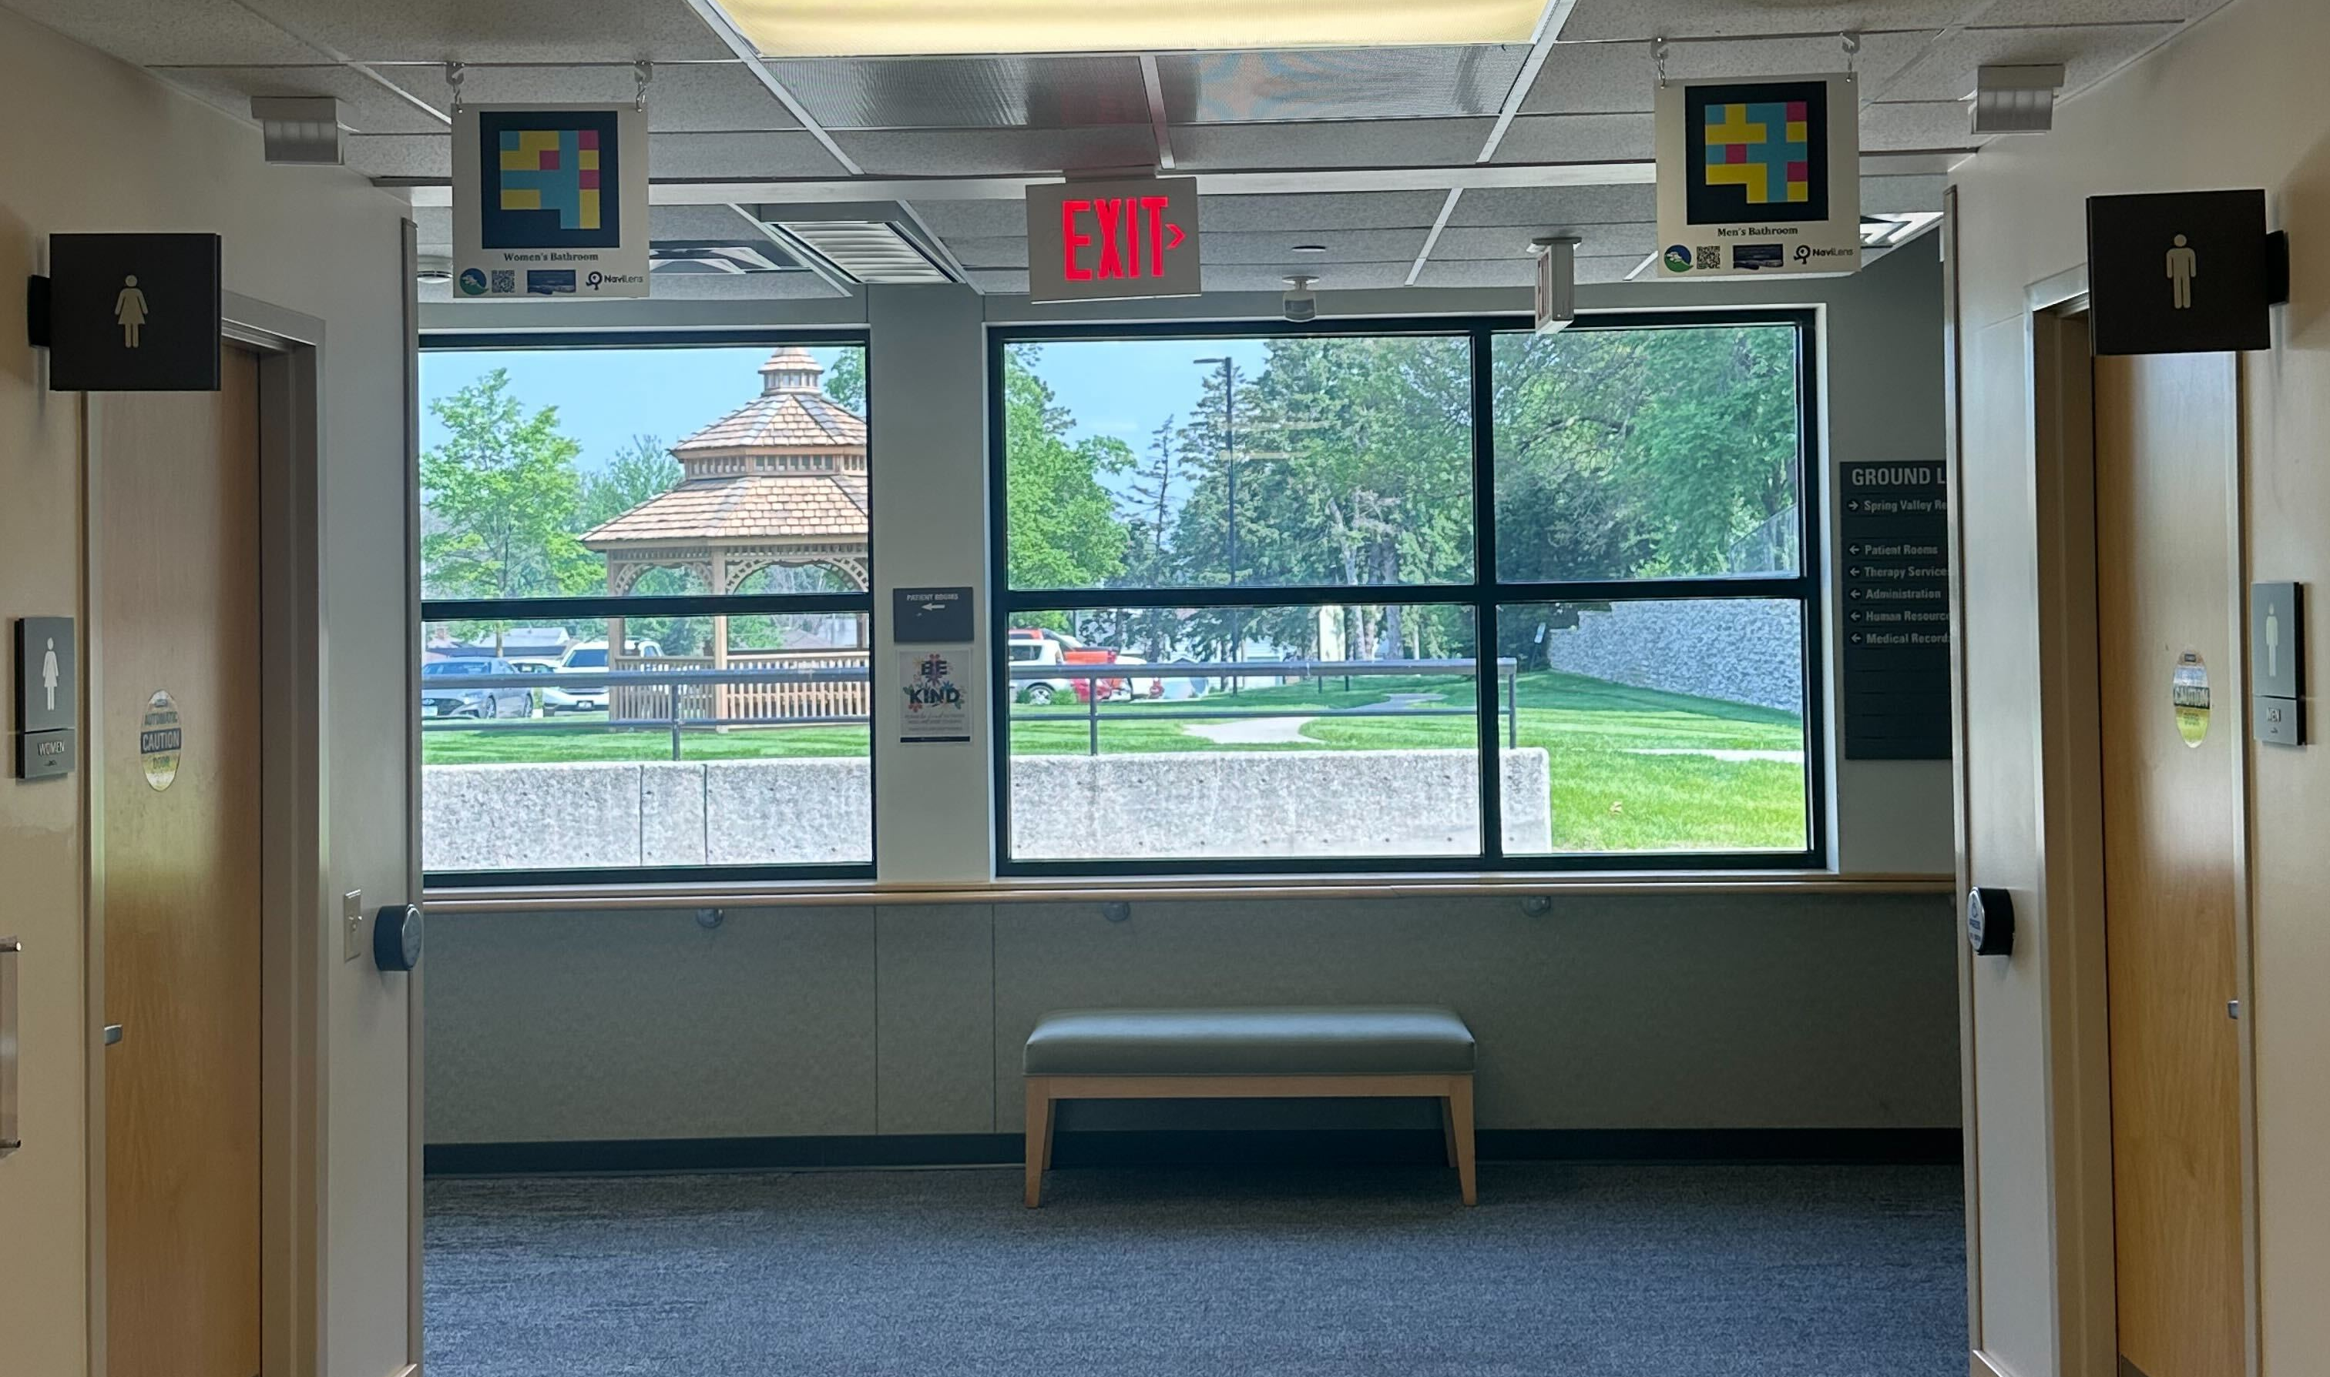
Notes:
Here’s an image of the NaviLens codes for the women’s and men’s restrooms at Dallas County Hospital. NaviLens can easily read and differentiate these codes from up to 60 feet away.

Slide 9
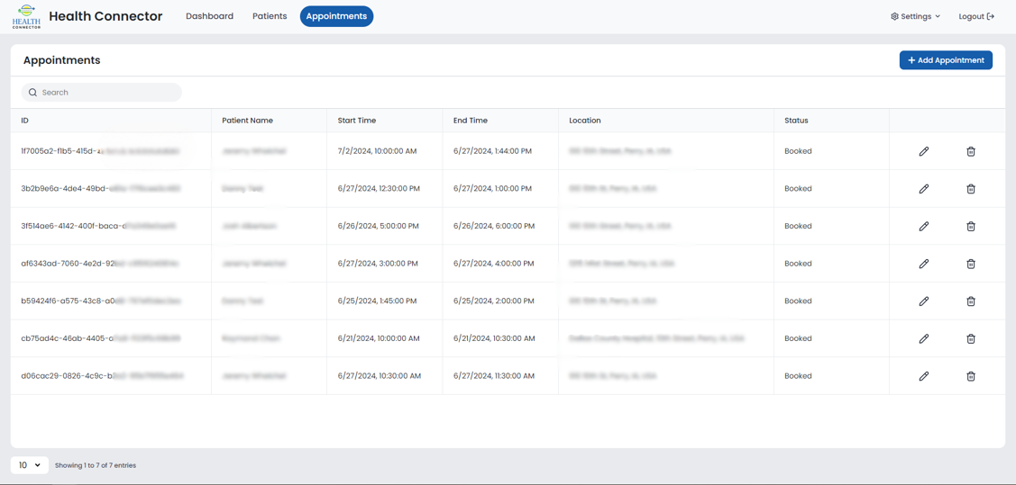
EHR Dashboard
Notes:
To solve one of the greatest challenges in healthcare-related transportation, our team developed a system that integrates seamlessly with Dallas County Hospital's Electronic Health Records (EHR) system. This integration provides both HIRTA and hospital staff with access to a dashboard where they can verify whether a patient has a trip booked. If a trip is not scheduled, or needs to be changed, hospital staff can easily arrange or modify transportation for the patient, without having to leave their Epic-based EHR platform. They also can check on patients’ trip status, such as for monitoring situations where a patient might be running late for an appointment. All this is accomplished without any HIPAA-restricted information leaving the EHR platform, and without any medical information being collected by HIRTA.

Slide 10
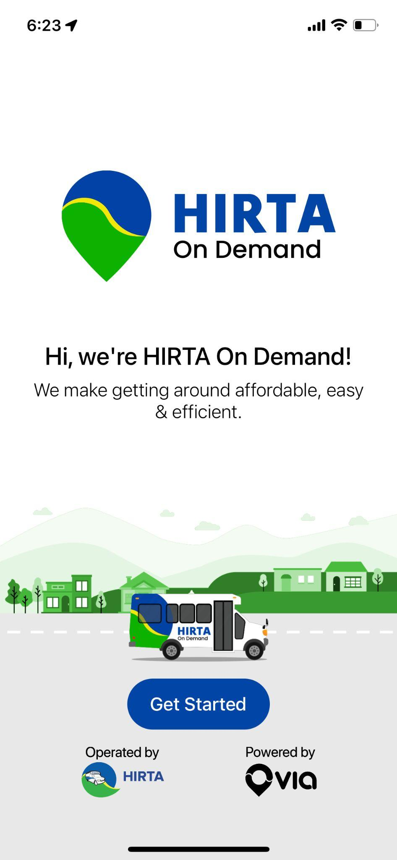
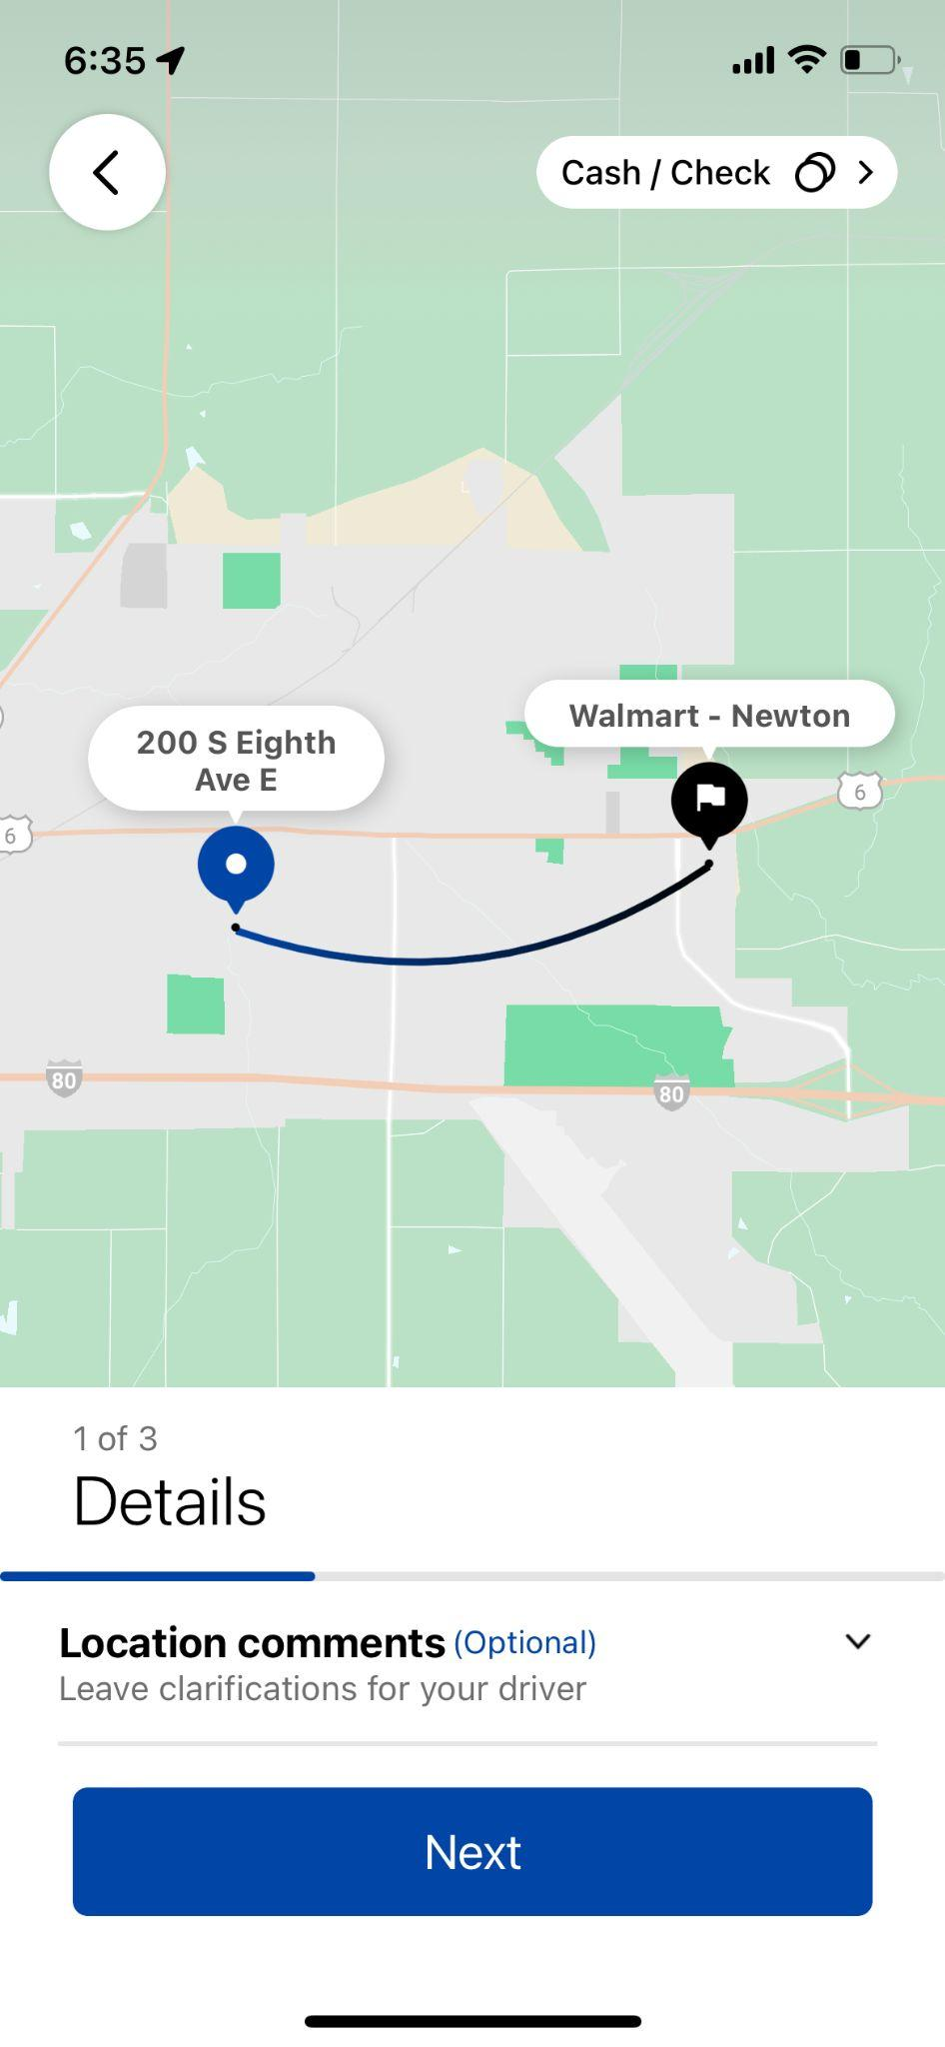
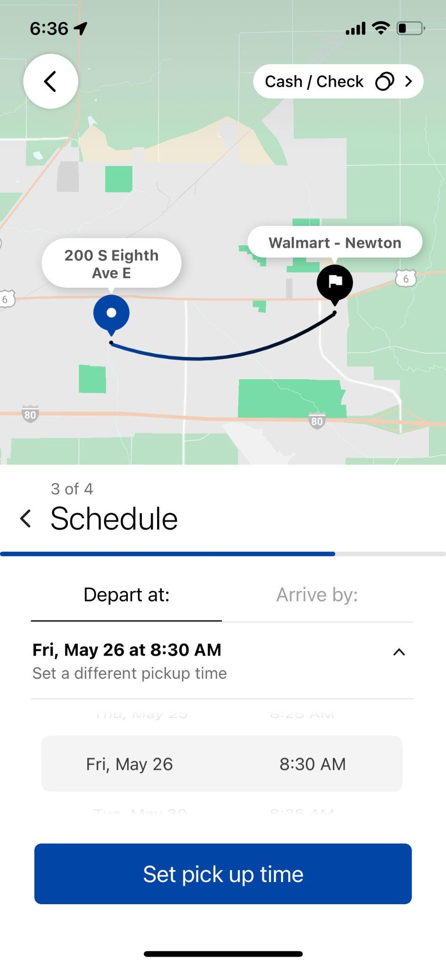
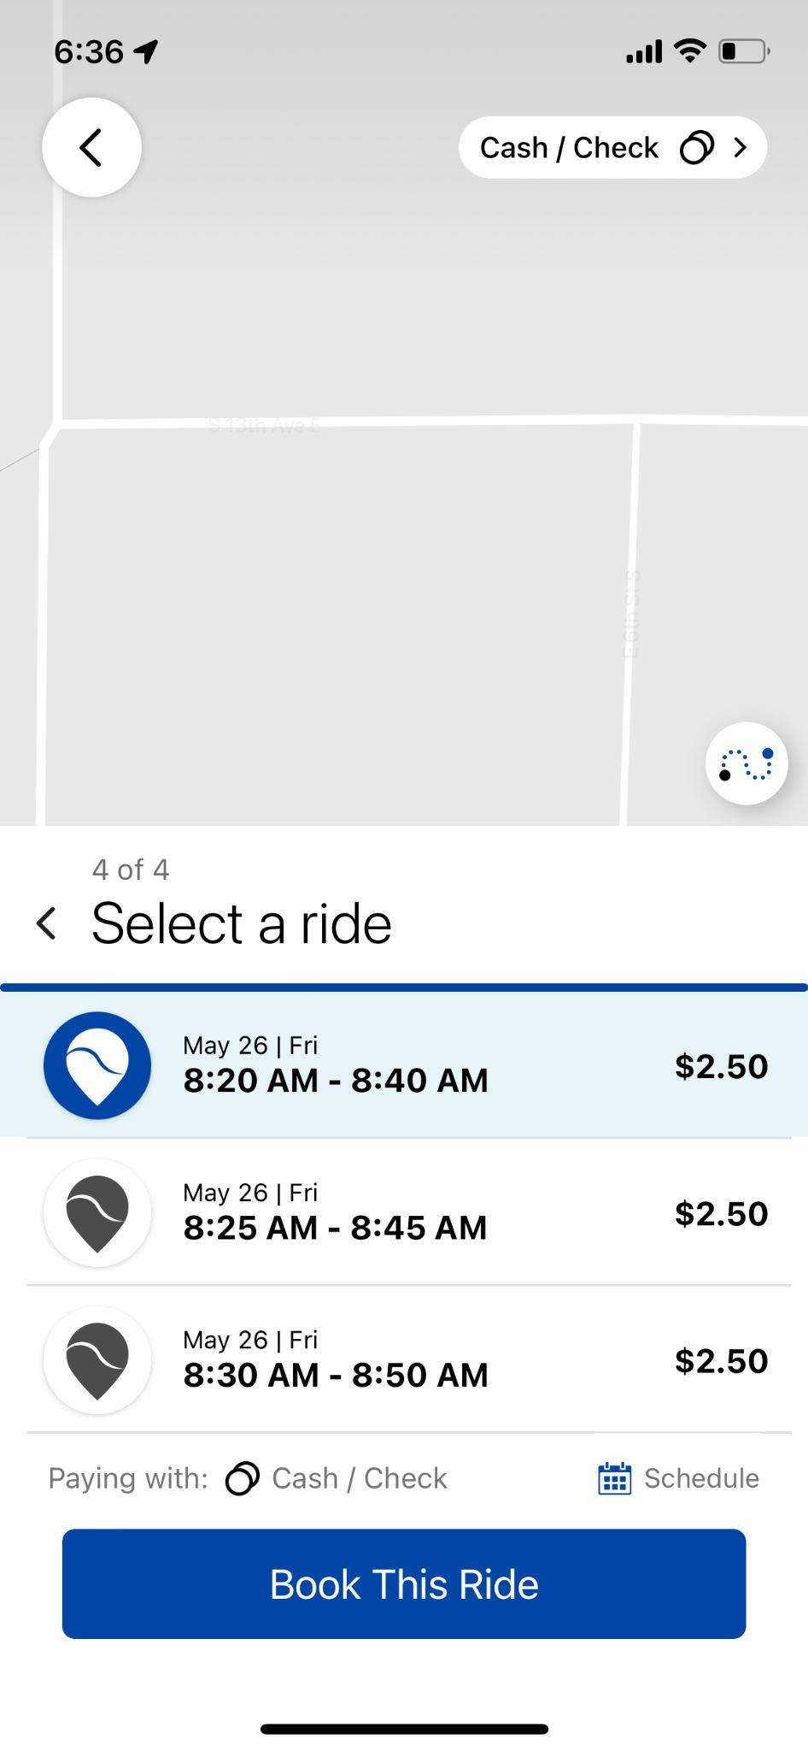
Scheduling through the app
Create your account
Select Sign Up and enter your personal details
Enter pickup and drop-off details
Let us know your destination and origin
Schedule your ride
Choose the date of your travel, select Arrive by or Depart at
Book your ride
Select the ride option that works best for your schedule
Notes:
The passenger-facing software is user-driven and based on the HIRTA On Demand app, as powered by Via Transportation’s technology. Users without smartphones, or with limited use of their smartphones, can contact HIRTA by telephone. Basic trip requesting and monitoring information is available through the kiosk.
As part of HIRTA’s commitment to inclusivity, the HIRTA On Demand app supports multiple languages. Additionally, the online booking portal offers translation support for 133 languages through Google Translate.

Slide 11
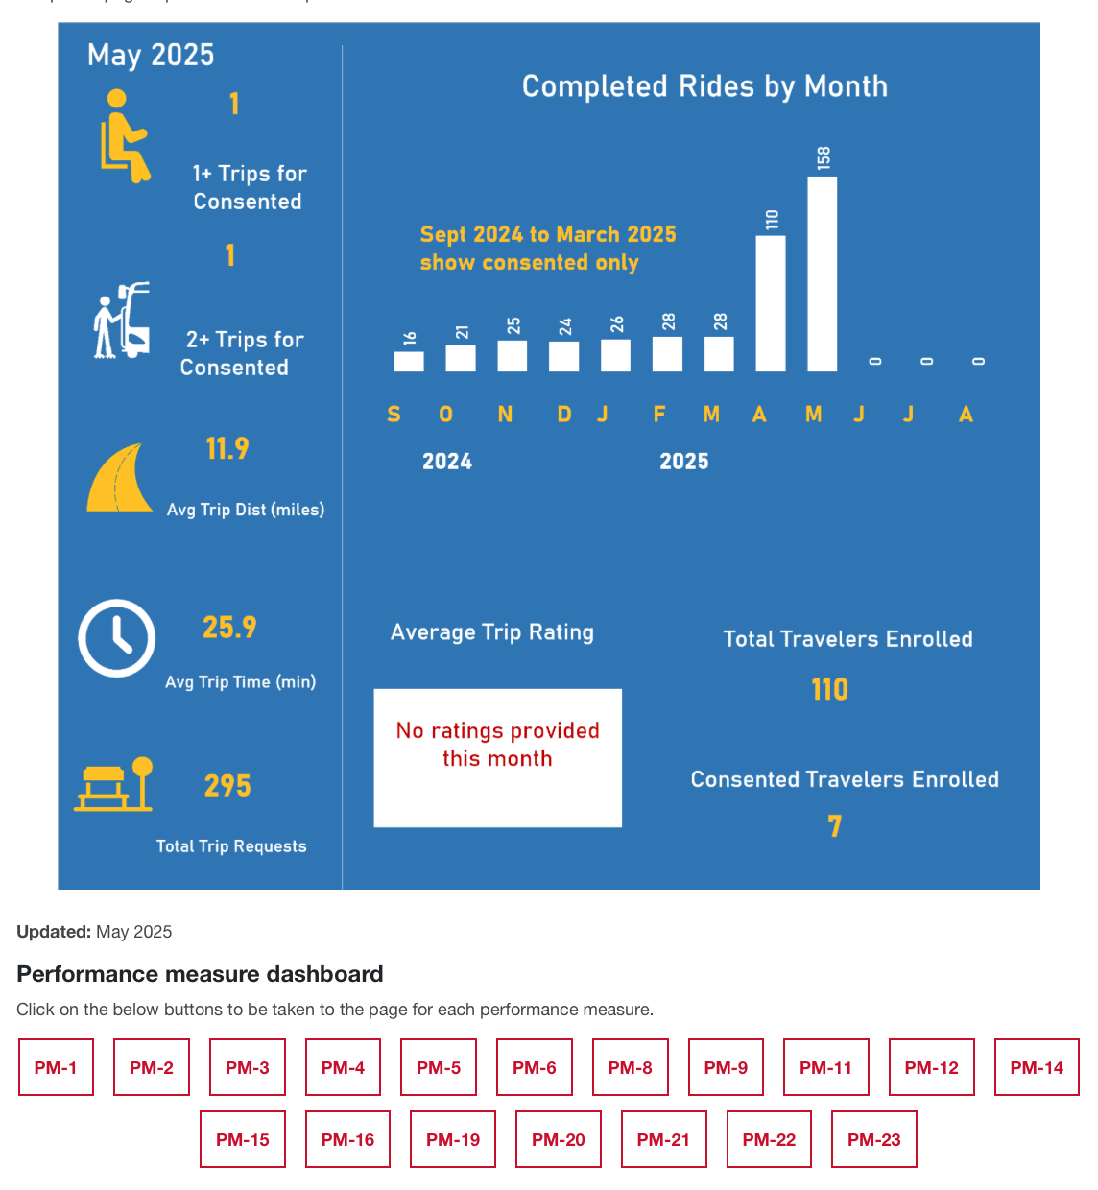
ISU Dashboard
Updated monthly. Can be viewed at https://www.intrans.iastate.edu/its4us-health-connector-deployment/
Notes:
Every month, ISU’s Institute for Transportation collects anonymized data on Health Connector usage, and posts those data on the ISU Health Connector Dashboard. These are the statistics for May 2025. In addition to the aggregate data shown here, ISU also posts data related to 18 of the project’s performance measures. Additional data are collected from Health Connector customers who have consented to participate in the project’s data collection and survey-based research.

Slide 12
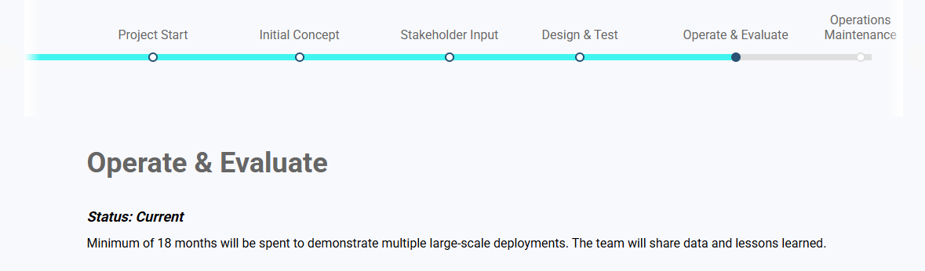
Health Connector Progress
Current Status
  We are currently in Phase 3 – Operate & Evaluate
  Service went “live” in March 2025
  Just held an Operational Showcase
Challenges Faced & Lessons Learned
  Recruitment; users’ willingness to provide informed consent for research purposes
  Turnover in healthcare facilities
    This lead to developing Train-the-Trainer materials for health facility staff
Upcoming
  Replicability
    Working on grants to expand Health Connector across HIRTA’s region
    Requiring future health partners to provide a letter of commitment

Slide 13
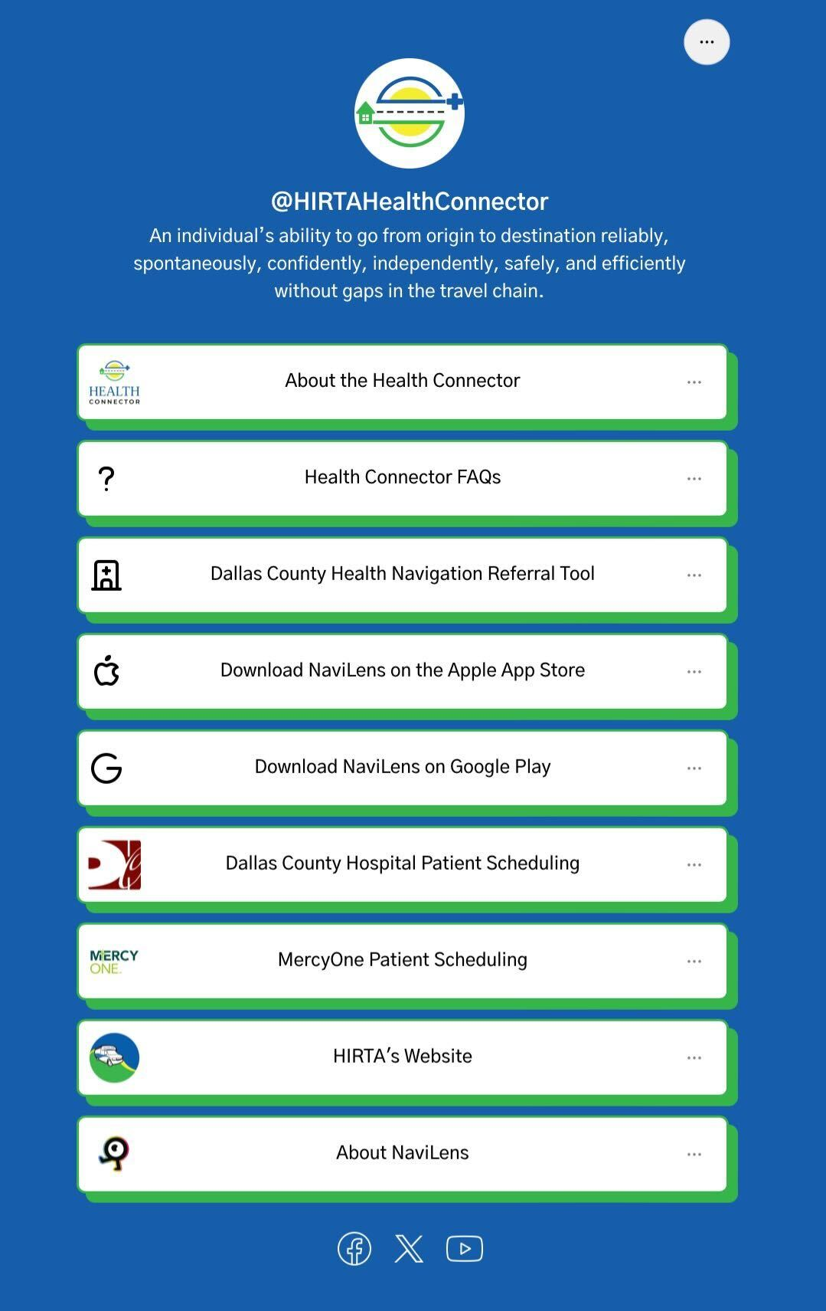
For more information
About Health Connector
  www.TransitHealthConnector.org
About HIRTA
  www.RideHIRTA.com
Health Connector Linktree (pictured)
  www.linktr.ee/hirtahealthconnector
Notes:
That concludes the overview of HIRTA’s Health Connector! For more information on Health Connector, visit www.TransitHealthConnector.org. For more information about HIRTA, visit www.RideHIRTA.com.
The Health Connector Linktree houses links for everything a rider needs to get the most out of Health Connector. It includes links about Health Connector and HIRTA, about NaviLens and links for downloading the NaviLens app to your phone, Dallas County Hospital and MercyOne Patient Scheduling, and more. This pop-up website provides riders a one-stop-shop for everything they need for an inclusive mobility experience from beginning to end.

Slide 14
Thank You!
HIRTA Health Connector
1 (877) 686-0029
healthconnector@ridehirta.com
www.TransitHealthConnector.org

