Slide 1



THE
APPROACH
SAFE SYSTEM
APPROACH
Zero is our goal. A Safe System is how we get there.

Slide 2
Note to presenters
This train-the-trainer presentation was developed with FHWA perspective for FHWA staff to provide an overview of the Safe System Approach.
Others are welcome to use it in whole or in part as appropriate to their purposes.
Thank you.
Notes:
Note to presenters: Remove this slide before finalizing the presentation.
Suggested process for shortening the presentation for various amounts of time:
Extended slides of the Queens Blvd case study.
One or both case studies.
Redundancy in topic slides that further clarify basic points:
Slides: 11, 12, 32, 34, 37, 38, 40, 43, 45, 47.
Slide 5.
Slide 57.
Covering all of the principles in slide 22 and removing some or most of slides 23 to 28.

Slide 3
Disclaimers
Except for any statutes or regulations cited, the contents of this presentation do not have the force and effect of law and are not meant to bind the public in any way. This presentation is intended only to provide information regarding existing requirements under the law or agency policies.
The U.S. Government does not endorse products, manufacturers, or outside entities. Names/logos appear in this presentation only because they are considered essential to the objective of the presentation. They are included for informational purposes only and not intended to reflect a preference, approval, or endorsement of any one product or entity.
Unless noted otherwise, FHWA is the source for all images in this presentation.
Notes:
Do not remove

Slide 4

Imagine our country as a place where nobody has to die from vehicle crashes.
Source: Fehr & Peers
Notes:
Key Message: Before we get started, let’s take a moment to reflect on the reason we are here today: each day, people are killed and seriously injured on our roads. Crashes can irreversibly change the course of human lives, touching victims, their families and loved ones, and society as a whole. But death and serious injury do not have to be consequences we live with simply to use our roadway system. Through collective action on the part of all roadway system stakeholders—from system managers and vehicle manufacturers, to law enforcement and everyday users—we can move to a Safe System approach that first anticipates human mistakes and second keeps impact energy on the human body at tolerable levels—with the goal of eliminating fatal & serious injuries for all road users. This presentation gives an overview of the Safe System approach, as outlined on the next slide.
Interactivity: Ask the audience how familiar they are with the Safe System approach. What Safe System practices are they implementing or planning to implement in their communities?
Background: The Safe System approach is a global movement that has been in place in countries across the globe for more than 30 years. The Federal Highway Administration’s (FHWA) top priority is safety, and for this reason it fully supports the vision of zero deaths and serious injuries on the Nation’s roadway system. While the Safe System approach is new to the United States, it is worth mentioning that the majority of the States have adopted a zero deaths approach (also known as Toward Zero Deaths (TZD)), and more than 50 communities across the United States have adopted Vision Zero initiatives that set a goal of eliminating fatal and serious injuries from the roadway system. TZD and Vision Zero provide opportunities to adopt Safe System, and some States and localities have already adopted the Safe System approach.
Notes: Additional information on the FHWA Safe System approach is available at https://safety.fhwa.dot.gov/zerodeaths/

Slide 5
Top 3 Takeaways
The Safe System Approach is “Principles Based”
Achieving a Safe System requires all five elements to be strengthened
Safe Roads is a continuum, not an absolute
Notes:
Key Message: The Safe System Approach is a complex topic and this presentation is an introduction. The top three things we want you to take away from this presentation are:
The Safe System Approach is “Principles Based” – you will learn the safe system principles that guide this approach and advance safety culture.
Achieving a Safe System requires all five elements to be strengthened – a system depends on each of its parts working together to achieve the best possible outcomes.
Safe Roads is a continuum, not an absolute – There are no “safe” or “unsafe” roads, but there are ways we can address the transportation system that can enhance the safety of its users.
Interactivity: No interactivity for this slide.
Background:

Slide 6
Presentation
Overview
1
2
3
4
5
Introduction
Safe System Principles
Safe System Elements
Case Studies
Conclusion & Resources
Notes:
Key Message: The presentation begins with an overview of the current traffic safety problem and introduces the key concepts of the Safe System approach. The next sections provide additional information on the principles and elements that make up the Safe System approach. The presentation then shows examples of how components of the Safe System approach are already being applied in the United States. The presentation concludes with additional resources that you can use to help bring the Safe System approach to your community.
Interactivity: Before moving into Section 1 on the next slide, do any attendees have questions at this point?
Background: No background for this slide.
Notes: The presentation has 5 sections. Safe System Principles and Safe System Elements are the longest sections, and the presentation typically takes between 30 and 45 minutes.

Slide 7
Introduction
Assessment of our current situation and introduction to the Safe System approach
1
2
3
4
5
Introduction
Safe System Principles
Safe System Elements
Case Studies
Conclusion & Resources
Notes:
Key Message: This section provides an assessment of our current traffic safety situation and an introduction to the Safe System approach. The next slides present global and national trends in traffic fatalities.
Interactivity: No interactivity for this slide.
Background: This section provides data on traffic fatalities and shows that, nationally, traffic fatalities are staying relatively constant, while pedestrian deaths are increasing. The graphs that follow demonstrate that we as a nation are not making substantial progress on reducing the traffic deaths, and, in order to make meaningful reductions, we need to rethink how we approach safety. With this in mind, slides that follow introduce the Safe System approach. They begin with the general premise of the approach, which is to eliminate fatal and serious injuries for all road users by accommodating human mistakes and keeping impacts on the human body at tolerable levels. The presentation shows successful Safe System adopters from around the world before explaining how the Safe System approach is being implemented in the United States. The Safe System approach is an overall guiding vision. There are six Safe System principles, which are the fundamental tenets of a Safe System. Then there are the five Safe System elements, which are avenues for implementing a Safe System.
Notes: No notes for this slide.

Slide 8
Thousands of Lives are Lost Each Year
Total US Traffic Fatalities
2014-2023
* 2023 number is preliminary
Source: NHTSA
Notes:
Key Message: Since 2020, fatalities were on the rise and remained above 40,000 in 2022. However, we saw a modest decrease in fatalities between 2021 and 2022, and preliminary data from 2023 indicate further decreases (40,990 fatalities, a decrease of about 3.6% as compared to 42,514 fatalities reported to have occurred in 2022). We are encouraged by the decreases, but this does not diminish the staggering losses we continue to see. Another troubling statistic is the trend in fatalities of users outside of vehicles, as shown on the next slide.
Interactivity: No interactivity for this slide.
Background: This slide shows the total police-reported US fatalities of motor vehicle traffic crashes, 2013-2022. This is the number of people who died, as opposed to the number of crashes, and it includes all motor vehicle occupants, motorcyclists, pedestrians, bicyclists, and people traveling by other modes. Data are from the NHTSA FARS database: https://www-fars.nhtsa.dot.gov/Main/index.aspx.

Slide 9
We have a National Roadway Safety Problem
Source: US DOT
Notes:
Key Message: Disproportionate impacts are felt acutely by people outside of vehicles. Fatalities among pedestrians and bicyclists have been increasing even faster.
Interactivity: No interactivity for this slide.
Background: This graphic from the National Roadway Safety Strategy shows that on a percentage change basis, fatalities of pedestrians and bicyclists have increased faster than total traffic fatalities from 2010 through 2020.

Slide 10
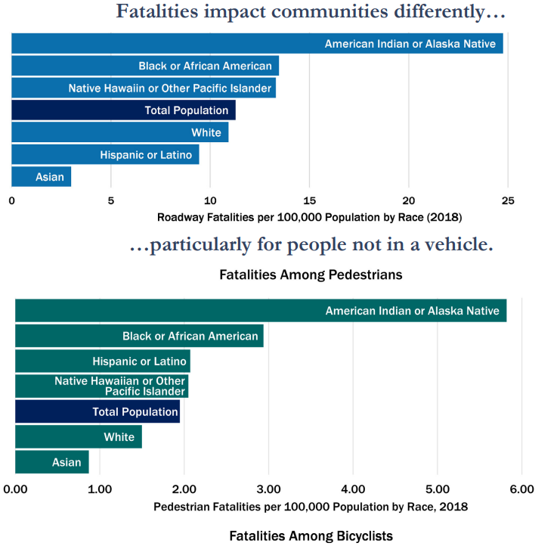
EQUITY
Opportunities to Simultaneously Address Safety, Equity, and Climate
Safety is and will always be the Department’s top priority. Roadway safety is also a foundational pre-requisite to our success in addressing two other major priorities: equity and climate.
“Traffic crashes are a leading cause of death for teenagers in America, and disproportionately impact people who are Black, American Indian, and live in rural communities. We face a crisis on our roadways; it is both unacceptable and solvable.”
Native Hawaiian or Other Pacific Islander
https://www.transportation.gov/sites/dot.gov/files/2022-02/USDOT-National-Roadway-Safety-Strategy.pdf
Notes:
Key Message: In addition to the increasing number of pedestrian and bicyclist fatalities, the data shows that traffic fatalities disproportionally impact people who are Black, American Indian, and live in rural communities.
Interactivity: No interactivity for this slide.
Background:
“Since 2015, the annual number of [roadway] fatalities has exceeded 35,000, with millions more injured – sometimes permanently – each year. Traffic crashes are a leading cause of death for teenagers in America, and disproportionately impact people who are Black, American Indian, and live in rural communities.[1] We face a crisis on our roadways; it is both unacceptable and solvable.” – U.S. Department of Transportation National Roadway Safety Strategy
[1] National Vital Statistics System, National Center for Health Statistics, Centers for Disease Control and Prevention; FARS 2018 Final File/Census Bureau.

Slide 11
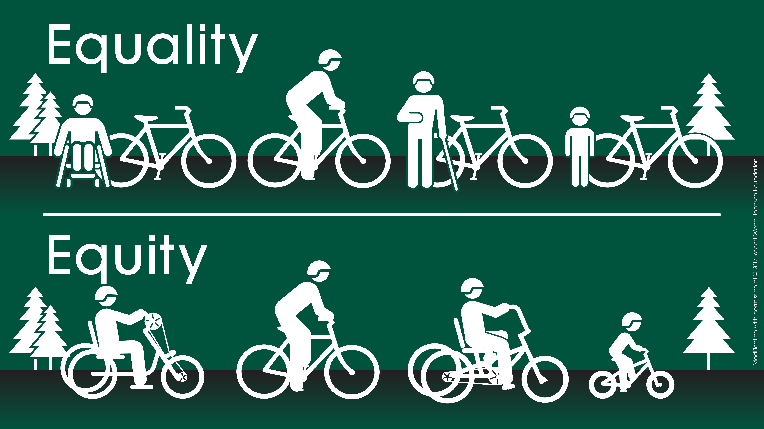
We will make more rapid progress toward the goal of zero deaths by addressing disparate traffic safety outcomes in underserved communities.
Source: FHWA. Modification with permission of © 2017 Robert Wood Johnson Foundation.
Notes:
Key Message: The US DOT equity strategic goal states: Reduce inequities across our transportation systems and the communities they affect. Support and engage people and communities to promote safe, affordable, accessible, and multimodal access to opportunities and services while reducing transportation-related disparities, adverse community impacts, and health effects.
Under Equality, everyone gets the same solution – even if it may not work for them. Under Equity, the specific needs, priorities and abilities of people and communities are taken into account and addressed. An equitable approach distributes investments so people with fewer resources and those who face exclusion and discrimination—on the basis of race, gender, age, disability, or income—will see priority improvements in their health and living conditions. Focusing on eliminating disparities leads to faster and more equitable progress towards the goal of zero!
Interactivity: No interactivity for this slide.
Background:
Incorporating equity into transportation safety means working with individuals in underserved communities to:
Collect and analyze data to identify communities experiencing disparities in roadway fatalities and serious injuries.
Engage community representatives to understand their transportation safety needs and build trust.
Implement improvements in safety planning, funding, design, operations, and maintenance processes to eliminate disparities in traffic fatalities and serious injuries.
Evaluate impacts by monitoring outcomes and working to continuously improve outcomes with communities.
U.S. DOT equity strategic goal: Reduce inequities across our transportation systems and the communities they affect. Support and engage people and communities to promote safe, affordable, accessible, and multimodal access to opportunities and services while reducing transportation-related disparities, adverse community impacts, and health effects.
U.S. DOT identified equity as a strategic goal because opportunities exist right now to redress historic inequities, remove barriers, and work toward more inclusive practices and benefits within U.S. DOT and for the public. Incorporating equity into U.S. DOT’s decision-making processes will result in a more robust and equitable transportation system that expands access and opportunities for all Americans.

Slide 12
Behind the numbers
Notes:
This slide is left blank intentionally. It is intended for the presenter to add a personal story, or a story tailored to the audience/community-to help participants see the story behind the numbers. The presenter may also add similar charts as the previous slides localized for the state/region/city as needed.

Slide 13

How does the United States reach zero deaths?
Source: Fehr & Peers
Notes:
Key Message: Imagine in the coming decades that not a single person in the United States dies in a traffic crash. Thinking about safety this way requires a paradigm shift in how we perceive the problem. Rather than accepting fatalities and serious injuries as a price for mobility, the philosophy of the Safe System approach is grounded in an ethical imperative that no one should be killed or injured when using the roadway system. The following slides introduce the concept of the Safe System approach—how it’s been applied globally and how it’s being implemented in the United States.
Interactivity: No interactivity for this slide.
Notes: No notes for this slide.

Slide 14

the safe system approach As a guiding principle
It involves a paradigm shift to improve safety culture, increase collaboration across all safety stakeholders, and refocus transportation system design and operation on anticipating human mistakes and lessening impact forces to reduce crash severity and save lives.
https://www.transportation.gov/sites/dot.gov/files/2022-08/SS4A-NOFO-FY22-Amendment-1.pdf
Notes:
Key Message: The guiding principle of the safe system approach is to improve safety culture and focus transportation system design and operation on anticipating human error and managing the transfer of kinetic energy that causes fatalities and serious injuries when crashes do occur.
Safety culture can be defined as the shared values, actions, and behaviors that demonstrate a commitment to safety over competing goals and demands.
Interactivity: No interactivity for this slide.
Background:

Slide 15

A New Paradigm
The Safe System approach aims to eliminate fatal and serious injuries for all road users by:
Accommodating human mistakes
Keeping impacts on the human body at tolerable levels
Notes:
Key Message: The Safe System approach aims to eliminate fatal and serious injuries for all road users by accommodating human mistakes and keeping impacts on the human body at tolerable levels. This is the fundamental objective of the Safe System approach. What separates the Safe System approach from the traditional approach to safety is the ethical imperative that not even one death is acceptable in our roadway system.
Interactivity: No interactivity for this slide.
Background: No background for this slide.
Notes: Examples of accommodating human mistakes include roadway design features like rumble strips, which alert a driver when they are unintentionally departing the roadway, or vehicle design features like autonomous emergency braking, which activate to stop the vehicle when the driver may not be able to do so. Examples of keeping impacts on the human body at tolerable levels include measures to control speed, physically separating users travelling at different speeds (e.g. drivers and people riding bikes), and vehicle safety features like seatbelts and airbags.

Slide 16







Successful Safe System Adopters
Changes from 2000 to 2019.
Norway
68.5%
France
57.6%
Sweden
Netherlands
47.3%
43.3%
Australia
33.5%
United States of America
5.6%
Source: FHWA with data from World Health Organization Global Health Observatory Repository
Notes:
Key Message: The Safe System approach is not a new concept. It has existed for more than 30 years in countries across the globe. Adopters of the Safe System approach, shown on this slide, has seen marked decreases in traffic fatalities across their roadway systems—with many achieving much greater reductions in traffic fatalities than the US over the previous 20 years. During this period, fatalities in the US were only reduced by 5.6%. The Safe System approach is how these countries moved off the “plateau” of safety to start achieving significant reductions. These examples show promise that, by implementing a Safe System approach in the United States, we may be able to achieve meaningful reductions in traffic deaths. Indeed, the US has started implementing a Safe System through various initiatives, which we’ll discuss on the following slide.
Interactivity: No interactivity for this slide.
Background: Data are from the World Health Organization Global Health Observatory Repository GHO | By category | Road traffic deaths - Data by country (who.int) estimate of motor vehicles fatalities, 2000-2019
Notes: Countries that have adopted a Safe System approach have both the lowest rates of fatalities per 100,000 inhabitants and the fastest rate of change in fatality levels. Norway, Sweden, and the Netherlands are frequently cited as the countries with the safest transportation system in the world.

Slide 17

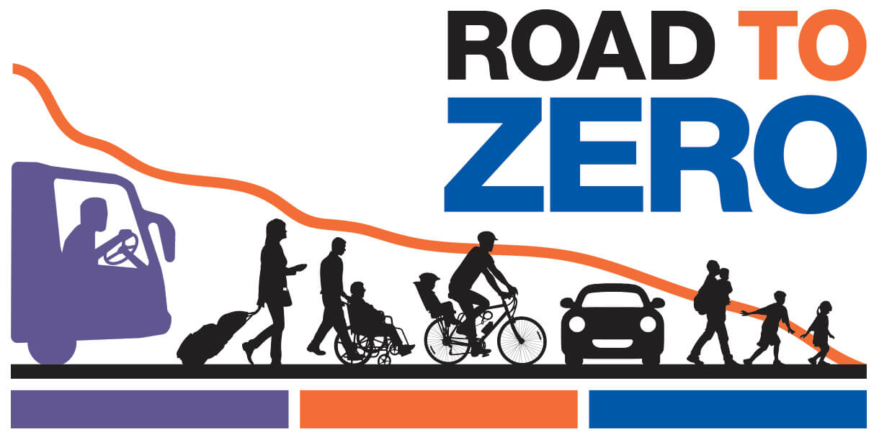


Safe System In the UNITED STATES
Notes:
Key Message: The Safe system Approach is newer in the United States, but efforts are underway to implement it more fully into our safety programs and coordinate more closely with our partners. Several initiatives are already advancing the concept of a Safe System approach. While the names differ, the efforts are aligned around a vision of eliminating deaths and serious injuries from our roadway system. FHWA collaborates with these organizations -Road to Zero, Toward Zero Deaths, and Vision Zero Network- and fully supports the zero deaths goal. These initiatives offer ample opportunities to incorporate Safe System at the national, state, and local levels. To date, a number of State and local communities have adopted zero deaths goals and are applying the Safe System approach to reach their goals.
The following slide shows the Safe System approach that these groups and FHWA are advancing in the United States.
Interactivity: Ask who from the audience has worked with any of these organizations.
Background:
In addition to partners like State DOTs, the American Association of State Highway and Transportation Officials (AASHTO), and the Institute of Transportation Engineers (ITE), Road to Zero, led by the National Safety Council (NSC), is an initiative to develop a coordinated approach to reaching zero deaths within the next 30 years. FHWA, the National Highway Traffic Safety Administration (NHTSA), and the Federal Motor Carrier Safety Administration (FMSCA), support the Road to Zero’s goals of: Double down on what works through proven, evidence-based strategies; Advance life-saving technology in vehicles and infrastructure, and; Prioritize safety by adopting a Safe Systems approach and creating a positive safety culture.
Toward Zero Deaths is the National Strategy on Highway Safety, an overarching vision to eliminate injuries and fatalities on America's roads. NHTSA, FMCSA, and FHWA provided technical support to a group of professional organizations with an active role in highway safety, led by AASHTO
Vision Zero Network collaborates with communities to reach the goal of Vision Zero while increasing safe, healthy, and equitable mobility. FHWA coordinates with the Vision Zero Network to provide assistance to these communities
Notes: No notes for this slide.

Slide 18
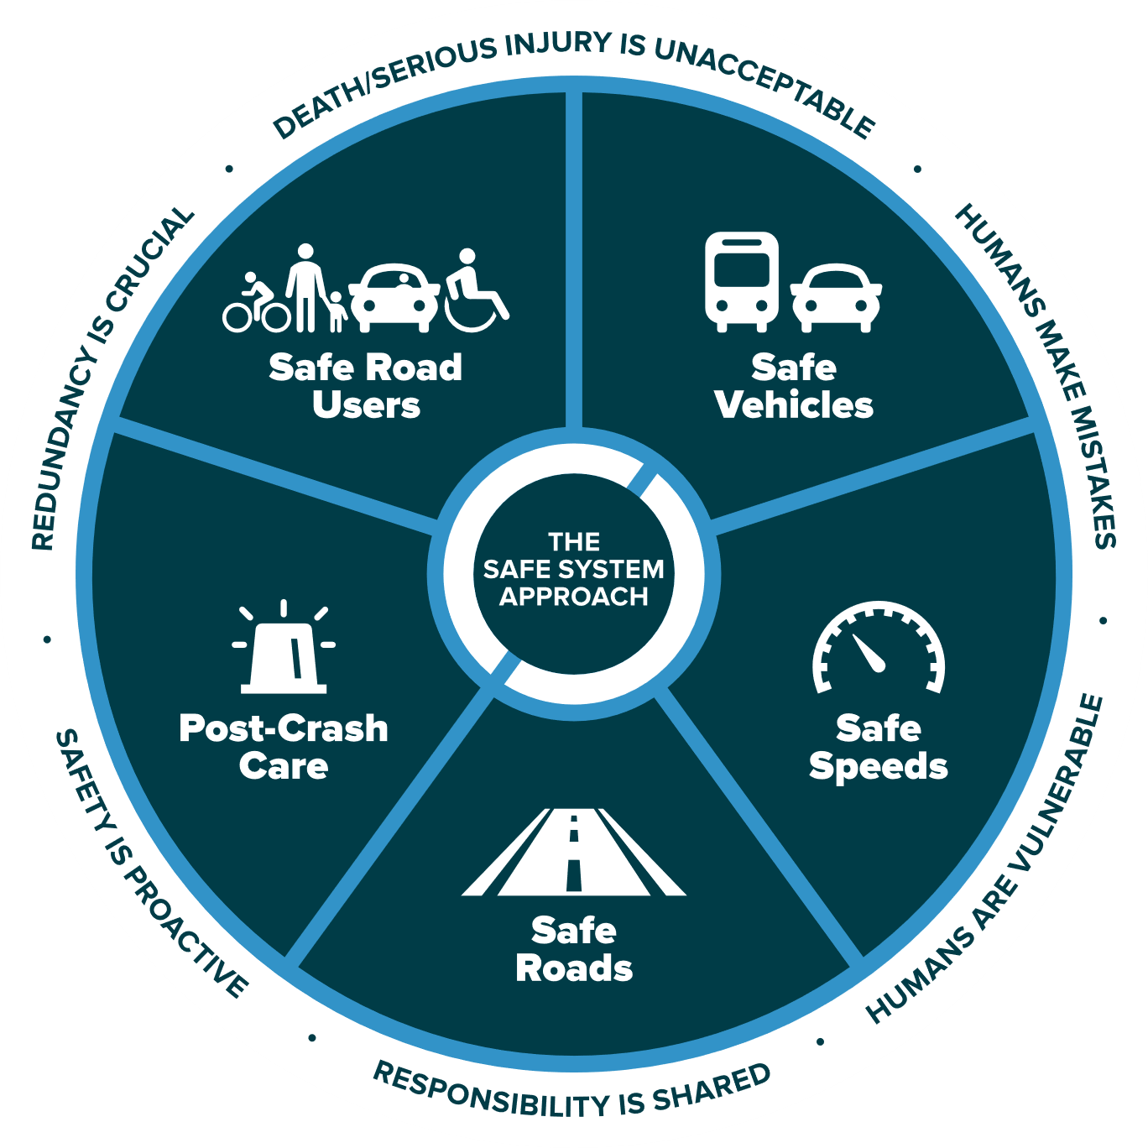
THE SAFE SYSTEM APPROACH
Source: FHWA
Notes:
Key Message: This graphic presents an overview of the Safe System approach. There are three key components to understand, which will be explained on this and the following slides. These are the Safe System “approach,” “principles,” and “elements.” The Safe System “approach,” shown by the graphic on this slide, is the broadest term and describes all aspects of the Safe System.
In addition, the term “Safe System” is singular to depict an overall Safe Road System. The National Safety Council and our international partners also use this version.
Interactivity: No interactivity for this slide.
Background: This graphic was created for FHWA drawing inspiration from similar designs by the Institute of Transportation Engineers (ITE), the Road to Zero Coalition, and the Royal Society for the Prevention of Accidents (ROSPA) in the United Kingdom.
Notes: No notes for this slide.

Slide 19






THE 6 SAFE SYSTEM PRINCIPLES
Death/Serious Injury is unacceptable
Responsibility is shared
Humans make mistakes
Safety is proactive
Humans are vulnerable
Redundancy is crucial
Source: FHWA
Notes:
Key Message: The six Safe System “principles,” shown around the outside ring of the graphic, are the fundamental beliefs that the approach is built on. They establish the goal of the Safe System approach, acknowledge human limitations, and set expectations for how to act. A successful Safe System approach weaves together all six principles. The principles will be discussed in depth in the next section.
Interactivity: No interactivity for this slide.
Background: No background for this slide.
Notes: No notes for this slide.

Slide 20

The 5 Safe System Elements
Source: FHWA
Notes:
Key Message: The five Safe System “elements,” highlighted in the middle ring of the graphic, are conduits through which the Safe System approach must be implemented. The key focus of the Safe System approach is to reduce death and serious injuries through design that accommodates human mistakes and injury tolerances. Making a commitment to zero deaths means addressing every aspect of crash risks through the five elements of a Safe System. These layers of protection and shared responsibility promote a holistic approach to safety across the entire roadway system. The five elements will be discussed in depth later in the presentation.
Interactivity: No interactivity for this slide.
Background: No background for this slide.
Notes: No notes for this slide.

Slide 21
Safe System Principles
Overview of the 6 principles of the Safe System approach
1
2
3
4
5
Introduction
Safe System Principles
Safe System Elements
Case Studies
Conclusion & Resources
Notes:
Key Message: This section provides information on the six principles of the Safe System approach.
Interactivity: No interactivity for this slide.
Background: No background for this slide.
Notes: The six Safe System principles are: Death/Serious Injury is Unacceptable; Humans Make Mistakes; Humans Are Vulnerable; Responsibility is Shared; Safety is Proactive; and Redundancy is Crucial. They will be explained one-by-one on the following slides.

Slide 22

The Safe System Principles
Death/serious injury is unacceptable
Humans make mistakes
Humans are vulnerable
Responsibility is shared
Safety is proactive
Redundancy
is crucial
Notes:
Key Message: The six Safe System “principles” are the fundamental beliefs that the approach is built on. They establish the goal of the Safe System approach, acknowledge human limitations, and set expectations for how to act. They will be explained one-by-one on the following slides.
Interactivity: Ask whom in the audience recognizes any of these.
Background: These six principles are based on a framework developed by other Safe System adopters outside the United States, including Sweden, the Netherlands, Australia, and New Zealand.
Notes: No notes for this slide.

Slide 23


Death/serious injury is unacceptable
Source: Vision Zero Network
Notes:
Key Message: The first principle is that death and serious injury is unacceptable. While no crashes are desirable, the Safe System approach prioritizes crashes that result in death and serious injuries, since no one should experience either when using the roadway system. The goal is to modify how users, vehicles, transportation infrastructure, and emergency response operate to reduce the likelihood of crashes happening at all, and to reduce their severity when they do happen.
Interactivity: No interactivity for this slide.
Background: The image shows a memorial to people killed in traffic crashes.
Notes: This Toward Zero Deaths video is an option for speakers (note that it is 3:44 minutes long): https://youtu.be/_AIubBHtz7g

Slide 24
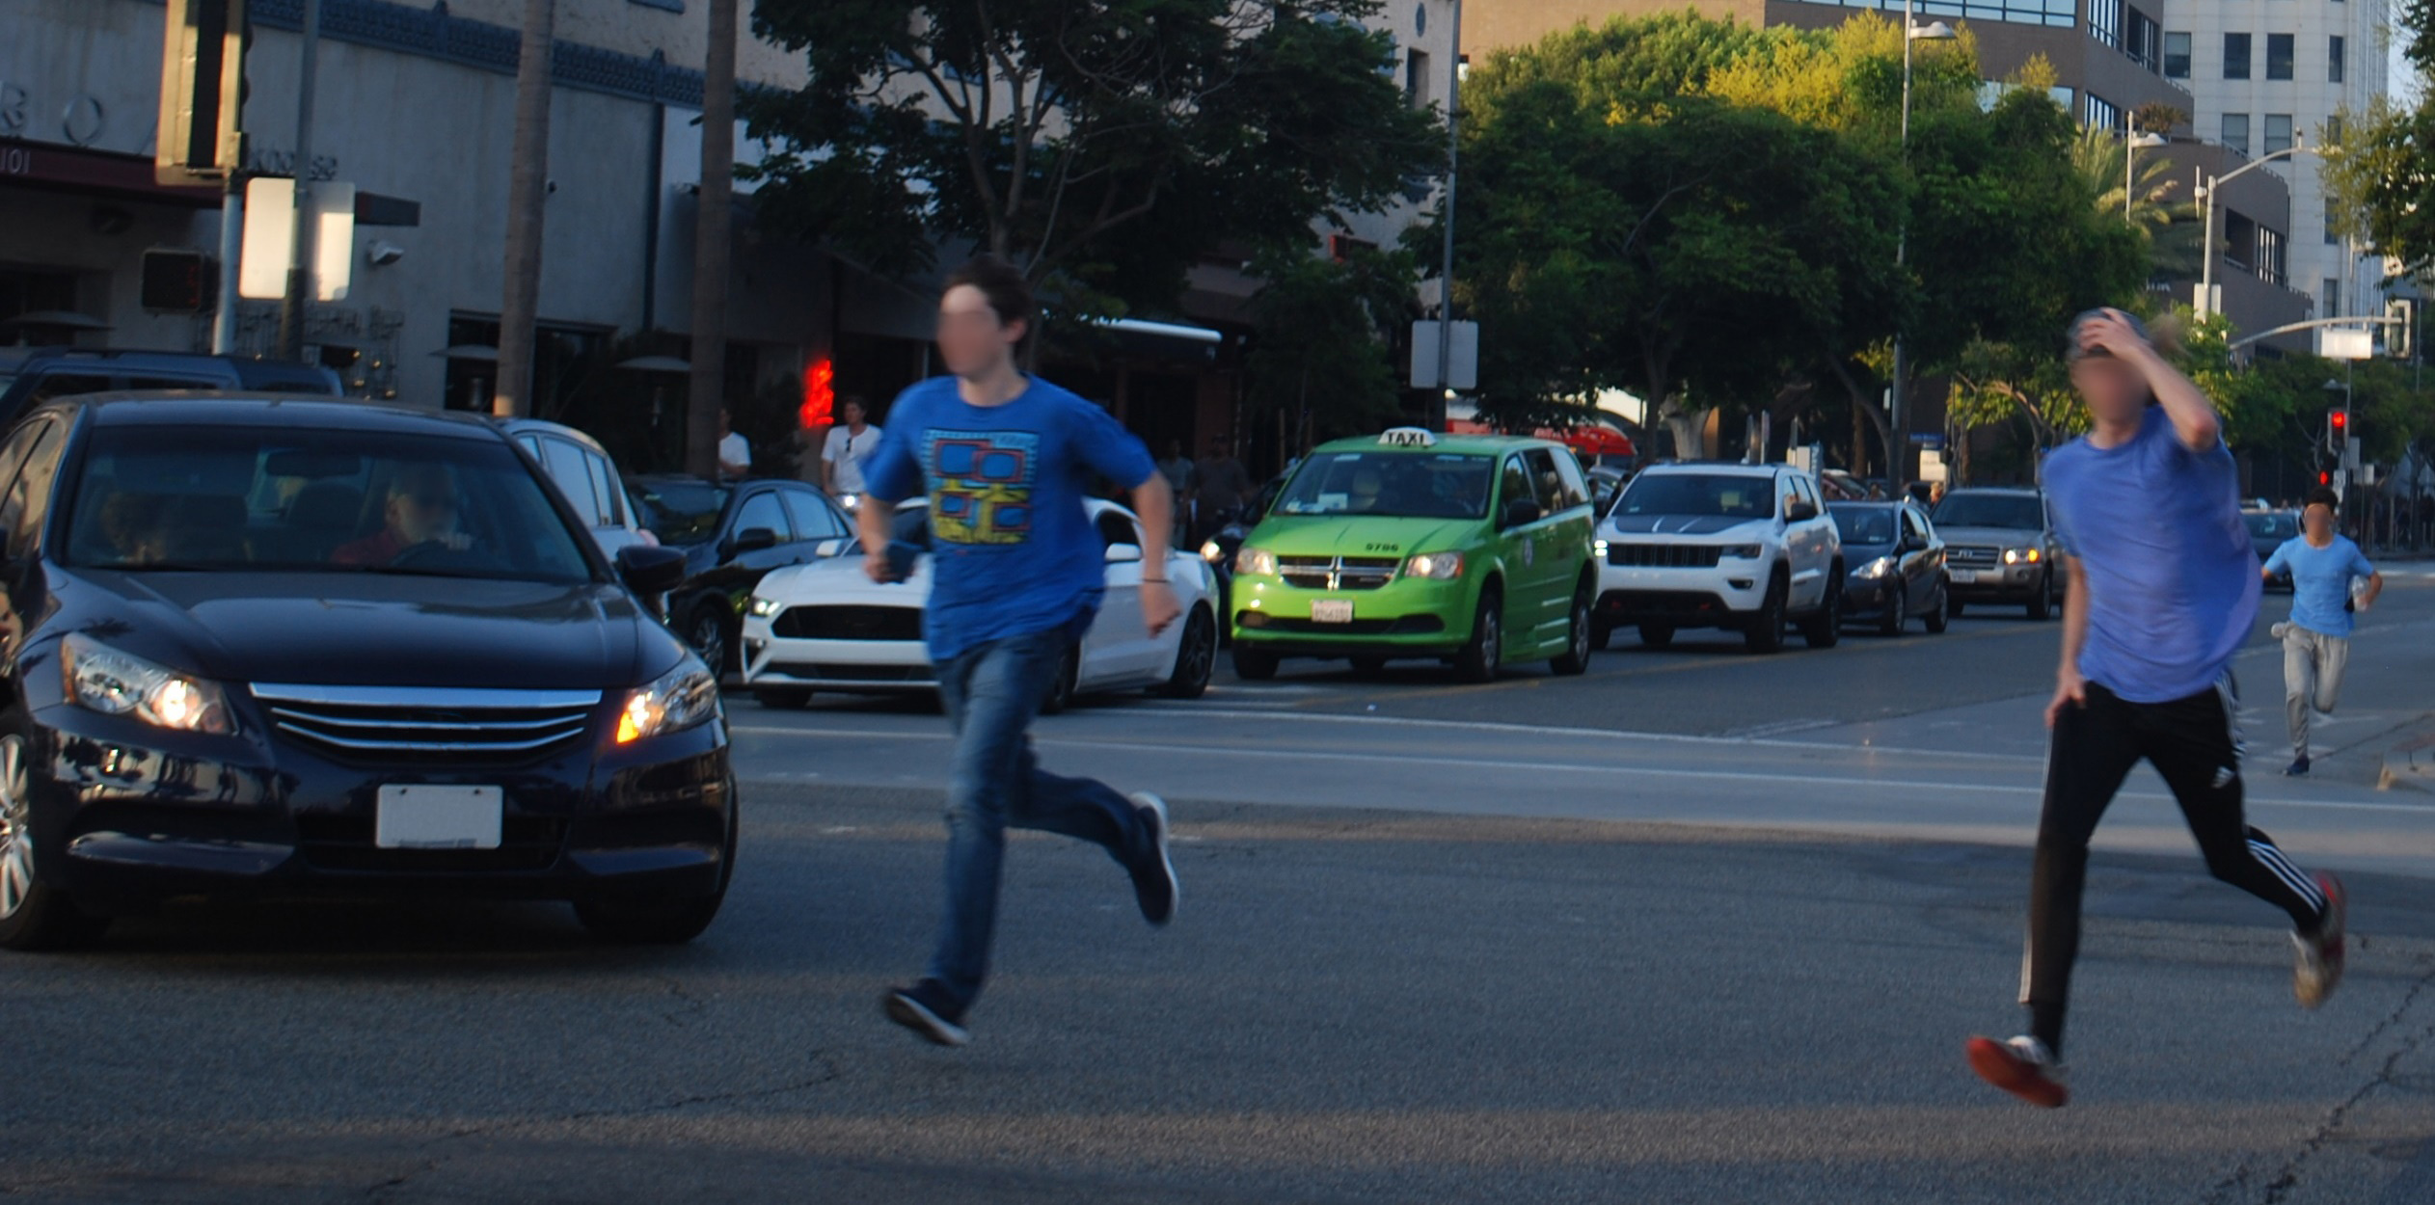
Humans make mistakes
Source: Fehr & Peers
Notes:
Key Message: The next principle is that humans make mistakes. People will inevitably make mistakes that can lead to crashes, but we can design and operate the roadway system to accommodate human mistakes to avoid death and serious injuries.
Interactivity: No interactivity for this slide.
Background: The image shows two people making a mistake by violating traffic rules and risking a collision.
Notes: An example of designing a roadway to accommodate human mistakes is adding a median to prevent errant drivers from entering oncoming traffic.

Slide 25
Humans are vulnerable
100%
Risk of Fatality and Serious Injury
0%
Crash Kinetic Energy
Source: FHWA
Notes:
Key Message: The next principle is that humans are vulnerable. As the chart shows, people have a limited ability to tolerate crash impacts before death and serious injuries occur. Human tolerance to crash impacts is central to the Safe System approach. The management of kinetic energy transfer to within survivable limits is important for understanding how to design and operate the road system consistently with the Safe System philosophy. The Safe System approach focuses not just on managing speed but managing transfer of kinetic energy.
Interactivity: No interactivity for this slide.
Background: The graphic was created for FHWA to explain the concept that as crash kinetic energy increases, so too does the potential of serious injury and death. It does not take particularly high kinetic energy levels for the potential of serious injury to occur.
Notes: No notes for this slide.

Slide 26
Responsibility is shared
System managers
  Planners, designers, builders, operators,
  maintenance workers
Vehicle manufacturers
Law enforcement personnel
Traffic Incident Management personnel
System users
Notes:
Key Message: The next principle is that responsibility is shared. System managers, vehicle manufacturers, law enforcement, post-crash personnel, and system users all have a responsibility to promote safe behavior and ensure that crashes don’t lead to fatal or serious injuries.
Interactivity: No interactivity for this slide.
Background: No background for this slide.
Notes: Examples include system managers designing facilities with proven safety countermeasures, like roundabouts or median barriers; system managers keeping roadway systems in good state of repair; vehicle manufacturers applying the latest safety features in vehicles; law enforcement equitably enforcing traffic safety laws; and users of all travel modes safely moving through the roadway system. “System managers” includes planners, designers, builders, operators, and maintenance.

Slide 27
Safety is proactive
Identify risks
Mitigate risks
Notes:
Key Message: The next principle is that safety is proactive. In addition to crash-based analysis, transportation agencies should use proactive tools to identify and mitigate latent risks in the roadway system, rather than waiting for crashes to occur and reacting afterwards. This process, known as the Systemic Approach to Safety, uses crash history, roadway design, and other data to identify patterns in geometric design that lead to certain crash types. System designers then identify appropriate countermeasures to mitigate the crash types. These countermeasures are systemically applied at all locations meeting the particular geometric design, irrespective of crash history. Rather than managing risk at certain locations, a systemic approach takes a broader view and evaluates risk across an entire roadway system. A system-based approach acknowledges crashes alone are not always sufficient to determine what countermeasures to implement, particularly on low-volume local and rural roadways where crash densities are lower, and in many urban areas where there are conflicts between vehicles and vulnerable road users (pedestrians, bicyclists, and motorcyclists).
Interactivity: The speaker may want to facilitate a discussion among the audience: "I have limited funds. How can I justify addressing latent risks when I have other locations with a history of crashes? I don't have funding to do both.“
Background: No background for this slide.
Notes: Additional information on the Systemic Approach to Safety is available at https://safety.fhwa.dot.gov/systemic/

Slide 28


Redundancy is crucial
Safe road users
Safe vehicles
Safe speeds
Safe roads
Post-crash care
Notes:
Key Message: The final principle is that redundancy is critical. Reducing risks requires that all parts of the roadway system are strengthened, so that if one part fails, people are still protected. This is the last of the six Safe System principles. The next section will address the five Safe System elements.
Interactivity: Ask the audience if they have questions about the principles.
Background: No background for this slide.
Notes: An example of redundancy is rumble strips, which protect people when their own ability to be safe road users is compromised by distraction or drowsiness.

Slide 29
Safe System Elements
Overview of the 5 elements of the Safe System approach
1
2
3
4
5
Introduction
Safe System Principles
Safe System Elements
Case Studies
Conclusion & Resources
Notes:
Key Message: This section provides information on the five elements of the Safe System approach.
Interactivity: No interactivity for this slide.
Background: No background for this slide.
Notes: The five elements of the Safe System approach are: Safe Road Users, Safe Vehicles, Safe Speeds, Safe Roads, and Post-Crash Care. They will be explained one-by-one on the following slides.

Slide 30





The Safe System Elements
Safe road users
Safe vehicles
Safe speeds
Safe roads
Post-crash care
Notes:
Key Message: The five Safe System “elements” are conduits through which the Safe System approach must be implemented. Making a commitment to zero deaths means addressing every aspect of crash risks through the five elements of a Safe System. These five elements will be explained one-by-one on the following slides.
Interactivity: No interactivity for this slide.
Background: These five elements are based on a framework developed by other Safe System adopters outside the United States, including Sweden, the Netherlands, Australia, and New Zealand.
Notes: The Safe System approach encompasses the elements of the 4Es (Enforcement, Education, Emergency Response, and Engineering). It refocuses efforts on reducing death and serious injury through accommodating human mistakes and reducing impact forces to tolerable levels.

Slide 31
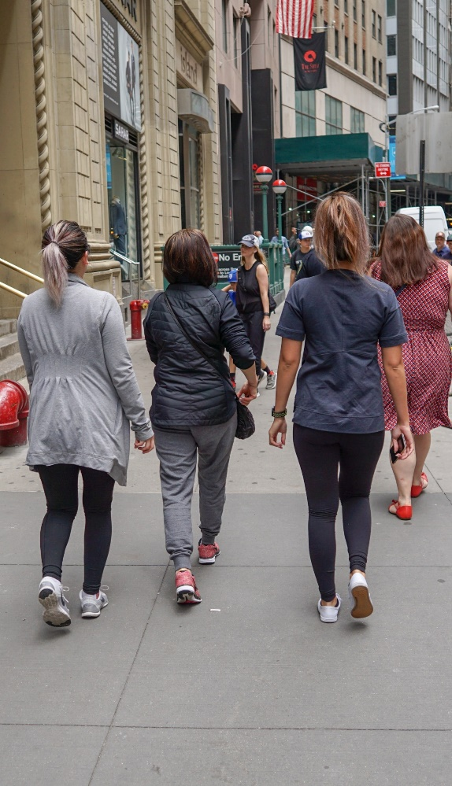
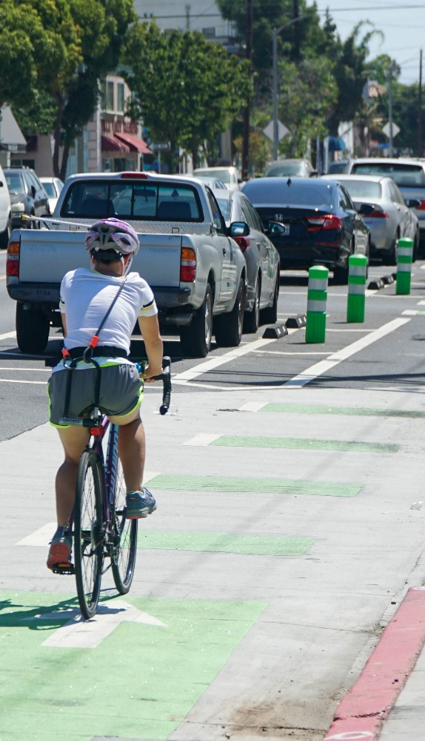


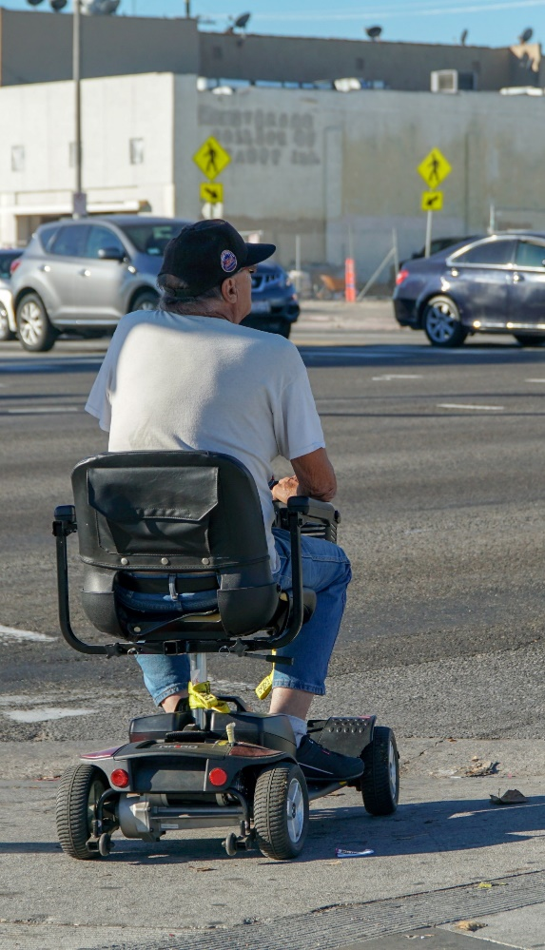
Safe Road Users
Walk
Bike
Drive
Transit
Other
Source for all images: Fehr & Peers
Notes:
Key Message: The first element is safe road users. The Safe System approach addresses the safety of all road users, including those who walk, bike, drive, ride transit, and travel by other modes. All road users are considered equal regardless of how they choose to travel. Each road user has a responsibility to operate, to the best of their ability, within the boundaries set by system managers, and education and enforcement can help to modulate user behavior.
Interactivity: No interactivity for this slide.
Background: The images show examples of the text below them.
Notes: An example of safe walking is starting to cross the street at a signalized intersection during the “walk” phase. An example of safe biking is riding with the direction of traffic. An example of safe driving is following signs and speed limits. An example of safe transit riding is not running for a transit vehicle. An example of safe travel by an “other” mode, such as a motorcycle, includes wearing proper protective equipment, or a wheelchair is obeying pedestrian traffic laws.

Slide 32





Safe Road Users – Continued
Not distracted or impaired
Follow rules
Act within the limits of the road design
Notes:
Key Message: We all make mistakes, but we all need to acknowledge the limits of our capabilities, so it is our responsibility to comply with the rules to ensure that we act within the limits of the road system’s design. System managers and law enforcement can use techniques like traffic or DUI enforcement, speed feedback signs, and education campaigns to promote compliance with rules.
Interactivity: Suggest asking participants provide examples for “act within limits of the road design”. Example may include slowing down at curves, walking against traffic where is no sidewalk available and must walk on the street.
Background: No background for this slide.
Notes: No notes for this slide.

Slide 33
Safe VEHICLES
Active safety
Passive safety
Measures to reduce the chance of a crash occurring
Lane departure warning
Autonomous emergency braking
Protective systems for when crashes do occur
Seatbelts and airbags
Crash-absorbing vehicle crumple zones
Notes:
Key Message: The next element is safe vehicles. Safe vehicles include “active” safety measures, to help prevent crashes from occurring, such as autonomous emergency braking; and “passive” safety measures, which protect occupants when a crash does occur, such as seatbelts and airbags. As described on the next slide, vehicle manufacturers are a key stakeholder in continuously evolving safety.
Interactivity: Ask the audience to name additional examples in each category.
Background: No background for this slide.
Notes: No notes for this slide.

Slide 34
Safe VEHICLES - continued
Other road user safety
New technology
Measures that protect other road users
Bicyclist and pedestrian detection
Vehicle size and design
Leveraging connected and automated vehicle (CAV) technology to improve safety
Notes:
Key Message: Safe vehicles must account for safety of other road users through elements such as size, design, and materials. Thinking ahead to the near future, elements such as bicyclist and pedestrian detection on connected vehicles (CVs) and automated vehicles (AVs) will be necessary to ensure vehicles are safe for all road users in the future.
Interactivity: Recommend some interactivity/discussion on vehicle size and design; are small vehicles safer? What designs are we referring to that make cars safer?
Background: No background for this slide.
Notes: No notes for this slide.

Slide 35
Safe Speeds
Speed is at the heart of a forgiving road transport system. It transcends all aspects of safety: without speed there can be no movement, but with speed comes kinetic energy and with kinetic energy and human error come crashes, injuries, and even deaths.”
Organization for Economic Co-operation and Development
Notes:
Key Message: The next element is safe speeds. As the quote on the screen shows, there is a direct linkage between safe speeds and our ability to survive a crash. Put simply, humans are unlikely to survive high-speed crashes. Adjusting speeds can accommodate human injury tolerances in three ways: reducing impact forces, providing additional time for drivers to stop, and improving visibility.
Interactivity: No interactivity for this slide.
Background: This quote is from the Organisation for Economic Co-operation and Development (OECD) International Transport Forum (ITF) 2016 report Zero Road Deaths and Serious Injuries: Leading a Paradigm Shift to a Safe System: http://www.towardszerofoundation.org/wp-content/uploads/2016/10/Zero_road_deaths-SafeSystems.pdf
Notes: The International Transport Forum is an intergovernmental organization with 57 member countries. It acts as a think tank for transport policy and organizes the Annual Summit of transport ministers. ITF is the only global body that covers all transport modes. The ITF is politically autonomous and administratively integrated with the OECD. It is based in Paris, France.

Slide 36
SAFE SPEEDS: reducing Pedestrian fatalities
Hit by a vehicle traveling at
23 MPH
10% risk of death
Hit by a vehicle traveling at
42 MPH
50% risk of death
Hit by a vehicle traveling at
58 MPH
90% risk of death
Source: FHWA. Adapted from USDOT Pedestrian Safety Action Plan
Notes:
Key Message: There is a direct relationship between the speed at which a vehicle is traveling and the likelihood of survival for the person being hit. 9 out of 10 pedestrians are likely to survive if hit by a vehicle traveling around 20 MPH, while only 1 in 10 pedestrians will likely survive an impact at around 60 MPH.
Interactivity: No interactivity for this slide.
Background: This graphic was adapted for FHWA from a similar graphic in the USDOT Pedestrian Safety Action Plan: https://highways.dot.gov/sites/fhwa.dot.gov/files/2020-11/FHWA_PedSafety_ActionPlan_Nov2020.pdf. The USDOT graphic is based on data from the AAA Foundation for Traffic Safety’s 2011 report Impact Speed and a Pedestrian’s Risk of Severe Injury or Death: https://aaafoundation.org/wp-content/uploads/2018/02/2011PedestrianRiskVsSpeedReport.pdf
Notes: No notes for this slide.

Slide 37
Safe Speeds: Fatality Risks
100%
Fatality
Risk
0%
10
20
30
40
50
60
70
Impact Speed (MPH)
Source: FHWA. Adapted from graphic created by Australian Roads and Traffic Authority of New South Wales.
Notes:
Key Message: As we saw on the last slide, the human body is vulnerable and unlikely to survive an uncushioned impact at a speed of more than about 20 mph. Even relatively low speeds can kill or seriously injure unless the vehicle and the road environment take account of the physical vulnerability of all road users.
Interactivity: No interactivity for this slide.
Background: This graphic was adapted for FHWA from a similar graphic created by the Australian Roads and Traffic Authority of New South Wales: https://nacto.org/wp-content/uploads/2016/04/4-1_NSW-Roads-Traffic-Authority-Safe-Systems-Approach_2011.pdf. Please note this graph has been converted from the metric system to the English system.
Notes: The further to the left that the curve is on the graph, the lower the speed at which death occurs.

Slide 38
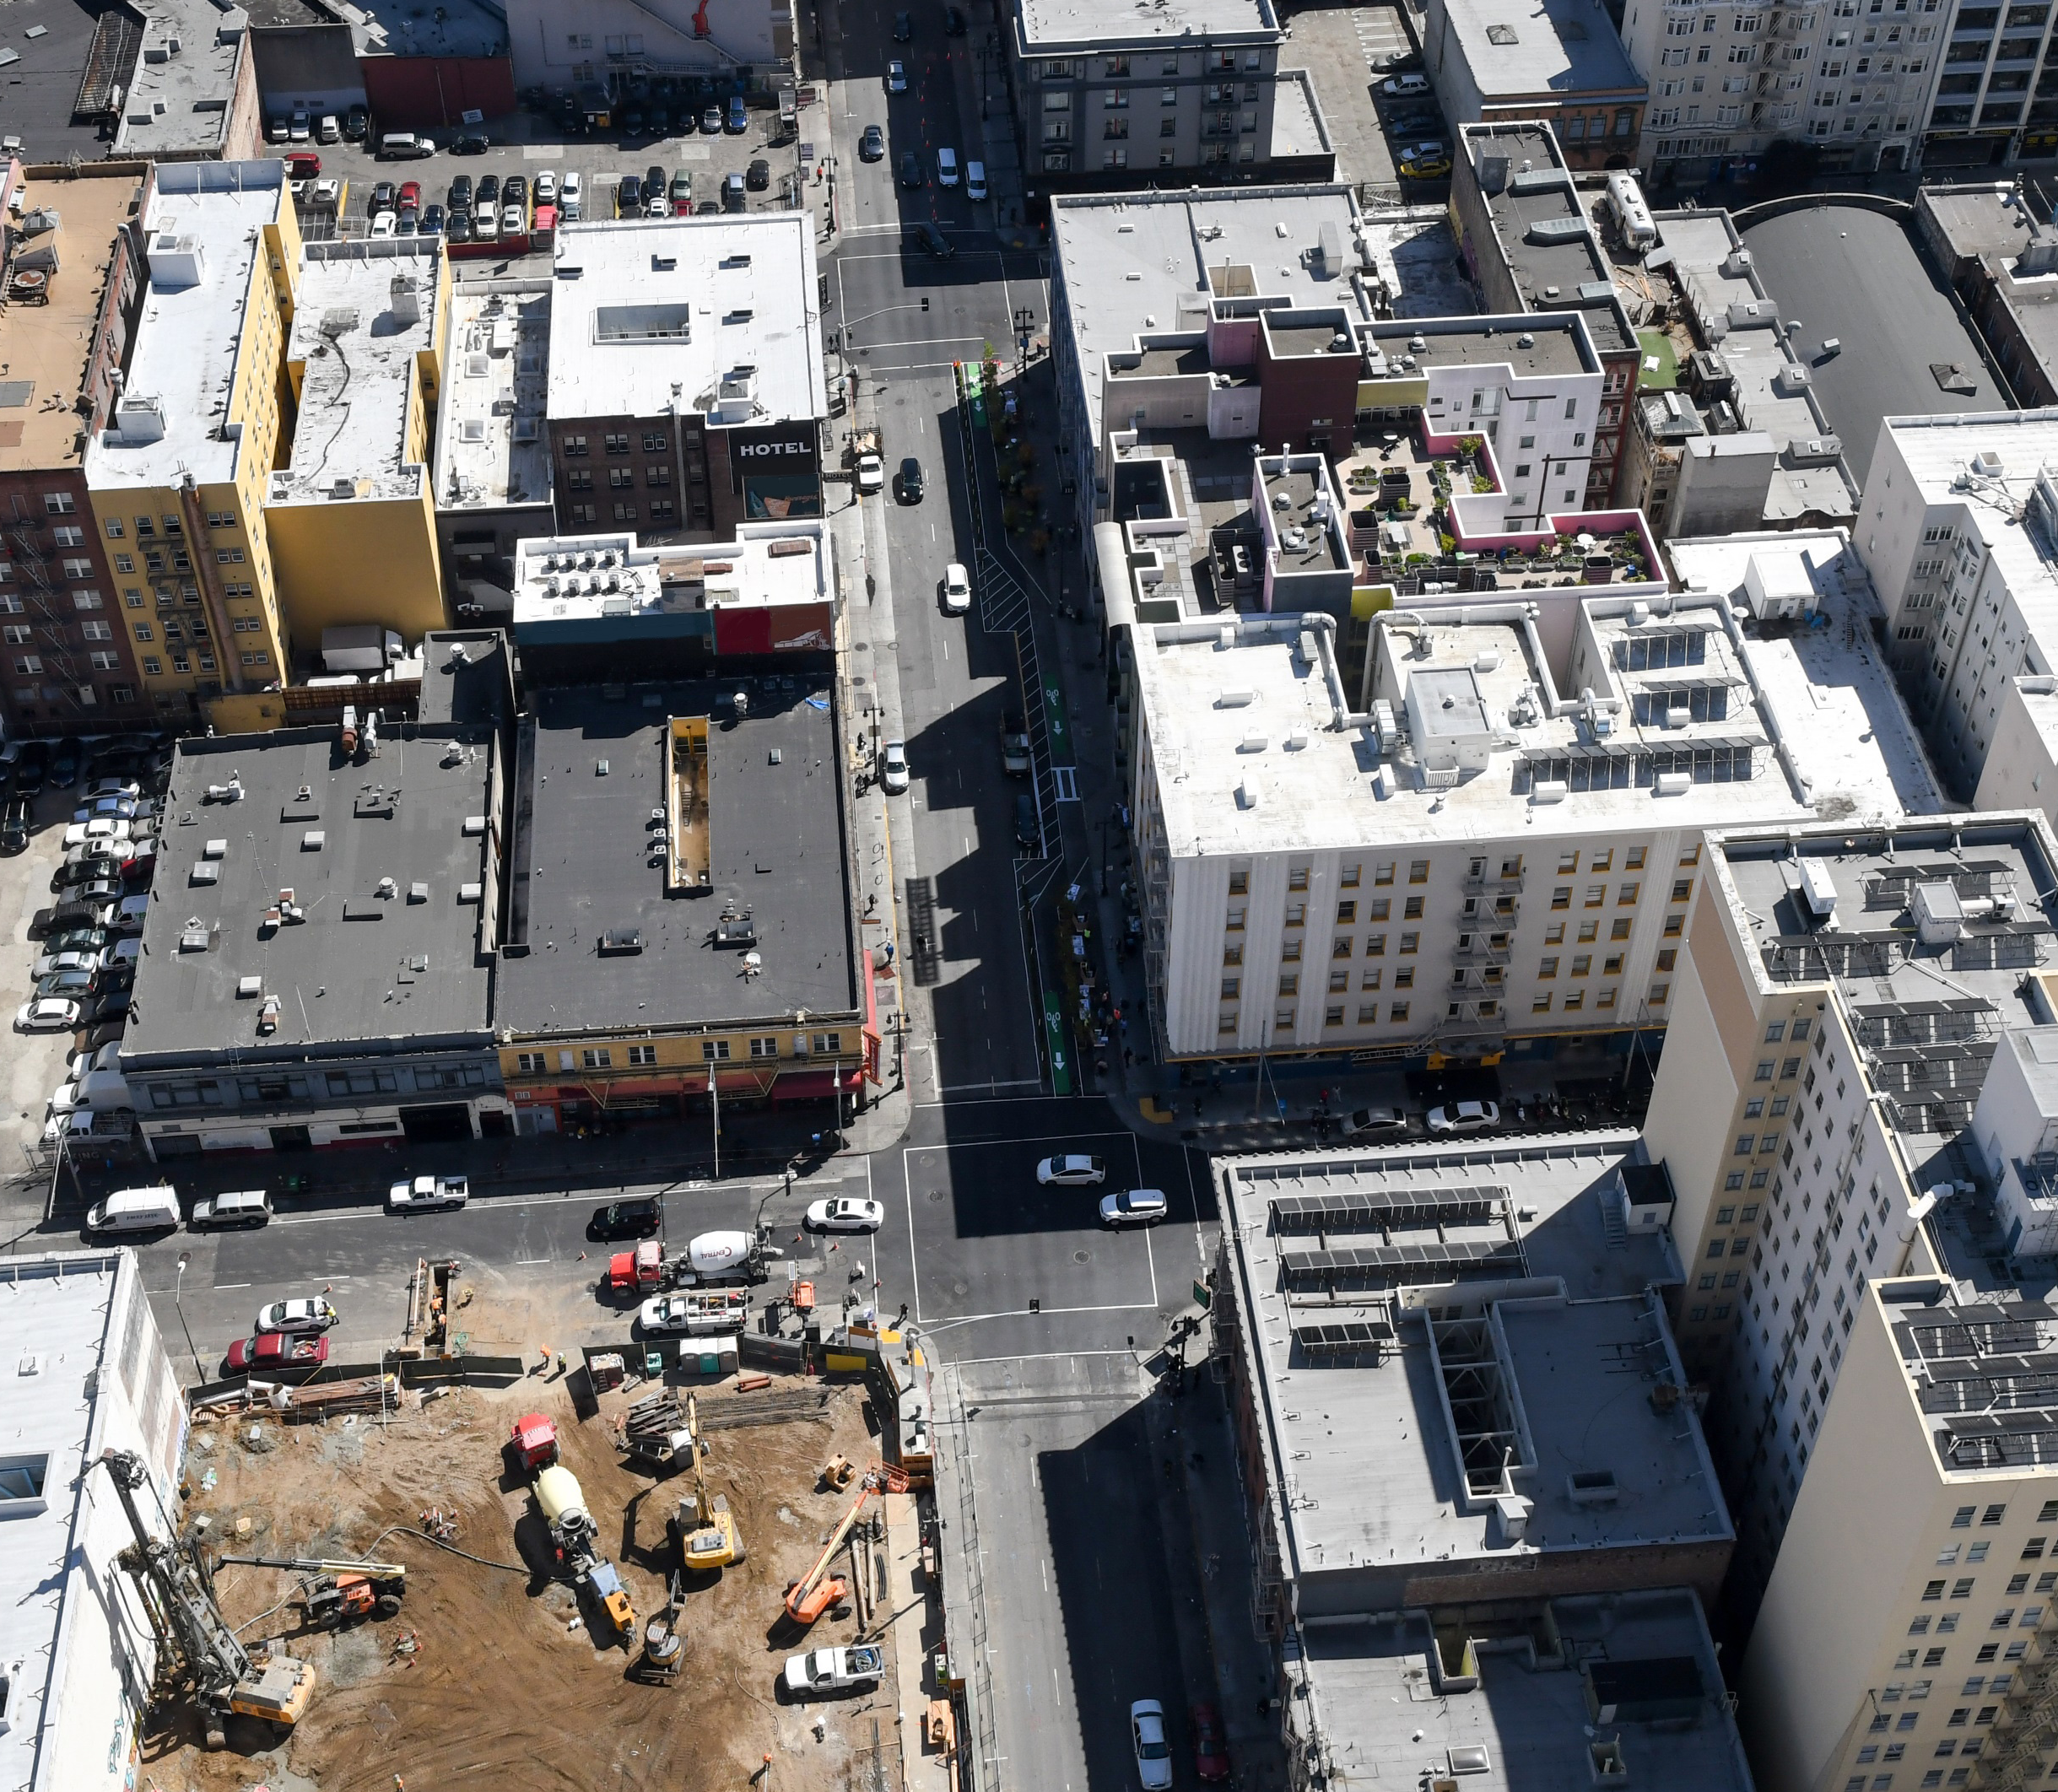
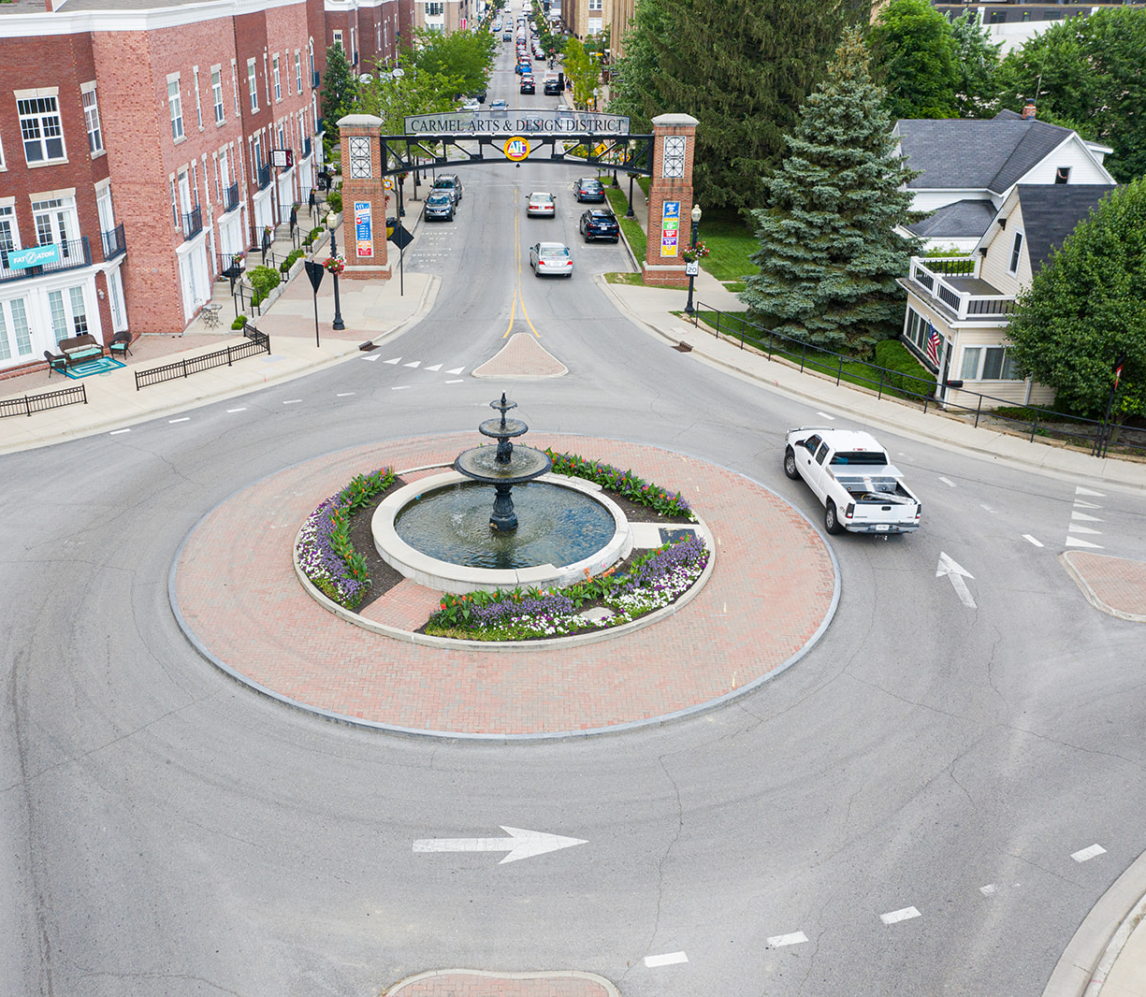
Safe SPEED: Treatments that Minimize Injuries
Speed through typical intersection
Speed through Safe System intersection
Source: Fehr & Peers
Source: City of Carmel, IN
Notes:
Key Message: This example shows that applying a Safe System treatment can reduce kinetic energy and the impact speed of a crash, which can help to minimize injuries.
Animation 1: The left side of the slide shows a typical intersection, where the design of the intersection does not necessarily limit the driver’s speed
Animation 2: The right side of the slide shows an intersection with a Safe System geometric design. The driver must slow their speed as they proceed around the roundabout
Speed limits help reduce speeds, too, but only when they are set with a context in mind. As an example, some Vision Zero cities set speed limits at 20 mph for urban areas with high pedestrian and bike activity.
Interactivity: This slide has 2 animations that require the speaker to click through each one at a time.
Background: Studies support the finding that even a small change in vehicle operating speed can have large safety impacts. According to NHTSA Countermeasures that Work, “a reduction of 3 mph in average operating speed on a road with a baseline average operating speed of 30 mph is expected to produce a reduction of 27% in injury crashes and 49% in fatal crashes.”
Notes: We will discuss the systemic deployment of roundabouts as a case study later in the presentation.

Slide 39
Safe ROADS
Safe roads are designed
and operated to:
Prevent crashes among all users
Keep impacts on the human body at tolerable levels
Notes:
Key Message: The next element is safe roads. Safe roads are designed and operated to prevent crashes and keep impacts on the human body at tolerable levels. As the following two slides show, we can keep impacts at tolerable levels by avoiding crashes altogether and by managing crash kinetic energy.
Interactivity: No interactivity for this slide.
Background: No background for this slide.
Notes: This slide introduces the objective of Safe Roads. The specifics are detailed on the following slides.

Slide 40



THOUGHTS ON THE SAFE ROADS ELEMENT
Think of “Safe Roads” as a continuum – not an absolute
The aim is to design and operate roads to continuously approach toward creating a Safe System by implementing features appropriate for the intended and actual road use and speed environment
  Reduce the likelihood of error
  Reduce the consequences of error
Risk of a Fatal or
Severe Crash
Consistency with a
Safe System
Source: FHWA
Notes:
Key Message: A given roadway or corridor is neither “safe” or “unsafe” and simply designing to standards does not ensure that a roadway will perform safely. Road design and operations should be thought of as a continuum, where safe system aligned design or countermeasures will improve safety performance (reduce crashes) incrementally.
Interactivity: No interactivity for this slide.
Background: A related concept is nominal vs. substantive safety. Nominal safety is the process of following design standards and meeting required design values for various roadway elements. Substantive safety is the evaluation of actual safety performance based on roadway characteristics, suggesting that changes in design have marginal impact in the actual safety performance rather than making a roadway simply “safe” or “unsafe”.
Graph: from DVC

Slide 41
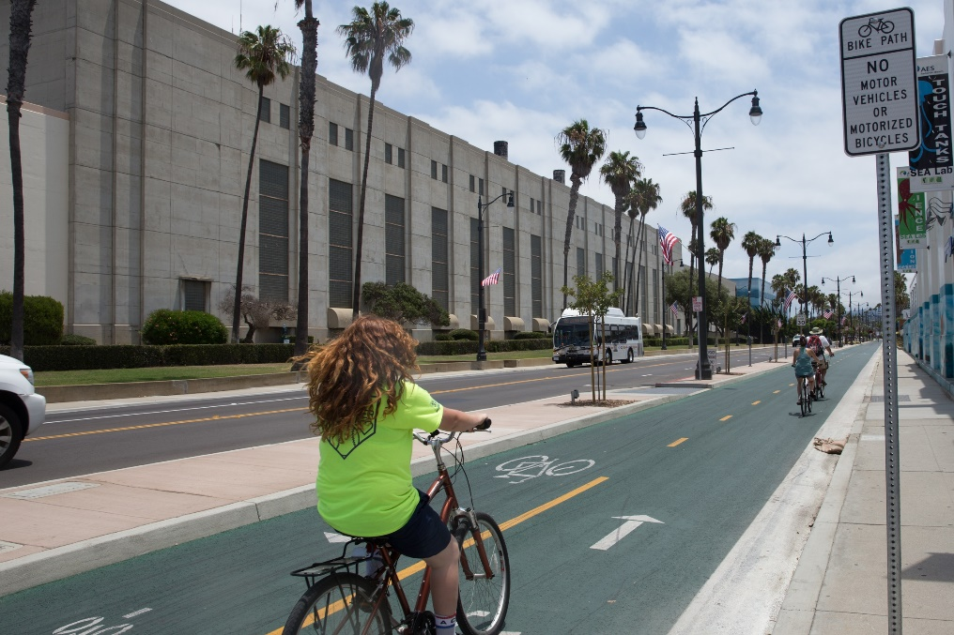
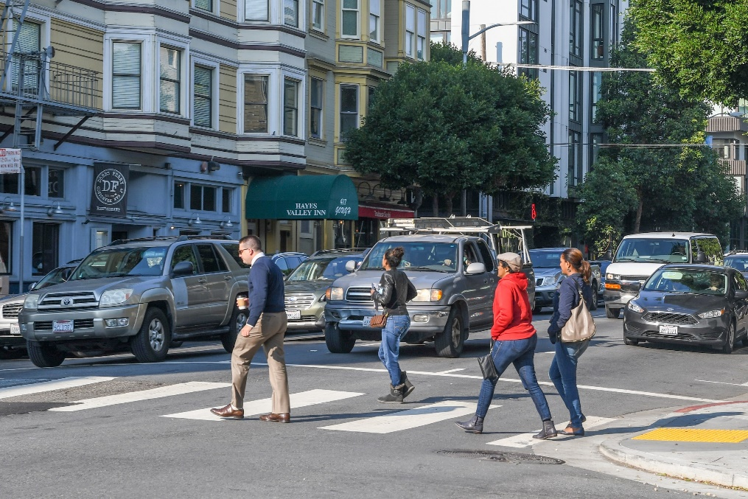
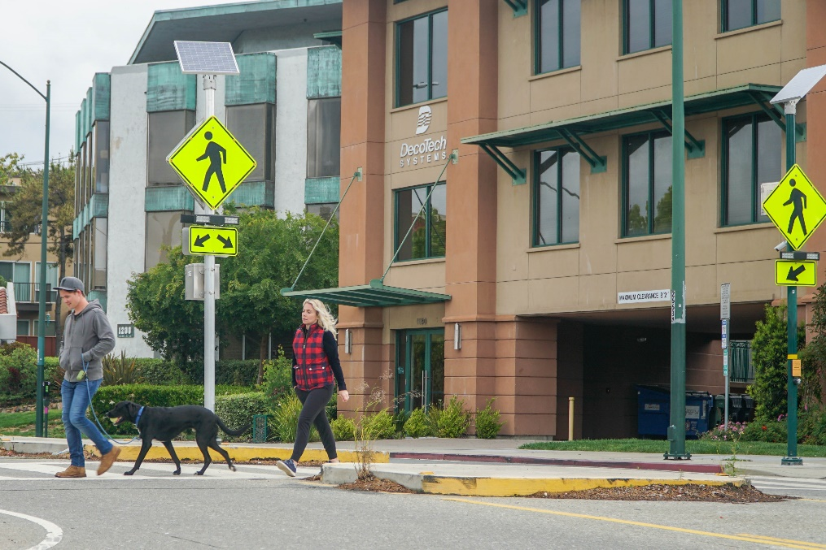
Safe ROADS: AVOIDING CRASHES
Avoiding crashes involves:
Separating users in space
Separating users in time
Increasing attentiveness and awareness
Source for all images: Fehr & Peers
Notes:
Key Message: Avoiding crashes involves:
Separating users in space – This approach segregates the physical space to provide travelers with a dedicated part of the right-of-way. Typically, travelers moving at different speeds – pedestrians, bicyclists, etc. (e.g. sidewalks, cycle tracks, pedestrian overpasses) – or different directions (e.g. turning vehicles in separate turn lanes) are separated in space to minimize conflicts with other users.
Separating users in time – This approach assumes that users will need to occupy the same physical space on the roadway, but creates a safer environment by separating the users in time and reducing vehicle interactions with vulnerable road users. An example is a pedestrian scramble phase at an intersection whereby pedestrians have exclusive access to the intersection while all vehicle movements are stopped.
Increasing attentiveness and awareness – This approach seeks to alert users to potential hazards and/or the presence of other users. These techniques can be vehicle, user or infrastructure-based, such as:
“Daylighting” intersections by removing parking at the corners to allow greater visibility between drivers and pedestrians.
Street lighting that increases nighttime visibility of users.
Rumble strips that alert inattentive or drowsy drivers that they are leaving their lanes.
Rectangular rapid flashing beacons that warn drivers of the presence of crossing pedestrians.
Interactivity: No interactivity for this slide.
Background: The images show examples of the text below them. At left, a street with clear physical separation for different users; in the center, users who are clearly separated by time while they cross the street; and at right, a rectangular rapid flashing beacon, which draws attention to the crossing pedestrians.
Notes: Sometimes a combination of multiple techniques is used, such as a protected left turn bay where the turning vehicles are physically separated while awaiting the opportunity to turn and separated in time with a protected left turn signal phase.

Slide 42
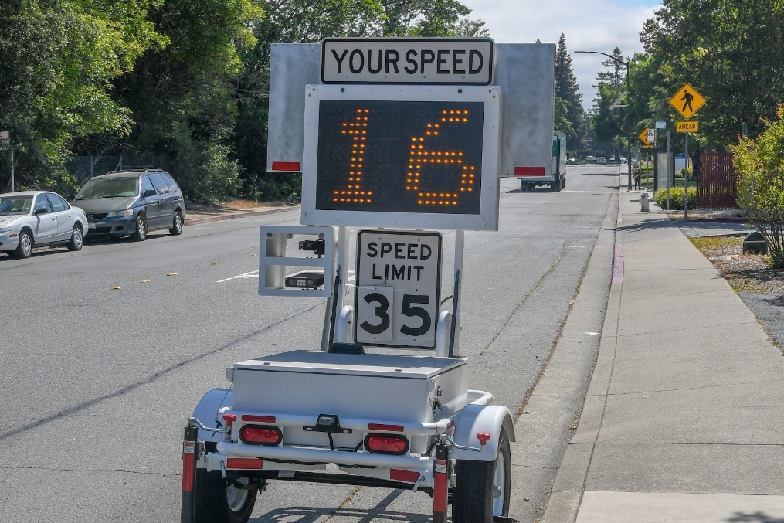
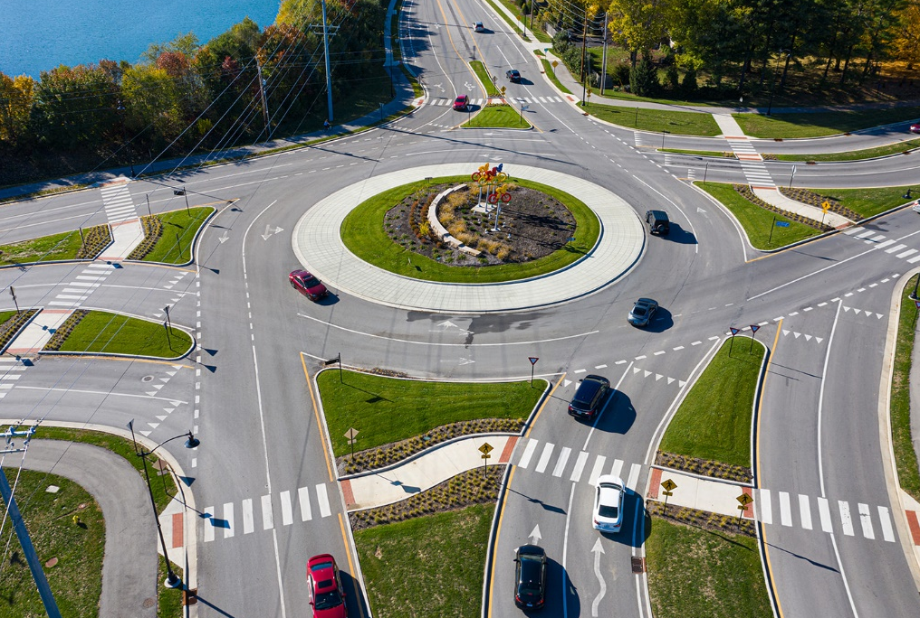

Safe ROADS: Crash Kinetic Energy
Managing crash kinetic energy involves:
Managing speed
Managing crash angles
Managing crash energy distribution
Source: Fehr & Peers
Source: City of Carmel, IN
Source: FHWA
Notes:
Key Message: Managing crash kinetic energy to within human tolerance levels can be achieved by:
Managing speeds – context sensitive speed limits; for example: setting lower speed limit in areas with more pedestrian traffic
Managing crash angles – road design that eliminates right angle crashes; for example: roundabouts
Managing crash energy distribution – roadside barriers are design to provide an impact that is less severe than the object being shielded by the barrier. They also reduce the force experienced by vehicle occupants by spreading the amount of time that the impacts occur in, controlling energy dissipation and it’s impact on the human body.
All of them play a critical role in producing impact forces to human bodies
Interactivity: The speaker may want to ask the audience to identify additional examples that demonstrate individual or combined strategies.
Background: The images show examples of the text below them. At left, a speed feedback trailer for speed management; in the center, collision absorbance devices; and at right, a roundabout, which reduces speeds and collision angles to limit impact forces.
Notes: No notes for this slide.

Slide 43



Safe ROADS: ALL ASPECTS OF THE ROADWAY SYSTEM
Safe roads include all aspects of the roadway system:
Design
Construction
Maintenance
Operation
Source: FHWA
Notes:
Key Message: Safe roads include all aspects of the road system. Each has a role in accommodating human mistakes and injury tolerances to reduce the severity of crashes that do occur. *add equity and ongoing systemic improvements talking point*
Interactivity: No interactivity for this slide.
Background: No background for this slide.
Notes: No notes for this slide.

Slide 44
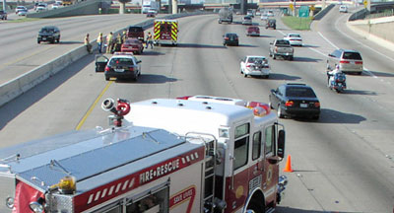
Post-Crash Care: Traffic Incident Management
First responders
Crash investigation
Medical care
Source: Ron Moore
Notes:
Key Message: The final element is post-crash care. This is one of the last lines of defense when other elements fail.
Traffic Incident Management (TIM) is the umbrella term for the actions of those that respond to a crash including law enforcement, emergency medical care, towing and recovery, and more. Restoring traffic as safely and quickly as possible helps avoid secondary crashes. Many states and major metropolitan areas have TIM working groups, and engineers and planners should work with these groups to enable safe and efficient incident clearance on roadways that are being planned and designed.
First Responders: First responders must be able to quickly access a collision or incident site, establish communications among the responding parties, set up traffic control to keep themselves and the public safe, and complete the various tasks required to reopen the roadway to its normal configuration.
Crash investigation: Quick-response and investigation by police and road managers can help ensure crash factors are documented and reported correctly.
Crash reporting practices, such as complete data collection and documentation of road user behavior and infrastructure, and sharing data across agencies or organizations (e.g., among police departments, transportation officials, and hospitals) can help lead to a greater understanding of the holistic safety landscape, and thus lead to improved investments in safety.
Emergency medical care: emergency first responders to quickly locate them, treat and stabilize their injury, and transport them to medical facilities.
Interactivity: No interactivity for this slide.
Background: No background for this slide.
Notes: The Toward Zero Deaths: A National Strategy on Highway Safety provides information on EMS and trauma care (from page 44) at https://www.towardzerodeaths.org/wp-content/uploads/2019/12/TZD_National_Strategy.pdf. Additional information on EMS can be found at https://www.ems.gov/whatisems.html. The National Association of State Emergency Medical Services Officials (NASEMSO) developed numerous materials such as the National Model EMS Clinical Guidelines to facilitate the creation of state and local EMS system clinical guidelines, protocols, or operating procedures. It can be accessed athttps://nasemso.org/projects/model-ems-clinical-guidelines/. Information on FHWA Traffic Incident Management program can be accessed at https://ops.fhwa.dot.gov/tim/.

Slide 45



Post-Crash Care: Other Aspects
Post-crash care extends to actions after TIM returns a crash scene to normal conditions:
Media
Engineering
Justice
45
Source: Gorodenkoff via USDOT/Adobe Stock
Notes:
Key Message: After the immediate crash response there are further parts of the safe system that help achieve safety goals.
Media: Media coverage of crashes and safety can vary, and agency staff can help spread the safe system approach that calls for improvements to all parts of the system.
Engineering: Feedback from crash investigations and first responders helps road managers address road safety in planning, design, and maintaining the roadways and traffic control system. This doesn’t not only help keep road users safe but also helps with movement and operations of emergency equipment.
Justice: The justice system can take appropriate action, and the risk of future crashes can be mitigated through an appropriate design and program or policy changes. These help inform our safety programs.
Interactivity: No interactivity for this slide.
Background: No background for this slide.
Notes: The Toward Zero Deaths: A National Strategy on Highway Safety provides information on EMS and trauma care (from page 44) at https://www.towardzerodeaths.org/wp-content/uploads/2019/12/TZD_National_Strategy.pdf. Additional information on EMS can be found at https://www.ems.gov/whatisems.html. The National Association of State Emergency Medical Services Officials (NASEMSO) developed numerous materials such as the National Model EMS Clinical Guidelines to facilitate the creation of state and local EMS system clinical guidelines, protocols, or operating procedures. It can be accessed athttps://nasemso.org/projects/model-ems-clinical-guidelines/. Information on FHWA Traffic Incident Management program can be accessed at https://ops.fhwa.dot.gov/tim/.

Slide 46
the 5 Safe System Elements Create Redundancy
The “Swiss Cheese Model” of redundancy creates layers of protection
Death and serious injuries only happen when all layers fail
Safe road users
Safe road users
Safe vehicles
Safe vehicles
Safe speeds
Safe speeds
Safe roads
Safe roads
Post-crash care
Post-crash care
Source: FHWA
Notes:
Key Message:
The left graphic shows how five Safe System elements work together, such that if one part fails, there are redundant systems in place. The “Swiss Cheese Model” helps demonstrate this redundancy. Layered safety measures are represented as slices of swiss cheese with the holes being weaknesses in individual parts of the system. The holes represent weakness causing failures or latent condition. When the cheese slices act as successive layers of defenses and the holes are not lined up, a person is protected.
The right graphic shows that a failure only results when a hole in each slice momentarily aligns, permitting a hazard to pass through holes in all the slices. The basic principle is that lapses and weaknesses in one part of the system can occur, but other parts compensate to not allow a failure. This relates back to the Safe System principles that redundancy is critical and responsibility is shared.
We’ve now discussed all six Safe System principles and all five Safe System elements. The next section of the presentation focuses on Safe System case studies.
Interactivity: Optional break for questions.
Background:
The “Swiss Cheese Model” is applicable to numerous risk management fields and was originally espoused by Dante Orlandella and James T. Reason of the University of Manchester. The graphic was adapted for FHWA from their work to explain the redundancy of the five Safe System elements.
We showed the previous slide where all the holes are lined up, meaning redundancy isn’t there. This slide shows cheese slices with the holes not lined up and how redundancy works.
Notes: A good example of how the five Safe System elements work together to create redundancy is distracted driving. Education campaigns focused on alert driving—avoiding behaviors like texting while driving—help create safe road users. Vehicle safety systems, like lane departure warnings, create safe vehicles that alert distracted drivers to potential hazards. Enforcement can help maintain safe speeds, so that if an incident should occur due to distracted driving, impact forces on the human body remain within tolerable levels. Infrastructure like rumble strips creates safe roads and an additional layer of redundancy to warn distracted drivers about a potential roadway departure. Sometimes, all these measures are not enough to prevent a distracted driving crash from occurring, but efficient, rapid post-crash care can help this mistake not be fatal.

Slide 47
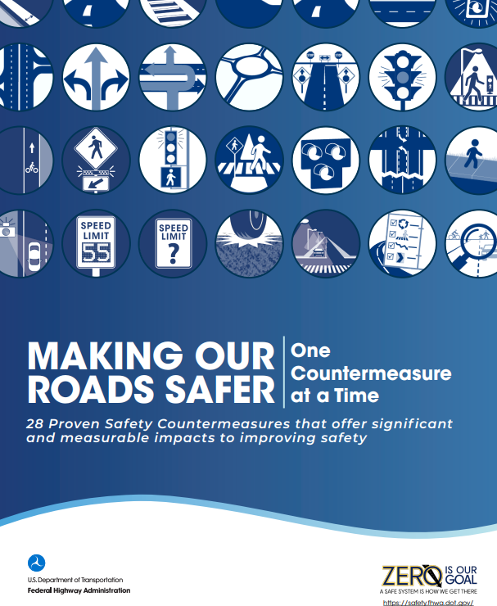
“Double-Down” on what works
Transportation agencies are strongly encouraged to consider widespread implementation of PSCs to accelerate the achievement of local, State, and National safety goals.
https://highways.dot.gov/safety/proven-safety-countermeasures
Notes:
Key Message: The safe system approach doesn’t throw away everything that we do already but enhances our focus in designing and operating for safety. In many cases, we know which countermeasures are effective at reducing crashes and/or reducing crash severities. While there are many places to start, the FHWA Proven Safety Countermeasures is one source for safety countermeasures that any agency can implement quickly and expect a positive impact on safety.
Interactivity: No interactivity for this slide.
Background: FHWA’s Proven Safety Countermeasures initiative (PSCi) is a collection of 28 countermeasures and strategies effective in reducing roadway fatalities and serious injuries on our Nation’s highways. Transportation agencies are strongly encouraged to consider widespread implementation of PSCs to accelerate the achievement of local, State, and National safety goals. These strategies are designed for all road users and all kinds of roads—from rural to urban, from high-volume freeways to less traveled two-lane State and county roads, from signalized crossings to horizontal curves, and everything in between. Each countermeasure addresses at least one safety focus area – speed management, intersections, roadway departures, or pedestrians/bicyclists – while others are crosscutting strategies that address multiple safety focus areas.
The PSC website includes a guided search function for browsing countermeasures for various scenarios, along with additional information on each countermeasure.

Slide 48
Case Studies
Examples of the Safe System approach in the United States
1
2
3
4
5
Introduction
Safe System Principles
Safe System Elements
Case Studies
Conclusion & Resources
Notes:
Key Message: We will now look at two case studies that show how components of the Safe System approach have been implemented in cities large and small across the United States.
Interactivity: No interactivity for this slide.
Background: No background for this slide.
Notes: The two case studies are a citywide roundabout implementation in Carmel, IN and a systemic, multimodal safety project along Queens Blvd in New York, NY.

Slide 49
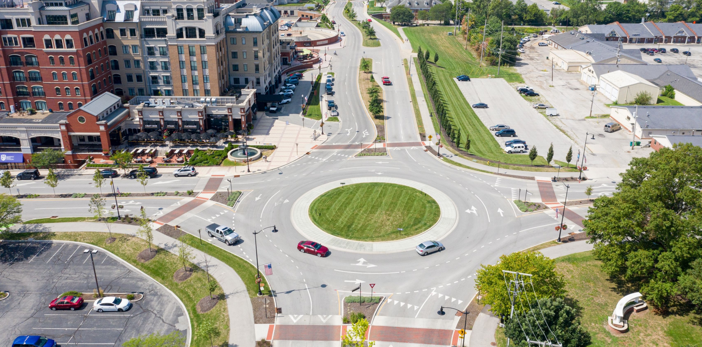
Roundabouts: Carmel, IN
Safe System Elements Covered
Source: City of Carmel, IN
Notes:
Key Message: Since 1997, Carmel, IN, has taken a Safe System approach to intersection design by installing roundabouts at intersections wherever possible. The city of Carmel took a systemic approach by converting over 125 intersections to roundabouts to improve safety citywide, regardless of crash history. Roundabouts move people through intersections more efficiently and safer than stop signs or signalized intersections. With roundabouts now at so many of the city’s intersections, Carmel has seen serious injury crashes reduced by about 80 percent, and the number of crashes overall has reduced by about 40 percent. The Mayor of Carmel instituted the comprehensive roundabout program to prioritize safety after learning from Europe that roundabouts eliminate right angle and head on crashes and reduce pedestrian conflict crashes. In addition, roundabouts slow the speed of vehicles maneuvering through an intersection, thus reducing the kinetic forces and crash severity if a crash occurs. In making these changes, designers addressed the Safe System elements of Safe Users, Safe Speeds, and Safe Roads.
Interactivity: Ask audience if their jurisdictions installed roundabouts and what the outcomes are.
Background: The image is an aerial view of one of Carmel’s roundabouts.
Notes: The City of Carmel maintains a website about its roundabouts, where additional information is available: https://www.carmel.in.gov/department-services/engineering/roundabouts
Note to presenter: Modify the use of either or both case studies as needed for time management.

Slide 50
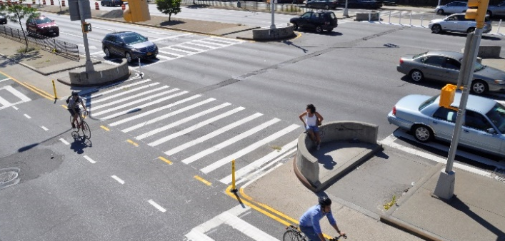
Queens Blvd: New York, NY
Safe System Elements Covered
Source: NYCDOT
Notes:
Key Message: New York City completed a systemic, data-driven crash analysis to understand where high concentrations of crashes are occurring. They used this information to develop a high-injury network (HIN), a concentration of streets where crashes are disproportionately happening. With the HIN in place, the City then set out to develop infrastructure countermeasures, such as those on Queens Boulevard, a major arterial in eastern Queens.
Interactivity: No interactivity for this slide.
Background: The image shows Queens Blvd after project implementation, with clearly delineated spaces for multiple users.
Notes: More information about the Queens Blvd project is available on the New York City Department of Transportation’s project website: https://nycdotprojects.info/queens-blvd

Slide 51
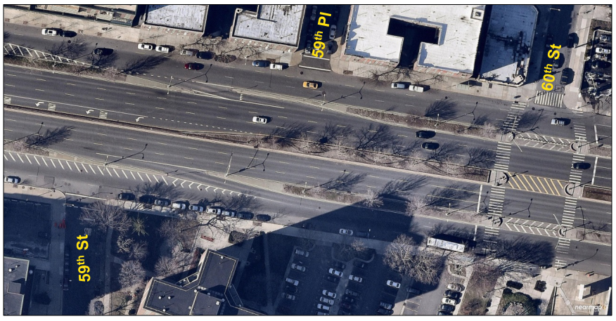
Queens Blvd: Before
High speed slip lanes
No bike facilities
Multiple lane frontage road
Source: NYCDOT
Notes:
Key Message: Queens blvd before improvements was a roadway with no facilities for people biking, enabled high speeds such as through the slip lane between the through lanes and the frontage road, and had many lanes for motor vehicles.
Interactivity: In smaller audiences, the presenter may wish to have them identify issues that are inconsistent with SSA and may contribute to the higher crashes experienced in the before condition.
Background: The image shows Queens Blvd before project implementation, with high speed slip lanes, no bike facilities, and many conflict areas.
Notes: More information about the Queens Blvd project is available on the New York City Department of Transportation’s project website: https://nycdotprojects.info/queens-blvd
Animation: Features of interest will appear on a mouse click

Slide 52
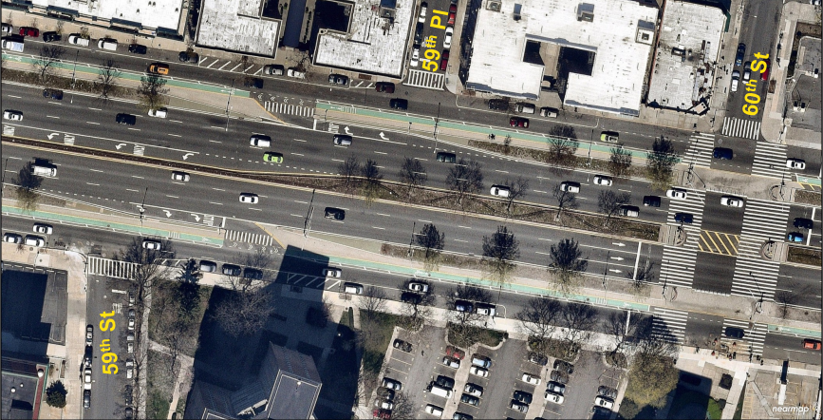
Queens Blvd: After
Dedicated bike lane
Removed frontage road lanes
More space for walking
Physical barriers
Stop controlled slip lane
Slower speed slip lane geometry
Source: NYCDOT
Notes:
Key Message: Countermeasures installed included pedestrian improvements, bike lanes, and physical barriers to separate users in space. These additions increased the safety of crossing pedestrians, reduced speeds, and separated users in time. The slip lane was redesigned for stop control, and the number of lanes on the frontage road were reduced, both of which contributed to reduced vehicle speeds. Use of bicycling increased greatly with the addition of the dedicated bike lanes.
Interactivity: : In smaller audiences, the presenter may wish to have them identify issues that are consistent with SSA and may contribute to the crash reductions experienced in the after condition.
Background: The image shows Queens Blvd after project implementation, with clearly delineated spaces for multiple users.
Notes: More information about the Queens Blvd project is available on the New York City Department of Transportation’s project website: https://nycdotprojects.info/queens-blvd
Animation: Features that enhance safety and can be seen in the after image will appear on mouse click.

Slide 53
Queens Blvd: results
Crashes and Injuries
One-Year After Analysis, Queens Blvd (Roosevelt Ave. to Eliot Ave.
Crashes and Injuries | Before Average (2012-2015) | After Average (2017-2018) | Change
 | Before Average (2012-2015) | After Average (2017-2018) | Average | Percent
Total Crashes | 798.7 | 648.0 | -150.7 | -19%
Crashes w/ Injuries | 148.3 | 123.0 | -25.3 | -17%
Motor Vehicle Occupant | 149.3 | 118.0 | -31.3 | -21%
Pedestrian | 40.3 | 18.0 | -22.3 | -55%
Cyclist | 14.0 | 18.0 | 4.0 | 29%
Total Injuries | 203.7 | 154.0 | -49.7 | -24%
Each before year period is the 24-month period beginning July 1 and ending June 30.
The 1-yr after period is January 1, 2017 to December 31, 2017.
The implementation period of July 1, 2015 to December 31, 2016 is excluded.
Source: NYCDOT NYPD AIS/TAMS Crash Database
Notes:
Key Message: As shown in the table, total injuries in the after period reduced by 24%, and pedestrian crashes and injuries were reduced by 55%. Crashes involving bicyclists did increase but the amount of bicycling greatly increased with the addition of the dedicated bike lane to the corridor.
Interactivity: No interactivity for this slide.
Background: The graphic shows Queens Blvd before and after project implementation crash data from NYC DOT.
Notes: More information about the Queens Blvd project is available on the New York City Department of Transportation’s project website: https://nycdotprojects.info/queens-blvd
https://nycdotprojects.info/sites/default/files/Queens%20Blvd%20CB%202%20TC%203-5-18.pdf

Slide 54
Conclusion & Resources
Tools to bring the Safe System approach to your community
1
2
3
4
5
Introduction
Safe System Principles
Safe System Elements
Case Studies
Conclusion & Resources
Notes:
Key Message: This final section summarizes the key distinctions of the Safe System approach and provides tools to bring the approach to your community.
Interactivity: No interactivity for this slide.
Background: No background for this slide.
Notes: No notes for this slide.

Slide 55
Where are You on the Safe System Journey?
Traditional approach
Safe System approach
Prevent crashes
Prevent death and serious injuries
Improve human behavior
Design for human mistakes/limitations
Control speeding
Reduce system kinetic energy
Individuals are responsible
Share responsibility
React based on crash history
Proactively identify and address risks
Notes:
Key Message: As we’ll see in the text that appears on the slide, implementing the Safe System approach requires moving away from several traditional safety paradigms.
Animation 1: Rather than preventing crashes, the Safe System approach seeks to prevent death and serious injuries
Animation 2: In addition to trying to improve human behavior, the Safe System approach designs for human mistakes and limitations
Animation 3: While the traditional safety approach focuses on controlling speeding, the Safe System approach attempts to reduce system kinetic energy
Animation 4: Rather than asserting that only individuals are responsible, the Safe System approach aims to share responsibility among system users, managers, and others
Animation 5: Instead of reacting based on crash history, the Safe System approach proactively identifies and addresses risks
Implementing the Safe System approach is our shared responsibility, and we all have a role. The next slide introduces FHWA resources to help agencies implement the Safe System approach.
Interactivity: This slide has 5 animations that require the speaker to click through each one at a time.
Background: No background for this slide.
Notes: The Safe System approach encompasses the elements of the 4Es (Enforcement, Education, Emergency Response, and Engineering). It refocuses efforts on reducing death and serious injury through accommodating human mistakes and reducing impact forces to tolerable levels.

Slide 56

FHWA Resources
Safe System Materials
Find more resources at: safety.fhwa.dot.gov/zerodeaths
Notes:
Key Message: FHWA is developing resources to help agencies implement the Safe System approach. FHWA currently offers Safe System outreach materials in addition to this presentation. The agency is working to integrate the Safe System approach and has released a number of reports related to linking the approach to programs such as HSIP/SHSP, intersection safety, speed management, and pedestrian and bicycle safety. They can be found on the FHWA Zero Deaths website, linked on the slide. The website provides resources on the Safe System approach as well as related approaches and strategies. Beyond FHWA, the three initiatives mentioned earlier in the presentation—Road to Zero Coalition, Toward Zero Deaths, and Vision Zero Network— and ITE offer additional resources for agencies looking to bring a Safe System approach to their community.
Interactivity: No interactivity for this slide.
Background: No background for this slide.
Notes: No notes for this slide.

Slide 57

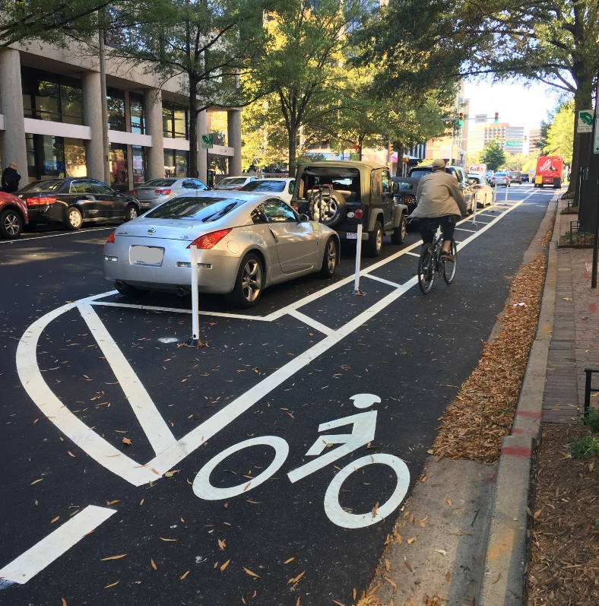
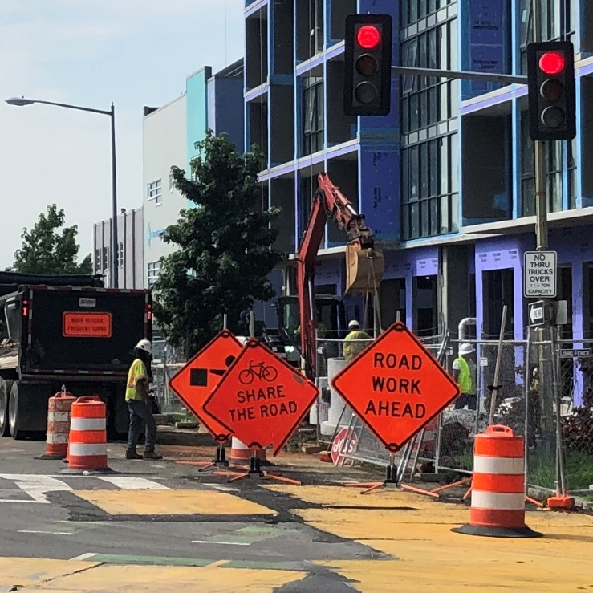
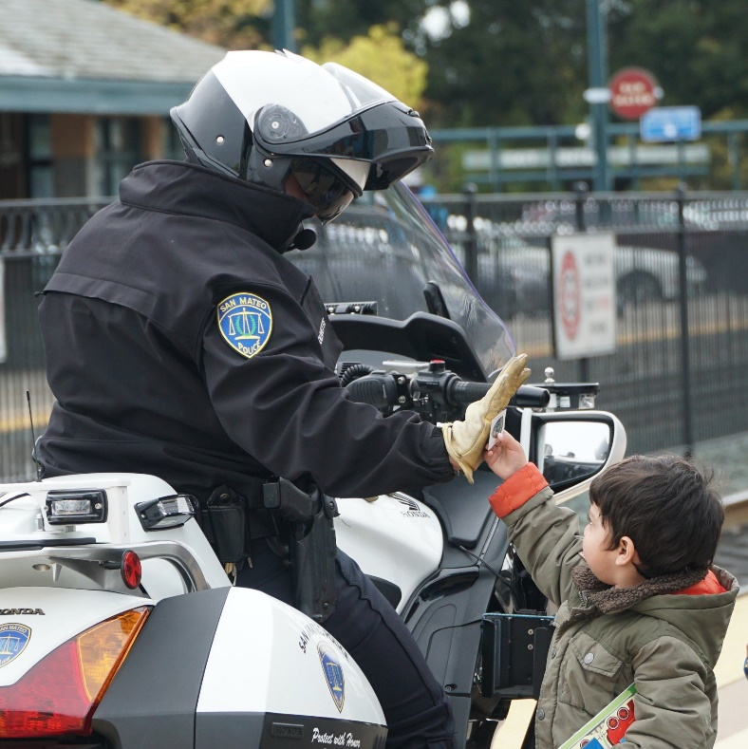
Implementing the Safe System approach is our shared responsibility, and we all have a role.
Source: Fehr & Peers
Source: Arlington County, VA
Source: Fehr & Peers
Source: Fehr & Peers
Notes:
Key Message: As we wrap up the presentation, it’s important to remember that road safety is truly a matter of life and death. To get the best result, zero deaths, we must integrate the safe system approach to our safety framework. We need to work together, and our system needs to work together, to get to zero. Achieving a future with zero traffic deaths requires a Safe System approach—shifting how we think about road safety and how we prioritize our investments. Consider applying a Safe System lens to upcoming projects and plans in your community: put safety at the forefront and design to accommodate human mistakes and injury tolerances. As transportation professionals, road safety is in our hands. We have the power to achieve a Nation where nobody has to die from vehicle crashes. At this point, we’ve reached the end of the presentation and can take any questions you have.
Interactivity: Consider what a Safe System approach means for your agency and areas of responsibility. What might a Safe System lens look like for an upcoming project or plan? How might a Safe System approach change your work? For example, more collaboration with operational safety agencies, EMS, public health, etc.
Background: No background for this slide.
Notes: No notes for this slide.

Slide 58
Zero is our goal.
A Safe System is how we get there.
Questions?

