Slide 1

Regional safety planning
NADO RPO Conference
July 16, 2025

Slide 2
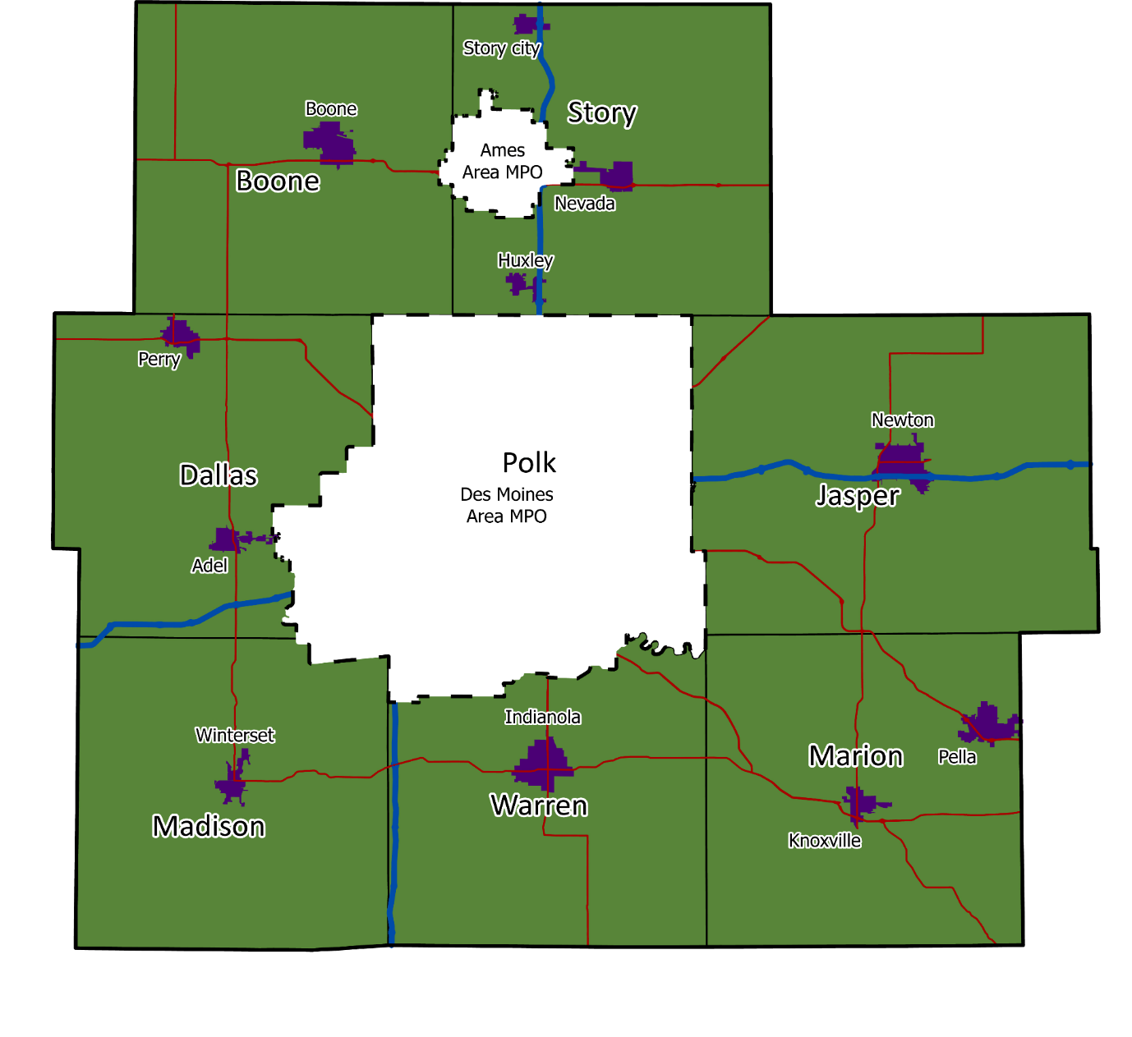










Central Iowa Regional Transportation Planning Alliance (RPA-11) - Overview
The Central Iowa Regional Transportation Planning Alliance is the Regional Planning Affiliation (RPA-11) for the 7 counties surrounding Polk County
RPAs must follow the same regulations and have the same functions as MPOs, but for less populated rural areas
CIRTPA coordinates with communities, other MPOs, the Iowa DOT, and other stakeholders on a variety of transportation activities and projects

Slide 3
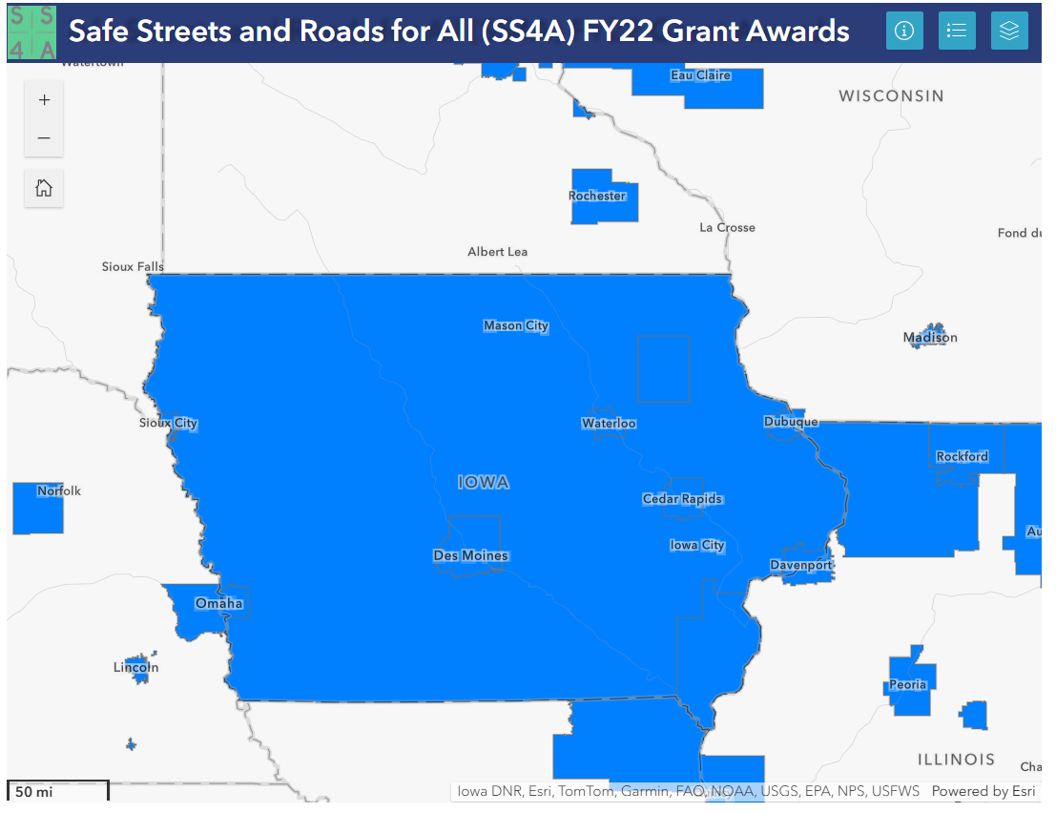
SS4A
The Safe Streets and Roads for All (SS4A) program first awarded projects in FY 2022
Iowa Received 9 awards
  8 Planning Grants
  1 Implementation
CIRTPA (through the Des Moines Area MPO) received a $200k planning grant to create a Comprehensive Safety Action Plan (CSAP) for the region

Slide 5
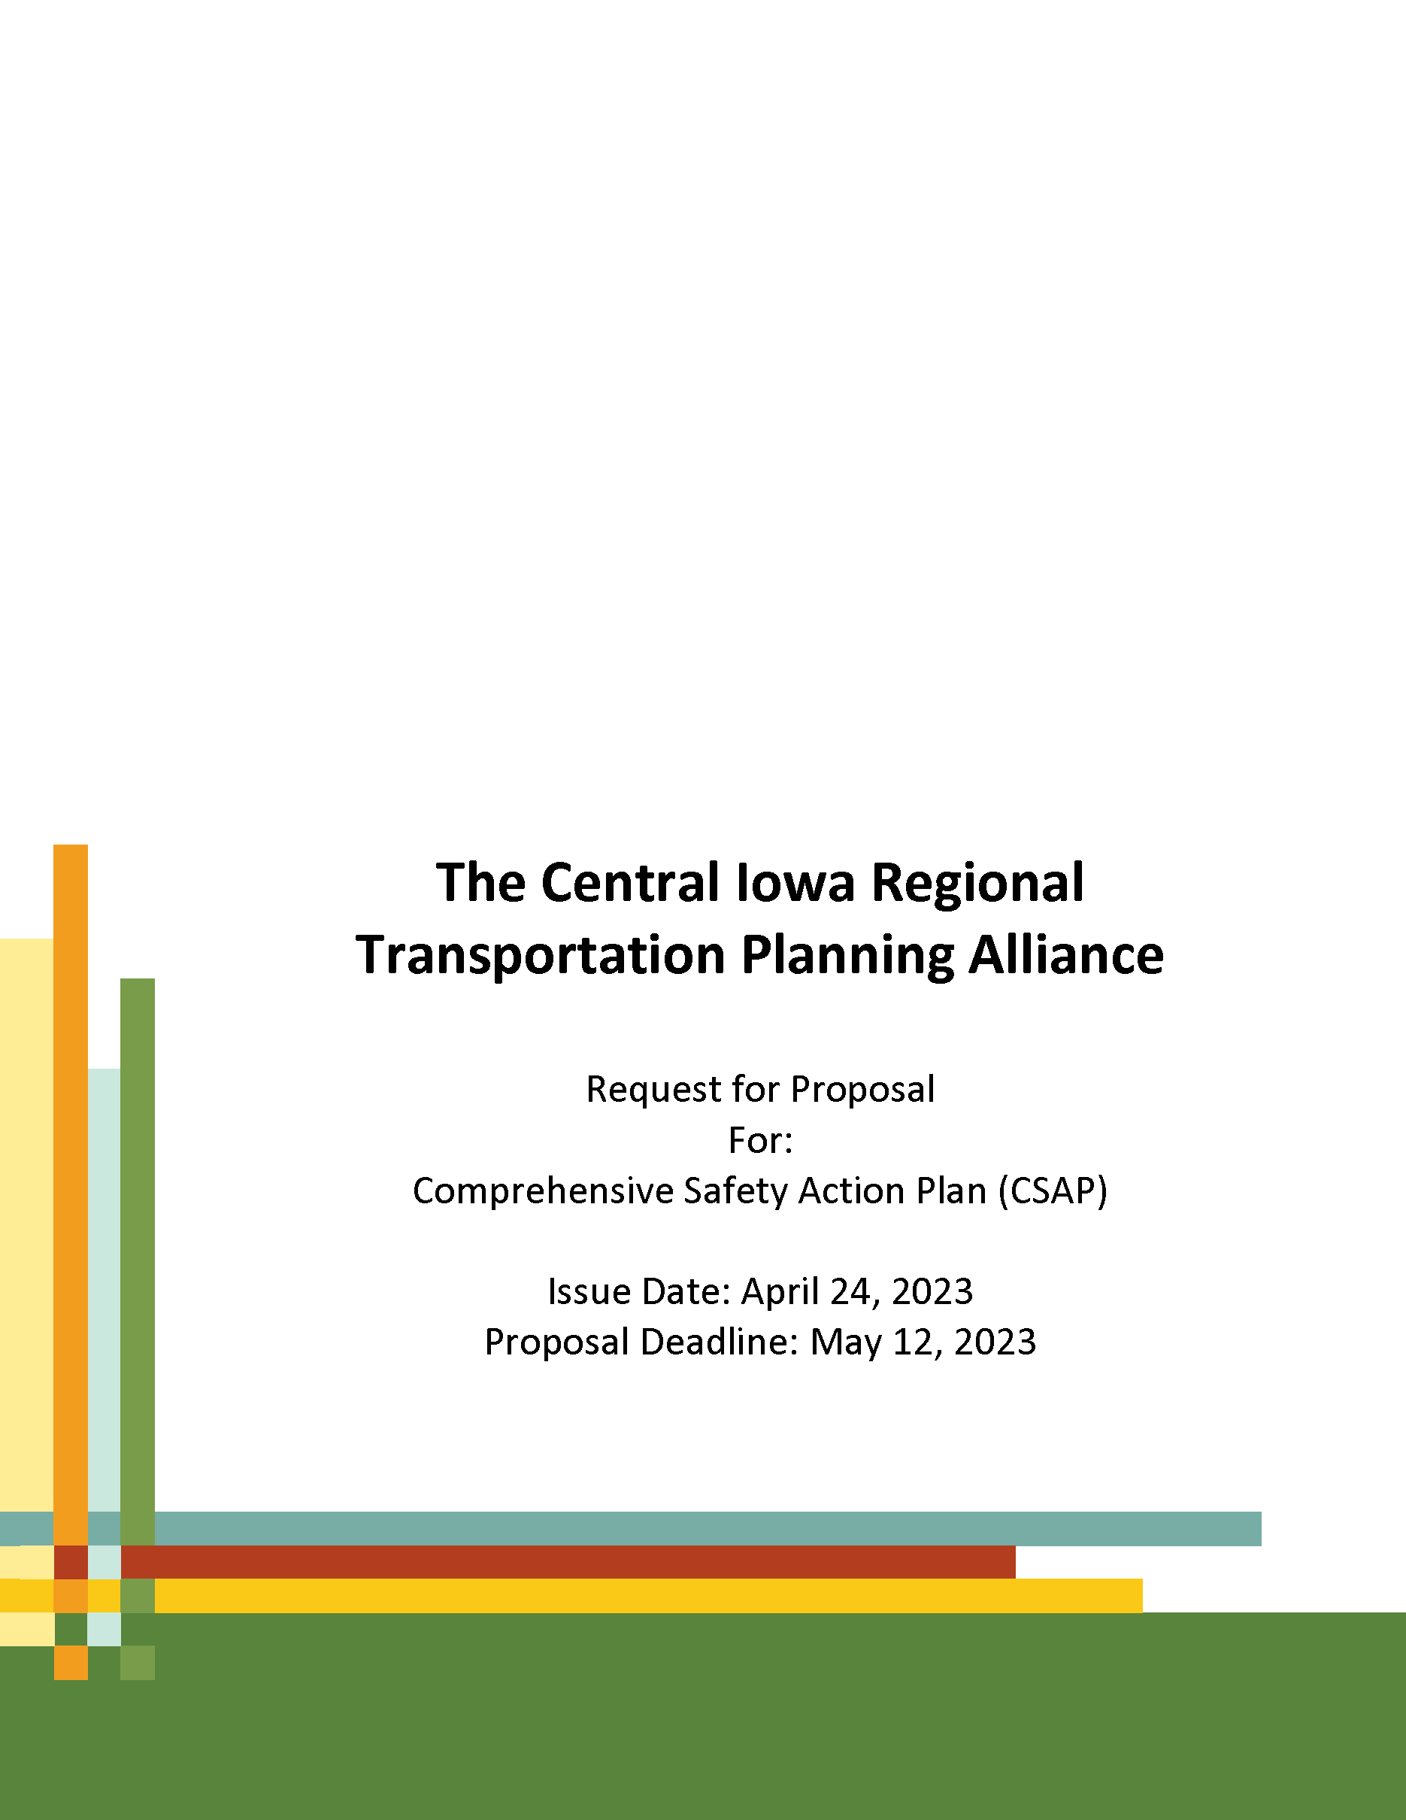
SS4A – Consultant Selection
CIRTPA utilized a consultant to complete the CSAP and ultimately apply for an Implementation Grant
Felsburg Holt & Ullevig (FHU) was ultimately selected

Slide 6
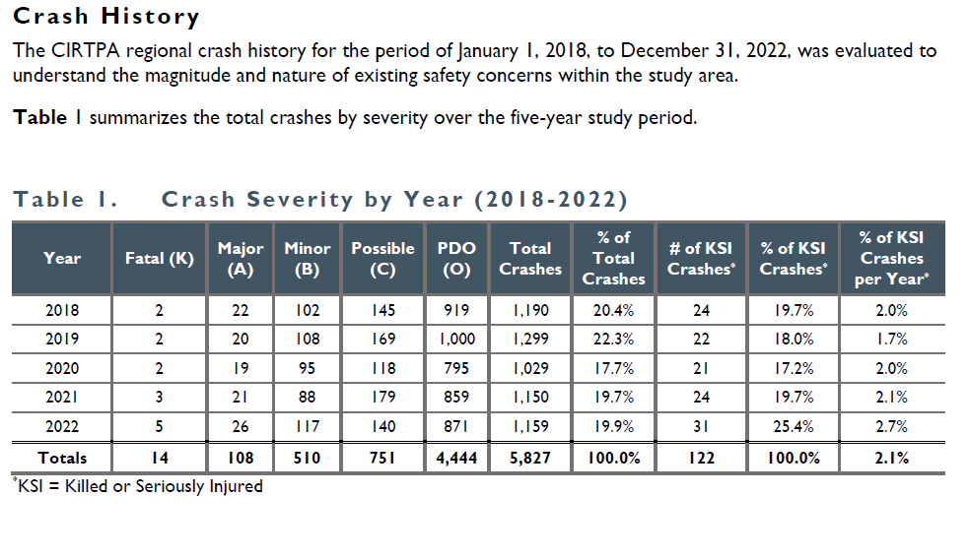
SS4A – CSAP Development
Safety/crash information primarily came from Iowa Crash Analysis Tool (ICAT) from the Iowa DOT
Data analyzed over a 5 year period – 2018-2022

Slide 7
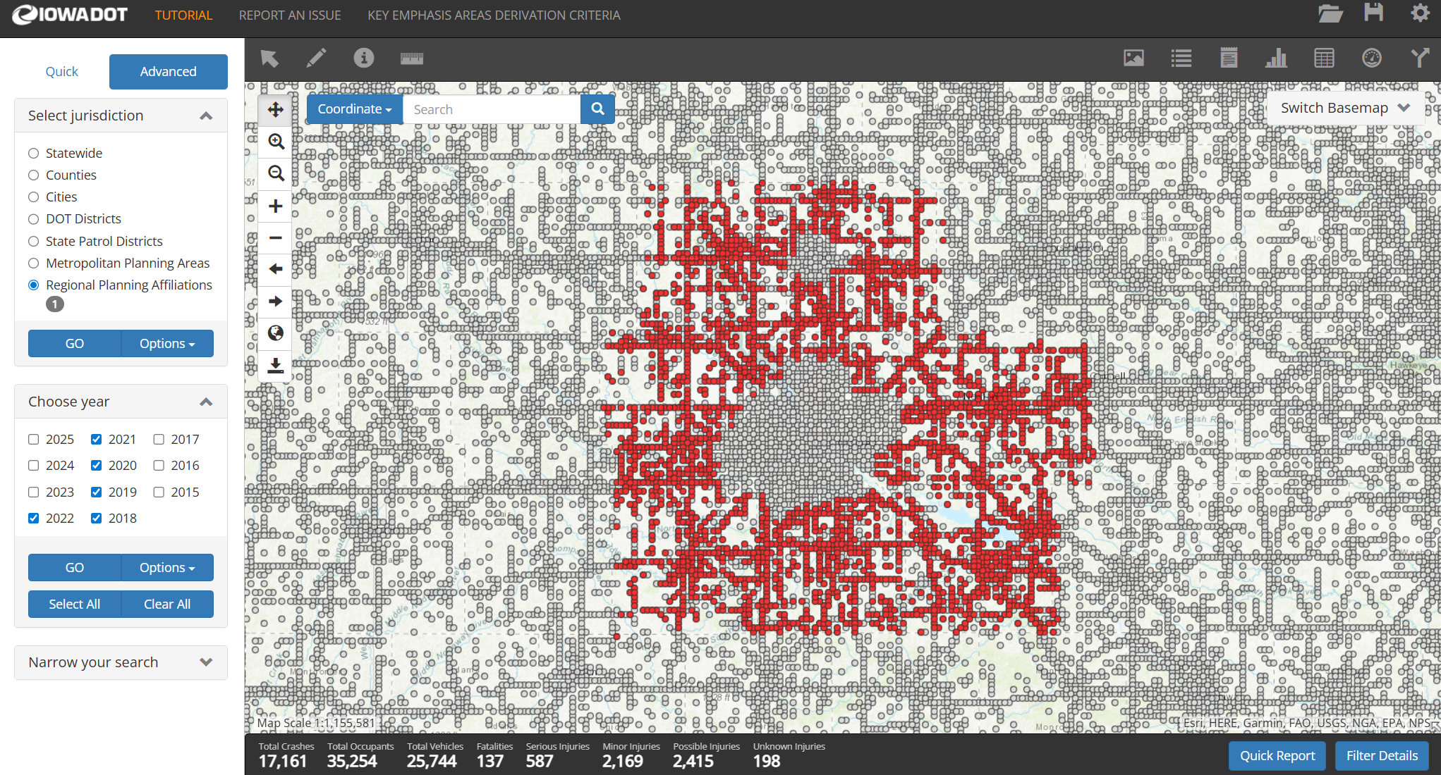

Slide 8
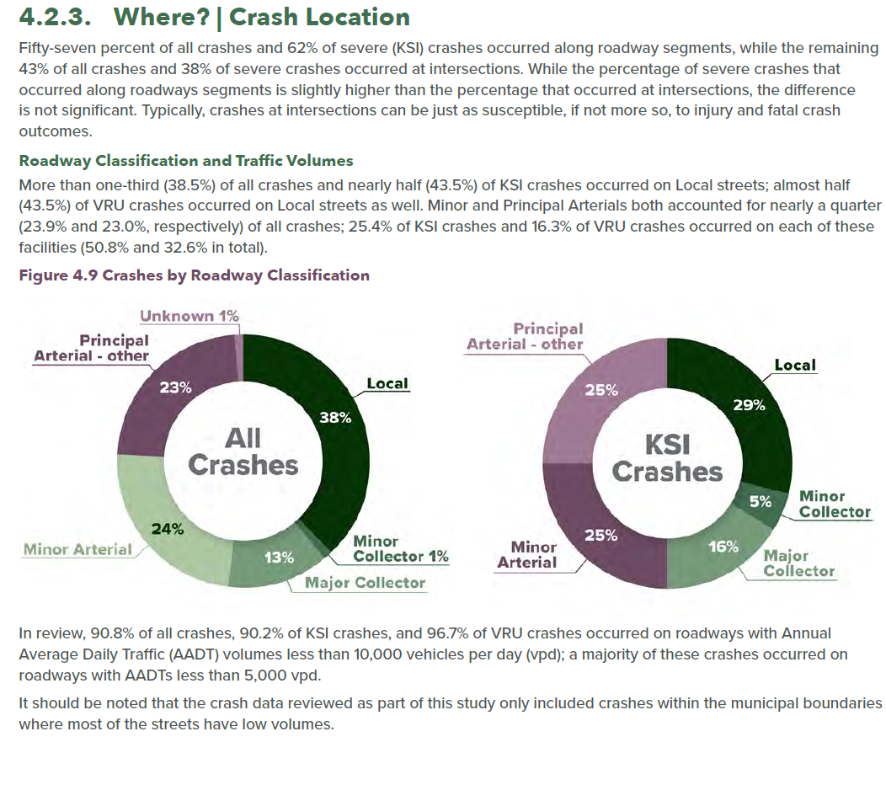
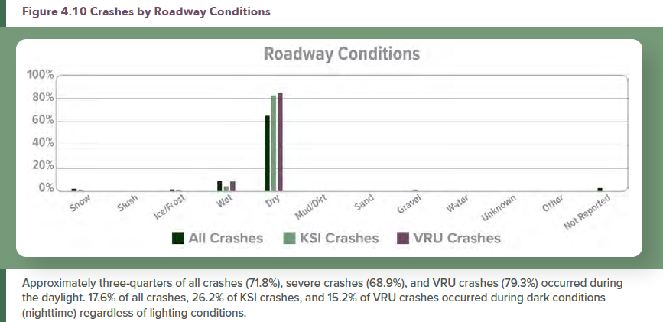
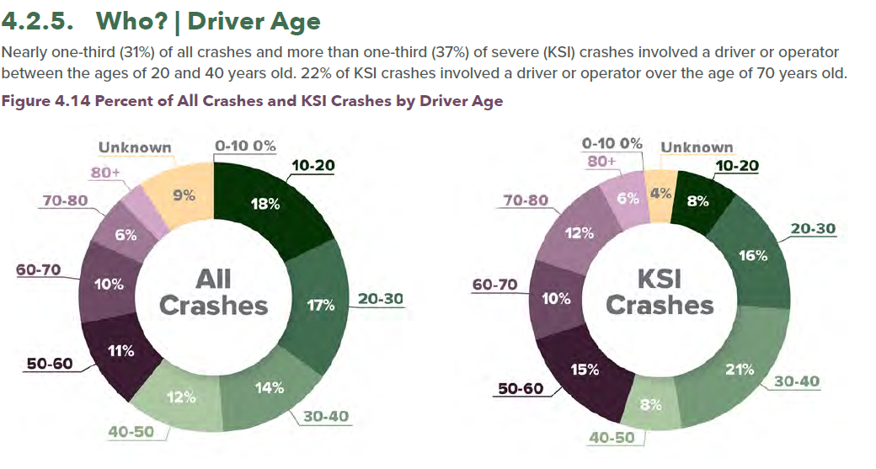
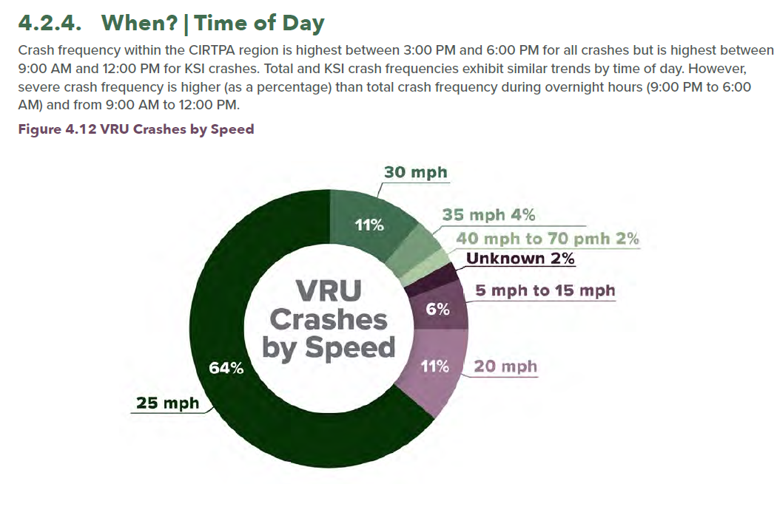

Slide 9
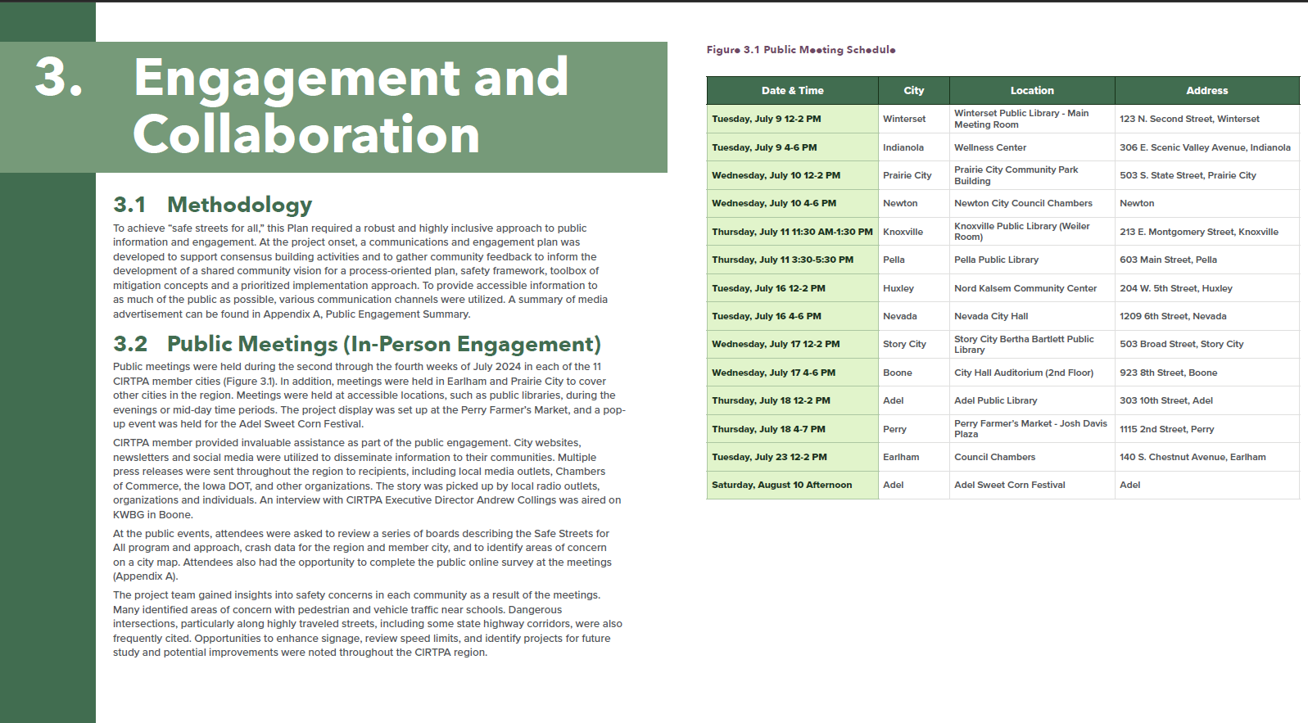

Slide 10
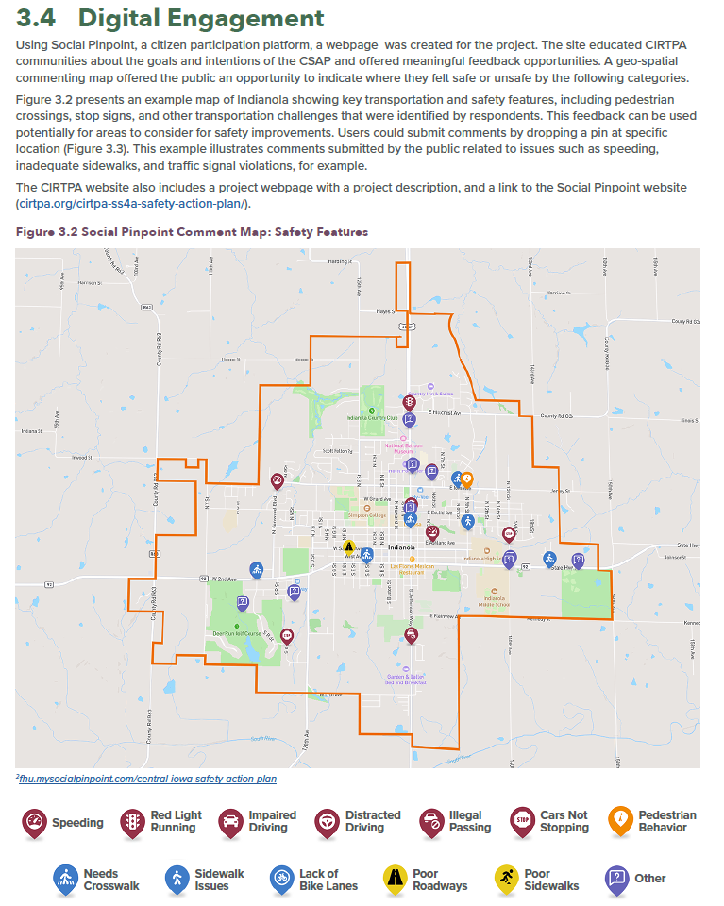
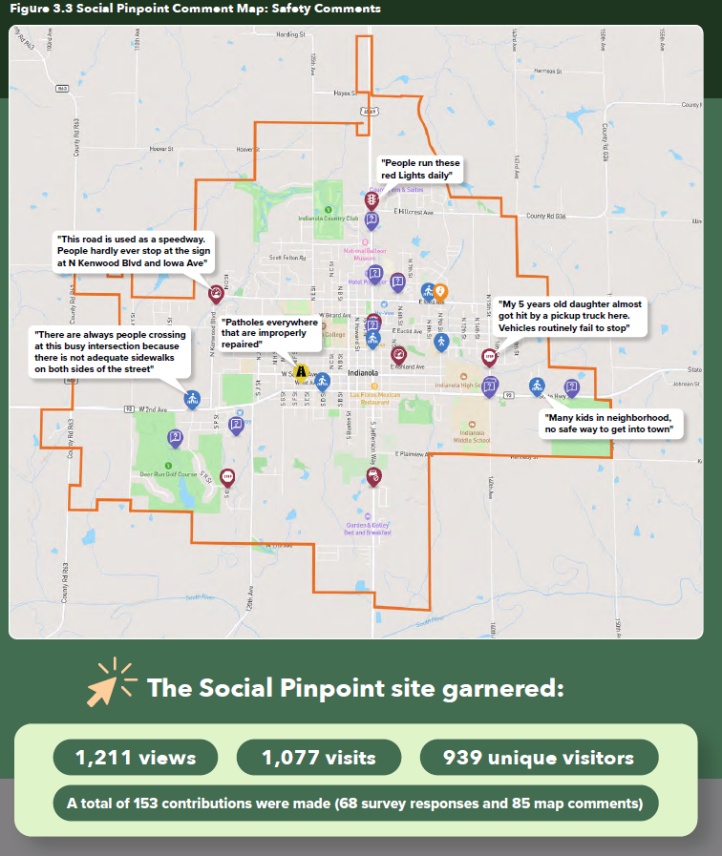

Slide 11
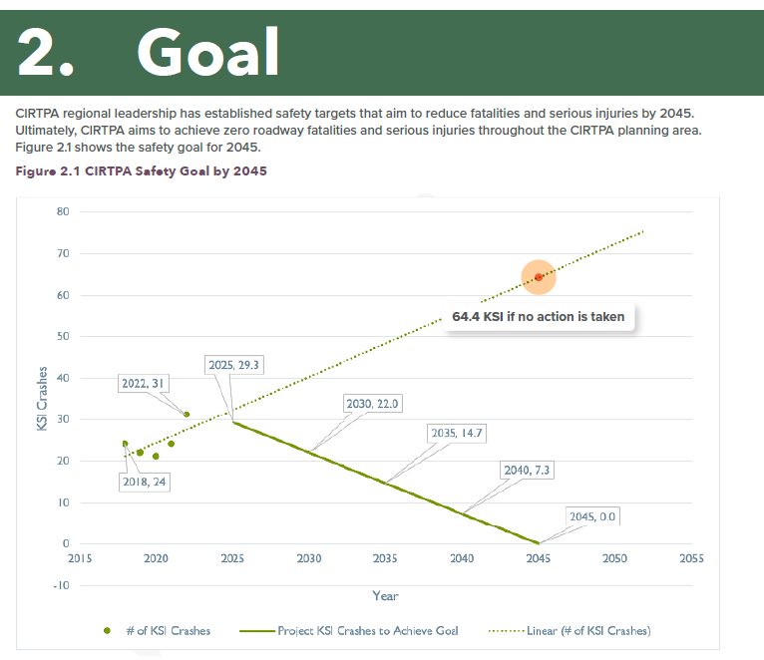

Slide 12
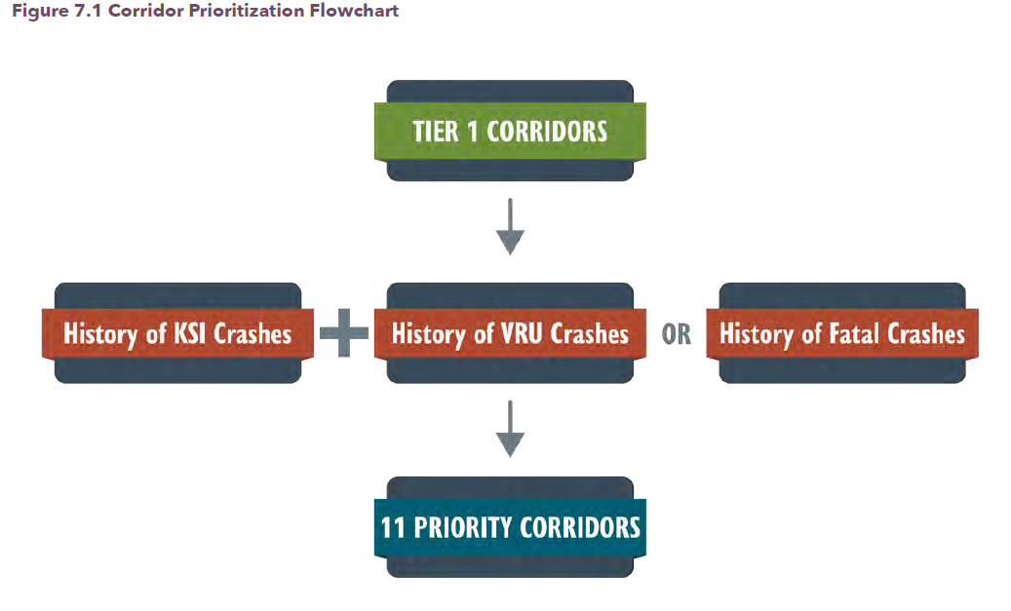
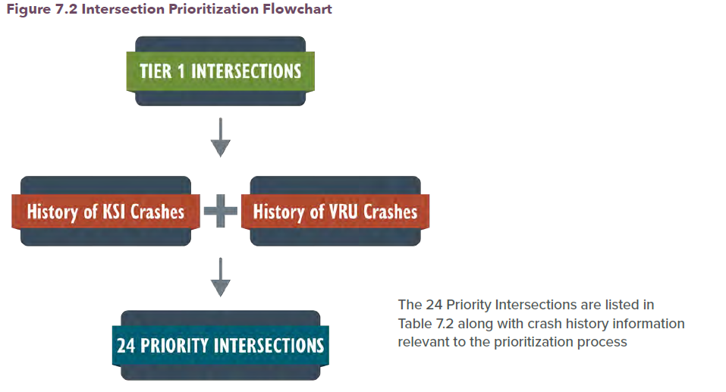

Slide 13
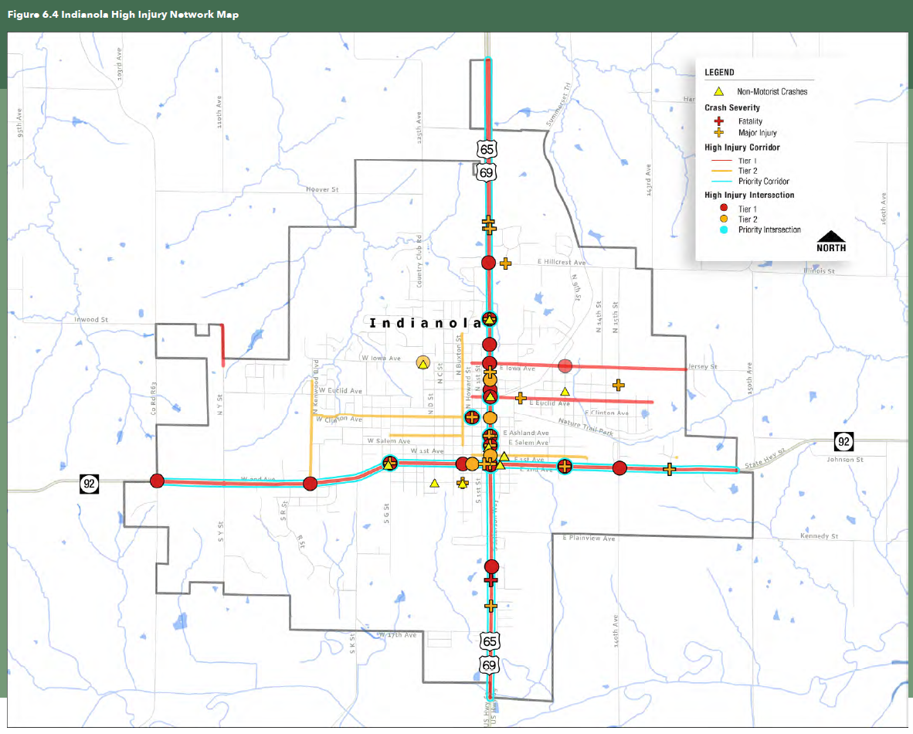

Slide 14
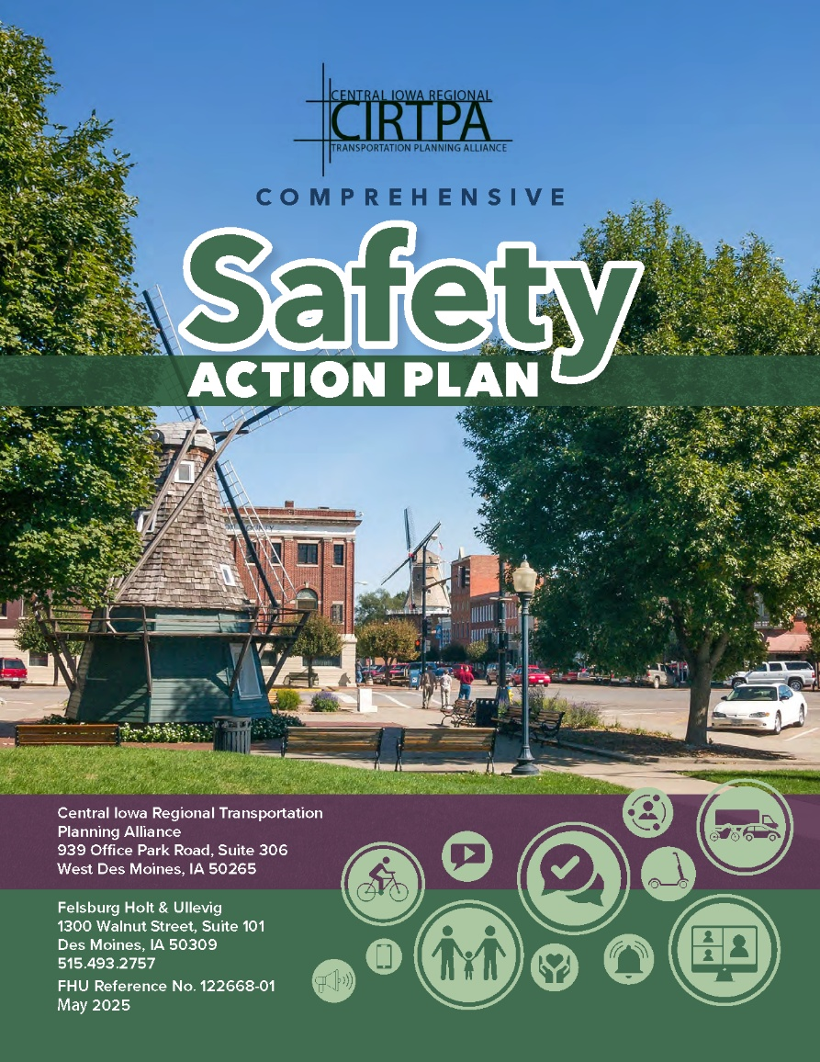
Central Iowa Regional Transportation Planning Alliance (RPA-11) – SS4A Implementation Grant
As part of the consultant procurement process, an application for an Implementation Grant
It was determined that CIRTPA would be the applicant on behalf of participating communities
If awarded, CIRTPA would subaward projects to the cities

Slide 15
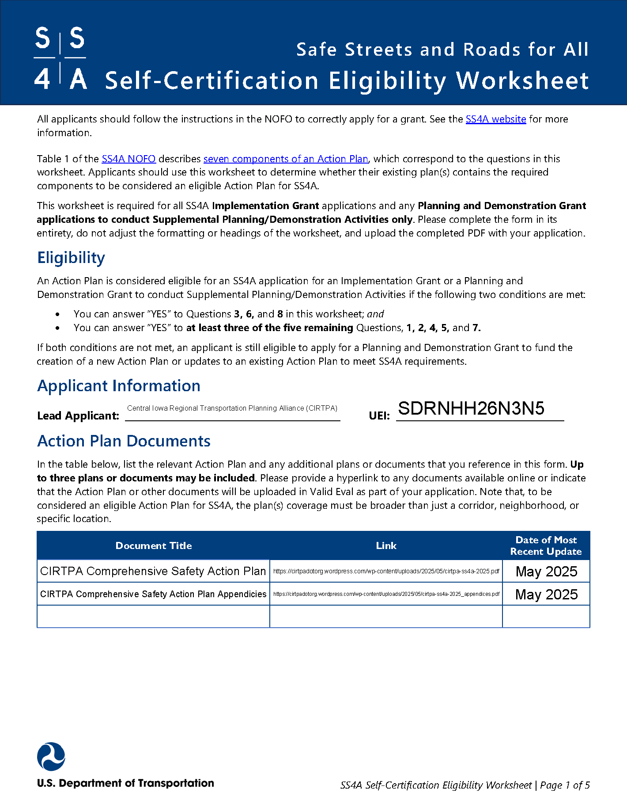
Central Iowa Regional Transportation Planning Alliance (RPA-11) – SS4A Implementation Grant
Participating communities
  Adel - $7,938,000 – Two to Three Lane Conversion on IA 92
  Nevada - $3,300,000 - Two to Three Lane Conversion on Washington St
  Newton - $4,904,500 - E 8th Street Reconstruction
  Pella - $3,857,000 - Two to Three Lane Conversions on Washington St
  Total - $19,999,500 – Grant - $15,999,600

Slide 16
Thank You!
Andrew Collings – Executive Director
Mid-Iowa Planning Alliance/Central Iowa Regional Transportation Planning Alliance
P: 515-304-3524
E: acollings@midiowaplanning.org

