Slide 1
Transportation Planning Support
NADO/ NADO Research Foundation

Slide 2
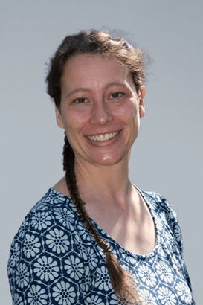
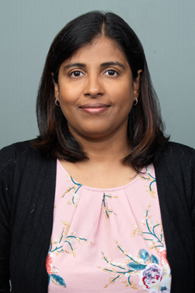
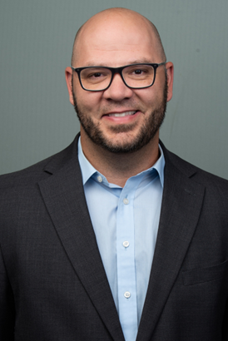
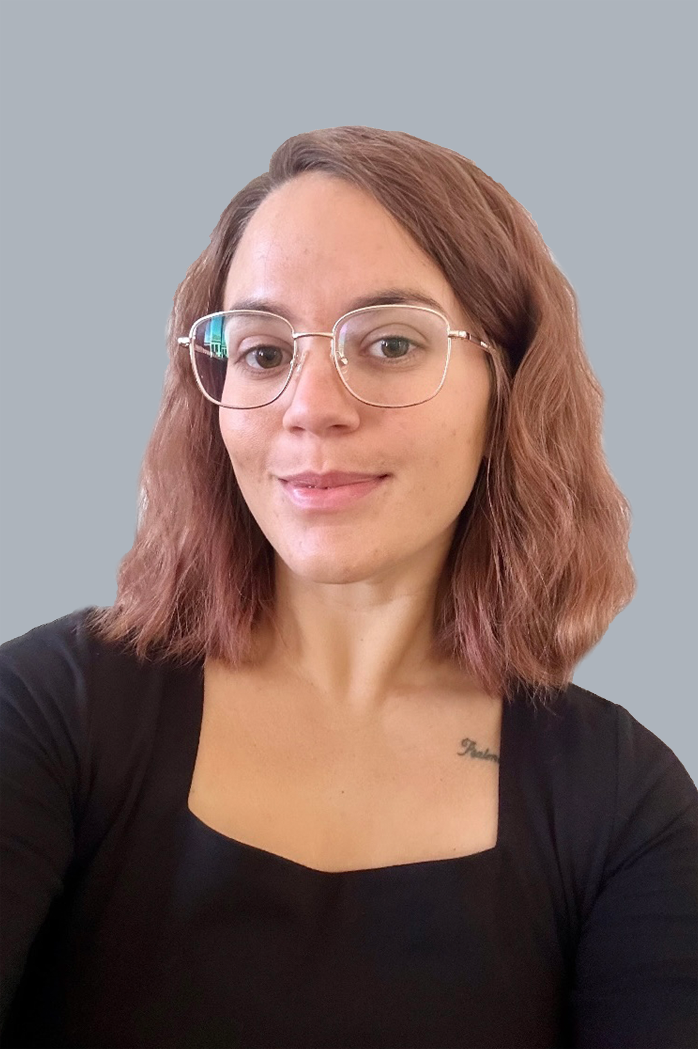

NADO Research Foundation
Transportation Team
Carrie Kissel
Krishna
Kunapareddy
Bret Allphin
Haley
Schultheis
Ryan Collins
Notes:
Carrie – 19 years @ NADO
Krishna – 15 years in Missouri
BA – 20 years in Ohio
Haley/Ryan – approx. 1 year and learning every day!

Slide 3
Common Transportation Activities
Planning program advocacy and liaison
Circulation of funding opportunities
Technical assistance
  Data analysis (safety, conditions, capacities, special studies, GIS, GTFS)
  Public transportation
  Active transportation (complete streets, etc.)
  Public engagement (consultation, coordination, organization)
Notes:
Planning advocacy and liaison not only includes advocating for RTPO specific programming, but also networking with agencies like FHWA and FTA, friend associations like AASHTO, AMPO,
The level and intensity of these efforts will vary depending on whether or not funding is offered to participating organizations.

Slide 4
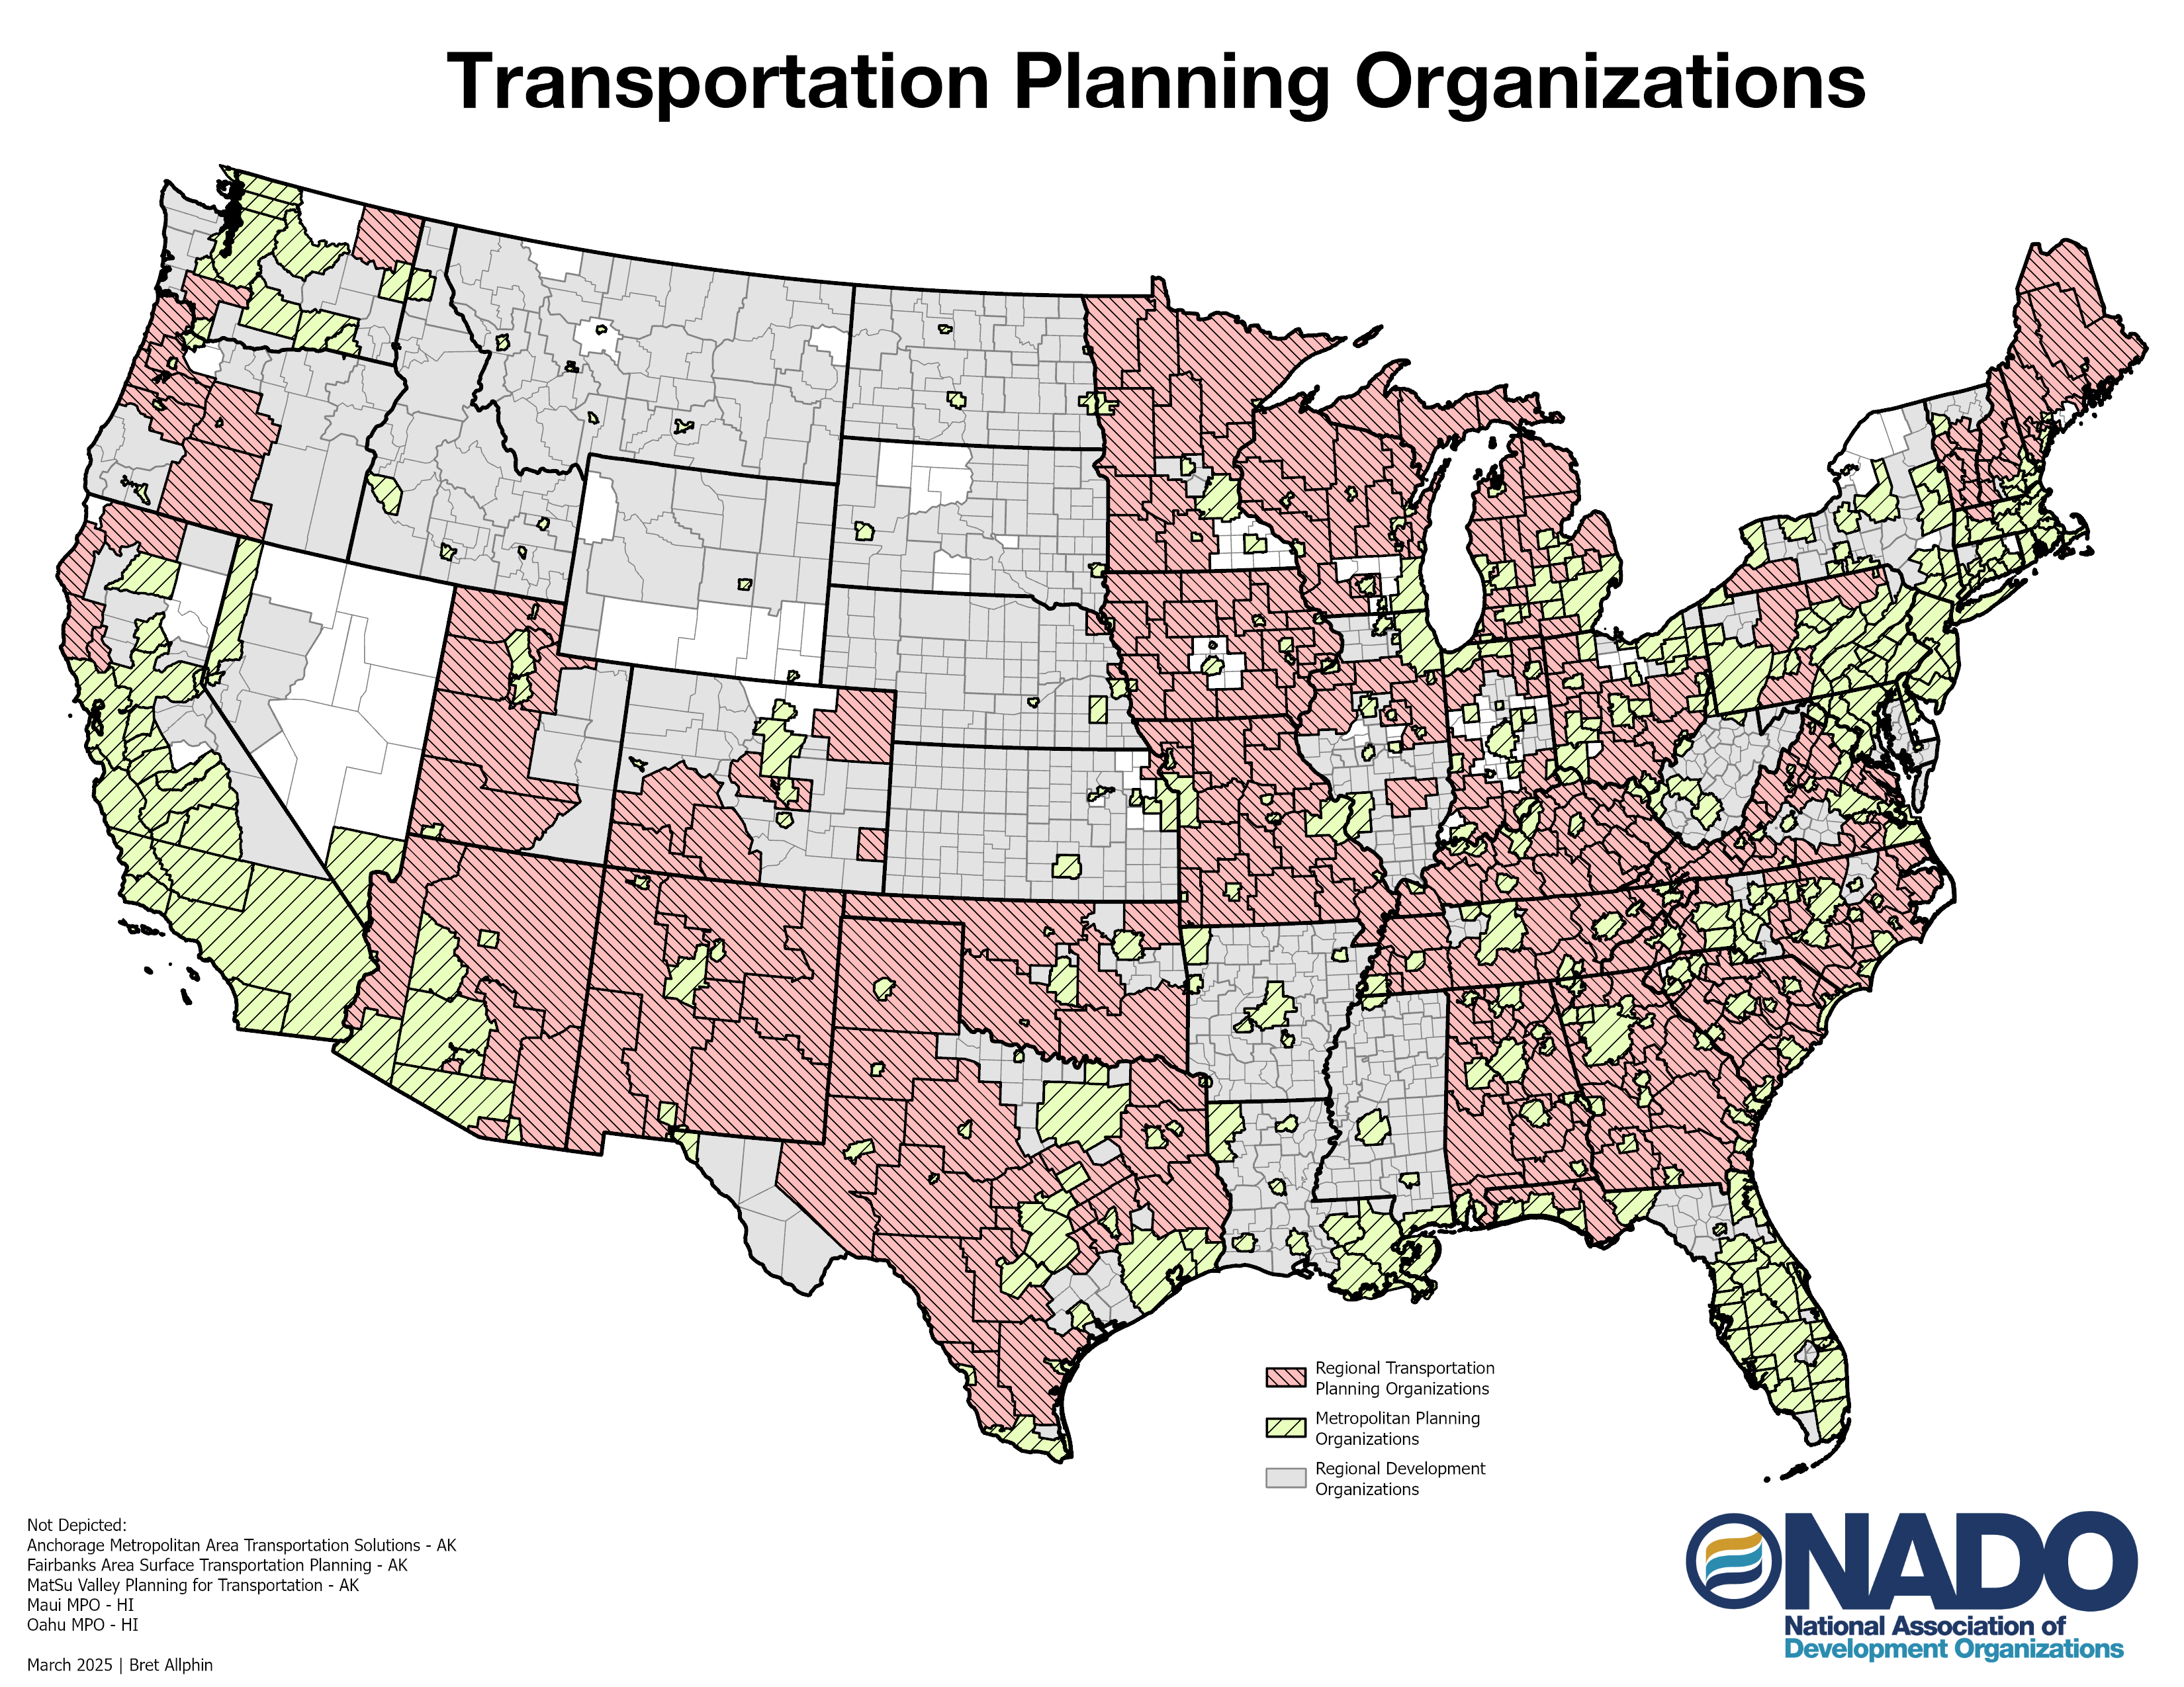
Notes:
Note: these are NOT all NADO members. These are all the RTPOs and MPOs we think we know about. This is not exactly up to date, but you get the idea.
Working to get rural voices more engaged in statewide transportation planning efforts.
https://ruraltransportation.org/about-rtpos/rtpo-states/
https://www.nado.org/wp-content/uploads/2016/11/Reg_transportation_planning_report_FINAL2.pdf

Slide 5

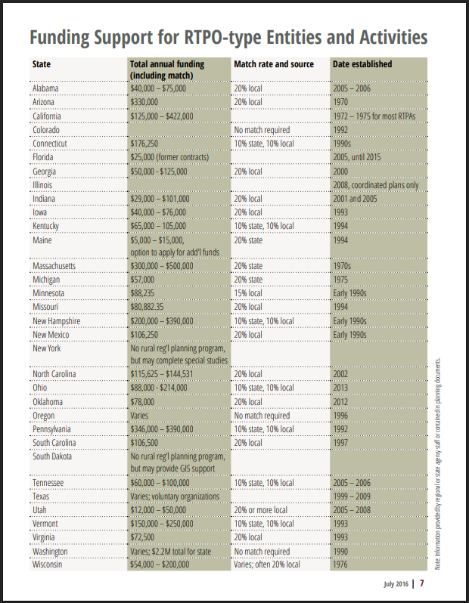
Notes:
Note: these are NOT all NADO members. These are all the RTPOs and MPOs we think we know about.
https://ruraltransportation.org/about-rtpos/rtpo-states/
https://www.nado.org/wp-content/uploads/2016/11/Reg_transportation_planning_report_FINAL2.pdf
National RTPO policy and advocacy has been central to the work of the NADO RF transportation team.

Slide 6


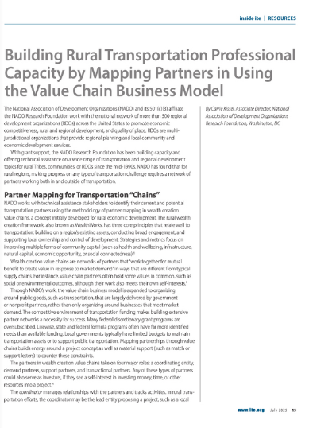

Notes:
Note: these are NOT all NADO members. These are all the RTPOs and MPOs we think we know about.
https://ruraltransportation.org/about-rtpos/rtpo-states/
https://www.nado.org/wp-content/uploads/2016/11/Reg_transportation_planning_report_FINAL2.pdf
National RTPO policy and advocacy has been central to the work of the NADO RF transportation team.

Slide 7
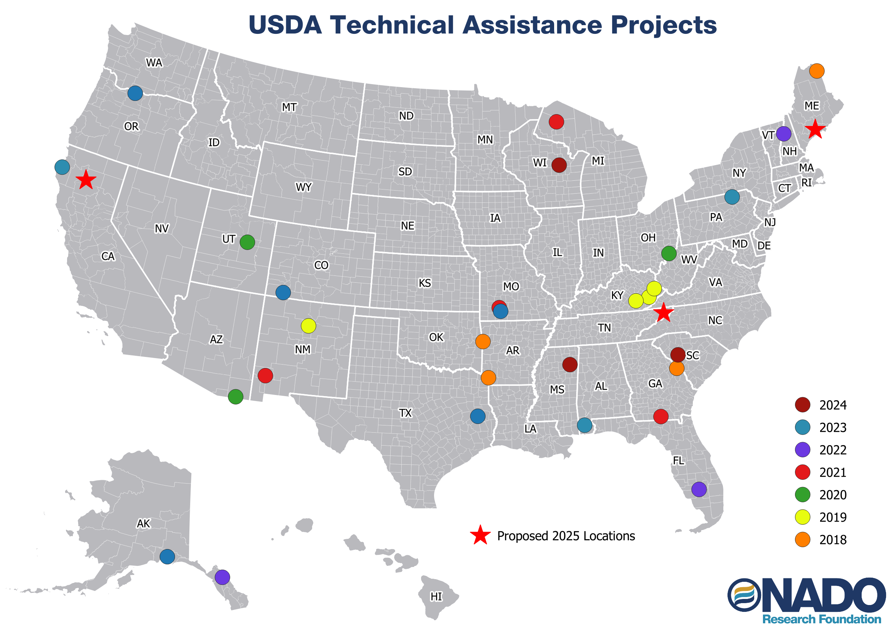
Notes:
Note: these are NOT all NADO members. These are all the RTPOs and MPOs we think we know about. This is not exactly up to date, but you get the idea.
https://ruraltransportation.org/about-rtpos/rtpo-states/
https://www.nado.org/wp-content/uploads/2016/11/Reg_transportation_planning_report_FINAL2.pdf

Slide 8
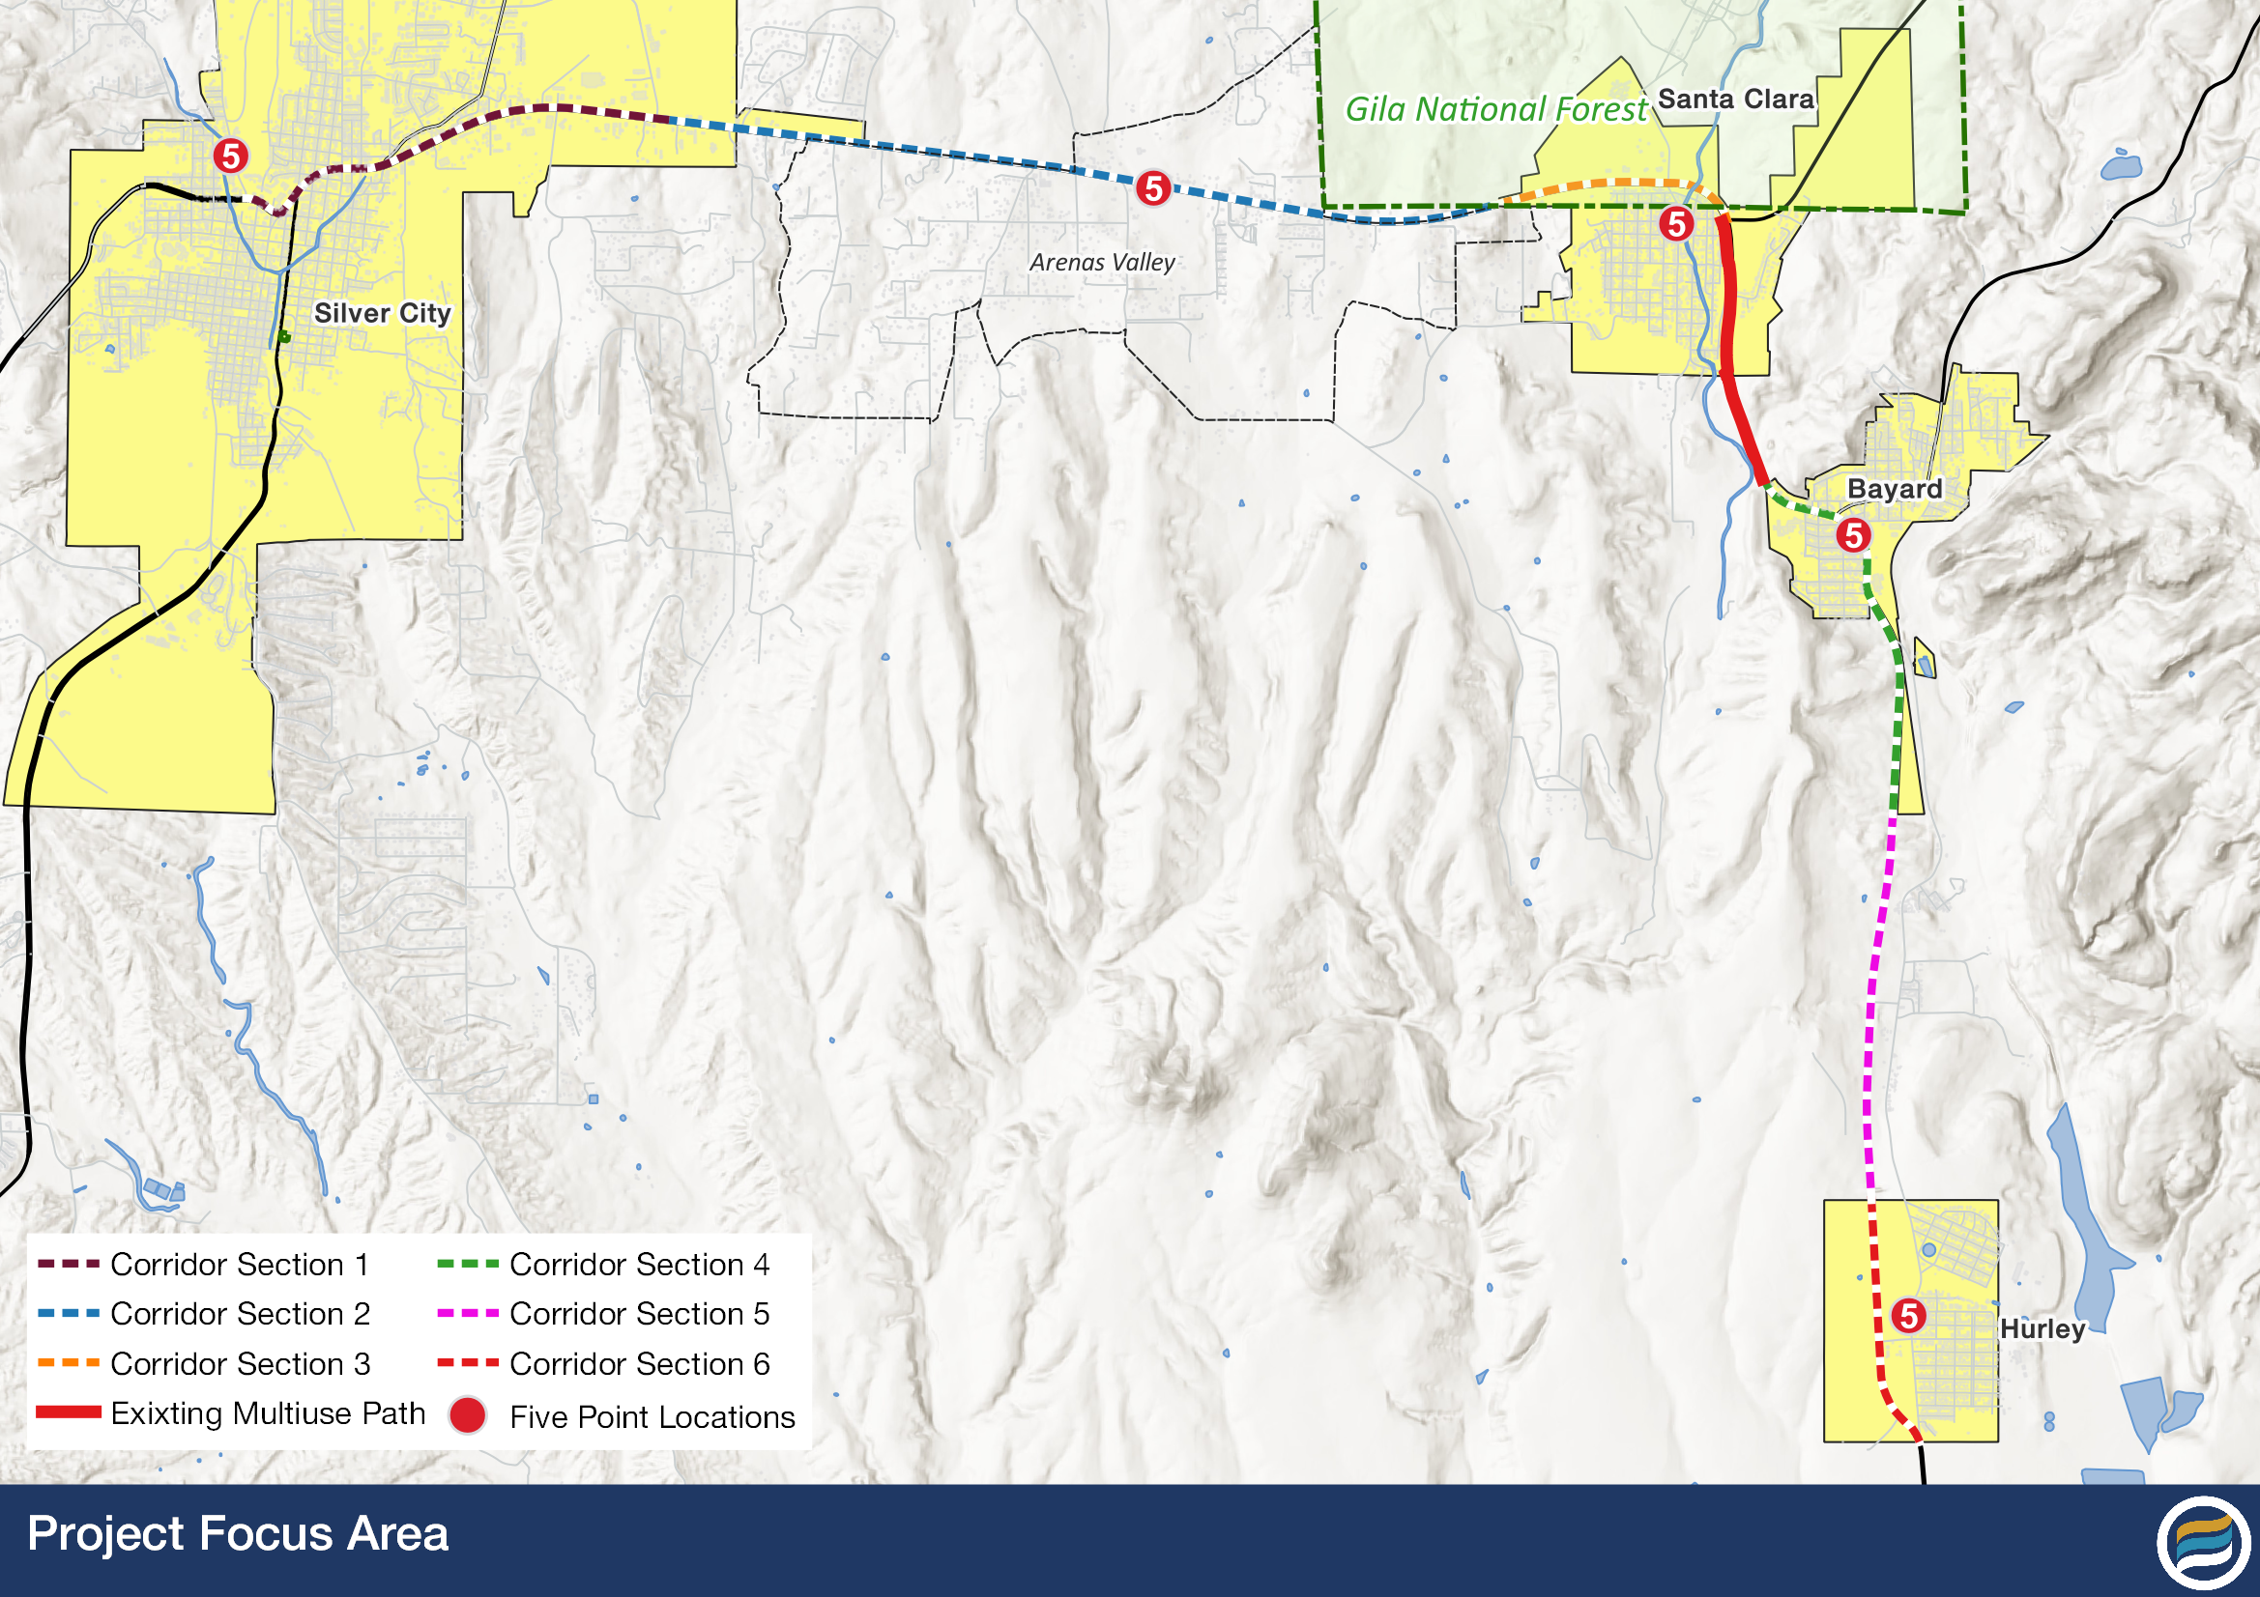
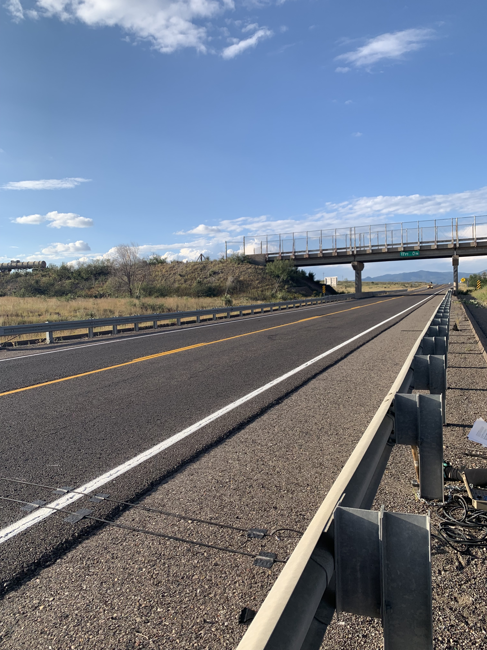
New Mexico – Active Transportation
Trail Extension Project Support
Bike/ped data collection
Basic cost estimation for construction
Proximity to other assets (transit, tourism, etc.)

Slide 9
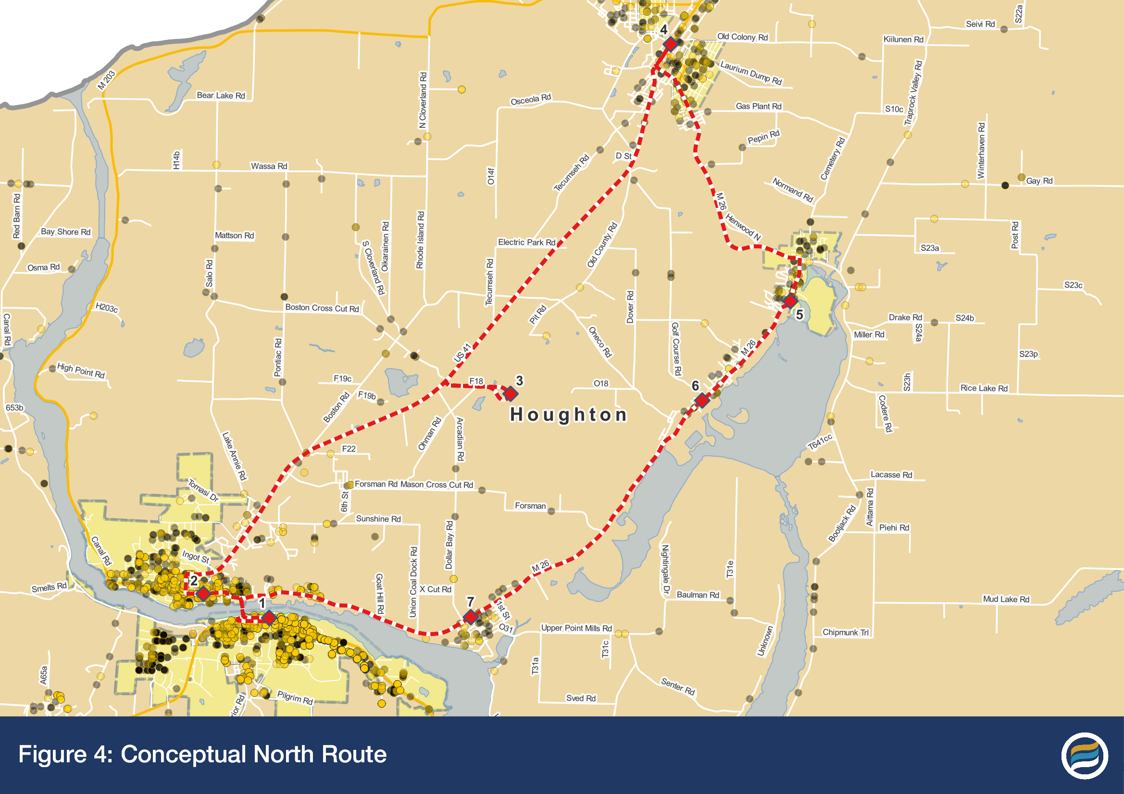
Western Michigan– Transit Assistance
Service Combination and Expansion
Best practices and capacity building
Route modeling
Cost and ridership estimation
RFP development

Slide 10
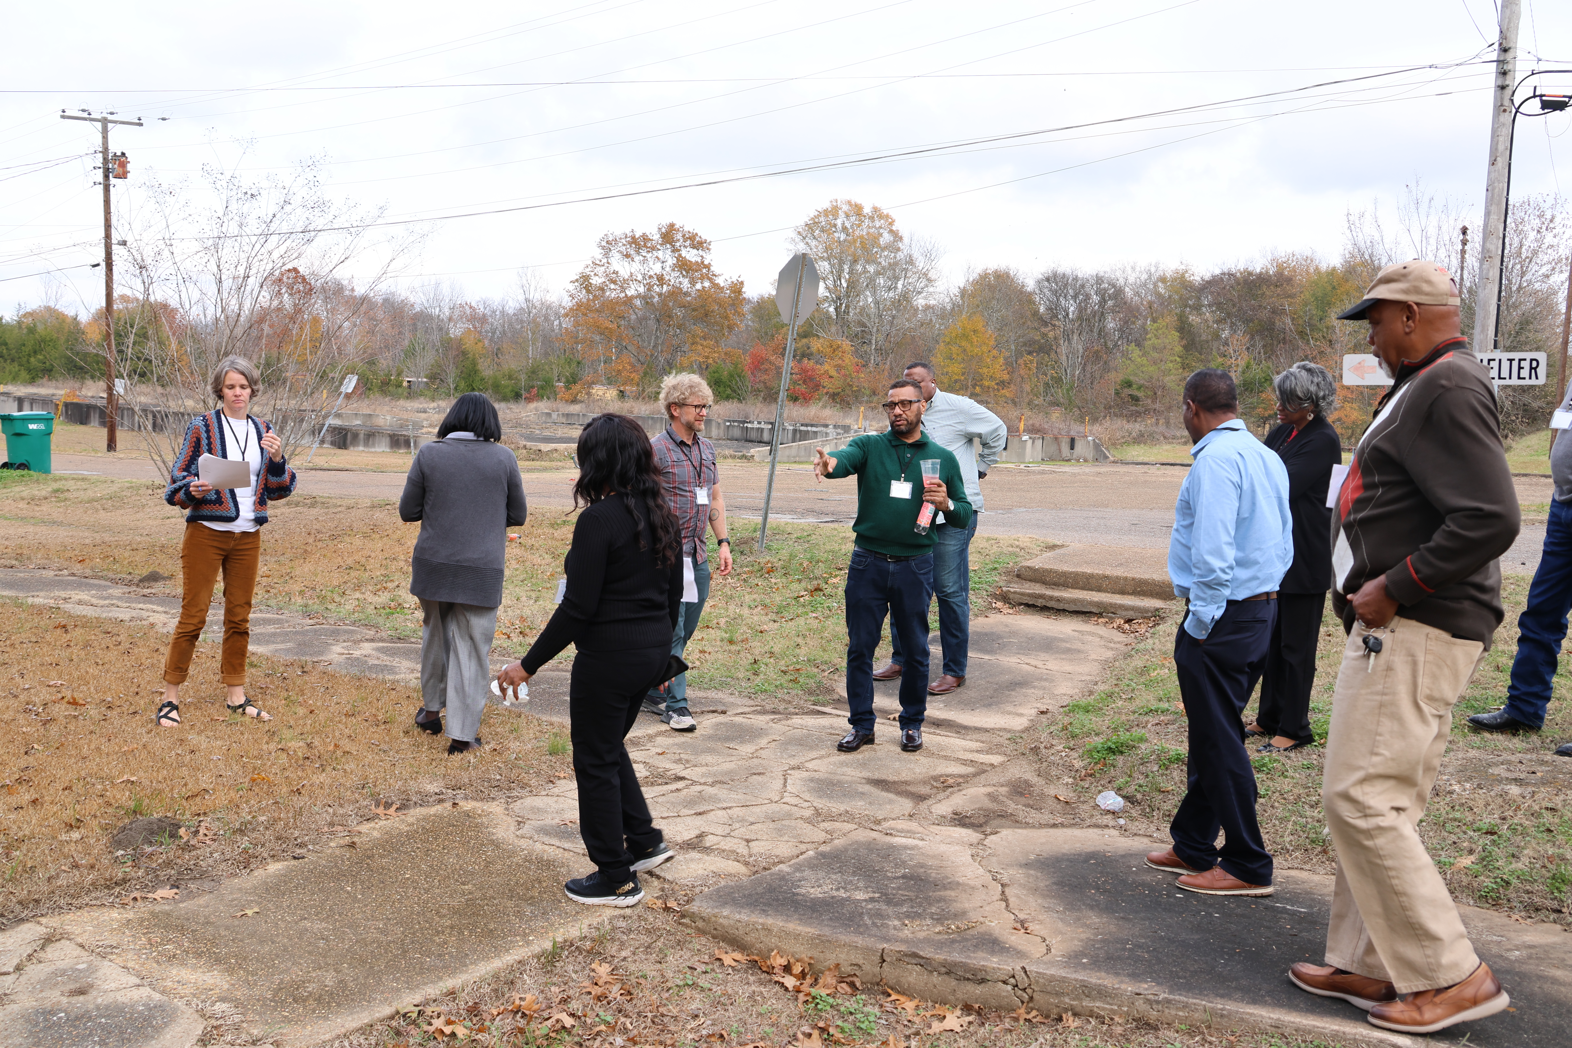
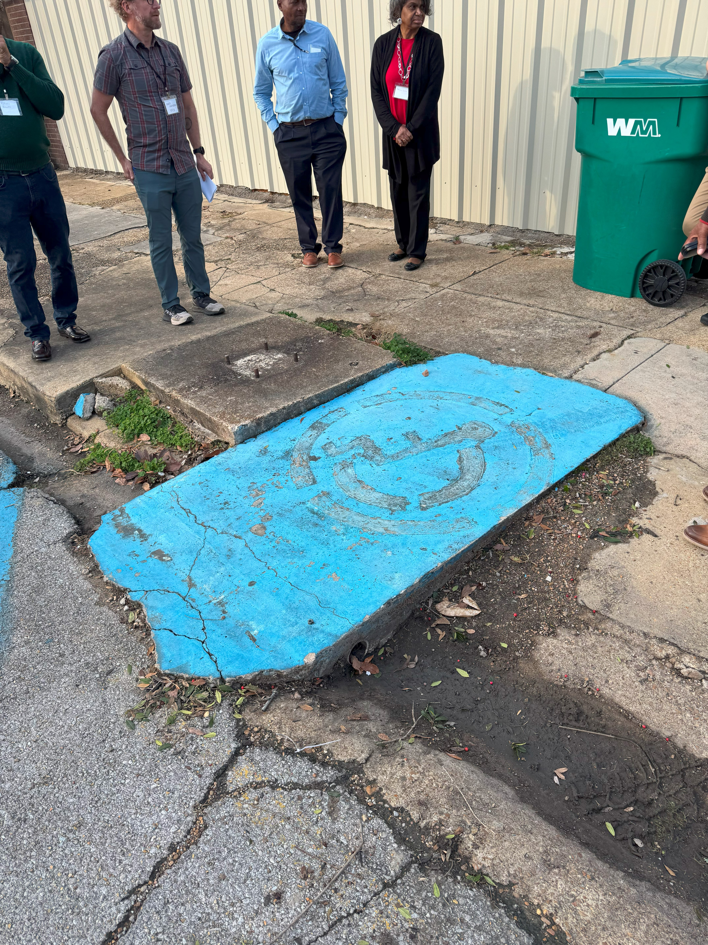
Mississippi– Active Transportation
Pedestrian Safety and Downtown Revitalization

Slide 11
Bret Allphin, Associate Director
ballphin@nado.org

