Slide 1
High Injury Networks for Dummies
July 2025
Notes:
The only dummy is me.
Warning, GIS lingo, jargon, terminology, and descriptions ahead. Proceed with caution.

Slide 2
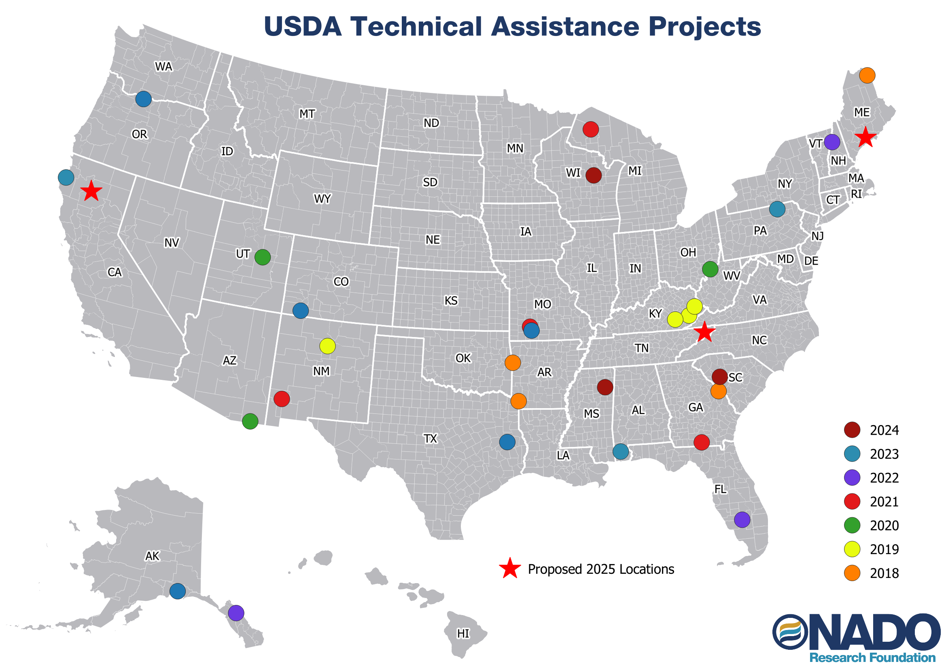
Notes:
What I will be showing here I learned during our Technical Assistance programming funded by USDA RD.

Slide 3

Eligible Grant Uses
Safety Action Plan
Planning and Demonstration Activities
Implementation Projects
Notes:
The SS4A program has been incredibly popular with communities.
And having a completed and active safety plan is really the key to accessing the many resources available in the program.
But also be clear, if all you get from this program is a completed Safety Action Plan – that is still very valuable for your ongoing transportation planning efforts.

Slide 4
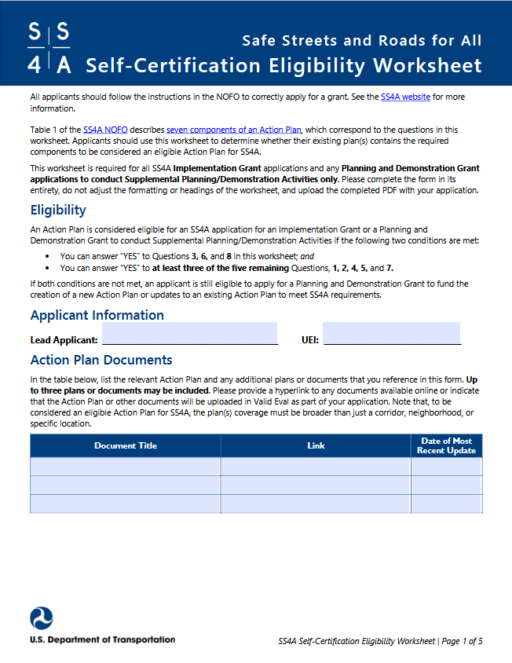
Action Plan Required Components
Leadership and Goal Setting
Planning Structure
Safety Analysis
Engagement and Collaboration
Policy and Process Changes
Strategy and Project Selections
Progress and Transparency
Notes:
USDOT has published excellent supporting resources for SS4A. They can be found here: https://www.transportation.gov/grants/SS4A/resources and include various checklists, worksheets, and templates. Definitely utilize these as you are considering any SS4A application.

Slide 5
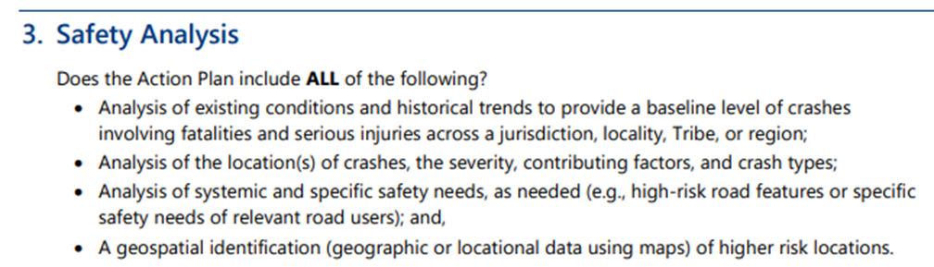
Notes:
I will argue, that if you are doing ongoing transportation planning – you probably already have an idea of what these locations are.

Slide 6


Long Range Transportation Plan
Active Transportation Plan
Bike/Ped. Plan
Notes:
Many agencies have some, or all, of these other planning documents, and they each have parts and pieces that an approved action plan would need, but our experience has been that few groups seem to have one single existing planning document that meets all the criteria of an action plan. We had several requests to review various planning docs for folks to see if we felt they met the action plan requirements in the checklist- none of them did.
Frustratingly, this is why a separate safety action plan effort is required.

Slide 7
High Injury Network
‘A geospatial identification of higher risk locations.’
Consult completed analyses for guidance:
  AMATS (Akron, Ohio)
  Toledo, Ohio
  CORPO (Columbus Ohio RTPO)
  Richmond, Virginia (PlanRVA – NADO Member)
  Mid Region COG (Albuquerque, NM)
  Indianapolis MPO
  City of Fort Collins (Fort Collins, CO)
  Pinellas County Florida
Notes:
These were some of the documents I consulted a year ago. I chose these because they specifically listed or discussed the methodology they used for creating their high injury network data. Not all of these are rural. There are WAY MORE of these out there now, I see more published every day – pay your Google bill and you’ll go far on finding examples.

Slide 8

High Injury Network
‘A geospatial identification of higher risk locations.’
What are the minimum data requirements?
  Desktop GIS Application
  Spreadsheet Application
  GIS Road Data
  GIS Crash Data (Must include at a minimum; crash location, date/time, severity level.)
Notes:
Minimum data requirements: a GIS road layer for your area of interest, and crash data that can be represented on a map, and accessible to your GIS application. The crash data must include incident severity – remember the point of SS4A is to REDUCE FATAL AND SERIOUS INJURY INCIDENTS.
DISCLAIMER: There are many ways to complete this analysis! This is the way I came up with based on my ‘research’ – think of this as a lowest common denominator version. There ARE better methods, you may ALREADY HAVE a better method.
This process is also done with the worst and most basic data. US Census Bureau TIGER roads and crash data (the quality of which varies WILDLY between states).

Slide 9
Notes:
Imagine that this is a road network, with various types of roads.
Red = Fatal
Yellow = Serious Injury
Remember our goal here is to relate the number and severity of these crash incidents to roads/road segments.

Slide 10
2
2
2
1
1
0
1
2
2
1
Notes:
Imagine that this is a road network, with various types of roads.
Red = Fatal
Yellow = Serious Injury
The general idea here is that we are trying to associate crashes (both number and severity) to road segments. NOTE: what ‘segments’ means will partly depend on the road data you are utilizing, and how it is segmented.
I’m omitting intersections here, but you can do a similar process by applying a radius buffer to intersections and follow the same process that I’m going to outline.

Slide 11
General Processing Steps
Crash Data/ GIS Application
Export Fatal and Serious Injury Incidents
  Optional: Remove any ‘Intersection Related’
Utilize ‘Join Attributes from Nearest Neighbor’ Analysis Tool*
  Keep FID or Other Identifying Value From Roads**
Export the New Attributes to Excel***
  Pivot Table to Summarize Count Based on FID or Road Name
Join Edited Attributes from Excel Back to Road Data, Symbolize
Notes:
The general data processing flow is as follows. (I have a more detailed process document I can share for anyone who cares to see it.) I’M WILDLY OVERSIMPLIFYING THIS FOR THE PURPOSES OF THE PRESENTATION. There is lots of trial and error here, making adjustments, making edits, etc. until you get something that you feel is relatively realistic.
*The ‘join attributes be nearest neighbor’ tool will be called different things based on what software package you’re using. (I use QGIS and this is the exact name, ha.)
By joining attributes, you are creating a new crash point layer, with road ID/names included. This is where we are associating a crash with ONE road segment, based on proximity. (In the tool you can set distance tolerances and number of features that can be joined. The result will also tell you how far the crash is from the segment it is joined to.
** Crashes will duplicate based on concurrent road features – warning**
***I created a scoring value for segments that was basically (Fatal Incidents x 2) + Serious Injury Incidents – you can do this in excel or in GIS.** This gives more weight to segments with fatal incidents.

Slide 12
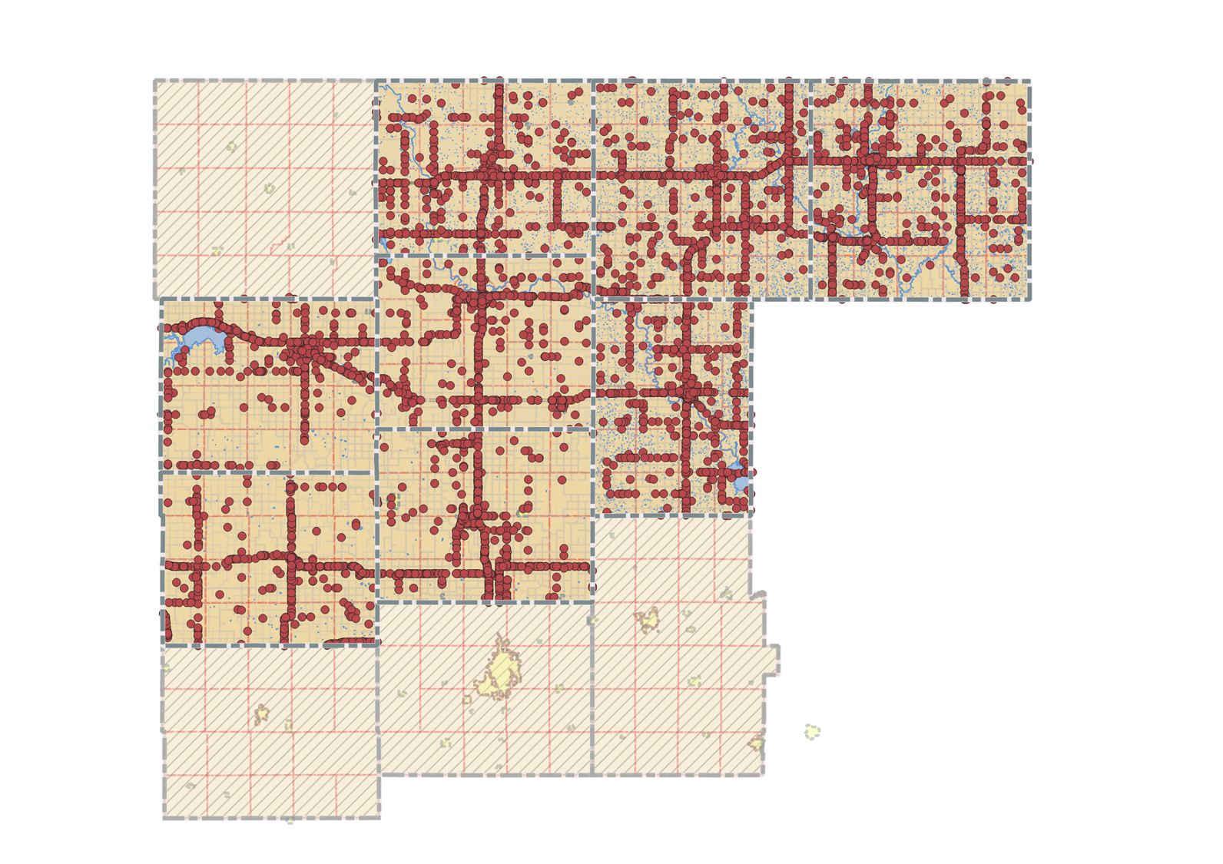
All Crashes

Slide 13
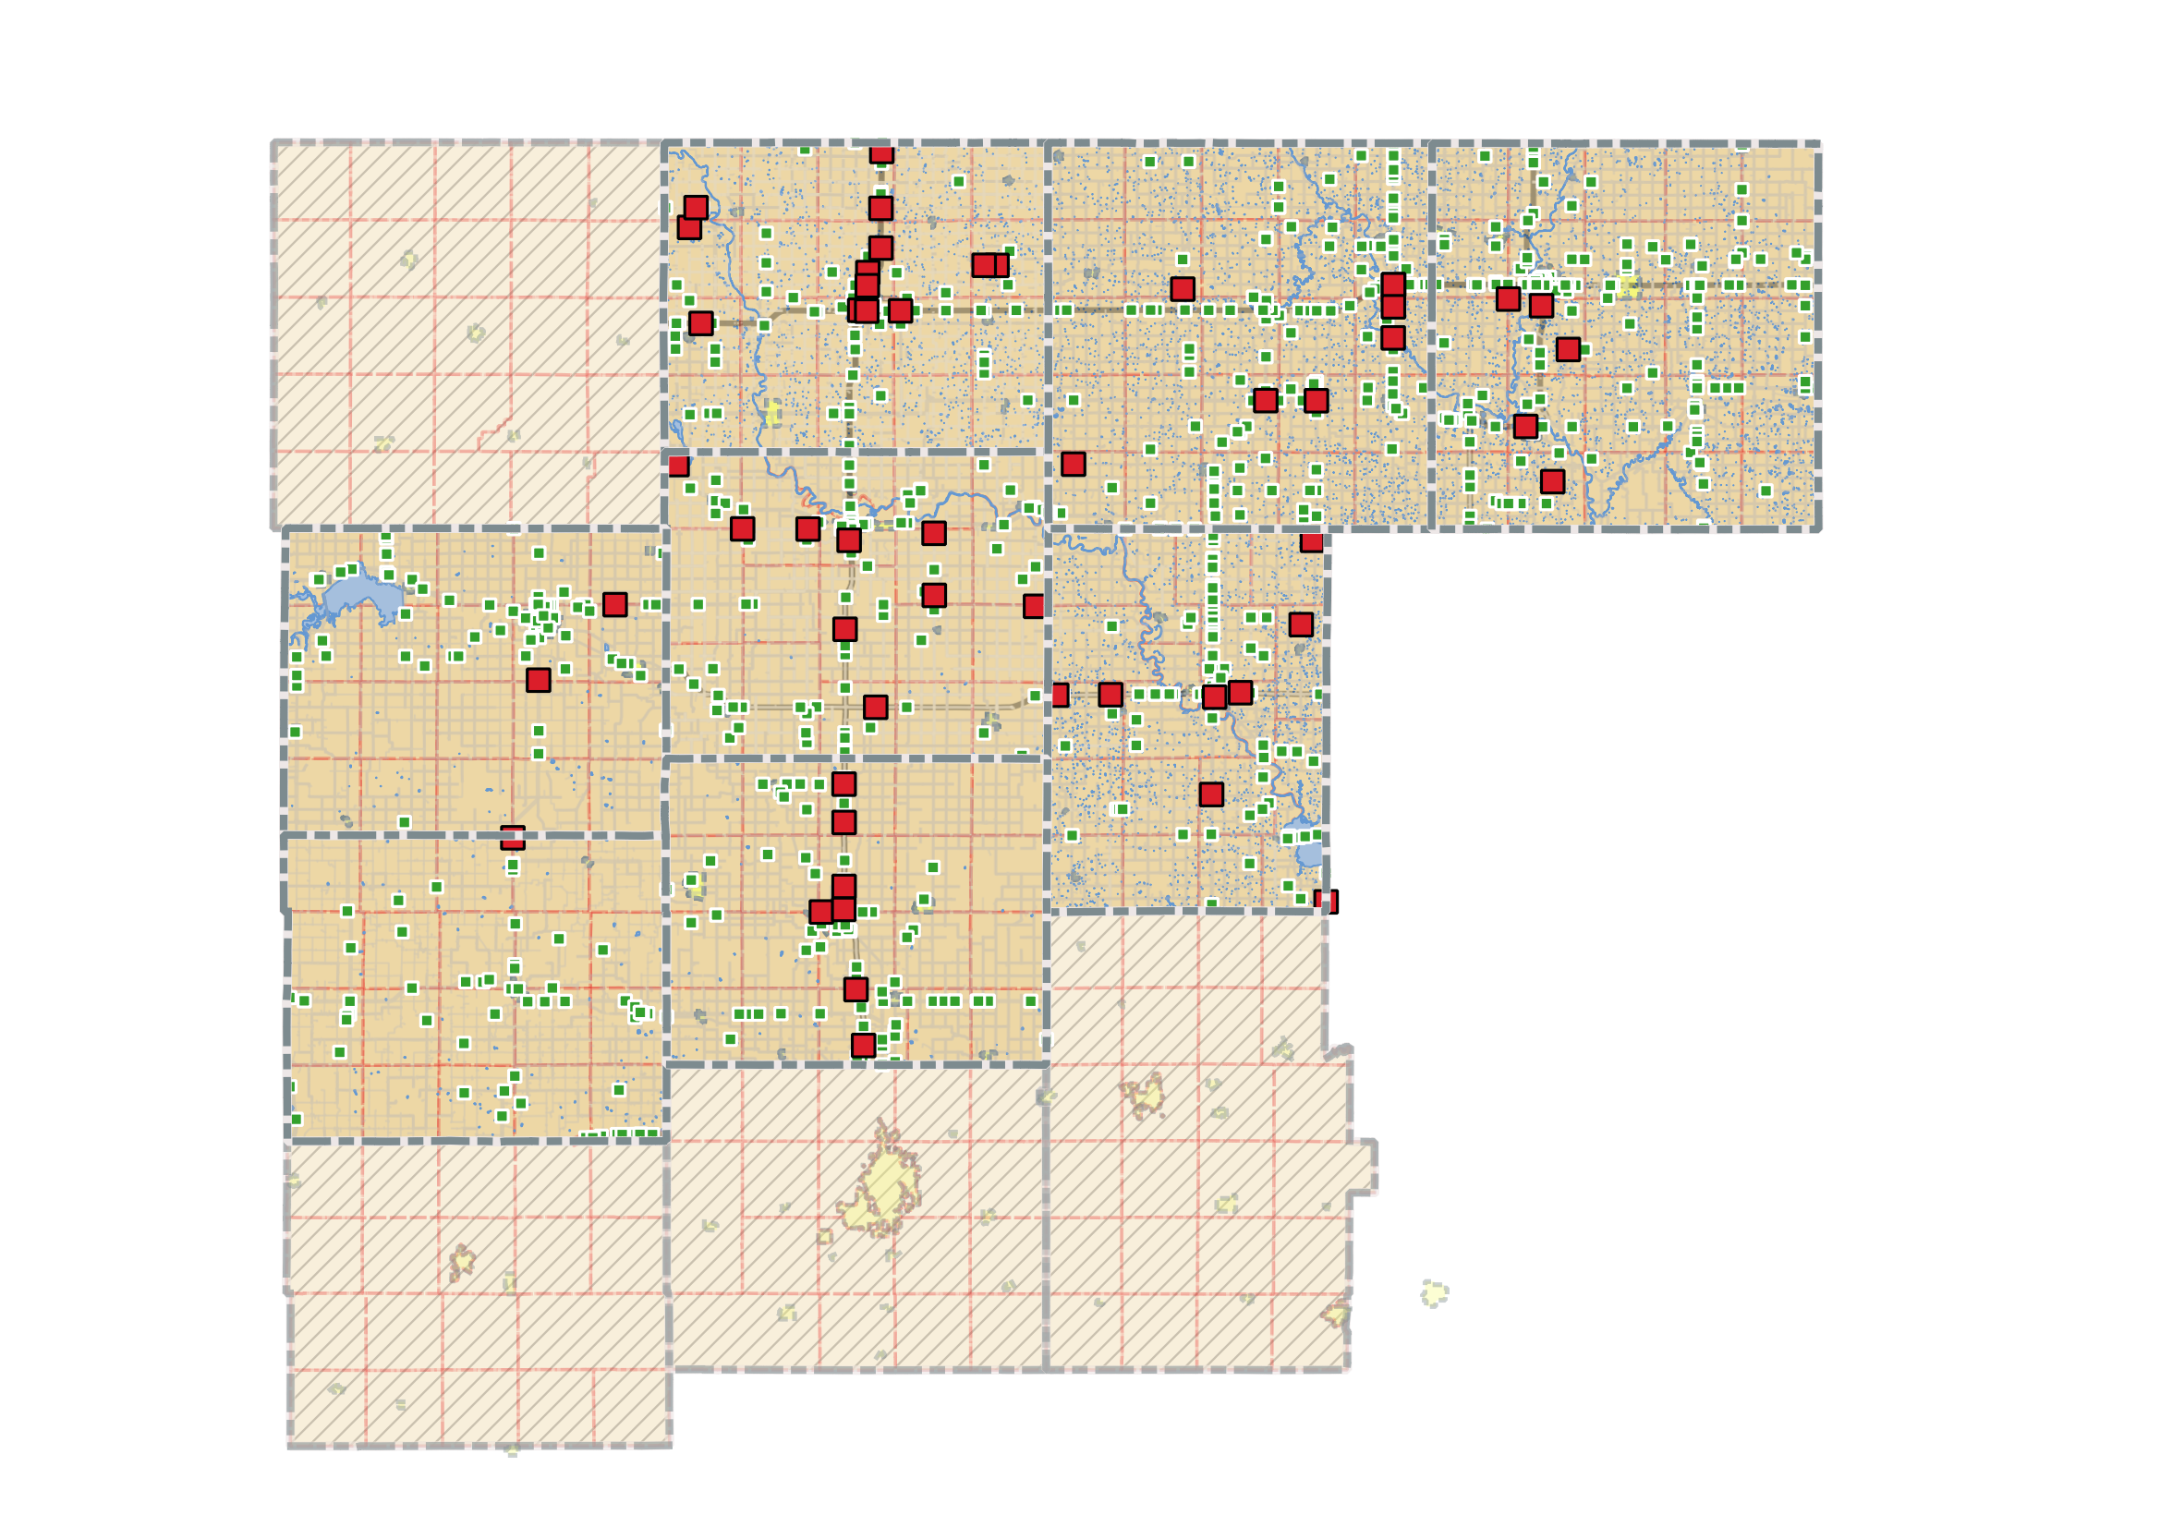
Fatal and Serious Incidents

Slide 14
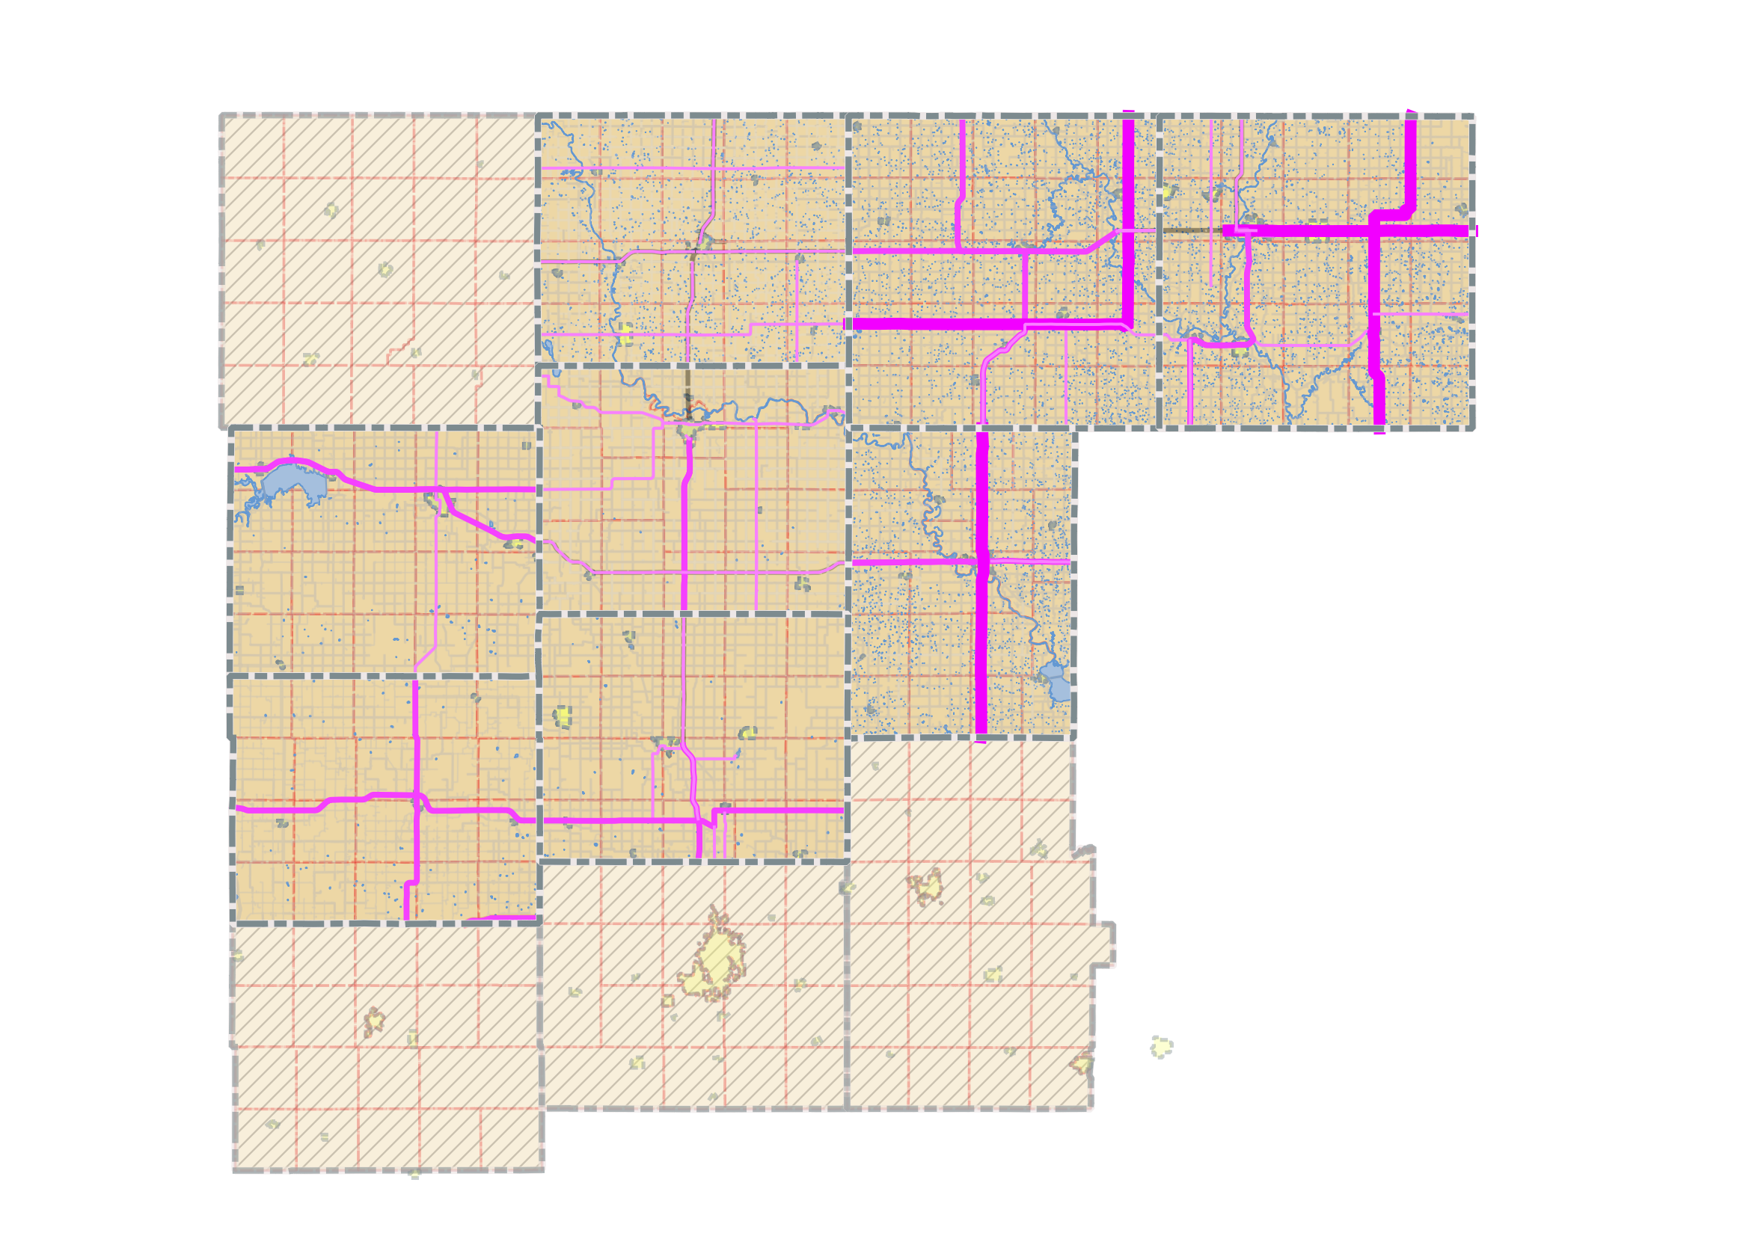
HIN – Low Resolution
Notes:
Again this is Fatal incidents x 2 + serious injury. Not accounting for distance. So there isn’t a ‘value per mile.’
I think of this lower resolution version as good for making broad, system wide recommendations for countermeasures or improvements. Think along the safe system approach and it’s goal of system wide improvements that can be made across a large area.
A study from California (prior to SS4A) indicated that in these HIN identification processes, the road mileage identified as part of the HIN should be between 5 and 20% of total road mileage, and generally never more than 50%. I stuck to this as a ‘rule of thumb’ and used it as a guide.

Slide 15
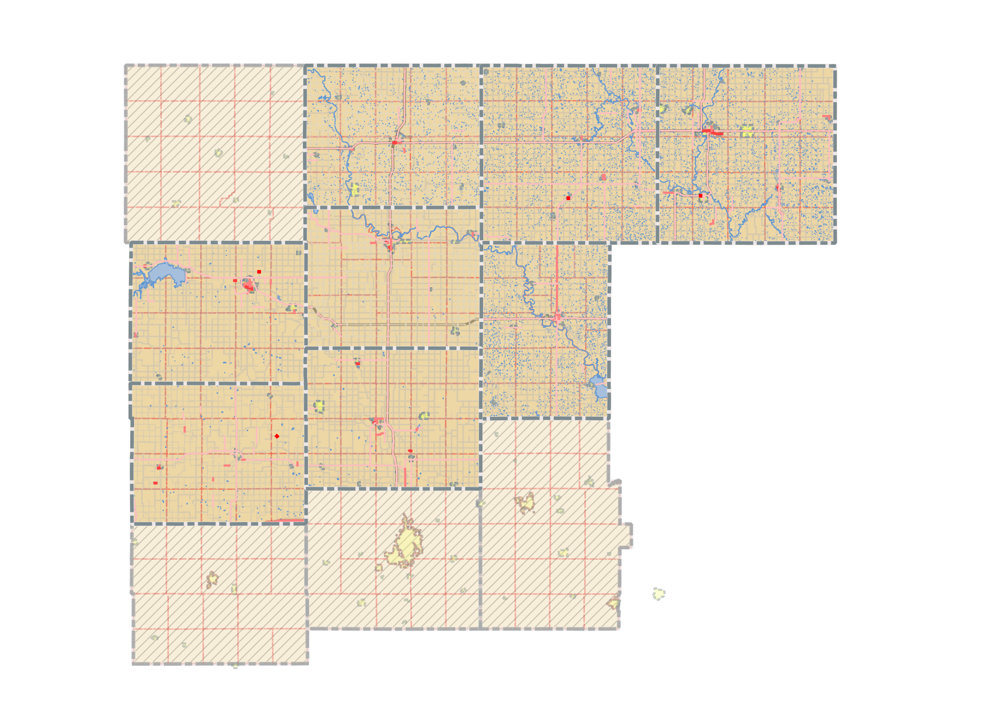
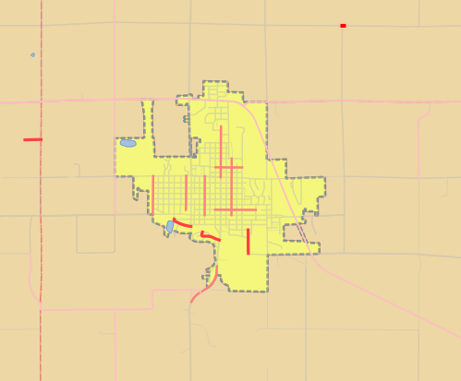
HIN – High Resolution
Notes:
This ‘higher resolution’ HIN is the exact same data, but just adjusted to reflect segment length. So it’s (Fatal Incidents x 2 + Serious Injury)/ Segment Length.
This provides an opportunity to get a much more detailed look at areas of concern. In my mind this is useful for targeting VERY SPECIFIC countermeasures or improvements.

Slide 16
Bret Allphin, Associate Director
ballphin@nado.org
Notes:
That was a lot. Thanks for holding on. Contact me directly with questions and I’ll be happy to lend a hand.

