Slide 1

Community-Driven Engagement: Lessons from the Webster County Public Transit and Active
Transportation Plan
2025 NADO Regional
Transportation Conference

Slide 2
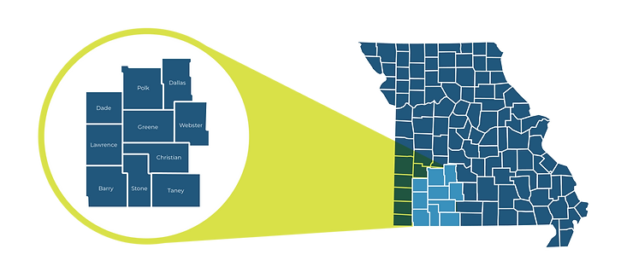

What is SMCOG?
Southwest Missouri Council of Governments (SMCOG; pronounced: ‘sim-cog’)
Regional Planning Commission or Council of Governments
  Established in 1989
  Serves 10 counties
Housed within Missouri State University, Center for Resource Planning and Management
Services include:
  Transportation Planning
  Grant Writing
  Comprehensive Planning
Notes:
Before we dive into the presentation, I wanted to talk about who we are and what we do.
Southwest Missouri Council of Governments is one of the 19 regional planning commissions in Missouri.
SMCOG was established in 1989 and serves 10 counties in SW Missouri.
Fun fact: We are the only COG that is administered and managed by a university. This unique partnership helps us access the university’s resources, collaborate with the faculty and increase student engagement.
Some of the services we provide are transportation planning, comprehensive planning, grant writing and administration, and hazard mitigation planning to our 10 counties. For transportation planning, we provide services outside the Springfield metro area as it is served by Ozarks Transportation Organization, the area MPO.

Slide 3

Project Background
2024 Rural Community Innovations Transportation Planning Grant
This plan is being developed with funds provided by the National Aging and Disability Transportation Center (NADTC). The NADTC is administered by Easterseals and USAging, with funding from the Federal Transit Administration and guidance provided by the Administration for Community Living.
Notes:
Talk about the grant program, grant objectives
This plan is developed with funds provided by the National Aging and Disability Transportation Center through their Rural Community Innovations Transportation Planning Grant Program. The purpose of this grant program is to engage in planning activities that identify transportation barriers, address current and future needs, establish multisector partnerships and actively involve older adults and people with disabilities.
This grant had no local match, which worked great for us, as most of our rural communities do not have the funds to develop planning documents.

Slide 4
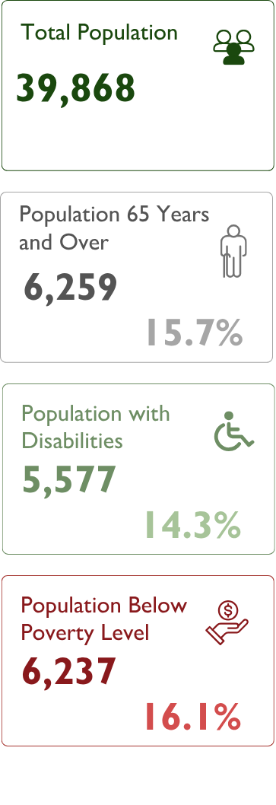
Webster County Demographics
Notes:
Webster County is one of the counties SMCOG serves in SW MO. Webster County is a predominantly rural county with about 40,000 residents and is a part of the Springfield Metropolitan Statistical Area. The Springfield Metropolitan Statistical Area is the third-largest MSA in the State of MO.
While agriculture remains central to the economy, the region is experiencing steady population growth, particularly among older adults and families.
The target population for the plan were individuals with disabilities, individuals with low income and older adults.
Fun fact about Webster County: Webster County is the birthplace of Edwin Hubble, the famous astronomer after whom the Hubble Space Telescope is named. He was born in Marshfield the county seat, in 1889.

Slide 5
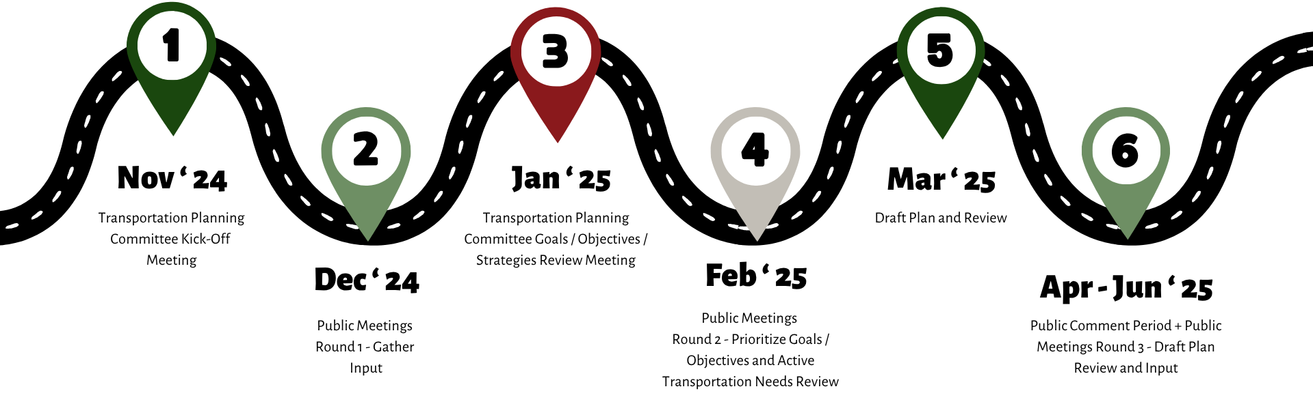
Planning Timeline
Notes:
We followed a similar planning process for this plan as we do for our other plans, such as a transportation plan or a comprehensive plan. But we made adjustments to our process based on what we were hearing from our committee members and also the public.
We started with a kick off meeting with our transportation planning committee where we went over what the plan was about and why it is important. We also reviewed the county wide survey with the committee and asked for their input on the questions and also various ways we could distribute the survey. We always ask our committee to be the champion of the planning process and asked for their help in distributing the survey to our target population. Some ways our committee helped us distribute the survey was by posting about our survey in various facebook groups within the county, our regional public transit service provide, OATS, representative was a part of the committee, she asked the bus drivers to encourage the users to fill out the survey.
After the kick-off meeting, we finalized the survey and published it. We facilitated 4 public meetings, 2 were at the senior centers, 1 at a library, and 1 at a clinic. During the meeting we asked everyone to complete the survey. We took ipads and paper copies but most preferred paper copies of the survey.
In our January meeting, which was our 2nd committee meeting, we presented the survey results and also presented the draft goals, objectives and strategies for the public transit portion of the plan and also presented the active transportation needs that we received from the survey and the public meetings. The committee helped us review the drafts and provided us with comments.
Then in February, we had a 2nd round of public meetings. In this meeting, we presented the GOS to the public and asked them to rank their top 3 objectives. We gave each attendee 3 stickers and asked them to prioritize. We also printed large maps of communities where active transportation needs were identified and asked them to review those needs and add/draw if we missed any. We had a meeting at a senior center, clinic, OACAC and church. For the meeting we had in the first round at the library, we only had a few people who attended. So the committee suggested having the meeting at the church instead of the library. This was once of the best decisions we made as the church meeting was one of the most well attended meeting during our process. Especially with this church being in the most rural community in the county.
Once we drafted the plan and published it for public comment, we didn’t receive any public comment as we had mainly asked everyone to review the plan and reach out to me with comments. We then decided to extend the public comment period and go to where people are to facilitate 2 meetings. We visited 2 senior centers, which are frequented by residents from multiple communities to get input.
Right now, we are in the process of finalizing our plan with all the comments and presenting it to the county commissioners for adoption.

Slide 6









Engagement Tools Used
Transportation Planning Committee: Representatives from local organizations
Survey mediums: Online, paper, QR codes at multiple locations
Public meetings: Hosted at senior centers, clinics, libraries, and churches
Media: Social media, press releases, flyers
Notes:
So previously, I briefly talked about our process, I mentioned our transportation planning committee. This committee had representatives from a lot of local organizations that represented our target population that are individuals with low income, individuals with disabilities, and older adults. Some of those organizations are webster county health unit, ….
As our committee worked with our target population on a day-to-day basis, they were able to provide us a lot of valuable input throughout the planning process.
In terms of survey, we used a lot of different survey mediums with in consideration of our target population. We had online survey links on flyers and also paper copies. We printed and handed paper copies to our committee members and they helped us distribute it.
For public meetings, we tried to go where the people are during their most busy days. I always like telling everyone that if you’re going to the senior centers, choose the days during lunch time with the popular lunch items. We have visited senior centers during days when they serve meat loaf on thursdays, fried chicken on Fridays. We also tried to be there on days when other events were scheduled like right before bingo days, during medical check up days… but make sure that you get there before lunch since they do not want to be disturbed during lunch time. In addition to the meetings, we also visited one of their food distribution days that’s usually attended by a couple hundred people and were there very early in the morning to hand our survey copies and flyers.
Our survey and public meetings information was distributed through social media, press releases and handing out flyers. Like I mentioned before with the OATS drivers handing out survey flyers, our committee posting on social media, adding it to their organization pages and website.

Slide 7
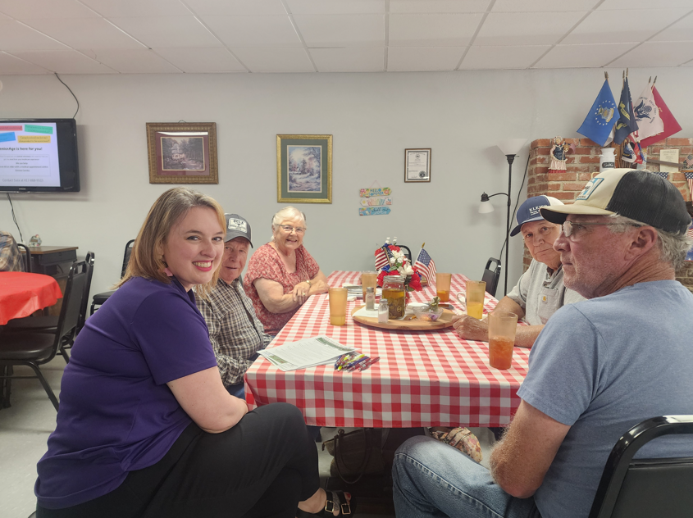
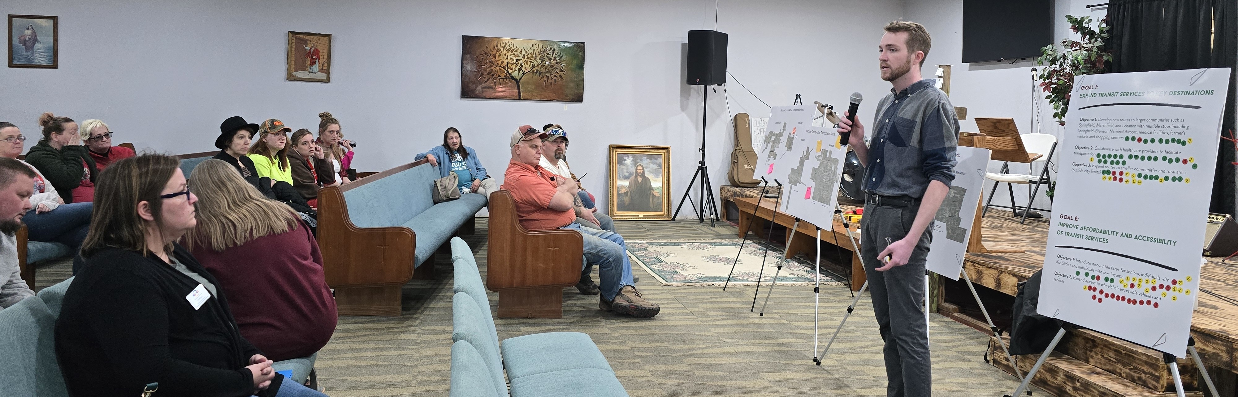
Innovative Engagement Approaches
Small group format in trusted venues
TPC members as local outreach leads
Big map exercises, dot exercises, plain language handouts, sticky note boards
Notes:
For some of the engagement ideas we tried, these were the most successful.
We tried to go to their trusted venues such as the senior centers, clinics and library. These are the spaces they frequent a lot so we tried to reach them where they usually are at. While we were there, we made a big announcement at the beginning but then also went to everyone individually at the tables they were sitting at. This helped us talked to them on a personal level instead of asking them to come up to us at the front of the room. This helped us to get to hear their personal stories and also address any accessibility issues such as hearing and reading.
We asked our committee to be the champion for this plan. Having them as our outreach leads helped us receive input. We not only asked them to help us with surveys but also asked them to attend the public meetings to talk to the attendees. As the attendees would be familiar with them more and maybe open up more to them.
We did more of interactive style meetings rather than just us talking to the attendees. We provided stickers for prioritization, sticky notes and markers for comments and drawing on the maps for active transportation. Everyone loved the dots exercise!

Slide 8
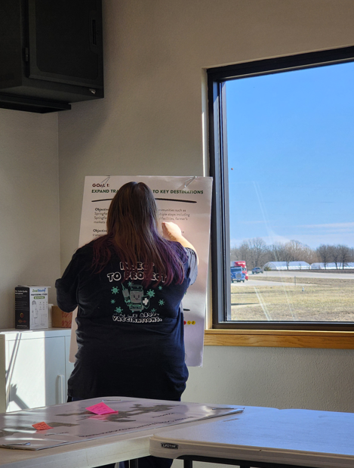
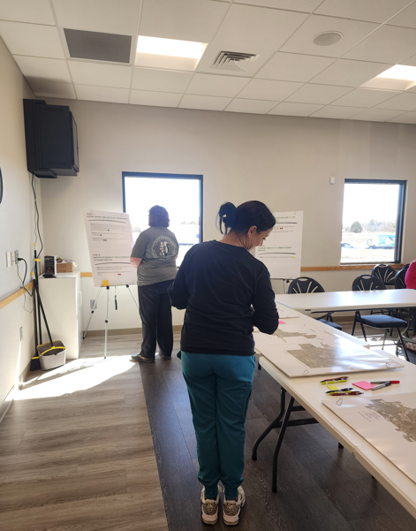
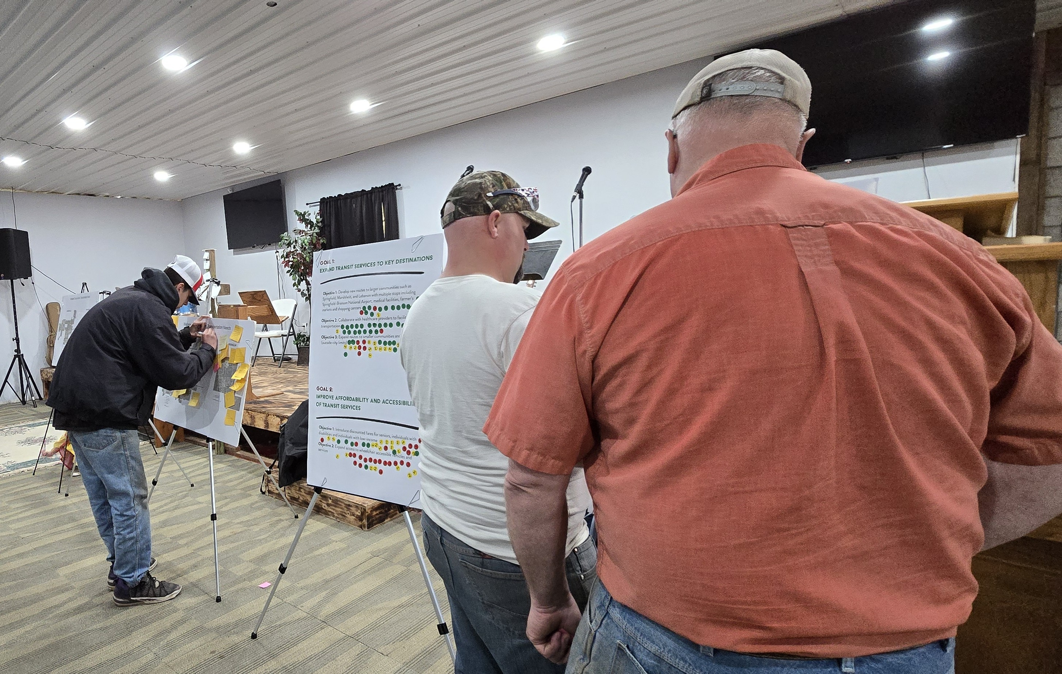
Innovative Engagement Approaches

Slide 9
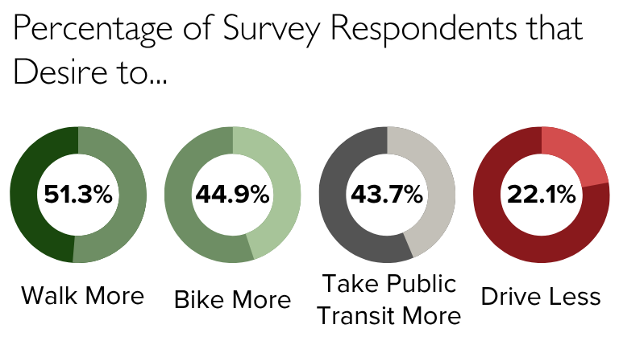
Engagement Insights
220 survey responses
Engaged with over 150 individuals during public meetings
The advisory committee remains committed to continue serving throughout implementation
Notes:
Primary GOS that were identified, how SMCOG will help the committee
For our surveys, we handed out about 600 paper copies along with flyers that had the survey link and QR codes. We received about 220 responses with many being paper copies.
We engaged with over 150 individuals during our 10 public meetings throughout the process. Our most attended meetings were at the senior centers and the church
Our planning committee said they would like to meet up up regularly even after the plan is adopted to help with the implementation phase. Our office will take a step back once the plan is adopted but will continue attending their meetings and help with the implementation phase.
Starting FY25, MoDOT provided RPCs additional funds for multi-modal transportation planning funds. Through these funds, we will be able attend more meetings, and also act as the regional coordinator between transportation agencies and human service agencies. Historically, we have only received public transit planning funds once every 5 years to update the PTHSCP, but now we are able to do more with the additional funds.

Slide 10
Success Factors and Lessons Learned
Partner with familiar non-profits and human service agencies
Choose accessible venues and survey mediums
Incentives for completing survey
Engage in small group or one-on-one discussions
Iterative public engagement plan
Share progress and summaries after each phase
“Go where people are”
Notes:
Partnering with local non profit organizations and human service agencies help people open up to this process and provide us with their input.
Choosing accessible venues such as the senior centers and also choosing survey mediums that work for the target population will help receive more survey responses.
We provided an incentive for completing the survey. We provided 5 $20 surveys through a random drawing. When we went back for the public meetings, we met with the ones who received the gift cards and they were very happy about it. As Dollar Generals are everywhere and also act as the only grocery store in many rural communities, we wanted to give dollar general gift cards. But during this process, we learned that they didn’t have gift cards to their own store. They do sell gift cards but for other stores. So then we used prepaid debit cards for the prizes
Engaging in small group discussions helped when explaining what we were asking of them, allowed us to explain the plan in more detail to each participant, and we could more easily address accessibility challenges this way (hearing, reading, writing, comprehension, etc) and allowed us to gather relevant stories and build trust among participants (some of them remembered us and grew hopeful about what the plan could bring)
Instead of doing 1 round of public meeting, doing it multiple times throughout the process helped build a connection with the residents
Additionally, sharing progress with them throught the process after major work during the process also helped the residents understand the process and build that trust
Lastly, the most important, going where people are instead of asking them to come to us. We tried that once at the library but then the second round when we went to where they are, at the church, we were able to connect with a big group of people.

Slide 11

Discussion Prompt
What’s one engagement tactic you have used that surprised you with its impact?

Slide 12

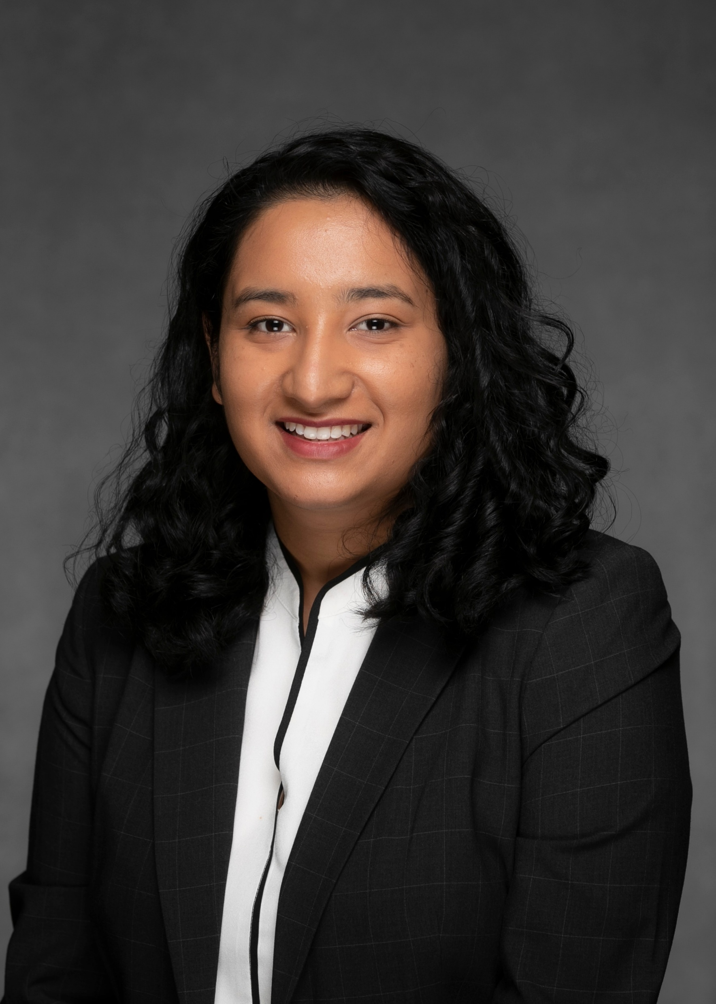
Questions?
      Aishwarya Shrestha, AICP
      Senior Planner
      AishwaryaShrestha@MissouriState.edu

