Slide 1
Alternative Fuels
Abbie Christophersen | Energy Project Manager
Iowa Economic Development Authority

Slide 2
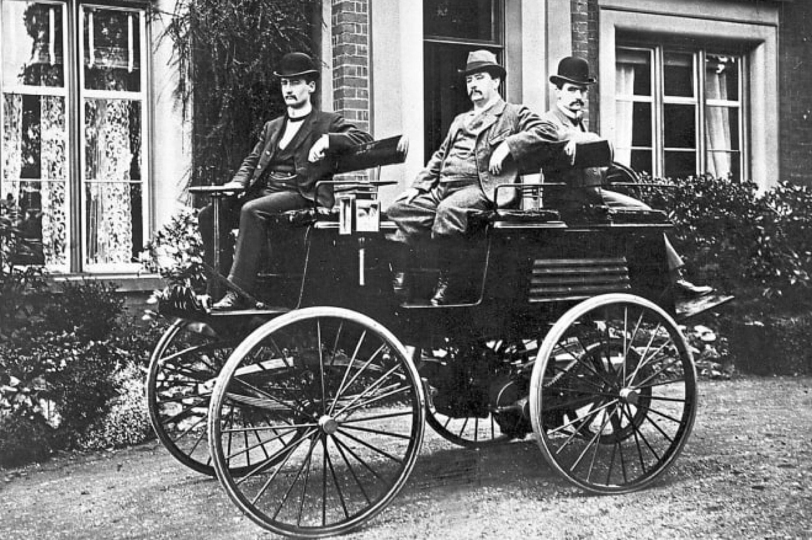
Fun Fact:
Notes:
Robert Anderson, Scotland, 1832. It could travel up to 5 mi/hr

Slide 3
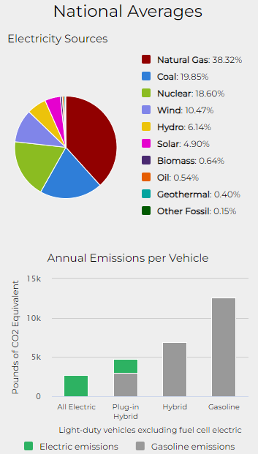
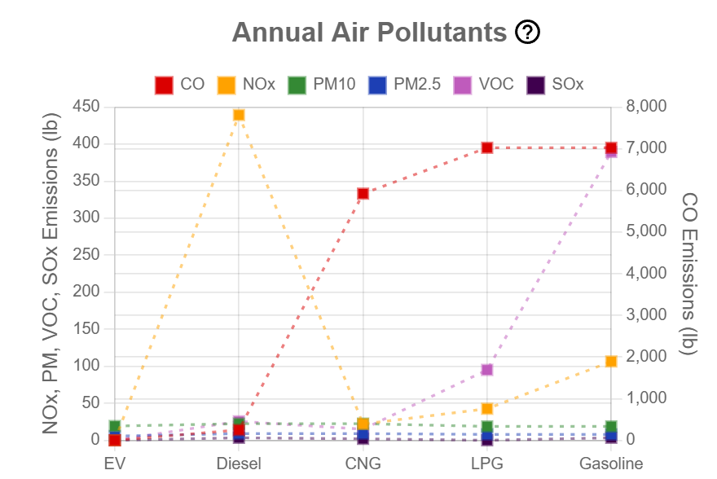
Notes:
Bi fuel, retrofits

Slide 4
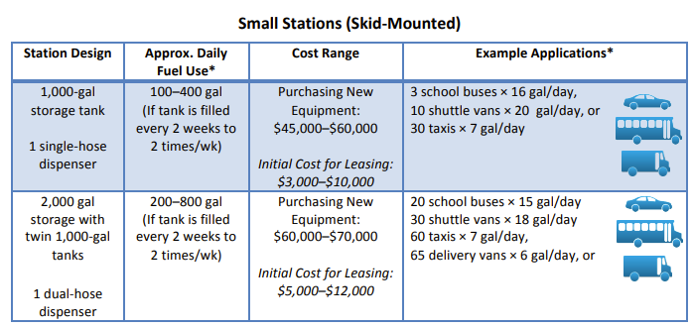
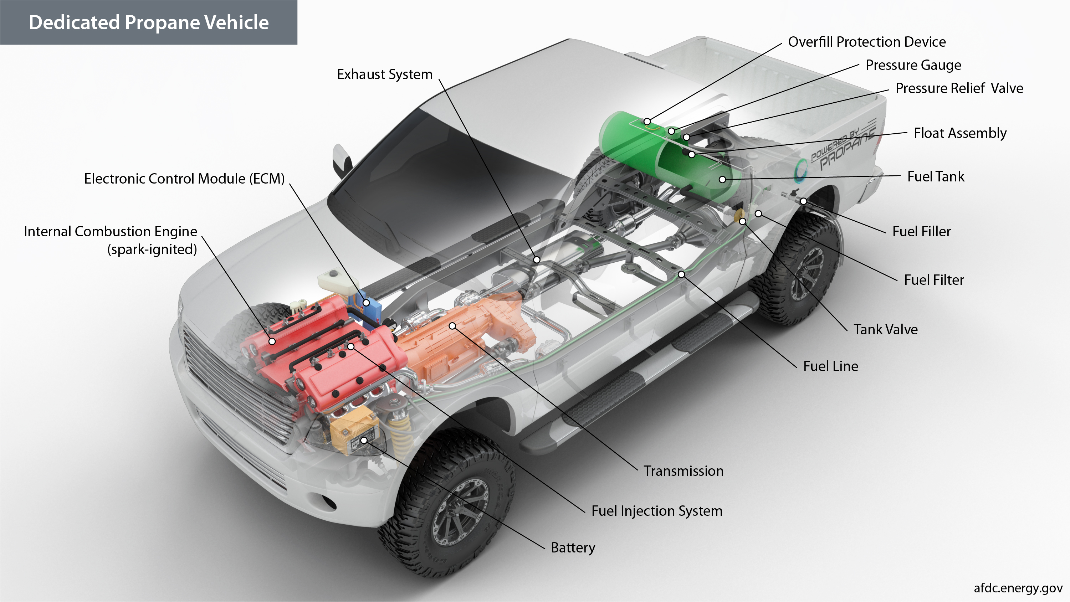
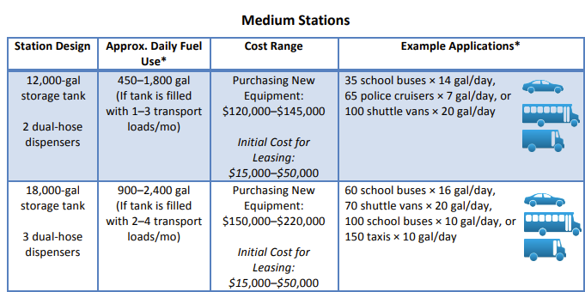
Propane
Storage Tank and Filling
Dispenser
Pump and Motor
Fuel Management System
Notes:
Storage Tank and Filling ($5,000 to $100,000)
• Propane is delivered to the site by a bulk truck and stored in an onsite tank. A fleet should select a storage tank size based on the fleet’s fuel use and the frequency of fills.
• Used propane tanks may be available for purchase and could cost less than new tanks.
• The fleet manager and the fuel supplier work together to determine the communication procedure for filling a propane storage tank. Options include: o A fleet manager has the tank filled at a specified frequency, such as once per week. o The tank is monitored with a sensor that notifies the supplier when filling is necessary. o A fleet manager tracks the fuel use and submits tank fill requests based on fleet needs and fuel pricing. In this case, the fleet manager should ensure the tank does not completely empty between fills, as this may damage equipment and prevent the tank from being able to fuel vehicles.
Dispenser ($5,000 to $35,000)
• The dispenser manages the propane that is delivered into the vehicle. It can vary in complexity and cost depending on the enclosure material, fueling flow rate, number of hoses, electrical system, size of pump motor, and fuel management system.
• Additional dispenser hoses reduce wait times by allowing more vehicles to fuel simultaneously. Depending on the station design and the dispensing rate, adding more dispensers may require purchasing a larger pump and motor.
Pump and Motor ($4,000 to $15,000)
• The motor is connected to the electrical setup and powers the pump. The pump pushes propane from the storage tank and to the dispenser, which delivers it to the vehicle via the hose.
• Propane generators can be used to run the motor during a power outage and are assets in an emergency preparedness plan. Propane generator costs can range from $3,000 to $10,000, depending on the pump and motor size.
Fuel Management System ($5,000 to $30,000)
• The fuel management system monitors and tracks the flow of fuel delivered to the vehicle. It can vary in complexity from a simple card reader to a full-service tracking system of driver and vehicle fueling history.

Slide 5
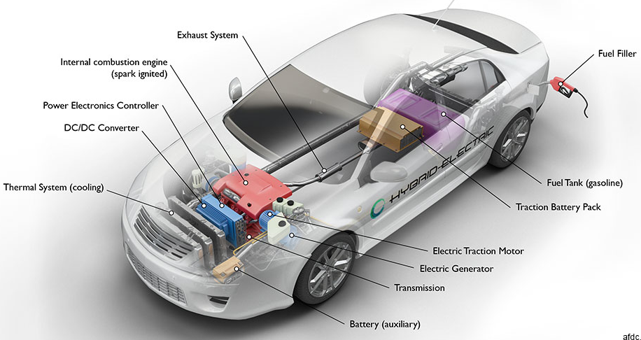
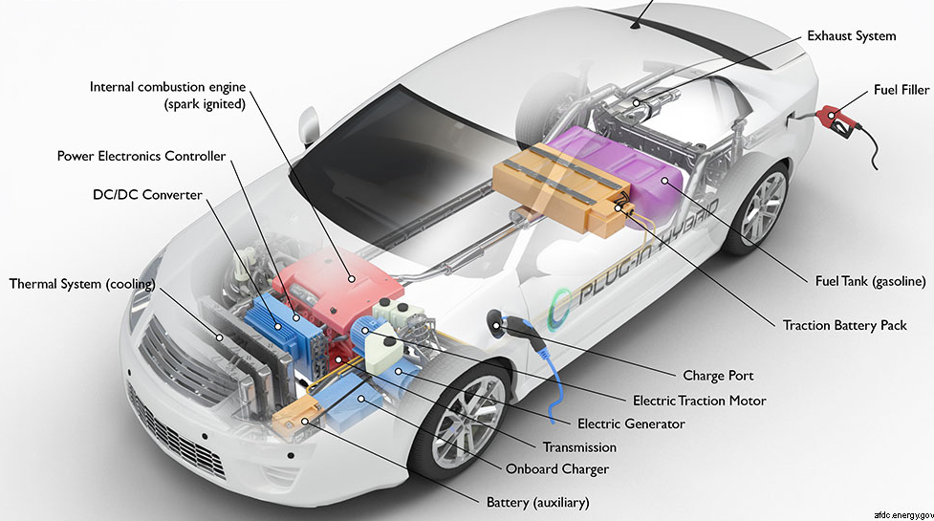
Plug-in Hybrid Electric Vehicle
Hybrid Vehicle

Slide 6
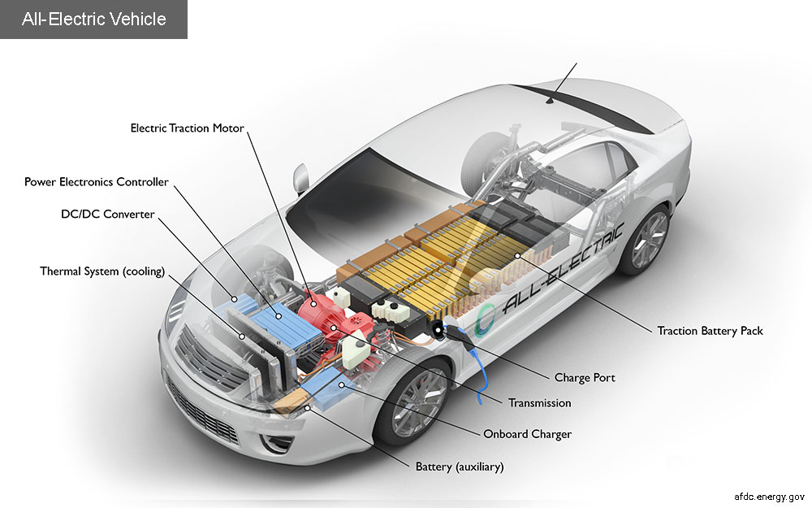

Slide 7
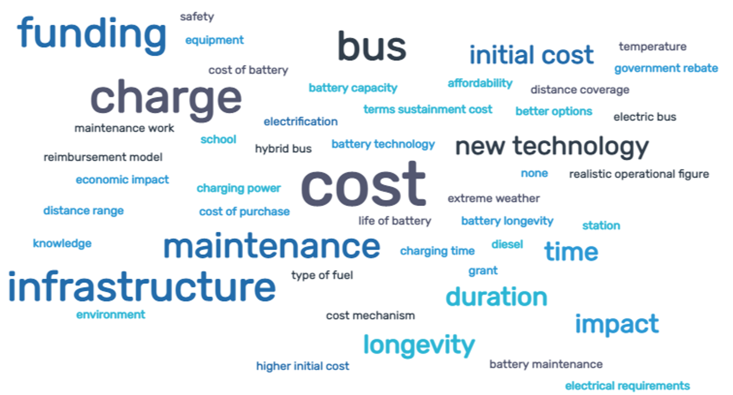
Barriers to fuel conversion
Building out infrastructure
Availability of budget
Accessing new funding or financing
Working with local utilities
Conducting maintenance
Notes:
Electric – 30 to 45 K
Propane – 45 to 60 K
NG – 60 to 100 K

Slide 8
Pros and Cons List
Pros
Cons
Winter range
Range - road trips
Charging availability
Vehicle cost
Maintenance costs
Politics
Road use taxes
Safety (batteries)
Grid reliability
Technological advancements
Automation
Environmental stewardship
Safety features
Perceived status
Speed, smell, sound
Model variety availability
Tax credits
Home charging cost
Resilience

Slide 9
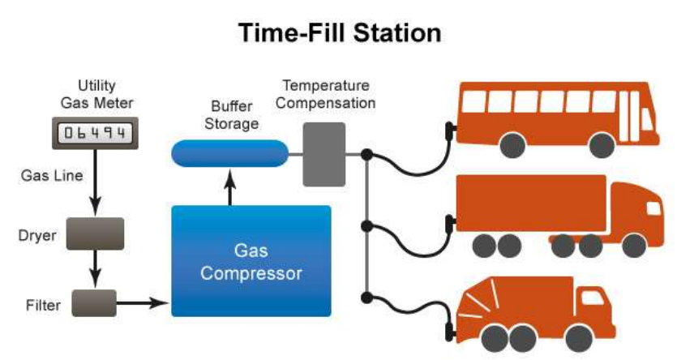
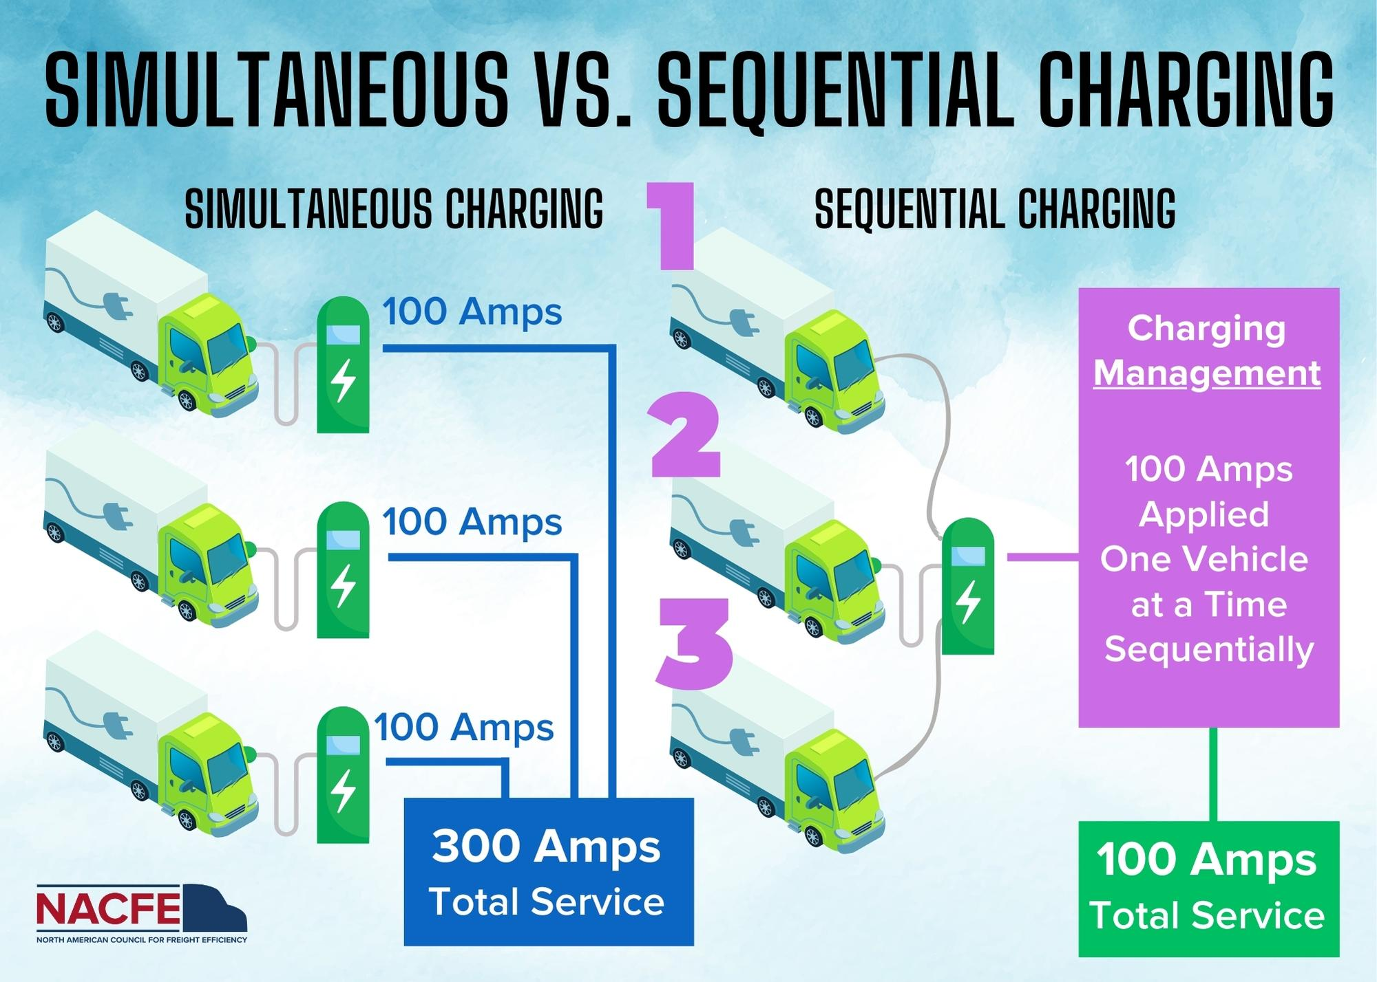
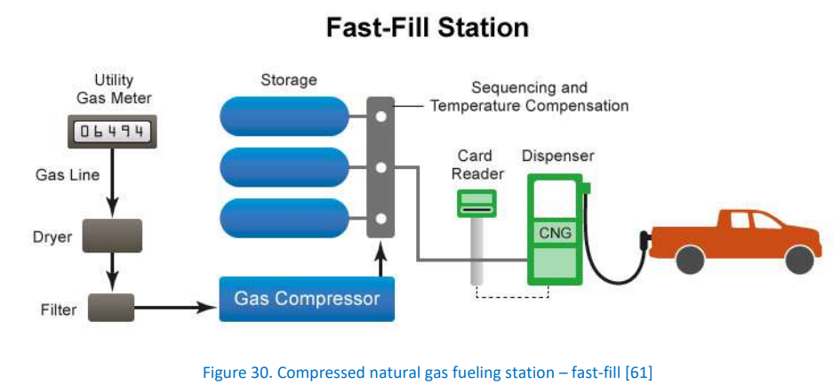
Notes:
Propane = 13 min fill
Demand charges

Slide 10
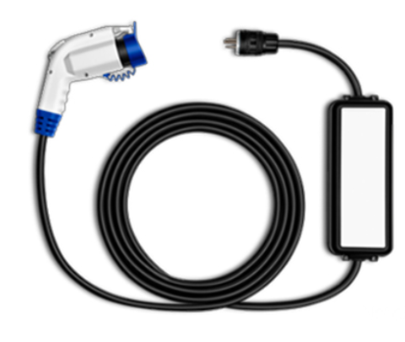
Chargers
AC Level 2
AC Level 1
DC Level 3

Slide 11




Name that connector
Options:
NACS (J3400)
CCS-1
J1772
CHAdeMO

Slide 12
Connectors
AC Level 1
AC Level 2
DC Level 3
J3400
J3400
CHAdeMO
J1772
CCS-1
CCS-1

Slide 13
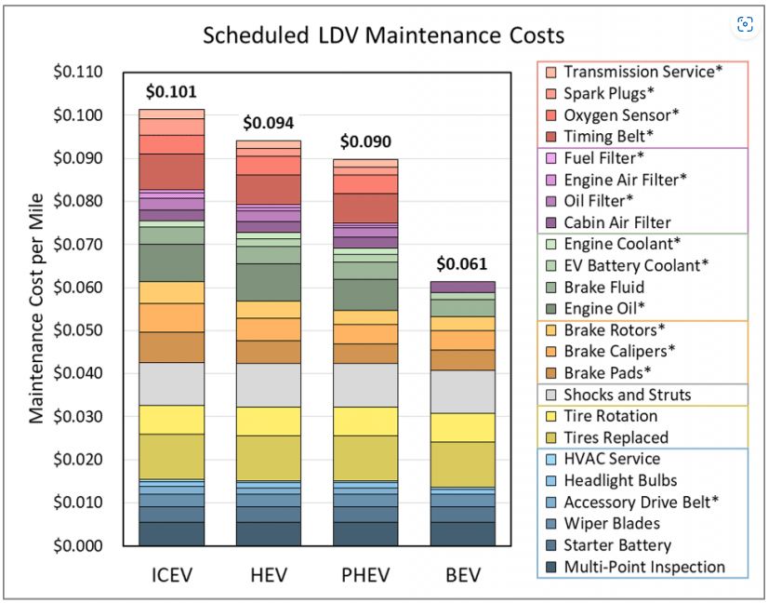
Notes:
No more oil changes!

Slide 14
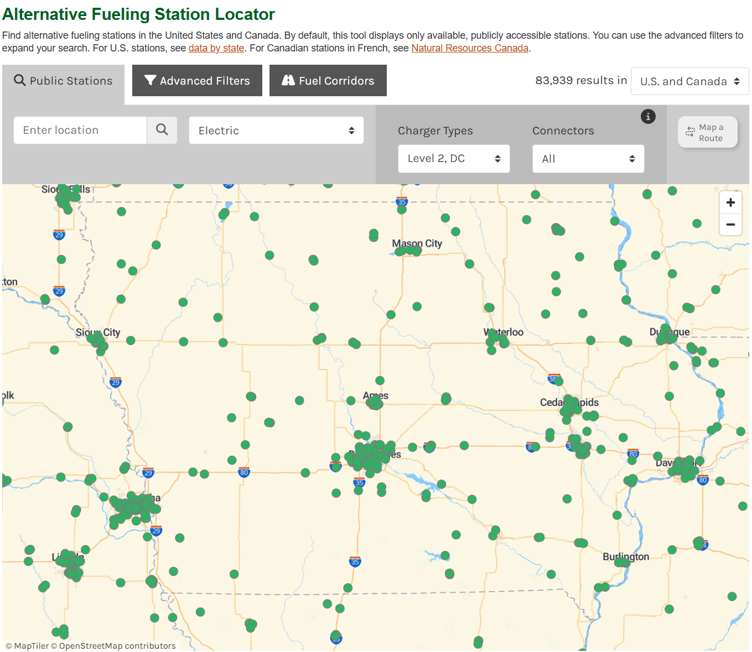
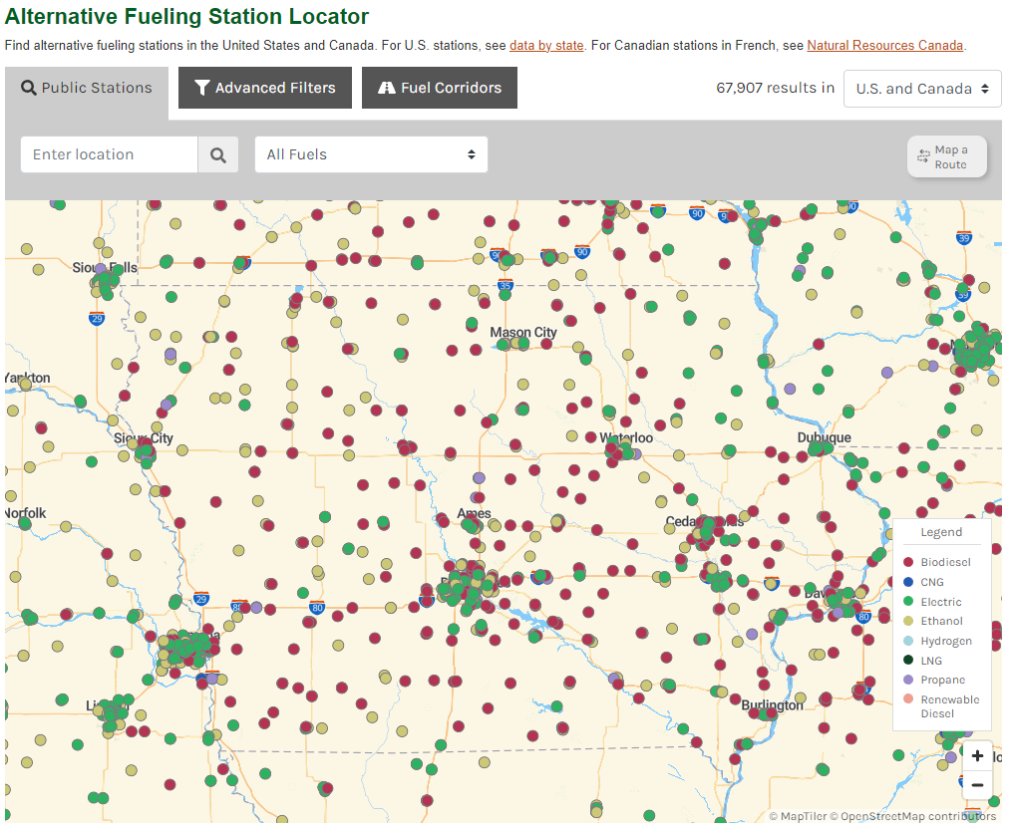
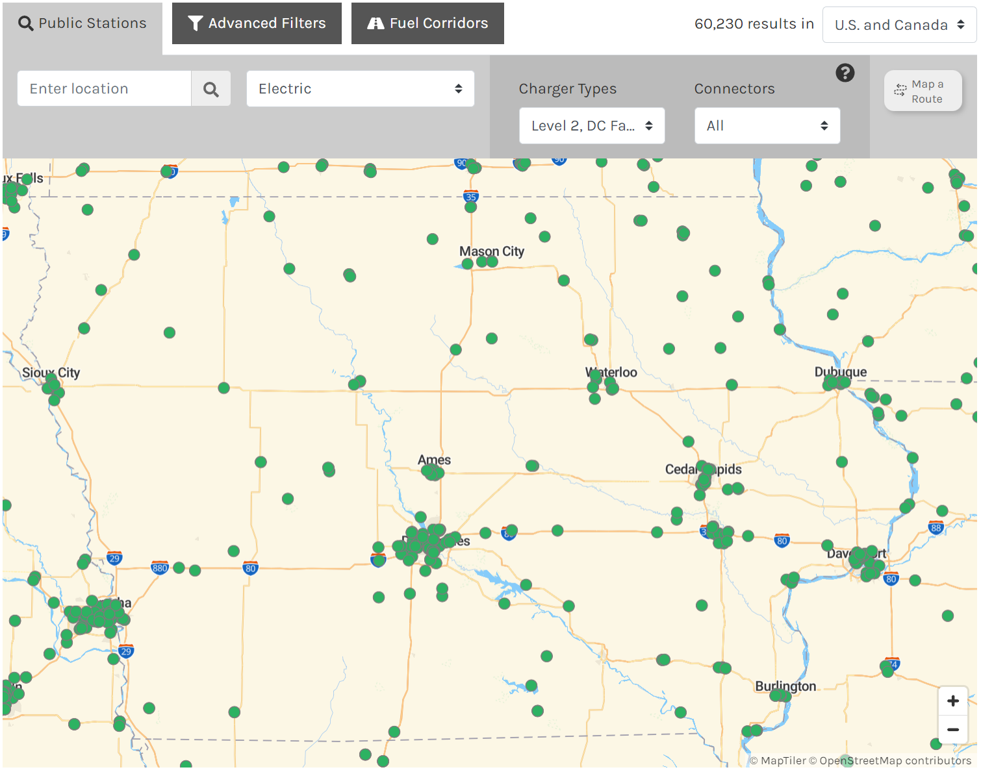
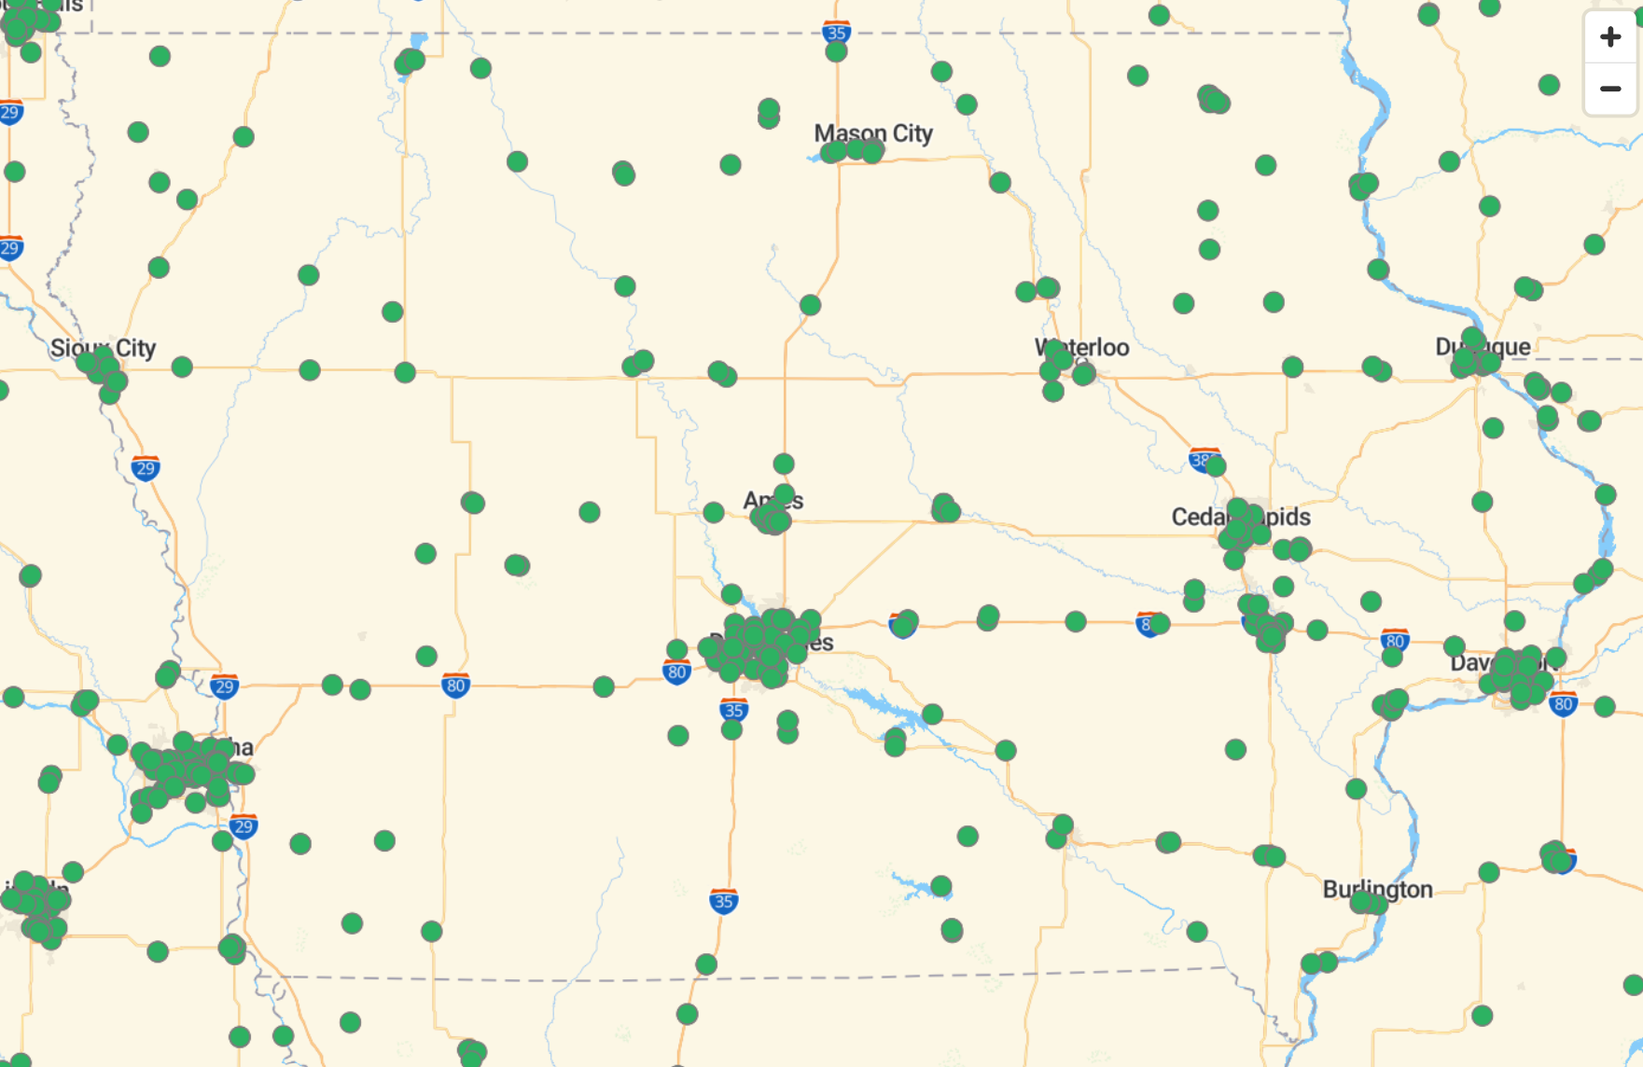
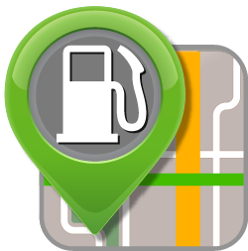
Station Locator
Locate alternative fueling stations and get maps and driving directions.
afdc.energy.gov/stations
Notes:
Biodiesel (B20 and above): 343
Electric (charging outlets): 1,171 (locations=457)
Ethanol (E85): 330
Hydrogen: 0
Natural Gas: 5
Propane: 24
Iowa has approximately 450 public charging station locations with over1100 ports. Currently 316 of those locations are level 2 and 142 are level 3.
If you're interested in learning more about stations nearest you I'd recommend using the AFDC station locator.

Slide 15
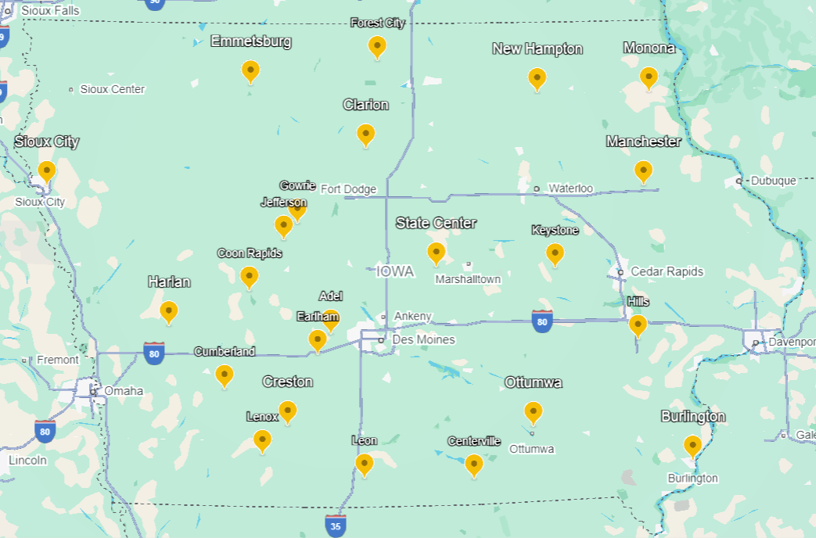
EV Emergency Response Firefighter Trainings
https://www.nfpa.org/

Slide 16


Slide 17
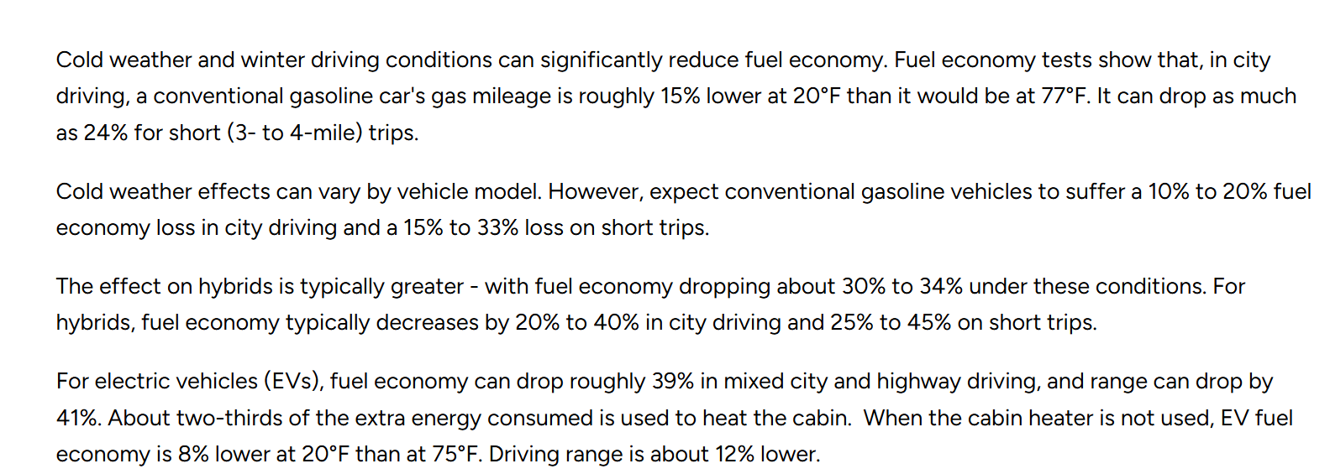
Fuel Economy in Cold Weather
https://www.energy.gov/energysaver/fuel-economy-cold-weather

Slide 18
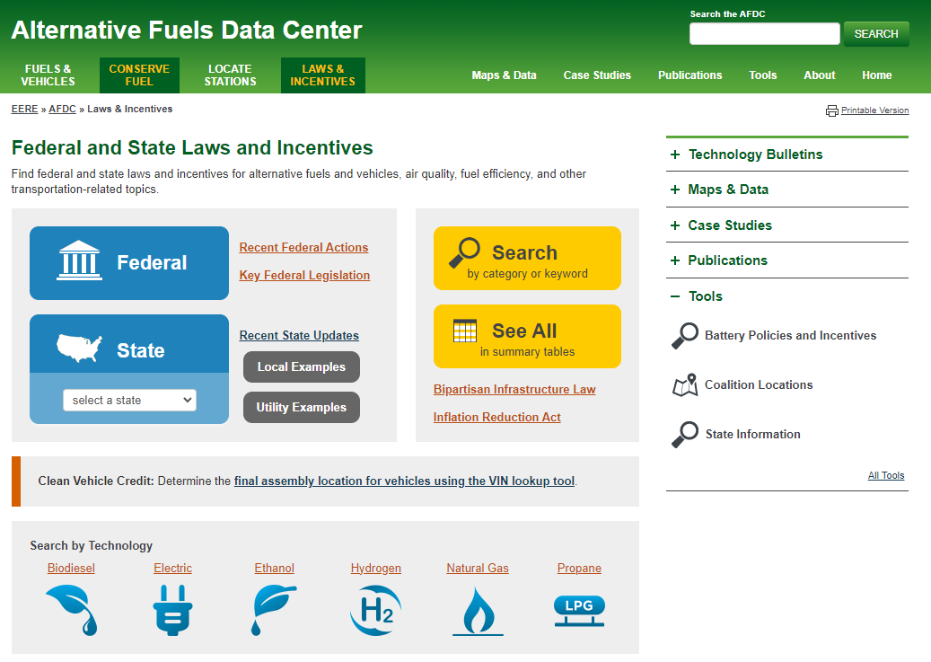

Laws & Incentives
Laws & Incentives
Find federal and state laws and incentives for alternative fuels and vehicles, air quality, fuel efficiency, and other transportation-related topics.
afdc.energy.gov/laws
Notes:
The Alternative Fuels Data Center Laws and Incentives website is a great resource to answer any questions regarding federal and state laws, incentives for alternative fuel investment, and many other transportation related topics. 64 Utilities, 1 city.

