Slide 1
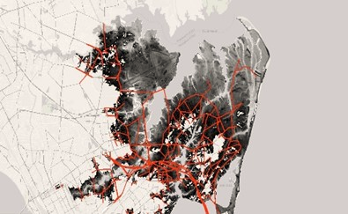
The Resilience and Disaster Recovery (RDR) Tool Suite
NADO RPO Conference
July 15, 2025
Kristin C. Lewis, Ph.D.

Slide 2
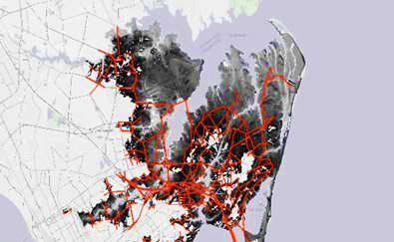
Transportation networks are under constant threat from hazard-related disruptions.
Notes:
Script: Transportation networks are under constant threat from hazard-related disruptions, such as floods, earthquakes, or landslides.

Slide 3
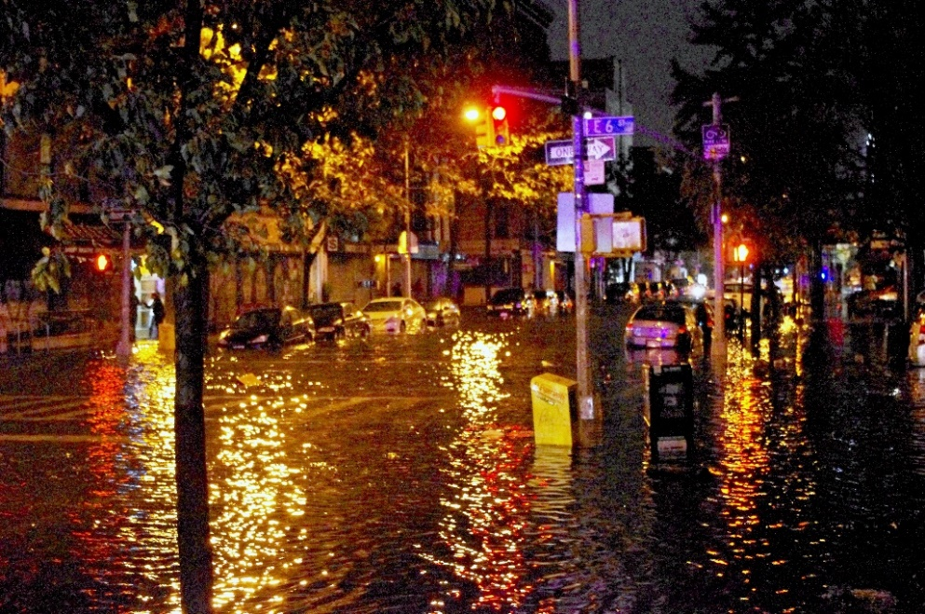
Resilience investments can reduce the impact of hazard disruptions on trips taken and travel time.
Notes:
Script: Resilience investments can reduce the impact of hazard disruptions on trips taken and travel time.

Slide 4
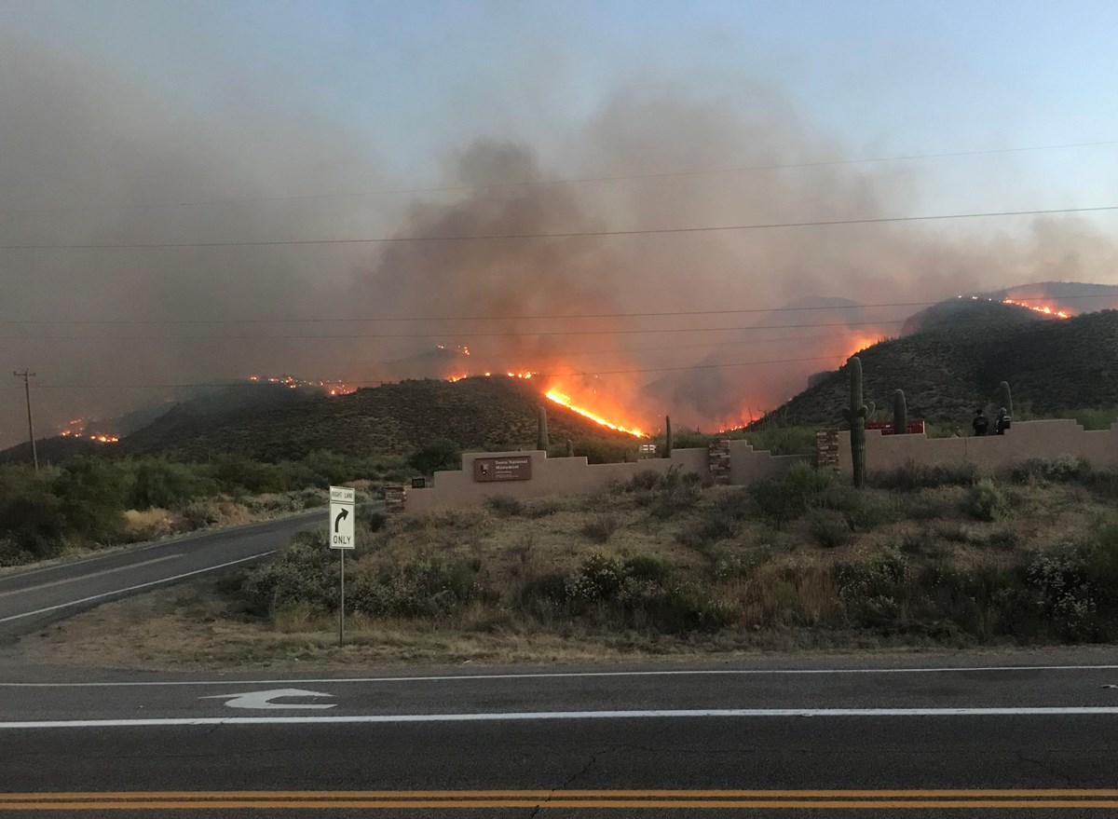
Which infrastructure investments provide the greatest impact reduction under a range of potential hazard conditions?
National Park Service, USA, Public domain, via Wikimedia Commons
Notes:
Script: Public agencies want to know which infrastructure investments provide the greatest return under a range of potential hazard conditions.

Slide 5
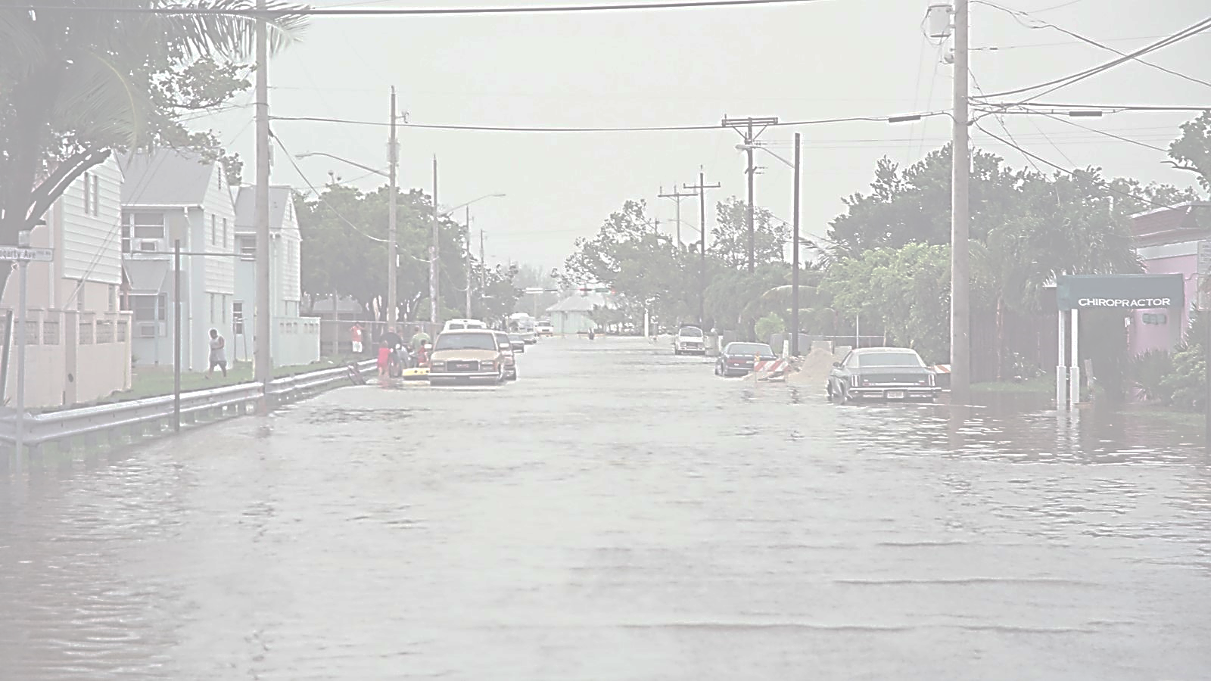
How are investment benefits distributed across transportation network users?
https://flickr.com/photos/97623182@N00/29762351987
Notes:
Script: They also want to know how benefits of infrastructure investments are distributed across users of their transportation network.

Slide 6
The RDR Tool Suite can help users explore scenarios to answer these questions.
Notes:
Script: RDR can help users explore scenarios to answer these questions.

Slide 7
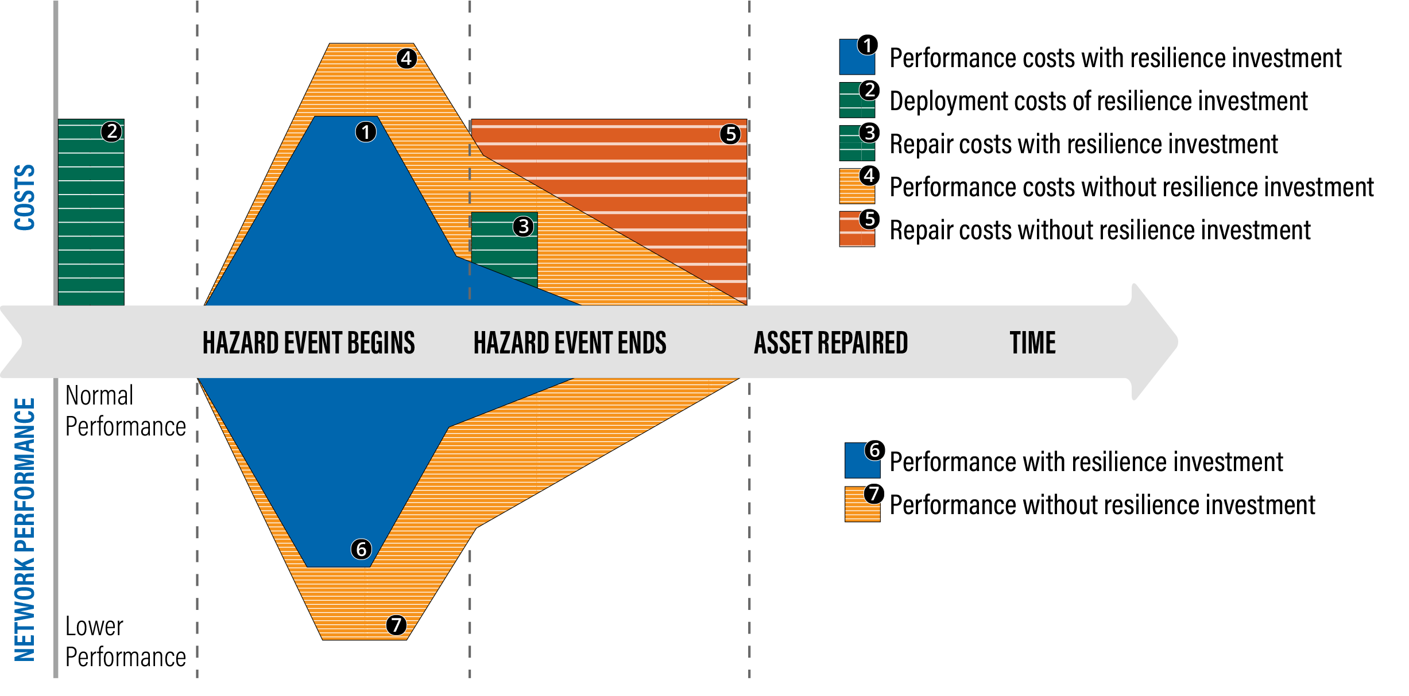

Estimating Return on Investment
NET BENEFIT
Net benefit = difference between areas with and without resilience investment
Notes:
ANIMATED SLIDE
More cost up front for resilience investments, but the pay off is not only more reliable performance during hazard event, but lower repair costs and time

Slide 8




Why a Resilience Investment Analysis Tool?
CHALLENGES
  Future hazard conditions are highly uncertain.
  A range of resilience investment options can mitigate effects.
  Leads to thousands of scenarios to test.
  Existing travel demand models are too slow to analyze many scenarios and cannot combine performance benefits across hazard conditions.
Notes:
Current travel models are designed for a point prediction forecasting average future conditions. They don’t handle uncertain events.
To deal with uncertainty, you need to consider several scenarios of possible futures. This implies the need for faster models (perhaps more approximate, but with the appropriate sensitivities to changes in inputs).

Slide 9
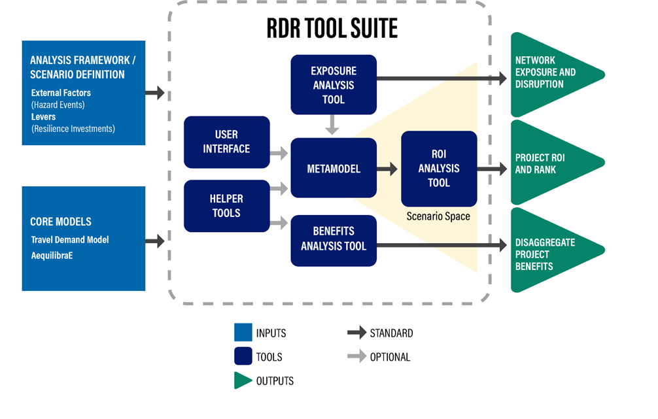

Why a Resilience Investment Analysis Tool?
Solution
A robust tool suite to help transportation practitioners evaluate resilience return on investment (ROI) for long-range planning across a range of uncertain scenarios.
Notes:
The RDR Tool Suite approach was inspired by another FHWA project: Travel Model Improvement Program – Exploratory Modeling and Analysis Tool (TMIP-EMAT), which provides a framework for running and evaluating many scenarios.

Slide 10
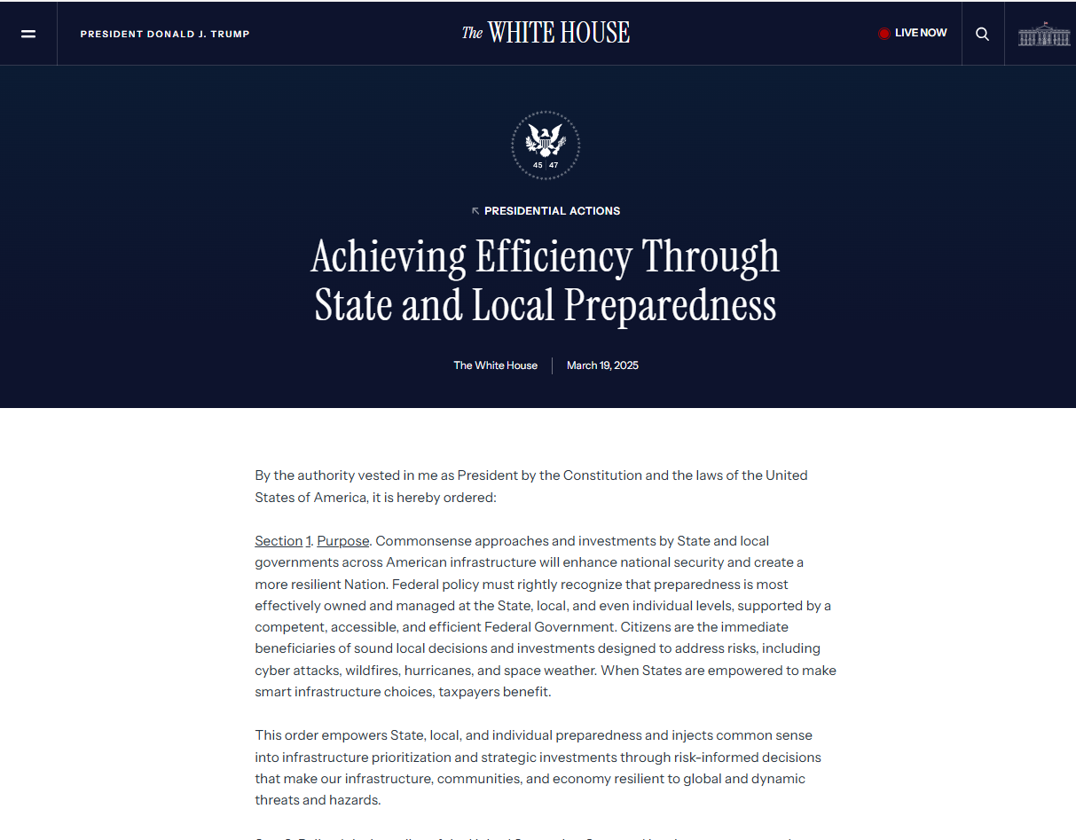
Why a Resilience Investment Analysis Tool?
  RDR Supports:
Benefit-cost analysis for cost-effective investments.
Investment in safe, high-integrity transportation infrastructure.
Expedites disaster recovery planning.
State and Metropolitan/Transportation Planning Organizations project prioritization.
Alignment with Achieving Efficiency Through State and Local Preparedness EO, March 19, 2025.

Slide 11

The RDR Tool Suite
  RDR Overview:
  RDR Features:
  Screening level network performance analysis tool.
  Hazard agnostic.
  Passenger and freight focused.
  Leverages agency data and modeling.
  Prioritizes resilience projects by ROI across range of future conditions.
  Robust Decision-Making based metamodel.
  Accommodates road and transit networks.
  Software: Python, R, optional Geographic Information System (GIS) components.
  Aligned with US DOT BCA guidance.
RDR Available at:
volpeusdot.github.io/RDR-Public
Created by the Volpe Center in support of the Office of the Secretary of US DOT (OST) and the Federal Highway Administration (FHWA).
Current activities supporting OST-R.

Slide 12





RDR Data Requirements
NETWORK DATA
TRIP DATA
HAZARD DATA
PROJECT DATA
Notes:
Data may come from different sources, including common publicly available data sources
-Network data
-Link-level hazard data (can be from Exposure Analysis Tool)
-Trip tables
-Resilience projects
-Configurations and user-defined/default relationships
-Economic data

Slide 13
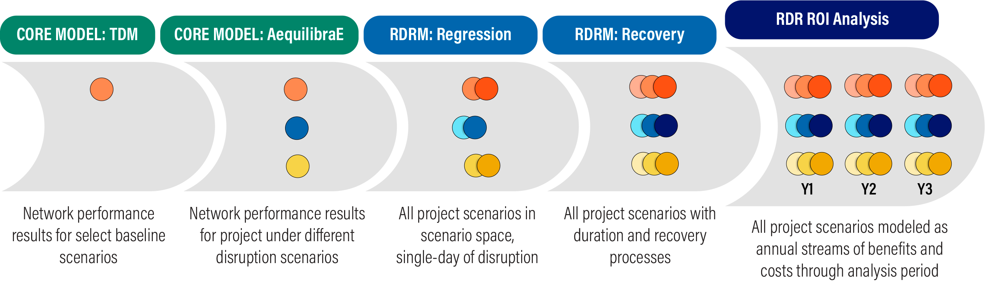
RDR Metamodel and ROI Analysis Tool – Scenario Development
Analysis defined by external factors (uncertainties) and levers (resilience investments)
Population and land use
Disruptive events
Uncertainties in recovery
Transport supply
Resilience investments
Recovery process
Notes:
This slide shows how the scenario space expands as one works through the RDR Tool Suite analysis process.
Core Models (Travel Demand Model, AequilibraE) are in green headings at the left: They perform initial sampling of runs to enable the metamodel to expand the scenario space to encompass the range of uncertainties. This starts with the travel demand model (TDM) and then leverages the open source AequilibraE package to supplement or replace TDM runs as needed.
RDR Metamodel (RDRM) aspects are in light blue headings in the middle: They expand the scenario space to assess hazard impacts and resilience project performance across a range of hazard conditions, recovery times, and years.
RDR ROI Analysis Tool is a dark blue heading at the right: This monetizes performance and damage/repair. It ranks proposed resilience investments based on return-on-investment (ROI).

Slide 14
RDR Metamodel and ROI Analysis Tool – Scenario Development
Analysis defined by external factors (uncertainties) and levers (resilience investments)
Population and land use
Disruptive events
Uncertainties in recovery
Transport supply
Resilience investments
Recovery process
Notes:
This slide shows how the scenario space expands as one works through the RDR Tool Suite analysis process.
Core Models (Travel Demand Model, AequilibraE) are in green headings at the left: They perform initial sampling of runs to enable the metamodel to expand the scenario space to encompass the range of uncertainties. This starts with the travel demand model (TDM) and then leverages the open source AequilibraE package to supplement or replace TDM runs as needed.
RDR Metamodel (RDRM) aspects are in light blue headings in the middle: They expand the scenario space to assess hazard impacts and resilience project performance across a range of hazard conditions, recovery times, and years.
RDR ROI Analysis Tool is a dark blue heading at the right: This monetizes performance and damage/repair. It ranks proposed resilience investments based on return-on-investment (ROI).

Slide 15
RDR Metamodel and ROI Analysis Tool – Scenario Development
Analysis defined by external factors (uncertainties) and levers (resilience investments)
Population and land use
Disruptive events
Uncertainties in recovery
Transport supply
Resilience investments
Recovery process
Notes:
This slide shows how the scenario space expands as one works through the RDR Tool Suite analysis process.
Core Models (Travel Demand Model, AequilibraE) are in green headings at the left: They perform initial sampling of runs to enable the metamodel to expand the scenario space to encompass the range of uncertainties. This starts with the travel demand model (TDM) and then leverages the open source AequilibraE package to supplement or replace TDM runs as needed.
RDR Metamodel (RDRM) aspects are in light blue headings in the middle: They expand the scenario space to assess hazard impacts and resilience project performance across a range of hazard conditions, recovery times, and years.
RDR ROI Analysis Tool is a dark blue heading at the right: This monetizes performance and damage/repair. It ranks proposed resilience investments based on return-on-investment (ROI).

Slide 16
Project Prioritization:
Economic Analysis Approaches
Benefit Cost Analysis under Uncertainty (BCA-U) /
Regret Analysis:
Benefit Cost Analysis (BCA):
Breakeven Analysis:
  Total net benefits of a project over selected analysis period (e.g., 50 years) based on probability of hazards and total resilience investment cost.
  Total net benefits of a project over analysis period relative to the best investment option for each scenario, without need for hazard probability. Projects are ranked by total “regret,” or how different the performance is from the best case in each scenario.
  Total benefits of a project over analysis period without taking into account cost of the investment. Result tells you what you can “afford” to spend to break even on a resilience investment.
Notes:
Visual outputs of these different economic analysis approaches are output in the Tableau workbook

Slide 17
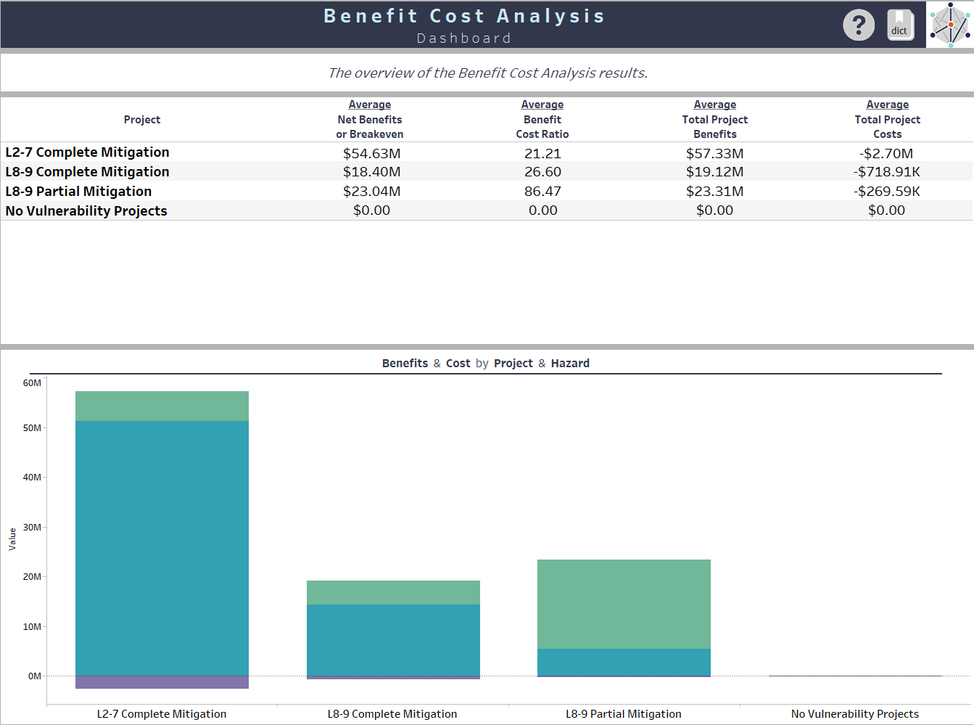
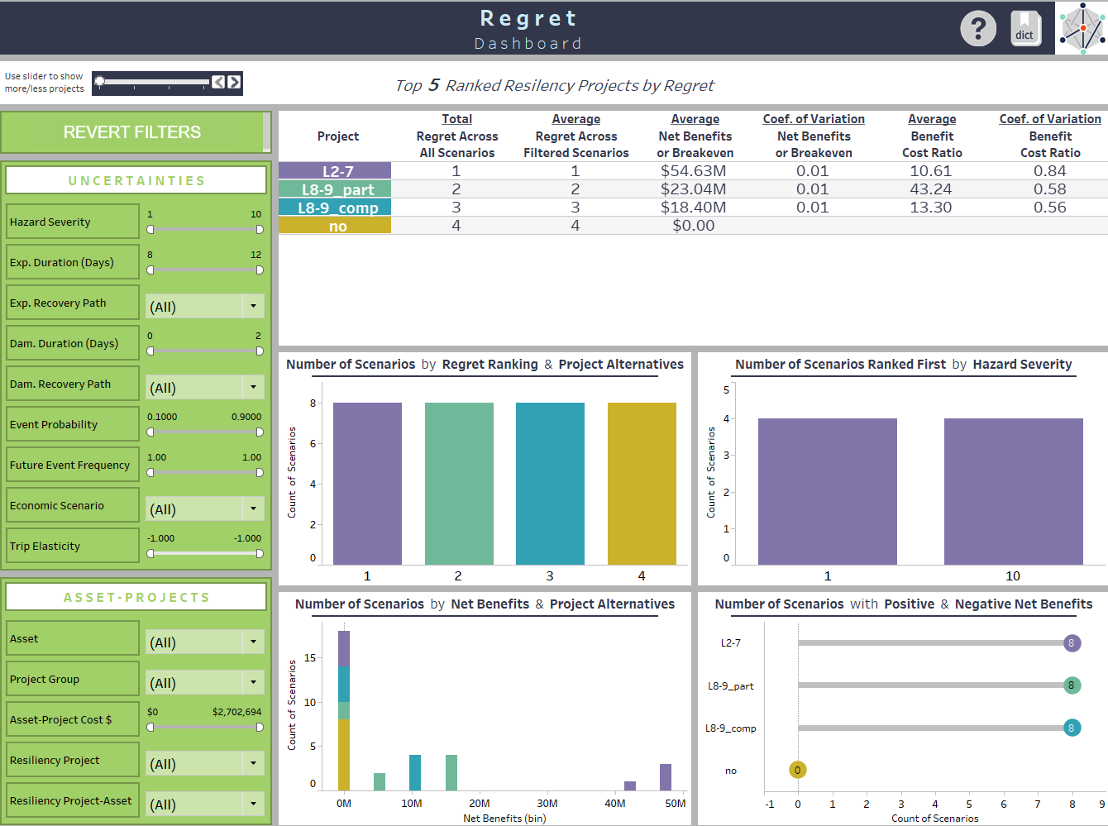
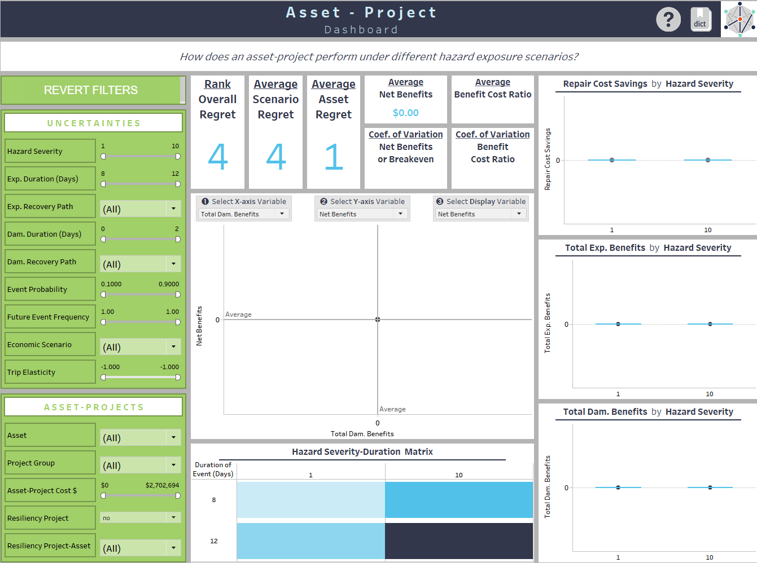
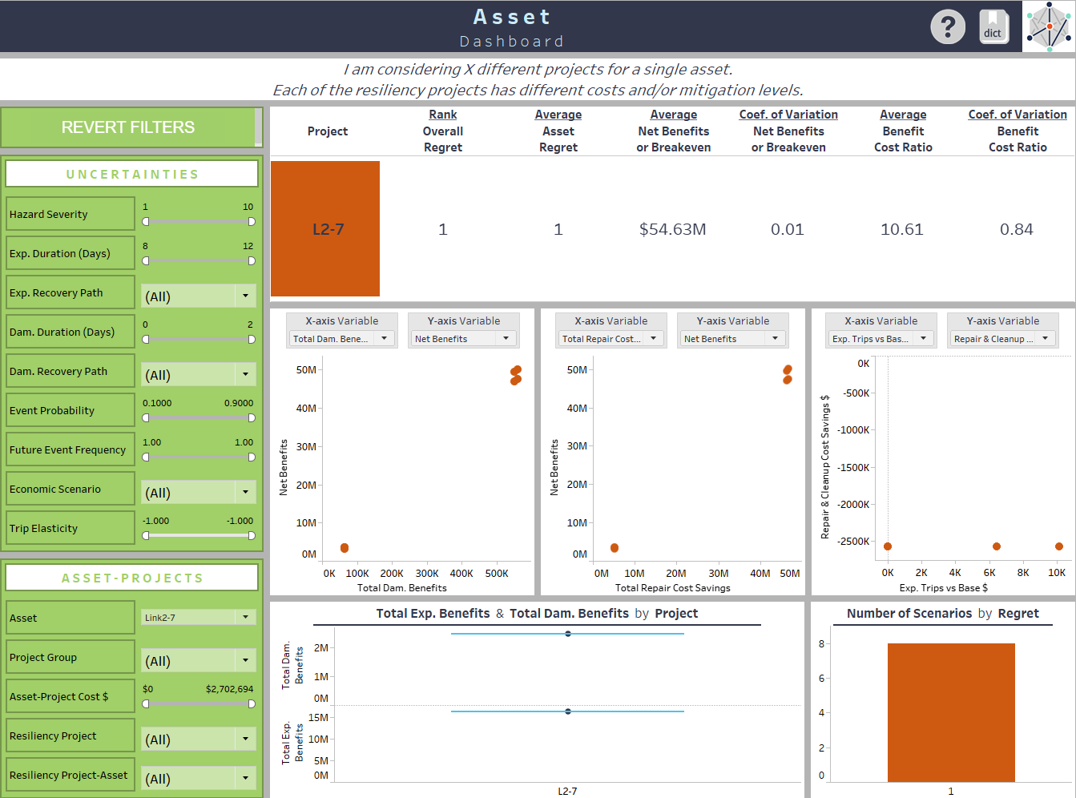
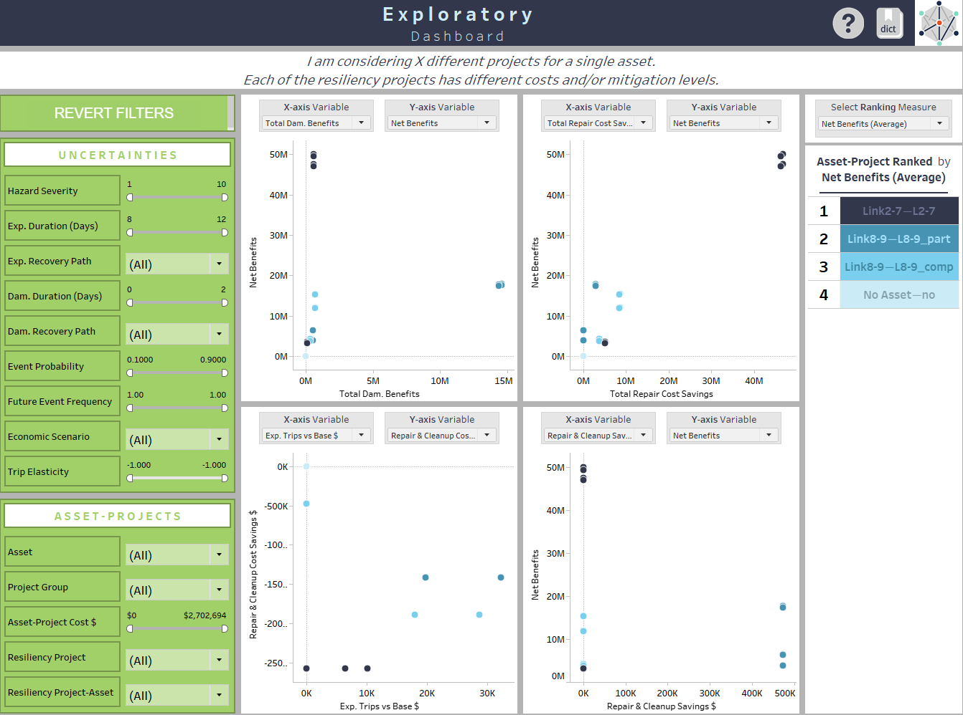
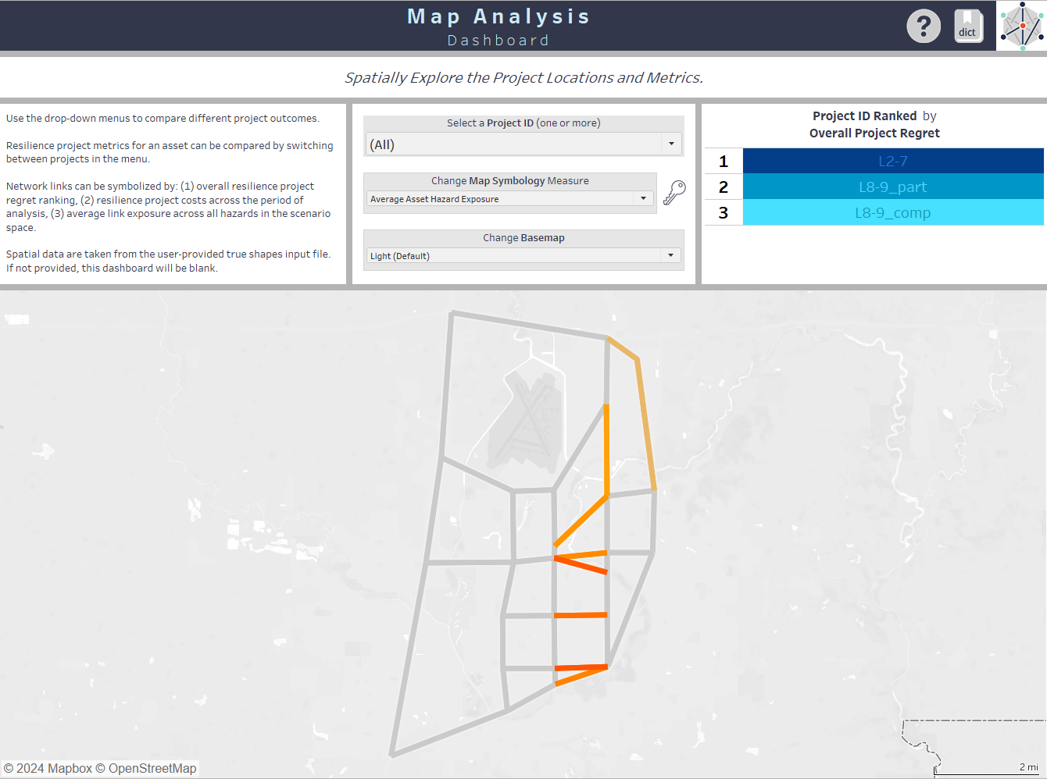
RDR ROI Analysis Tool – Tableau Dashboards
Benefit-Cost Analysis
Regret
Asset-Project
Asset
Exploratory
Map Analysis
Notes:
Given that the RDR Tool Suite is used when the potential future conditions are very large in number (the scenario space is very large) reviewing and understanding the outputs of the analysis can be challenging in text form. Therefore, the RDR ROI Analysis Tool final output imports into visualization dashboards in Tableau. The Tableau workbook includes six dashboards:
Benefit Cost Analysis
Regret
Asset-Project
Asset
Exploratory
Map
Run Parameters
You can access the dashboards with free Tableau Reader or the full Tableau Desktop version.
The series of dashboards allow for increasing levels of granularity in investigating the outcomes and exploring the data., ranging from highest level (just ranking) to exploring data across all projects and all the scenario space, to drilling down to a specific asset and even a specific project at that asset. Interactive scenario dashboards allow the user to rank and explore project performance under different scenario conditions at a variety of scales.

Slide 18
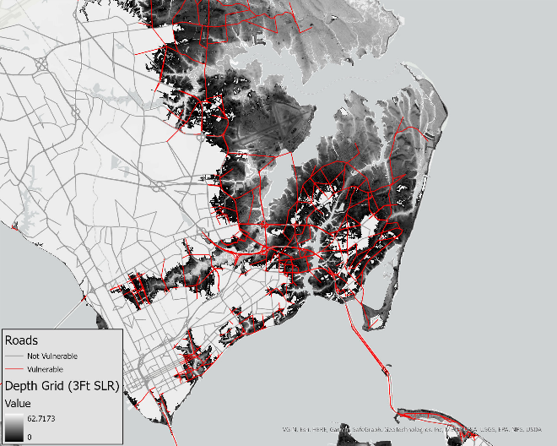
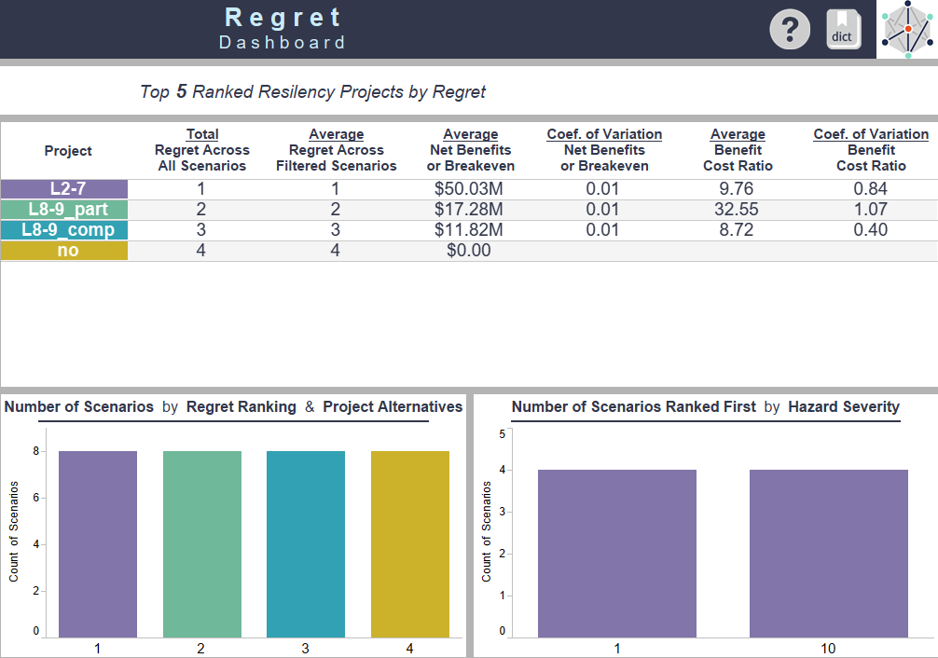
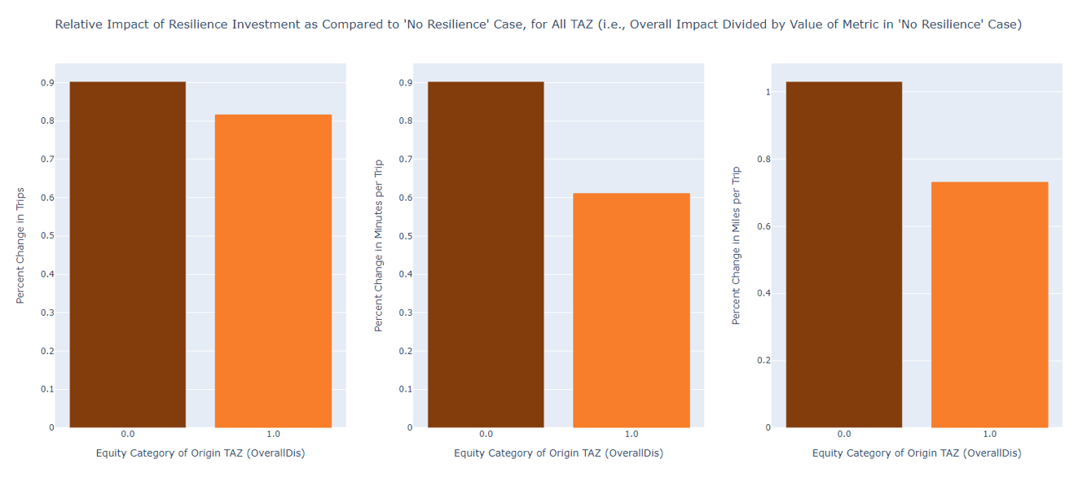
Functionality of RDR Tool Suite Components
RDR Exposure Analysis Tool
RDR ROI Analysis Tool
RDR Benefits Analysis Tool
Which of my network assets are vulnerable under a given hazard event?
Outputs: Network link-level exposure and disruption
Which resilience projects provide the most benefit across the range of future hazard scenarios of concern?
Outputs: Resilience project ROI and rank
How are the benefits of a resilience project under a given hazard event experienced by different users of my transportation network?
Outputs: Network performance changes by TAZ

Slide 19
Defining Your Analysis: Key Questions
What is my region of interest?
  What network size and level of detail do I want to quantify impacts for?
  Should transit be incorporated into the analysis?
What hazards are important to consider in my region?
  What type(s) of hazard am I considering mitigation strategies for?
  What set of hazard events / severities will adequately encompass future conditions in my region?
What resilience projects am I considering?
Who are the users of my transportation network?
  What subsets of network users do I want to compare performance for?
  Is car ownership a significant transportation factor in my region?

Slide 20
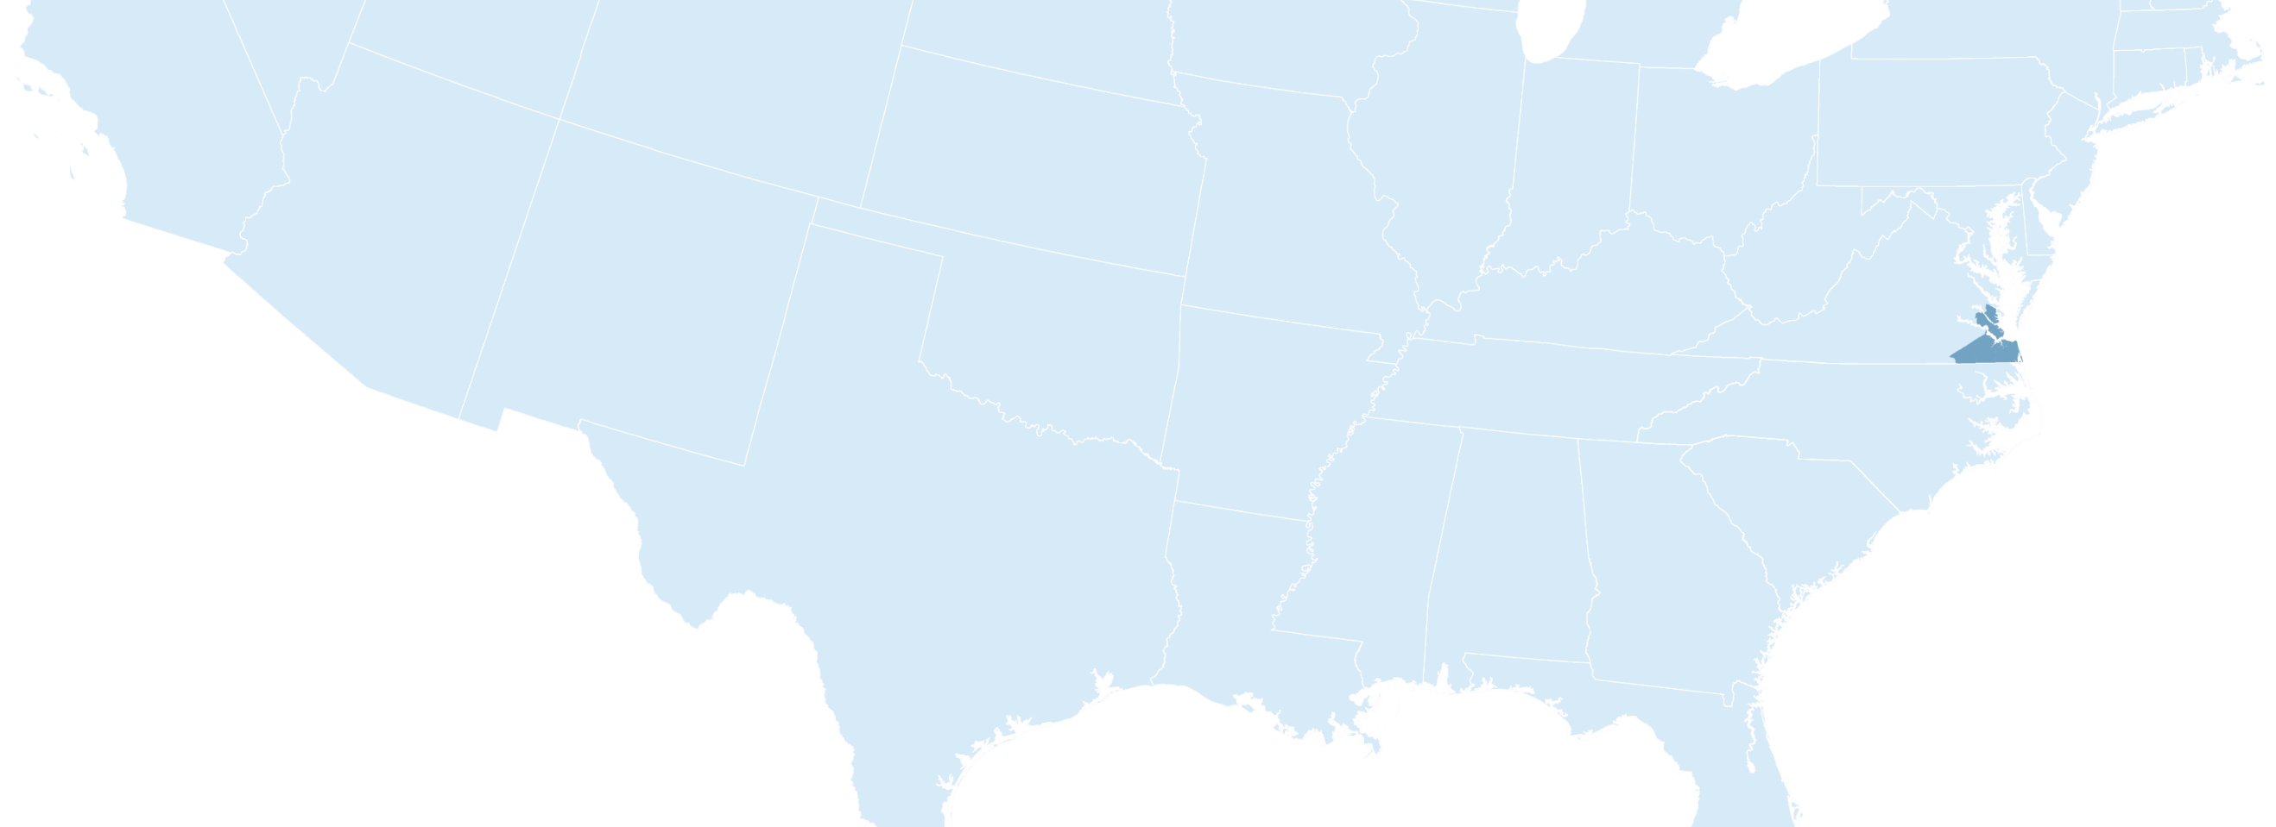





HAMPTON ROADS
Coastal Virginia
Mouth of the Chesapeake Bay
1.7
HAMPTON ROADS
Million
People
Strategic Location
Foreign Trade
Tourism
Military Facilities
Slide courtesy of HRTPO
Notes:
- Network not only sufficient for our everyday needs, but needs to support tourism

Slide 21










Project Evaluation
Across Scenarios
HRTPO PROJECT PRIORITIZATION TOOL
Project Utility
Economic Vitality
Project Viability
CANDIDATE PROJECTS
PROJECT UTILITY
Land Use Model
ECONOMIC VITALITY
Travel Demand Model
PROJECT VIABILITY
Economic
Model
Slide courtesy of HRTPO
Notes:
Break down how we evaluate projects across scenarios, using SP tools and PPT

Slide 22



Project Evaluation
Across Scenarios
Land Use Model
HRTPO PROJECT PRIORITIZATION TOOL
Project Utility
Economic Vitality
Project Viability
CANDIDATE PROJECTS
PROJECT UTILITY
Travel Demand Model
ECONOMIC VITALITY
RDR Tool
PROJECT VIABILITY
Economic
Model
Slide courtesy of HRTPO
Notes:
Break down how we evaluate projects across scenarios, using SP tools and PPT

Slide 23
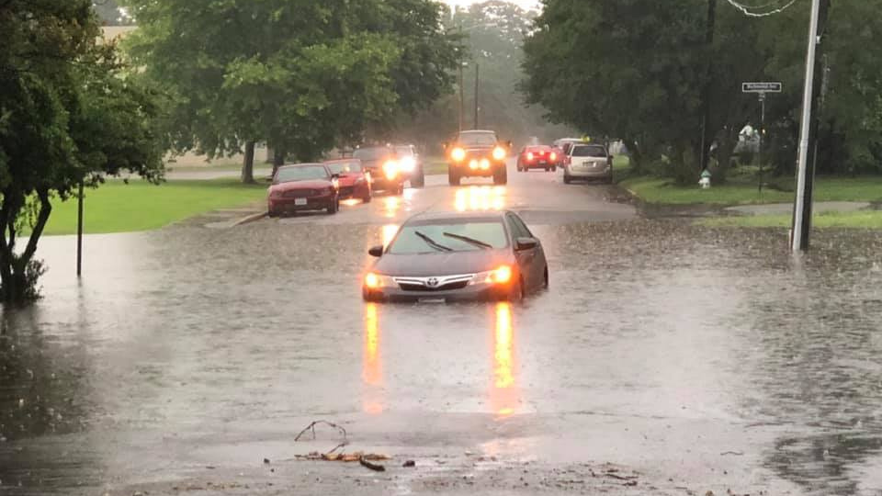

HRTPO Objectives with RDR Tool Suite
    Model multiple flooding scenarios efficiently
    Support objective, data-driven resiliency measures for use in Project Prioritization Tool
      Identify inundation and extent (low and high frequency events)
      Quantify congestion as a result of flooding
      Quantify congestion avoided from mitigating flooding
      Cost-benefit ratio of resiliency improvements
    RDR Tool explores multiple scenarios to assess network-wide effects of losing some assets (highway links).
Uncertainty
Disruption
Resilience Investment
Slide courtesy of HRTPO
Notes:
Over the past several years, worked to integrate resilience considerations into project prioritization using a variety of ranking elements.
Partnered with Volpe, serving as a pilot area for a nationally-replicable modeling tool that quantifies direct and indirect costs of disruptive events
Leverages the travel demand model and an open-source routing tool to provide the initial parameters for the metamodel
- The metamodel expands the conditions evaluated to allow the user to explore a range of hazard conditions and durations and the economic performance of resilience investments to help prioritize resilience projects

Slide 24
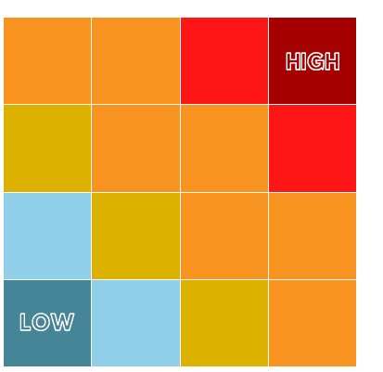

Volpe RDR Tool: HRTPO Planning Applications
Measuring Criticality and Vulnerability
Scenario Planning
  Multiple flooding scenarios
Candidate Project Identification
  Identification of high disruption assets for project consideration
  Project design/cost refinement incorporating resilience
Factors for Project Prioritization
CRITICALITY
  Vulnerability/exposure across scenarios
  Disruption severity/change in network performance
  Equitable access in hazard events
  Refinement of cost effectiveness measures
VULNERABILITY
Fiscal Constraint
  Help identify critical projects to constrain in LRTP
Slide courtesy of HRTPO
Notes:
RDR Tool met our Resiliency Planning Objectives: multiple scenarios, support data-driven process
Specifically:
Explore impacts of more than 1 SLR scenario, identify vulnerable projects (ensure all critical vulnerable projects are being considered for plan)
More robust data for PPT and other PMs (more data-driven, robust measures capturing network impacts – Criticality and Vulnerability matrix)
Improved cost effectiveness
Refine FC (most critical projects are included)
Refine project design/cost/build order based on resiliency
Mention that subsequent phases added EQUITY considerations and TRANSIT as a mode
Applicable to current and future LRTP efforts and other regional/local planning efforts (e.g. JLUS)
Future events projected to increase in frequency and severity. Ensure equity in transportation and resilience planning.
Combines Social Vulnerability with Roadway Network Analysis
- Vulnerable areas: high sensitivity to transportation disruptions due to community characteristics and low adaptive capacity (ability to cope)
- Baseline Drive Times to core service (e.g., hospital, school, employment)
- Flood Altered Drive Time
- Combined Vulnerability and Risk (dark areas = greatest transportation risk with highly vulnerable populations)

Slide 25




RDR Tool Suite Users
Hampton Roads Transportation Planning Organization and Planning District Commission
Hillsborough, FL Transportation Planning Organization (with Florida DOT support)
Houston-Galveston
Area Council
Testing Partners:
User Types:
State DOTs and MPOs
Academics
Transportation Consultants
The RDR team is available for technical assistance of public users.
New versions are released biannually with new features, including user suggestions.
Notes:
Hampton Roads MPOs have been working to integrate resilience considerations into their project prioritization using a variety of ranking elements.

Slide 26

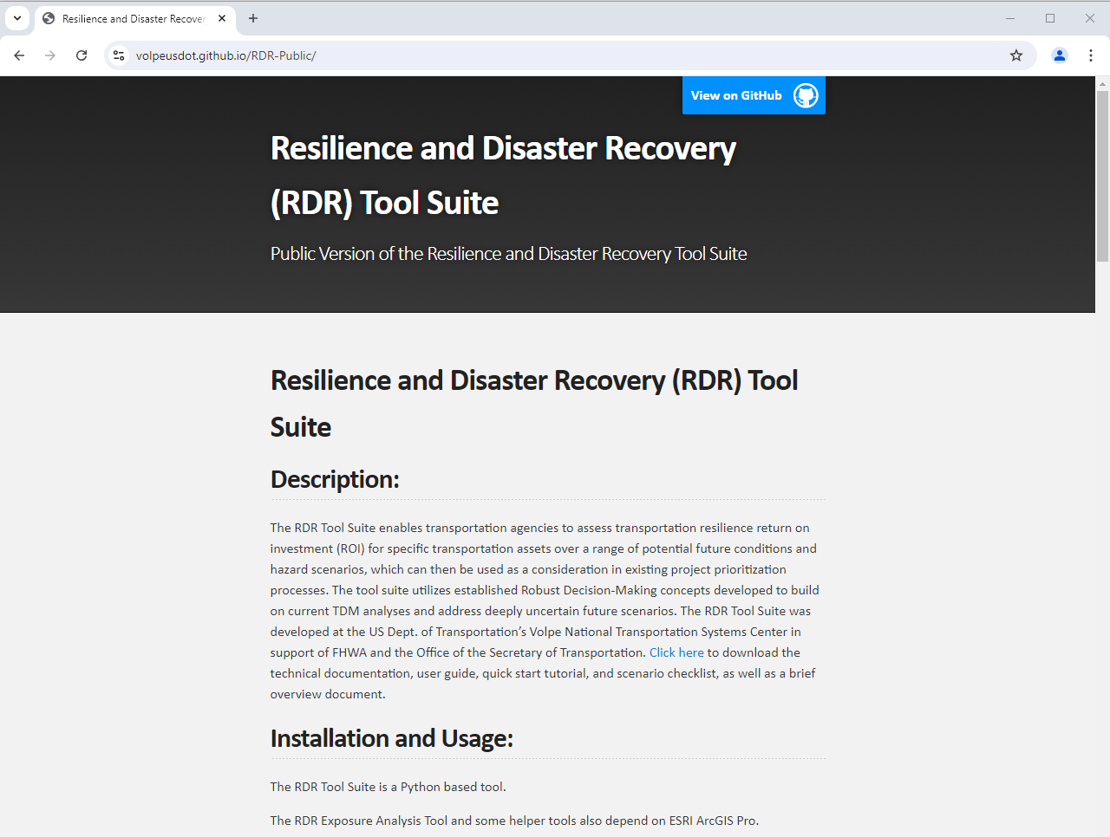
RDR Tool Suite Highlights
Download the latest release: volpeusdot.github.io/RDR-Public
RDR is a free, open-source tool available on GitHub for evaluating resilient infrastructure return on investment.
Codebase includes full documentation and reference scenarios.
Issues / bugs / requests can be raised on GitHub site.
The RDR team is available for technical assistance now.
Email RDR-Team@dot.gov!

Slide 27
Thank you!
OST-R (Sponsor) PMs:
Shawn Johnson
Hamid Ghasemi
Reach us at RDR-team@dot.gov
Current Development Team (alphabetical):
Jonathan Badgley
Andrew Breck
Juwon Drake
Dan Flynn, Ph.D.
Michelle Gilmore
Kristin Lewis (PM)
Alexander Oberg
Tess Perrone
Gretchen Reese
Scott Smith, Ph.D.
Kevin Zhang, Ph.D. (RDR Tool Lead)

