Slide 1
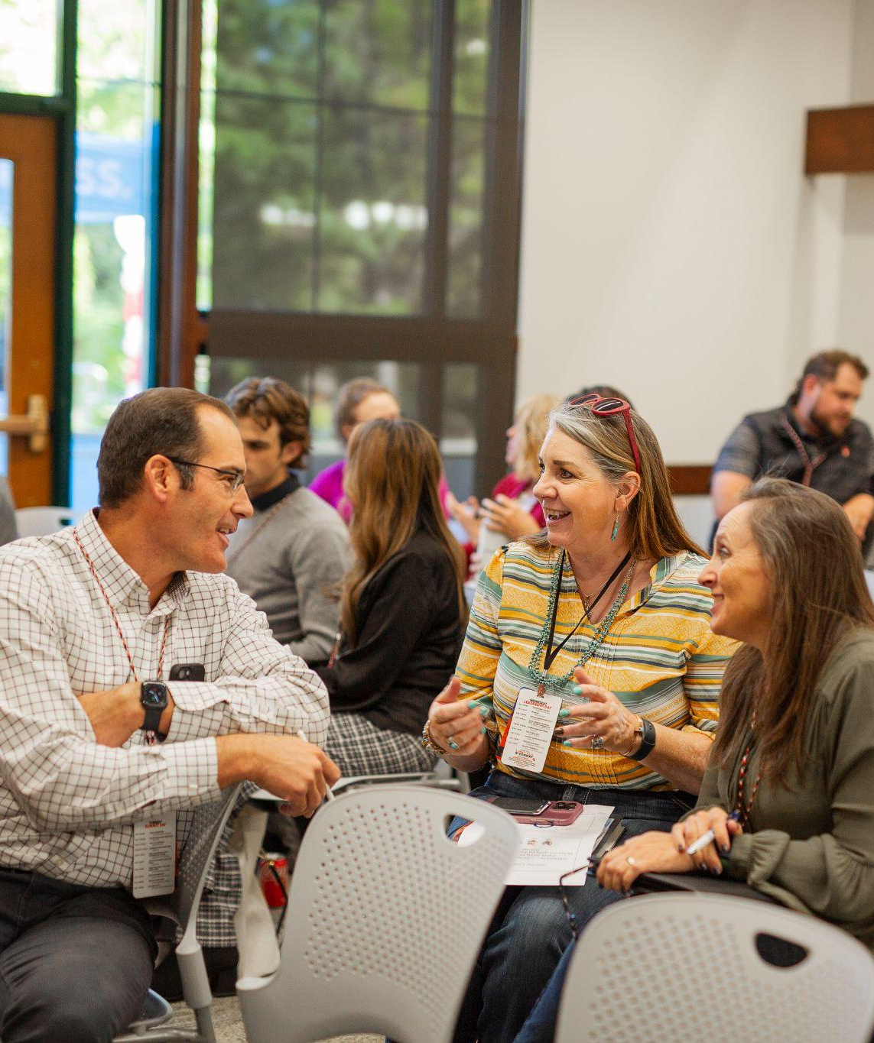
Building a Resilient Economic Ecosystem through Workforce Education

Slide 2
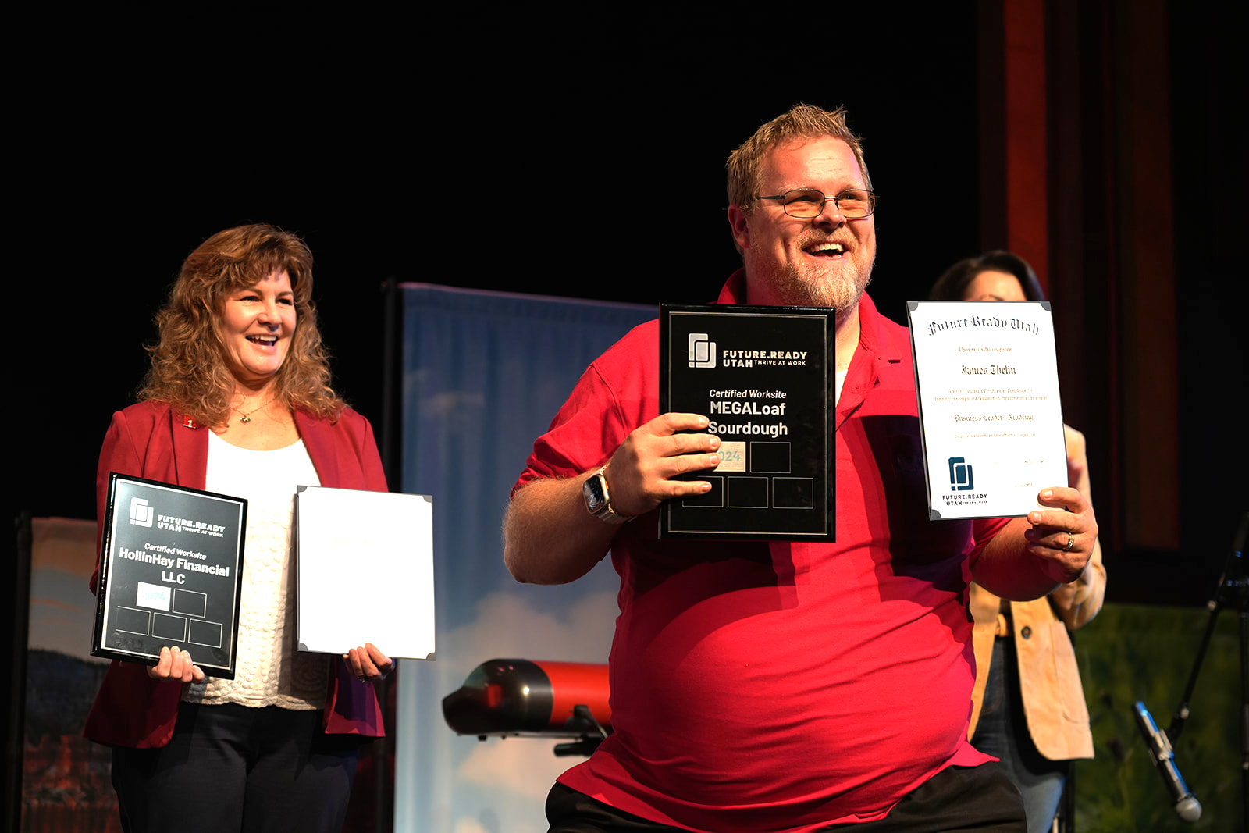
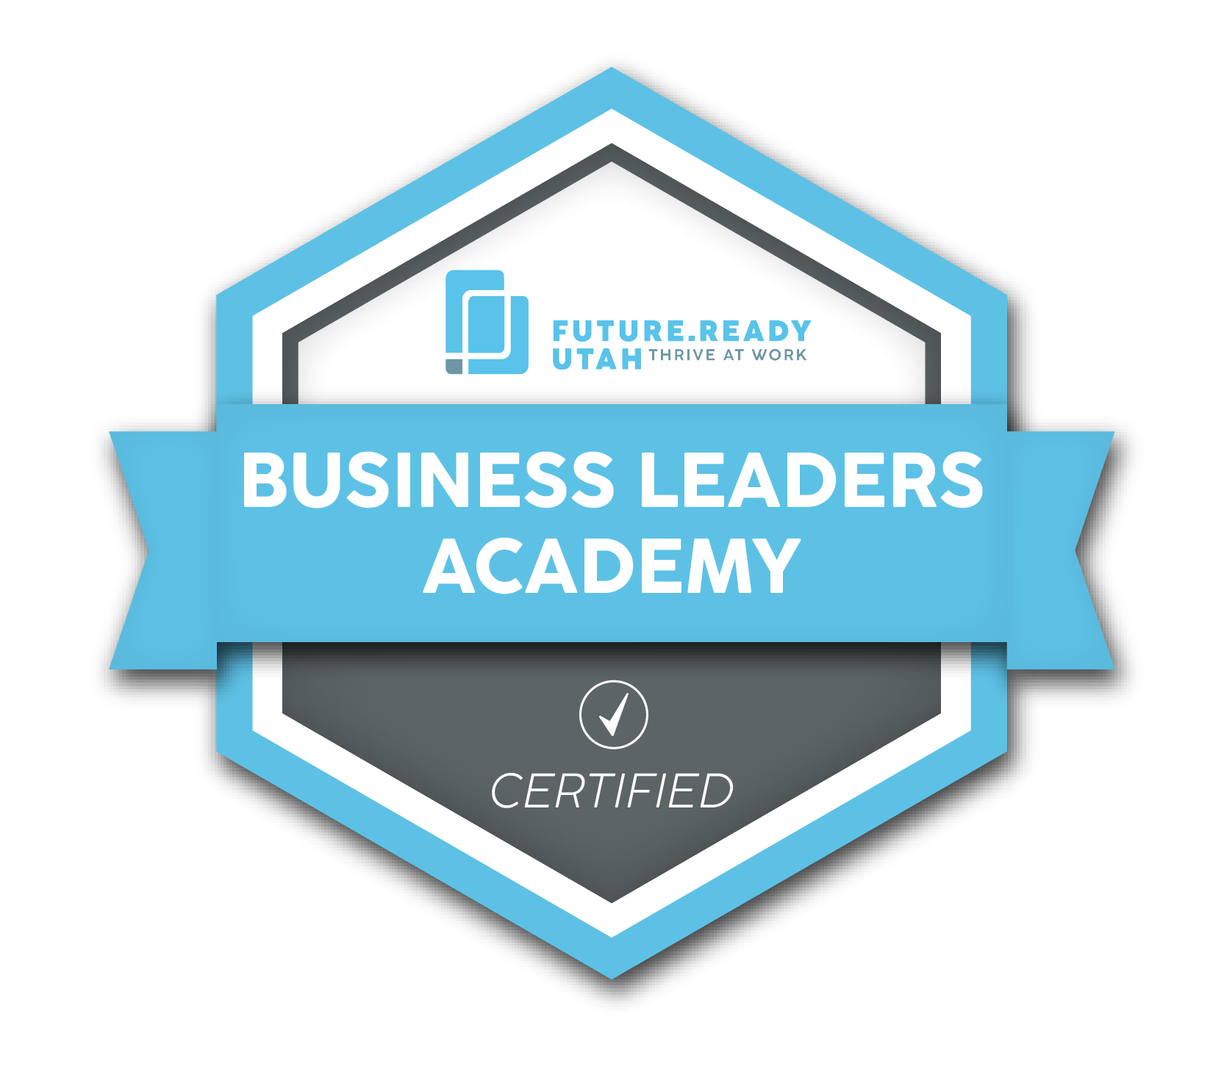
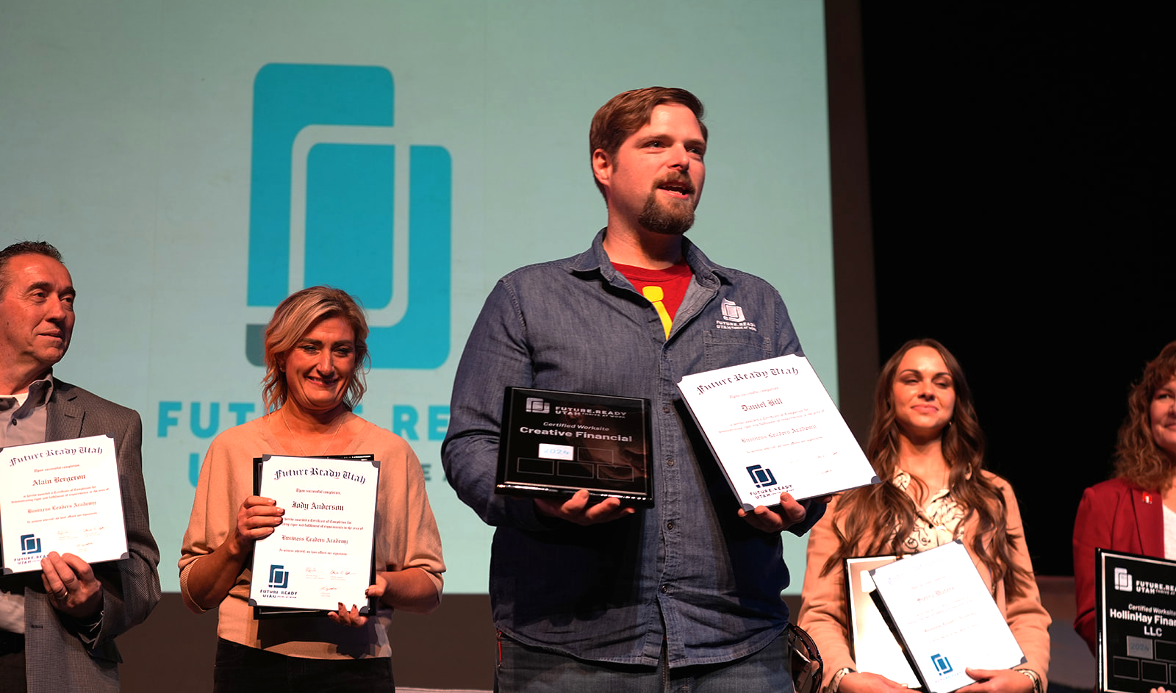
Program Goals
For Employers, Business Owners:
Deliver no-cost training for understanding new generations in the workplace and increasing employee retention
Certify local employers as ready to meet the demands of an evolving workforce
Connect businesses to local resources for fostering growth and expansion
For Workforce:
Teach Workplace Ready durable skills
Develop short-term training options that lead local residents to living-wage jobs in five targeted industries

Slide 3
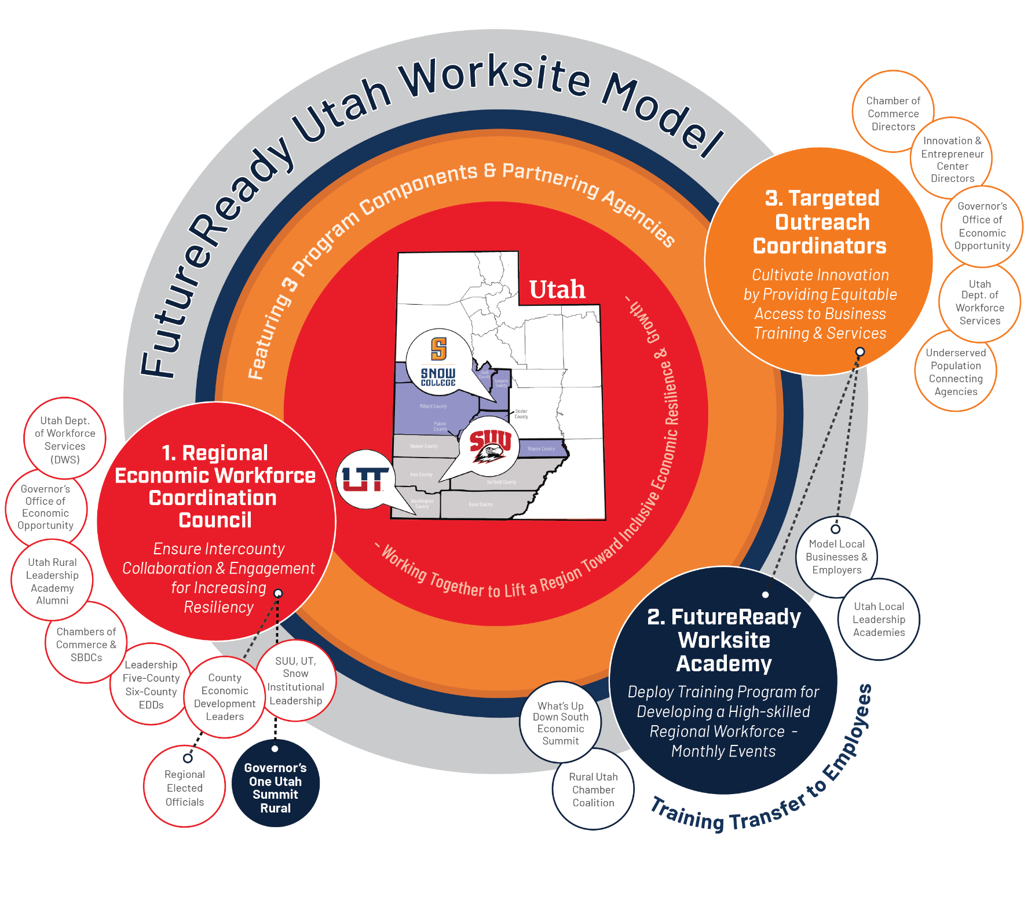
Collaboration Engine
Access: meetings and workshops attract in-person and online participants

Slide 4
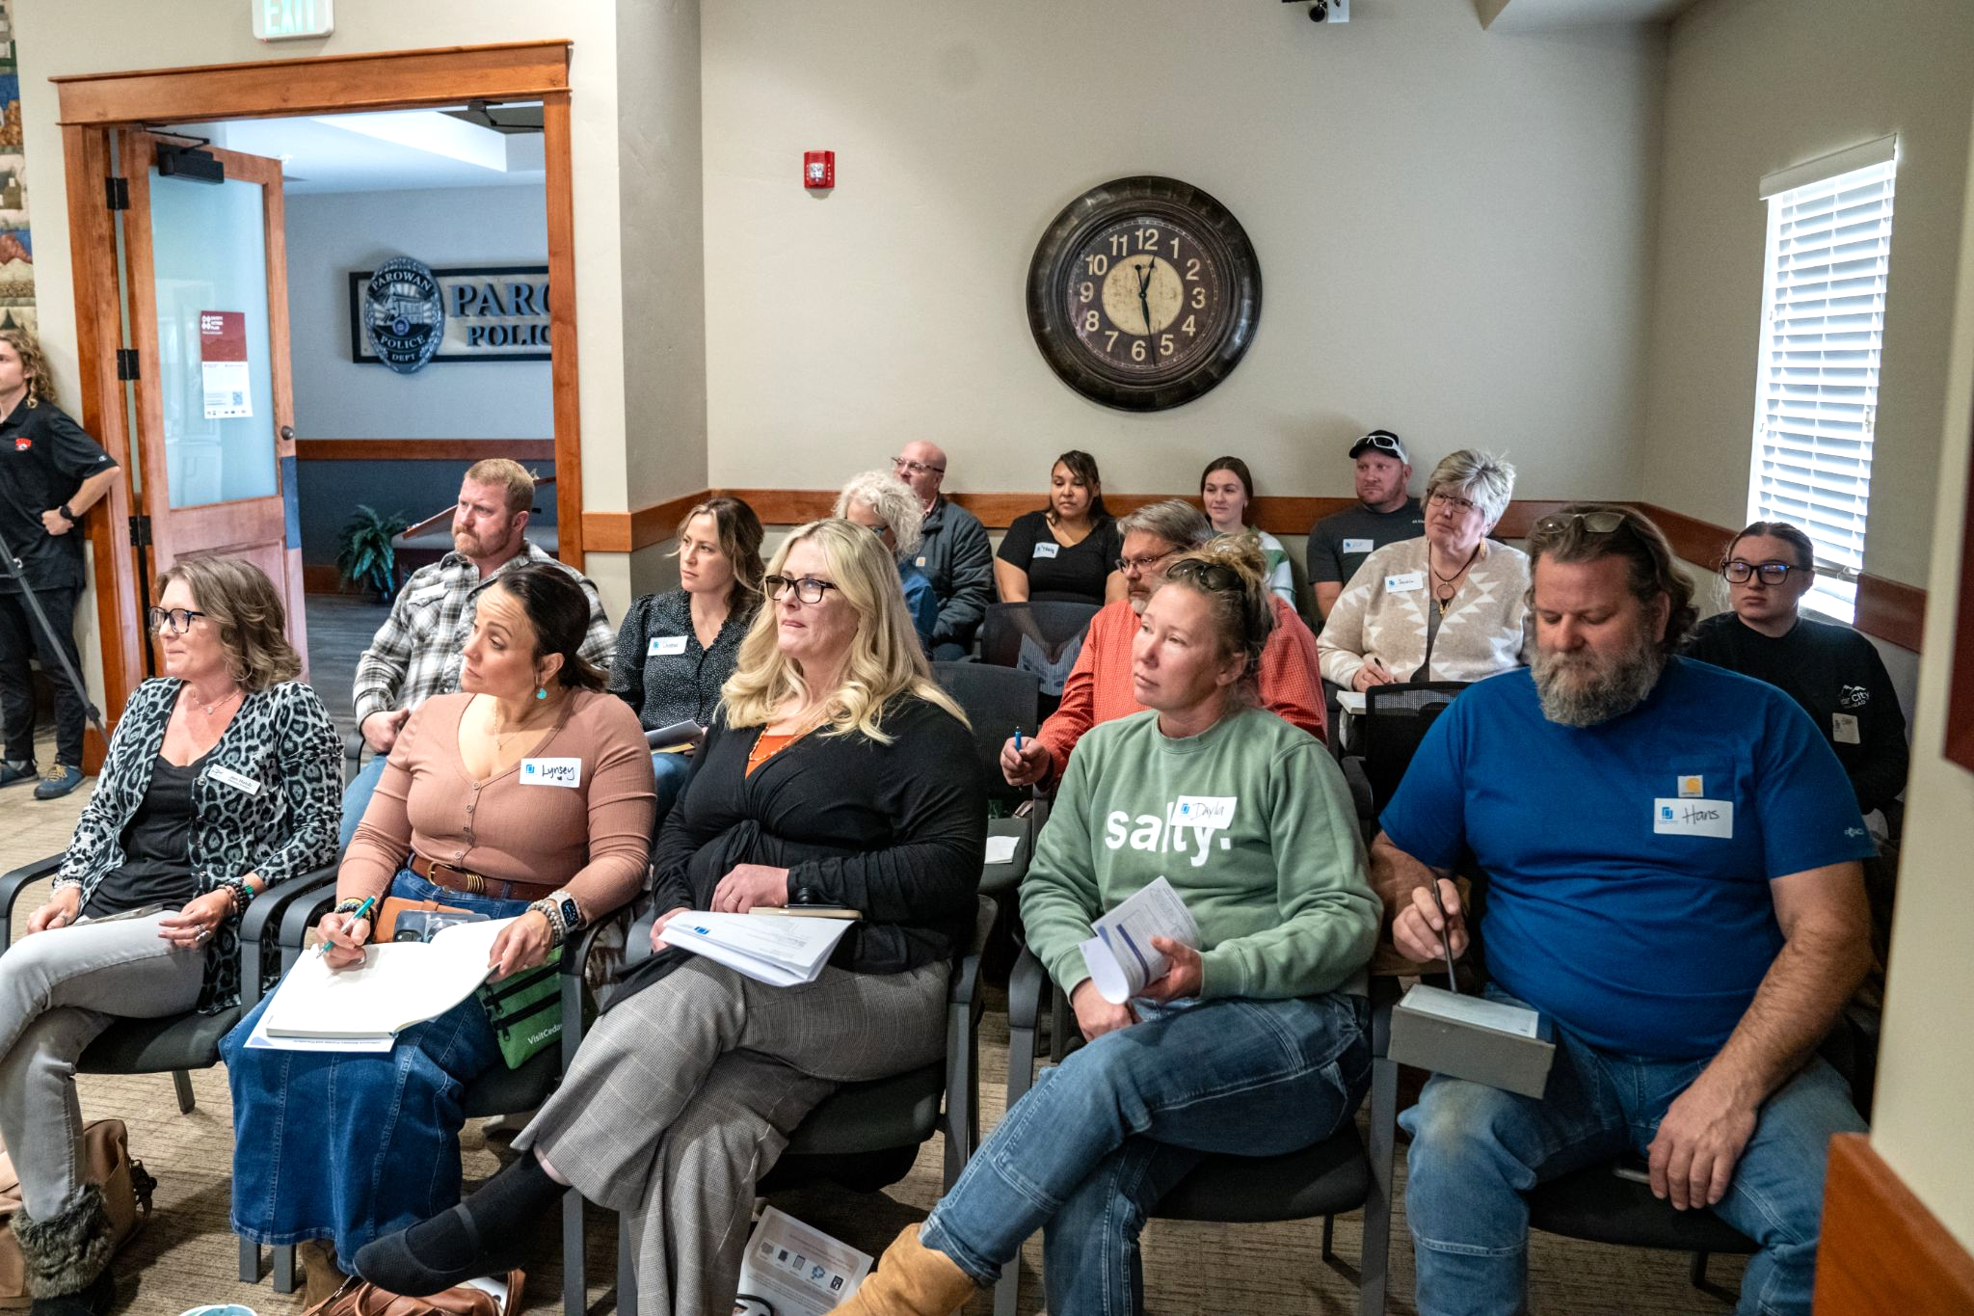
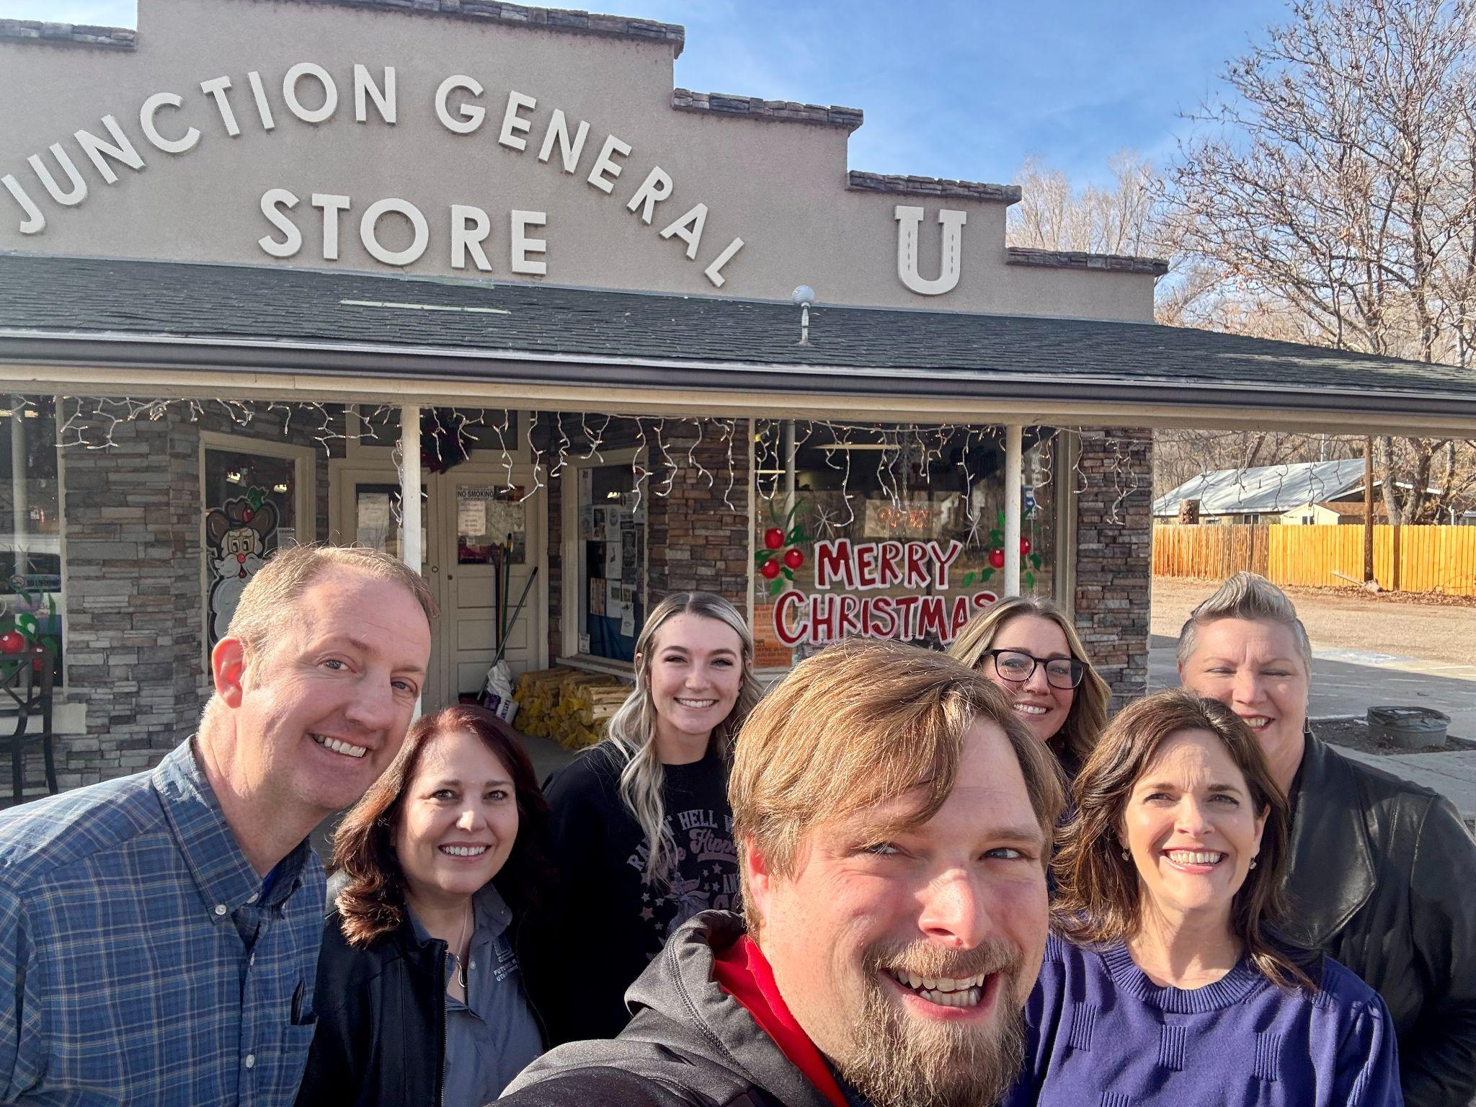
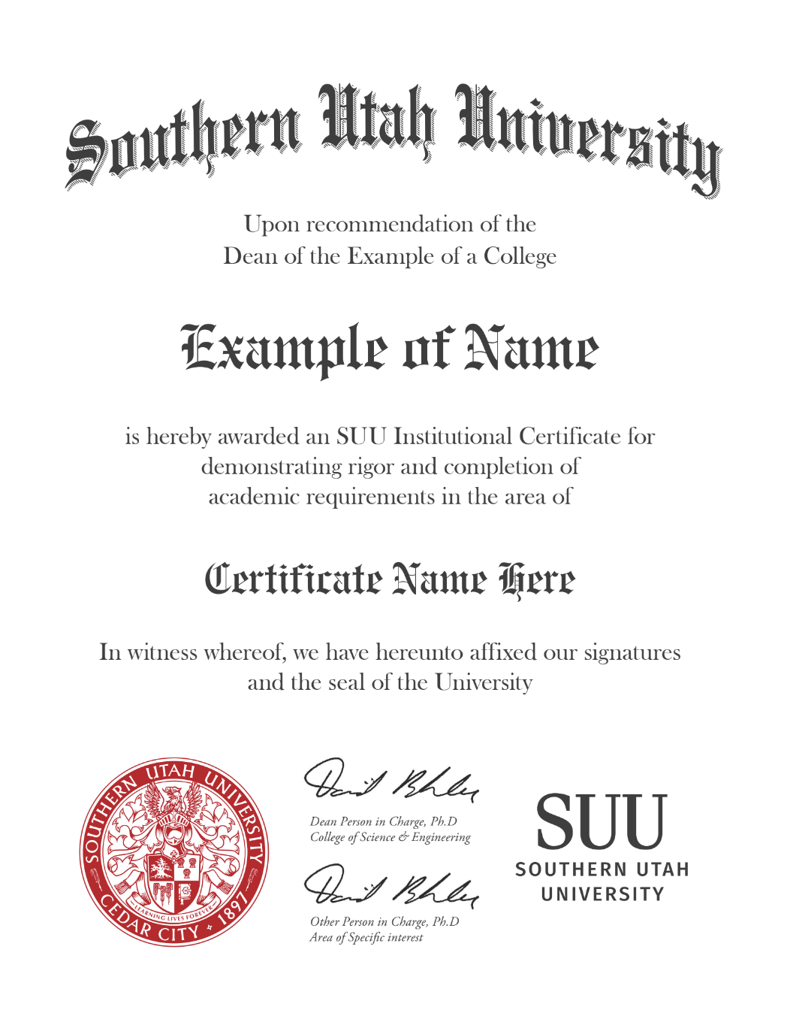
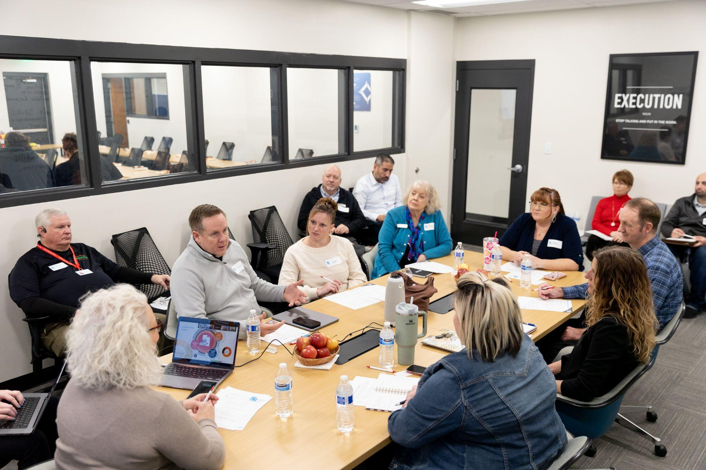
Promoting Job Growth, Talent Retention,
Access to Higher Education
1
Industry, Academic,
Professional Education
Curriculum Team
2
Short Online Courses
6-8 Weeks
Badges & Certificates
Stackable to Degrees
MICROCREDENTIAL MODEL
3
Job Connection
Professional Networking
Guaranteed Interviews, Networking Conference,
Ongoing Upskilling,
Degrees

Slide 5
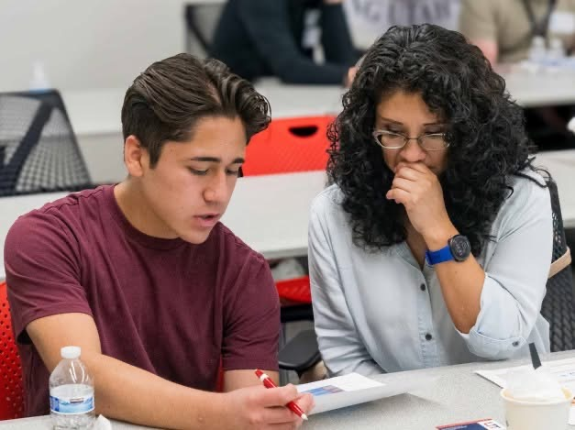
Results: First 18 Months
1,518 Organizations Engaged
with FutureReady
299 Business Site Visits
14 FutureReady Utah Certified Employers Year 1; with 62 Now in
the Pipeline
80% Completing Teamwork Assignments
800+ Microcredential Earners at SUU
94% pass rate
40% = 2+ courses
39 = avg. age

Slide 6
