Slide 1
Industry 4.0 for
Welcome to the Future!
The Digital Technology Impact on Economic and Workforce Development
Mark Yoss
April 26, 2025
Notes:
Good morning, everyone. It's an honor to be here with you at the Denver EDA Conference.
My name is Mark Yoss. I’m the Director of the Advanced Manufacturing Sciences Institute at Metropolitan State University of Denver just across Speer Boulevard.
Today, I’m excited to share how our Industry 4.0 Center of Excellence at Auraria is offering practical, proven, and scalable solutions to make digital transformation successful.

Slide 2
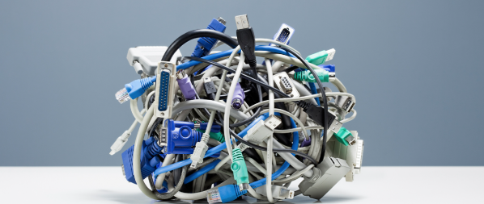
Over 70% of Digital Transformation Initiatives in Manufacturing Fail
Notes:
We’ve all heard the hype—digital transformation will revolutionize manufacturing. But the truth is that Over 70% of these initiatives fail.
Not because the tech isn’t ready—but because the strategy, skills, and systems around it aren’t.
Today’s talk is about how we can flip that failure rate—and make this a win for communities, workers, and regional economies.

Slide 3
Colorado Advanced Manufacturing
$28.88B in GSP from Manufacturing
149,000+ Employed in Colorado
3,200+ Manufacturers in Metro Denver
$1 : $2.60 Economic Multiplier
Notes:
In Colorado, manufacturing contributes nearly $29 billion to our economy and supports over 149,000 jobs.
In the Denver metro area alone, we have over 3,200 manufacturers employing more than 86,000 workers.
But here’s the kicker: every $1 invested in manufacturing adds $2.60 to the economy. That’s the highest multiplier effect of any sector. Which means—when we help manufacturing modernize, we don’t just help companies—we supercharge entire communities.

Slide 4
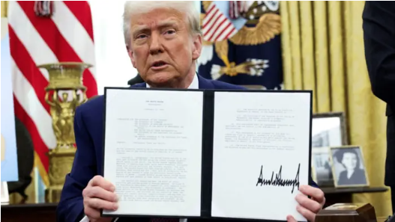
The Tariff Effect
Aimed At Reshoring Manufacturing And Reducing Foreign Dependency
Reality: Higher Costs For Many U.S. Manufacturers, Especially Small and Medium Sized Manufacturers (SMM)
Notes:
Recent tariff policy—like the reinstatement of 25% steel and aluminum tariffs—has reignited efforts to bring manufacturing back to U.S. soil. But reshoring isn’t simple. Tariffs raise costs for U.S. manufacturers who rely on imported materials. The only way reshoring works sustainably is if we help companies become radically more efficient. That’s where Industry 4.0 comes in—it gives us the tools to make reshoring not just a policy dream, but an economic reality.

Slide 5
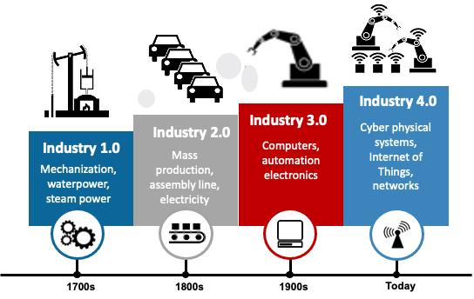
The Promise of Industry 4.0
Connected Systems (Iot), AI, AR, Robotics, 3D Printing, VR
Lower Labor Intensity, Higher Skill Demand
Improved On Time Delivery And Operating Costs
Faster Iterations In Product Design & Development
Reduced Downtime Or Lost Production Time From Worker Shortages
Increased Customer Satisfaction
Notes:
Industry 4.0 isn’t science fiction—it’s already here. We’re talking about real-time machine data, AI-powered quality control, and predictive maintenance. These technologies cut downtime, boost throughput, and reduce reliance on offshore labor. Bottom line: it’s not just about “bringing jobs back”—it’s about creating better, higher-value jobs right here at home.

Slide 6
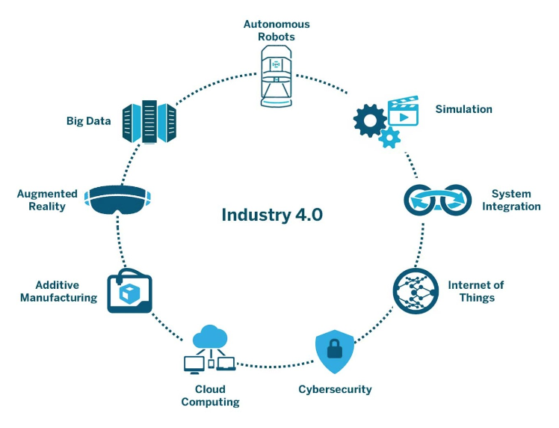
Barriers to Realizing the Potential
Legacy Equipment
Digital Skills Gap
High Adoption Costs
Cyber Risks
Misconceptions About Automation = Job Loss
Notes:
Despite the promise, the path isn’t easy. Legacy equipment can’t connect to modern systems. Workers need new digital skills. Many small and mid-sized manufacturers can’t afford to innovate—and cyber threats are rising. And perhaps most importantly—there’s still fear that automation equals job loss. Your role, as workforce and economic developers, is critical in removing these roadblocks.

Slide 7
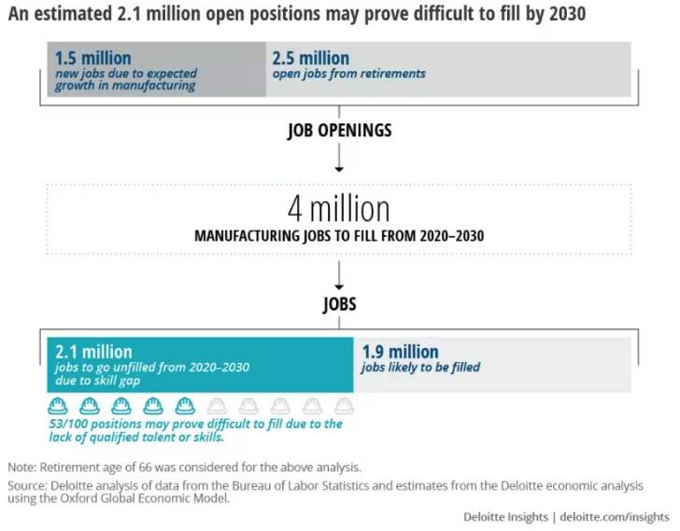
Workforce Gaps
Technology Is Ready
Our Workforce Must Catch Up — Fast.
Notes:
Here’s the workforce reality: By 2030, over 2.1 million U.S. manufacturing jobs could go unfilled. Not because there aren’t jobs—but because there aren’t people with the right skills. We don’t have a technology problem—we have a talent alignment problem. We must shift from job training to future-of-work training—and we need to do it now.

Slide 8
What Economic & Workforce Leaders Can Do
Micro-credentials & Industry-aligned Training
Grants & Support For SMM Tech Adoption
K–12 To Career Pathway Integration
Regional Collaboration Task Forces
Reframe The Automation/Jobs Narrative
Notes:
So what can we do? A lot. ✅ Build microcredential programs that can upskill workers fast. ✅ Use EDA funding to help small manufacturers pilot tech with less risk. ✅ Design K–12 to career pathways focused on advanced manufacturing careers. ✅ Create cross-sector task forces to stay aligned and nimble. ✅ And most importantly—help reframe the narrative. Automation isn’t the enemy—it’s the evolution of work.

Slide 9
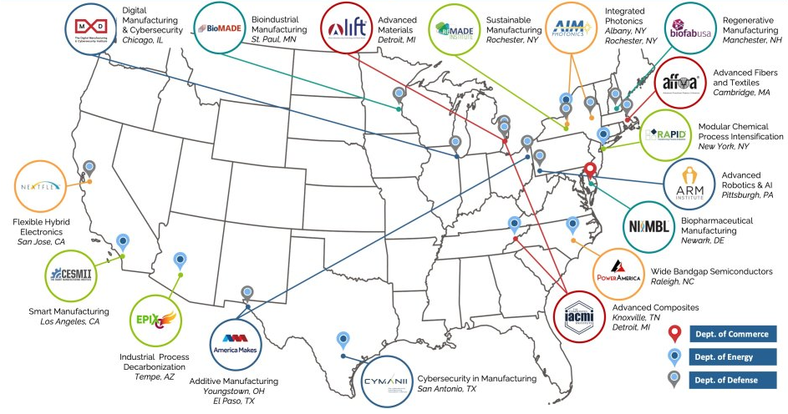
Manufacturing USA Network
Notes:
Manufacturing USA® is a national network created to secure U.S. global leadership in advanced manufacturing through large-scale public-private collaboration on technology, supply chain and education and workforce development. The network comprises the U.S. Departments of Commerce, Energy and Defense, their sponsored manufacturing innovation institutes, and six additional federal agency partners, creating a whole-of-government, national effort to drive innovation in manufacturing.
Each institute includes members from industry, academia, and state and federal governments with a shared interest in advancing manufacturing. 17 manufacturing innovation institutes collectively worked with over 2,500 member organizations to collaborate on more than 670 major technology and workforce applied research and development projects and engaged over 106,000 in advanced manufacturing training. The institutes attracted $307M from state, federal, and private funds in addition to $109M in base federal funding.

Slide 10
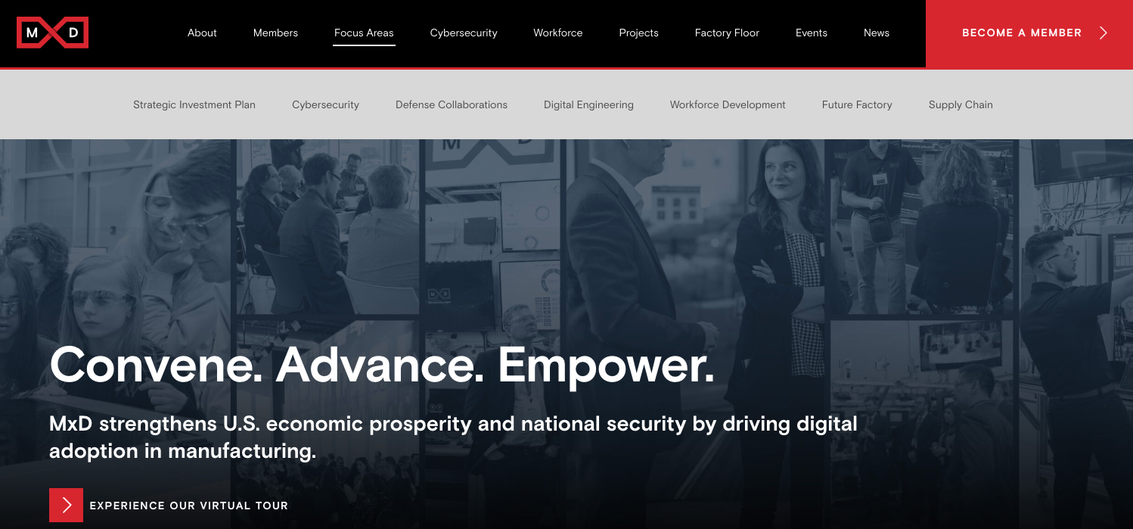
Manufacturing Times Digital

Slide 11
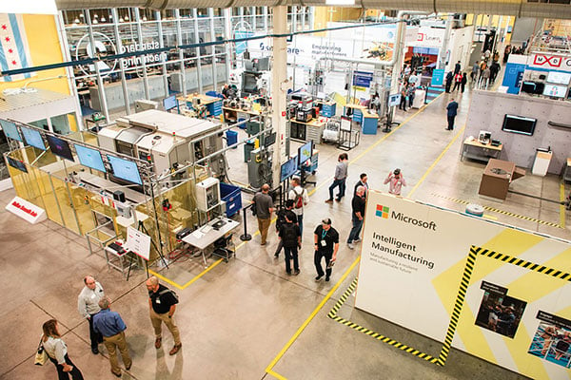
Manufacturing Times Digital
Notes:
MxD’s 22,000-sq-ft research factory in Chicago is used to test and demonstrate new technology, train the workforce on smart factory systems and tools, and demonstrate the need for cybersecurity in manufacturing. (Provided by MxD)

Slide 12
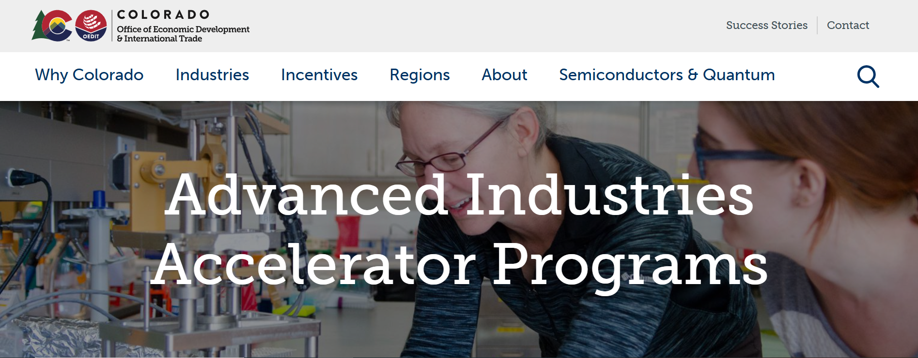
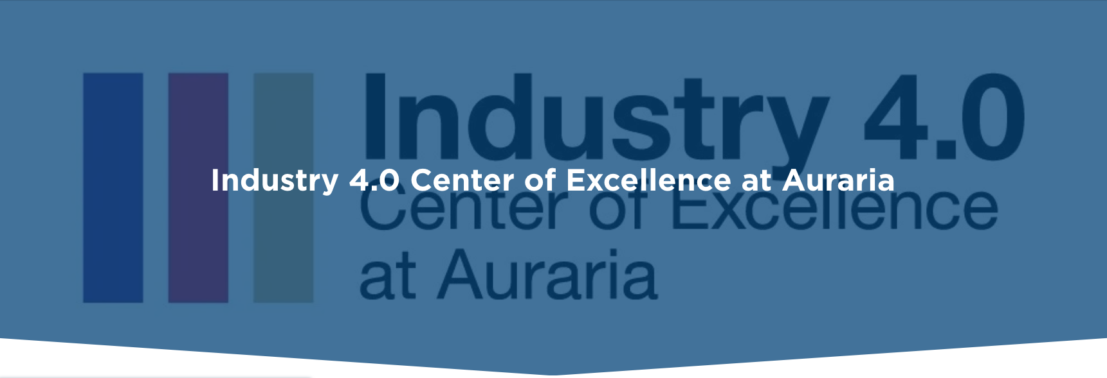
Notes:
At the Industry 4.0 Center of Excellence at Auraria, we’re putting these ideas into action. We offer hands-on training for students and upskilling for incumbent workers. We’re running pilot projects with local manufacturers. And we’re building the partnerships needed to ensure no one is left behind in this transition. This isn’t just about Colorado—it’s a model for how regions across the country can lead.

Slide 13
Industry 4.0 COE at Auraria
AI/ML
For 3D Metal
Printing

Slide 14
Our Call to Action
Tariffs may bring production home—but only smart, inclusive transformation will keep it here.
Align your workforce and economic development strategies with Industry 4.0.
Notes:
Let’s be clear: tariffs may nudge production back to the U.S.—but without workforce and tech alignment, it won’t stick. The regions that succeed will be those that marry policy with productivity, and reskilling with reinvention. We have an opportunity to build smarter economies, stronger communities, and more resilient industries—together.

Slide 15
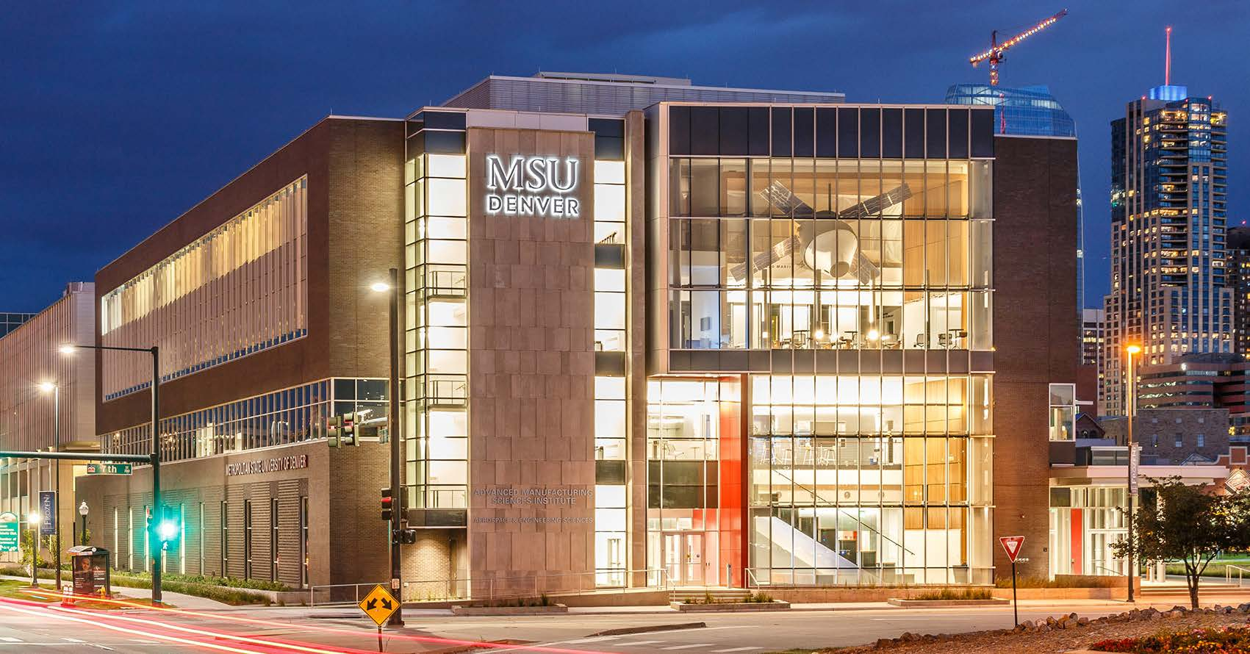

Slide 16
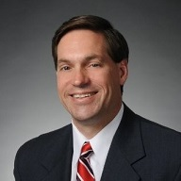
Mark Yoss
Director, Advanced Manufacturing Sciences Institute
https://www.msudenver.edu/advanced-manufacturing/
Email: myoss@msudenver.edu
Cell: 303-243-2637

