Slide 1
The Breadth and Depth of University Center Work in the Southwest Region
New Mexico State University

Slide 2
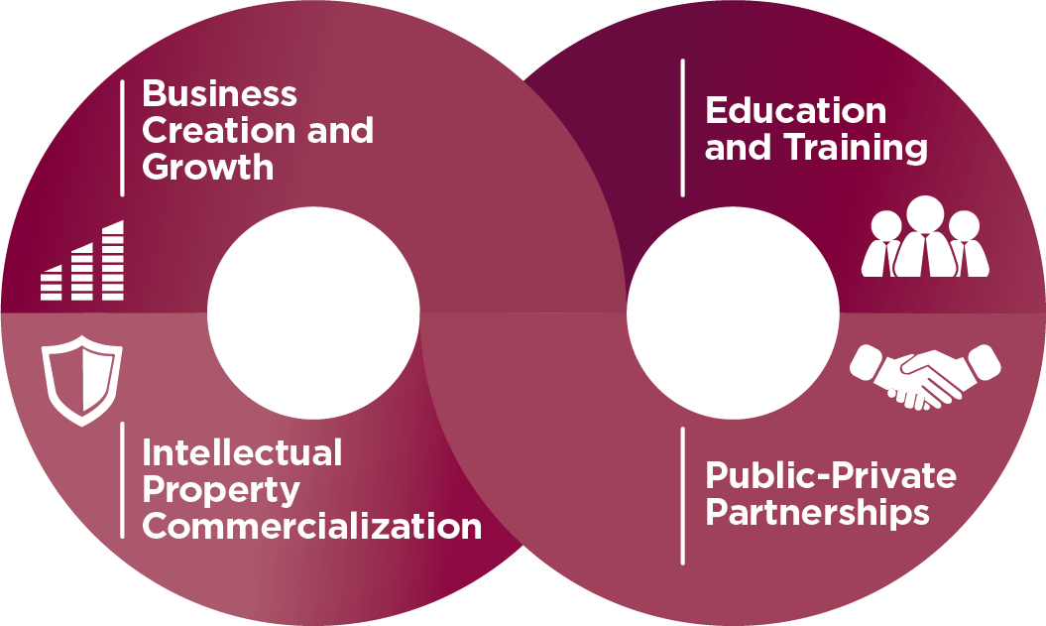
Create economic opportunity through entrepreneurship and innovation

Slide 3
Arrowhead Center’s student business incubator that helps college students and recent graduates start and grow their own businesses through mentorship, training, and resources.

Slide 4
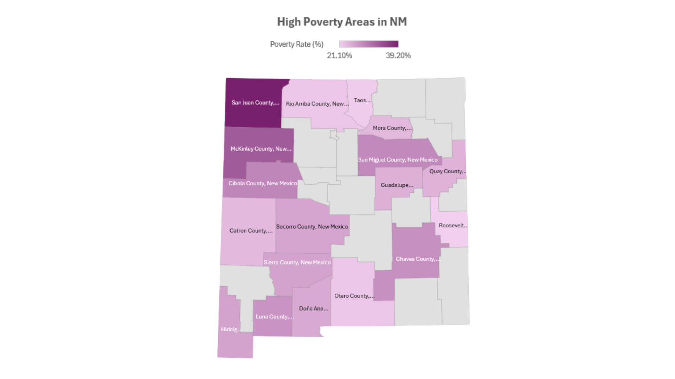

Slide 5
What We Knew: Education Helps Reduce Poverty
Bachelor’s degree holders earn ~67% more than high school grads.
Every year of additional schooling is associated with lower unemployment and higher job stability
Among adults without a high school diploma, ~24% live in poverty.
Among bachelor’s degree holders, that number drops to ~4%.
Ref: (U.S. Census)

Slide 6
The Thought Process: Create economic opportunity

Slide 7
What We Knew: Entrepreneurial Education
Improves Employment Outcomes and Income Potential- European Commission (2012)
Builds Transferable Life Skills- NACE (2022)
Fosters Economic Mobility in Underserved Communities- Kauffman Foundation (2020)
Supports Community-Level Economic Development- UNDP, 2013
Ref: (U.S. Census)

Slide 8
The Thought Process: Create economic opportunity through entrepreneurship and innovation

Slide 9
The Thought Process: Create economic opportunity through entrepreneurship and innovation

Slide 10
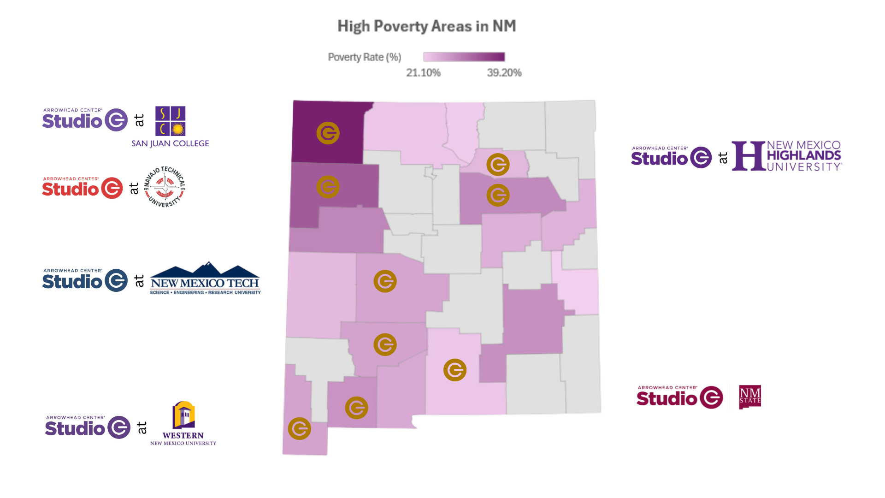

Slide 11
What We Knew: NM Counties Face Challenges
Counties with the lowest educational attainment often have the highest poverty rates (e.g., McKinley, Luna, Socorro).
Access to college — especially local access — is a key barrier in rural and tribal communities.

Slide 12
For students exploring entrepreneurship for the first time
Learn the fundamentals of entrepreneurship and innovation.
Participate in workshops on business ideas, models, and customer discovery.
No business idea needed — just curiosity and a desire to learn
Build transferable skills: problem-solving, creativity, and pitching
Designed for early-stage exploration and confidence-building
For students actively working on launching or growing a startup
One-on-one mentorship and tailored business advising
Support with market research, funding, legal, and operations
Ideal for students with a validated idea or existing venture
Helps move from concept to traction and growth
Fully virtual and self-paced options

Slide 13
The Thought Process: Create economic opportunity through entrepreneurship and innovation

Slide 14
Arrowhead Center’s student business incubator that helps college students and recent graduates start and grow their own businesses through mentorship, training, and resources.

Slide 16
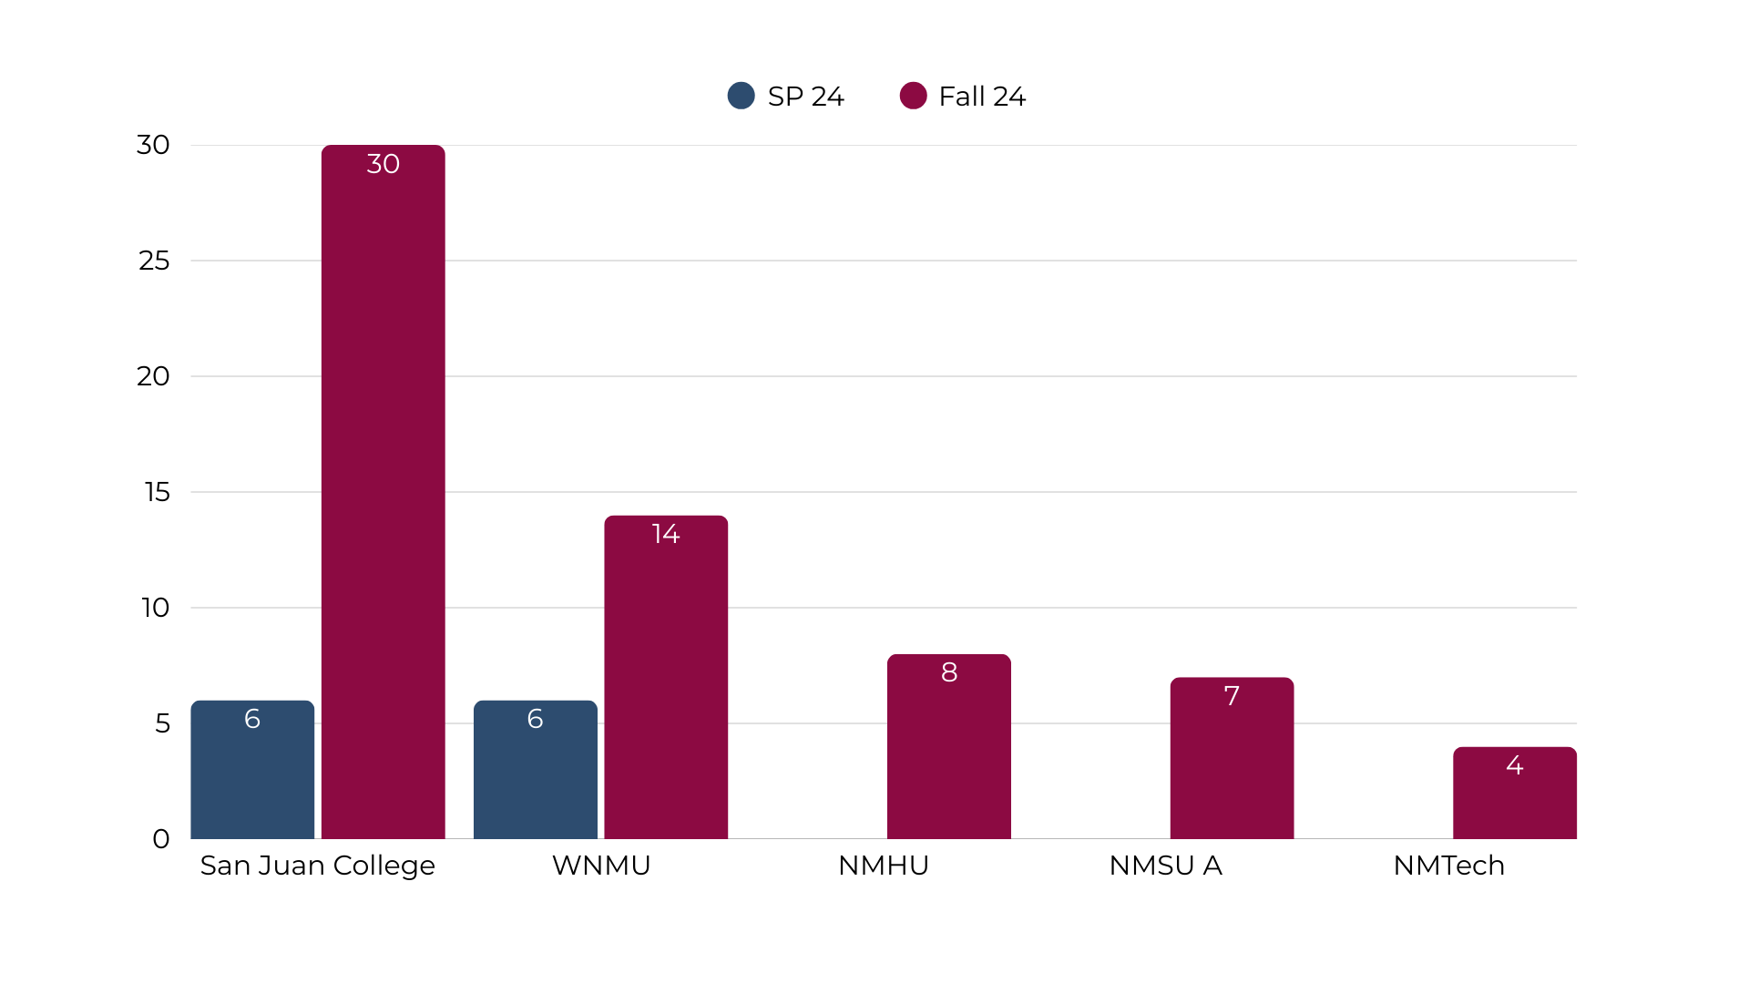
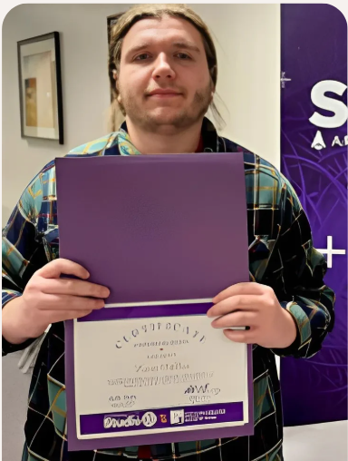
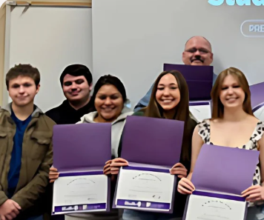
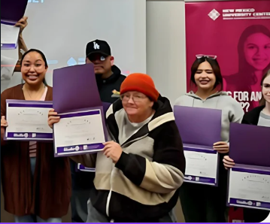
Results: Entrepreneurial Education Certifications

Slide 17
Results: Internship Placements
Summer 2024
Summer 2025
Successful placement of (6) students:
New Mexico Tech
Western NMU
NMSU (Main & Satellites)
Successful placement of (4) students and (4) in pipeline:
New Mexico Tech
Western NMU
NMSU (Main & Satellites)
NMHU

Slide 18
Current Initiatives and Future Goals

Slide 19
We would love feedback and improvement suggestions…

