Slide 1
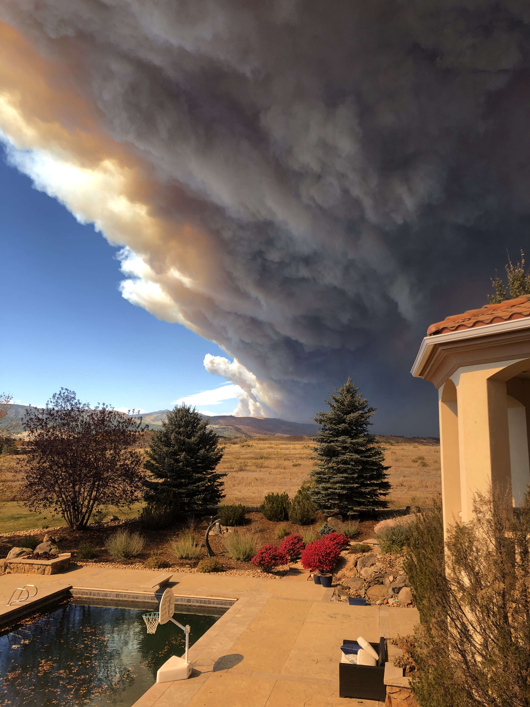
NSF-ASCEND Engine in
Colorado and Wyoming
We are building a regional, place-based innovation ecosystem using the Advanced Sensing and Computation for Environmental Decision-making (ASCEND) framework to guide the development of cutting-edge tools to address pressing environmental and societal challenges in the region
This ecosystem will:
Strengthen national competitiveness
Expand economic opportunities
Lay the foundation for long-term resilience and sustainability
Notes:
Mike

Slide 2
10 Year expected outcomes aim to generate significant economic impact:
18K
$2.7B
$2B
140
New Jobs
GDP Boost
Capital Raised
Translation, Emergent Grants Awarded
750
1,500
50
400
Internships/ Apprenticeships
Upskilled
Post-Docs Placed
Student Trained Systems Engineering

Slide 3
NSF Innovation Ecosystem Life Cycle
Phase 2: NASCENT
Phase 3: EMERGENT
Phase 4: GROWTH
Phase 5: MATURE
Solidify organization and partnerships
Ramp up innovation activities
Scale technological products and services
Scale workforce capabilities
Attract sizeable external funding to promote innovation-based economic activity
Grow innovation ecosystem as a national leader
Attract increasing levels of economic activity and business creation
Support from state, local and federal governments
Innovation ecosystem is well established and can sustain itself without NSF funding
Year 1-2
NSF $7.5M/Year
Cost Share $7.5M/Year
Years 3-5
NSF $15M/Year Cost Share $30M/Year
Years 6-10
NSF $20M/Year Cost Share $60M/Year
Notes:
Mike

Slide 4
Pillar One: Regional Ecosystem Building
4
The NSF ASCEND Engine is a place-based innovation ecosystem that transforms research in Advanced Sensing and Computation for Environmental Decision-making (ASCEND) into scalable technologies, economic opportunity, and community resilience.
Notes:
Mike

Slide 5
5
ASCEND: Advanced Sensing and Computation for Environmental Decision Making
Decision support
Prediction and preparedness
Risk assessment and mitigation
Scarce resource allocation/optimization
Actionable insight
Translational data analytics
Digital twinning
Knowledge-guided machine learning
Causal modeling
Advanced environmental sensing
Low-cost, distributed sensor networks
Aerial, space and field-based remote sensing
Biorepositories/multi-omics
Data
Notes:
Alan

Slide 6
Pillar Two: Research & Development
Uses the Advanced Sensing and Computation for Environmental Decision-making (ASCEND) framework
ASCEND recognizes that our region is uniquely differentiated in its ability to (1) develop and deploy advanced sensing capabilities, and; (2) exploit large volumes of data through advanced computational techniques
Our R&D investments will be divided into Technical Areas (TAs) based upon the ASCEND Framework: Advanced sensing (TA1), Computation (TA2), and Decision Support (TA3).
This framework will be used to support 2-4 programs, whose solutions will generate outcomes within our one or multiple of our use cases:
Wildfire Preparedness and Response
Water Quality and Availability
Soil Health and Productivity
Air Quality
Notes:
Alan

Slide 7
Pillar Three: Translation
7
Translation bridges the gap between research and market adoption.
Key Components of Translation Research:
Advancing ASCEND Technologies Through TRLs 4-6.
Facilitate Technology De-Risking
Explore and Define Commercial Pathways
Provide Market and Customer Insights
Determination for Pilot Readiness
The Key Components of Translation-to-Market:
Advancing ASCEND Technologies Through TRLs 7-9.
Facilitating pilots
Market Intelligence and Customer Discovery
Business Model Viability and Planning
Access to Capital
Manufacturing and Supply Chain Readiness
Partnerships and Customer Adoption
Notes:
Alan

Slide 8
Pillar 4: Workforce Development
A skilled workforce is integral to the Engine’s vision of an ASCEND Technologies-focused innovation ecosystem. The CO-WY Engine collaborates with industry partners, universities, and community colleges to develop training programs supporting ASCEND education and technologies across Colorado and Wyoming.
Secondary STEM Programs: Building Foundations for Future Innovation in ASCEND
Activating Degreed and Non-Degreed Workforce
Expanding Career Pathways in ASCEND Technologies
Notes:
Amber

Slide 9
Accomplishments in Years 1-2
9
Ecosystem Development
Funded the Metro-Denver Economic Development Corporation to recruit companies to Colorado
Hosted 60+ events, including monthly Innovation after Hours sessions, Competitiveness Conversations, and outreach and education.
Research and Development
Invested $5M in use-inspired R&D and translation projects will support
Startup Support
Launched the Innosphere Wyoming Innovation Fund, venture capital fund dedicated to providing early-stage financing for Wyoming-based startups
Established the Digital Twins Accelerator for early-stage startups that use digital twinning as part of their solution. We welcomed our inaugural cohort of six companies in March 2025.
Supported X number of companies
Workforce Development and Regional Engagement
Placed over 50 interns/apprentices in climate resilience through MSU Denver and Colorado Community College
Upskilling efforts: partner with Wyoming Innovation Partnership Software Dev Program to fast-track software developers, established the Gener8tor Upskill program in Wyoming.
STEM Education: partnered with University of WY and 4-H to support k-12 robotics and drone programs
OEDIT-funded program to place 120 systems engineering interns, support four advance engineering competitions, and expand formal SE certs at CSU

Slide 10
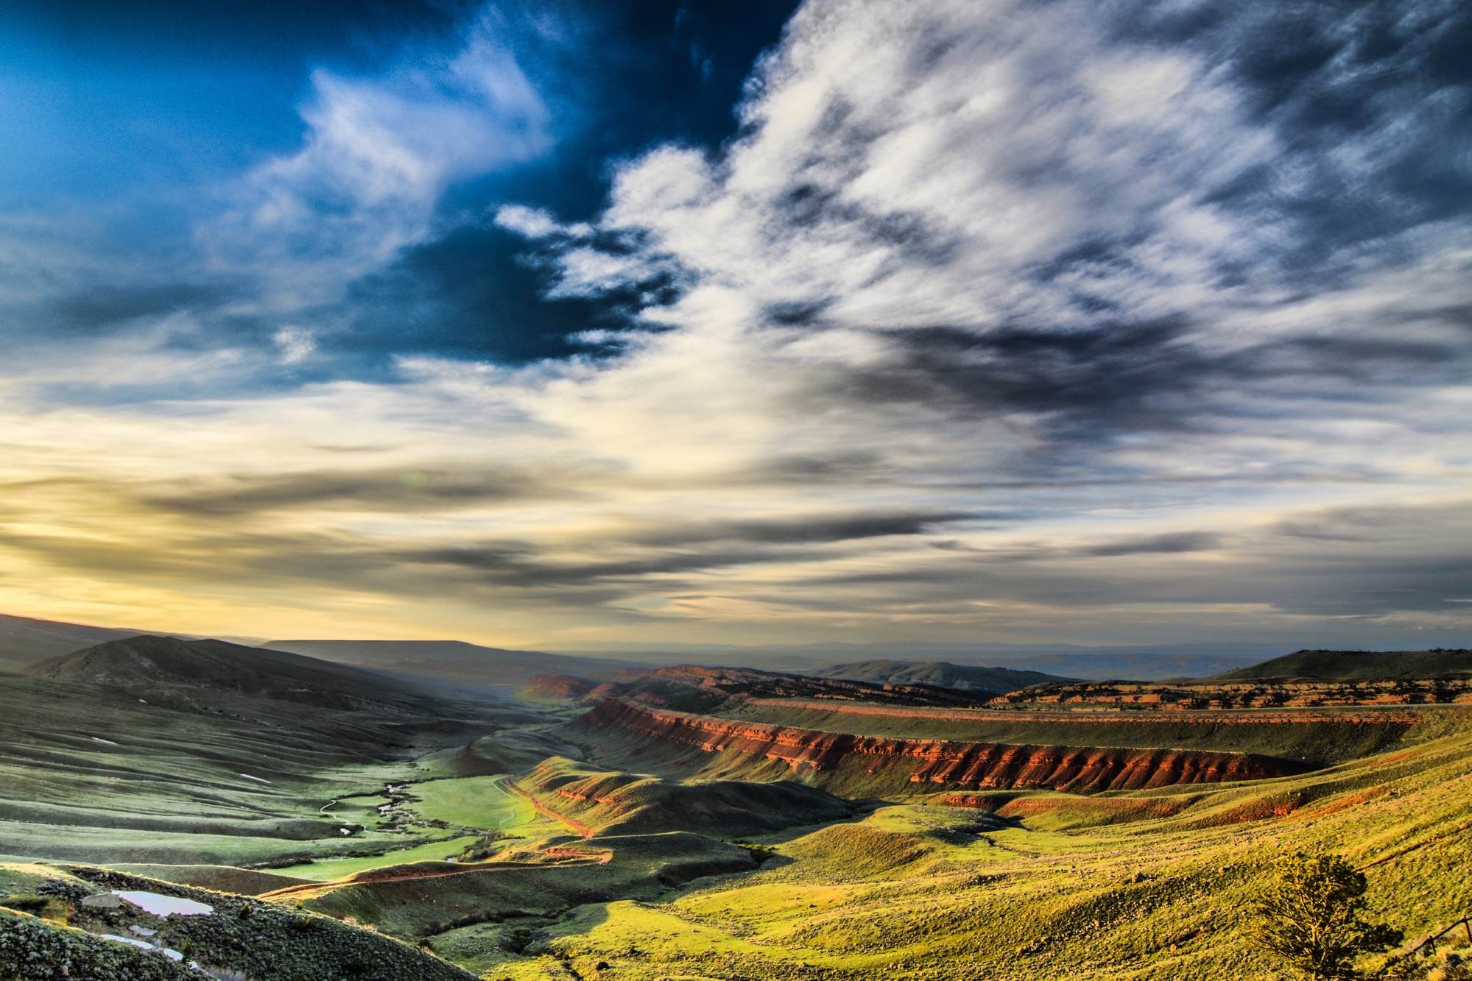
Contact us if you would like a one-one-one briefing with the Engine Team.
Email: Betty Cozzolino, CMO, CO-WY Engine
Betty@Innosphere.org
Notes:
Please have your attendees send this document back to your email. ( whoever is presenting )
Do you understand the strategy that we are laying out?
Do you see major gaps?
Do you see refinements or enhancements?
Would you like a one-on-one with the Engine?

