Slide 1
Closing Plenary – The State of the Region: A Snapshot of Economic Development Trends and Actions
EDA Denver Region 2025 Conference
April 17, 2025
Brian Kelsey
Manager, Economic Development Advisory Services
Fort Worth, Texas | brian.kelsey@ey.com

Slide 2
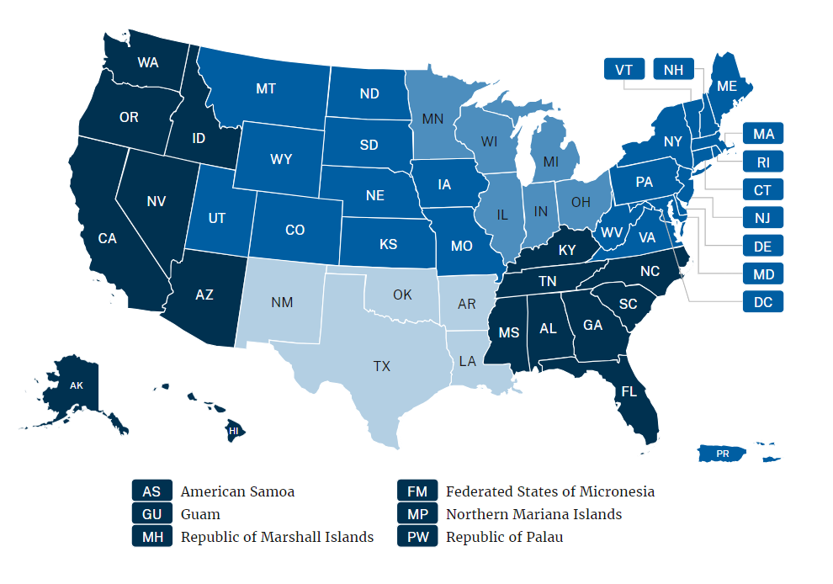
EDA Regions
Denver
Chicago
Philadelphia
Seattle
Atlanta
Austin
* Map and charts omit U.S. Territories and Puerto Rico due to data availability.

Slide 3
Economic growth

Slide 4
Denver is the third-fastest growing EDA regional economy
GDP growth, 2019-2024
Job growth, 2019-2024
EDA Denver is a nearly $2 trillion economy, about 8% of total U.S. GDP. Employers added about 605,000 jobs in 2019-2024.
Source: Lightcast. GDP growth is not adjusted for inflation.

Slide 5
EDA Denver is home to two of the fastest growing metro job markets
All U.S. metros, February 2025
EDA Denver metros, February 2025
 | Jobs(k) | YoY Growth
Sandusky, OH | 50.1 | 6.14%
Barnstable, MA | 91.0 | 5.94%
Rochester, MN | 129.5 | 5.46%
Napa, CA | 76.4 | 4.80%
Coeur d'Alene, ID | 75.0 | 4.60%
Traverse City, MI | 70.0 | 4.17%
Atlantic City-Hammonton, NJ | 167.6 | 4.10%
St. George, UT | 89.1 | 3.60%
Kennewick-Richland, WA | 128.3 | 3.38%
Chambersburg, PA | 62.6 | 3.30%
Eagle Pass, TX | 18.8 | 3.30%
Boise, ID | 407.8 | 3.29%
Walla Walla, WA | 28.4 | 3.27%
Goldsboro, NC | 42.9 | 3.12%
Rapid City, SD | 74.0 | 3.06%
 | Jobs(k) | YoY Growth
St. George, UT | 89.1 | 3.60%
Rapid City, SD | 74.0 | 3.06%
Grand Forks, ND | 56.0 | 2.94%
Logan, UT | 73.0 | 2.53%
Ogden, UT | 272.8 | 1.91%
Jefferson City, MO | 83.1 | 1.84%
Manhattan, KS | 56.7 | 1.61%
Salt Lake City-Murray, UT | 832.3 | 1.55%
Missoula, MT | 68.8 | 1.47%
Iowa City, IA | 102.9 | 1.38%
Springfield, MO | 235.5 | 1.38%
Helena, MT | 44.3 | 1.37%
Bismarck, ND | 72.3 | 1.26%
Lincoln, NE | 196.2 | 1.24%
Grand Junction, CO | 67.8 | 1.19%
Source: U.S. Bureau of Labor Statistics, CES. February report released on April 9, 2025.

Slide 6
Tourism

Slide 7
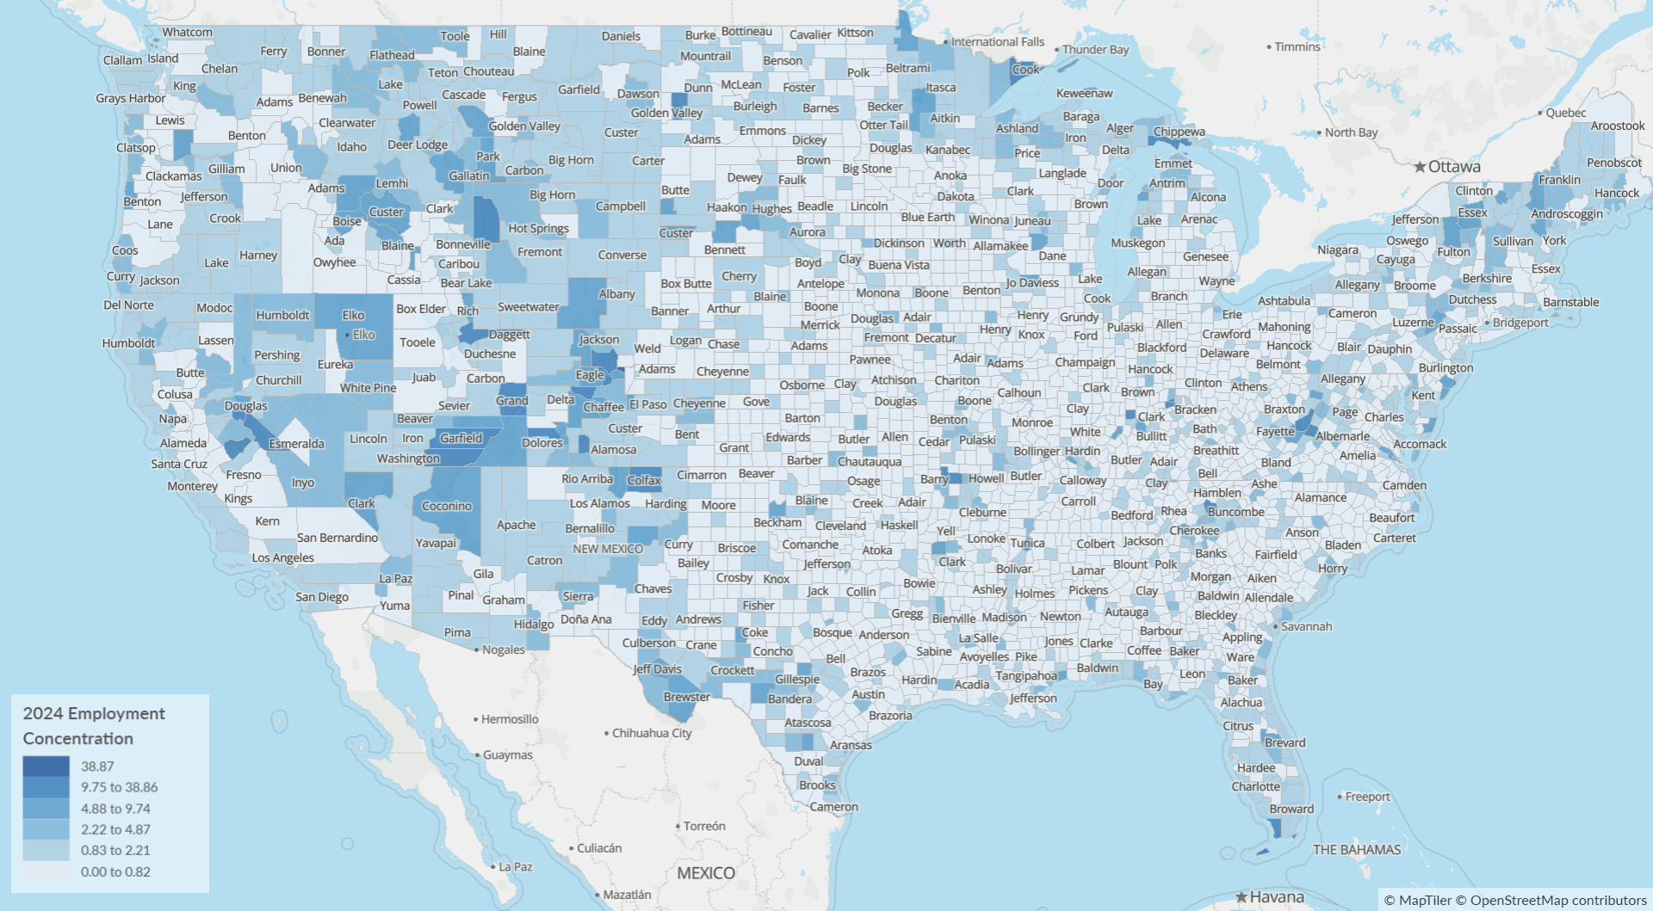
Hospitality and Tourism
 | GDP ($b) | 2019-24 | Jobs | 2019-24
Atlanta | $83.99 | 38.7% | 757k | 1.3%
Denver | $31.45 | 34.6% | 313k | -0.5%
Austin | $36.82 | 35.5% | 340k | -0.6%
Seattle | $120.31 | 26.4% | 883k | -5.1%
Chicago | $44.47 | 25.5% | 391k | -5.3%
Philadelphia | $93.54 | 24.1% | 688k | -6.1%
Gilpin County, CO
Source: Lightcast
Page 7

Slide 8
Workforce availability

Slide 9
Job openings could significantly outpace labor supply in four EDA regions
Unemployment rate, December 2024
Potential labor shortage, 2024-2034
 | Job Change 2024-2034 | Pop Change Age 25-64 | Difference Pop-Jobs
Seattle | 3,050,217 | 29,275 | -3,020,942
Philadelphia | 2,200,518 | -269,645 | -2,470,163
Chicago | 735,906 | -218,738 | -954,644
Denver | 1,303,605 | 858,508 | -445,097
Atlanta | 2,784,237 | 2,997,625 | 213,388
Austin | 2,399,303 | 2,640,043 | 240,740
Denver’s age-75+ population is expected to grow by 34% by 2034 (+650k). Total population is expected to grow by only 5% (+1.4m).
Source: Lightcast

Slide 10
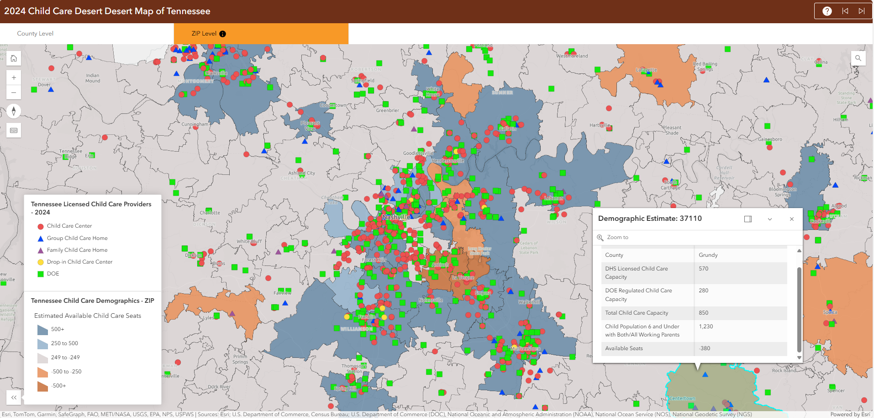
CEDS: Closing childcare gaps as a workforce development strategy
Source: Tennessee Department of Human Services. https://tnchildcarehelpdesk.sworpswebapp.sworps.utk.edu/child-care-desert-map/

Slide 11
Housing

Slide 12
Housing supply in EDA Denver never fully recovered from the Great Recession
 | AvgAnn
1980s | 48
1990s | 55
2000s | 57
2010s | 41
2020-23 | 56
Zillow Home Value Index (ZHVI)
 | Feb-09 | Feb-25 | Real %*
Colorado | $225,346 | $546,004 | 62%
Utah | $225,571 | $523,712 | 55%
Montana | $189,972 | $452,837 | 59%
Wyoming | $201,192 | $353,826 | 17%
South Dakota | $144,720 | $302,465 | 39%
North Dakota | $159,968 | $265,402 | 11%
Nebraska | $124,439 | $260,028 | 39%
Missouri | $132,056 | $247,099 | 25%
Kansas | $115,828 | $227,854 | 31%
Iowa | $117,520 | $216,891 | 23%
Sources: HUD SOC Building Permits, Zillow Research. ZHVI is a measure of the typical home value and market changes across a given region and housing type. It reflects the typical value for homes in the 35th to 65th percentile range. Seasonally adjusted. *Home values expressed in current dollars. Real growth rate calculated by adjusting February 2009 values to 2025 dollars.

Slide 13
Entrepreneurship

Slide 14
Venture funding share is low but compares favorably per capita to other regions
% U.S. venture capital investment, 2019-24
VC investment per resident, 2019-24
Companies in EDA Denver raised $69.33 billion in VC in 2019-2024. Leading verticals: SaaS ($16.5b), AI & machine learning ($12.2b)
Source: PitchBook

Slide 15
EY | Building a better working world
EY exists to build a better working world, helping to create long-term value for clients, people and society and build trust in the capital markets.
Enabled by data and technology, diverse EY teams in over 150 countries provide trust through assurance and help clients grow, transform and operate.
Working across assurance, consulting, law, strategy, tax and transactions, EY teams ask better questions to find new answers for the complex issues facing our world today.
EY refers to the global organization, and may refer to one or more, of the member firms of Ernst & Young Global Limited, each of which is a separate legal entity. Ernst & Young Global Limited, a UK company limited by guarantee, does not provide services to clients. Information about how EY collects and uses personal data and a description of the rights individuals have under data protection legislation are available via ey.com/privacy. EY member firms do not practice law where prohibited by local laws. For more information about our organization, please visit ey.com.
© 2025 Ernst & Young LLP.
All Rights Reserved.
ey.com

