Slide 1
Welcome!
Please sit with a group that doesn’t include someone from your organization ☺

Slide 2
Attracting, Retaining, & Nurturing EDD Staff
2025 SWREDA Annual Conference Las Cruces, NM

Slide 3
Brett Schwartz Associate Director NADO Research Foundation
bschwartz@nado.org

Slide 4
More info at: www.nado.org/EDDCoP

Slide 5
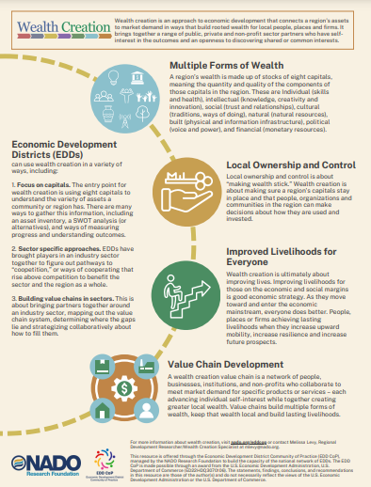
Visit: www.nado.org/eddcop

Slide 6
Agenda
10 minutes – Intro / Framing
5 minutes – Turn and Talk Ice Breaker
30 minutes – Small Group Discussions
15 minutes – Sharing Out

Slide 7
If you are lucky enough to be someone’s employer, then you have a moral obligation to make sure people do look forward to coming to work in the morning.
John Mackey, Co-Founder, Whole Foods

Slide 8
90,000 Hours

Slide 11
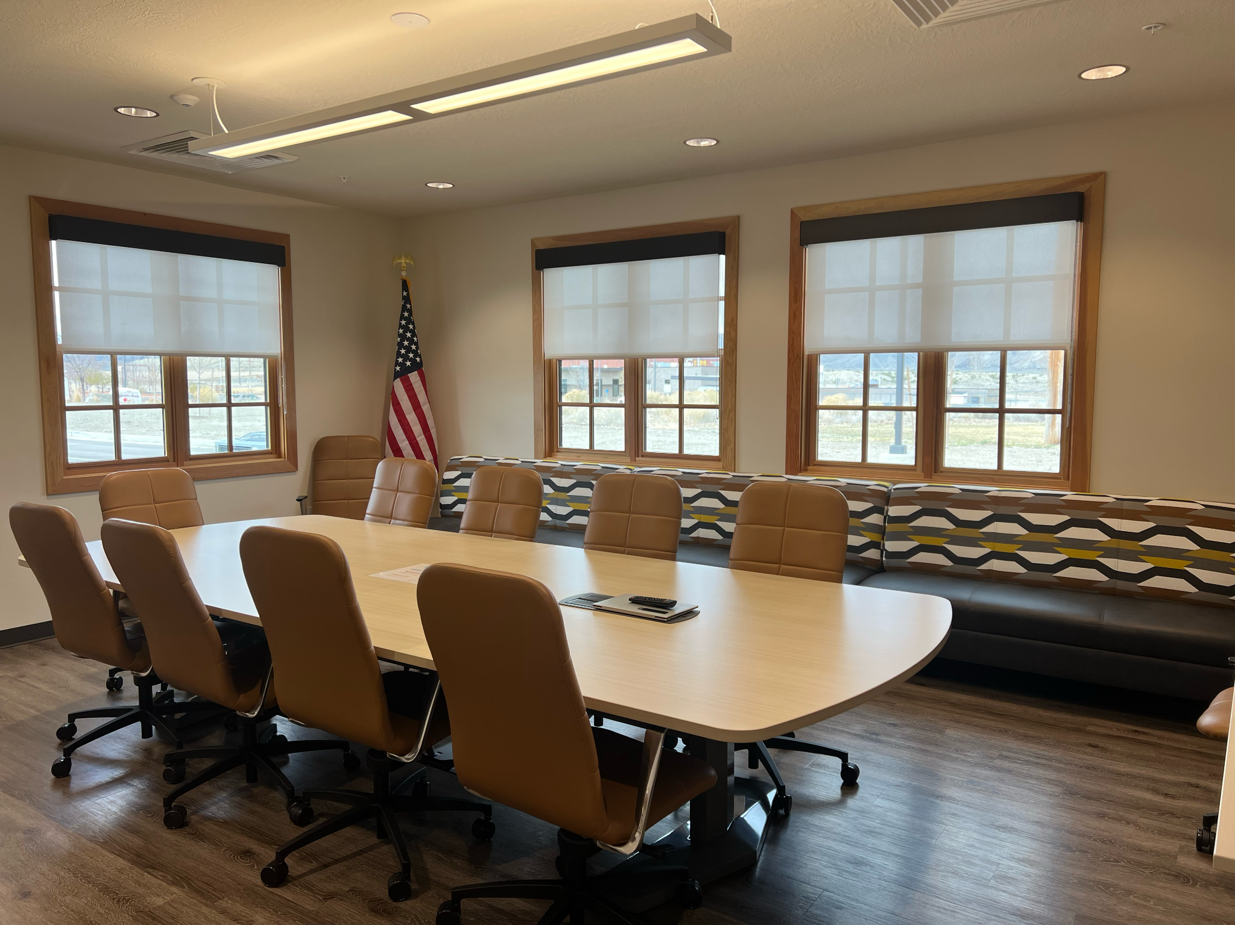
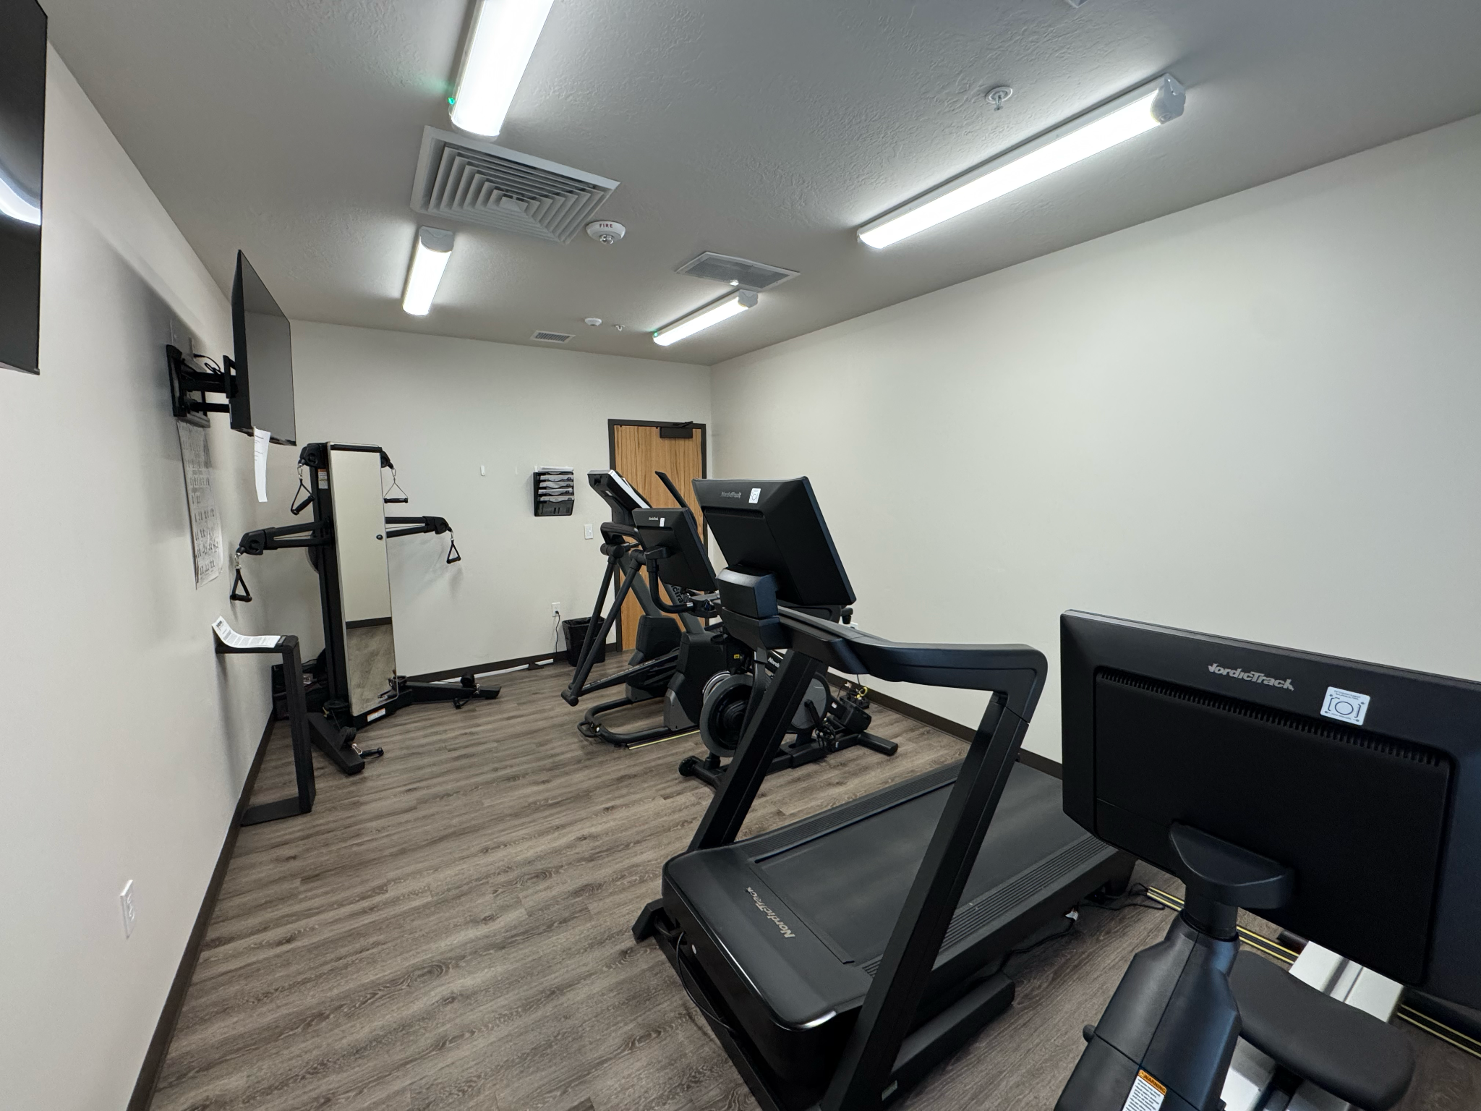
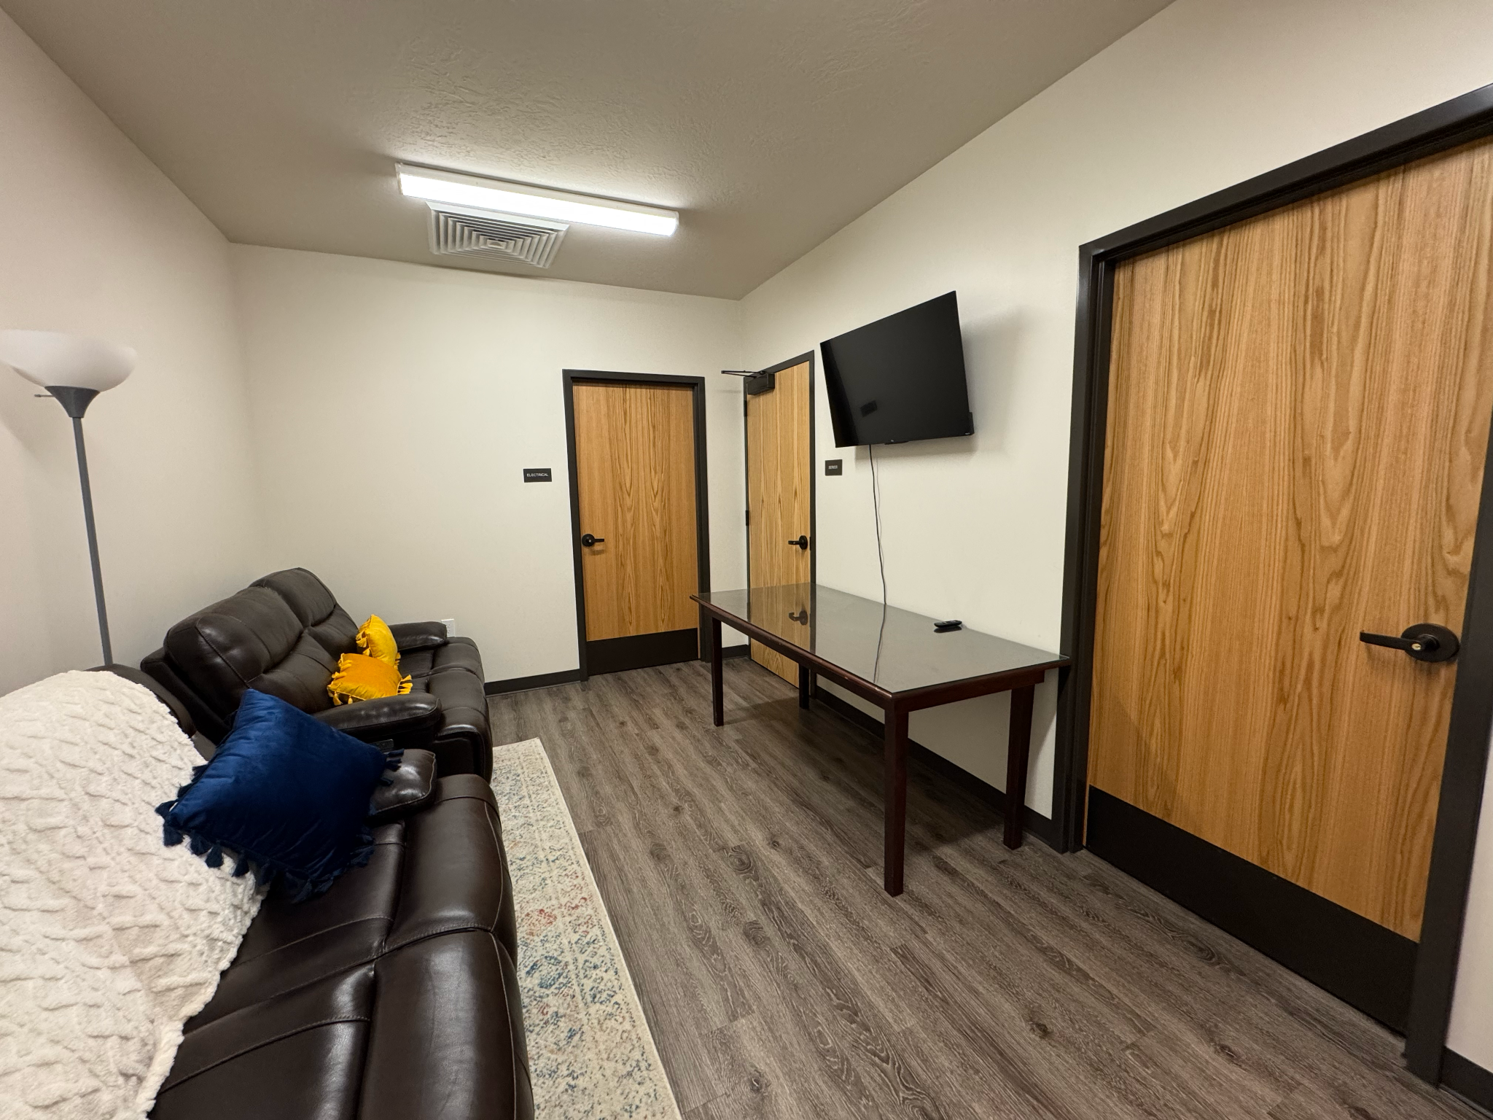
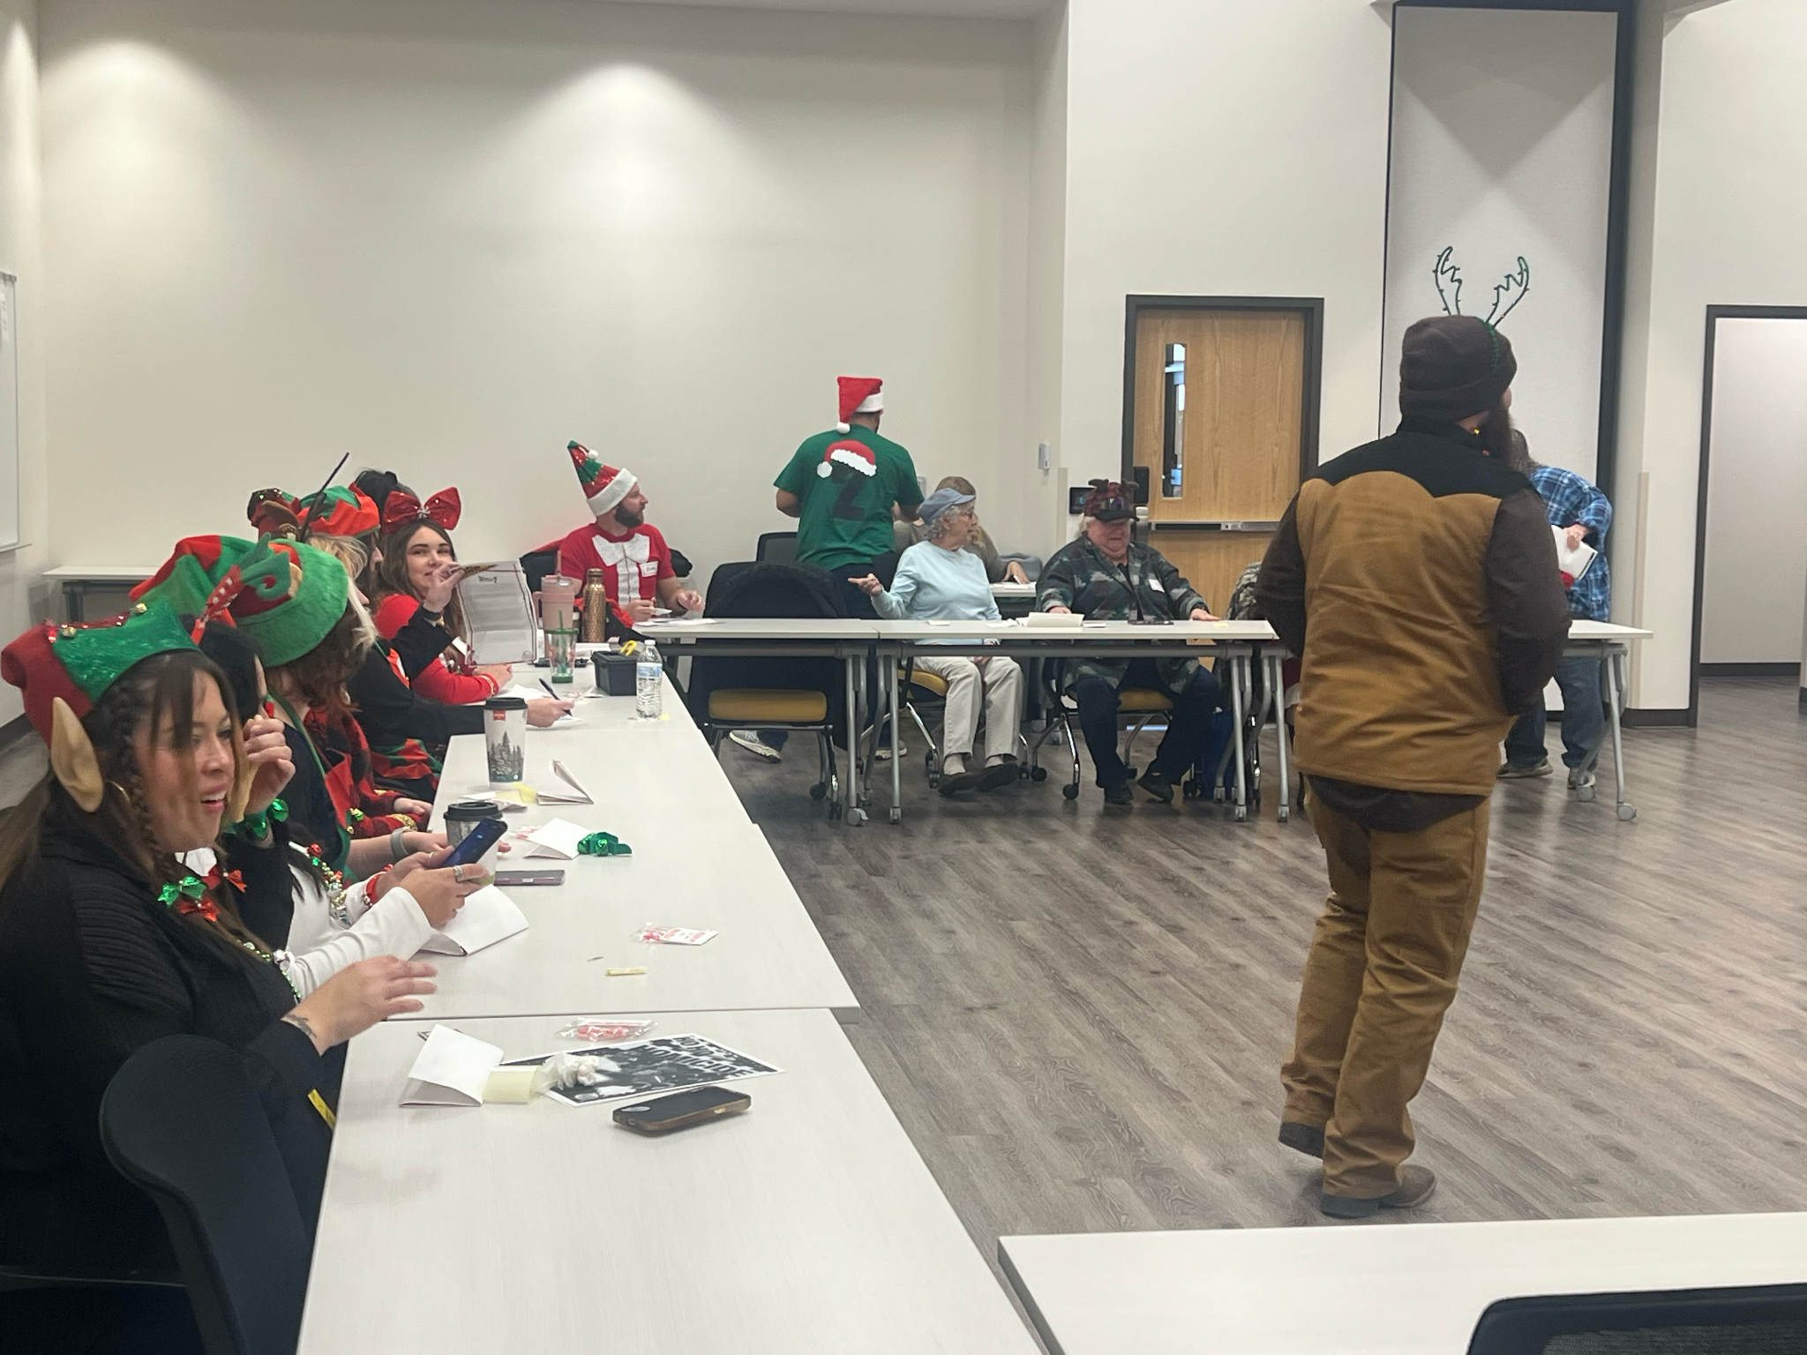
Team Member Incentives / Benefits:
Birthday “Extra Holiday” Day Off
Employee Appreciation Day Off
17 Paid Holidays
Flexible Schedule - Child Care or Education
Company Contributes 6% to 401k
Anniversary Day Off
Neighborhood Activities - Luncheons with partnering agencies
Holiday Celebrations / Activities
Management Retreat
Remote work for parents with special needs children - Rural Utah doesn't have many resources
Team members can donate their sick leave to other team members in need
Volunteer Exchange - For every hour donated we offer as paid time off
Fitness Facility - Employees and family can use facility - Reserve through a calendar system. Every employee receive 3 hours off per week - limits to 1 hour per day for exercise
Notes:
Now, for the reason we are gathered here - our agency incentives

Slide 12
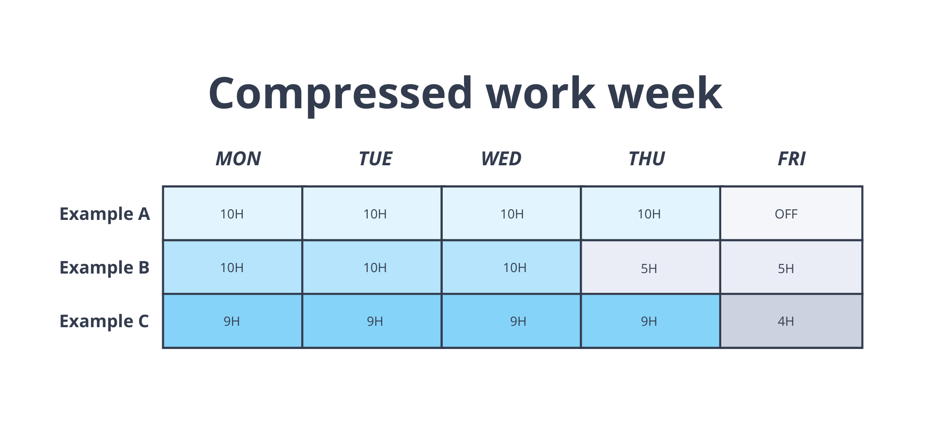
Flexible Work Arrangements
Compressed Work Week
Flex Fridays
Mondays-Thursday = 9 hours
Fridays = 4 hours
Employees get to pick their work schedule
Piloted Flex Friday beginning January 1, 2025 for three months
Employees are allowed to work remotely on Fridays beginning April 1, 2025
Always have the option to come into the office
MUST come into the office for meetings
New employees must work in the office on Fridays for three months

Slide 13
Education Assistance
SECOG will reimburse employees for courses/training that will improve or enhance performance or career growth
Must have a written Career Growth Plan
80% of tuition expenses up to $3,000 a year
Must have completed at least 90 days of employment
Must complete the course with a
“B” for graduate courses
“C” for junior, community or college courses
A pass or certificate of completion for training or apprenticeship courses
Employee must reimburse SECOG if they leave the organization within 12 months of completion of the class

Slide 14
Volunteer Opportunities
SECOG sponsors a meal at a meal ministry twice a year
Pay employees for volunteering for up to three hours
Also invite clients/customers and board members to serve
Other examples: mentoring, Meals on Wheels

Slide 16
Visit: www.nado.org/wellness-webinar

Slide 18
Turn & Talk (5 minutes)
What’s one thing your organization does well and one thing your organization struggles with around talent?

Slide 19
Group Prompt #1 (10 minutes)
Recruitment strategies: What has helped you attract talent despite tight budgets?

Slide 20
Group Prompt #2 (10 minutes)
Building culture: How do you create a workplace that people want to be a part of?

Slide 21
Group Prompt #3 (10 minutes)
Flexibility and benefits: What non-salary incentives have made a difference for your team?

Slide 22
Sharing Out (15 minutes)

