Slide 1
The Gateway to Space®
Spaceport America Overview
Scott McLaughlin, Executive Director
Presented to:
May 8, 2025

Slide 2
What is a Spaceport?
Spaceport means any area of land or water that is used, or intended for use, as a spacecraft launch or landing area and any appurtenant areas that are used, or intended for use, for spaceport buildings or other spaceport facilities or rights−of−way, together with all spaceport buildings and facilities located thereon. (www.lawinsider.com/dictionary/spaceport)
In the US, a Spaceport means a launch or reentry site that is operated by an entity licensed by the Secretary of Transportation, through the Federal Aviation Administration, Office of Commercial Space Transportation (AST). (www.congress.gov/115/plaws/publ254/PLAW-115publ254.pdf and www.faa.gov/about/office_org/headquarters_offices/ast)
Allowed via the Commercial Space Launch Act of 1984 (and amendments) fostering private space activities in the US.

Slide 3
Spaceports around the World
https://brycetech.com/reports

Slide 4
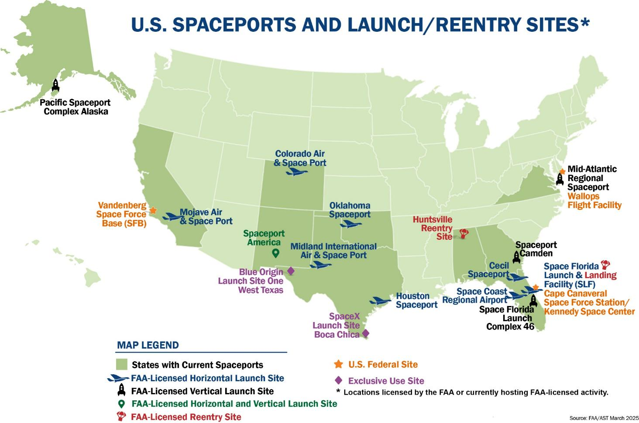
U.S. Spaceport & Launch/Reentry Sites

Slide 5
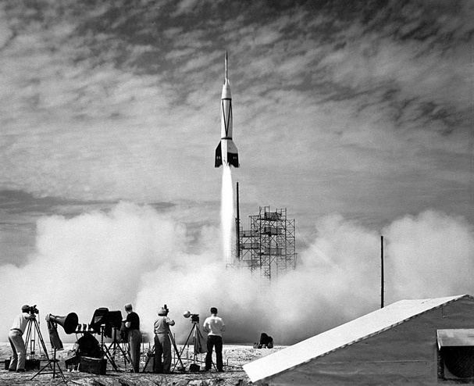
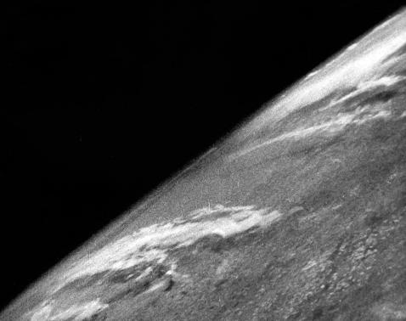
New Mexico’s Space History
1930’s – Robert Goddard’s liquid rocket engine tests
1940’s – Werner Von Braun and V-2; Also, Los Alamos National Laboratory and Sandia National Laboratory.
1950’s – U.S. Army WSMR continues rocket development
1960’s – NASA and White Sands Test Facility (materials/engines) & Astronaut Training in NM
1970’s – Space Shuttle related R&D and training
1980’s – Kirtland Air Force Base R&D for Space
1990’s – Continuation of above, and NM Space Office
2000’s – Spaceport America, Virgin Galactic…
2010’s – Space Rapid Capabilities Office and other USSF
2020’s – Boeing Starliner lands at WSMR; Confluence of space in region to be called Space Valley; 3rd state to host humans in space
So much more: Old and new observatories (Chaco Canyon, Apache Peak, VCLA), Holloman AFB (high-altitude balloon, sled track), NASA WSTF, LANL, Sandia, AFRL, USSF RCO, great universities…
World’s first photograph from space…
V-2 launch from White Sands Proving Ground on October 25, 1946

Slide 6
Important SpA Dates
1984 U.S. Commercial Space Launch Act (amended 1988, 2004)
1990-1993 Phase I: Spaceport Startup
NM has significant benefits (low population density, high ground elevation, good weather, low corrosion, and uncongested airspace)
Seed funding for the spaceport and started courting capsule landing and space launch
1994-2003 Phase II: Southwest Regional Spaceport (SRS)
Studies continue and establishment of the NM Office of Space Commercialization and eventual selection of an area for a spaceport (along with EIS and FAA license)
Shift to orbital launch site instead of capsule reentry (e.g., LM VentureStar)
Started working with WSMR, BLM, FAA, etc.
X-Prize becomes technology driver
2004-present Phase III: Spaceport America
Advanced Composites wins Ansari X-Prize (fall of 2004)
Passage of the Spaceport Development Act (2005) and first contact with Virgin Galactic
NM Legislature passed funding authorization (2006), conditional upon: signing a major customer, passage of a tax increase by at least two counties, and obtaining a license
Spaceport America is funded and built
About $250M spent so far, all from New Mexico
2006 – First flight at SpA by UP Aerospace
2021 – Virgin Galactic sends first humans to space from NM

Slide 7
NMSA Statutory Mission
The New Mexico Spaceport Authority shall:
Encourage and foster development of the state and its cities and counties by developing spaceport facilities in New Mexico;
Actively promote and assist public and private sector infrastructure development to attract new industries and businesses, thereby creating new job opportunities in the state;
Create the statutory framework that will enable the state to design, finance, construct, equip and operate spaceport facilities necessary to ensure the timely, planned and efficient development of a southwest regional spaceport; and
Promote educational involvement in spaceport activities and education and training of the workforce to develop the skills needed for spaceport operations.
Stipulated in the New Mexico Spaceport Development Act, 2005
We are open to use by commercial and governmental entities, including from other countries.

Slide 8
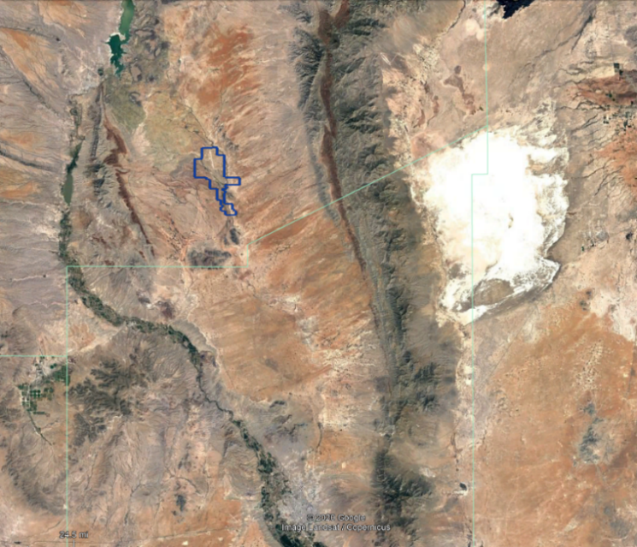
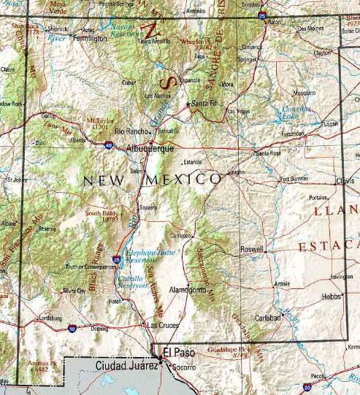
Spaceport America New Mexico Location
Facilities across 18,000 acres in Sierra County, New Mexico
Adjacent to White Sands Missile Range (WSMR)
Easy road access to I-25 and I-10
No rerouting of air traffic for launches
WSMR Landing Zone
Truth or Consequences
19 miles
Holloman AFB
48 miles
White Sands Missile Range HQ
Las Cruces

Slide 9
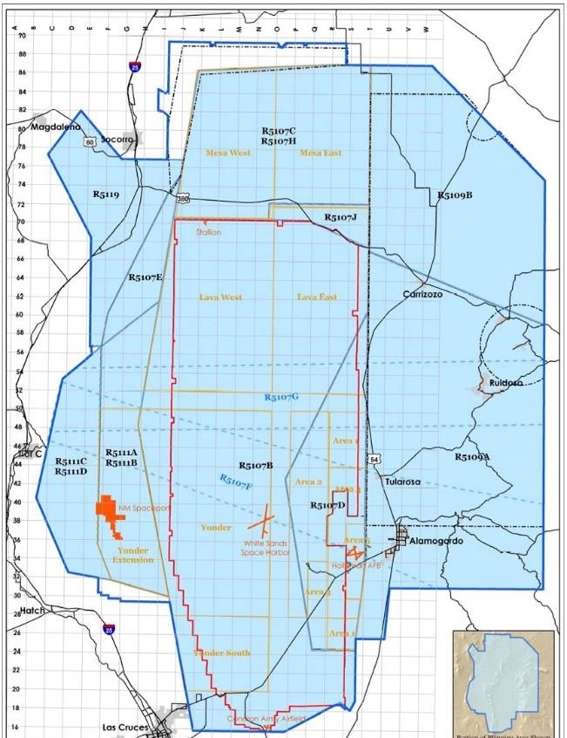
Spaceport America’s Unique Benefits
Good launch weather with 340+ days of sunshine
High elevation of 4,600 ft MSL beneficial for launch
No salt air corrosion
Remote location with very low population density
24/7 security, Fire, and EMS protection
Access to 6,000 sq. miles of restricted airspace (R5111 and R5107), surface to unlimited
Available assets from nearby White Sands Missile Range include Radar, Telemetry, Optics, and Meteorological Services
Spaceport
America

Slide 10
Example Airspace Flight Pattern
The ‘time lapse’ image of commercial air traffic shows how airlines must fly around WSMR airspace, including Spaceport America
With WSMR’s partnership, the airspace allows for considerable flexibility for different flight vehicles and usage
Note that SpA customers must pay for scheduling of the airspace
Spaceport America

Slide 11
The Continental U.S. at Night
Remote location & low nearby population reduce risk

Slide 12
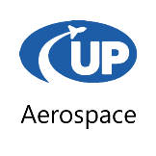
Area Descriptions
Horizontal Launch Area (HLA)
• 12,000-ft long, 200-ft wide runway
• Horizontal and air launch operations
• Space tourism
• Conventional aircraft operations
• Unmanned aircraft operations
• High-altitude balloon operations
→ Tenants: Virgin Galactic, HAPS Mobile
6 miles
Vertical Launch Area (VLA)
• Suborbital launch vehicles & R&D
• Solid, liquid, and hybrid propellant support
• Rocket motor manufacturing and testing
• Commercial and academic customer support
• Launch from SA, land on WSMR
• Small UAVs
→ Tenants: UP Aerospace, AeroVironment
9 miles
Advanced Technology Area (ATA)
• Emerging technology R&D
• Isolated environment
→ Tenant: SpinLaunch

Slide 13
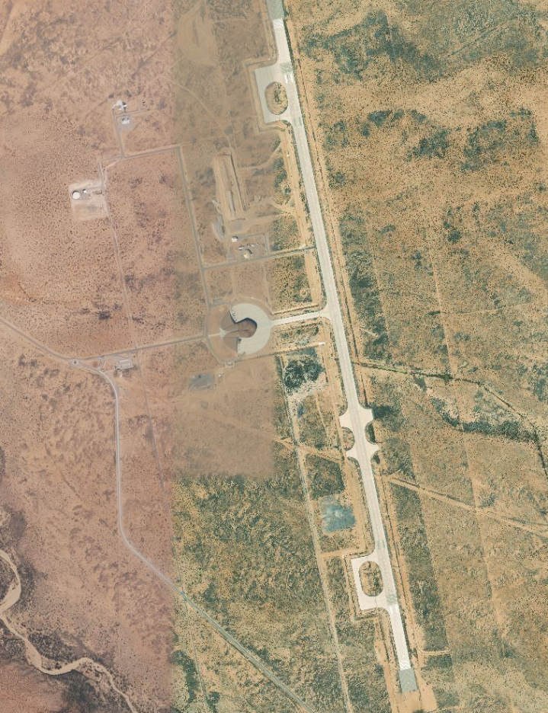
Horizontal Launch Area (HLA)
Spaceport Operations Center (SOC)
New Visitor Reception and IT Center for 2022
Security/Safe Team Quarters
VG and AV operations
12,000’ x 200’ Runway
In-ground utilities for water, wastewater, electricity, fiber
Plenty of space for additional hangars or support facilities
New 4,000’ x 500’ UAS test area (no shown in picture)
Future point-to-point transportation

Slide 14
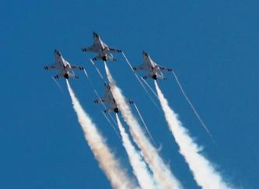
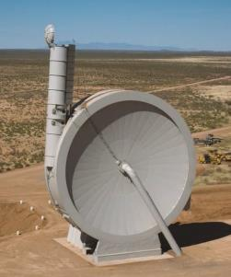
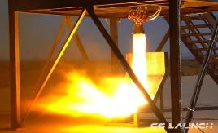
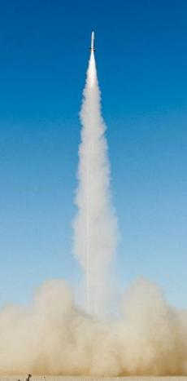
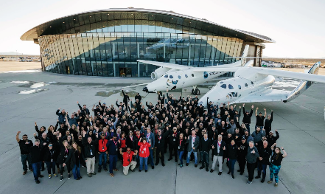
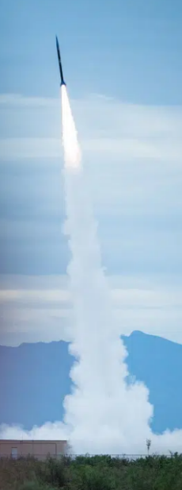
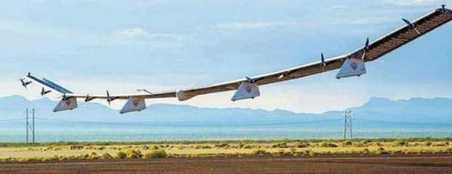
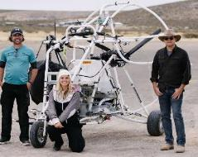
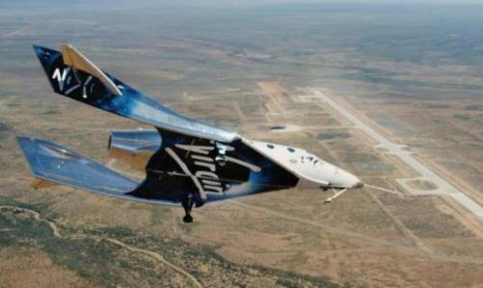
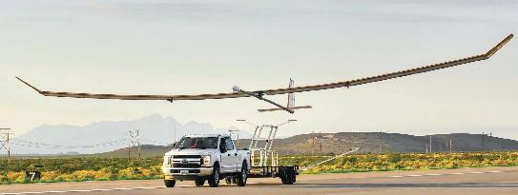
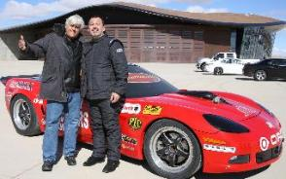
Many Kinds of Customers

Slide 15
VG and Gateway to Space

Slide 16
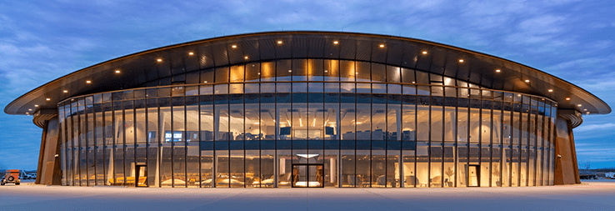
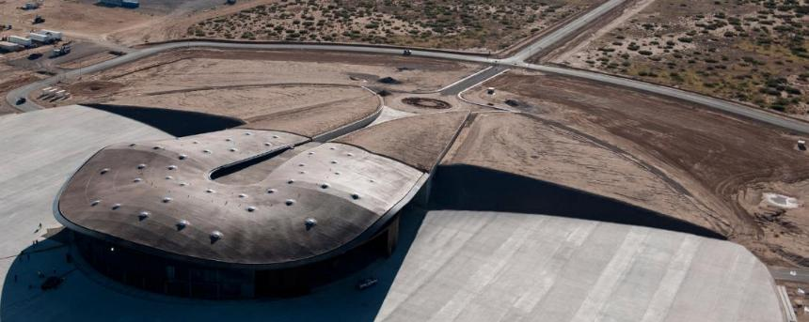
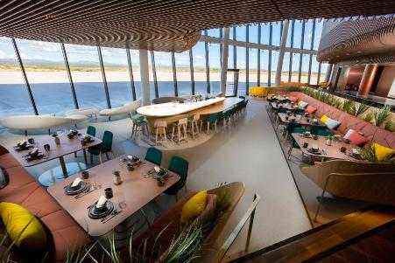
The Gateway to Space® Terminal and Hangar Facility

Slide 17
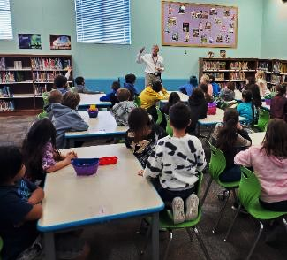
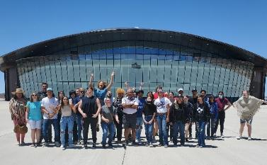
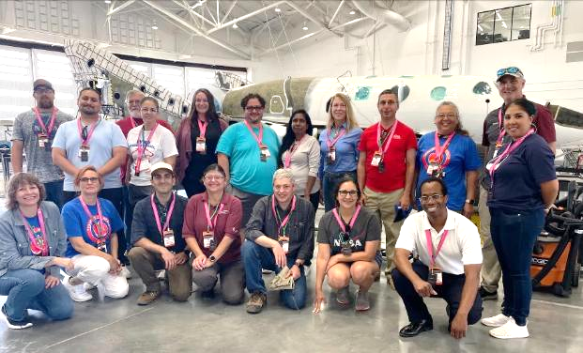
STEM and Outreach
Leading GSA Academic Partnership Working Group - ISS data collection program running in LCPS
Assisted in bringing Teachers in Space Workshop to NM late June
Supported Girls in Aviation event during SA Cup
NMSA Outreach efforts recognized by state Delta Kappa Gamma group
STEM Visits to local schools
Student site visits to SA and partnership with tenants
Supported the Tuskegee Airmen Space Camp rocket launches
Creating new STEM SA activity teaching coloring book
Working on updating Visitor Experience and merchandise (partnership with DCA)

Slide 18
Economic Impact 2022
Study completed with NMSU Center for Border and Economic Development (https://cbed.nmsu.edu/)
Study was released on 8/25/23 (https://www.spaceportamerica.com/spaceport-america-releases-economic-impact-study-for-2022/)
Impacts include tenant employment (direct, indirect, induced), privately funded construction, out-of-state visitor spending, and spaceport customer revenues.
We are working on CY23 and CY24 economic reports

Slide 19
Space Economy
Morgan Stanley: Space economy will surpass $1T by 2040, www.morganstanley.com/ideas/thoughts-on-the-market-space (2022)
CNBC: The space economy grew at fastest rate in years to $469 billion in 2021, report says (https://tinyurl.com/23wgr8mz)
CNBC: Space economy worth $424B in 2020, and is rapidly expanding (https://tinyurl.com/y2px7l7x)
PNAS: Space exploration and economic growth: New issues and horizons; https://tinyurl.com/yfjp5rop (October 2023)
AP Article: 60 years since 1st American in space: Tourists lining up, https://tinyurl.com/yjq9k8bf (May 2021)
Brookings Institute: How space exploration is fueling the Fourth Industrial Revolution, https://tinyurl.com/47mwe8ny (March 2023)

Slide 20
But – Space is Hard… …Spaceports as Well
Agreement first signed with Virgin Galactic in 2006…
It is difficult to keep momentum… stakeholders want quick success
What is Success? → Revenue? | Economic Impact ?| Jobs? | Space Cluster Growth? | And – Need Workforce, STEM, Universities
The Competition does not sleep, it is a commercial business…
But the Space Industry growth is incredible
Spaceport America is making progress…
And looks to orbital launch…
But success is not guaranteed

Slide 21
Strategy – Next five years
Work with Virgin Galactic to maximize economic impact of regular space tourism flights and space operations
As Virgin Galactic moves toward 2 carrier aircraft and 3 spaceships, the region should see significant and regular positive economic benefits.
Focus on emerging markets and tenants that increase local private sector jobs and enable the NM aerospace economy
Continually update business development targets and operational plans as the commercial space marketplace continues to grow.
Acquire FAA reentry license to support customers like Sierra Space
Suborbital point-to-point and orbital re-entry programs are upcoming markets which SpA can host.
Watch new technologies…
Continue watching for other emerging markets, technologies, and requirements. Adjust our operational capabilities to meet them as test and operations range.
Spaceport America is well positioned for
the New Space market.

Slide 22
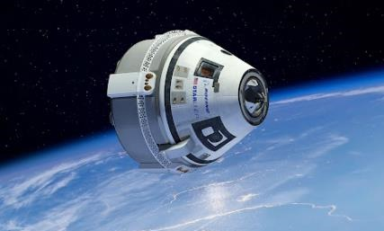
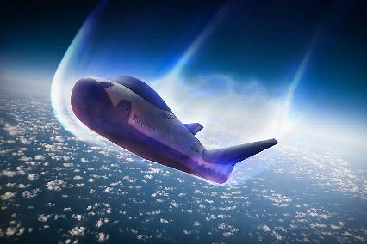
Orbital Reentry License
Submitting to the FAA in September 2024, the license is expected in early 2025 (our FAA Launch Site Operator license already supports vertical and horizontal launch – suborbital or orbital)
An orbital reentry can occur on our 12,000-ft long, 200-ft wide runway or other parts of the Spaceport
A reentry license will enable Spaceport America to accommodate various reentry vehicles, including crewed, uncrewed, and reusable spacecraft while encouraging facilities for recovery and refurbishment.

Slide 23
World Orbital Launches
USA 154, China 68
SpaceX was 83% of spacecraft

Slide 24
Orbital Launches by Country for 2024
84% of USA launches
were from SpaceX
Krebs, Gunter D. & ldquo; Orbital Launches of 2024&rdquo;. Gunter's Space Page. Retrieved May 08, 2025, from https://space.skyrocket.de/doc_chr/lau2024.htm

Slide 25
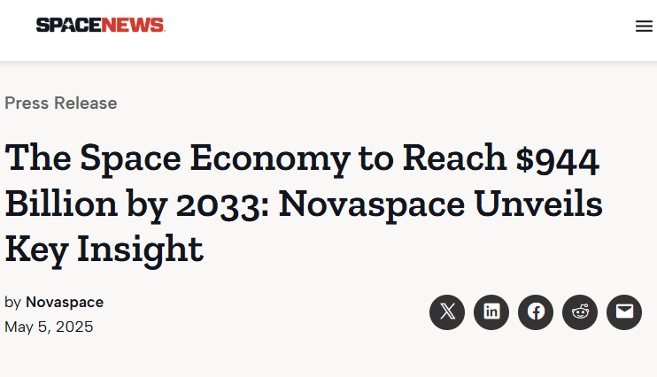
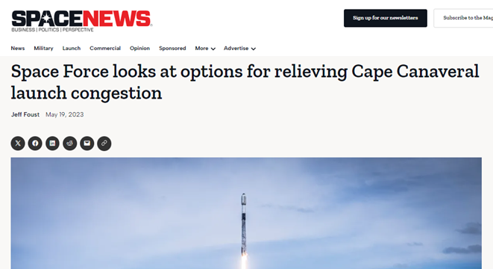
Opportunity and Competition

Slide 26
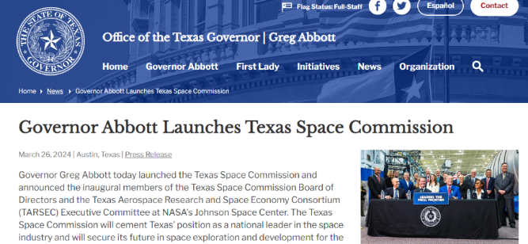
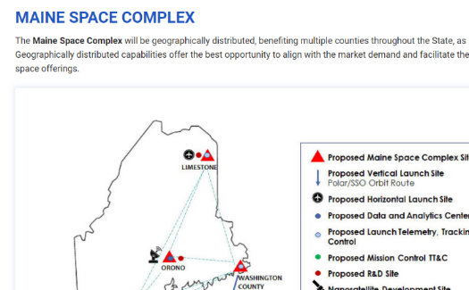
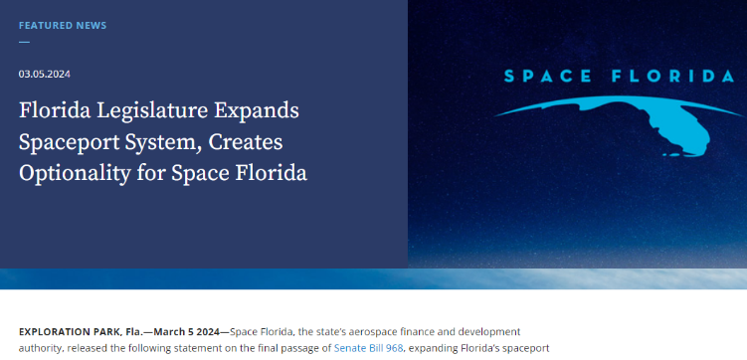
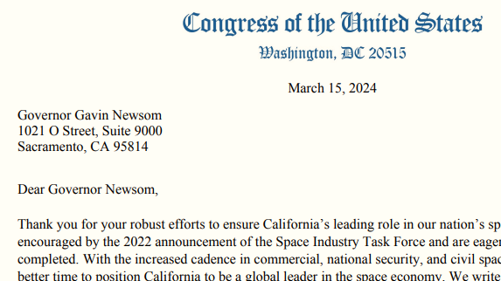
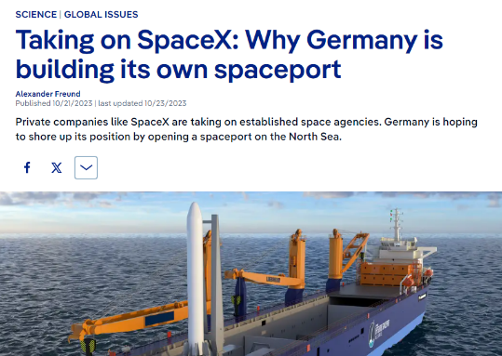
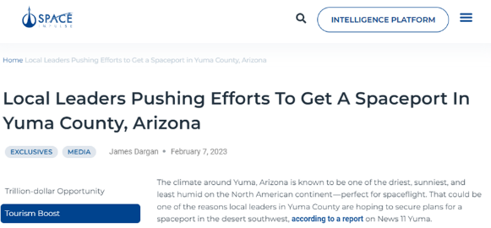
And More…

Slide 27
2024 Space Economy Valuation

Slide 28
Commercial Spaceport Success
One or more foundational aerospace partners can be vital
Long-term local and regional support is essential, through political support, incentives, taxes, and continuous advocacy
Identification and communication of clear goals is important for all stakeholders; what could the spaceport look like in 5, 10, & 20 years
Don’t oversell – due to the space industry, regulations, detractors, young & inexperienced companies, a turbulent process is guaranteed
Be innovative and collaborative, and include other spaceports, industry groups, and local & regional stakeholders

Slide 29
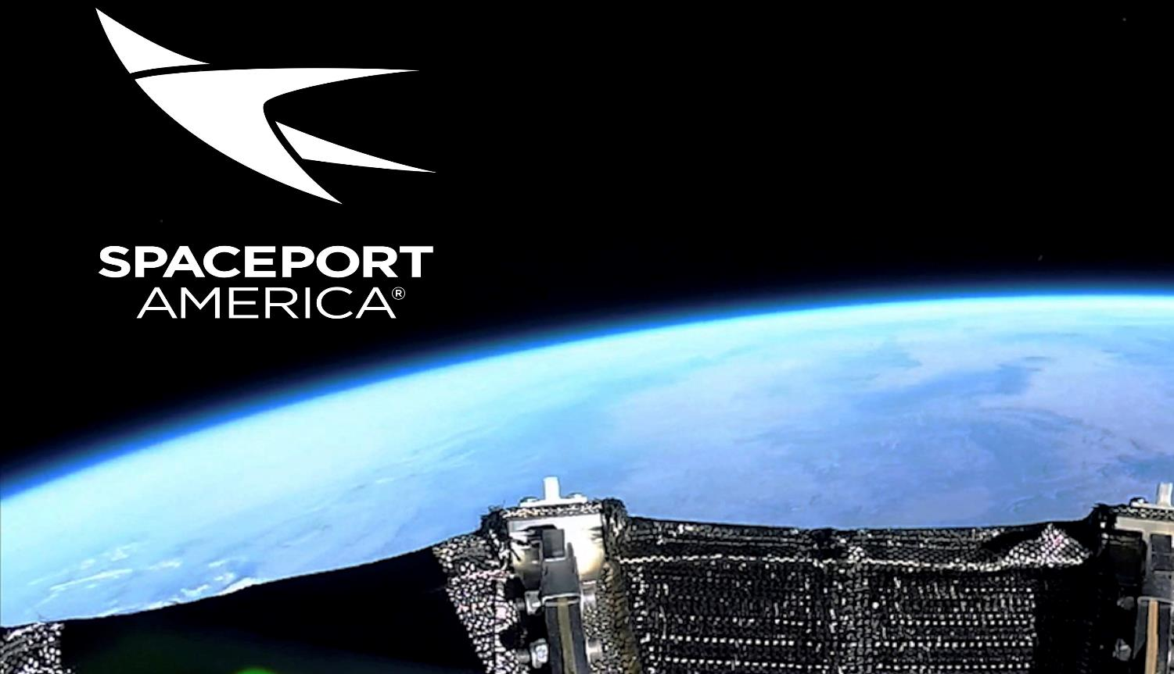
Thank you! Questions?
URL: www.spaceportamerica.com
Email: scott.mclaughlin@spaceportamerica.com

