Slide 1
Resilient Underwriting: Best Practices for Startups and Economic Uncertainty
This presentation was prepared by Grow America using Federal funds under award ED22HDQ3070190 from the Economic Development Administration, U.S. Department of Commerce. The statements, findings, conclusions, and recommendations are those of the author(s) and do not necessarily reflect the views of the Economic Development Administration or the U.S. Department of Commerce.
Notes:
Welcome to Resilient Underwriting: Best Practices for Startups and Economic Uncertainty
My name is Toni Stinnett, and I am a Program Manager with Grow America. This presentation is being offered through the Revolving Loan Fund Community of Practice (aka RLF CoP), operated by Grow America with support from the US Economic Development Administration.
Before I turn it over to our presenters, I want to discuss more about the RLF CoP.

Slide 2
RLF CoP Objectives
Increase the capacity of RLFs to meet the needs of their local economic develop strategies.
Increase organizational capacity.
Increase the volume of loans and loan capital.
Establish a peer-to-peer group of RLFs to collaborate on needs, strategies, capacities, and program impact.
Increase understanding of broader economic development strategies through training and curriculum.

Slide 3
RLF CoP Activities
Self-assessments
Virtual Portal
ED-209 Data
Industry Analysis
Establish RLF Network
6-month Cohort Trainings
9 peer leaders
Monthly
Workshops
RLF Advisory Committee
Trainings and Resources
Notes:
The activities of the RLF CoP will help us meet the objectives and increase RLF capacity.
Training and Resources & RLF Network –
Virtual Monthly workshops – such as this one, you can join our mailing list or check out NADO News to hear about our workshops.
Cohort – We are currently on our fourth and final training cohort that will be taught during this grant. The cohorts are intended to improve organizational capacity and help improve participants’ skills.
Virtual portal – the portal stores helpful resources, including workshop and cohort recordings, and acts as a virtual space to have conversations among your peers in the regional forums.
Industry analysis
Self-assessment – this is a tool that will provide insights on RLFs in America. It will be open for all RLFs to complete in April.
ED-209 data –Nowak will combine RLF 209 data w/ the findings from the self-assessment to create a white paper on the RLF industry
Cohort evaluations – there are 3 evaluations of the training cohorts that also provide a look at RLFs’ challenges and successes
Advisory Committee
9 peer leaders that were nominated by colleagues, EDA regional offices, or other organizations
Representation from around the country and from each RO
Meet with them at least once a month to get insights on what RLFs are interested in and make sure that our plans are relevant
May join classes or workshops to provide their tips/ perspective and examples – we will be hearing from one of our peer leaders today

Slide 4
Scan this QR codes to register for the webinar!
Notes:
One example of a monthly workshop is happening later this month on May 20th
The webinar will feature presenters from CVL Economics – an econometric firm focused on the creative economy. During the first portion of the webinar, you will learn more about the creative economy and how it can benefit your community. Following their presentation, Mary Louk will present best practices on how RLFs can lend to businesses in the creative economy.
You can scan the QR code on the screen to register for the webinar

Slide 5
Stay Connected!
You can scan these QR codes to stay up to date about the RLF Community of Practice.
Scan this to subscribe to our listserv
Scan this to create a FREE profile on the RLF Portal
Notes:
While you are scanning the QR codes, I have the pleasure of introducing our speakers today, Mary Louk.
Mary is the Director of Credit at Grow America Lending, where she leverages over 15 years of expertise in commercial and small business lending, credit analysis, and portfolio management to help small businesses grow. She first joined Grow America in 2022 as a Programs Manager and Fund Administrator. In that role Mary played a pivotal role in launching loan programs nationwide, specifically designed to support low-income and minority-owned businesses. Her contributions also extend to special projects, including grant applications, lender technical assistance programs, and other strategic initiatives. In April of 2024 she was named Director of Credit for Grow America. Since then, she has made many improvements to Grow America’s credit process with an eye to improving the customer experience.
Mary will be joined by Kelly Crisswell. Kelly is the Deputy Executive Director for the South Plains Association of Governments (SPAG) and Caprock Business Finance Corporation. She has managed the EDA funded RLF and CDC operations since 2018 and oversees an RLF portfolio that spans 3 regions in West Texas with over 150 active loans and a portfolio of over $12MM ($9MM outstanding in active loans). Additionally,as the Deputy Executive Director, Kelly oversees Regional Services & Economic Development which contains several programs that serve the SPAG region as well as other parts of Texas, including the SBA 504 loan program operated through Caprock BFC, SPAG LoanStar Fund, and the SPAG CORE specialty loan programs which cumulatively have a small business portfolio of over $60 million. In January, Kelly was named the next Executive Director of SPAG and will be stepping into the role currently held by Tim Pierce, as he retires from SPAG in June after 40 years of service.

Slide 6
Agenda
Start-up Specifics
Documents to Request and Underwriting Reminders
Projections and Stress Analysis
Industry Comparisons
Underwriting in Economic Uncertainty
Key Items to Mitigate Risk

Slide 7
Start-up Specifics
Start-ups …
Reasons Start-ups Fail
Have highest failure rate
Do not have historic results to evaluate
Can have high growth rates requiring significant cash
Can require significant equity injections from Ownership
Poor business plan
Lack of working capital
Poor locations
Bad market research
Rapid expansion
Notes:
1 in 4 small businesses fail in the first year of operation, 45% in the first 5 years. Only 25% of all businesses make it to 15 years or more. (BLS)

Slide 8
Documents to Request
Personal tax returns
Full business plan with 2-5 year projections
Any additional market research that has been done
Personal Financial Statement with accompanying back up for significant assets
Resumes for ownership and key staff

Slide 9
Underwriting Reminders
Remember: start-up requests take the longest time and require the most in-depth detail.
Set expectations on timing and amount of information needed early.
Make sure the entrepreneurs are aware that they may need to pledge personal assets, such as their home, from the beginning.
Make sure that the start-up is engaged with Business Advising, business planning, etc.

Slide 10
Underwriting Reminders
Read the business plan.
Evaluate the assumptions.
Find the gaps.
Ask if there was any professionals that assisted in the preparation of the business plan.
Make sure you understand the local environment.
Analyze the resumes to make sure the experience of the ownership will relate to the business.

Slide 11
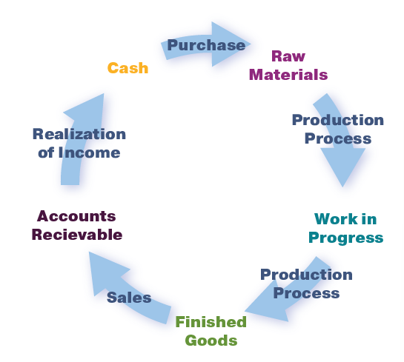
Projections and Stress Analysis
All projections should be evaluated with a critical eye.
They should be compared to Risk Management Association (RMA) standards, your own portfolio, IBIS, franchise information, etc.
Review history, location, market/competition, etc.
Cash cycle calculations should be done to insure adequate working capital.

Slide 12
Projections and Stress Analysis
Do the spreads with the business plan projections first.
Additional spreads to stress them down to a 1:1 breakeven (or your preferred) debt service coverage ratio.
You can do as many scenarios as you feel is applicable, but at a minimum you should have spreads on the provided and worst-case scenarios.
This allows you to see how much “give” the projections have.
If the projections can only be off by 5% of sales/expenses before deal is at 1:1, it is a riskier deal.
If the projections can be off by 10-15%, this gives them room in case the business doesn’t take off like the entrepreneur believes it will.

Slide 13
Projections and Stress Analysis
If it’s a variable rate loan you should do a stress analysis to analyze rate risk – especially in a rising rate environment.
Look at what happens to DSCR if WSJP increase 1-2%.
Depending on the reset time frame this may be done at annual review time as well.

Slide 14
Industry Comparisons
Projections should be compared to RMA standards, your own portfolio, IBIS, etc.
Compare NI, GP, COGS margins of projections against the averages.
There are many ratios provided in the reports - use what is applicable to your deal.
If the projections are out of line from industry averages, you need to discuss with the clients and find out why they believe their business will operate differently.
Bring the projections in line with industry averages to analyze how the business will fare.

Slide 15
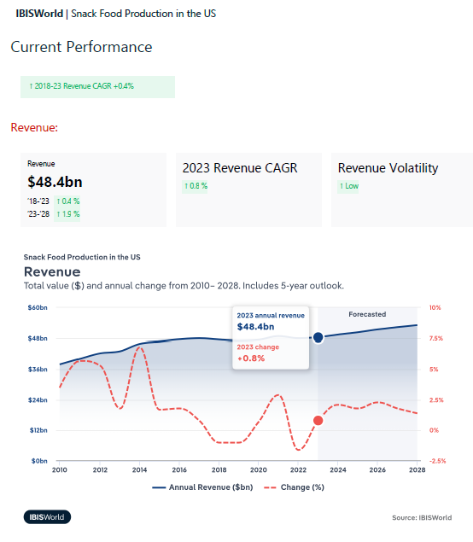
Industry Comparisons
Industry reports can give you more knowledge but have limitations.
They are based on variety of sizes of companies across the country.
IBIS World – includes industry analysis and forecasts.
https://www.ibisworld.com/
Risk Management Association (RMA) – member organization focused on risk management tools and education.
https://www.rmahq.org/
*EDA doesn’t require use of a specific service
Screenshot from IBISWorld’s recent publication, Snack Food Production in the US

Slide 16
Key Items to Mitigate Risk
Outside income of guarantor’s/owner operators
This is a huge mitigant for me.
Putting the weight of the new business plus personal debt service/living expenses is risky.
Make sure the business has the professional advisors it needs
Accountants, lawyers, marketing, etc.
Consider requiring TA for the first 2 years.
Owners’ industry experience
Preferably in the same geographic region.

Slide 17
Key Items to Mitigate Risk
Absentee owners are very risky
Collateral = Cooperation
Take all available collateral - as long as it can be liquidated
There must be equity available for injection into the business

Slide 18
Underwriting in Economic Uncertainty
Many businesses will be affected by tariffs.
Items to think about including in your underwriting:
Do they have enough cash on hand to cover tariffs on existing?
How does/will this affect their working capital?
Are they able to raise prices immediately or in contracts that will need to be amended?
Do they have other options for suppliers?

Slide 19
Underwriting in Economic Uncertainty
Break Even Analysis is going to be more important then ever.
Run several different scenarios - decreasing sales, increasing costs.
It may take discussion with the business owner to understand fixed costs, variable costs
Remember variable costs include direct hourly labor, COGS (Raw Materials, inventory etc), royalty fees, shipping fees, etc.

Slide 20
Underwriting in Economic Uncertainty
Results from Financial Statements:
Revenue $1,500,543.
Variable Costs 41.5%
Fixed Costs $802,133
Net Income $75,684
Annual Debt Payments:$38,886
DSCR 1.95x
Scenario 1
Break even at the same Variable and Fixed Costs
$1,383,798 is break even sales
8% decline in sales
This is a tight margin. Little room for error.

Slide 21
Underwriting in Economic Uncertainty
Results from Financial Statements:
Revenue $1,500,543.
Variable Costs 41.5%
Fixed Costs $802,133
Net Income $75,684
Annual Debt Payments:$38,886
DSCR 1.95x
Scenario 2
Break even at the Variable Costs increasing 10% and Fixed Costs 2%
$1,702,193 in Revenue
13% INCREASE in sales to support 1:1 DSCR

Slide 22
Underwriting in Economic Uncertainty
Clients will tell you they can raise their prices to cover tariffs BUT
Will consumers continue to spend $ on their product?
Will the consumer buy less items or look for a cheaper product?
There is an equilibrium point of how much you can raise prices before the consumer stops spending.
Even if they are not direct to consumer this applies.

Slide 23
Thank you!
Questions?
Mary Louk: mlouk@growamerica.org
Kelly Crisswell: kcriswell@spag.org

