Slide 1
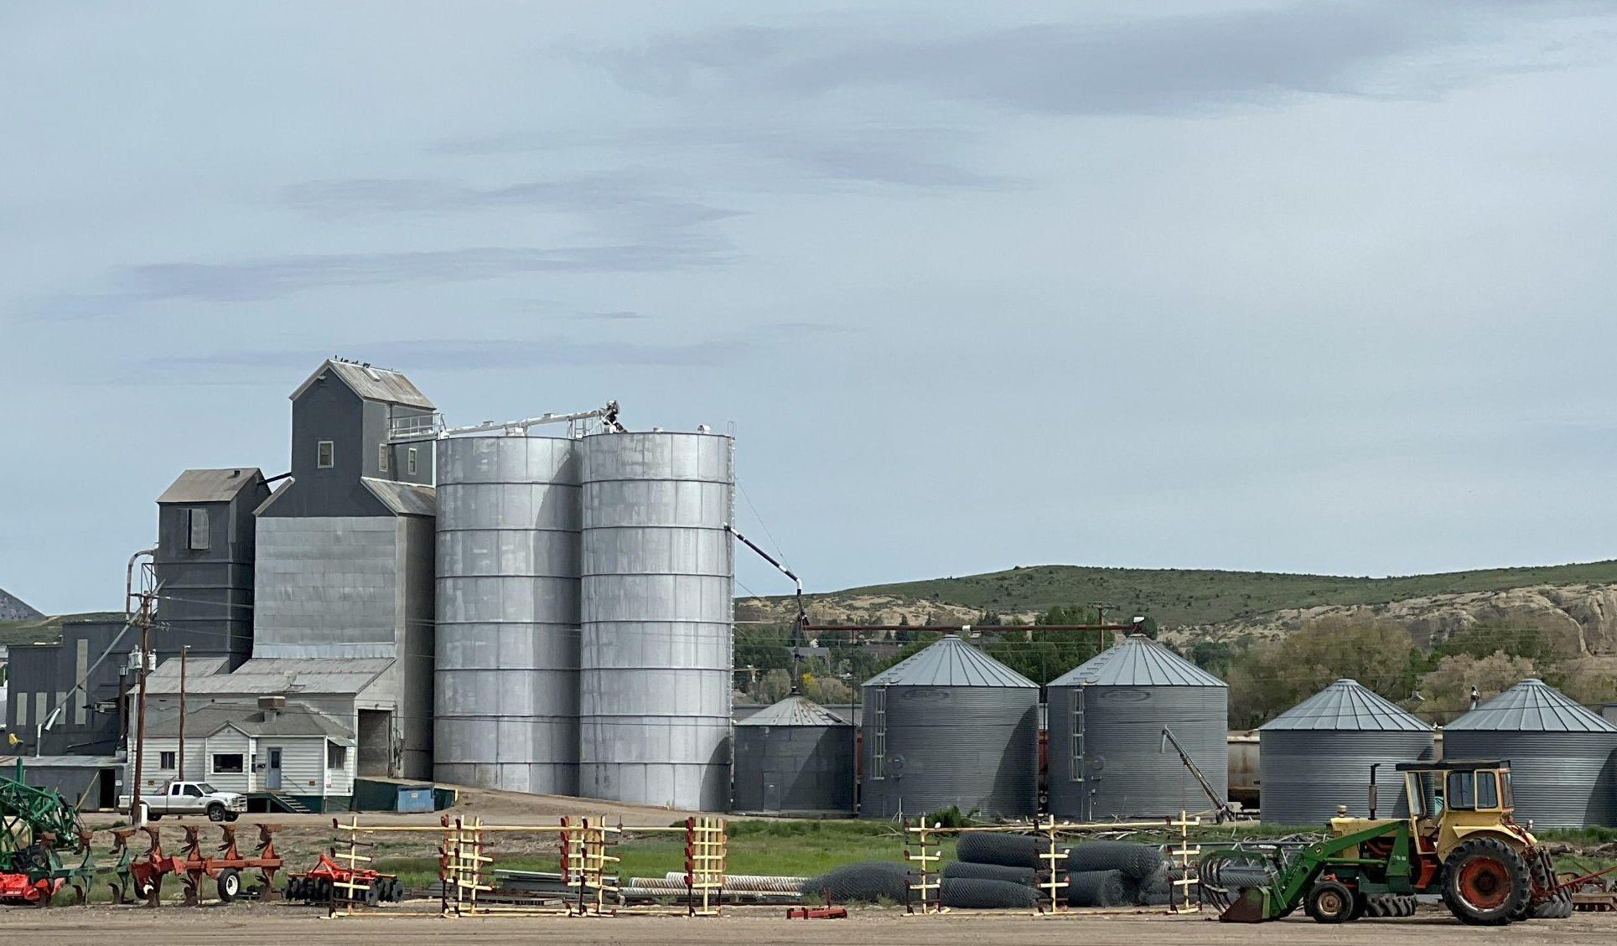
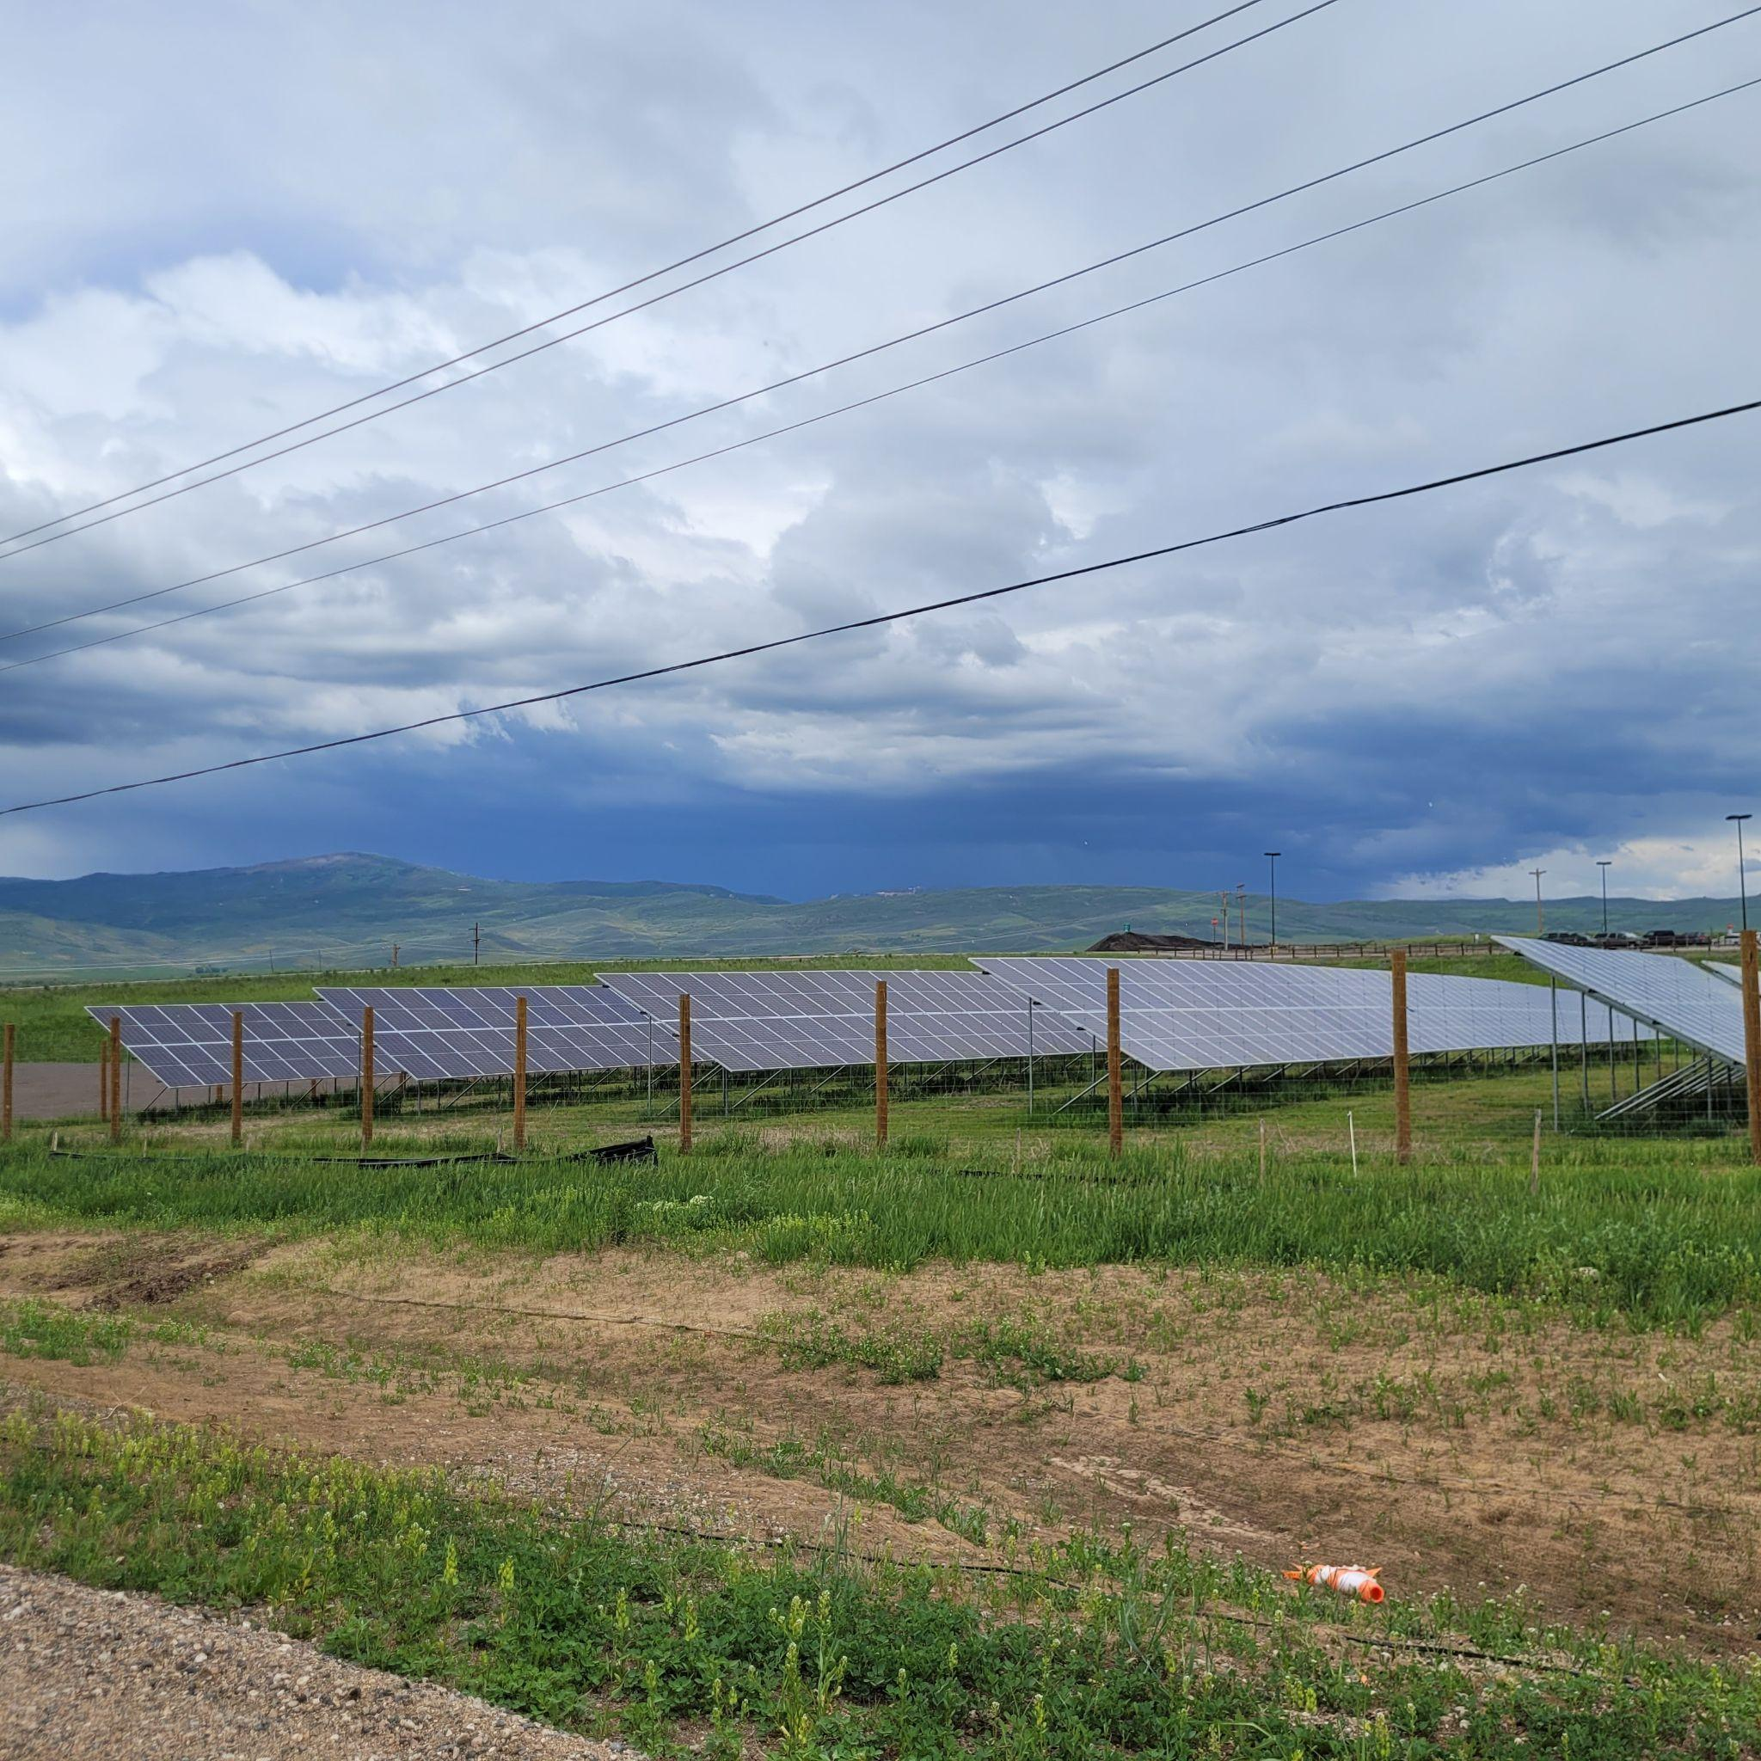
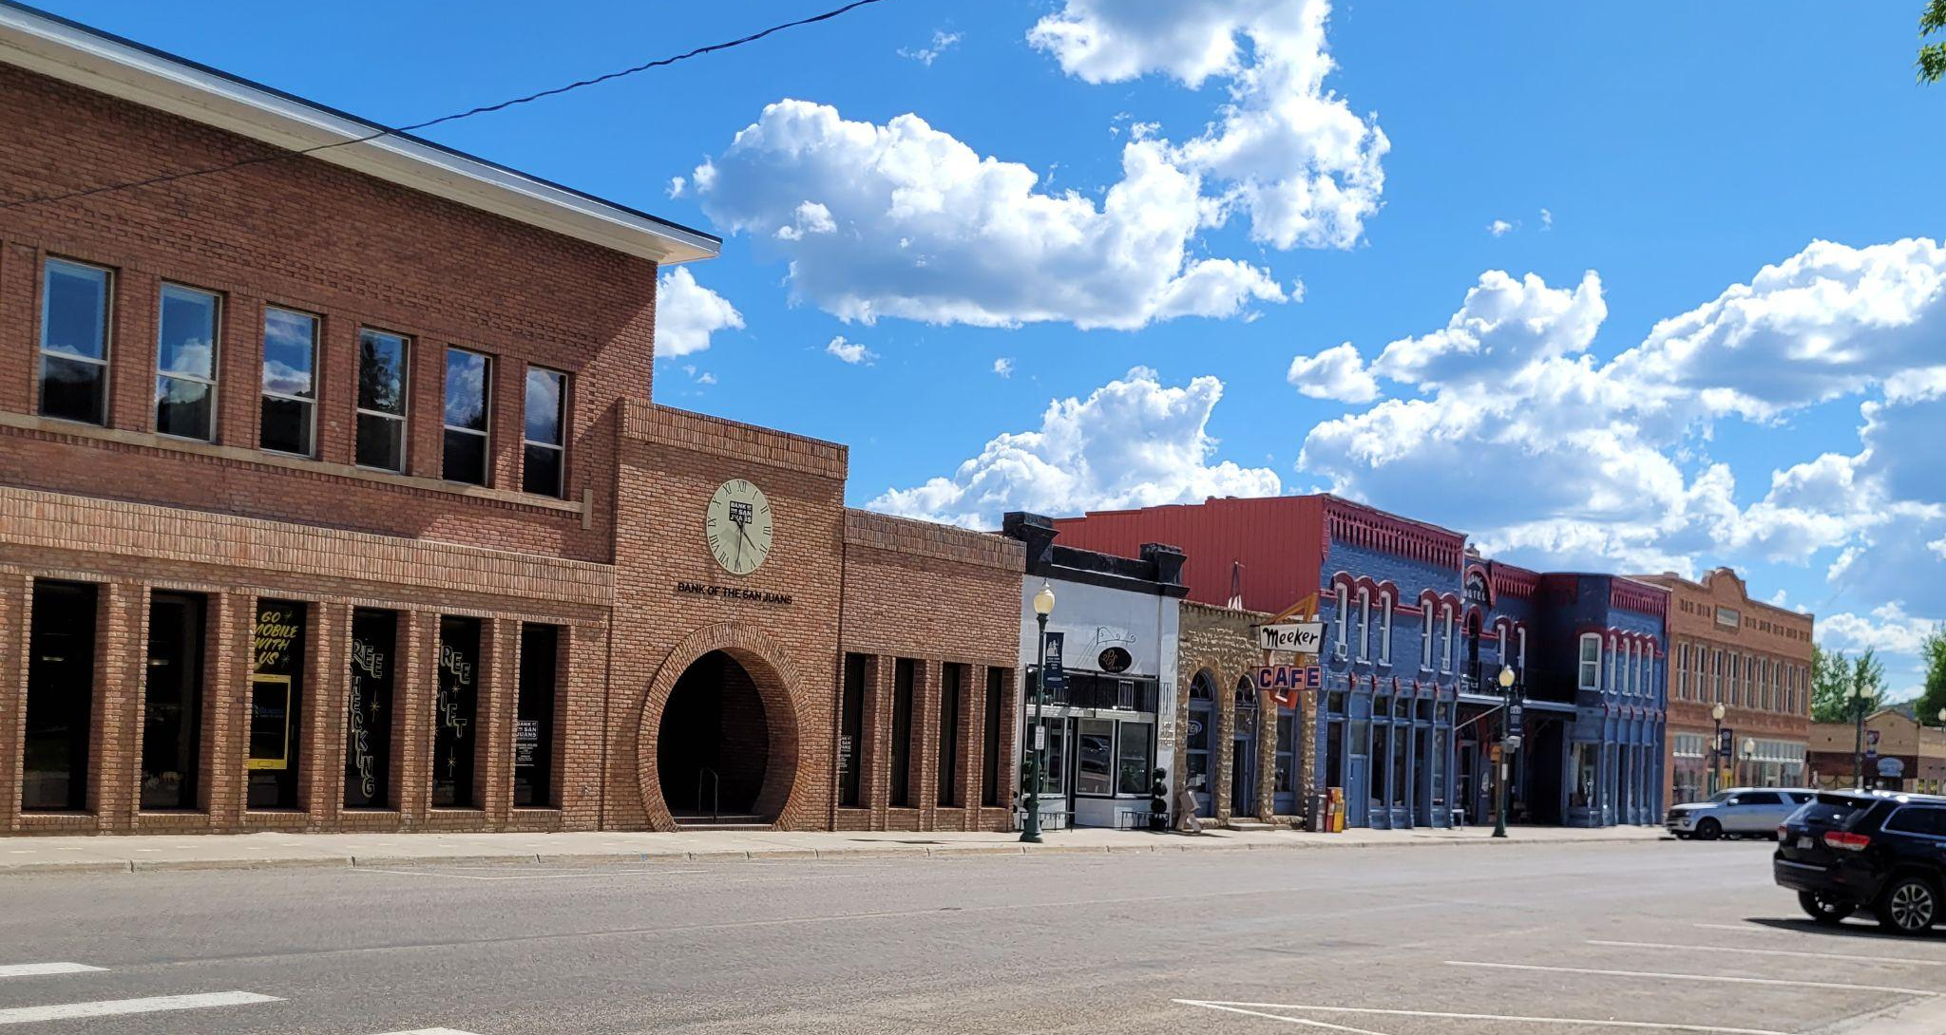
Regional Coal Transition Strategy
Northwest Colorado Routt, Moffat & Rio Blanco Counties

Slide 2
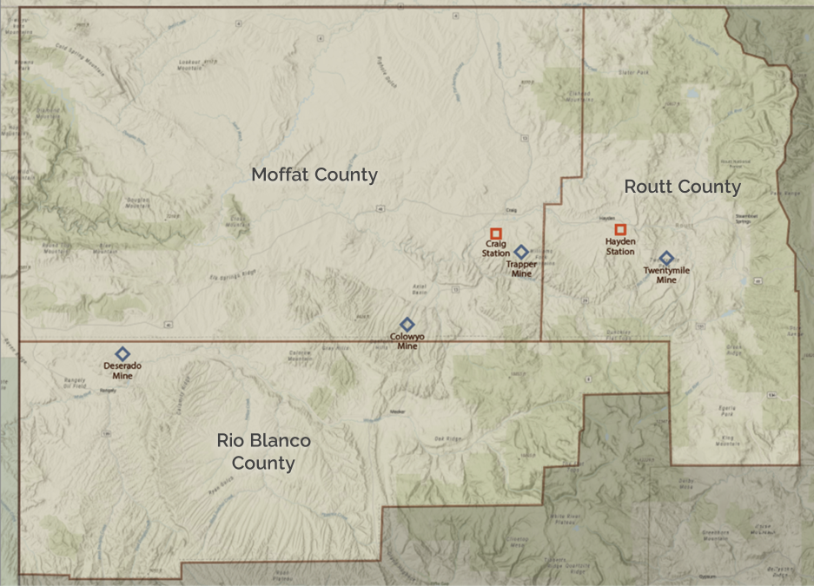
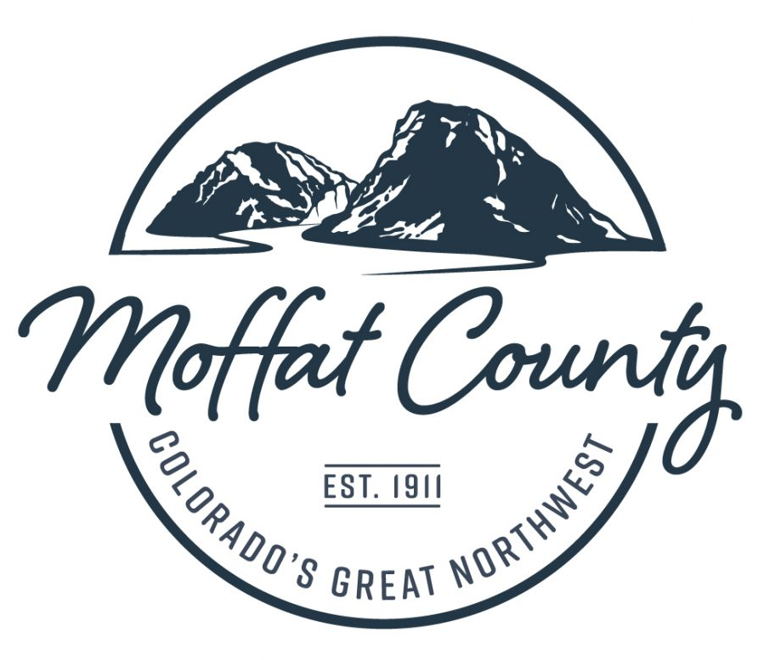
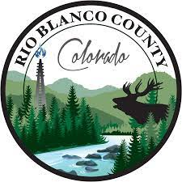
Northwest Colorado
Large land area, 3 Counties, 10,342 sq miles (larger than Vermont)
Over 50% is public land, limited private ownership
Small population, 44,650 residents
Strong regional collaboration

Slide 3
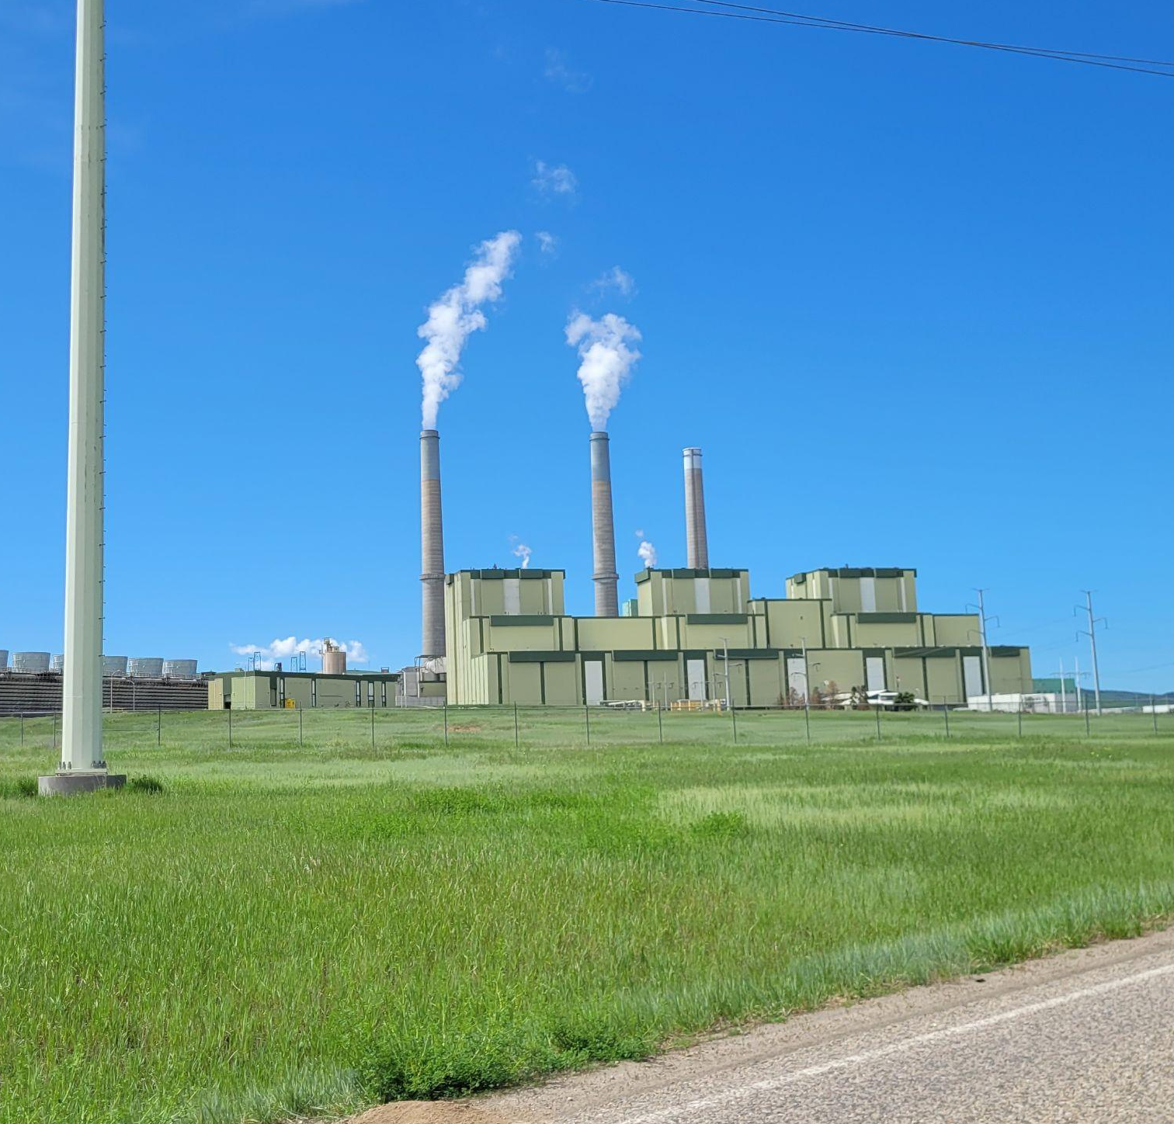
Coal Transition Status
2 Closing Power Plants
Hayden Generating Station, 2028
Craig Generating Station, 2028
4 Threatened Coal Mines
Trapper, Twentymile, Colowyo, and Deserado Mines
Estimated 2,800+ jobs and 22% of regional GDP will be lost
Estimated GDP loss upwards of more than 45% depending on taxing district.

Slide 4
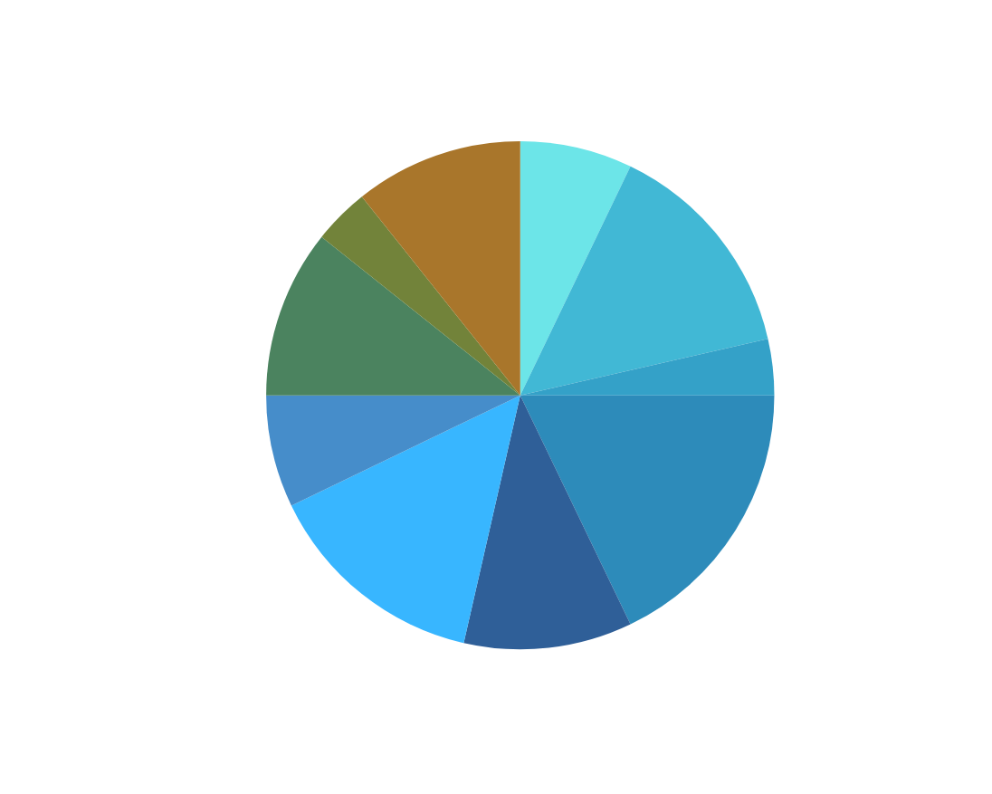
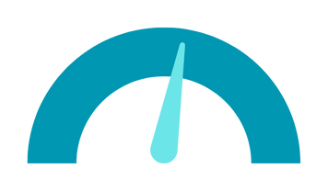
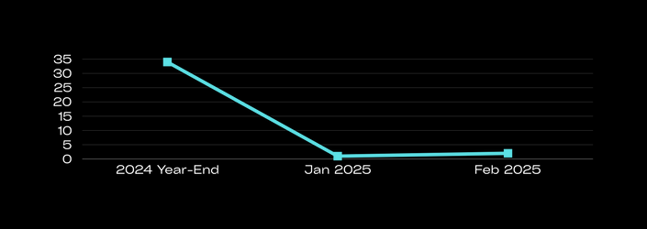
Signs of Success
28 Projects
BY SECTORS
CAPITAL INVESTMENT
$ 2.36 Billion
JOBS
783
19
BR&E VISITS 2025 YTD

Slide 5
How?
Collaboration & Capacity

Slide 6
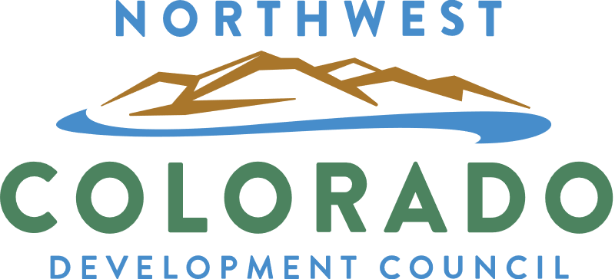

Slide 7
Scope
01
Small Business Development
02
Entrepreneurship Development
03
Business Retention & Expansion
04
Ecosystem Building
05
Regional Coordination & Collaboration
06
Sustainability
Notes:
Overarching goals: increase local jobs, diversify industries

Slide 8
Learn more….
Our trifecta & how we’re leveraging the Aspen Institute’s Rural Hub model to:
increase access to capital,
close gaps in our business ecosystems, and
support generational sustainability.

Slide 9
Thank you!
Northwest Colorado Routt, Moffat, & Rio Blanco Counties

