Slide 1
2025 EDA NADO Regional Conference Denver, CO ~ April 16, 2025 “Powering Resilient Economies in Energy Communities” Jim Atchison

Slide 2
Four (4) County Region - EDD since 2004
* Custer County, Rosebud County,
Powder River County & Treasure County
5 Year CEDS Planning Document
* Regional Pro Active Planning Effort
Annual CEDS Community Recaps
* 7 Communities – Four County EDD
* SWOT Format – Each Community
* Recaps are Shared with Stakeholders
* Projects - Mutually Identified / Prioritized
Supplements Other Planning Efforts

Slide 3
Colstrip Diversification Strategy
6
2015 CEDS Recap – Colstrip, MT
(Released in 2017)
Six Goals / 17 Strategies
Need More Broadband Capacity
Market the Region – QOL Benefits
Build a Business Innovation Center (BIC)
Complete PER for Industrial Site (Energy Park)

Slide 4
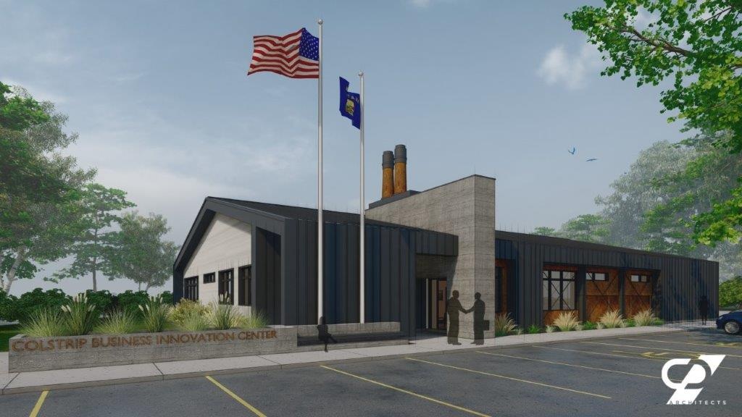

Slide 5
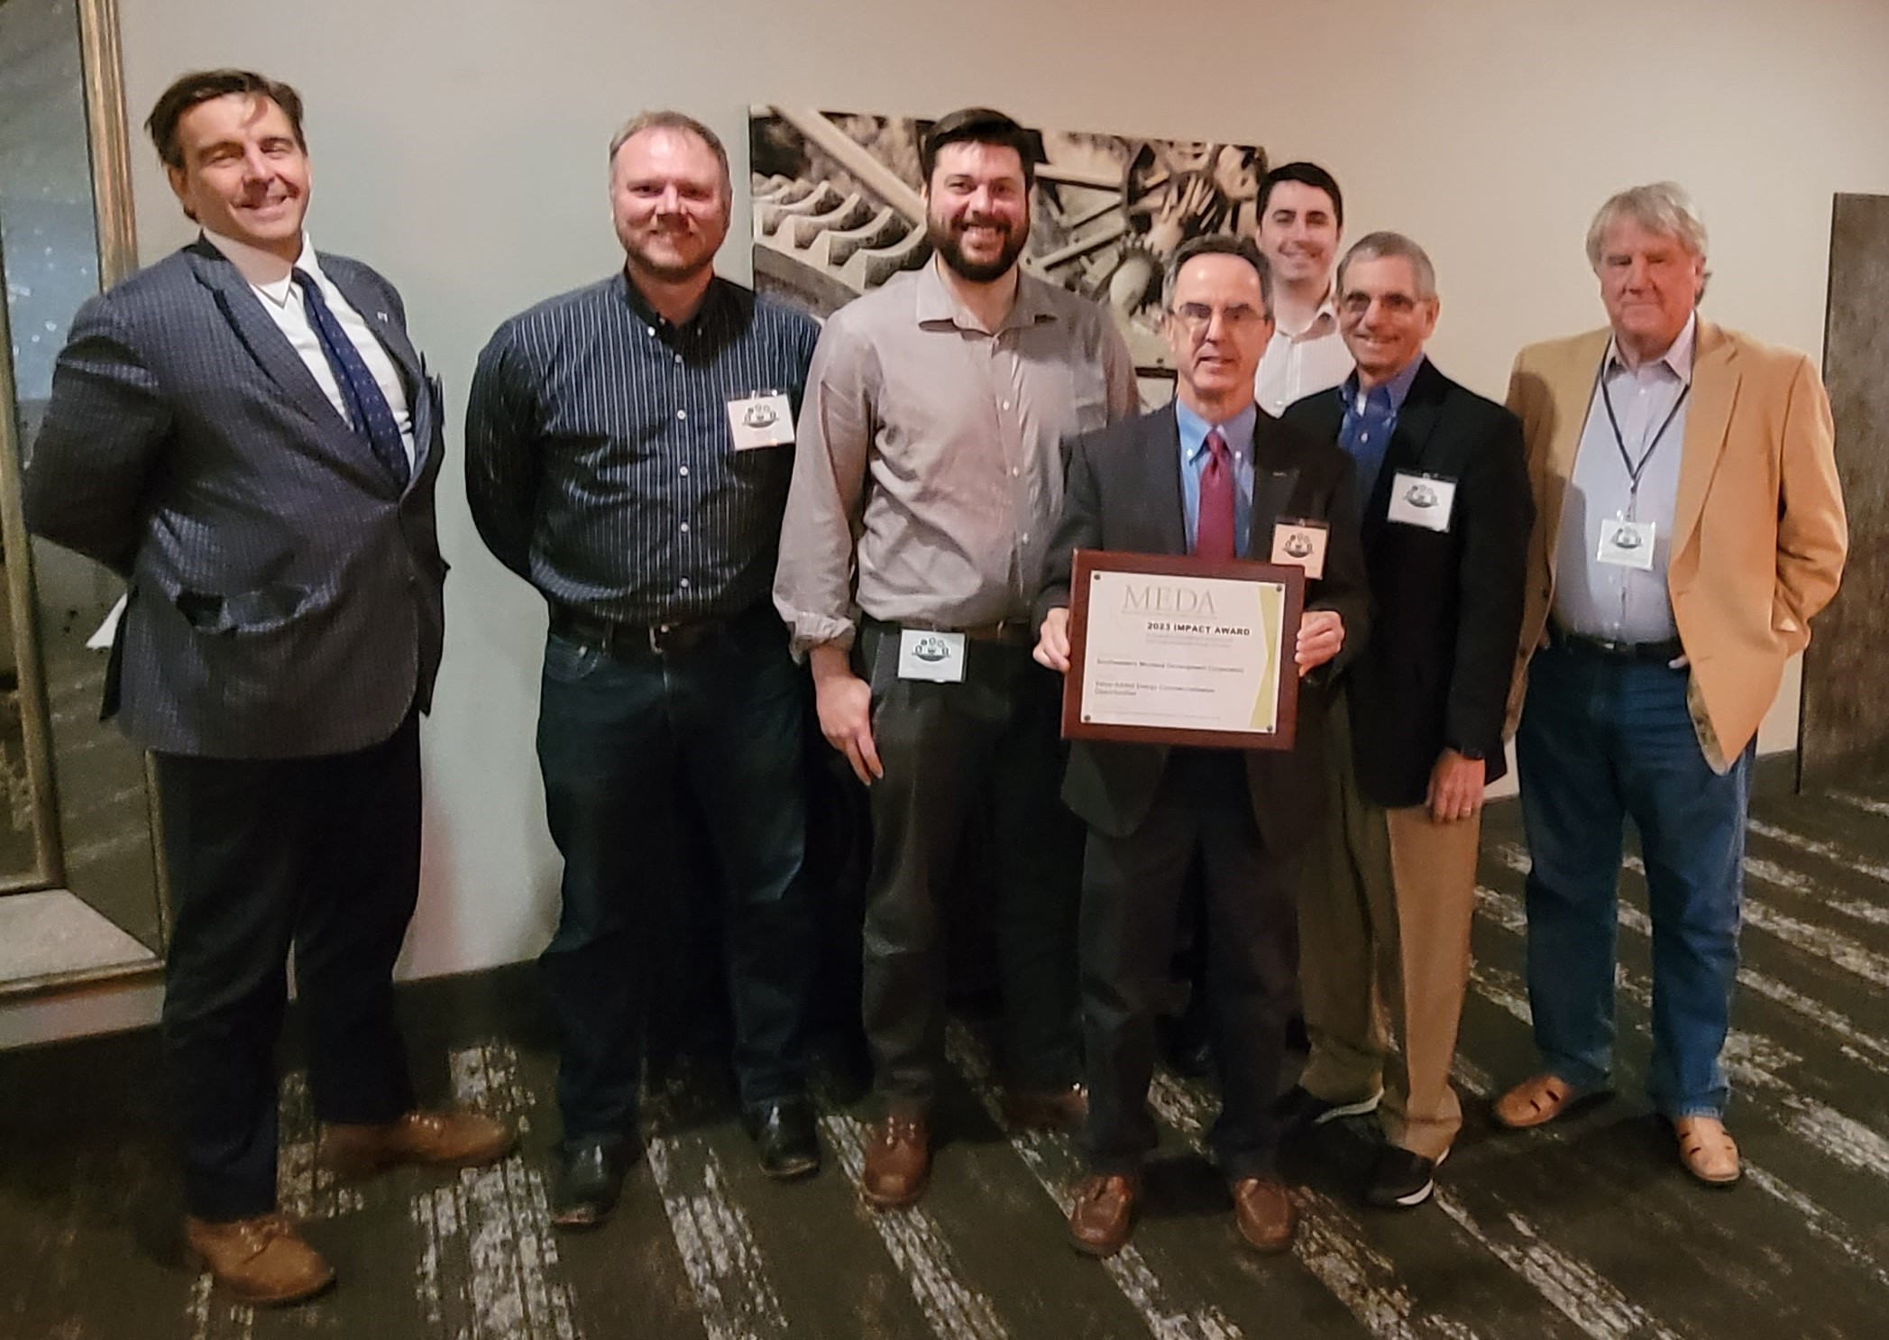
SEMDC Receives 2023 MEDA Impact Award
Jim Atchison sharing the SEMDC 2023 Impact Award for it’s
“Value-Added Energy Commercialization Opportunities Project.”

