Slide 1
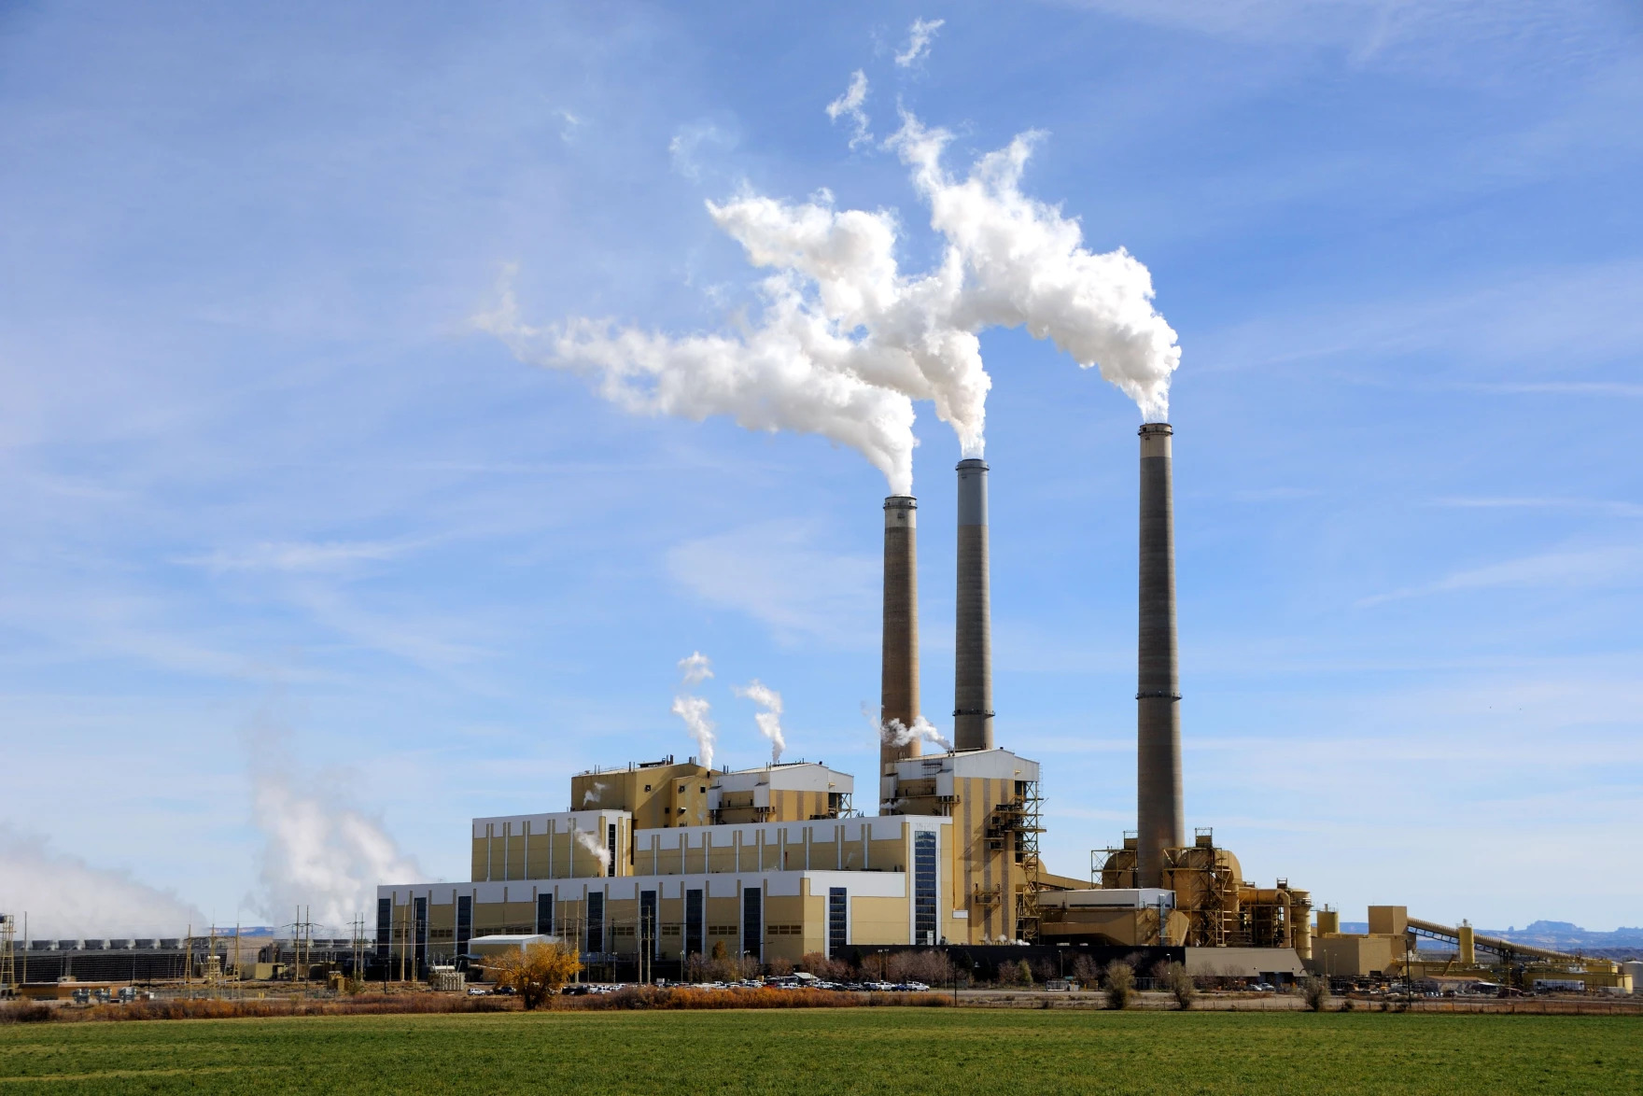
Powering Resilient Economies in Energy Communities
Southeastern Utah - Carbon, Emery, Grand and San Juan Counties

Slide 2
Formally known as Southeastern Utah Association of Local Governments | Southeastern Utah Economic Development District (SEUALG | SEUEDD)
80+ State, Federal and Private Active Grants
4 Nonprofits:
Business Technical Assistance Center
Utah Regional Growth Association
Southeastern Community Action Partnership
Main Street Southeastern
Areas of Focus:
Economic & Community Development
Community Services
Housing and Weatherization
Aging and Senior Services
Coordinator of the Utah Coal Country Strike Team Project
SERDA
Overview
Castle Gate, Utah

Slide 3
Economic Impact Analysis & Redevelopment Strategy
Emery County has two coal-fired power plants being that was announced to be decommissioned (Huntington - 2036; Hunter - 2042)
Loss of jobs, revenue decrease, population decline
Stakeholder engagement 4 focus areas:
Nuclear Development & Siting
OR-SAGE modeling shows Hunter Power Plant as an ideal and cost-effective location for a coal-to-nuclear conversion
Carbon Capture & Sequestration
Buzzards Bench and Drunkards Wash gas fields show capacity of storing at least 1.3 billion tons of CO2
Repurposing Energy Assets
Carbon County Airport - Aviation Campus Development
Rail line and spurs redevelopment
Transmission Lines and Water Availability
Microgrids
Providing energy independence
Energy source diversification (e.g., biofuels)
Funded by Department of Energy’s Capacity Building for Repurposing Energy Assets grant program
Hunter Power Plant, Castle Dale, Utah

Slide 4
Planning Documents:
Stakeholder Mapping and Engagement
Initial Siting Assessment for Nuclear Energy
Creation of a Long-Term Energy Diversification Plan
Other Technologies that are Compatible to the Region
Work with National Renewable Energy Lab (NREL) as main point of contact but will be introduced and assigned to national labs based upon agreed upon scope of work to develop abovestated documents.
Technical assistance grant awarded to southeastern Utah through Department of Energy’s Community Local Energy Action Plan program.
Strategic Planning
Huntington Canyon, Utah

Slide 5
Strategic Planning, cont.
GAIN Voucher Program*
Coal to nuclear feasibility study with an emphasis on repurposing coal burning power plant assets for nuclear generation (e.g., plant equipment, transmission lines, other infrastructure)
Anticipated funding and technical assistance from Department of Energy, Office of Nuclear Energy
Good Jobs in Clean Energy Prize*
“Prize” money designated to aid communities to create coalition-driven initiatives focused on quality, accessible jobs and training partnerships in energy.
Anticipated funding and technical assistance from Department of Energy, Office of Energy Efficiency and Renewable Energy
*Anticipated applications to be submitted in Mid-2025.
Coke Ovens, Columbia, Utah

Slide 6
Lead by the Utah Governor’s Office of Planning and Budget
Collaborative effort dedicated to address key challenges, explore potential partnerships and funding opportunities, and develop strategies in alignment with long-term goals of the region.
Quarterly Meetings with a Policy Meeting held Monthly
Charter created to include:
Purpose / vision
Success metrics
Expected deliverables
Roles and responsibilities of groups / organizations
Tactics Tracker
Southeastern Utah Regional Opportunity Council
Consumers, Utah

Slide 7
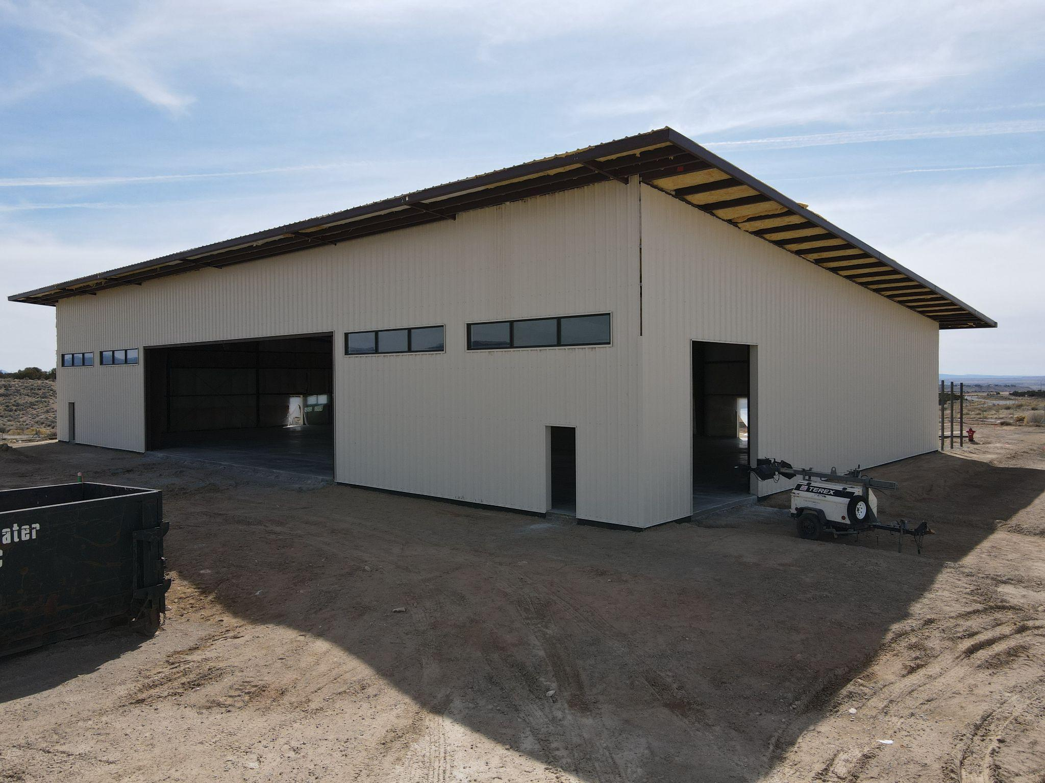
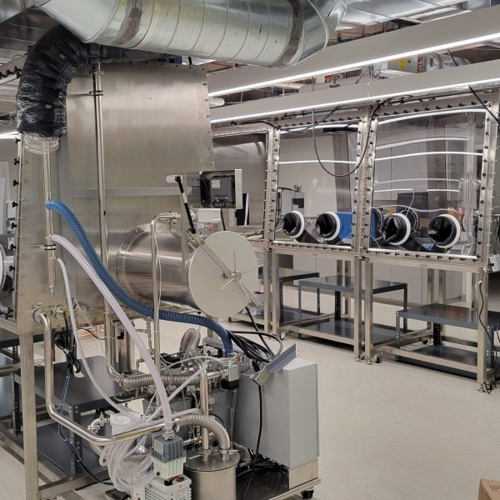
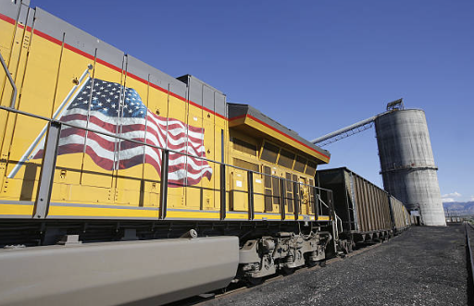
Projects in Southeastern Utah
Carbon County Aviation Campus
4th Largest Runway in Utah (because of energy industry)
All encompassing aviation center (e.g., maintenance, licenses, airport management)
Constructing a 10,400 sq ft hangar for USU Aviation Maintenance Technician Program with funding from EDA, State of Utah, USU
Estimated to train 20 students per year to be a highly skilled workforce
Utah San Rafael State Energy Lab
Located in Emery County, Utah
Over 30,000 sq ft of space for energy research and development (i.e. coal combustion, nuclear and SMRs, hydrogen)
Adjacent industrial park with ready-to-build opportunities
Support commercialization of new energy technologies to diversify regional economy
Ridge Road Industrial Park
Shipping logistic center for coal exports and other hydrocarbons
Being repurposed for other industry needs (e.g., manufacturing, oil transloading, etc.)
Land and water resources acquired by Carbon County to attract businesses / industry
Designated as an inland port in the State of Utah

Slide 8
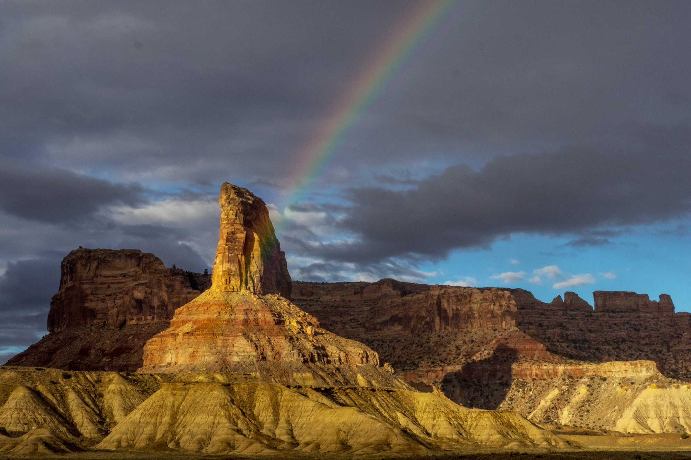
Thank you
Jade Powell, Deputy Director
e: jpowell@seualg.utah.gov
c: (435)650-7411

