Slide 1
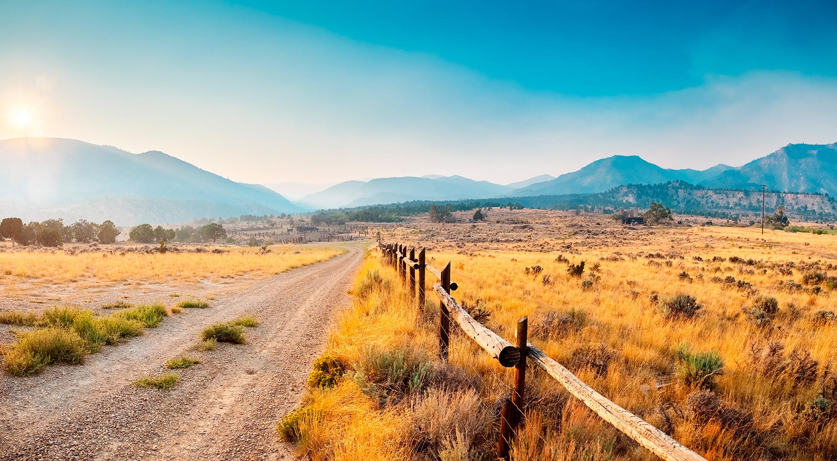
Southeastern Regional Development Agency
Housing Program

Slide 2
Formally known as Southeastern Utah Association of Local Governments | Southeastern Utah Economic Development District (SEUALG | SEUEDD)
Services Carbon, Emery, Grand and San Juan Counties
One of the seven association of governments (AOG) in Utah
Areas of Focus:
Economic & Community Development
Community Services
Housing and Weatherization
Aging and Senior Services
Population of Region: Approx. 55,000
~24% of the landmass of Utah
1.7% of the total population of Utah
Median Income / Average Home Cost:
Carbon: $53,673 / $319,000
Emery: $69,956 / $340,000
Grand: $59,171 / $675,000
San Juan: $54,890 / $420,000
SERDA
Overview
Castle Gate, Utah

Slide 3
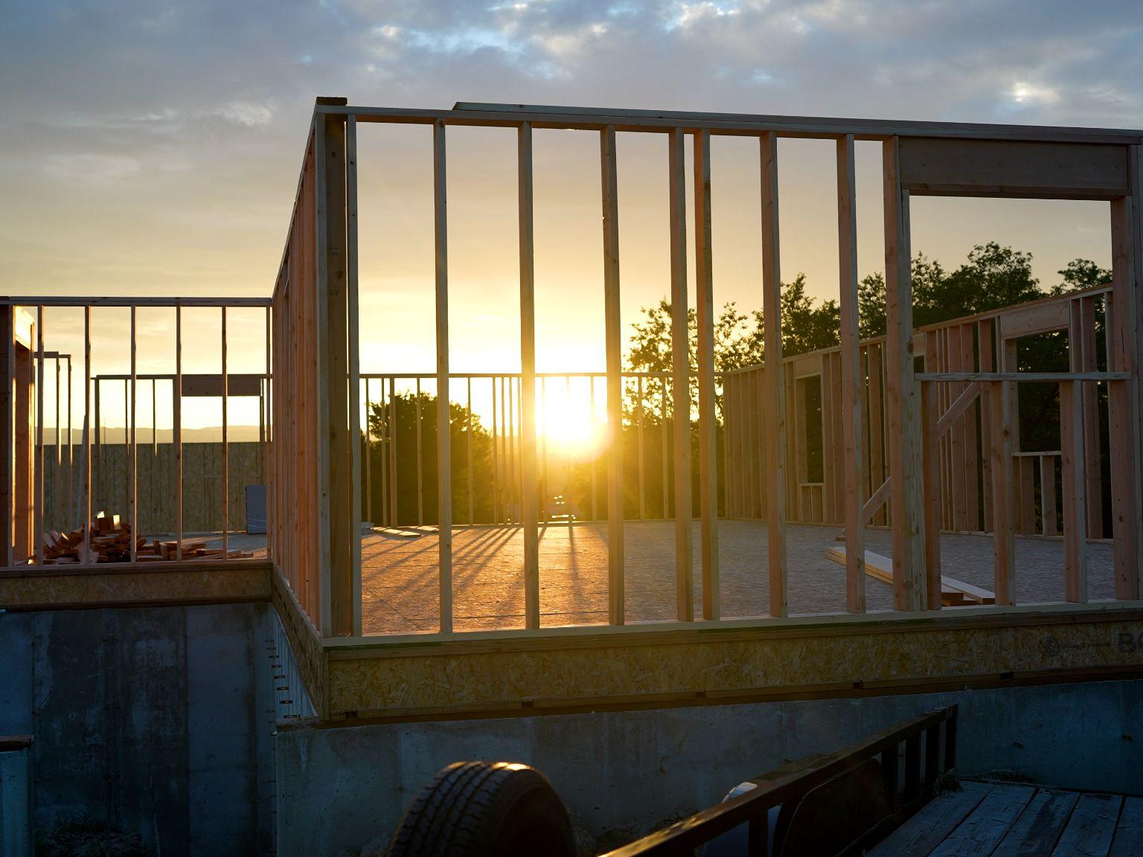
USDA Mutual Self Help Program
Affordable Housing Program
Income qualified - Up to 80% AMI
USDA guaranteed loans
Low interest rates
Extended mortgage terms
Subsidy to lower payment
Participants of the program (4-10 families, depending on USDA contract) are first time homebuyers that construct each other’s homes
Sweat equity
Barn-raising concept
Teaches new skills
Technical assistance and construction management by SERDA (funded by USDA)
Program Manager
Construction Supervisor with over 40 years of homebuilding experience
Cohort #2 Framed House

Slide 4
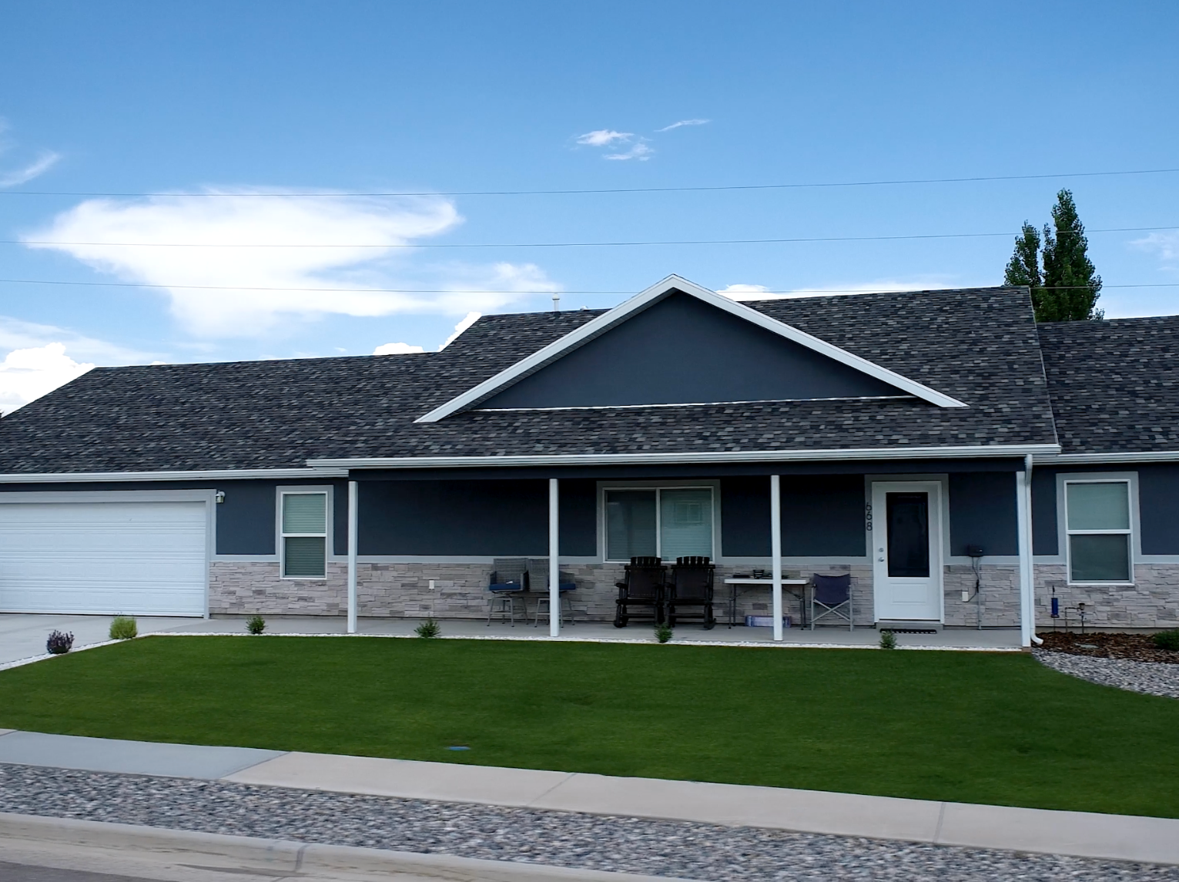
10 homes have been completed since program inception in 2023 (4 homes in Cohort #1; 6 homes in Cohort #2)
Participants’ Careers:
Public servant (3)
IT technician
Diesel mechanic
Garbage truck driver
Electrical supply
Nurse
Educator (2)
Participant annual incomes ranging from approximately $30,000 to $75,000
Construction costs of program ranging from $218,000 to $285,000 with appraised values of over $400,000+
Average Cost / Square Foot: $195-$220
Program’s Cost / Square Foot: $72-$95
Homes are 1,500+ sqft with unfinished basements
Historic Information
01
Home from Cohort #1

Slide 5
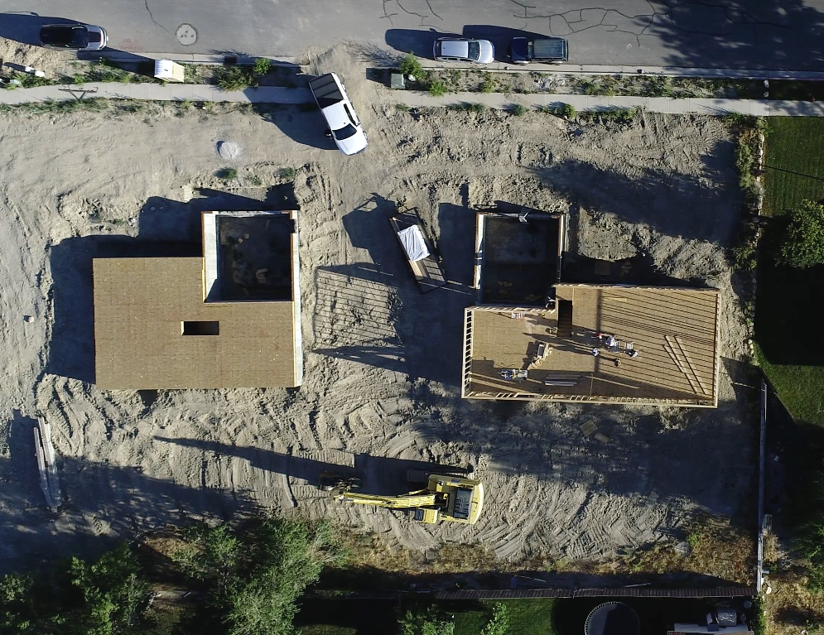
Land Strategy
Program works best if all building lots for participants are located within the same subdivision or area
SERDA created a revolving land fund to ensure participants are located within the same area
SERDA purchases lots in bulk (6+ lots), then sells developed lots at cost to participants which are included in mortgage
The revolving land fund was initially funded by the Community Development Block Grant
Cohort #2 Participants Framing

Slide 6
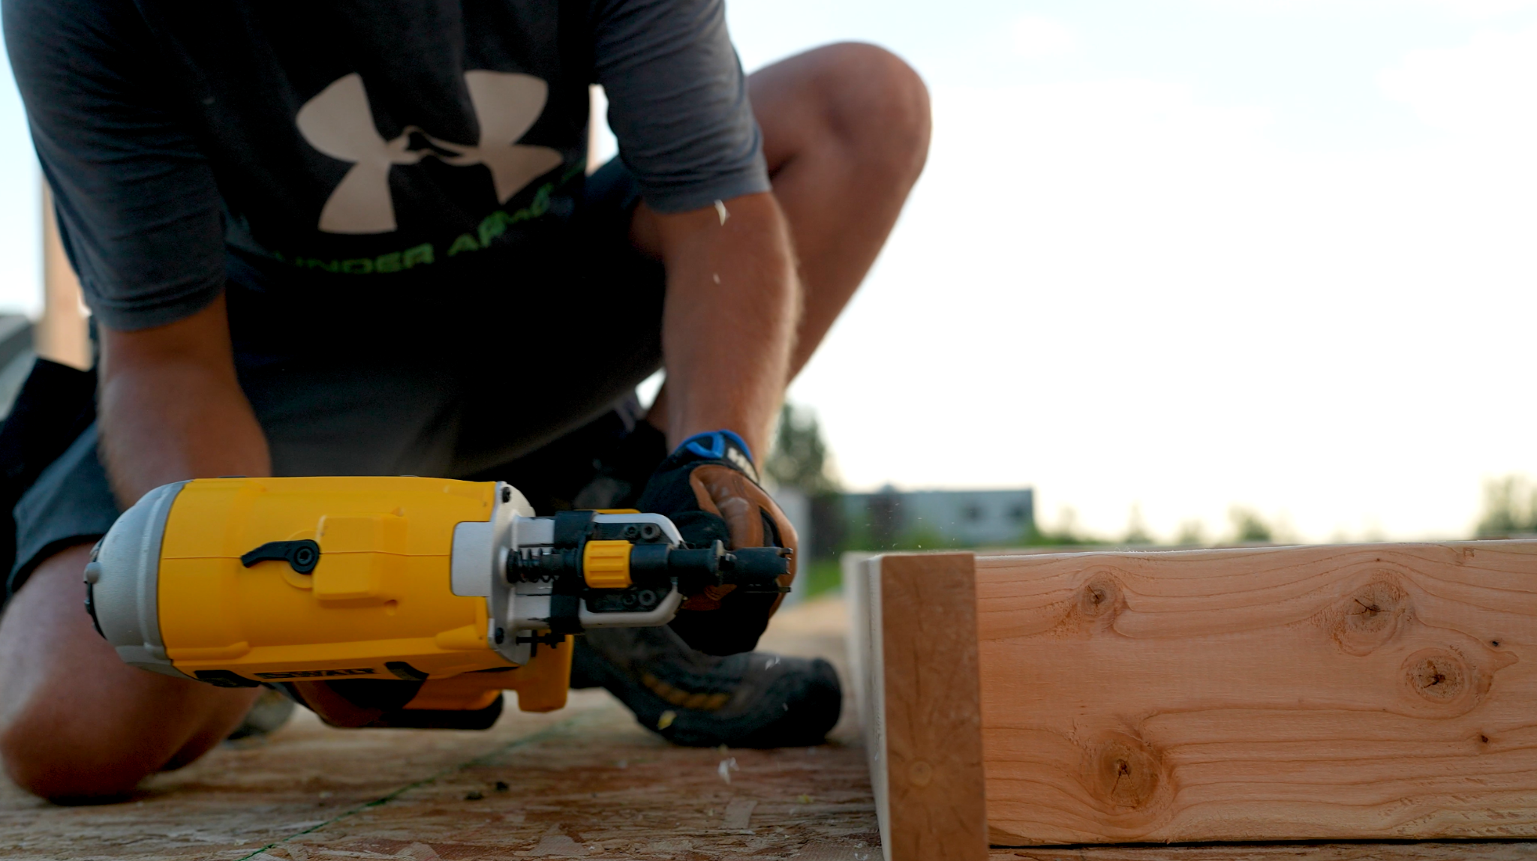
Working with Carbon County to utilize Community Reinvestment Area (CRA) housing set-aside dollars as a bridge for Cohort #3 to acquire up to 15 building lots. This funding will not be used to revolve for future housing projects. This is a one time collaboration.
Average building lot costs in Carbon / Emery Counties is approximately $50,000 to $65,000 (unimproved lots could have increased costs)
SERDA has partnerships established in Emery County (12 building lots) and San Juan County (20 building lots) for land development and program expansion
Moving Forward
01
Home from Cohort #1

Slide 7
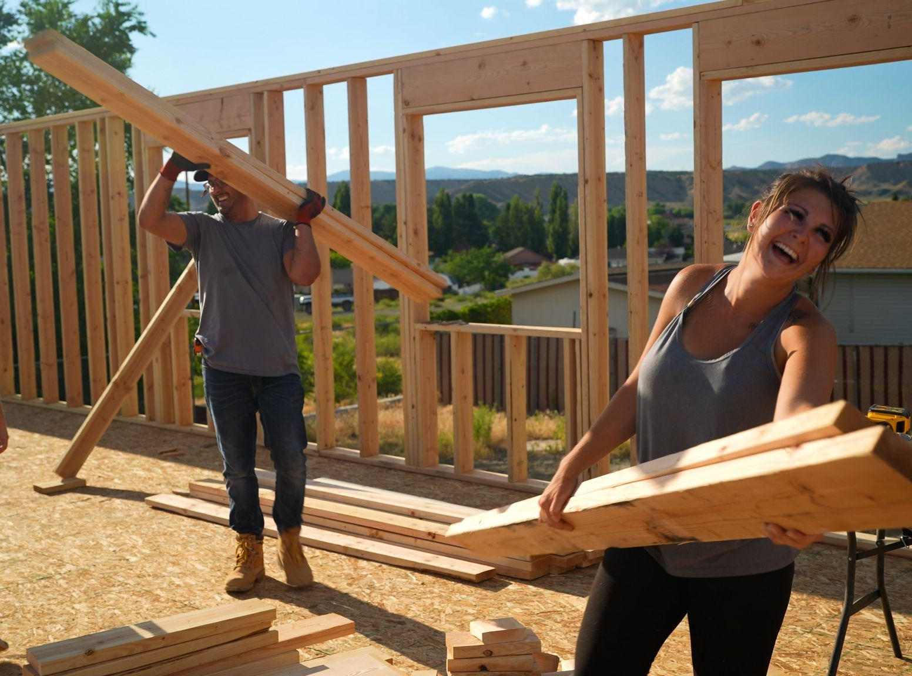
Questions?
Thank you
Chris Allred, Housing Program Manager
callred@seualg.utah.gov
801-512-1563

