Slide 1
Federal Legislative Update
April 2025

Slide 2
Latest Updates

Slide 3
Continuing Resolution passed
    A seven-month Continuing Resolution (CR) for the remainder of FY 2025 was passed by Congress and signed by the President on March 15, 2025.
    In most categories, it extended current funding levels through the end of the fiscal year, but there are some adjustments: it increased defense spending by $6 billion and decreased non-defense spending by $13 billion.
    The proposed funding reductions will not impact Social Security, Medicare and Medicaid.
    The CR does not include disaster funding and does not raise the debt limit.
Notes:
https://bipartisanpolicy.org/explainer/whats-in-the-fy2025-house-budget-resolution/
https://www.everycrsreport.com/reports/RL30297.html

Slide 4
Budget Authority Allocations by Appropriations Title (billions)
Appropriations Title | FY 2024 (Actual) | FY 2025 CR | Difference
Agriculture | $26.2 | $26.6 | $0.4
Commerce, Justice, Science | $66.5 | $67.8 | $1.3
Defense | $824.5 | $831.5 | $7.0
Energy and Water | $58.2 | $58.1 | -$0.1
Financial Services and General Government | $13.7 | $15.9 | $2.2
Homeland Security | $61.8 | $65.0 | $3.2
Interior and Environment | $38.6 | $40.9 | $2.3
Labor, HHS, Education | $194.4 | $198.2 | $3.8
Legislative Branch | $6.8 | $6.7 | -$0.1
Military Construction, VA | $153.9 | $146.6 | -$7.3
State, Foreign Operations | $55.8 | $56.8 | $1.0
Transportation, HUD | $89.5 | $86.4 | -$3.1
Total Base Funding | $1.59 trillion | $1.60 trillion | $10 billion
Source: Congressional Budget Office.

Slide 5
Budget Reconciliation Process

Slide 6
What is a budget resolution
    A budget resolution is a document that outlines desired spending, revenue, debt, and deficit levels for the federal government over a specified period (often 10 years). It is the first step Congress is supposed to take in order to pass annual spending bills ahead of the October 1 start of the fiscal year; it also enables the optional reconciliation process. Under the 1974 Congressional Budget and Impoundment Control Act (CBA), Congress is supposed to complete action on the budget resolution by April 15, though it often fails to do so.
    As a concurrent resolution, it is not presented to the President for his signature and thus does not become law. Instead, when adopted by Congress, the budget resolution serves as an agreement between the House and Senate on a congressional budget plan.
Notes:
https://bipartisanpolicy.org/explainer/whats-in-the-fy2025-house-budget-resolution/
https://www.everycrsreport.com/reports/RL30297.html

Slide 7
What is reconciliation?
    Reconciliation is an optional tool – a special process – that makes legislation easier to pass in the Senate.
    Instead of needing 60 votes, a reconciliation bill only needs a simple majority in the Senate. It also cannot be stalled by a Senate filibuster.
    Reconciliation starts when Congress passes a budget resolution that includes reconciliation instructions.
Notes:
https://democrats-budget.house.gov/resources/fact-sheet/budget-reconciliation-explainer

Slide 8
Executive Orders and Presidential Actions

Slide 9
Executive orders and federal funding pauses
Even though the OMB memo “freezing” federal funding was rescinded, federal agencies are still being directed to complete internal review processes to determine whether their grant programs are in alignment with the Administration’s Executive Orders
Temporarily, federal funds may be paused. Many of the EOs have 60 or 90 day targets for implementation, or longer
Until federal agencies come out with additional guidance, we cannot know what the final impacts of many of these internal funding review processes will be
It is important to stay in touch with your grant officers and EDRs regularly
If your organization is directly impacted by federal funding pauses or “stop work orders,” communicate with your Senators and Representatives and make them aware of any detrimental impacts
Notes:
Many of you have reached out regarding federal grant funds that have been paused, despite the rescission of OMB memo M-25-13. As you may know, many federal agencies are continuing to go through a process of reviewing their federal grant programs to determine whether they are in alignment with the Administration’s recent Executive Orders (EOs), and in the meantime, we understand that some of our member organizations have received “stop work orders” or other notifications of paused federal funds. There are still many unanswered questions regarding these EOs, and we recognize that this uncertainty along with disruptions in federal funds may pose challenges for our member organizations. NADO is working to monitor these developments and to better understand how they may impact our membership. We remain committed to keeping you informed as we learn more, and although NADO is not able to provide legal advice, we do intend to provide information, resources, and updates to help you navigate the changing federal landscape.
One area of reassurance that we want to provide to the NADO membership is that, to the best of our understanding, EDA Partnership Planning grants should not be in jeopardy. There may be a temporary pause while EDA goes through a process to ensure internal compliance with the EOs and the Administration’s priorities, but ultimately, it is not anticipated that Partnership Planning or other core EDA funding programs are likely to be impacted. We encourage you to remain in frequent communication with your Economic Development Representatives (EDR). If your organization is facing extenuating circumstances that could make you particularly vulnerable to temporary funding pauses, you should communicate this to your EDR.
https://www.constitutionpartners.com/executive-order-tracker
https://www.mayerbrown.com/en/insights/publications/2025/02/updates-and-summary-of-the-evolving-executive-federal-funding-freeze
https://www.mayerbrown.com/en/insights/resource-centers/washington-update/trump-2-executive-order-tracker

Slide 10
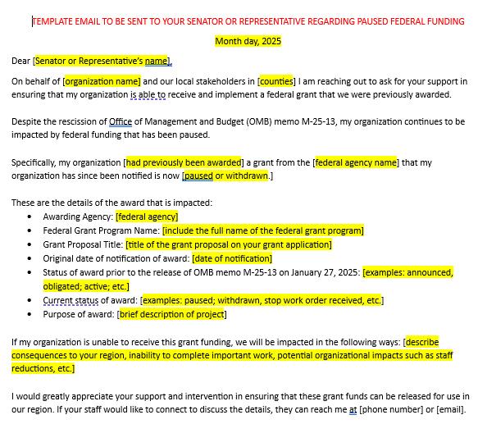
TEMPLATE LETTER TO CONGRESS:
Funding pauses
If your organization is being negatively impacted by pauses in federal grant funding, you can use this template letter to contact your Senators and Representatives.
www.nado.org/advocacy-resources/
Notes:
Many of you have reached out regarding federal grant funds that have been paused, despite the rescission of OMB memo M-25-13. As you may know, many federal agencies are continuing to go through a process of reviewing their federal grant programs to determine whether they are in alignment with the Administration’s recent Executive Orders (EOs), and in the meantime, we understand that some of our member organizations have received “stop work orders” or other notifications of paused federal funds. There are still many unanswered questions regarding these EOs, and we recognize that this uncertainty along with disruptions in federal funds may pose challenges for our member organizations. NADO is working to monitor these developments and to better understand how they may impact our membership. We remain committed to keeping you informed as we learn more, and although NADO is not able to provide legal advice, we do intend to provide information, resources, and updates to help you navigate the changing federal landscape.
One area of reassurance that we want to provide to the NADO membership is that, to the best of our understanding, EDA Partnership Planning grants should not be in jeopardy. There may be a temporary pause while EDA goes through a process to ensure internal compliance with the EOs and the Administration’s priorities, but ultimately, it is not anticipated that Partnership Planning or other core EDA funding programs are likely to be impacted. We encourage you to remain in frequent communication with your Economic Development Representatives (EDR). If your organization is facing extenuating circumstances that could make you particularly vulnerable to temporary funding pauses, you should communicate this to your EDR.
https://www.constitutionpartners.com/executive-order-tracker
https://www.mayerbrown.com/en/insights/publications/2025/02/updates-and-summary-of-the-evolving-executive-federal-funding-freeze
https://www.mayerbrown.com/en/insights/resource-centers/washington-update/trump-2-executive-order-tracker

Slide 11
Typical path of EXECUTIVE ORDERS
And Subsequent guidance
1. An Executive Order (EO) is put forward
2. Overarching guidance surrounding the EO from OMB or OPM is released
  The White House Office of Management and Budget (OMB) and/or the U.S. Office of Personnel Management (OPM) may release guidance providing broad instruction to federal agencies on how to implement the Executive Order
3. Subsequent guidance released from relevant federal agencies

Slide 12
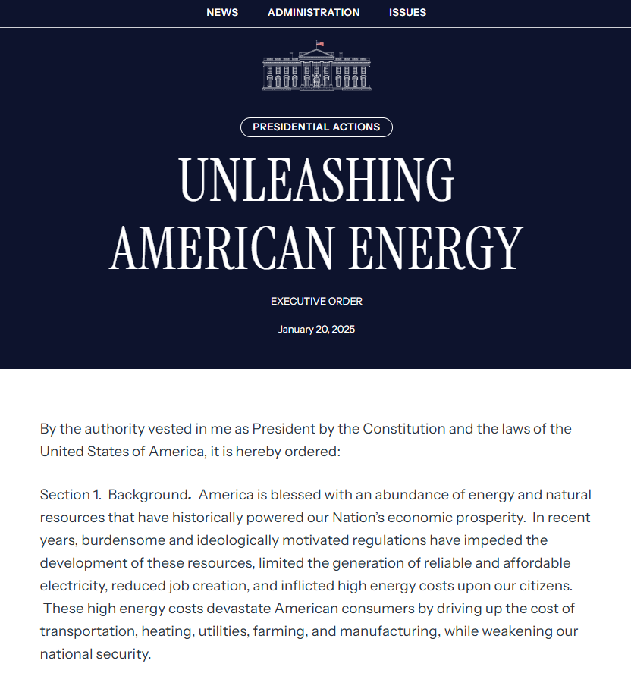
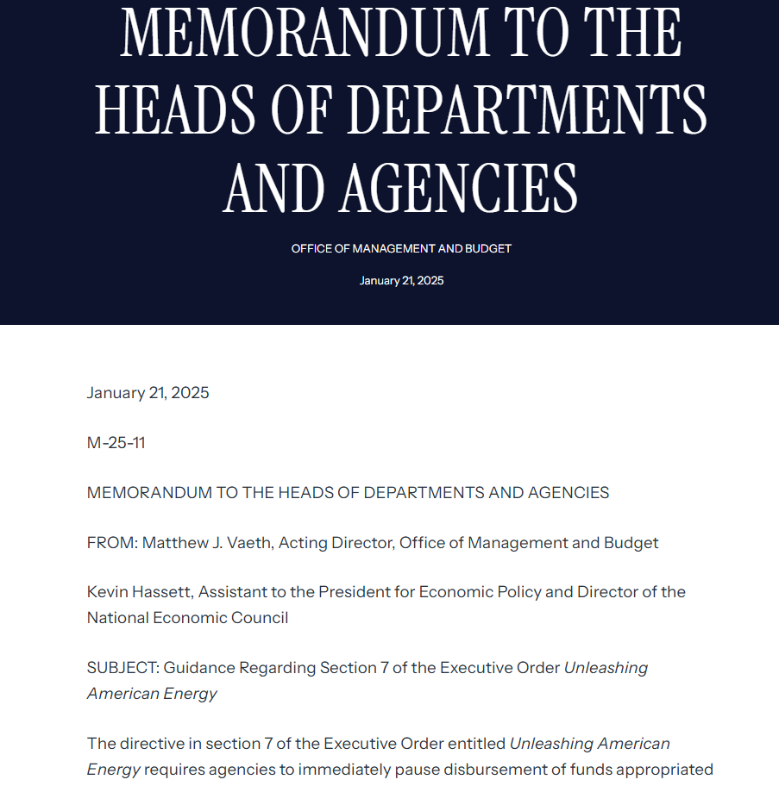
Example: Executive Order
Example: Subsequent Guidance
https://www.whitehouse.gov/presidential-actions/2025/01/unleashing-american-energy/
https://www.whitehouse.gov/briefings-statements/2025/01/omb-memo-m-25-11/

Slide 13
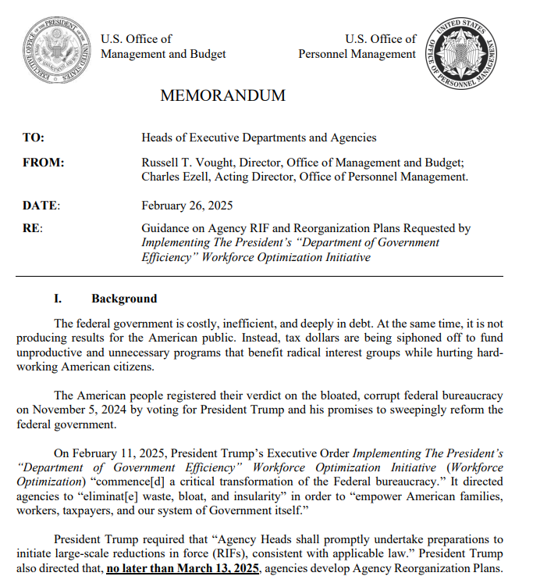
February 26: OMB and OPM Memo
“Agency Heads shall promptly undertake preparations to initiate large-scale Reductions in Force (RIFs)….and “Agency RIF and Reorganization Plans (ARRP)”
Agencies should seek to “consolidate agency organization….consolidate management layers….”
“…close and/or consolidate regional field offices to the extent consistent with efficient service delivery”
“…maximally reduce the use of outside consultants and contractors”
Memo includes 30, 60, and 90 day targets
March 13 – agencies must submit Agency Reorganization Plans
April 14 – agencies must submit Phase 2 ARRPs
https://s3.documentcloud.org/documents/25545392/omb-opm-memo.pdf
Notes:
Many of you have reached out regarding federal grant funds that have been paused, despite the rescission of OMB memo M-25-13. As you may know, many federal agencies are continuing to go through a process of reviewing their federal grant programs to determine whether they are in alignment with the Administration’s recent Executive Orders (EOs), and in the meantime, we understand that some of our member organizations have received “stop work orders” or other notifications of paused federal funds. There are still many unanswered questions regarding these EOs, and we recognize that this uncertainty along with disruptions in federal funds may pose challenges for our member organizations. NADO is working to monitor these developments and to better understand how they may impact our membership. We remain committed to keeping you informed as we learn more, and although NADO is not able to provide legal advice, we do intend to provide information, resources, and updates to help you navigate the changing federal landscape.
One area of reassurance that we want to provide to the NADO membership is that, to the best of our understanding, EDA Partnership Planning grants should not be in jeopardy. There may be a temporary pause while EDA goes through a process to ensure internal compliance with the EOs and the Administration’s priorities, but ultimately, it is not anticipated that Partnership Planning or other core EDA funding programs are likely to be impacted. We encourage you to remain in frequent communication with your Economic Development Representatives (EDR). If your organization is facing extenuating circumstances that could make you particularly vulnerable to temporary funding pauses, you should communicate this to your EDR.
https://www.constitutionpartners.com/executive-order-tracker
https://www.mayerbrown.com/en/insights/publications/2025/02/updates-and-summary-of-the-evolving-executive-federal-funding-freeze
https://www.mayerbrown.com/en/insights/resource-centers/washington-update/trump-2-executive-order-tracker

Slide 14
KEY WORDS that federal agencies are instructed to flag in internal reviews of grant programs
Equity, diversity, DEI, DEIA, inclusion, equality, race
Climate crisis; climate change; climate science; energy; clean energy; green energy; wind energy; energy transition; solar energy
Green new deal; electric vehicle
Gender; gender identity; transgender; LGBT; nonbinary
Environmental justice; Justice 40
Notes:
Many of you have reached out regarding federal grant funds that have been paused, despite the rescission of OMB memo M-25-13. As you may know, many federal agencies are continuing to go through a process of reviewing their federal grant programs to determine whether they are in alignment with the Administration’s recent Executive Orders (EOs), and in the meantime, we understand that some of our member organizations have received “stop work orders” or other notifications of paused federal funds. There are still many unanswered questions regarding these EOs, and we recognize that this uncertainty along with disruptions in federal funds may pose challenges for our member organizations. NADO is working to monitor these developments and to better understand how they may impact our membership. We remain committed to keeping you informed as we learn more, and although NADO is not able to provide legal advice, we do intend to provide information, resources, and updates to help you navigate the changing federal landscape.
One area of reassurance that we want to provide to the NADO membership is that, to the best of our understanding, EDA Partnership Planning grants should not be in jeopardy. There may be a temporary pause while EDA goes through a process to ensure internal compliance with the EOs and the Administration’s priorities, but ultimately, it is not anticipated that Partnership Planning or other core EDA funding programs are likely to be impacted. We encourage you to remain in frequent communication with your Economic Development Representatives (EDR). If your organization is facing extenuating circumstances that could make you particularly vulnerable to temporary funding pauses, you should communicate this to your EDR.
https://www.constitutionpartners.com/executive-order-tracker
https://www.mayerbrown.com/en/insights/publications/2025/02/updates-and-summary-of-the-evolving-executive-federal-funding-freeze
https://www.mayerbrown.com/en/insights/resource-centers/washington-update/trump-2-executive-order-tracker

Slide 15
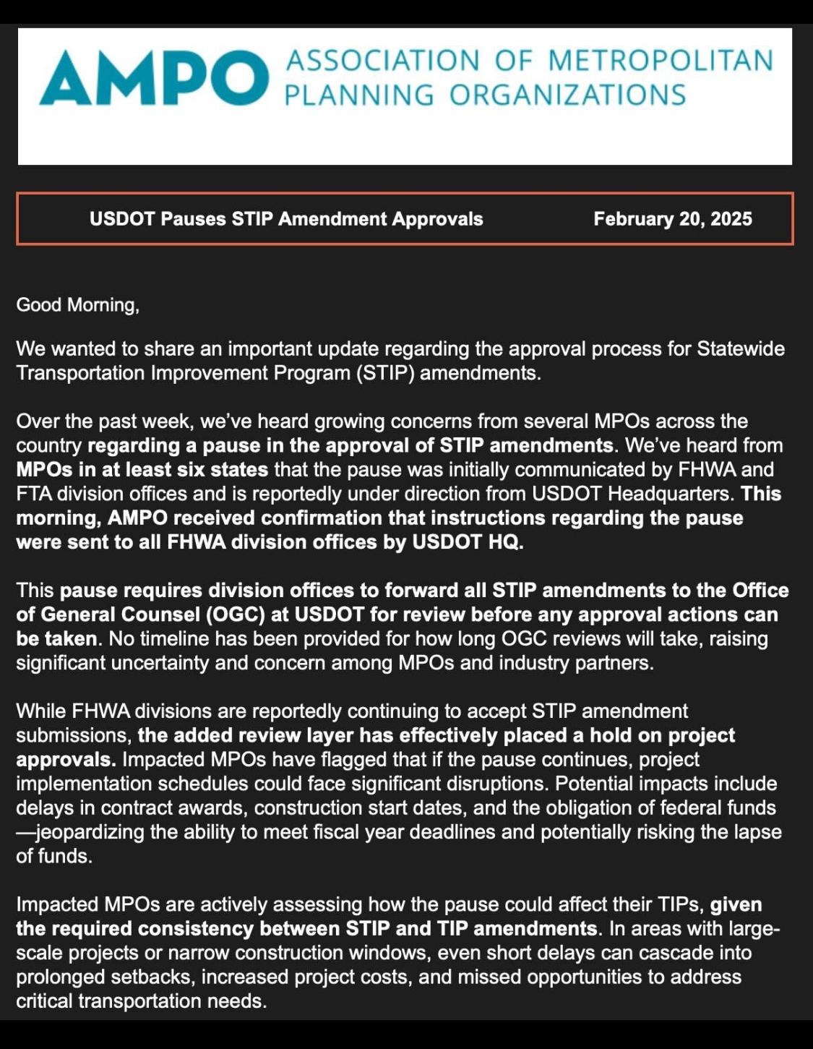
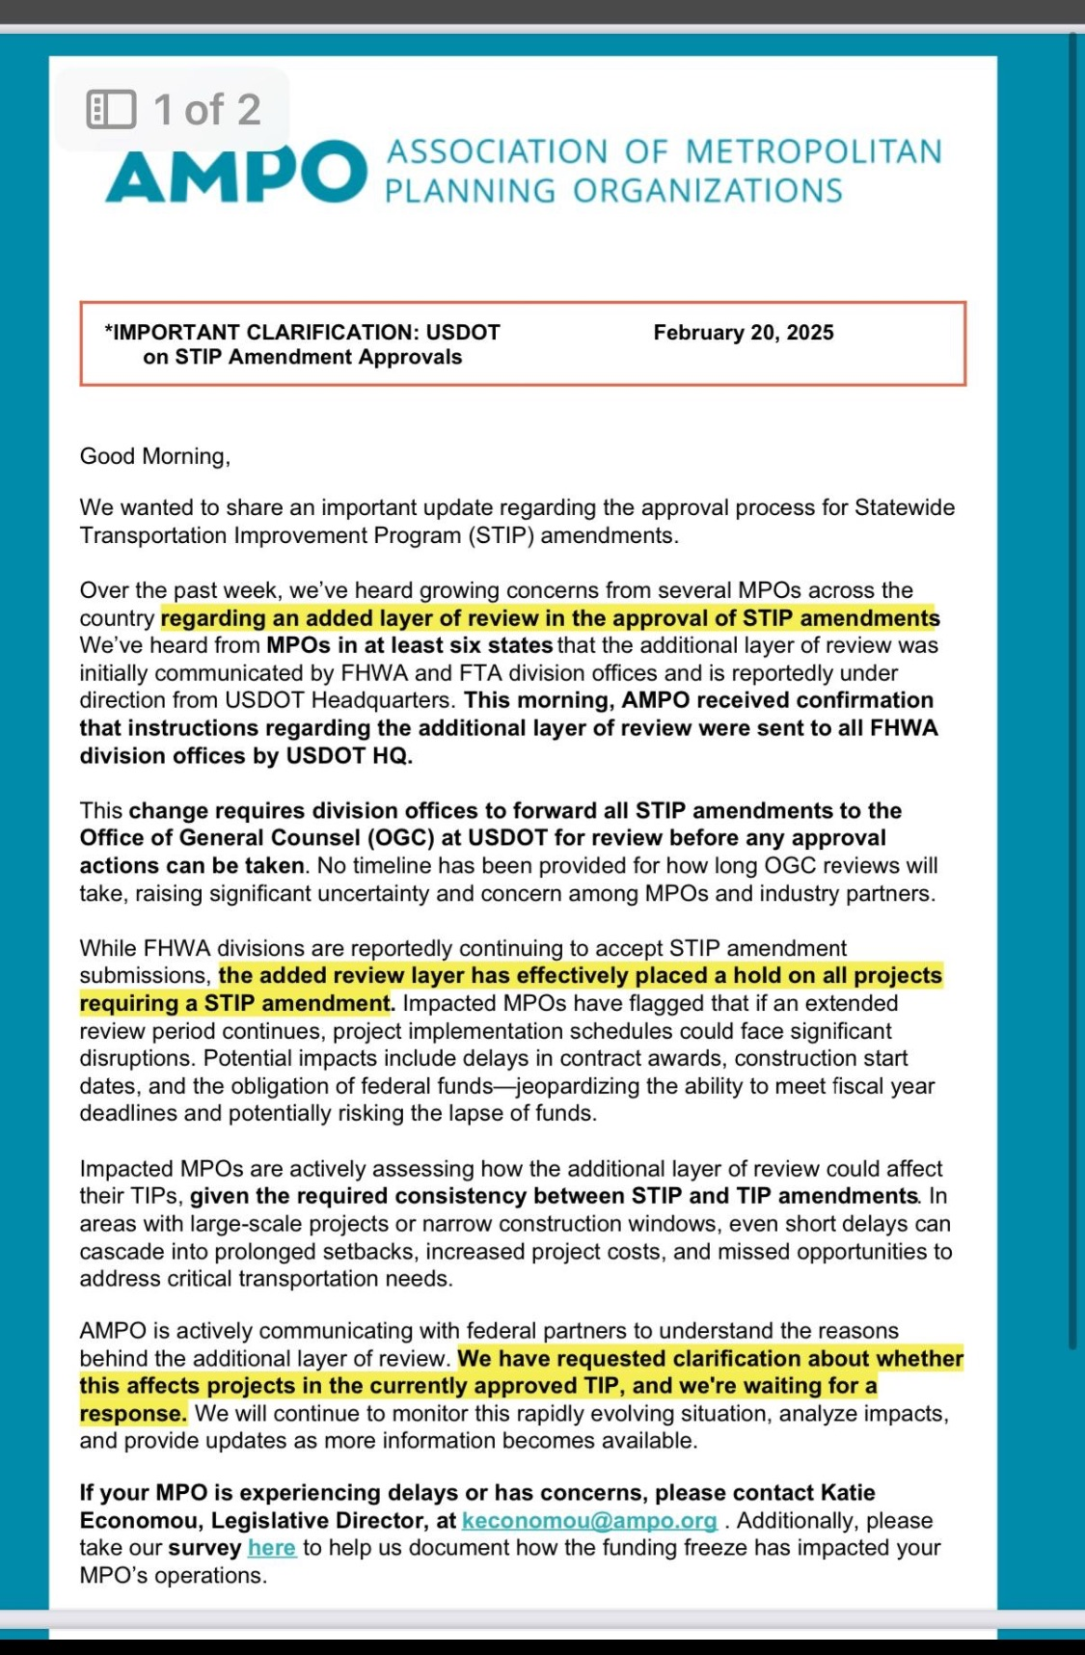
On 2/28, Federal Highway Administration officials confirmed that planning approvals are being handled by FHWA Division Offices again, and that state and MPO partners should assume a resumption of these activities as before.

Slide 16
Reauthorization of the
Economic Development Administration

Slide 17
EDA Reauthorization signed into law
    On January 4 2025, the Thomas R. Carper Water Resources Development Act of 2024 (S. 4367) was signed into law, following its passage in the House and Senate with overwhelming bipartisan support.
    The reauthorization of the EDA will strengthen and protect EDA’s programs and will enhance key initiatives that are vital to the success of NADO members and Economic Development Districts across the country.
    The legislation also bolsters many of the core traditional programs that EDA has administered ever since it was originally authorized in the Public Works and Economic Development Act of 1965.

Slide 18
EDA Reauthorization bill highlights
    Authorization Level for EDA Partnership Planning Grants
    The EDA reauthorization legislation includes the following authorized funding levels for Partnership Planning Grants:
      $90 million for Fiscal Year 2025
      $100 million for Fiscal Year 2026
      $110 million for Fiscal Year 2027
      $120 million for Fiscal Year 2028
      $130 million for Fiscal Year 2029
    Authorization versus Appropriation Level
      The amounts listed above are authorized funding levels, not actual appropriated funding levels. In order for the authorized funding levels to be provided to Economic Development Districts, Congressional appropriators would still need to provide appropriated levels of funding that are equivalent to the authorized amounts. This has not yet happened.

Slide 19
EDA Reauthorization bill highlights
    Federal Cost Share and Local Mach for Partnership Planning Grants
    The EDA reauthorization legislation includes a provision that states that the Secretary of Commerce may increase the Federal Share for Partnership Planning Grants up to 100 percent of the total cost of the project. This is at the discretion of Commerce and EDA and is not something that the agency is required to do.
    Baseline Cost Share for All EDA Grants
    The EDA reauthorization legislation includes a provision that increases the baseline cost share for all EDA grants from 50% to 60%. This is a “floor” amount for the federal cost share of all EDA grants carried out under 42 U.S.C. § 3144.
    The EDA reauthorization legislation also includes a provision that states that any funds contributed by a Regional Commission for an [EDA] project may be considered to be part of the non-federal share of the project.

Slide 20
Federal Regional Commissions
The EDA reauthorization legislation updates the definitions of the Regional Commissions and enhances the ability of EDA to coordinate with the Regional Commissions. It also authorizes some new Regional Commissions. The following are the Regional Commissions outlined in the legislation:
− The Appalachian Regional Commission
− The Delta Regional Authority
− The Denali Commission
− The Great Lakes Authority
− The Mid-Atlantic Regional Commission (NEW)
− The Northern Border Regional Commission
− The Northern Great Plains Regional Authority (Newly reauthorized; previous authorization had lapsed)
− The Southeast Crescent Regional Commission
− The Southern New England Regional Commission (NEW)
− The Southwest Border Regional Commission

Slide 21
EDA Appropriations FY 2026

Slide 22
Economic development administration Appropriations
Economic Development Administration | FY 2020 Final | FY 2021 Final | FY 2022 Final | FY 2023 Final | FY24 House proposed | FY24 Senate proposed | FY24 Final | FY25 House | FY25 Senate | FY26 NADO REQUEST
EDA Total Appropriation | $333 million | $346 million | $373.5 million | $498 million | $254.5 million | $466 million | $468 million | $324.5 million | $483 million
Total – Economic Development Assistance Program | $292.5 million | $305.5 million | $330 million | $430 million | $211 million | $396 million | $400 million | $256.5 million | $410 million | At least $545 million is requested, which is the authorized funding level.
EDA Partnership Planning Grants | $33 million | $33.5 million | $34.5 million | $36 million | N/A | $36 million | $34.5 million | N/A | $35.5 million | At least $100 million is requested, which is the authorized funding level.

Slide 23
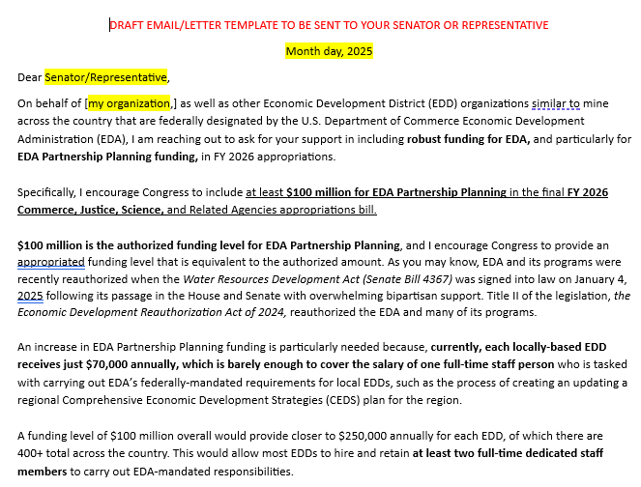
Congressional Outreach - Appropriations
NADO encourages our membership to send letters to their members of Congress advocating for robust funding for EDA, and particularly for EDA Partnership Planning funding, in FY 2026 appropriations.
www.nado.org/advocacy-resources/
Notes:
The Appropriations Committee has not yet released FY26 guidance for CPF requests. https://www.vanhollen.senate.gov/imo/media/doc/fy26_earmarks_guide.pdf
The Appropriations Committee has also not yet released deadlines for FY26. You are encouraged to prepare submissions as early as possible using FY25’s guidance
https://reimagineappalachia.org/a-guide-to-earmarks-for-appalachian-communities/

Slide 24
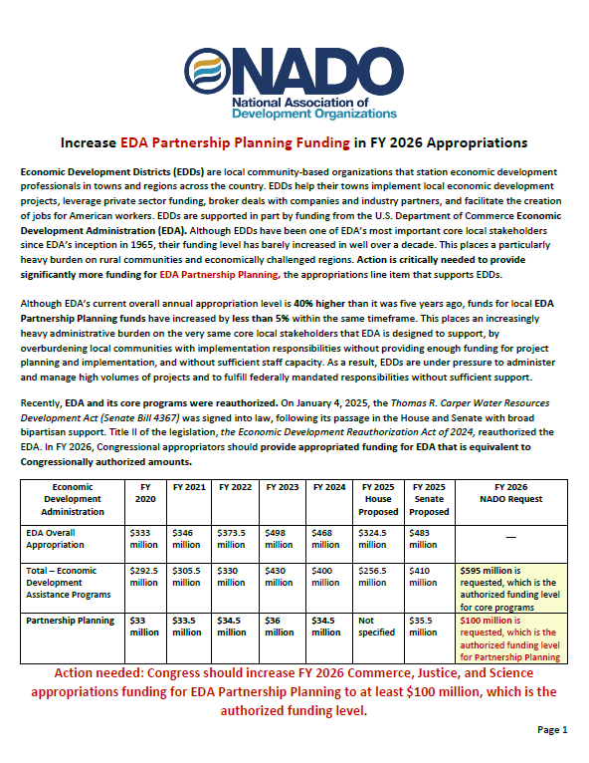
EDA appropriations advocacY
The enacted EDA reauthorization legislation AUTHORIZED higher funding levels for EDA Partnership Planning
Ask your Senators and Representatives to provide APPROPRIATED funding levels that are equivalent to authorized levels
www.nado.org/advocacy-resources/
https://www.nado.org/wp-content/uploads/2024/12/EDA-Partnership-Planning-Appropriations-Fact-Sheet-FY-2026-Final.pdf
Notes:
Many of you have reached out regarding federal grant funds that have been paused, despite the rescission of OMB memo M-25-13. As you may know, many federal agencies are continuing to go through a process of reviewing their federal grant programs to determine whether they are in alignment with the Administration’s recent Executive Orders (EOs), and in the meantime, we understand that some of our member organizations have received “stop work orders” or other notifications of paused federal funds. There are still many unanswered questions regarding these EOs, and we recognize that this uncertainty along with disruptions in federal funds may pose challenges for our member organizations. NADO is working to monitor these developments and to better understand how they may impact our membership. We remain committed to keeping you informed as we learn more, and although NADO is not able to provide legal advice, we do intend to provide information, resources, and updates to help you navigate the changing federal landscape.
One area of reassurance that we want to provide to the NADO membership is that, to the best of our understanding, EDA Partnership Planning grants should not be in jeopardy. There may be a temporary pause while EDA goes through a process to ensure internal compliance with the EOs and the Administration’s priorities, but ultimately, it is not anticipated that Partnership Planning or other core EDA funding programs are likely to be impacted. We encourage you to remain in frequent communication with your Economic Development Representatives (EDR). If your organization is facing extenuating circumstances that could make you particularly vulnerable to temporary funding pauses, you should communicate this to your EDR.
https://www.constitutionpartners.com/executive-order-tracker
https://www.mayerbrown.com/en/insights/publications/2025/02/updates-and-summary-of-the-evolving-executive-federal-funding-freeze
https://www.mayerbrown.com/en/insights/resource-centers/washington-update/trump-2-executive-order-tracker

Slide 25
Questions?

