Slide 1



Grantwriting that Resonates:
Using Memory & Your Senses
to Enhance Your Craft
Reed Bobroff
writer, performer,
organizer & educator

Slide 2
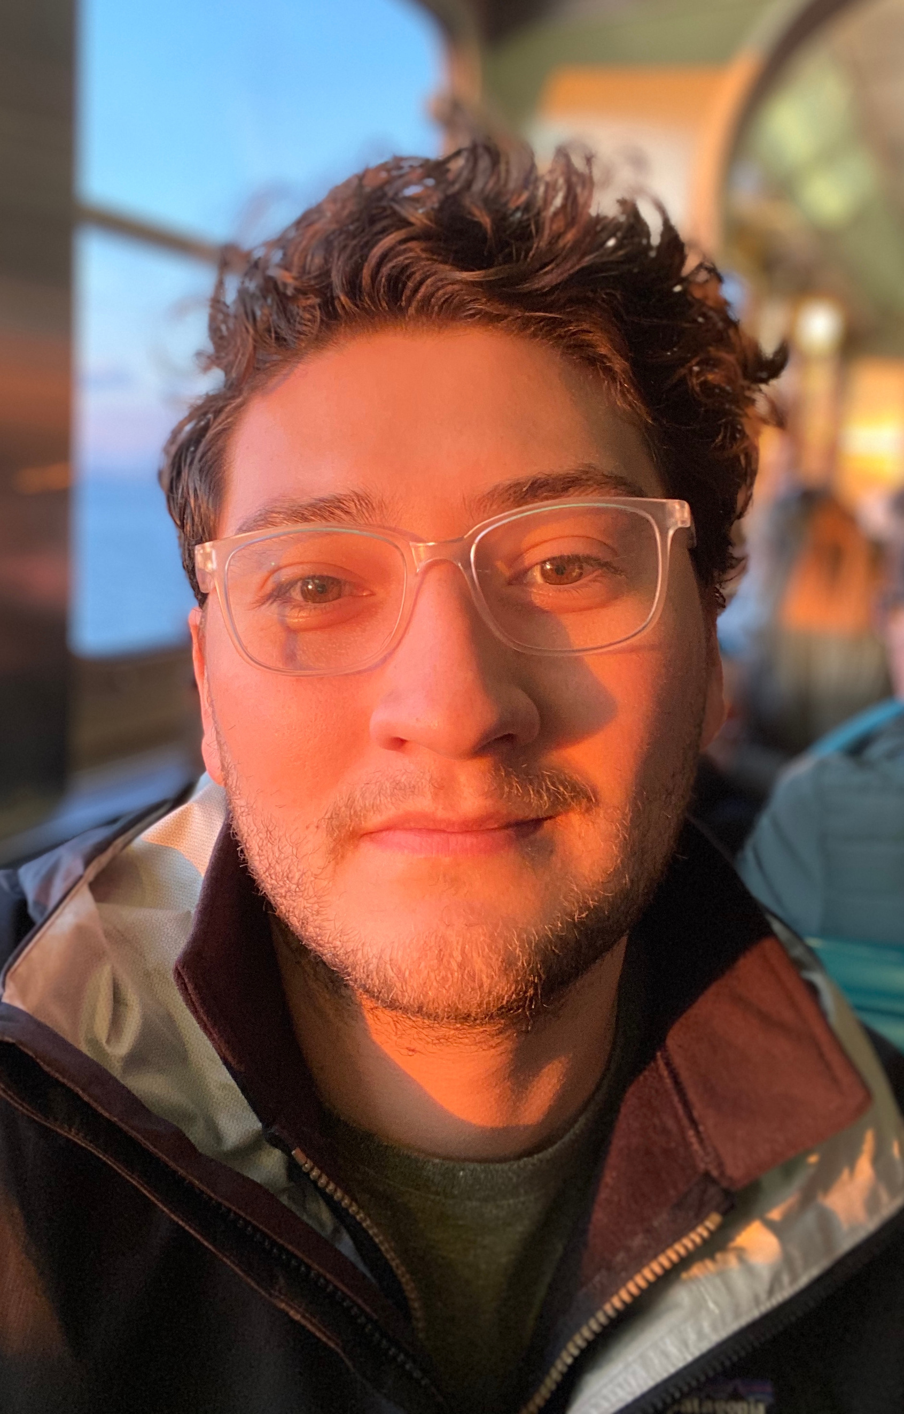

Reed Bobroff
Diné (Navajo Nation)
Pushcart Prize-nominated writer, performer, organizer & educator from Albuquerque, NM. He received his B.A. in Theater Studies from Yale University and has performed domestically, internationally, and on PBS and HBO. He was the inaugural winner of the Yale Young Native Storytellers award and has published work in journals and anthologies such as The Breakbeat Poets. Reed has led workshops in communities around the country to help youth use writing as a tool for self-expression and healing. He has led this work through various fellowships, notably through the Loft Literary Center and developed curriculum formally as a licensed Creative Writing teacher at the Native American Community Academy. His experience in storytelling has informed his work as a Creative Director and Marketing professional. He currently manages Marketing & Communications for the City of Albuquerque’s Office of Equity & Inclusion.

Slide 3


Data proves impact. Stories get funded.
Grounding
Think about the work you do.
Aloud, in one sentence say,
    “[My Organization] sounds/smells like…”

Slide 4


Data proves impact. Stories get funded.
Guided Free Write
Think about how your work affects the communities you serve. Visualize with all 5 senses what your organization’s impact is when you are most successful.
Write...
  “The future of [my Organization]...
    smells like
    sounds like
    looks like
    tastes like
    feels like
  “I know this because…
    [what is a work memory that inspires you?]”

Slide 5


Data proves impact. Stories get funded.
Reflection
Share writings aloud
  What line stuck with you?
  Could this be in a fundraising letter or pitch deck?

Slide 6

Reed Bobroff
writer, performer,
organizer & educator
rabobroff@gmail.com

