Slide 1
Center for Economic Development

Slide 2
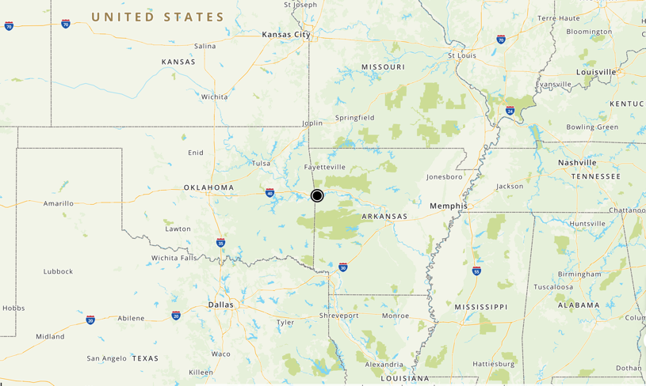

Slide 4
Slide Title
Sub-title
Opportunity to place text. The images can easily be replaced with new creative. They will automatically resize to fit the power point template.

Slide 5
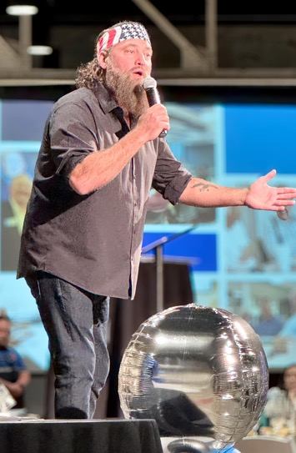
Jim Walcott Family Enterprise Center
Highlights
>$1 million endowment - Jim Walcott Family Enterprise Center
71 Peer Group lunches (495 participants)
Six new member companies
$25,000 donation - Shipley Collaboration Space.
Highest number of annual events in FY’24

Slide 6
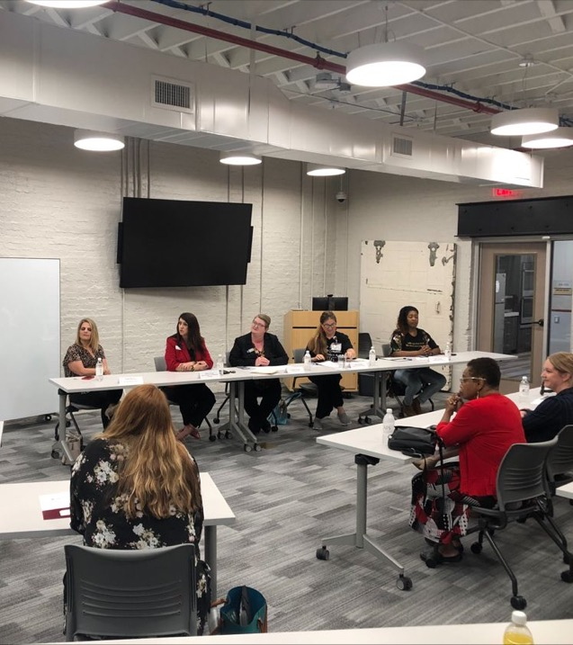
Highlights
Arkansas Small Business & Technology Development Center
$4.07 million in loans and investments
Delivered 16 workshops (minority, veteran, and women business owners)
2 workshops in Spanish
2023 Ambassador Award - exemplary outreach to underserved communities.

Slide 7
Center for Business & Professional Development
Highlights
72 training events
1,121 students, 85 unique companies
Workplace Leadership Series
Industrial Technology and Advanced Manufacturing training
Diverse professional development topics
103 Lean Six Sigma certifications

Slide 8
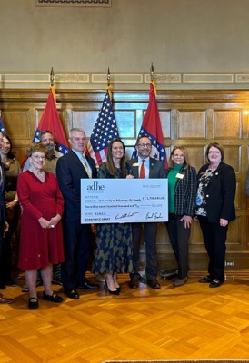
Strategic Plan 3.2
Strengthen partnerships with regional organizations to develop customized learning opportunities, including internships, clinical experiences, and apprenticeships, expanding students’ real-world experience.
HIRED Grant Implementation ($4m Department of Commerce, $1.7m Arkansas Department of Higher Education – 23 partners)
Expand Lion’s Lair Student Pitch Competition to all 3 colleges
Utilize student workers to support Artificial Intelligence training to local business & industry
Collaborate with Western Arkansas Manufacturing Council to develop and host annual Workforce Best Practice Summit (150 attendees)

Slide 9
With economic growth at the core of its mission and a 20-year lease secured at the Bakery District downtown, the UAFS Center for Economic Development (CED) demonstrates an unwavering commitment to the future of the River Valley. As a hub of collaboration, the CED connects regional economic needs with the expertise of over 200 UAFS faculty and staff, fostering innovative solutions tailored to a dynamic workforce.
By combining expertise, innovation, and a commitment to community needs, the CED is a vital driver of economic growth and workforce excellence in the River Valley.
Notes:
Mission
UAFS empowers the social mobility of its students and the economic growth of the River Valley through exceptional educational opportunities and robust community partnerships.
Vision
Through dynamic academic programs, innovative research opportunities, and transformational centers of intellectual and economic development, UAFS will advance its community and become an institution renowned for educating and inspiring the ambitious students who call it home.

Slide 10
Photo Collage

