Slide 1
EDDs and State Economic Development Department Connections
Erik R. Pages
EntreWorks Consulting
April 15, 2025

Slide 2
Project Overview
Two-year RNTA project designed to:
  Promote better alignment in state and regional strategies
  Improve collaboration
  Develop a more coherent planning process between states and EDA -designated Economic Development Districts (EDDs)
  Partners included:
    National Association of Development Organizations (NADO)
    State International Development Organizations (SIDO)
    American Manufacturing Communities Collaborative (AMCC)
    State Economic Development Executives (SEDE)

Slide 3
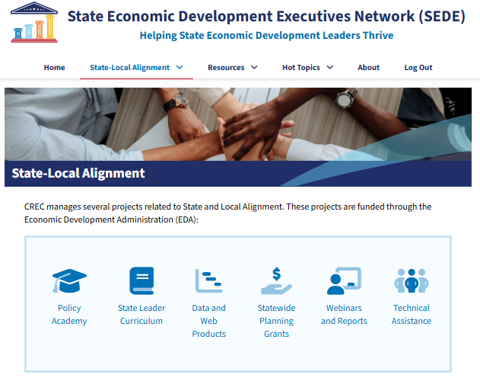
Key Deliverables
Databases and web sites
Reports and blogs
Webinars
One-on-One TA
Conference presentations and workshops
Practices Issue Briefs
State Leader Curriculum
Policy Academy for Strategic Alignment
Statewide Planning Grants
These deliverables and more can be found at stateeconomicdevelopment.org
Notes:
SLEDS, SPG, USA Competes
30 webinars, several reports and blogs
Let’s get into a few specifics

Slide 4

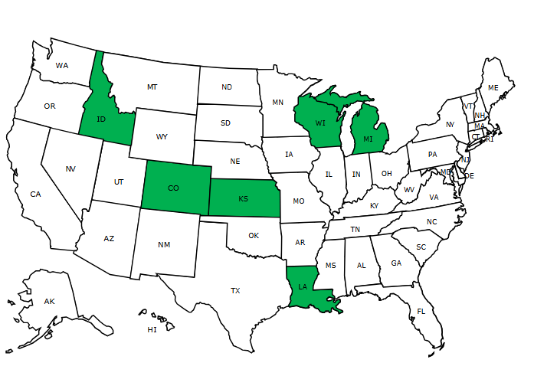
Policy Academy for Strategic Alignment
Participants from six states representing four (4) EDA regions:
    Colorado
    Idaho
    Kansas
    Louisiana
    Michigan
    Wisconsin
9-month cohort learning process—akin to Community of Practice
Goal: To better align strategies and actions between state leaders, EDDs, and other stakeholders by collaborating and developing unique approaches to strategic alignment.
Notes:
TA at conferences, workshops at conferences
RFP
Atlanta and Philadelphia not represented

Slide 5
Early Team Visions
Colorado | Establish and promote a framework between EDDs, governmental and non-governmental agencies, and other key workforce and economic development stakeholders to guide enhanced communication, collaboration, and alignment of economic development strategies and actions within Colorado.
Idaho | (What) To formalize and institutionalize collaborative regional and state planning processes… (Why) … to create an inclusive economic development community within the state.
Kansas | Create dynamic, inclusive, and actionable economic development strategies that align each region’s assets to grow vibrant communities, enhance our competitive edge, and accelerate economic prosperity throughout the state.
Louisiana | To develop an inclusive state economic development strategic plan and formalize and institutionalize our collaborative regional and state planning processes.
Michigan | To create a sustainable long-term commitment to unifying shared economic development priorities among the three regional economic development districts in Michigan’s Upper Peninsula and the Michigan Economic Development Corporation in order to achieve greater shared success in economic development across the entire region.
Wisconsin | There is a commitment to efficiently collaborate between the state, regions, Tribes, and universities toward economic well-being.

Slide 6
Priority Goals

Slide 7
More Priority Goals

Slide 8


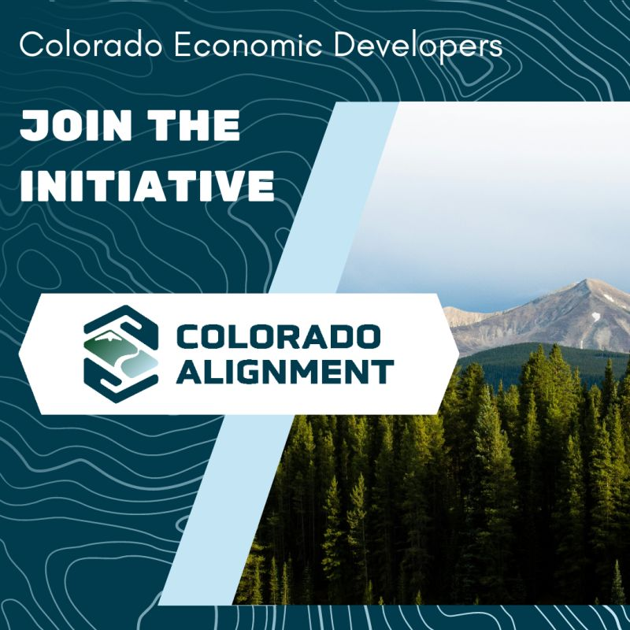
High-Level Achievements
Creation of New Initiatives
Formalized Partnerships
  EDD-EDO MOUs
    CO, LA, MI
New Branding and PR Opportunities
Relationship Growth
Notes:
Matt will be sharing his experience in KS
I’ll share my experience in LA. Very little interaction beforehand but this process was a big force in new Gov Landry’s new ED strategy—first statewide ED Plan in a long time.
Also, let do some major project wins. First Solar in Acadiana Parish. One of the biggest solar mfg. plants in the US. LA has also made 2 other big recent announcements that also had close EDD-EDO ties. Meta Data Center in NE LA and Hyundai Steel Plant in Donaldsonville ($5.8b investment projected)

Slide 9
Project Takeaways
Need to be intentional about relationship building.
Cultural change is needed for sustainability.
The work is “simple” – but “simple” is not “easy.”
High-level buy-in is vital but staff buy-in is essential for long term success.
Notes:
Not spontaneous – need to be committed and deliberate
Engrain and institutionalize – otherwise it’s a one-off for a project
Riding a bike is simple – but not easy
Everyone needs to support

Slide 10
Strategy Ideas for State Agencies and LDDs
Engage Top Officials at the Outset
  Ideally championed by Secretary of Commerce (or equivalent)
Developed Coordinated Communications Strategies
  Regular cadence of news and outreach
Create Organizational and Program Asset Maps
Align Planning Cycles and Processes
  All state CEDS on common cycle/timeline?

Slide 11
More Potential Strategies
5. Formalize Collaboration
  Via MOUs and other tools
Set Shared Goals
  In targeted areas with shared responsibilities
7. Create a Common Brand

Slide 12
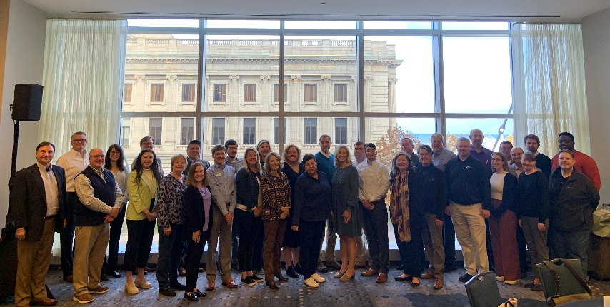
Policy Academy for Strategic Alignment
  See SEDE website for:
    Blogs
    Alignment webinars
    Team reports and presentations
    Comprehensive final report
    stateeconomicdevelopment.org
Notes:
Teams implemented practices and developed strategies that ensured the long-term sustainability of their new alignment foundation long past the Academy’s conclusion.

Slide 13

Contact Information
Erik R. Pages
EntreWorks Consulting
epages@entreworks.net
703-237-2506
www.entreworks.net
BLOG: www.entreworks.net/blog
Newsletter Sign-Up: http://www.entreworks.net/Newsletter.php

