Slide 1
Closing Plenary – Economic State of the Region
2025 SWREDA Conference | Las Cruces, NM
May 9, 2025
Brian Kelsey
Manager, Economic Development Advisory Services
Fort Worth, Texas | brian.kelsey@ey.com

Slide 2
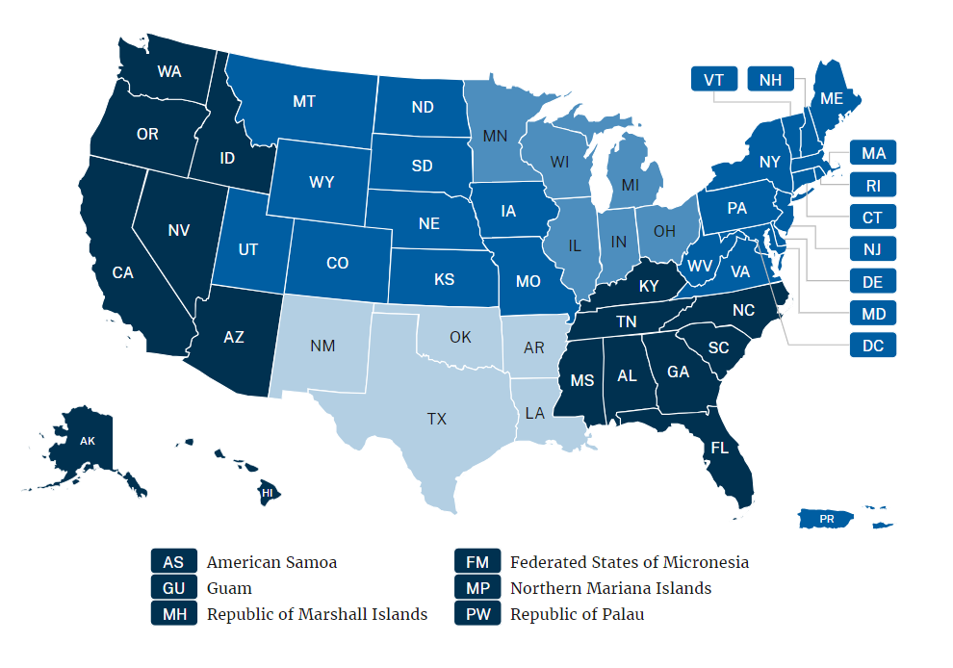
EDA Regions
Denver
Chicago
Philadelphia
Seattle
Atlanta
Austin
* Map and charts omit U.S. Territories and Puerto Rico due to data availability.

Slide 3
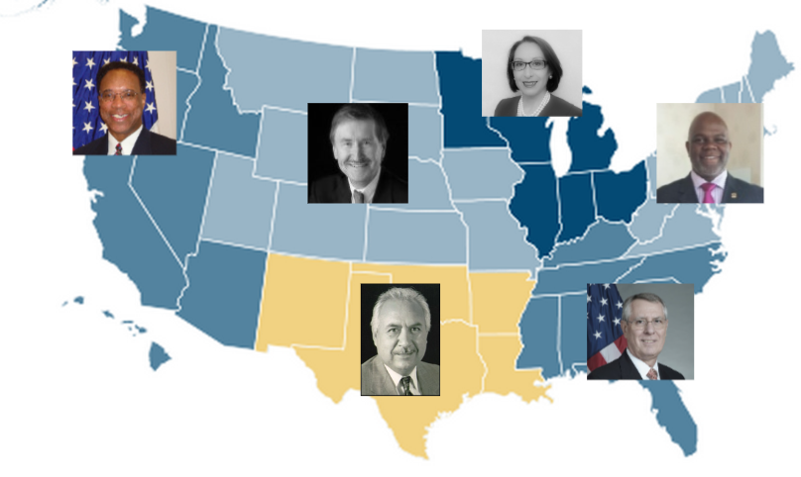
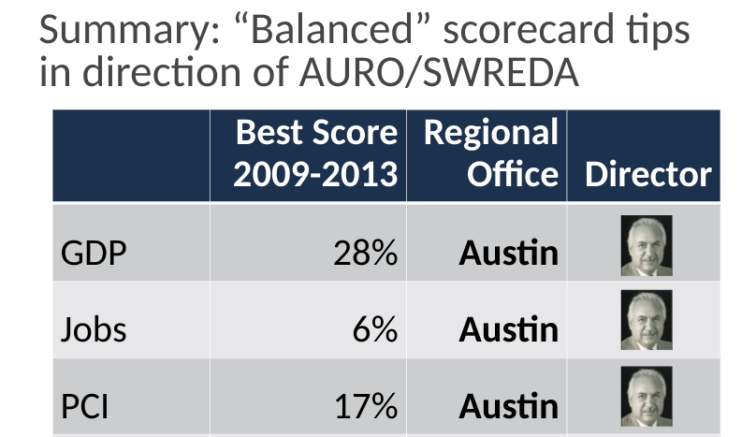
State of the Region: The Origin Story
EDA Regional Office Directors, 2014
2014 SWREDA: Mano a mano results

Slide 4
Economy

Slide 5
EDA Austin is the second-fastest growing EDA regional economy
GDP growth, 2019-2024
Job growth, 2019-2024
EDA Austin is a $3.2 trillion economy, about 13% of total U.S. GDP. Employers added nearly 1.5 million jobs in 2019-2024.
Source: Lightcast. GDP growth is not adjusted for inflation.

Slide 6
Fastest growing U.S. metro job markets, February 2024-February 2025 (YoY)
All U.S. metros, February 2025
EDA Austin metros, February 2025
 | Jobs(k) | YoY Growth
Sandusky, OH | 50.1 | 6.14%
Barnstable, MA | 91.0 | 5.94%
Rochester, MN | 129.5 | 5.46%
Napa, CA | 76.4 | 4.80%
Coeur d'Alene, ID | 75.0 | 4.60%
Traverse City, MI | 70.0 | 4.17%
Atlantic City-Hammonton, NJ | 167.6 | 4.10%
St. George, UT | 89.1 | 3.60%
Kennewick-Richland, WA | 128.3 | 3.38%
Chambersburg, PA | 62.6 | 3.30%
Eagle Pass, TX | 18.8 | 3.30%
Boise, ID | 407.8 | 3.29%
Walla Walla, WA | 28.4 | 3.27%
Goldsboro, NC | 42.9 | 3.12%
Rapid City, SD | 74.0 | 3.06%
 | Jobs(k) | YoY Growth
Eagle Pass, TX | 18.8 | 3.30%
College Station-Bryan, TX | 147.9 | 2.78%
Fayetteville-Springdale-Rogers, AR | 311.5 | 2.47%
Laredo, TX | 114.2 | 2.33%
Albuquerque, NM | 427.6 | 2.13%
Slidell-Mandeville-Covington, LA | 101.9 | 2.00%
Hammond, LA | 51.1 | 2.00%
Lafayette, LA | 185.7 | 1.98%
Amarillo, TX | 130.4 | 1.95%
San Antonio-New Braunfels, TX | 1,191.30 | 1.82%
Beaumont-Port Arthur, TX | 169.2 | 1.81%
Midland, TX | 40.4 | 1.76%
Santa Fe, NM | 63.6 | 1.76%
El Paso, TX | 355.9 | 1.74%
New Orleans-Metairie, LA | 478 | 1.68%
Source: U.S. Bureau of Labor Statistics

Slide 7
Workforce

Slide 8
EDA Austin is best positioned overall to meet forecasted labor demand
Unemployment rate, March 2025
Potential labor surplus/deficit, 2024-2034
 | Job Change 2024-2034 | Pop Change Age 25-64 | Difference Pop-Jobs
Austin | 2,399,303 | 2,640,043 | 240,740
Atlanta | 2,784,237 | 2,997,625 | 213,388
Denver | 1,303,605 | 858,508 | -445,097
Chicago | 735,906 | -218,738 | -954,644
Philadelphia | 2,200,518 | -269,645 | -2,470,163
Seattle | 3,050,217 | 29,275 | -3,020,942
Source: U.S. Bureau of Labor Statistics, Lightcast.

Slide 9
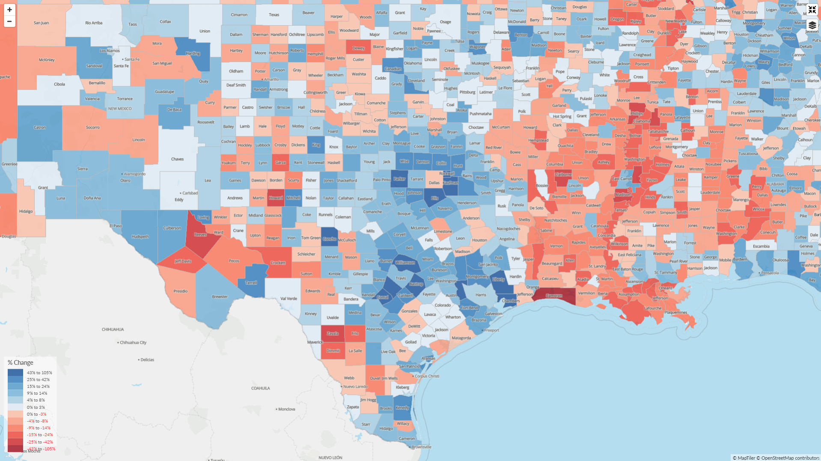
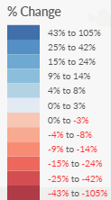
Projected growth in working-age population by county (25-64), 2024-2034
Source: Lightcast

Slide 10
Housing

Slide 11
Housing supply: New units permitted per 10,000 residents, 1980-2023
Avg Ann | 1980s | 1990s | 2000s | 2010s | 2020s
Atlanta | 88 | 72 | 80 | 43 | 70
Austin | 68 | 46 | 63 | 48 | 63
Denver | 48 | 55 | 57 | 41 | 47
Seattle | 82 | 55 | 57 | 31 | 40
Philly | 46 | 33 | 34 | 23 | 27
Chicago | 37 | 47 | 43 | 20 | 26
Sources: HUD SOC Building Permits, U.S. Bureau of Economic Analysis.

Slide 12
Childcare

Slide 13
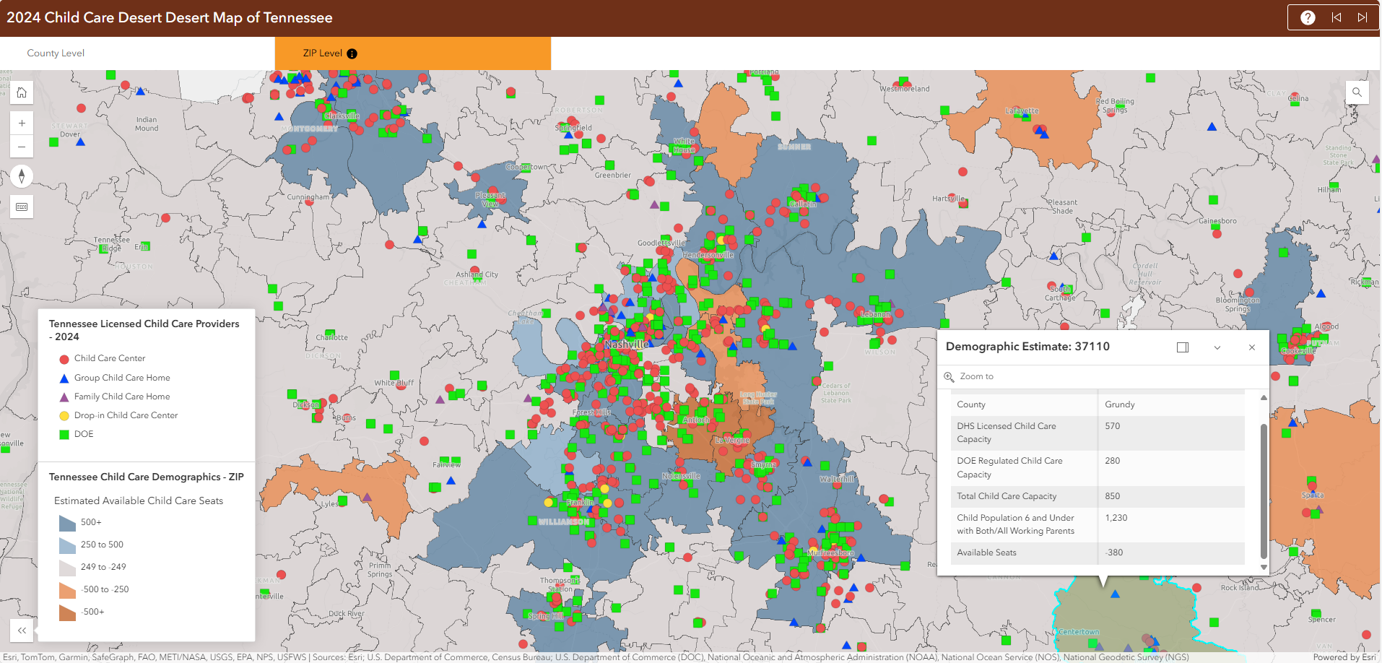
CEDS: Closing childcare gaps as a workforce development strategy
Source: Tennessee Department of Human Services. https://tnchildcarehelpdesk.sworpswebapp.sworps.utk.edu/child-care-desert-map/

Slide 15
EY | Building a better working world
EY exists to build a better working world, helping to create long-term value for clients, people and society and build trust in the capital markets.
Enabled by data and technology, diverse EY teams in over 150 countries provide trust through assurance and help clients grow, transform and operate.
Working across assurance, consulting, law, strategy, tax and transactions, EY teams ask better questions to find new answers for the complex issues facing our world today.
EY refers to the global organization, and may refer to one or more, of the member firms of Ernst & Young Global Limited, each of which is a separate legal entity. Ernst & Young Global Limited, a UK company limited by guarantee, does not provide services to clients. Information about how EY collects and uses personal data and a description of the rights individuals have under data protection legislation are available via ey.com/privacy. EY member firms do not practice law where prohibited by local laws. For more information about our organization, please visit ey.com.
© 2025 Ernst & Young LLP.
All Rights Reserved.
ey.com

