Slide 1



Alamo Area Housing Finance Corporation
Claudia Mora, Regional Services Administrator
May 2025

Slide 2
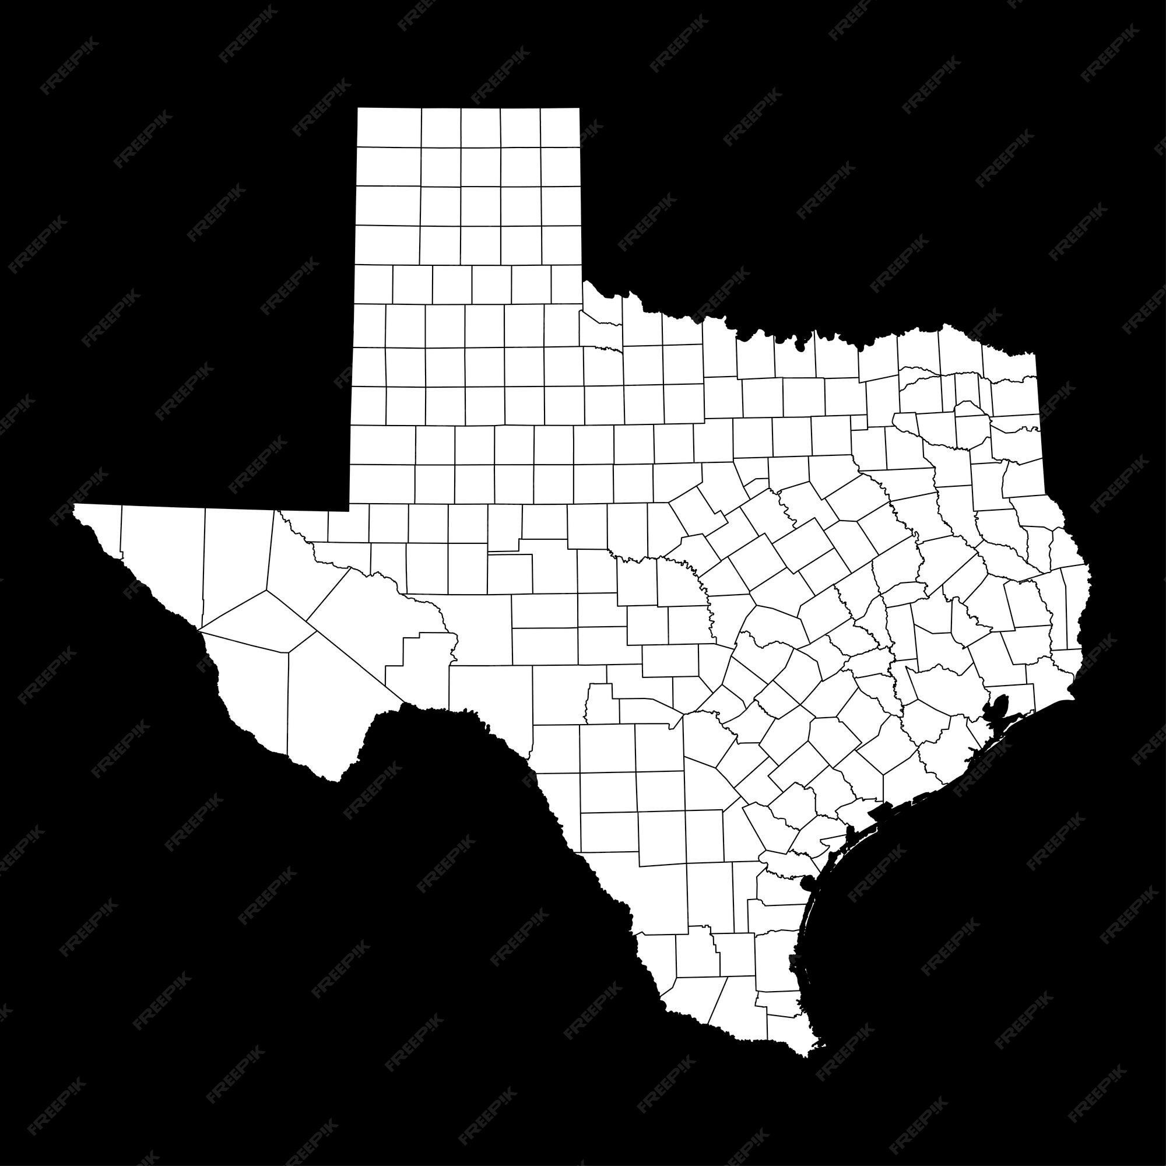

Slide 3
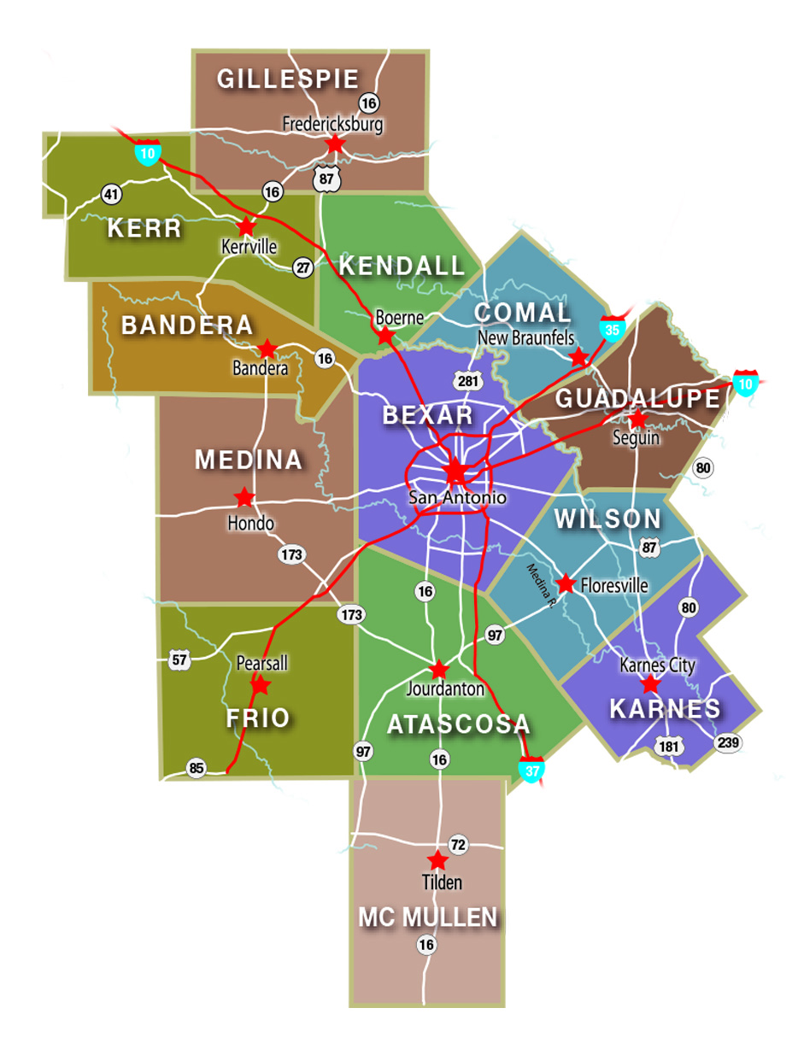
The Alamo Area
AACOG serves the Alamo Area State Planning Region 18, which is comprised of Atascosa, Bandera, Bexar, Comal, Frio, Gillespie, Guadalupe, Karnes, Kendall, Kerr, McMullen, Medina, and Wilson counties.
The AACOG 13-County region covers 12,585 square miles and with a population of approximately 2.7 million.
Notes:
Over 52 member governments
24 EDCs and several economic development foundations
13 housing authorities
Mix of industries
Manufacturing areas in the west (Medina) and north/northeast (Comal, Guadalupe)
Oil and Gas / Eagle Ford Shale (McMullen, Karnes)
Tourism
Dude Ranches
Wineries
Over 1M housing units of which ~ 90% are occupied
Need for affordable / workforce housing

Slide 4
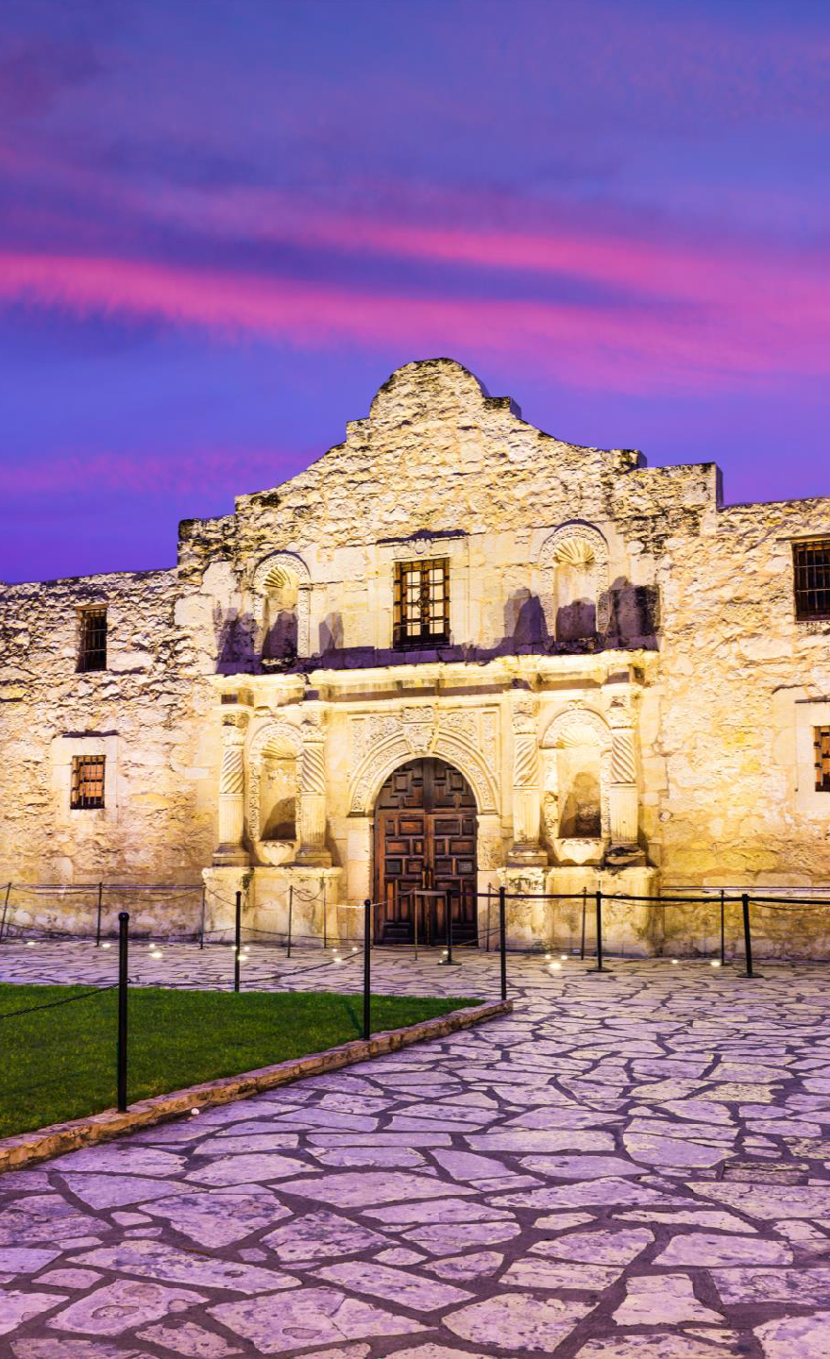
AAHFC – Purpose and Organization
AAHFC Statutory Authority
Chapter 394 Texas Local Government Code
  Purpose - Finance the cost of affordable housing
    Ownership and Development
Benefits the People of the State
  Improves the public health and welfare
  Promotes the economy
  Reduces the adverse effects of unemployment
AAHFC was created in 1984
  Dormant but still current with the Secretary of State
Notes:
Economic development tool
Other HFCs in region
AAHFC was dormant until 2018

Slide 5

AAHFC – Opportunity
LDG Development
Based in Louisville, KY w/ office in Austin, TX
Co-principals Chris Dischinger & Mark Lechner
Over 20 years in Affordable Housing
#1 Affordable Housing Developer in the nation in 2017
77 developments and over 13,600 units across eight states
36 developments and over 6,800 units in Texas
Develop and hold – Never sold an asset (until December!)
Jake Brown – Development Manager
Approached AACOG – Gauge interest in participating in a Tax Credit Financing Project
KEY TO SUCCESS IS A GREAT DEVELOPER PARTNER!
Notes:
3 projects in region
Pecan Grove in Seguin, Guadalupe County COMPLETED
Oak Creek in New Braunfels, Comal County CONSTRUCTION IN PROGRESS
Walnut Springs in Seguin, Guadalupe County NOT STARTED

Slide 6
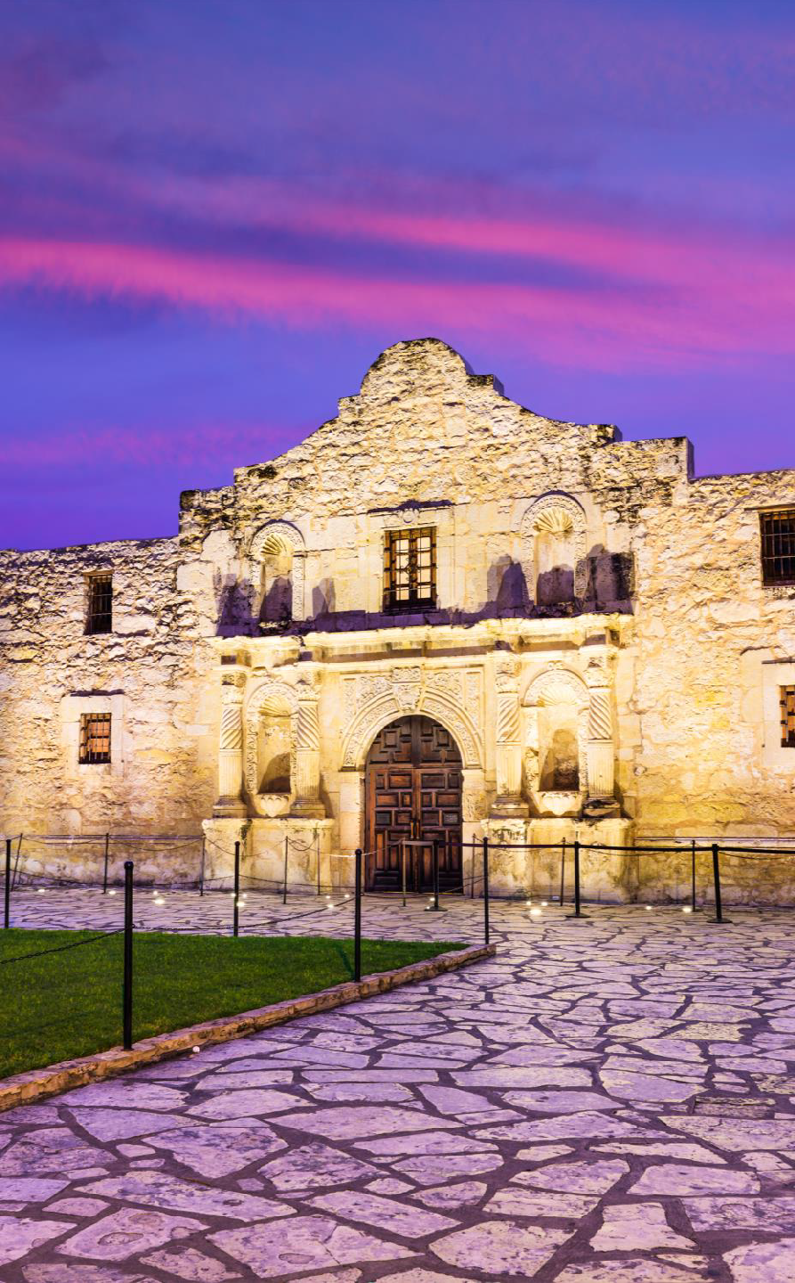
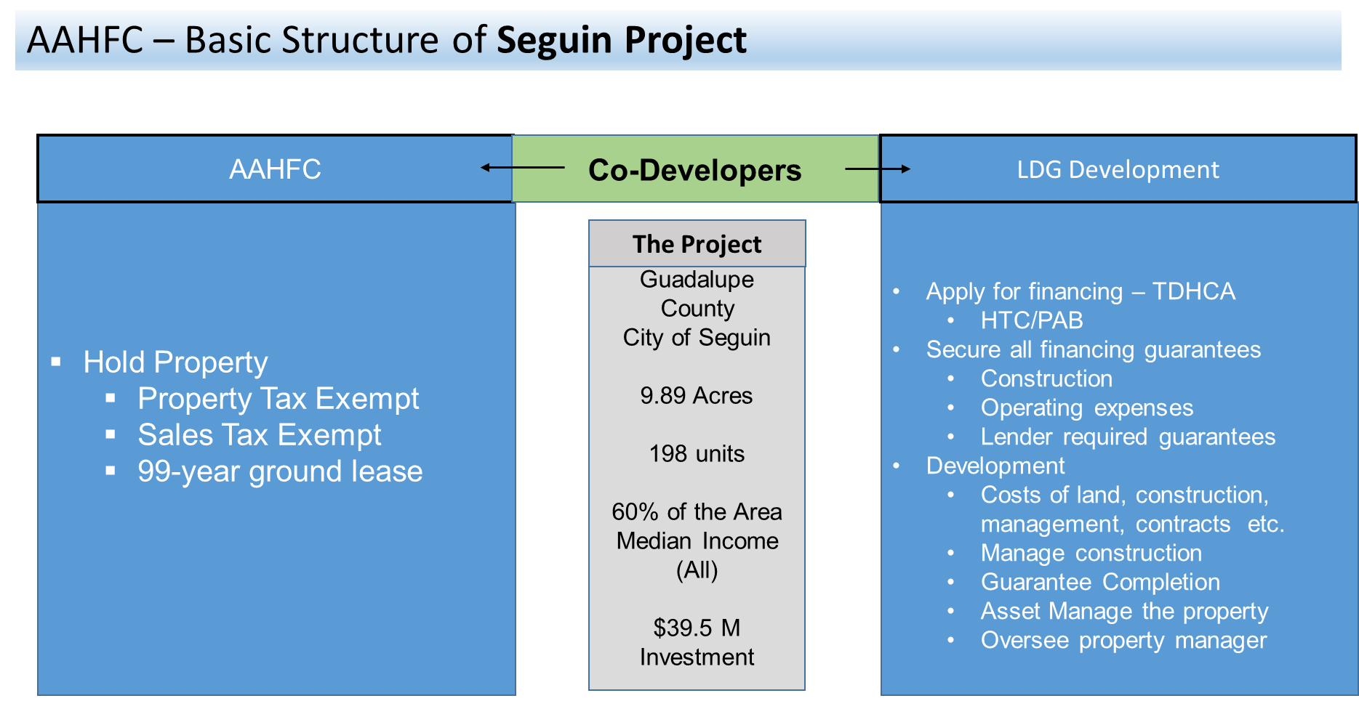

Slide 7

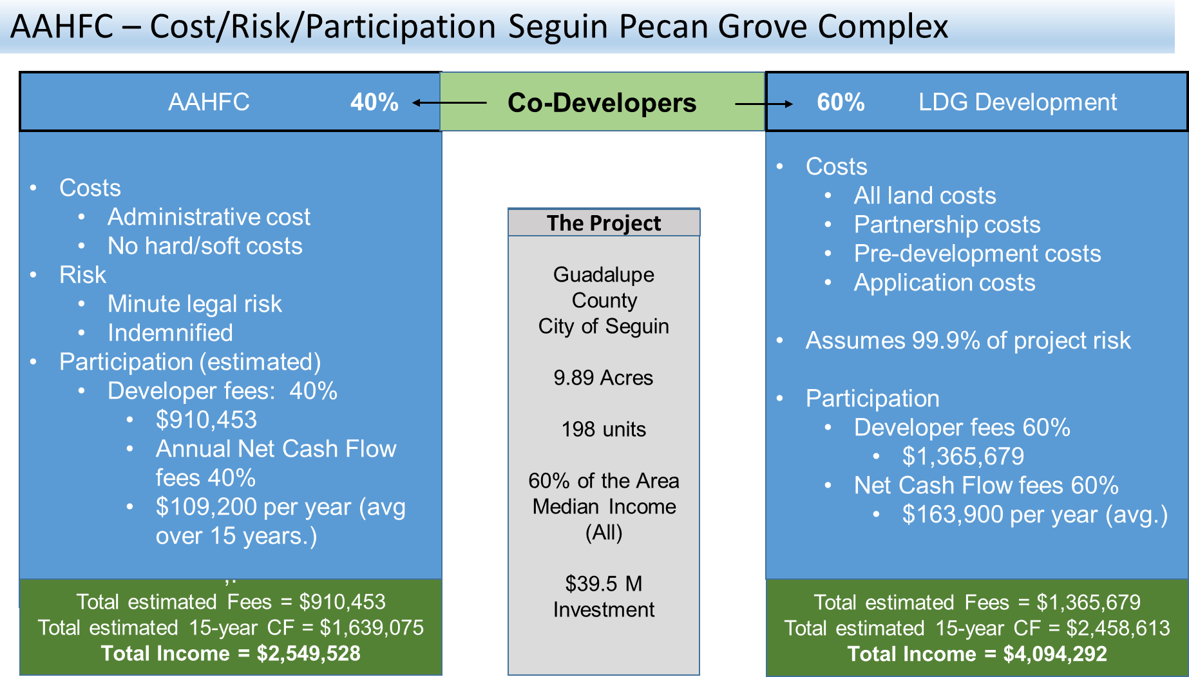

Slide 8
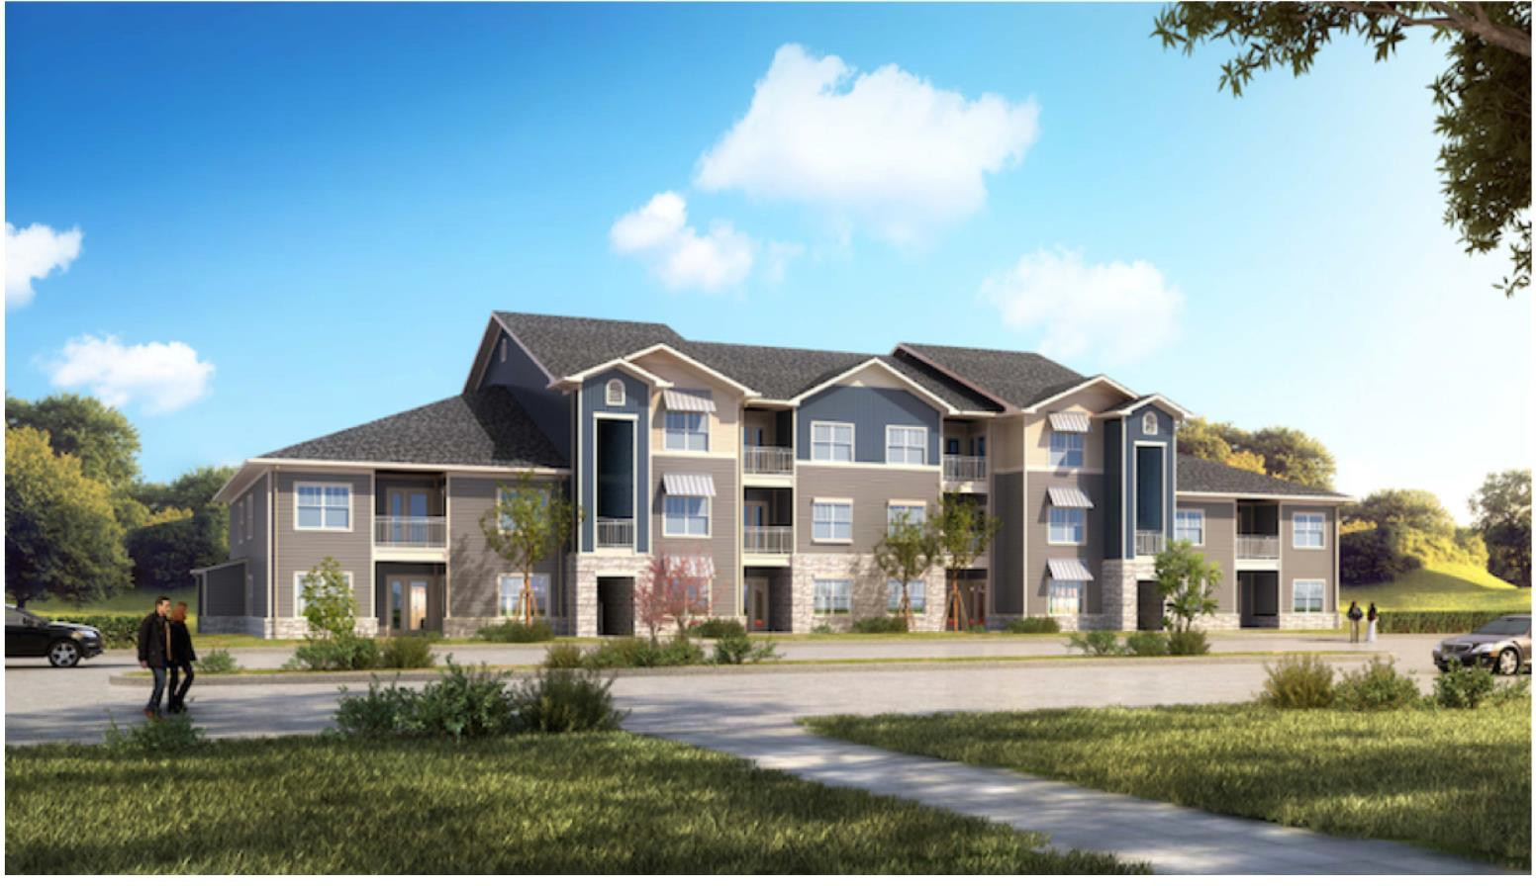

Slide 9
BUILDING SPECIFICATION LIST
100% stone & cementitious exterior composition
35-year dimensional roof shingles
15 SEER air conditioning units
R-30 building insulation
Fire sprinklers in all units
Granite countertops in all units
Energy Star rated appliances in all units
Covered patios and balcony
Laundry and dryer hook-ups
Built to LEED certified standards
Gated community with decorative perimeter fencing

Slide 10

PECAN GROVE
BUILDING SPECIFICATION LIST
Garden Style
8 residential buildings
1 clubhouse
198 units
1-BR – 18
2-BR – 60
3-BR – 114
4-BR – 6
Pool, Clubhouse, Fitness Center, etc.
Parking – 449 spaces

Slide 11
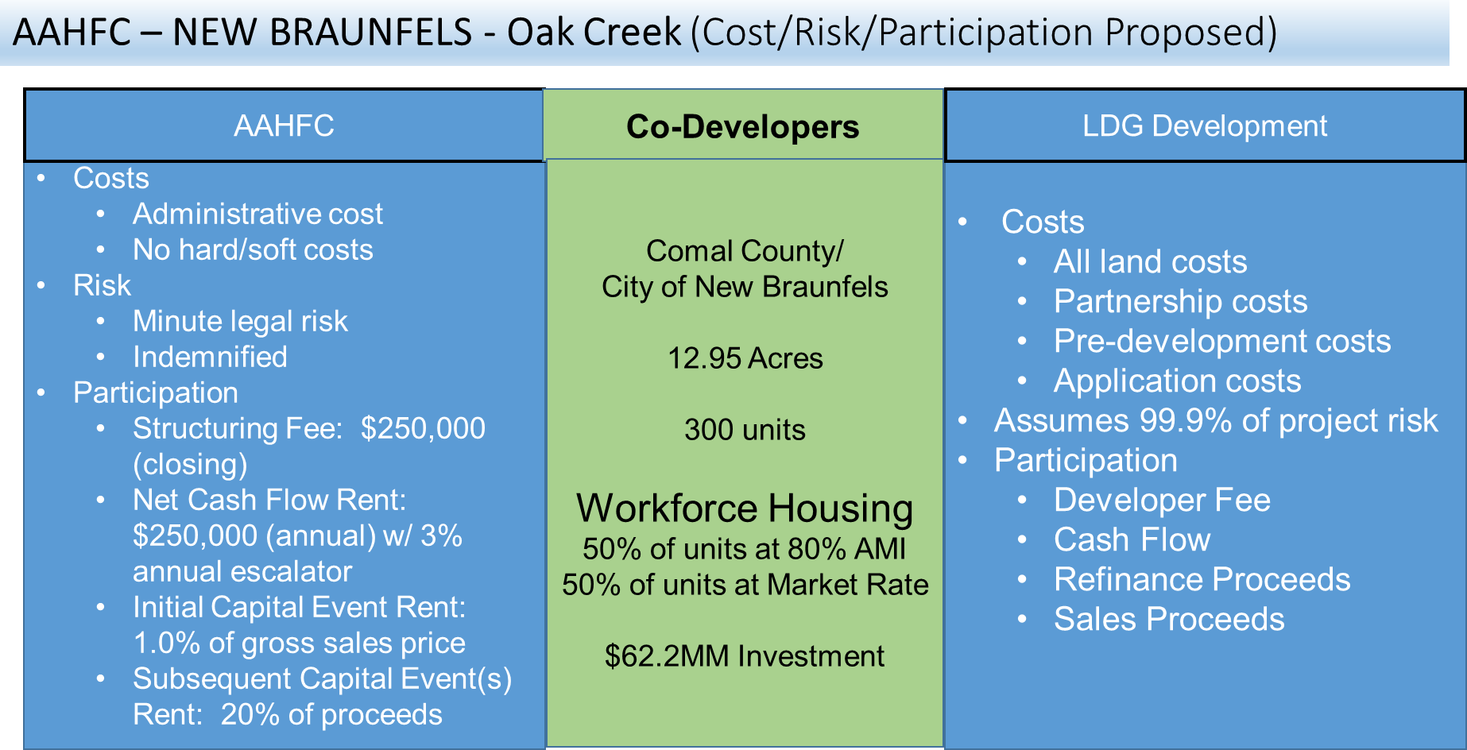

Slide 12
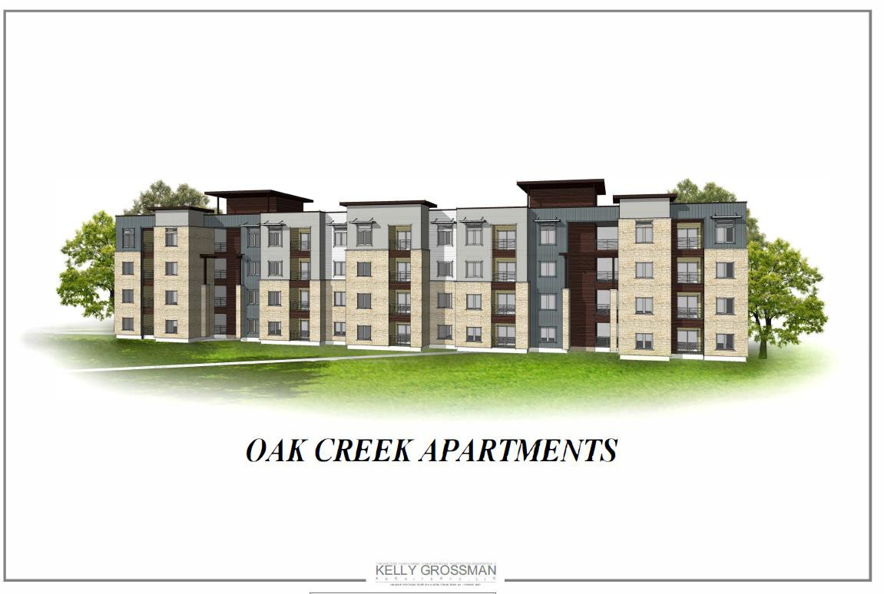

Slide 13
BUILDING SPECIFICATION LIST
100% stone & cementitious exterior composition
35-year dimensional roof shingles
15 SEER air conditioning units
R-30 building insulation
Fire sprinklers in all units
Granite countertops in all units
Energy Star-rated appliances in all units
Covered patios and balconies
Laundry and dryer hook-ups
Built to LEED certified standards
Gated community with decorative perimeter fencing

Slide 14
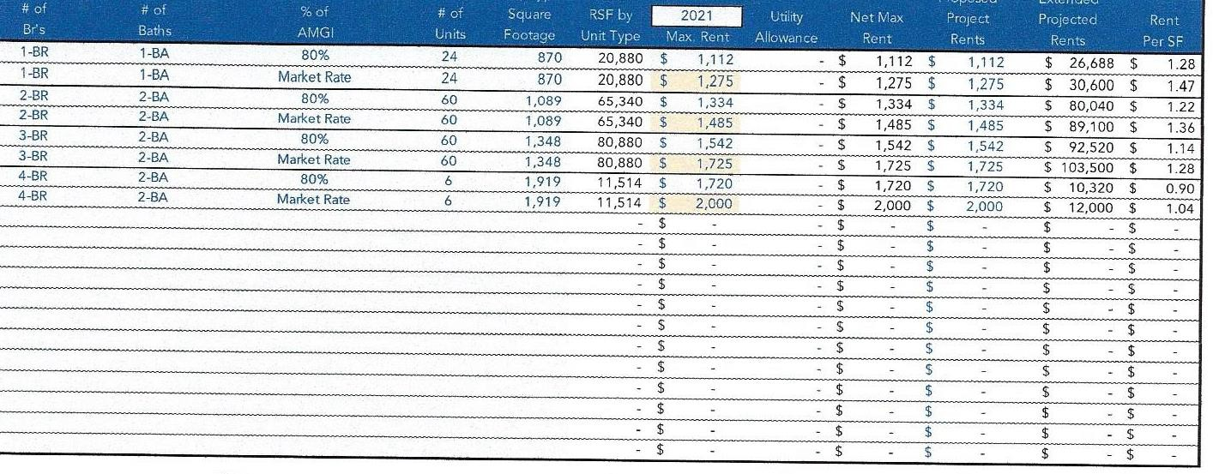
New Braunfels – Oak Creek

Slide 15
AAHFC CLOSING FEES
Half GC Fee | $238,528
Structuring Fee | $250,000
TOTAL | $488,528
Original Projected Closing in March or _{New Braunfels Oak Creek} April, 2022 – delayed due to change in financing from tax credits to standard financing. Current estimated Summer 24
AAHFC COMPLETION FEES
Half GC Fee | $238,528
TOTAL | $238,528
AAHFC NET CASH FLOW RENT
Year 1 | $200,000
Year 2 | $204,000
Year 3 | $208,080
Year 4 | $212,242
Year 5 | $216,486
Year 6 | $220,816
Year 7 | $225,232
Year 8 | $229,737
Year 9 | $234,332
Year 10 | $239,019
Year 11 | $243,799
Year 12 | $248,675
Year 13 | $253,648
Year 14 | $258,721
Year 15 | $263,896
Year 16 | $269,174
Year 17 | $274,557
Year 18 | $280,048
Year 19 | $285,649
Year 20 | $291,362
TOTAL | $4,859,474

Slide 16

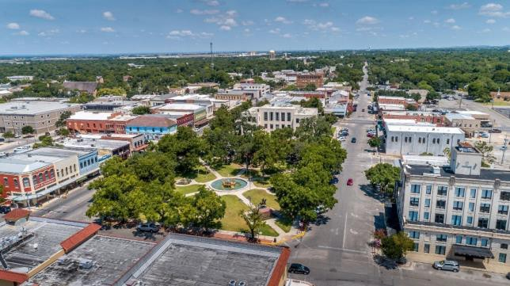
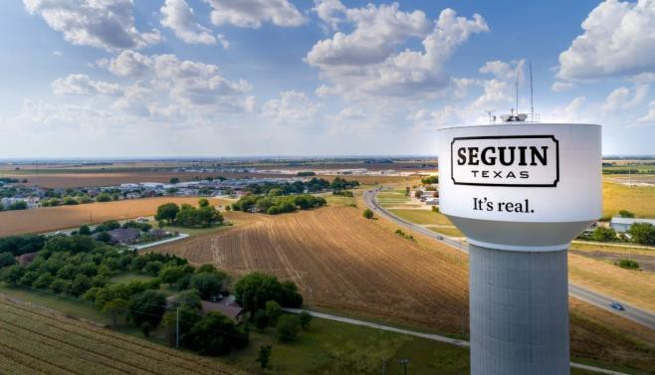

WALNUT SPRINGS SEGUIN, TX

Slide 17
Co-Developers
Seguin – Walnut Springs
AAHFC
LDG Development
The Project
Guadalupe County
City of Seguin
Apply for financing – TDHCA
  HTC/PAB
Secure all financing guarantees
Hold Property
Property Tax Exempt
Sales Tax Exempt
75-year ground lease
Construction
Operating expenses
Lender required guarantees
8.89 Acres
182 units
Development
Costs of land, construction, management, contracts etc.
Manage construction
Guarantee Completion
Asset Manage the property
Oversee property manager
60% of the Area Median Income (All)
$51.9 M
Investment

Slide 18
Walnut Springs
Project Schedule of Fees
Alamo Area HFC
AAHFC Fees at Closing
Issuance Fee |  | $ 175,000
Administrative Fee |  | $ 75,000
Developer Fee |  | $ 109,344
Total $ 3 5 9 , 3 5 4
Schedule of Paid Developer Fee to AAHFC
Benchmark | Date | Amount
Admission | 2/1/2024 | $ 109,344
Construction Period | 2/1/2026 | $ 131,213
Stabilization – 90/90 | 10/1/2026 | $ 135,587
8609's | 1/1/2027 | $ 61,233
Total $ 4 3 7, 3 7 6
Schedule of Cash Flow Distributions to AAHFC (including repayment of deferred developer fee)
 | Year 1 | Year 2 | Year 3 | Year 4 | Year 5 | Year 6 | Year 7 | Year 8 | Year 9 | Year 10 | Year 11 | Year 12 | Year 13 | Year 14 | Year 15
Cash Flow | $ 151,889 | $ 162,184 | $ 172,591 | $ 118,398 | $ 129,029 | $ 139,771 | $ 150,622 | $ 161,583 | $ 172,652 | $ 183,827 | $ 195,108 | $ 206,493 | $ 217,981 | $ 229,569 | $ 241,257
Total Cash Flow | $ 151,889 | $ 162,184 | $ 172,591 | $ 118,398 | $ 129,029 | $ 139,771 | $ 150,622 | $ 161,583 | $ 172,652 | $ 183,827 | $ 195,108 | $ 206,493 | $ 217,981 | $ 229,569 | $ 241,257
Cumulative Cash Flow | $ 151,889 | $ 314,073 | $ 486,663 | $ 605,062 | $ 734,090 | $ 873,861 | $ 1,024,483 | $ 1,186,066 | $ 1,358,718 | $ 1,542,545 | $ 1,737,653 | $ 1,944,146 | $ 2,162,127 | $ 2,391,696 | $ 2,632,952
40% of Developer Fee, Cash Flow, Refi Proceeds, and Sale Proceeds

Slide 19
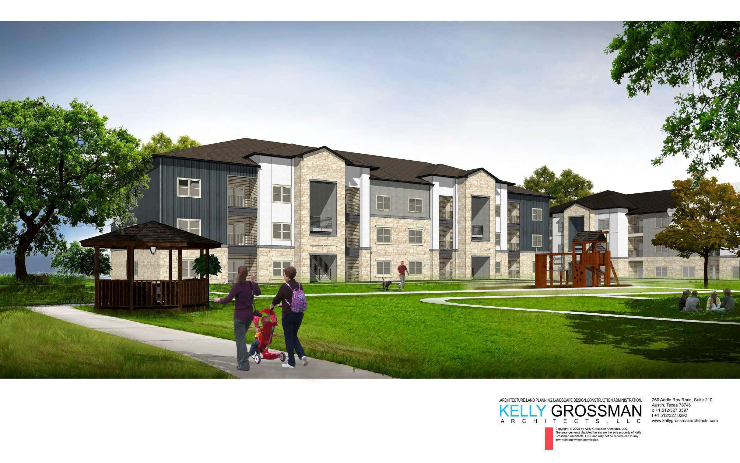

Slide 20


Thank You For Your Time
Contact Us
Claudia Mora
210-918-1284
cmora@aacog.gov
2700 NE Loop 410
Suite 101
San Antonio, Texas 78217

