Slide 1
Housing Initiatives
And Innovation in the Tulsa Region
SWREDA Conference
May 2025

Slide 2
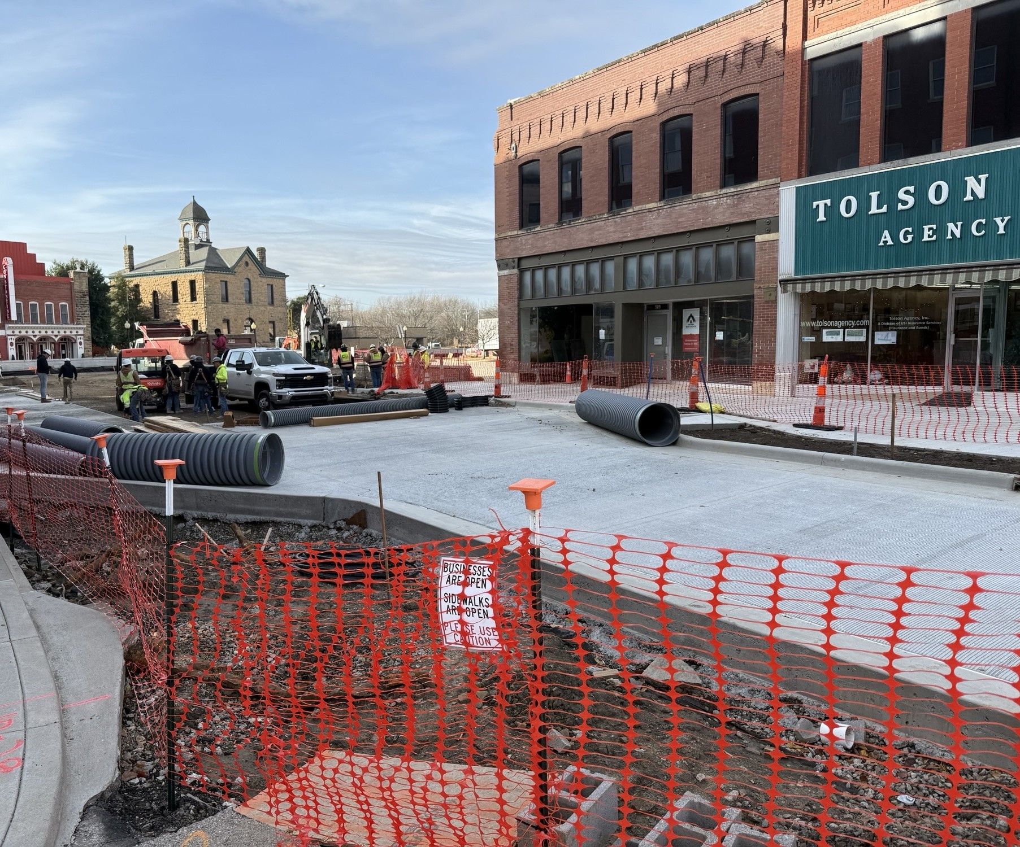
Housing & Community Development
Community Development Programs
Urban County CDBG
Small Cities CDBG Projects
REAP
Housing Programs
HOME Consortium
Affordable Senior Housing
12 Developments with 468 units
Home Buyer Assistance
New Construction
Homeless Programs
Notes:
Our division administers a variety of grant programs, primarily funded by HUD. Tulsa County is the direct recipient of HUD funds for the CDBG Urban County and the HOME Consortium. The Oklahoma Department of Commerce is the funder of the Small Cities CDBG program. REAP funds are appropriated by the State and come through ODOC to the 11 substate planning districts.

Slide 3
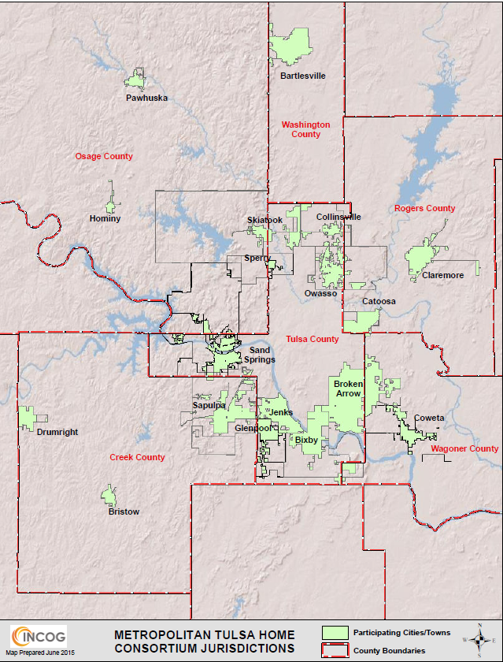
Housing Programs
Tulsa County HOME Consortium
Formed in 1994
FY2024 Allocation- $1,049,423
Serves 24 members governments in Northeastern Oklahoma in a geographic area that covers 5,291 square miles
Includes 18 cities and 6 counties with an estimated total 2023 population of 593,606
Includes rapidly growing suburban areas adjacent to the corporate city limits of Tulsa and small communities over 2,500 population, as well as the unincorporated rural areas of 6 counties
Notes:
Counties of Creek, Osage, Rogers, Tulsa, Wagoner and Washington.

Slide 4
HOME Consortium Mission:
Foster partnerships for the creation of affordable housing for low- and moderate-income people
Housing needs identified in Consolidated Annual Action Plan based on information provided by the public, local governments, lenders, and social service providers;
Partners include three designated CHDO non-profit housing partners: Vintage Housing, Community Action Resource & Development and Boomtown Development Company (Habitat for Humanity);
Certified Non-Profit Developers
Notes:
One of the primary programs of the HOME Consortium is the creation of affordable apartment units for seniors in our region. From 1996 to 2012, in partnership with Vintage Housing, created about 435 units. The statutory 20 year period of affordability has now expired on about half of the complexes. HOME funds are now being used to do major energy efficiency improvements to complexes in order to extend the life of the buildings for another 20 years. Just completed the renovation of Hickory Crossing in Sapulpa and will begin rehabilitation on Autum Park in June.

Slide 5
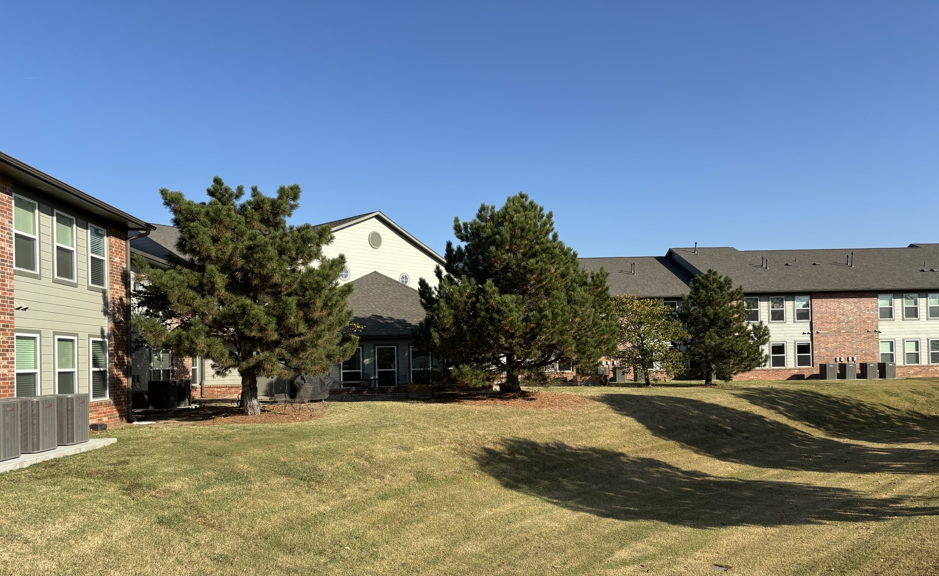
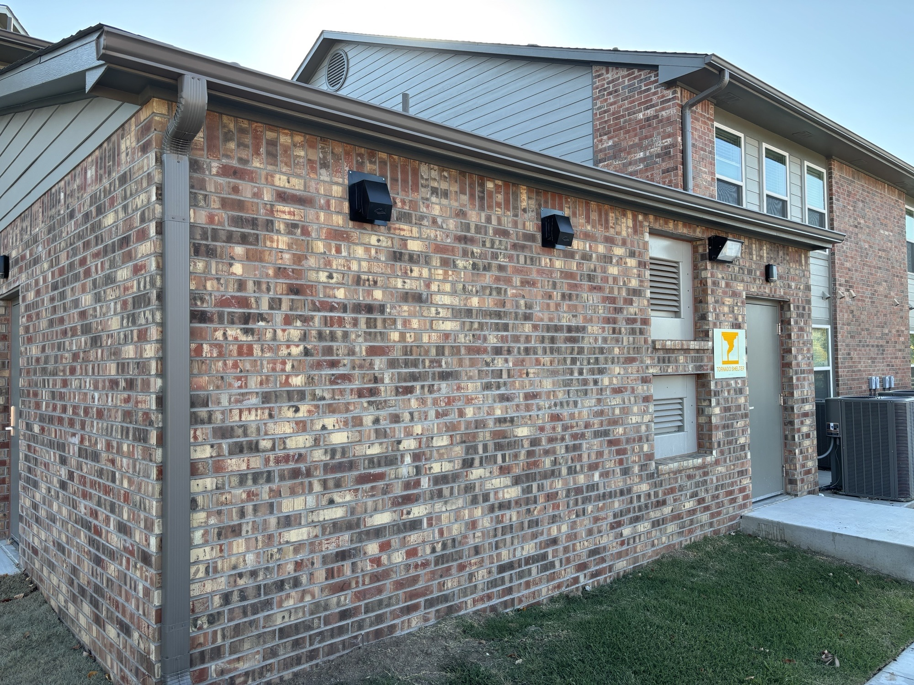
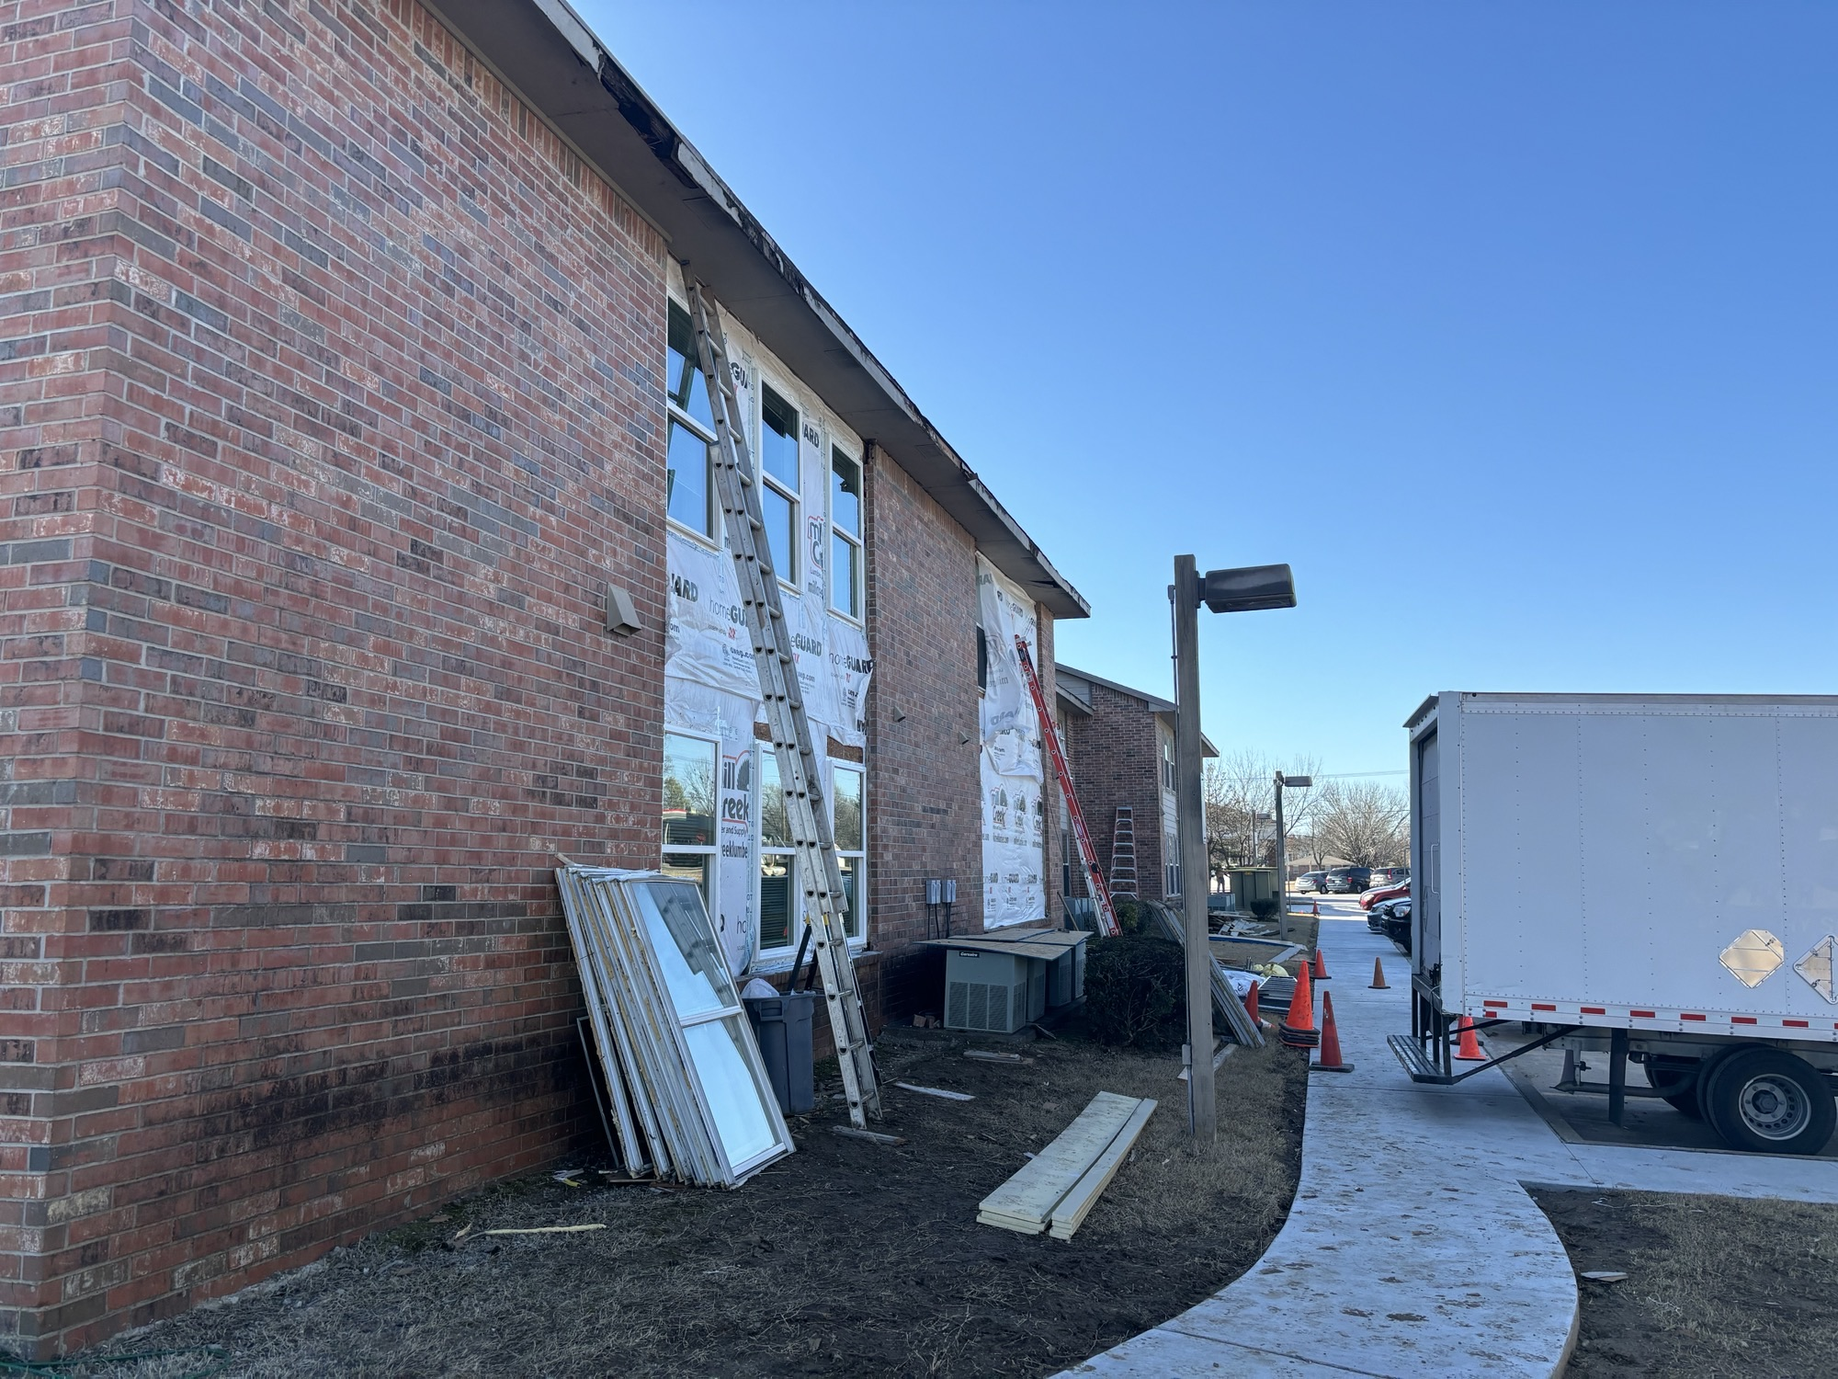
Rehabilitation of Senior Apartments
Vintage Housing Complexes
3 Completed To Date (Jenks, Coweta, Sapulpa)
Notes:
One of the primary programs of the HOME Consortium is the creation of affordable apartment units for seniors in our region. From 1996 to 2012, in partnership with Vintage Housing, created about 435 units. The statutory 20 year period of affordability has now expired on about half of the complexes. HOME funds are now being used to do major energy efficiency improvements to complexes in order to extend the life of the buildings for another 20 years. Just completed the renovation of Hickory Crossing in Sapulpa and will begin rehabilitation on Autum Park in June.

Slide 6
Rental Housing Construction
Nehemiah Community Development- Developer
Funding Partners
Tulsa Co. HOME Consortium (40%)
Federal Home Loan Bank of Topeka
Lyon Foundation
Truity Credit Union
Ribbon Cutting Phase I on August 30, 2018
18 units completed
The Cottages on 6th Street in Bartlesville
Notes:
A project that was a show stopper and highlight of our HOME program was the development of 18 units of cottage style housing in Bartlesville. These units provide housing for clients who are at risk of homelessness.

Slide 7
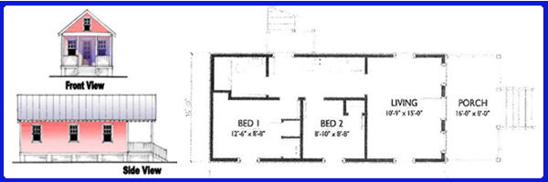
Rental Housing Construction
Phase I & II- 12 units
544 Sq. Ft. of Living Space
Living Room
Full Kitchen
Bathroom
2 Bedrooms
Phase III- 6 units
1,080 Sq. Ft. of Living Space
3 Bedrooms

Slide 8
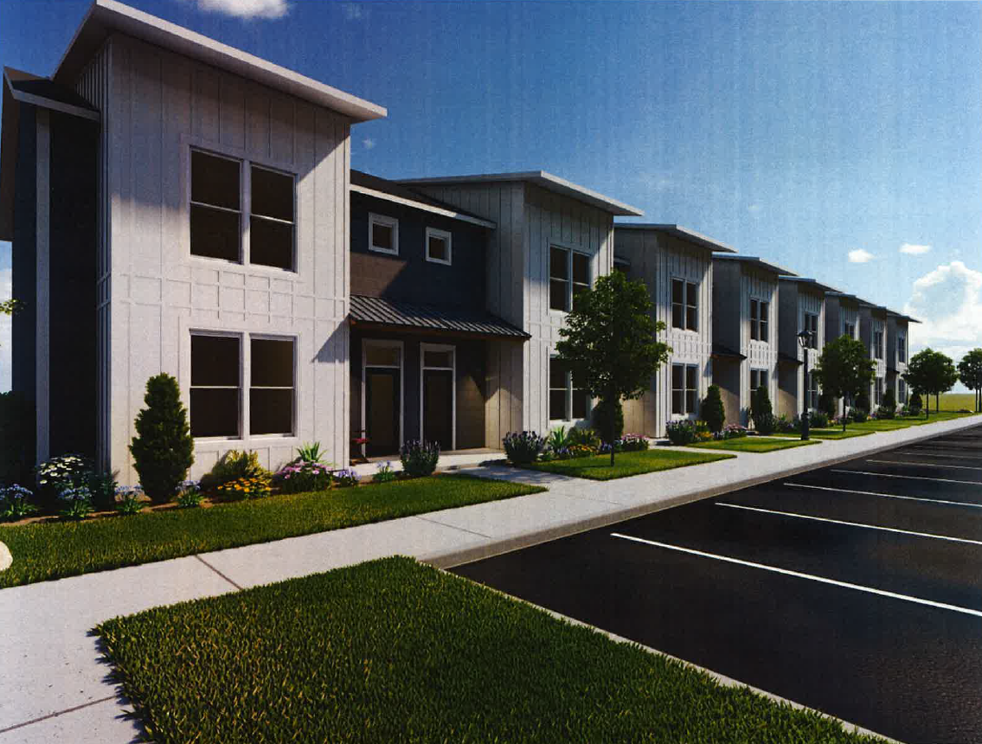
Rental Housing Construction
40 Total Units; 5 HOME Units
Total Budget $9.9 Million; $1.03M HOME
2-Story Townhomes; 3 Bedroom Units
Sources of Funds
USDA 538 Loan: $3.170M
HOME: $1.03M
Federal HLB AHP: $1.2M
OHFA Credits: $4.1M
Pioneer Townhomes Pawhuska
Notes:
New construction of apartments in Pawhuska, home of The Pioneer Woman’s business endeavors. Addressing need for housing for workers in the community. Any time housing comes up for sale, it is acquired by out of town/state owners for Air BnB.

Slide 9
Homebuyer Assistance Program
HOME-funded
Downpayment and closing cost assistance to income-eligible homebuyers
Traditional requirements such as maximum of $5,000
Provided to over 750 households since program initiated in 1994
Administered through Subrecipient partners (CAPs)
Homebuyers assisted in communities throughout the Consortium region
Assistance provided mostly in principal cities and less frequently in rural areas

Slide 10
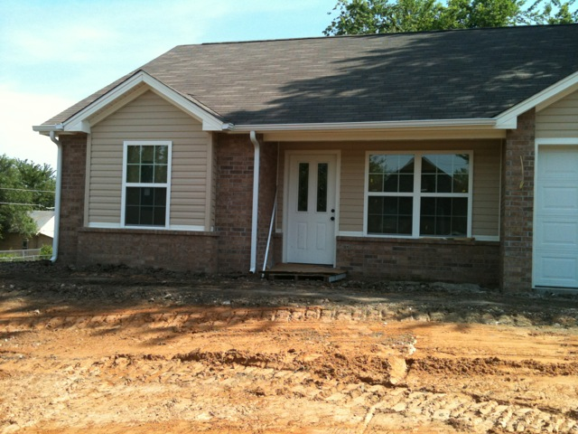
Innovative Housing Initiatives
Single Family New Construction
Provides homeownership opportunities for income eligible buyers.
Housing constructed in larger communities of region: Bartlesville, Bristow, Drumright, Claremore, Sand Springs, Tiawah
Constructed in partnership with Community Action Program

Slide 11
Types of Housing Programs Utilized
Over the past 40 years, INCOG has created affordable housing units across the Region using a wide variety of government-funded programs:
Traditional Housing Rehabilitation of single family owner-occupied units:
First through CDBG
Transitioned to using HOME when program was created
No housing rehabilitation programs in recent years because of cost to bring units into code compliance
Neighborhood Stabilization Program (NSP) operated in 3 counties:
Program designed to acquire, rehabilitate and sell foreclosed houses during 2008 housing crisis
However, Oklahoma had very few foreclosed units that met program guidelines
Acquisition and demolition, and new construction of affordable units used to produce 15 new units throughout 3 counties
Notes:
Capitalize on specialty funding programs

Slide 12
Types of Housing Programs Utilized
Housing programs to address households at risk of homelessness have been administered throughout the Region:
2009 Homelessness Prevention and Rapid Re-Housing Program (HPRP)
Provided financial assistance and services to prevent individuals and families from becoming homeless and quickly re-housed and stabilized households experiencing homelessness
Targeted to a population at-risk of homelessness through the loss of their current stable, long-term affordable housing location (the YMCA). Transitioned SRO clients to other housing and closed the Y building
Funds sub granted to homeless service providers who assisted in housing relocation and stabilization services through case management, housing search and placement services, and rental assistance.
CDBG-CV1, 2, 3 to prevent, prepare and respond to COVID-19
Program activities directed to a social services response to COVID-19
Financial assistance for short and long term rental and utility assistance
Emergency Overflow Shelter Operations

Slide 13
Types of Housing Programs Utilized
Housing programs to address households at risk of homelessness have been administered throughout the Region:
HOME-American Rescue Plan (HOME-ARP)
Provides housing, service, and shelter to individuals experiencing homeless and other vulnerable populations
On-going HUD program in RFP stage
Activities will consist of construction of Permanent Supportive Housing units and Supportive Services

Slide 14
Strategies to Develop Housing Innovations for the Region
INCOG uses a variety of strategies to think about housing creation in the Region:
Housing needs identified in Consolidated Annual Action Plan based on information provided by the public, local governments, lenders, and social service providers;
Administration of CDBG Infrastructure projects creates familiarity with needs of communities and builds partnerships with local leaders;
Long-established working relationships with member governments;
Emphasis on matching available resources with needs and focus on implementation;
Over time, established close relationships with non-profits and other community-based professionals;

