Slide 1
A Closer Look at the CEDS
2025 SWREDA Annual Conference Las Cruces, NM

Slide 2
Today’s Presenters
Brett Schwartz, Associate Director NADO Research Foundation (CA)
Emily Martinez, Executive Director Coastal Bend Council of Governments (TX)

Slide 3
More info at: www.nado.org/EDDCoP

Slide 4
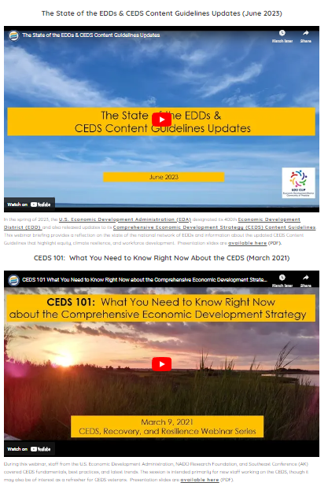
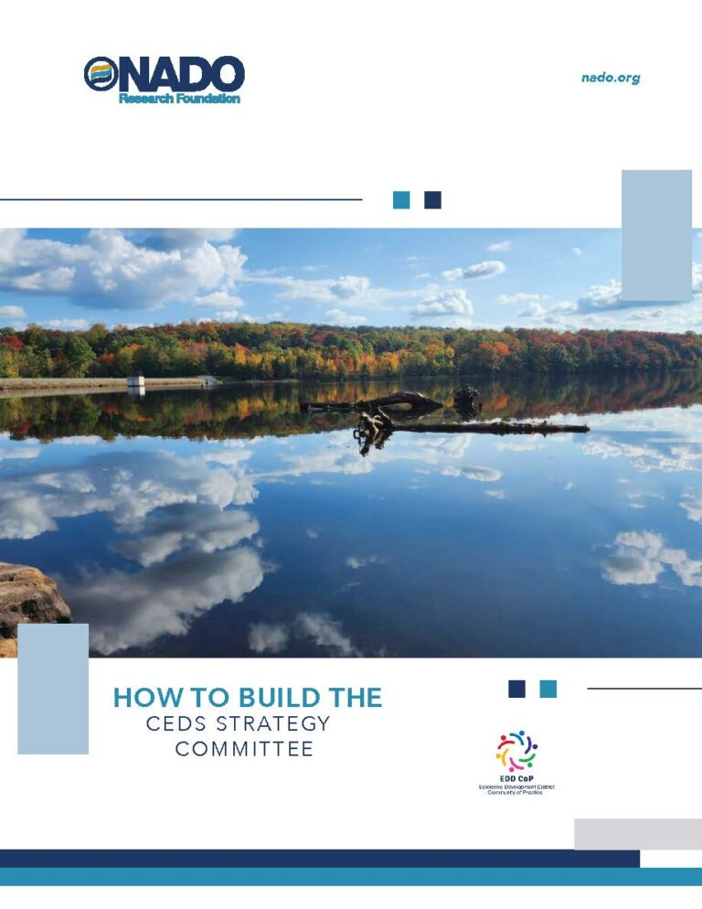
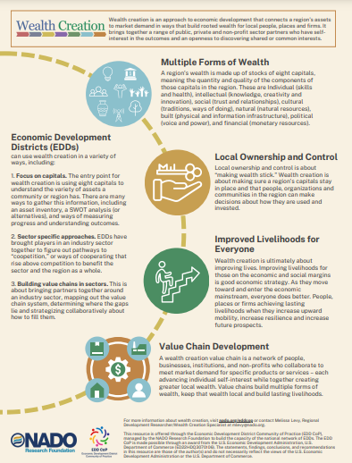
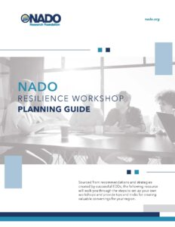
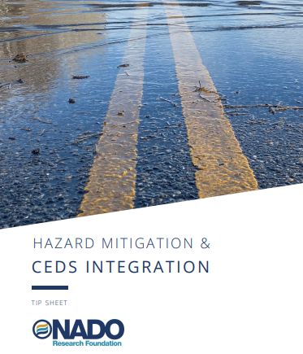
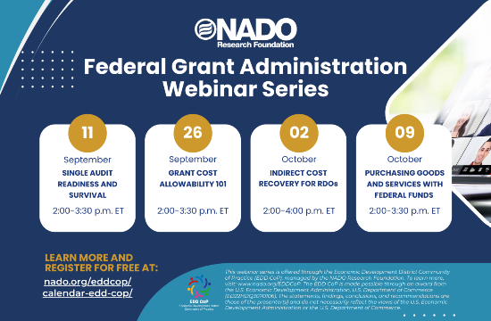
Visit: www.nado.org/eddcop

Slide 5
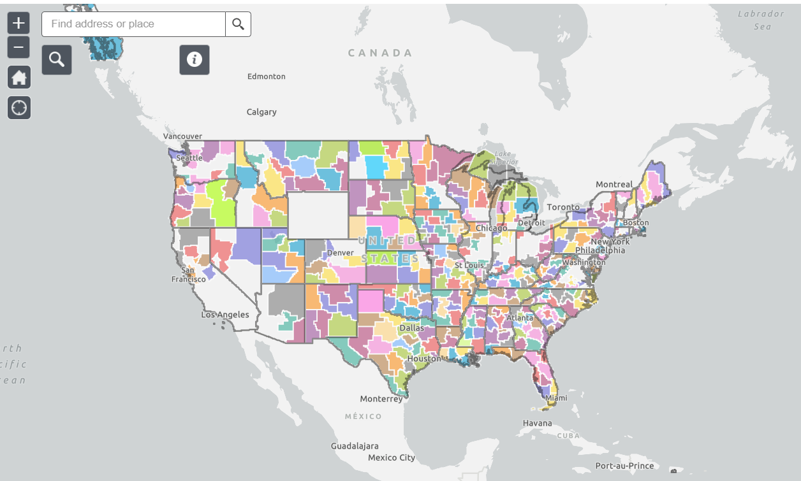
Interactive EDD Map available at: www.nado.org/EDDMap

Slide 6
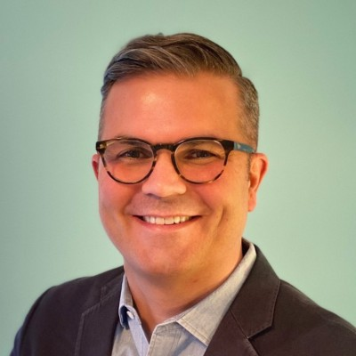
Good economic development…starts with good economic development planning!
- David Ives, US EDA

Slide 7
CEDS Help Build Regional Capacity
Volume and complexity of federal support for economic development can be difficult to navigate.
New funding and programs from an array of agencies
Eligibility, timing, procedures vary
Capacity required to assess, compete, implement
EDDs are essential convenors, curators, connectors, networkers, facilitators and implementors for advancing regional and statewide CEDS.
CEDS process is a crucial forum for scanning, prioritizing and coordinating a strategic, regional approach for the integrated use of myriad local, state and federal funds.

Slide 8
4 Ways to Think About the CEDS...

Slide 9
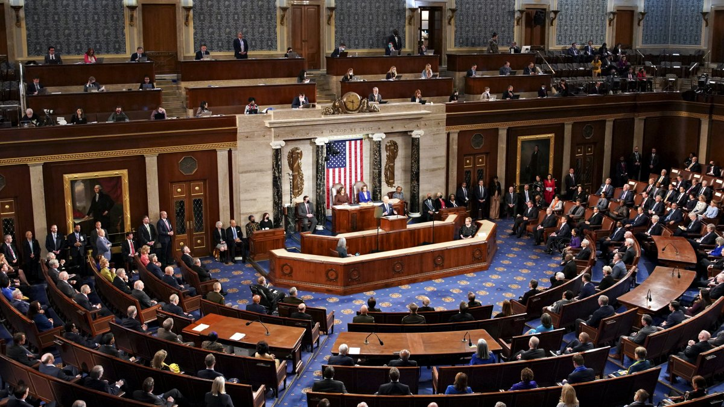
The CEDS is Your Region’s “State of the Union”
NBC4 News

Slide 10
The CEDS is Your Region’s Strategic Plan
Harvard Business School

Slide 11
The CEDS is a Roadmap for Regional Economic Development
Francesco Paggiaro

Slide 12
The CEDS is a Conduit of Resources to Your Region

Slide 13
How Do You Think About Your Region’s CEDS?

Slide 14
The CEDS

Slide 15
What is the CEDS?
The Comprehensive Economic Development Strategy (CEDS) is a locally-based, regionally-driven economic development planning process and document that creates the space for your region to identify its strengths and weaknesses and brings together a diverse set of partners to create good jobs, diversify the economy, and spur economic growth.

Slide 16
A Brief History of EDA, EDDs, and the CEDS
EDA was established through the Public Works and Economic Development Act of 1965 with the purpose of facilitating public works projects, creating jobs, and building local capacity in distressed rural regions of the United States
This was followed by the creation of a network of Economic Development Districts in 1966 to serve as multi-county economic development entities that would be professionally staffed and provide local technical assistance and support in accessing federal and state resources
EDDs were required for decades to maintain an Overall Economic Development Program (OEDP) as a prerequisite for funding
The OEDP was replaced by the more streamlined Comprehensive Economic Development Strategy (CEDS) as part of the 1998 EDA Reauthorization
The 2015 CEDS Content Guidelines Updates offered recommendations and examples about how to complete the required sections of CEDS and also introduced the concept of economic resilience
New recommended sections in the CEDS were offered in 2023: equity, climate resilience, and workforce development. In 2025, the sections on equity and climate resilience were removed.
In the almost 60 years since the first-ever EDD was designated in Texas, the network has grown to over 400 organizations that cover around 85% of U.S. counties

Slide 17
Additional Details
Required for designation as an Economic Development District from U.S. EDA
Tribes and some states and municipalities also maintain a CEDS
Updated every five years with annual reports
Submitted to EDA regional office for approval
A CEDS Committee should be organized that “must represent the main economic interests of the Region”
Requirement for various EDA funding including EDA’s Public Works and Economic Adjustment Assistance programs & other funding

Slide 18
What are the Required Sections of the CEDS?
Summary Background: A background summary of the region should answer the question, “What have we done?” and present a clear understanding of the local economic situation, supported by current, relevant data.
SWOT: A SWOT analysis of the regional economy should answer the question, “Where are we now?” by using the relevant data and background information to help identify the critical internal and external factors that speak to the region’s unique assets and competitive positioning.
Strategic Direction/Action Plan: The strategic direction and corresponding action plan contained within the CEDS are the heart and soul of the document. They should answer the questions “Where do we want to go?” and “How are we going to get there?” by leveraging the analysis undertaken in the SWOT.
Evaluation Framework: The evaluation framework helps answers the question “How are we doing in meeting our goals?” and serves as a mechanism to gauge progress on the successful implementation of the overall CEDS while providing information for the CEDS Annual Performance Report.
Economic Resilience: In building economic resilience, it is critical that economic development organizations consider their role in the pre- and post-incident environment to include steady-state and responsive initiatives.

Slide 19
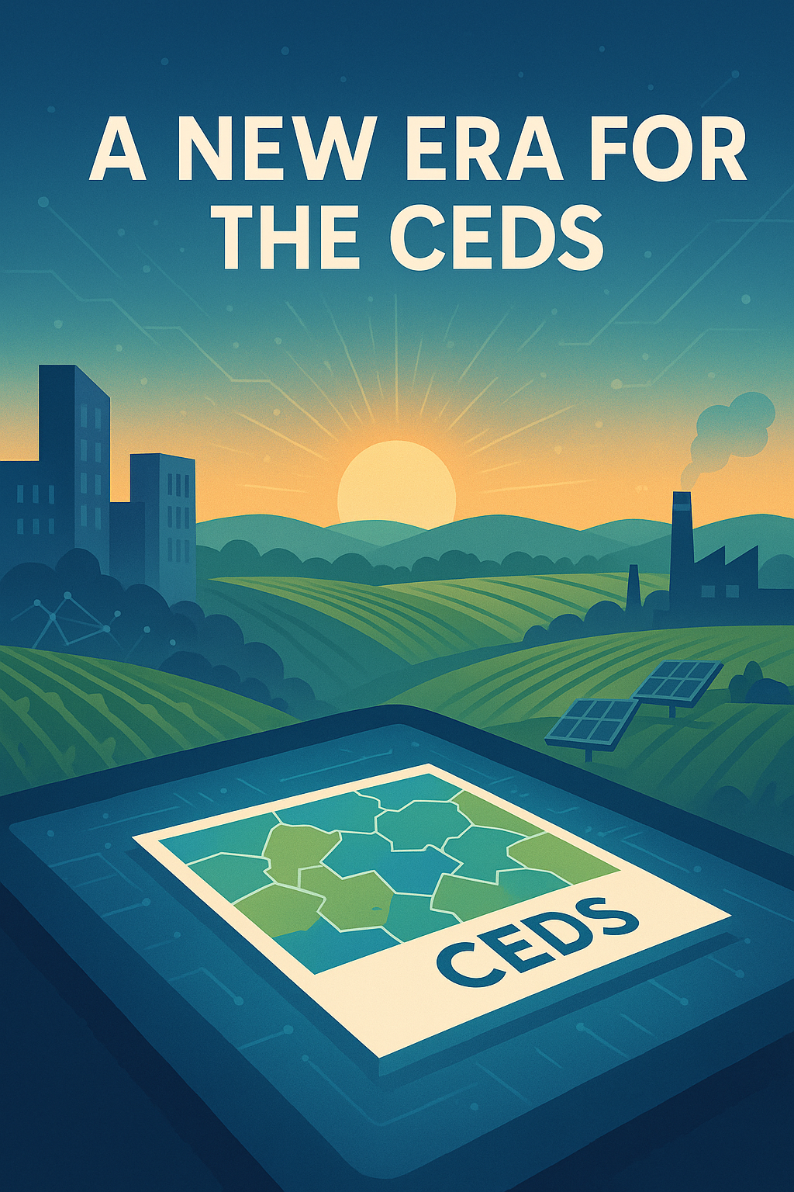
Rawpixels.com

Slide 20
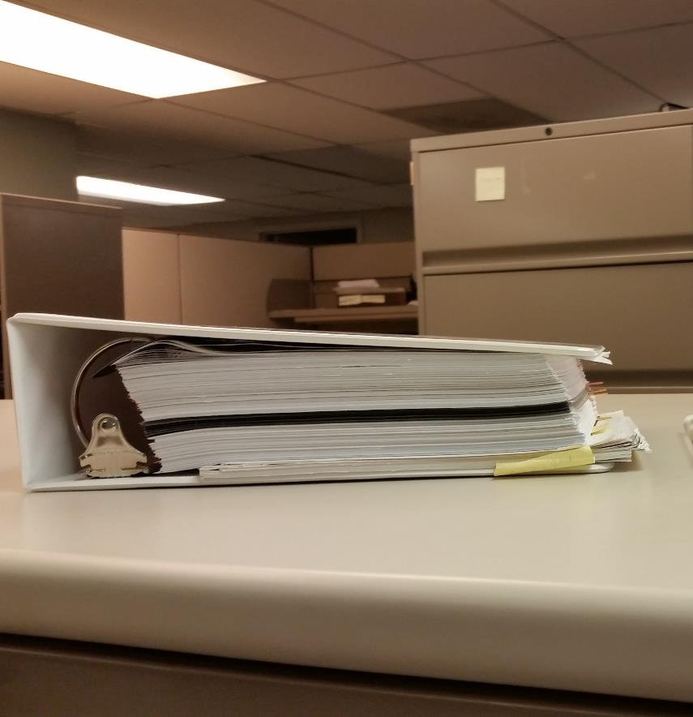
The “Door Stopper” CEDS Era (~ 20 years ago)

Slide 21
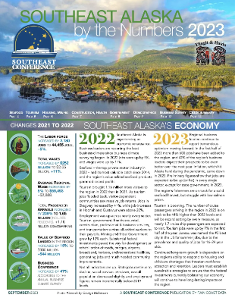
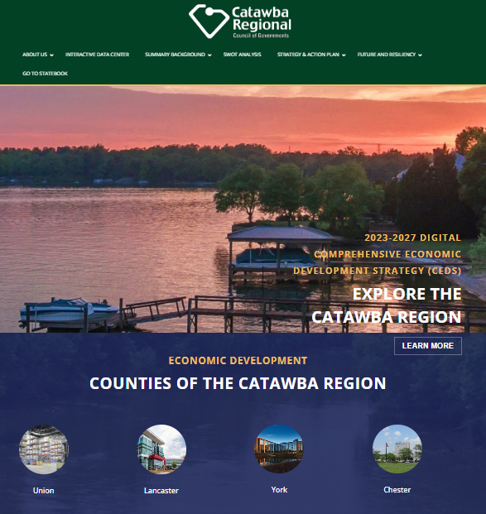
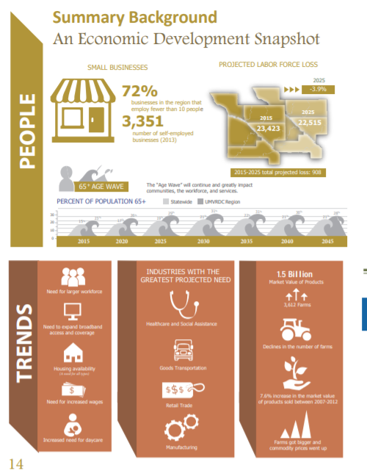
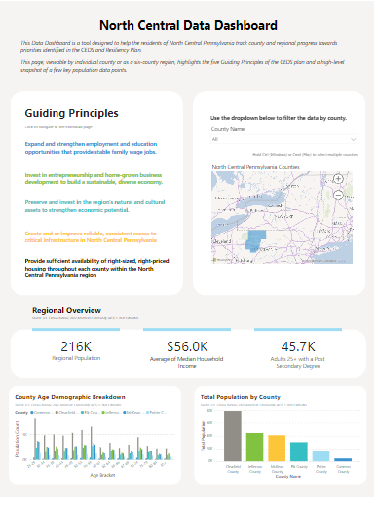
What Do Today’s CEDS Look Like?

Slide 22
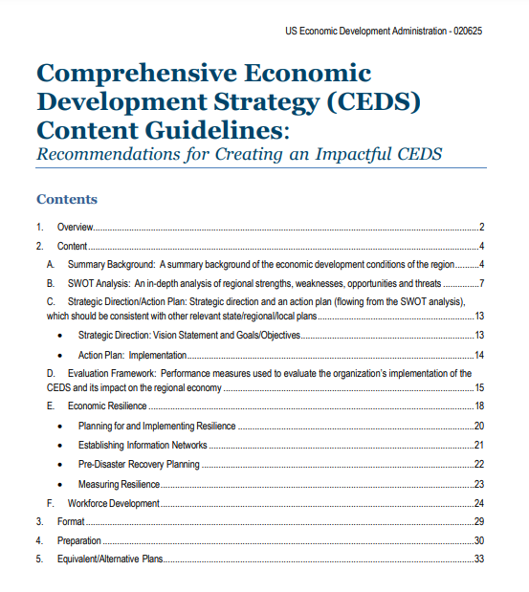
CEDS Content Guidelines
Intended to help regional planning organizations craft more impactful CEDS
Provides guidance on the required sections of the CEDS
Summary Background
SWOT
Strategic Direction/Action Plan
Evaluation Framework
Economic Resilience
Focused on best practices, case studies, and links
Collection of suggestions and recommendations. . .not a list of additional requirements
https://www.eda.gov/CEDS

Slide 24
Latest CEDS Guidance (April 2025)
In-Process CEDS: CEDS that are under development (i.e., in any stage of development prior to EDA final approval) should have all references to and sections about equity and/or climate removed from the document.
Previously-Approved CEDS: CEDS that have been previously approved (prior to the change in Administration) by EDA do not need to be changed or altered in order to remove references or sections related to climate or equity. While voluntary changes to remove such language outside of the regular 5-year update process will be allowed (e.g., as part of an annual update), no changes will be required before the regular 5-year update. However, as part of the regular 5-year update, it will be expected that grantees make changes to their CEDS as noted above for in-process CEDS.

Slide 25
Investment Priorities
Critical Infrastructure
Workforce
Innovation & Entrepreneurship
Economic Recovery Resilience
Manufacturing

Slide 26
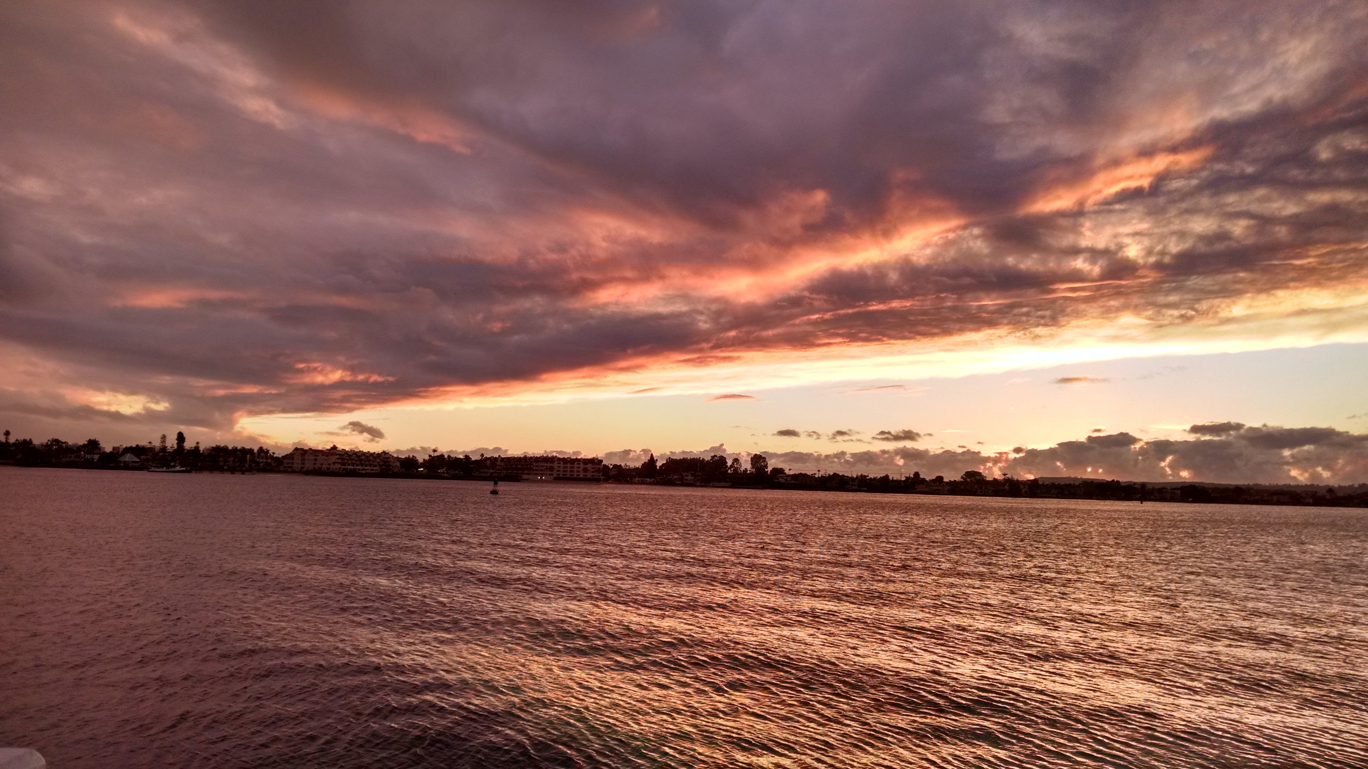
Resilience: The ability of a region or community to anticipate, withstand, and bounce back from shocks, disruptions, and stresses including:
Weather-related disasters or hazards
The closure of a large employer or military base
The decline of an important industry
Changes in workforce / effects of automation
COVID-19 response & recovery
Much more…

Slide 27
Flickr User: Syahmir
Flickr User: Dave Gingrich
Flickr User: Aaron Rosenberg
Pexels

Slide 28
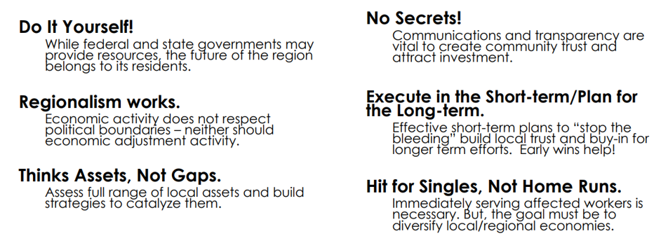
Regional Economic Development & Diversification Cheat Sheet

Slide 29
CEDS Outreach & Engagement

Slide 30
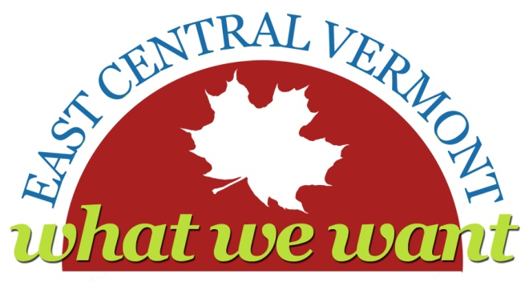
Language Matters Two Rivers-Ottauquechee Regional Commission (VT)
Remember to be from this PLANET…not the PLAN
X Regional Sustainability Plan for the Two Rivers-Ottauquechee/Southern Windsor County Region
X East Central Vermont Regional Sustainable Development Plan
East Central Vermont: What We Want
Use Words that Humans on Earth Use!
Then they will care: housing our homes
Then they will think you are talking about them: transit-dependent populations our elders and youth
Then they will understand: Multi-modal systems cars, buses, walking, and bikes
Thanks to Kevin Geiger, Senior Planner, Two Rivers-Ottauquechee Regional Commission

Slide 31
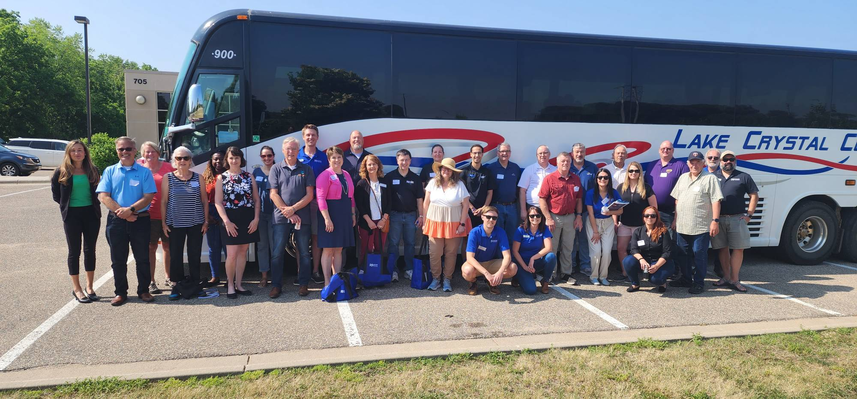
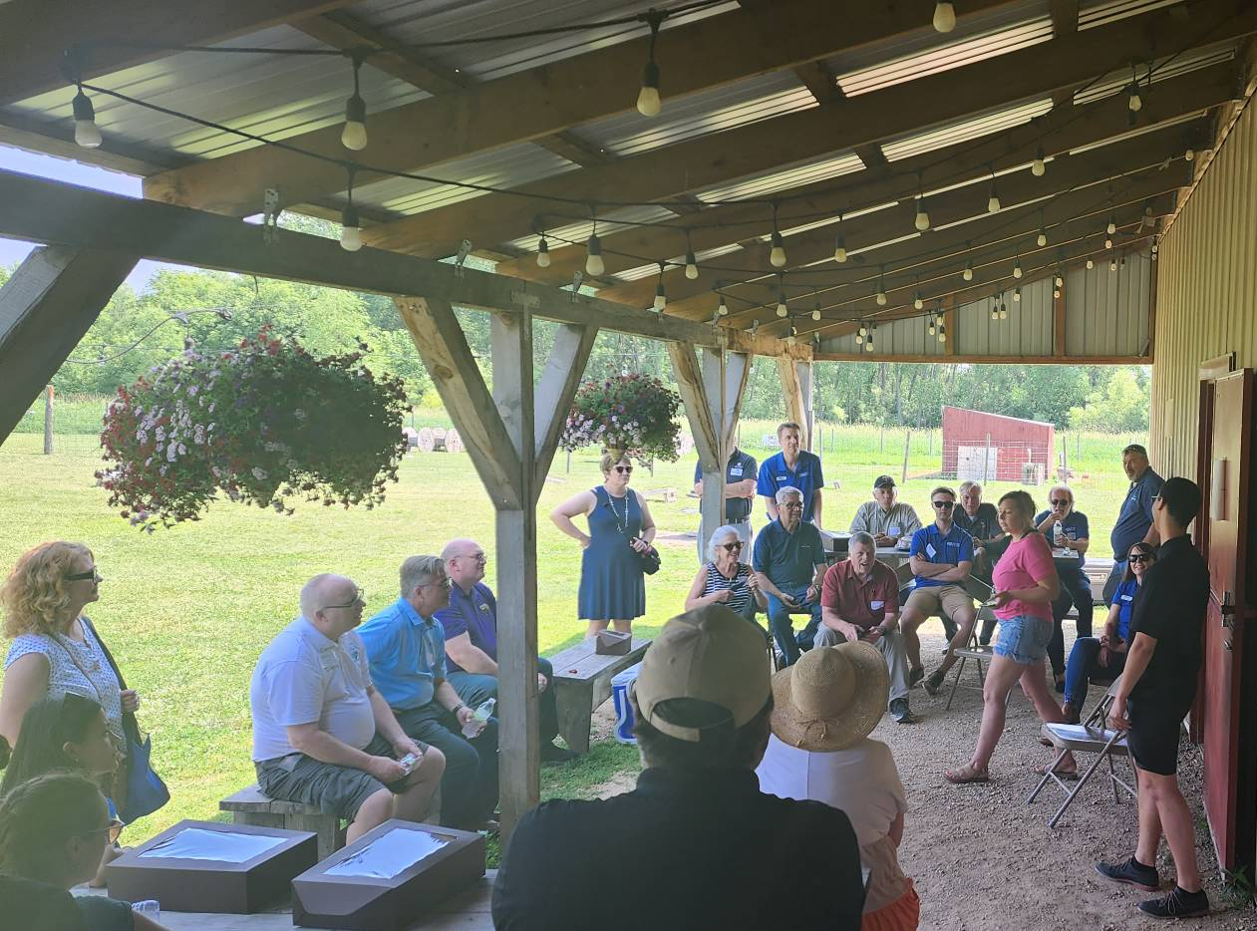
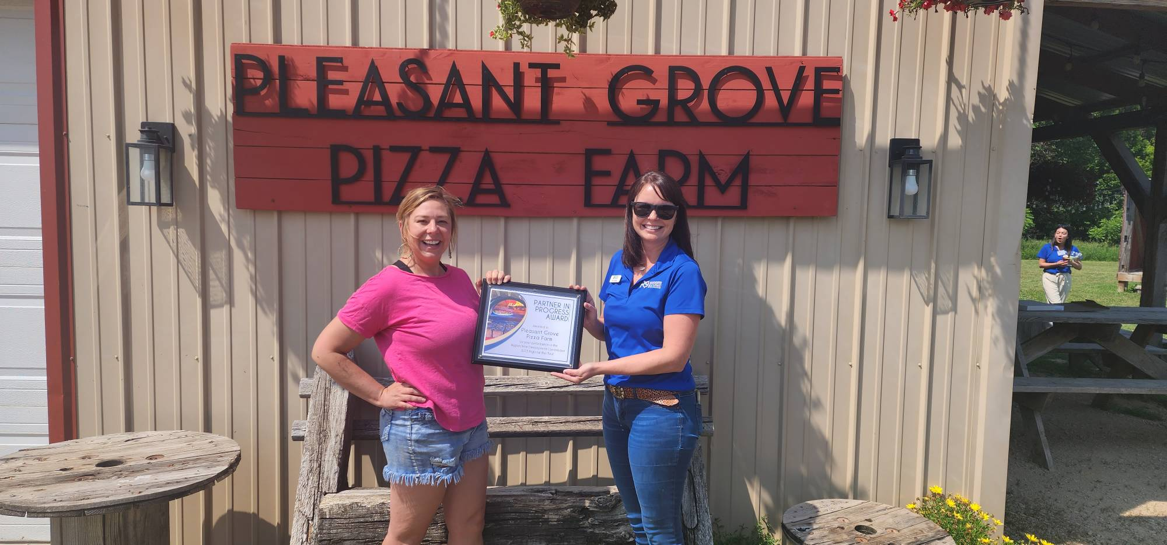
Get Out in the Community with Partners and Funders Region Nine Development Commission (MN)

Slide 32
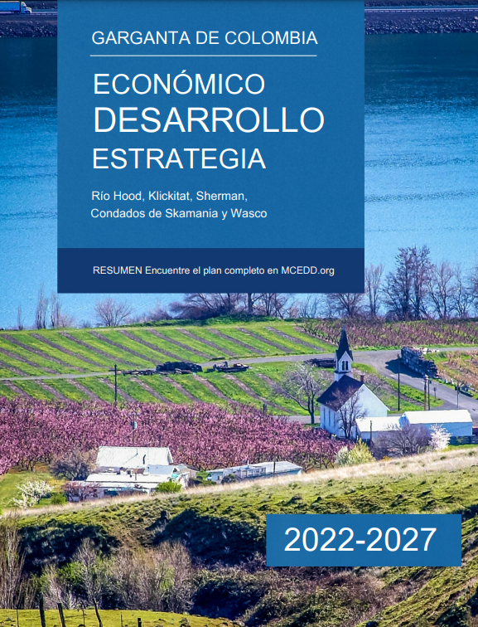
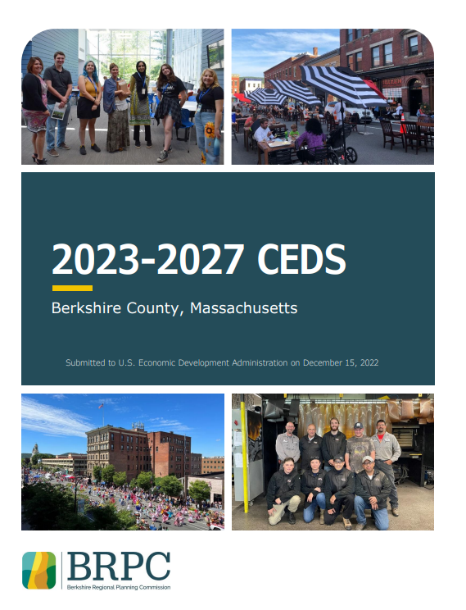
Partner with Local Non-Profits and Community-Based Organizations Mid-Columbia EDD (OR/WA) + Berkshire Regional Planning Commission (MA)

Slide 33
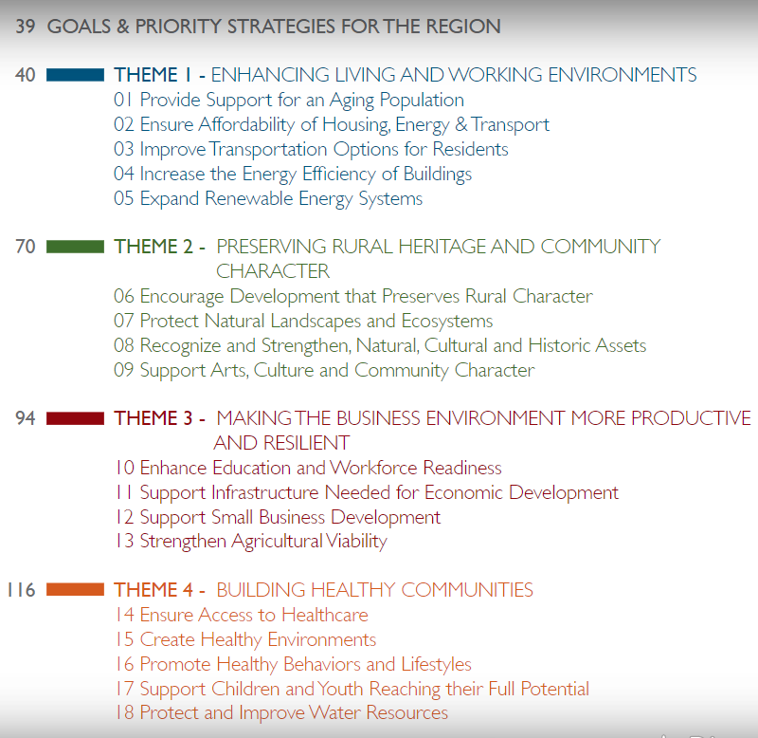
Engage with Philanthropic Partners
New River Valley Regional Commission (VA)
New River Valley Regional Commission (VA)

Slide 34
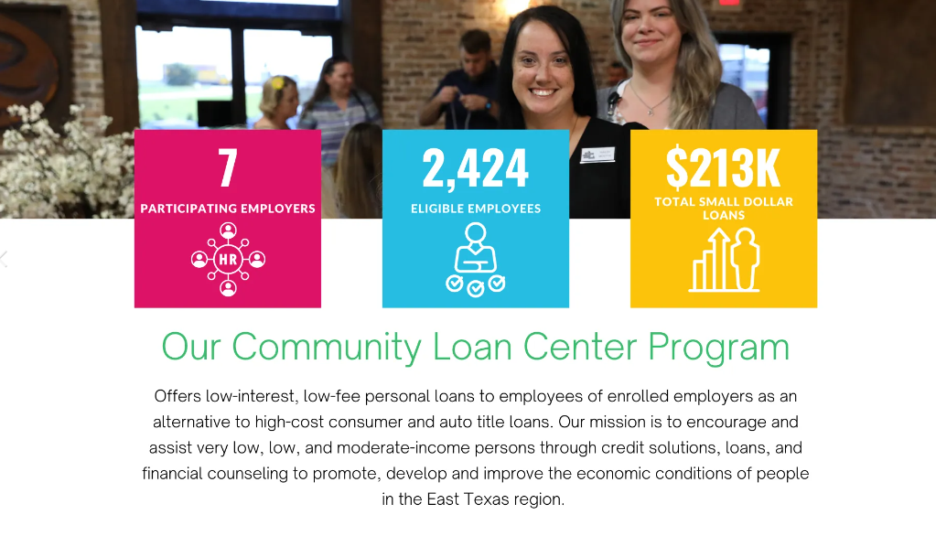
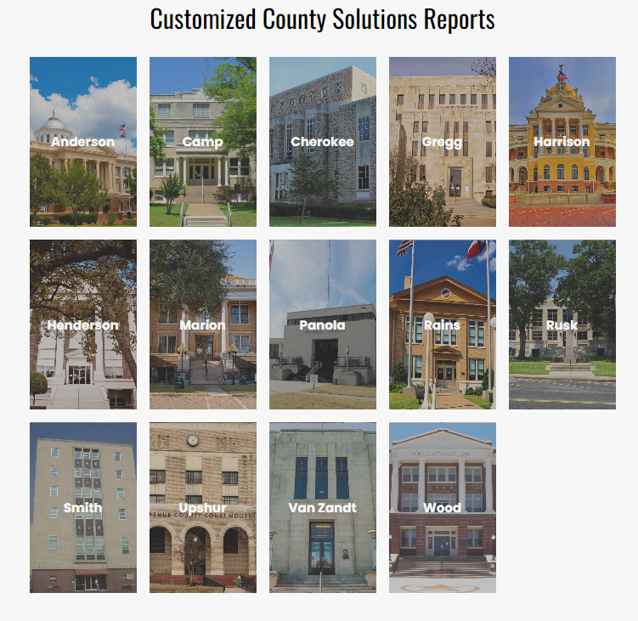
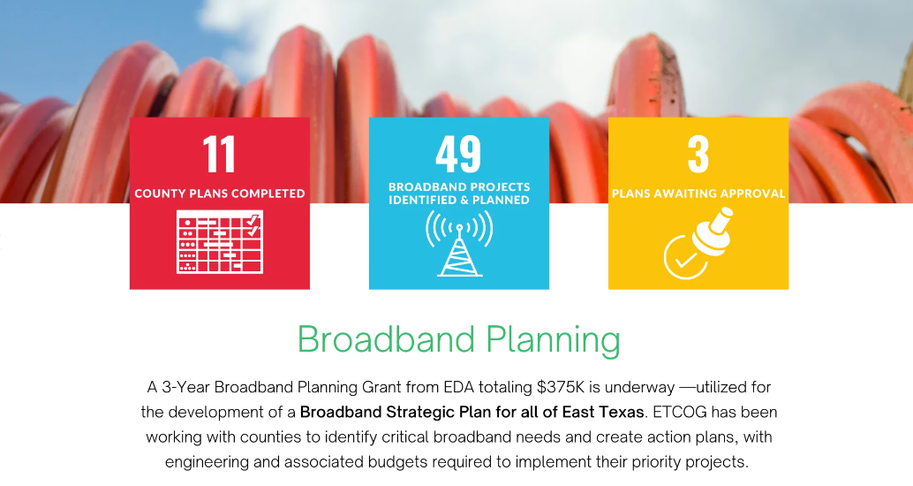
Document and Share Your Impact with Members & Partners East Texas Council of Governments
https://www.etcog.org/solutions-reports

Slide 35
Creative
Engaging
Driven by Data
Storytellers
The Most Impactful CEDS Are:

Slide 36
www.CEDSCentral.com

Slide 37
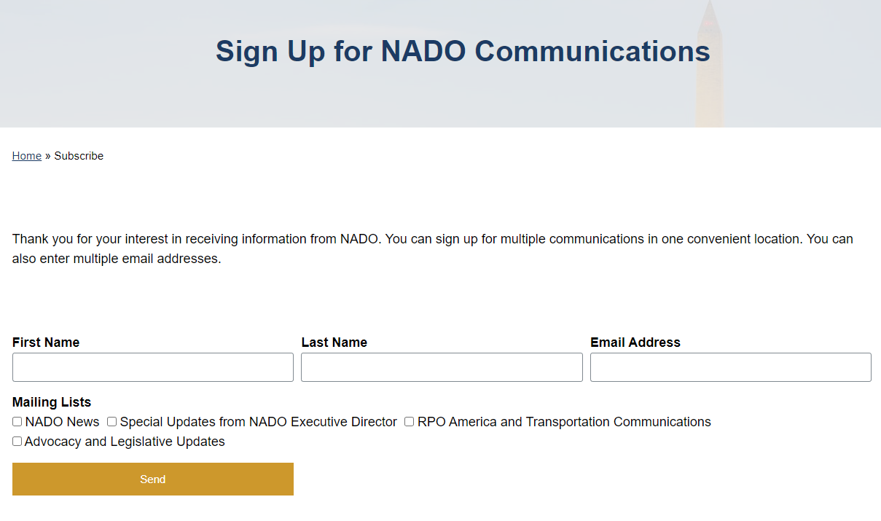
https://www.nado.org/subscribe/

Slide 38
Stay in Touch!
Brett Schwartz Associate Director NADO Research Foundation
bschwartz@nado.org

Slide 39
Regional Resiliency Partnership
A Comprehensive Economic Development Strategy

Slide 40
ABOUT
CBCOG
Established 1966
Covers 11 Counties
6 Coastal Counties
Serves 35 Cities
10,273 square miles
Close to 600,000 Texans in region
Sensitive ecosystem of Bays, Estuaries and Islands
Home to many endangered species, including turtles and whooping cranes
Home to largest Port in US by tonnage

Slide 41
Unique Vulnerabilities
Hurricanes
&
Tropical Storms
Oil Economy
Water Supply
Uncertainty

Slide 42
Limited Access to Resources
Verifiable Data
Environmental Science
Human Capital
Political Acumen
Economic Trends
Infrastructure Knowledge

Slide 43
MOU between Coastal Bend Council of Governments and Texas A&M Corpus Christi Harte Research Institute
Key Partners in CEDS planning
Action Team designed to respond in real time to crisis
The Solution

Slide 44
Regional Resilience Partnership
Purpose and Actions
Provide Scientific and Technical advice, training and capacity building
Promote interchange between University and Local Officials and experts for investigating, training and teaching
Simplify access and exchange of information
Aid Coastal Bend Communities in identifying and Prioritizing Risk
Build strategic partnerships and funding strategies to mitigate risk
Provide resources for the development of programs or projects
Build and Develop a Sustainable Funding Model to continue RRP Initiatives

Slide 45
CEDS 2021
Content Rich
Graphic Format
High Visual Appeal
Designed as an Action Plan
Targeted Users: Economic Developers, Professional and AdHoc Grant Writers, Elected Officials, Community Leaders, Industry Leaders, Other Stakeholders

Slide 46
Strategic Planning
Ready to Implement Plans
Clear, actionable items
User friendly for smaller communities

Slide 47
RRP IN ACTION
Gregory Water Line
CEDS Goal 2: Strengthen Resilient Infrastructure Investments
CBCOG wrote grant (gratis); City of Gregory contracted CBCOG to administer project
Construction Started 4/28/2025

Slide 48
RRP IN ACTION
Broadband Collaboration
CEDS Goal 2: Strengthen Resilient Infrastructure Investments
Mission Critical to infrastructure and resilience
RRP served as moderator to convene Regional Stakeholders
Included County Judges, IT Professionals, City Leaders and engineers
Identified potential funding
Set tone for future initiatives

Slide 49
RRP IN ACTION
Workforce & Economic Development Accellerator
$1,000,000 ARPA Funds through EDA
CEDS Goal 3: Promote Workforce Agility
Partners:
TAMUCC (CEDS Committee Member)
UTSA
CBCOG

Slide 50
RRP IN ACTION
GeoRED
CEDS Goal 4: Support Community Well-Being
Collect GIS Data for region to identify high risk areas
Started with Aransas, Bee, Refugio, and San Patricio Counties
Added Nueces, Jim Wells, Kleberg
Train practitioners in counties to use data for real-time response
Provides full time Coordinator to outreach and assemble stakeholders, gather and distribute data
Adding additional layers for Situational Awareness Tool, Flood Study & others

Slide 51
Looking to the Future
Incorporate new partners such as The Water Institute
Focus CEDS on economic development for rural counties

Slide 52
Transportation Planning
In partnership with TxDOT and the Corpus Christi MPO, CBCOG looks to provide comprehensive transportation planning, particularly in the rural areas

Slide 53
Broadband Planning
In partnership with Stakeholders, CBCOG looks to provide comprehensive telecommunications planning, particularly in the rural areas

Slide 54
Capacity Building
Assist smaller rural communities acquire and manage funds to build critical infrastructure

Slide 55
CEDS 2026
Increased Rural Representation
Interactive Online
High Visual Appeal
Designed as an Action Plan
Targeted Users: Economic Developers, Professional and AdHoc Grant Writers, Elected Officials, Community Leaders, Industry Leaders, Other Stakeholders

Slide 56
Emily Martinez
Executive Director
Coastal Bend Council of Governments
emily@coastalbendcog.org
o. 361-883-5743
c. 361-815-5444

