Slide 1
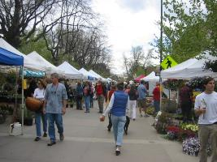
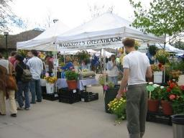
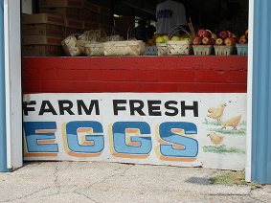
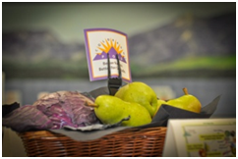
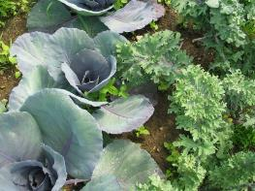
Food Roots, Stronger Economies: Local Systems in Action
2025 Economic Development Conference for the EDA Denver Region
April 2025

Slide 2
Food Systems Panel of Speakers
Willie Wilkins, CSU Extension, Moderator
Dawn Thilmany, CSU Dept of Ag and Resource Economics
  Local Food Economics Community of Practice
  USDA Regional Food Business Centers
Brian Coppom, Colorado Dept of Agriculture
  An Overview of Funding Strategies and Initiatives in the Local and Regional Food System Space
Libby Christensen, CO Food Systems and Food Business Center lead
  Best Practices and Collaborations in the Colorado Food Start-Up Space
Michael Gabel, CSU SPUR Food Innovation Center
  Food Business Development Trends and Opportunities
Notes:
Willie….do you need full bios? I think we are all ok just introducing ourselves

Slide 3
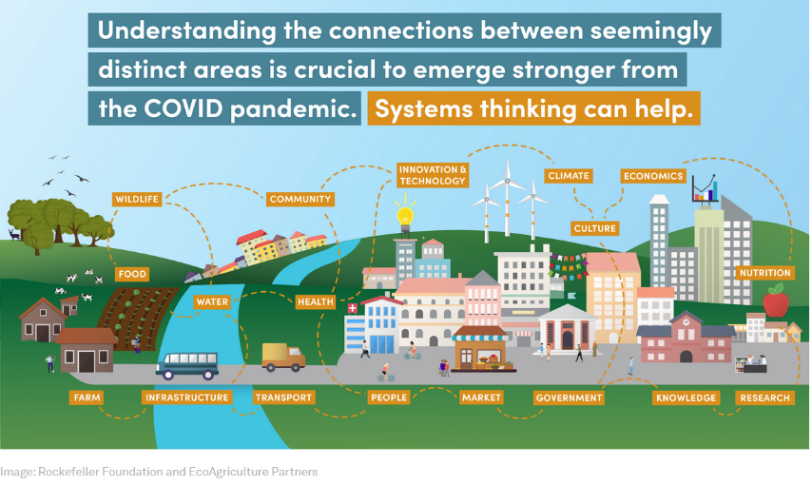
Food Supply Chain Disruptions: COVID & New Policy Dynamics
Short Chain systems
increasingly popular
increasing public funding
Resiliency implications ??
New Policy levers….
New funding strategies…..

Slide 4
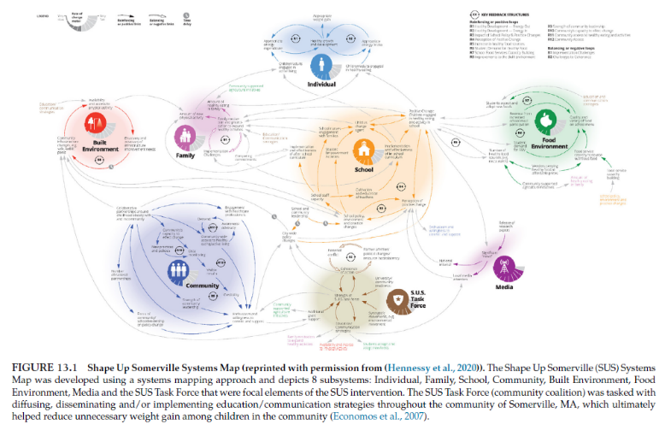
Drivers of Resiliency: The Players and the Environment
Peters and Thilmany, 2021. Food System Modeling https://www.sciencedirect.com/book/9780128221129/food-systems-modelling. Chapter 10.

Slide 5
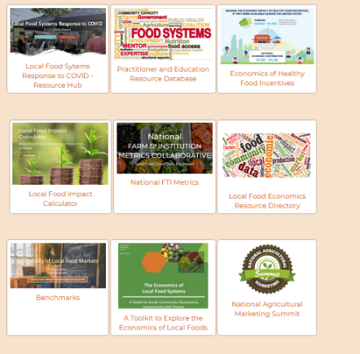
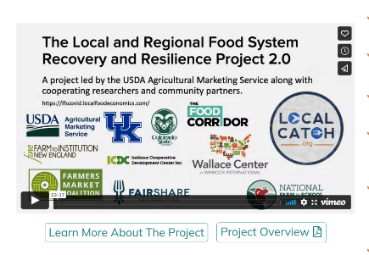
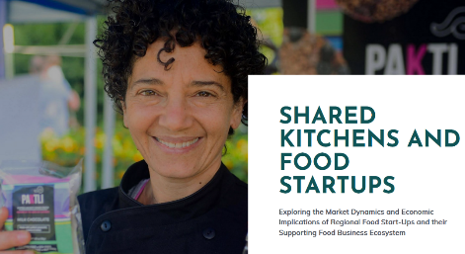
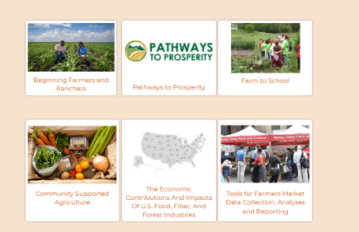
Growing Community of Practice: localfoodeconomics.com/

Slide 6
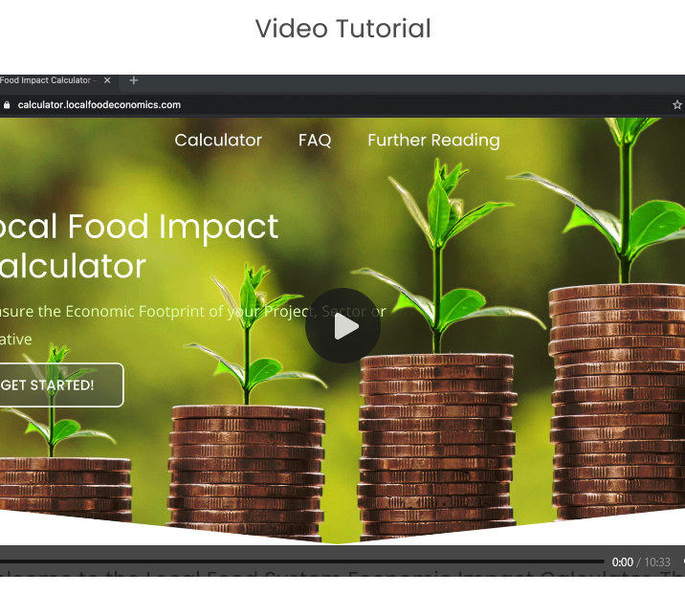
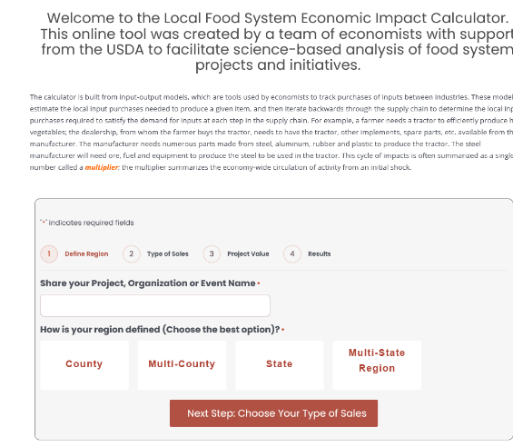
An Online Tool to Explore Economic Contributions/Impacts https://calculator.localfoodeconomics.com/

Slide 7
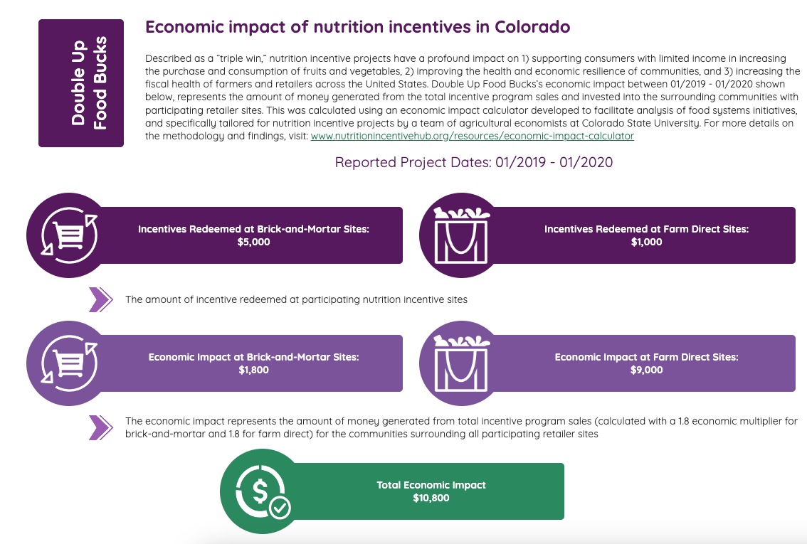

Slide 8

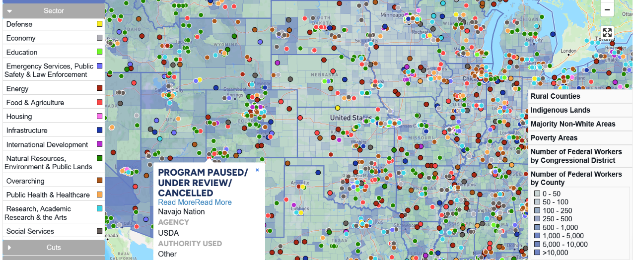


Changing Winds for Funding…..
https://docs.google.com/forms/d/e/1FAIpQLSdzDEb15pqDIZj6_qyaKLzqJXRmAFug7w0rdQaH_thq_wtM5w/viewform
https://theimpactproject.org/the-impact-map/

Slide 9
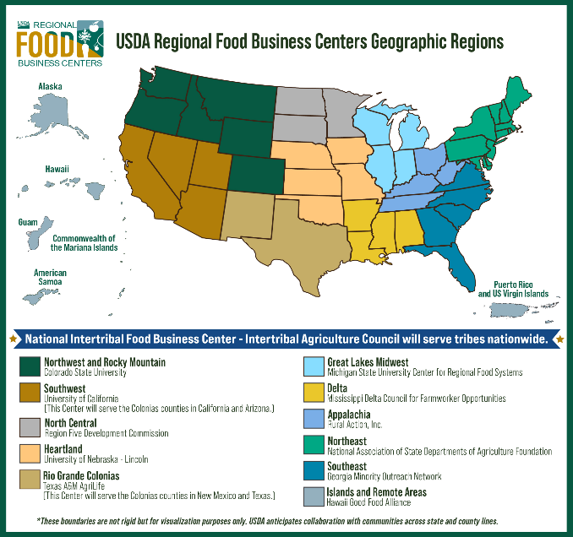
Goal: Support a more resilient, diverse, and competitive food system by providing localized assistance to local and regional supply chain, linking producers to wholesalers and distributors. Centers have three main responsibilities:
Coordination
Technical Assistance
Capacity Building
Notes:
Awarded amounts ranged from $15-50M over 5 years

Slide 10
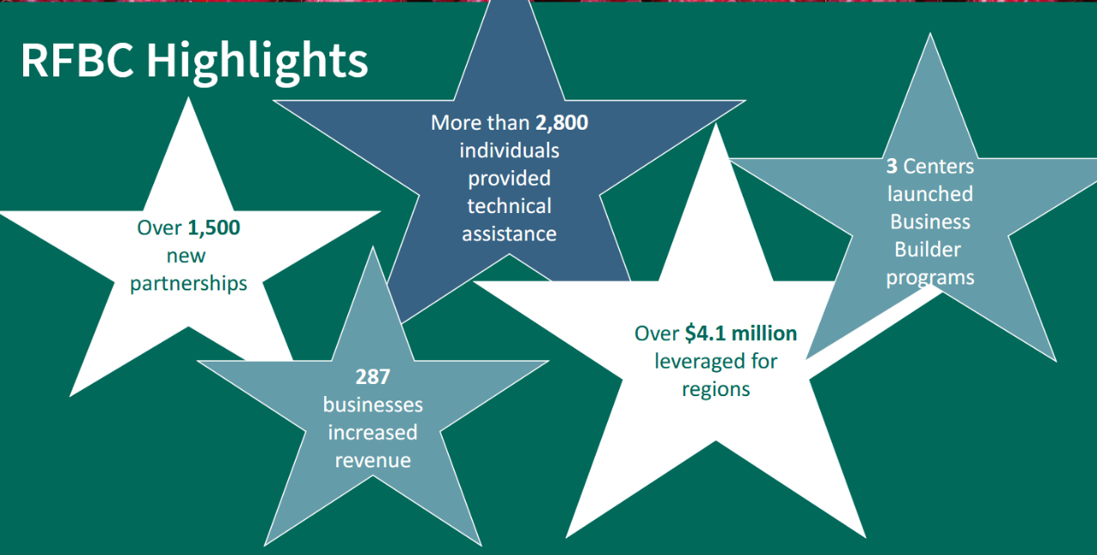
Year 1

Slide 11
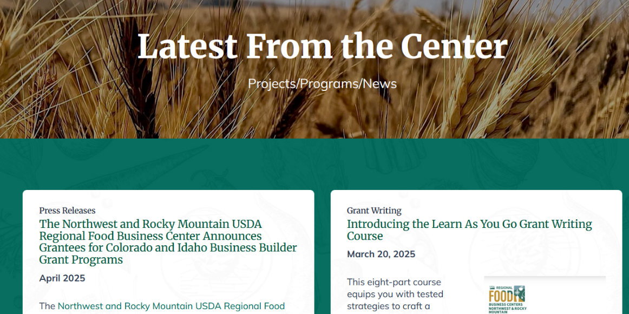
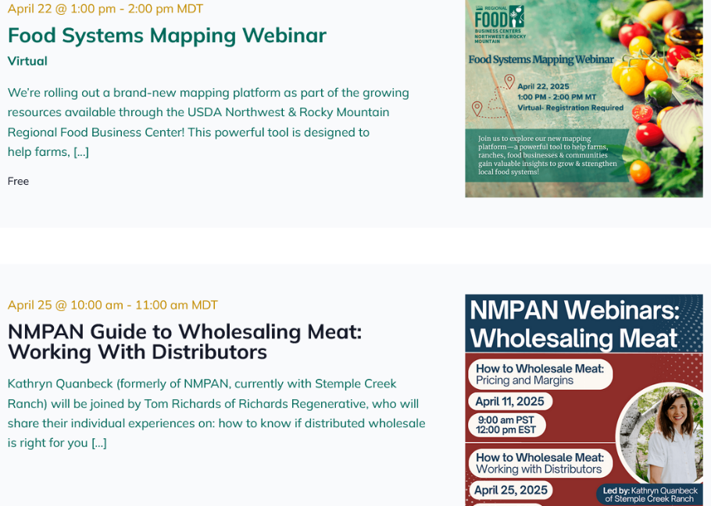
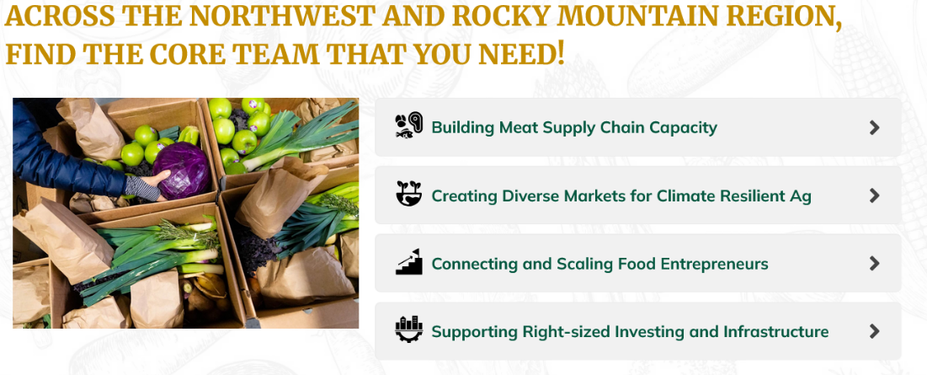
https://nwrockymountainregionalfoodbusiness.com/contact/

Slide 12
Food Financing Dynamics
Brian Coppom
Notes:
Now we will switch gears a bit to have Brian Coppom share insights on the changing funding landscape, both from the CO Dept of Ag but across the broader set of funders in this arena

Slide 13
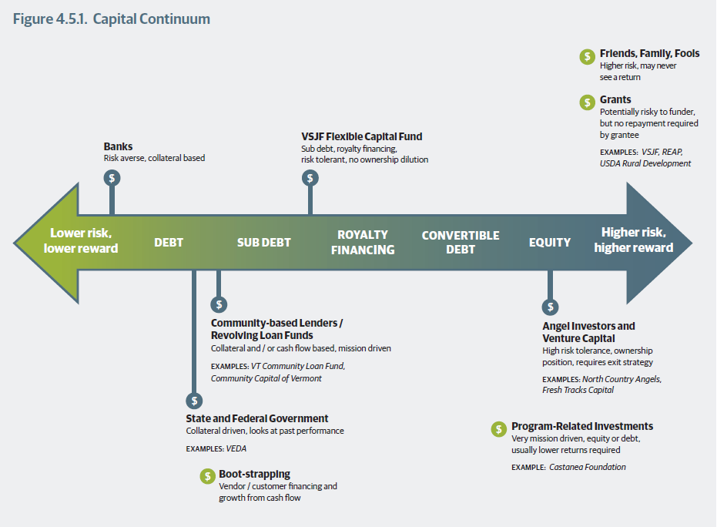
Vermont Farm to Plate. 2013. Strategic Plan: 4.5 Financing the Food System. May 2013, Accessed at: https://www.vtfarmtoplate.com/plan/chapter/4-5-financing-the-food-system

Slide 14
PUBLIC SPENDING MAY LINK TO BROADER IMPACTS
Farm Structure, Viability and Management
Supply Chain Performance, Linkages and Governance
Community Economic, Health and Ecosystem Impacts
Sales Growth
% change, new markets
Identity Preserved, Local Label/Dist.
Market channel diversity, value added
Governance and Mgmt.
ownership, jobs/wages
participation in conserve., feeding, comm programs
Location Quotient
Food sector leakage
Market Access
Sellers and eaters
Sales created and/or Jobs Creation
Downstream from farmgate
Ownership/Governance
Coops/public-private partnerships
Food Access and Security
$/volumes to food assistance/ GUSNIP/
Land/Energy/Water Conservation
Env. Friendly labels, scorecards, GHG metrics
Shifting Tides on metrics related to Diversity, Equity and Inclusion Bonus: Gender, Race, Socially Disadvantaged, Veteran, Limited Resources
Notes:
Example METRICS FROM PAST SCORING RUBRICS

Slide 15
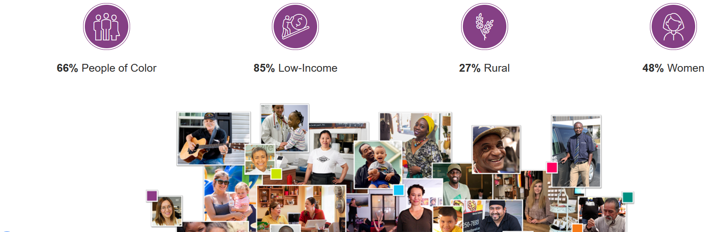
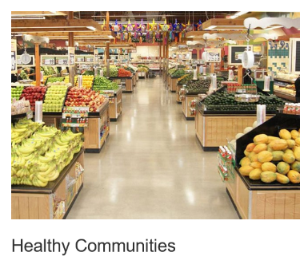
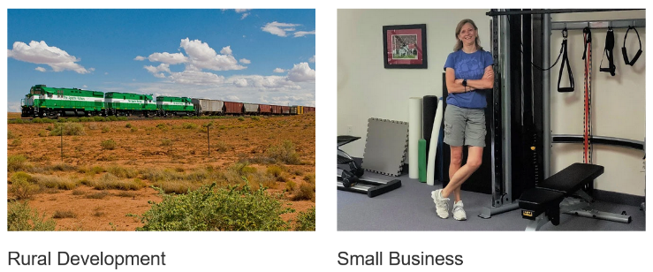
Opportunity Finance Network-CDFIs
https://www.ofn.org/what-is-a-cdfi/key-priorities/

Slide 16
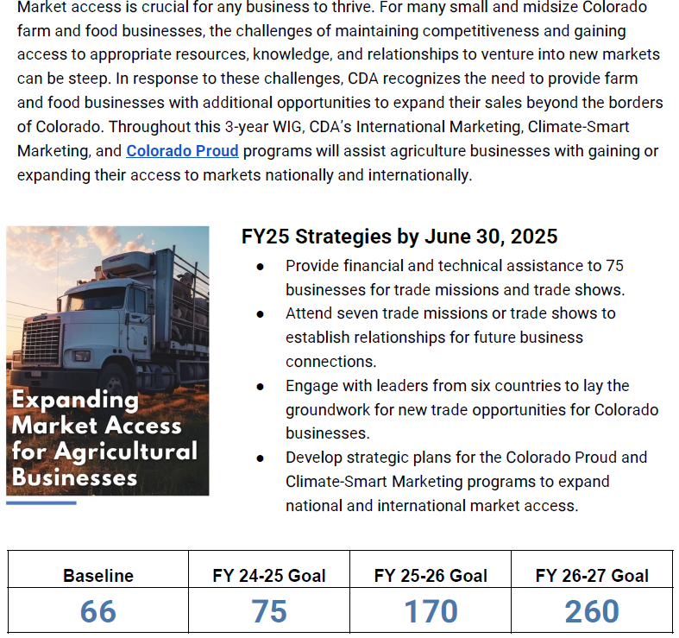


Slide 17
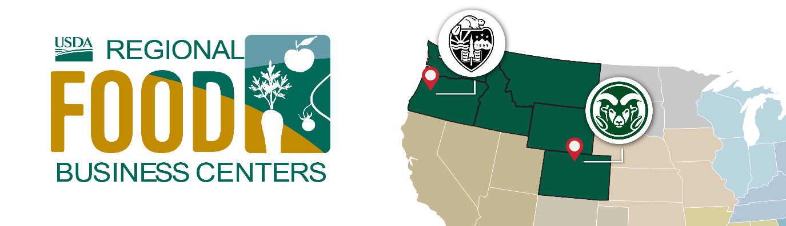
NW and Rocky Mountain Regional Food Center
Connecting Food and Ag Enterprises with Resources in Colorado
Connecting, Strengthening, and Scaling Food Supply Chains in the Mountains and Northwest
Libby Christensen
Libby.Christensen@colostate.edu
Newsletter and update sign up: https://nwrockymountainregionalfoodbusiness.com/contact/
Notes:
Libby- tell us about the NW Regional Food Center!
What is your role with the center and how did you get involved?
What are the top priorities of the center?
If there was one thing you would like to share about the Center - what would it be?
How could CP members reach you or the center if they have questions or want to get involved
Dawn Thilmany
Dawn tell us about your role at the Center and how you got involved in the new Regional Food Center?
LIbby shared the priorities of the Center - are there also funding opportunities? How could a company access those funds or apply?
The priorities of the Center have been talked about in many circles for a while - are we getting closer (here in Colorado) to more meat processing capacity? Creating diverse markets for climate resilient ag?
When it comes to connecting and scaling food entrepreneurs = what do we need to do to help this move forward?

Slide 18

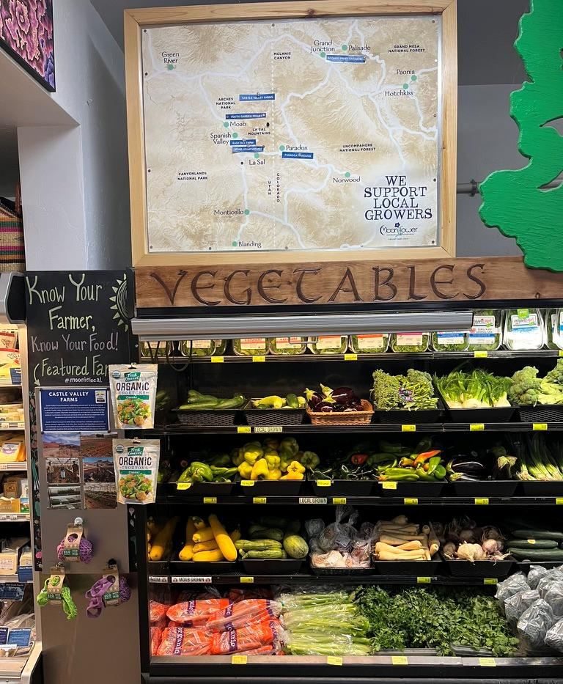
Introduction
Libby Christensen, PhD
Colorado Coordinator and Co-Lead for the NW and Rocky Mountain Regional Food Business Center
Statewide Food and Agriculture Specialist with Colorado State University Office of Engagement
libby.christensen@colostate.edu

Slide 19
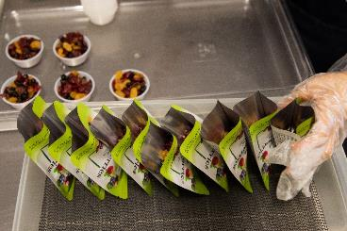
Center purpose & design
The USDA Regional Food Business Centers (RFBCs)
are established to drive economic opportunities across their region, creating a more diversified and resilient food system.
RFBCs are designed to:
Create opportunities for targeted, region-specific solutions.
Maximize locally driven investment impact.
Complement and support other USDA programs.
Collaborate with USDA Agricultural Marketing Service to ensure ongoing, regionally appropriate support and coordination.

Slide 20
Colorado Center Activities & Support
Coordination
Technical Assistance.
Capacity Building

Slide 21
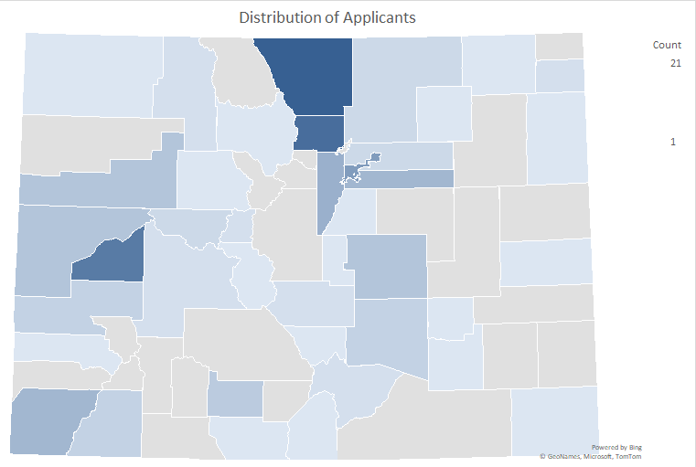
Colorado Capacity Building
Financial assistance to support projects focused on emerging regional needs and businesses that are working towards expansion and other investment.
First Round:
  Small grants up to $10,000
  163 applications – 32 awardees
  $1,478,746 total ask - $300K in awards
  124 beginning operations
  Worked with CSU Extension

Slide 22
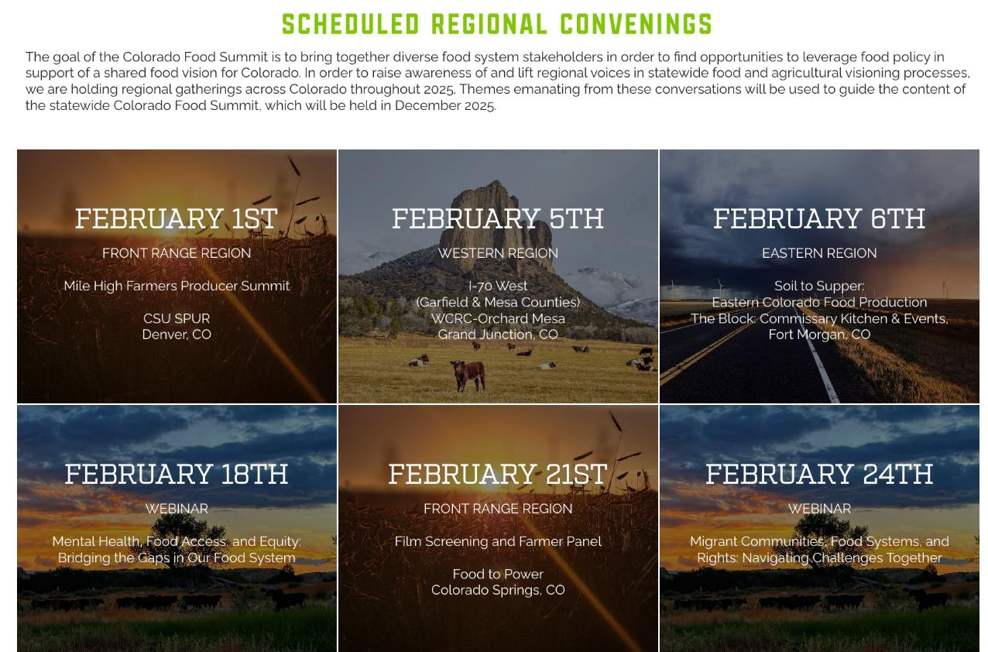
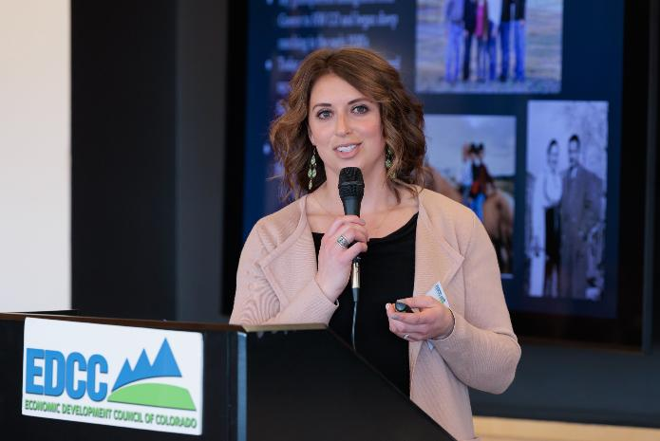
Colorado Coordination

Slide 23





Technical Assistance
FOOD AND AG ADDITION

Slide 24
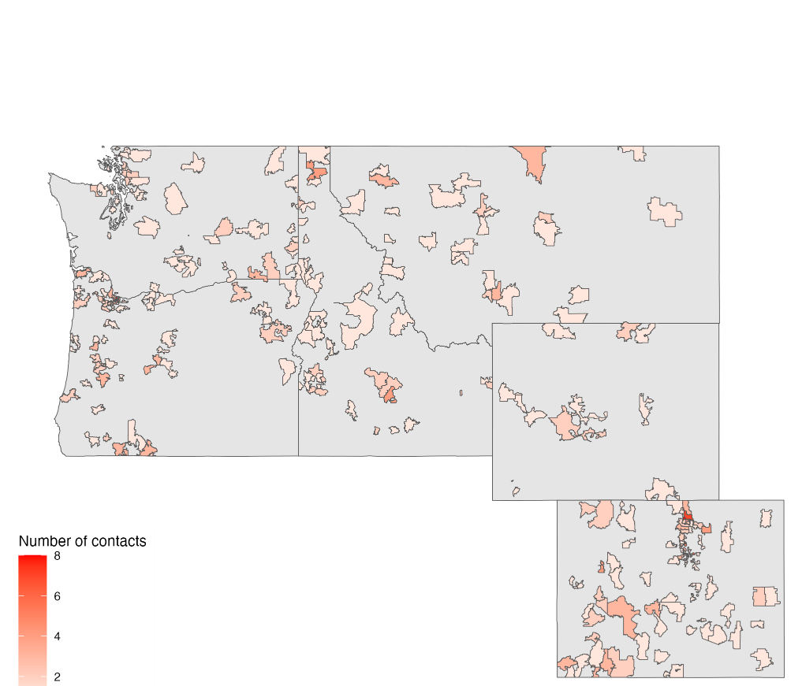
OTHER ACTIVITIES
Over 1000 contacts – Over 200 in Colorado alone
Sent 4 businesses to Regenerative Food System Investment Forum
Annual Colorado Food Collision
Shared Kitchen Workshops
Statewide Food Summit

Slide 25
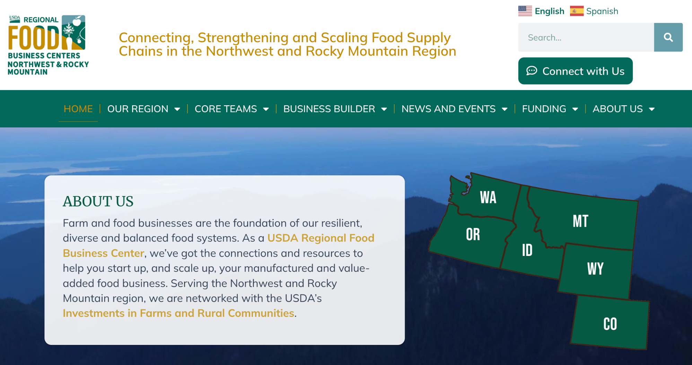


Slide 26
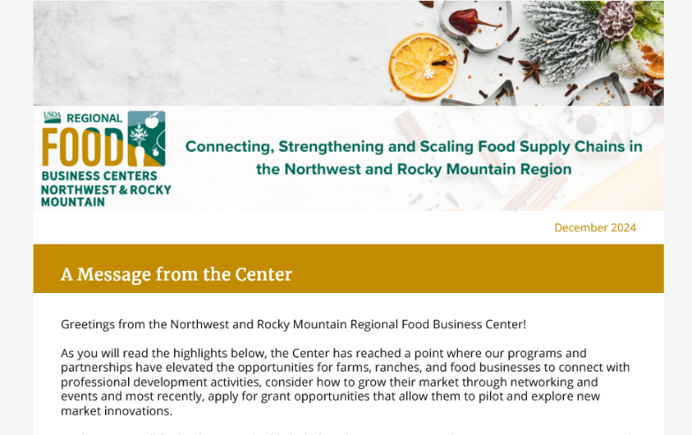
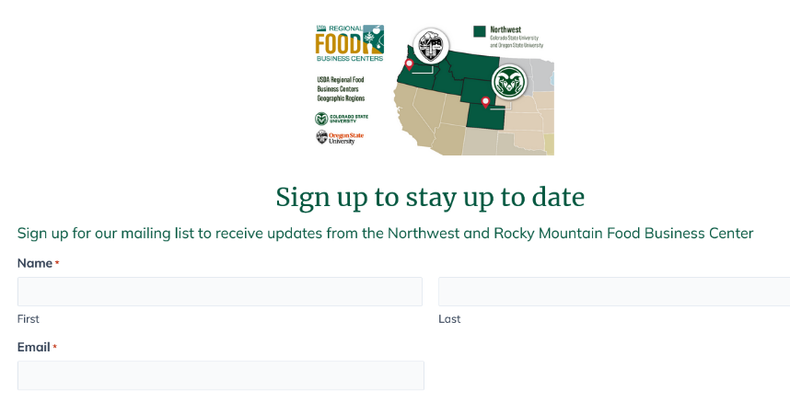
Reach out
Libby Christensen
Libby.Christensen@colostate.edu Colorado State Co-Lead
Dawn Thilmany
Dawn.Thilmany@colostate.edu
NWRM Center Leadership Team
Newsletter and website sign up: https://nwrockymountainregionalfoodbusiness.com/news/#

Slide 27

Food Innovation Center
Notes:
Now Mike Gabel, who you may also see on a tour of SPUR later this conference, will share a bit of how his new Center fits into the biz dev space

Slide 28
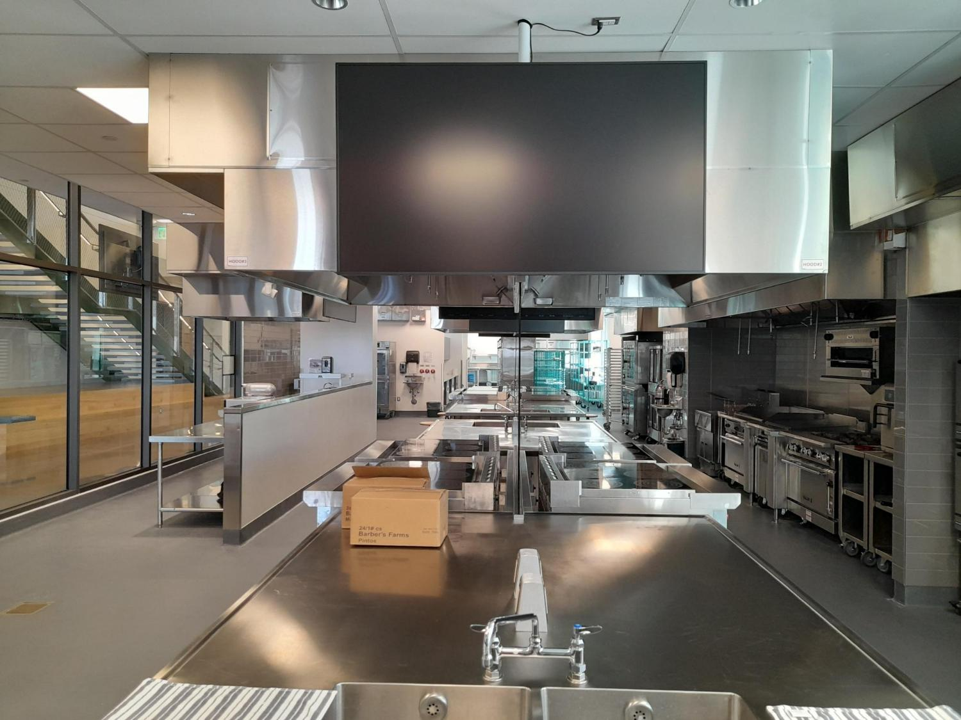
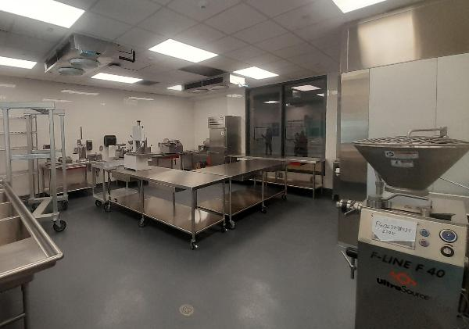
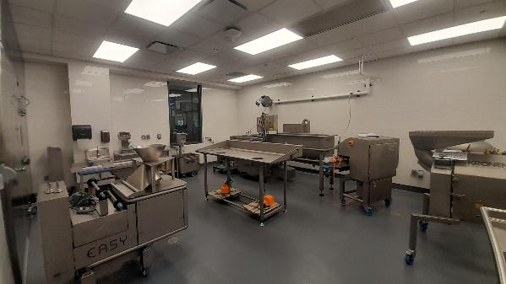
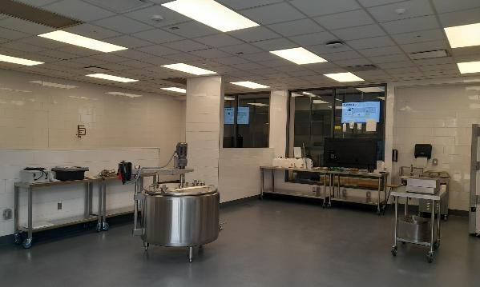

Slide 29
Product & Process Development
Food & Produce Safety Program
Concept to prototype
Food & beverage formulation
Process improvements
Copacker sourcing and production support
Concept to prototype
Food & beverage formulation
Process improvements
Copacker sourcing and production support
Our Services
Sensory & Consumer Testing
Shelf Life, Food Analysis, Label & Claims
Online, home-use and in-person testing
Hedonic, discrimination and trained panel evaluation
Test design, administration and execution.
Statistical analysis & interpretation
Standard and accelerated shelf-life testing
pH, water activity, brix testing
Nutrition Facts Panel creation
Packaging support
FDA Process Letters

Slide 30
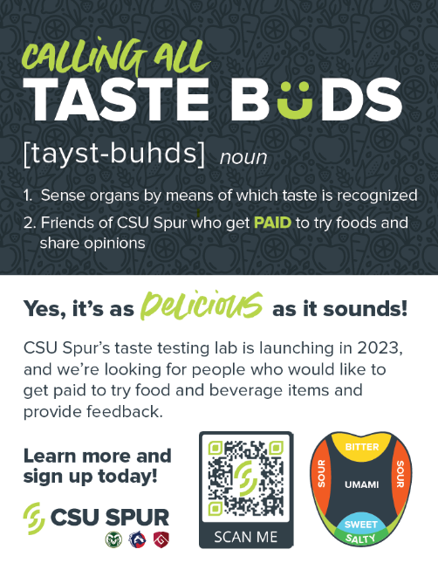
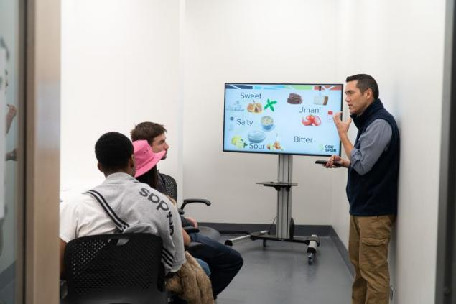

Slide 31
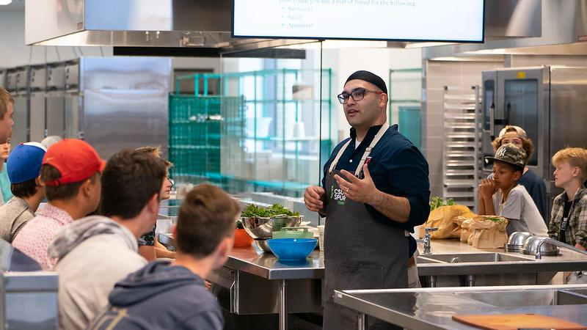

Slide 32
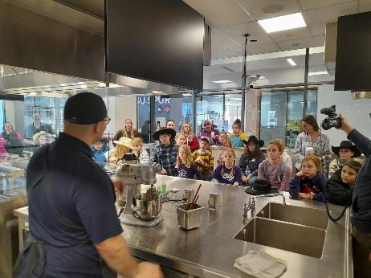
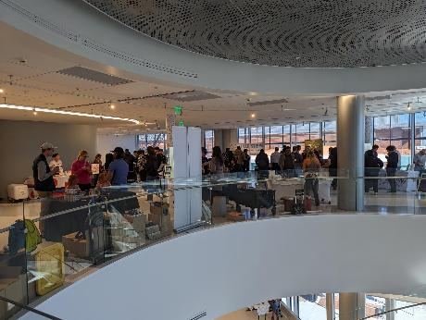
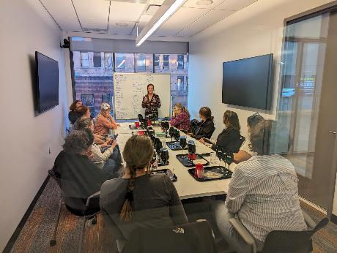
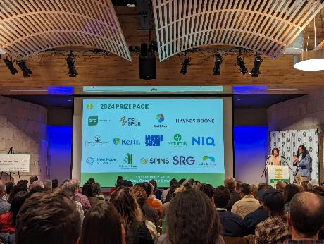

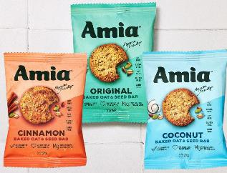
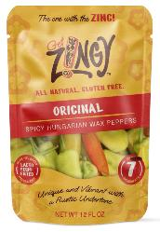



















Taste Buds Panelist
Brands Supported
Sensory Studies
Trained Panelist
NUMBERS
3000+
200+
65+
45
PRODUCTS
DEVELOPED
Dozens
In the
pipeline
PARTNERS
CLIENTS

Slide 33
Questions for the panelists
How do you see the ag and food sector’s role in economic and community development changing?
How do you view your work contributes to food system and community resiliency?
What kind of collaborations do you think are needed in the future to enhance food system work?

