Slide 1
Attracting, Retaining, & Nurturing EDD Staff
2025 Economic Development Conference
for the EDA Denver Region

Slide 2
If you are lucky enough to be someone’s employer, then you have a moral obligation to make sure people do look forward to coming to work in the morning.
John Mackey, Co-Founder, Whole Foods

Slide 3
90,000 Hours

Slide 4
More info at: www.nado.org/EDDCoP

Slide 5
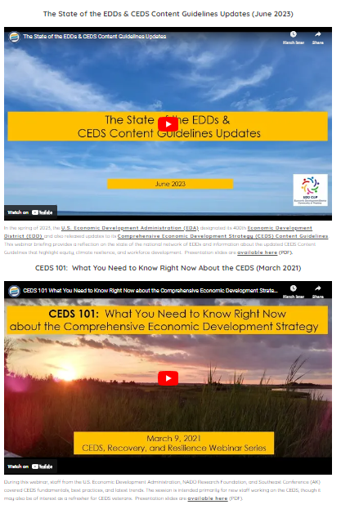
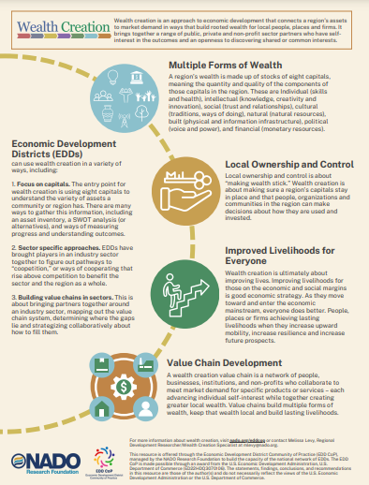
Visit: www.nado.org/eddcop

Slide 9
Stay in Touch!
Brett Schwartz Associate Director NADO Research Foundation
bschwartz@nado.org

Slide 10
Today’s Presenters
Brett Schwartz, Associate Director NADO Research Foundation (CA)
Geri Gamber, Executive Director South Eastern Regional Development Agency (UT)
Lynne Keller Forbes, Executive Director South Eastern Council of Governments (SD)
Rachelle Howe, Executive Director Upper Explorerland Regional Planning Commission (IA)

Slide 11
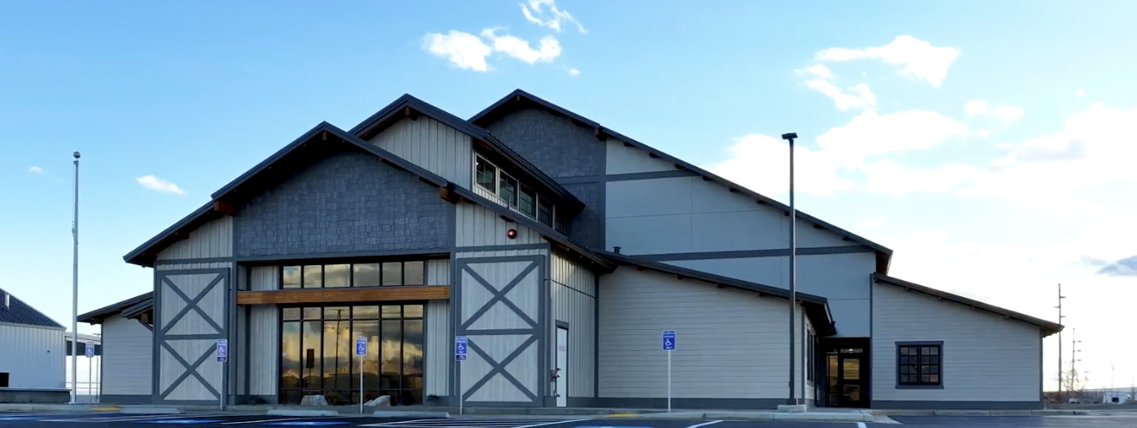
2025 Economic Development Conference for the EDA Denver Region
Attracting, Retaining and Nurturing the EDD Team
Notes:
Good Morning

Slide 12
Formally known as Southeastern Utah Association of Local Governments | Southeastern Utah Economic Development District (SEUALG | SEUEDD)
Services Carbon, Emery, Grand and San Juan Counties
One of the seven association of governments (AOG) in Utah
Areas of Focus:
Economic & Community Development
Community Services
Housing and Weatherization
Aging and Senior Services
Population of Region: Approx. 55,000
~24% of the landmass of Utah
1.7% of the total population of Utah
Median Income / Average Home Cost:
Carbon: $53,673 / $319,000
Emery: $69,956 / $340,000
Grand: $59,171 / $675,000
San Juan: $54,890 / $420,000
SERDA
Overview
San Rafael Swell, Utah
Notes:
Background of our rural area

Slide 13
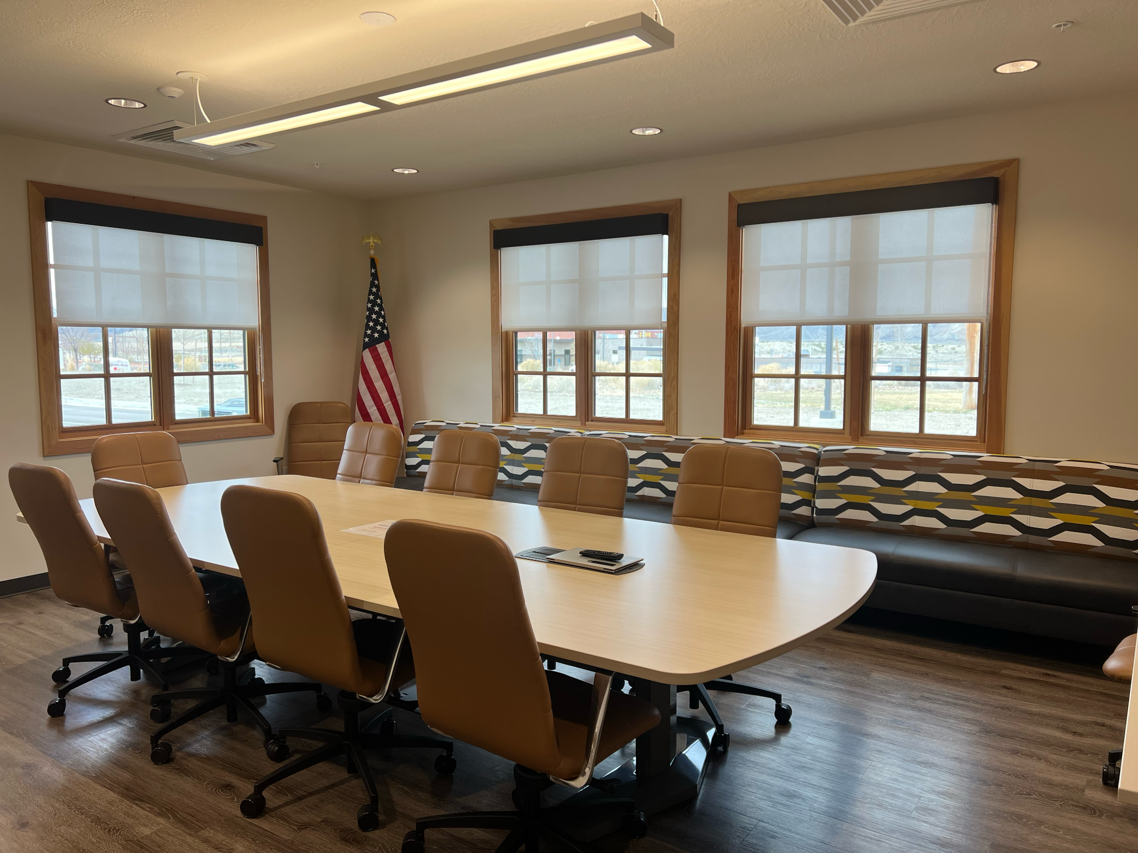
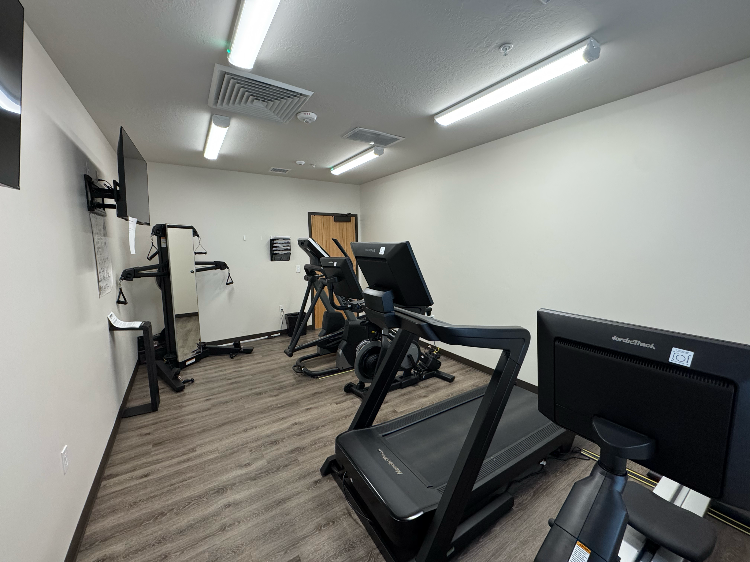
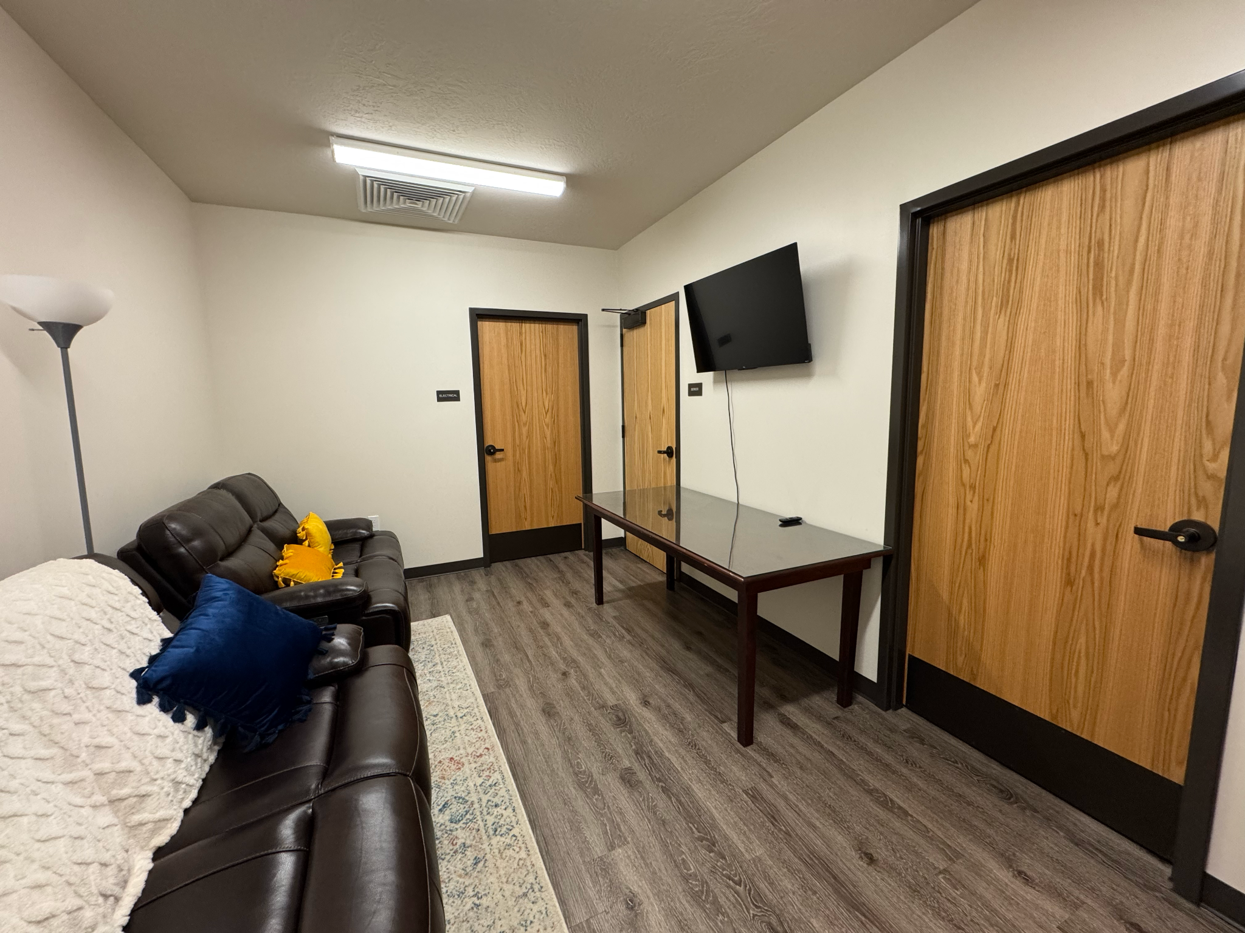
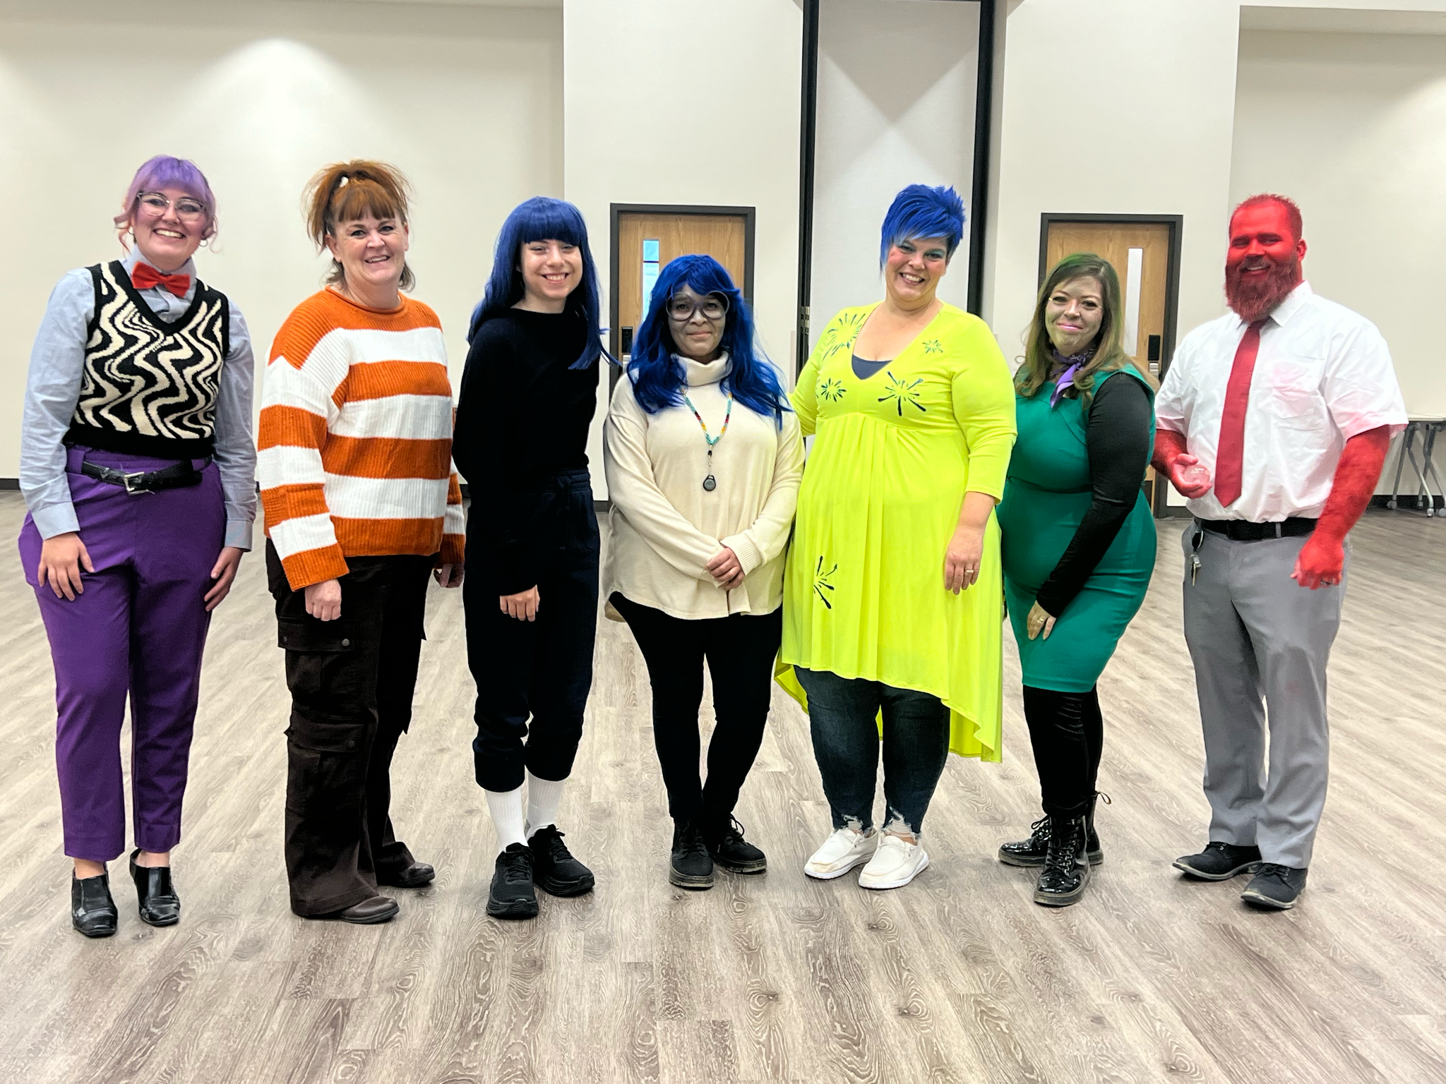
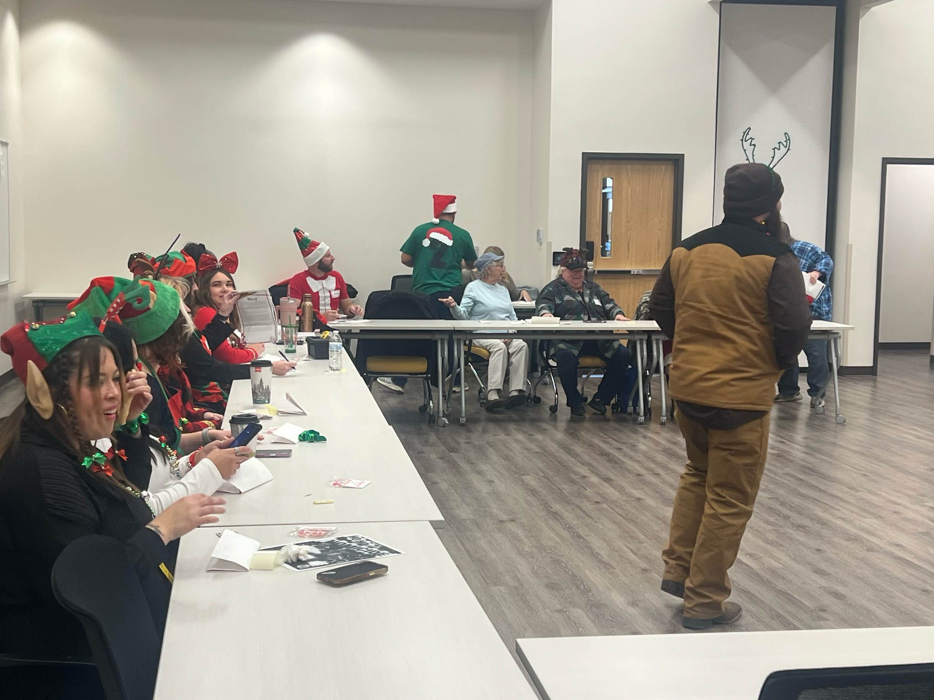
Team Member Incentives / Benefits:
Birthday “Extra Holiday” Day Off
Employee Appreciation Day Off
17 Paid Holidays
Flexible Schedule - Child Care or Education
Company Contributes 6% to 401k
Anniversary Day Off
Neighborhood Activities - Luncheons with partnering agencies
Holiday Celebrations / Activities
Management Retreat
Remote work for parents with special needs children - Rural Utah doesn't have many resources
Team members can donate their sick leave to other team members in need
Volunteer Exchange - For every hour donated we offer as paid time off
Fitness Facility - Employees and family can use facility - Reserve through a calendar system. Every employee receive 3 hours off per week - limits to 1 hour per day for exercise
Notes:
Now, for the reason we are gathered here - our agency incentives

Slide 14
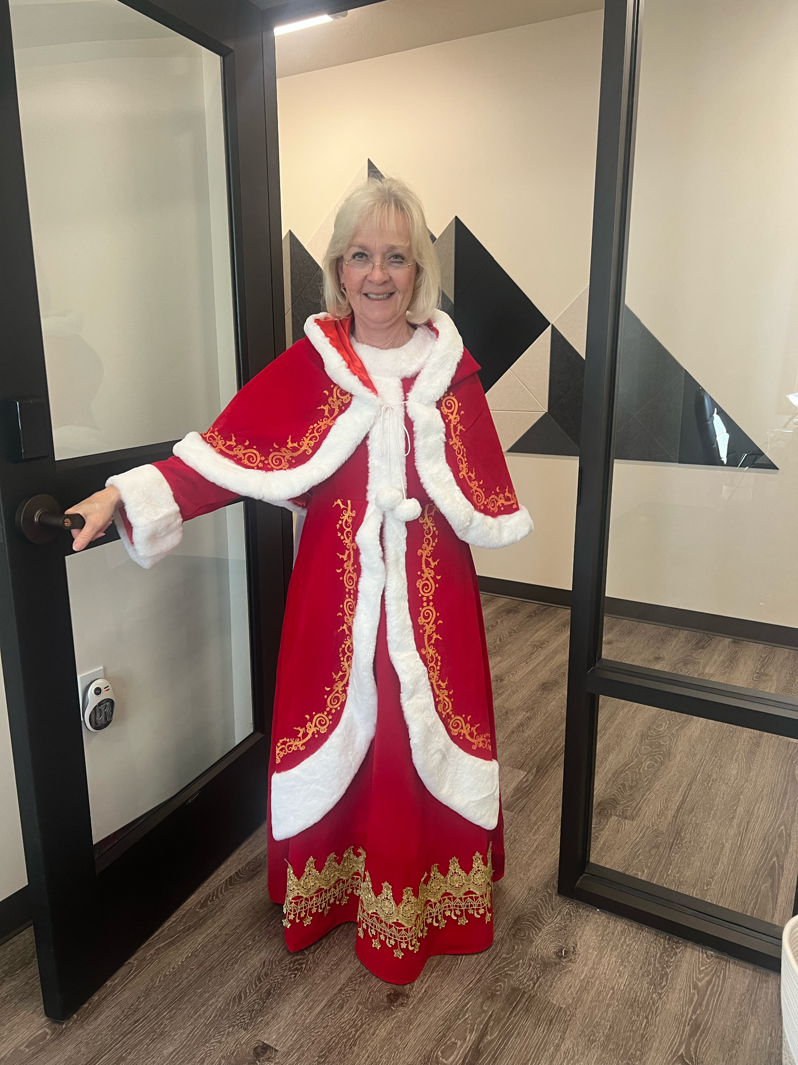
Questions?
Thank you
Geri Gamber, Executive Director
ggamber@seualg.utah.gov
435-215-9142
Notes:
Thank you - please, reach out anytime you have any questions

Slide 15
South Eastern Council of Governments’ (SECOG) Employee Retention Strategies
By Lynne Keller forbes, President & cEO

Slide 16
Overview of Strategies
Compressed Work Week
Flex Fridays
Front-loading Annual Leave
Floating Holidays
Cash Out Leave
Housing Opportunities
Education Assistance
Volunteer Opportunities

Slide 17
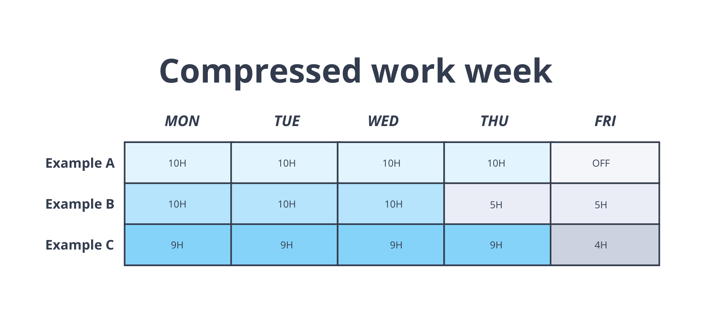
Flexible Work Arrangements
Compressed Work Week
Flex Fridays
Mondays-Thursday = 9 hours
Fridays = 4 hours
Employees get to pick their work schedule
Piloted Flex Friday beginning January 1, 2025 for three months
Employees are allowed to work remotely on Fridays beginning April 1, 2025
Always have the option to come into the office
MUST come into the office for meetings
New employees must work in the office on Fridays for three months

Slide 18
Employee Leave
Paid Time Off
Cash Out Leave
New employees are front-loaded 40 hours of annual leave
13 paid holidays
1 personal day
2 weeks of sick leave
Floating holidays
Must be used in the same calendar year
Must have more than 160 hours
Done in November each year for December pay out

Slide 19
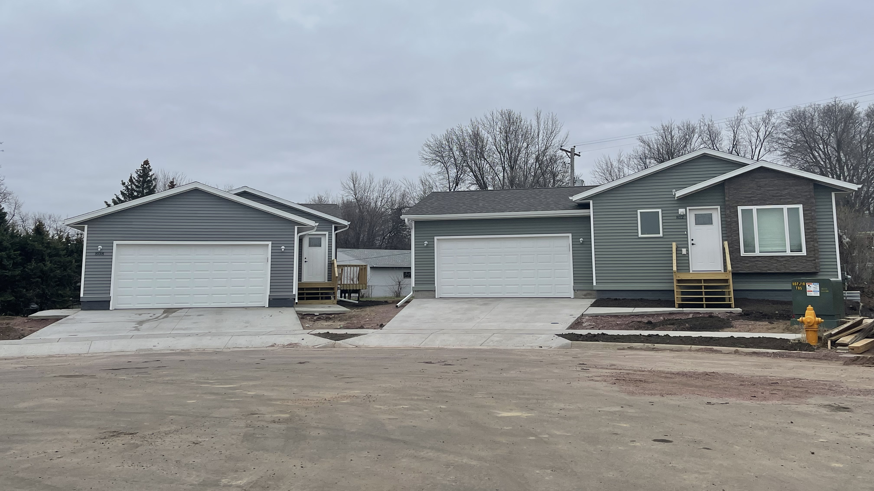
Housing Opportunities
Employees have first “shot” at SECOG’s housing
Receive 3% reduction in price if they do not use a realtor
Option to purchase houses before they are listed

Slide 20
Education Assistance
SECOG will reimburse employees for courses/training that will improve or enhance performance or career growth
Must have a written Career Growth Plan
80% of tuition expenses up to $3,000 a year
Must have completed at least 90 days of employment
Must complete the course with a
“B” for graduate courses
“C” for junior, community or college courses
A pass or certificate of completion for training or apprenticeship courses
Employee must reimburse SECOG if they leave the organization within 12 months of completion of the class

Slide 21
Volunteer Opportunities
SECOG sponsors a meal at a meal ministry twice a year
Pay employees for volunteering for up to three hours
Also invite clients/customers and board members to serve
Other examples: mentoring, Meals on Wheels

Slide 22
UERPC’s WELLNESS PLAN
Health is the new Wealth……

Slide 23
Retaining Employees
Top reasons why employee leave….
Lack of career development
Poor work-life balance
Upsetting manager behavior
Perilous job characteristics
Unsatisfactory compensation and benefits
78% of the reasons could been prevented

Slide 24
Why Develop a Wellness Plan
W.K. Kellogg Foundation – Northeast Iowa Food and Fitness Work
Brain/Mental Health Story

Slide 25
Benefits to UERPC
Improved employee health * Reduced absenteeism
Increased productivity * Higher employee morale
Lower healthcare costs * Improved employee retention
Reduced stress levels * Positive company image
Enhanced teamwork and camaraderie
Better work-life balance

Slide 26
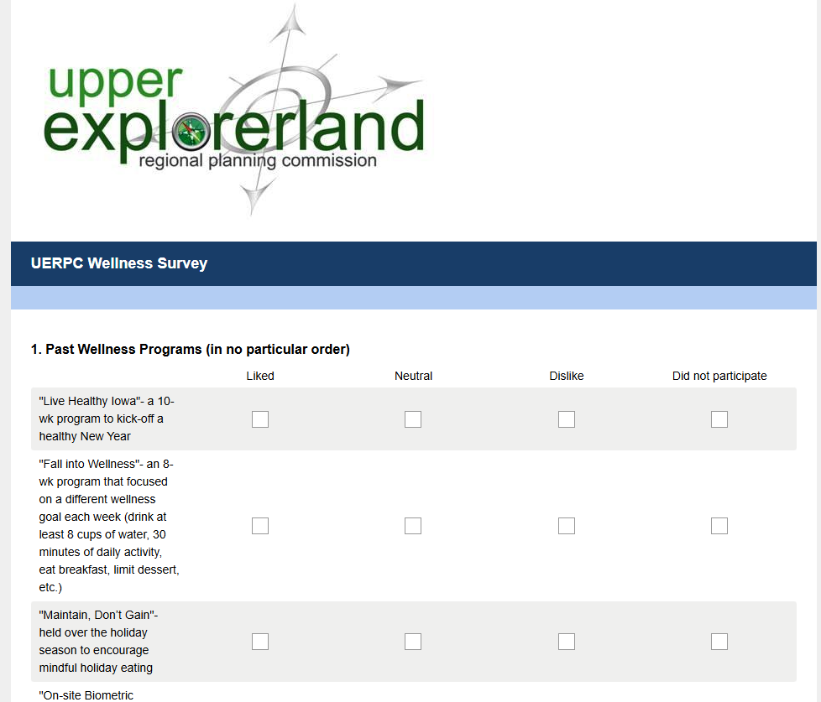
UERPC Process
A survey was developed for find out the challenges for staff and ideas for the plan
Biggest challenge was time – gave an extra 15 minutes to your morning/lunch/afternoon break if doing physical activity

Slide 27
Wellness Challenges
100 Point Wellness Challenge
Water Drinking Challenge
Make Your Streak Challenge
Pick your own wellness
Kindness Challenge
Bingo sheet with random acts of kindness for the month
Thanksgiving to New Years Hold for the Holidays Challenge
Walking Challenge
Sleep and Relaxation Challenge

Slide 28
Wellness Challenges
Gratitude Challenge
Mindful Bingo
Summer Movement Challenge
Estate Planning learning session
Financial Planning learning session
Spread the Love Challenge
Earth Month Challenge
Onsite Biometric screening

Slide 29
Flywheel Strategic

Slide 30
Today’s Presenters
Brett Schwartz, Associate Director NADO Research Foundation (CA)
Geri Gamber, Executive Director South Eastern Regional Development Agency (UT)
Lynne Keller Forbes, Executive Director South Eastern Council of Governments (SD)
Rachelle Howe, Executive Director Upper Explorerland Regional Planning Commission (IA)

