Slide 1
Rural Economic Development: Attracting and Retaining Talent & Business
Erik R. Pages EntreWorks Consulting
April 15, 2025

Slide 2
Today’s Presentation
The Silver Tsunami: Why we are all workforce development professionals now!
From Economic Development to Talent Development
People are the New Companies
Embracing New Strategies
Upskilling Current Workforce (Talent Retention)
Support Local Entrepreneurs
Quality of Life (Talent Retention and Attraction)
Building Local Capacity

Slide 3
The Coming (and Current) Talent Storm
Notes:
Lightcast The Rising Storm—great resource
These total numbers vary because more than 4m were added to workforce in 2024.

Slide 4
Key Demographic Forces at Work
Boomers are retiring at faster rates (and earlier) than expected
Actual Avg. US Retirement Age: 61
Labor Force Participation Rates at Historic Lows (around 61%)
100m Americans currently not in workforce
Higher share in rural areas
Growing Role of Transfer Payments
53% of US counties receive at least ¼ of income from transfer payments (SS, health, disability, etc.)
Sources of New Workers Less Promising
Immigration Crackdowns
Lower Birth Rates
Plus, mismatch between current skills/competencies and employer needs
Notes:
Actual avg. retirement age in US is 61. Boomers (55+) account for 80% of folks who have left the workforce since 2020
Across rural US, 26% of rural adults not in workforce/21% in urban areas. Across South, 1/3 of workers are not working.

Slide 5
Strategies to Survive (and Thrive!)
The New 3-Legged Stool
Attract, Retain & Develop Talent
Potential Focus Areas
Upskill and Engage Current Workforce
Support Local Entrepreneurs
Build Local and Regional Capacity
Invest in Quality of Life

Slide 6
Upskill and Engage Current Workforce
Embrace an “All Hands-on Deck” Mentality
Talent Development ≠ Workforce Development
Training and Education Matter but so do:
Available and Affordable Housing
Affordable Broadband for Remote Work
Amenities and Things to Do

Slide 7
New Workforce Development Models
Some Strategies to Consider:
Expanded Career Counseling
Career Compass (LA)
Free Community College/More Dual Enrollment
Michigan Reconnect: “Last dollar” funds to support cost-free community college education
Target Key Populations
JFF Disconnected Youth programs
Upskilling of Existing Workforce
Michigan Employer Resource Networks

Slide 8
Support Local Entrepreneurs
Supporting Entrepreneurs Creates Local Jobs & Wealth
It also:
Helps Diversify Local Economy
Revitalizes Downtown Areas
Creates a Local Sense of Hope/Momentum
Empowers Local People
Attracts New Residents

Slide 9
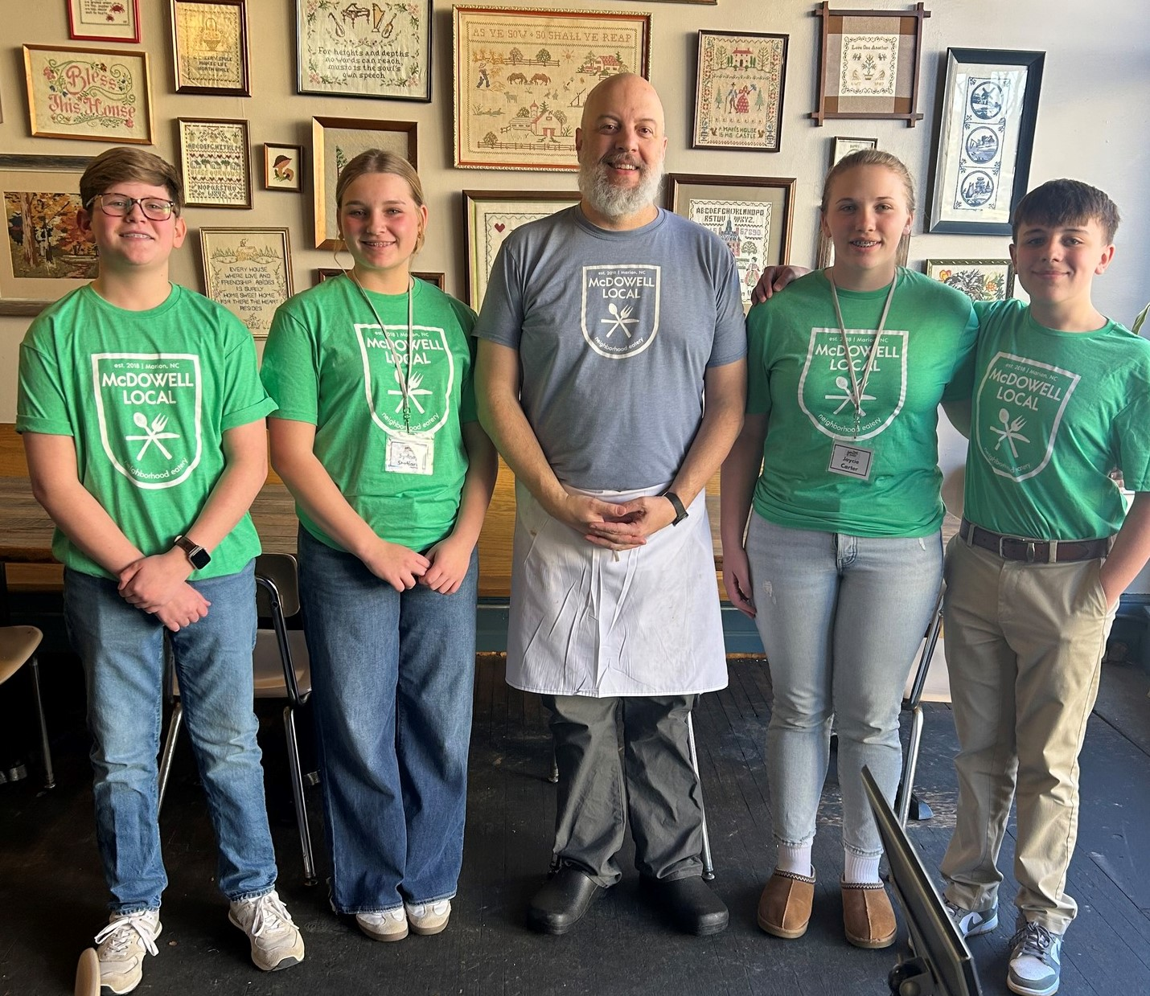
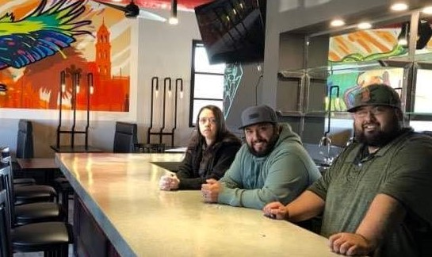
Lessons from Marion NC
Started Growing Entrepreneurs Marion in 2016
Since then,
Trained 206 Local Entrepreneurs
Who Have Started 63 New Ventures
Retained 30 Businesses
Created/Retained 211 jobs
Invested $4.1m in downtown district
Notes:
City of Marion has 7,800 residents in Western NC/McDowell County Population is 45,000

Slide 10
Build Local and Regional Capacity
Low-Capacity Regions Comprise about 50% of all US Communities
Measured by staff and funding levels, civic engagement, access, etc.
Most Low-Capacity Regions Unable to Access Federal or other Outside Funds
3% of FEMA funds to Low-Capacity Counties
62% of rural PA Counties Did Not Apply for DOT grants due to capacity constraints
Notes:
(ASPEN) Community capacity is the combined influence of a community’s commitment, resources, and skills that can be deployed to build on community strengths and address community problems and opportunities.

Slide 11
Getting Serious About Capacity
Diversify Funding Sources
Build Capacity
Import Capacity
Change Business Practices
Embrace New Missions

Slide 12
Diversify Our Funding Sources
RETHINK THE COMMUNITY CAPITAL STACK
As Federal/State grant opportunities slow, consider other sources of revenue
Memberships
Fees for Services
Corporate Partnerships
Community Philanthropy

Slide 13
Build New Capacity
Continue to invest (more!) in community capacity programs like:
Leadership Development
Peer Networks
Staff Training
Community Partnering (e.g. Sister Cities etc.)
Recent Federal Models
Communities of Practice
Economic Development Recovery Corps

Slide 14
Import Capacity
Embrace Any and All Approaches to Import Talent and Capacity
Interns
Community Volunteers
Student Teams
Consultants
New Non-Profit Capacity Building Models are Emerging
WV Community Hub
Center on Rural Innovation
Northern Forest Center
Community Builders (CO)
SolSmart Program for Solar Development

Slide 15
Embrace New Ways of Doing Business
Rethink the Grantmaking Process
Single Federal Portal
Streamlined Reporting and Evaluation Processes
Rethink Matching Grants
EDA Reauthorization—Eliminates Match for some Small or Distressed Regions
Rethink Grant Competitions
Tiered Competitions?
Embrace Non-Competitive Grants
Rethink Technical Assistance
Engage outside help
Provide more proactive outreach

Slide 16
Invest in Quality of Life
Successful places offer affordable living while also offering a desirable mix of cultural, recreational, and lifestyle amenities.
What Does Talent Want?
Opportunity
Anchors
Attachment
Amenities

Slide 17
What Makes A Region Attractive? Global Perspectives
OECD Regional Attractiveness Project (2023)
Key Factors:
Strong digital performance and transportation access (for inward investment)
Available housing, internet speed, and the ability to attract international students (for talent development)
Vibrancy, creativity, and natural amenities (for visitor attraction).

Slide 18
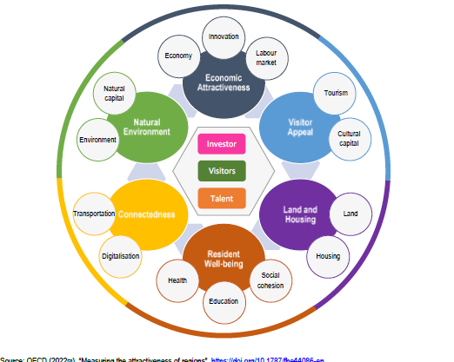

Slide 19
Two Promising Models—1)Maine
Highest Levels of In-Migration among US States
Increases in all 16 Maine Counties
Key Attraction Factors:
Outdoor Recreation Amenities
Social connections: Closer to family, friends, network.
Ability to Work Remotely (for self or partner)
Employment Opportunity (self or partner)
Community Security
https://www.liveandworkinmaine.com/
Notes:
For many decades, states in the Southeast and Southwest were the top places for new in-migration. These patterns have shifted in recent years, and we’re now seeing other places among the top spots for attracting talent. Over the past few years, Maine has become a hot spot for incoming talent, An excellent new study from Maine’s Department of Community and Economic Development assesses the factors driving such moves, and their findings offer many useful lessons about what factors help attract and retain talented workers.
Why People Move to Maine shares findings from extensive surveys of new Maine residents, asking why they moved to Maine and what they look for in a community. Robust broadband access clearly matters, with 80% of respondents noting that remote work access allowed them to make the move. Many of the newcomers (14%) are/were self-employed. Most of this group brought their business with them, but 30% started a company after the move to Maine. When asked to rank the top five factors driving their relocation decisions, the respondents identified (in rank order) the following as top priorities:

Slide 20
2) Indiana and READI
Major Regional Investment ($1B)
Backed by ARPA and Lilly Endowment
Focused on Quality of Life and Quality of Place
Investing in:
Community Facilities
Trails and Parks
Housing
Innovation Hubs/Coworking Spaces
https://indianareadi.com/

Slide 21
Indiana’s First Region
Workforce
Health Care Simulation Lab
Megasite Upgrades
Expanded Tech Training (Ivy Tech)
Housing (9 Local Projects)
Quality of Life
New Sports Complex
Local Amphitheater
Playground/Trail Upgrades

Slide 22
Guiding Questions to Consider:
Are we effectively supporting skills development and wealth creation opportunities for all residents?
Are we growing our talent base?
Have we aligned/connected regional economic, community and workforce development efforts?
Are we developing new amenities that can attract and retain talent?
Are we diversifying our local economy?
Are we future ready?

Slide 23
Contact Information
Erik R. Pages
EntreWorks Consulting
epages@entreworks.net
703-237-2506
www.entreworks.net
BLOG: www.entreworks.net/blog
Newsletter Sign-Up: http://www.entreworks.net/Newsletter.php

