Slide 1
Safe Streets for All Comprehensive Safety Action Plan

Slide 2
Topics
About SEKRPC
Project Funding Sources
Project Goals
SEKRPC’s Role
Results to Date
Impact
SS4A and CEDS
Challenge and Solution

Slide 3
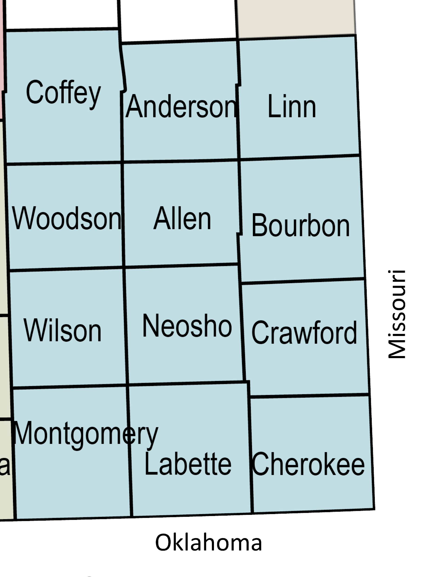
About SEKRPC
Serves a 12-county area
Covers 7,134 square miles
Includes 155 communities
5 full-time team members

Slide 4
Project Funding Sources
$800,000 from the U.S. Department of Transportation Safe Streets for All Program
$200,000 from the Kanas Department of Transportation SS4A Match Program
$35,000 in-kind from the SEKRPC for project administration

Slide 5
Project Goals:
Develop a Comprehensive Safety Action Plan aimed at enhancing safety across the 12-county region
Identify areas of transportation challenges, efficiency, and safety concerns for residents and commerce movement throughout the region
Provide targeted improvements through actionable solutions
Plan will provide a framework for decision-makers
Plan will serve as a supporting document for communities and counties to seek additional funding from federal and state sources

Slide 6
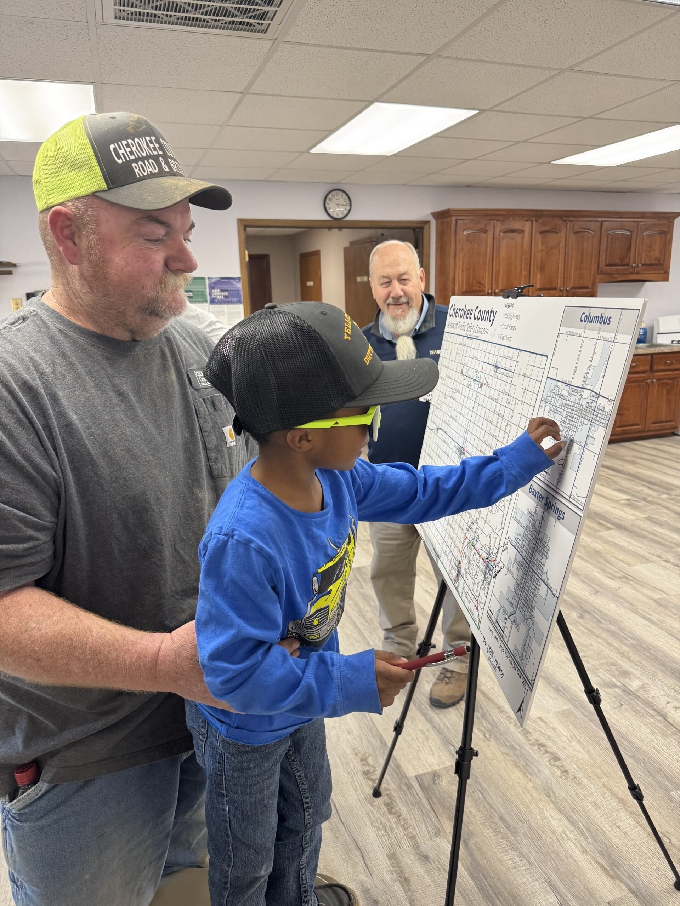
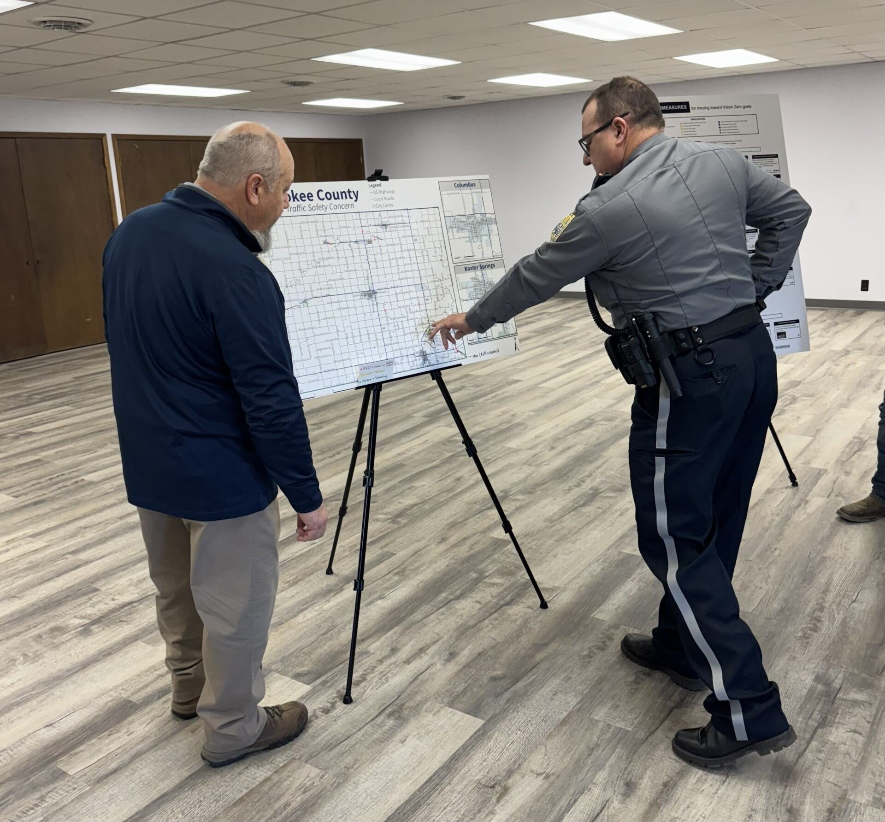

Slide 7
SEKRPC’s Role
Application:
Lead role in the development and submittal of the SS4A Comprehensive Safety Plan application
Convening a series of meeting to bring stakeholders together
Discuss goals and overall vision
Post Award:
Project administration
Procurement process for selecting the consultant to develop the Safety Plan
Managing funding reimbursement requests from both FHWA and KDOT
Communication and outreach support to the consultant team

Slide 8
Results to Date
First time a project of this scope has been developed for the region
County Meetings Convened in each of the 12 counties
Information gathered from local participants identifying locally known crash locations and hazardous areas near schools and similar facilities
Data collected from these meetings is being compiled by the consultant
Completion anticipated by the end of May 2025

Slide 9
SS4A and CEDS
Identifies and addresses areas of transportation challenges, efficiency, and safety concerns for residents and commerce movement throughout the region
A holistic approach to regional challenges
Sets benchmarks and measurable outcomes making it impactful and a guiding beacon for future endeavors
Will enhance the region’s highway infrastructure making it better equipped to handle the growing flow of freight and personal travel
Improvements will support local industries and strengthen connections to larger markets, improving overall economic opportunities for the region
Empowers local leaders to make informed choices, ensuring resources are allocated where they are most needed

Slide 10
Challenge and Solution
The Challenge:
Community attendance at county level meetings
Understanding local concerns and interests
Building trust within the community
Facilitation of discussions and feedback
The Solution:
Recruit a “cheerleader” from each county
Leverage existing networks to encourage local participation
Can lead to more effective outreach and higher turnout
Share event details and increase visibility and engagement

Slide 11
Thank you
Carey Spoon
620-431-0080
director@sekrpc.org
www.sekrpc.org

