Slide 1
WealthWorks and CEDS for South Eastern Council of Governments (SECOG)
By: Sean Hegyi, Community Development Manager

Slide 2
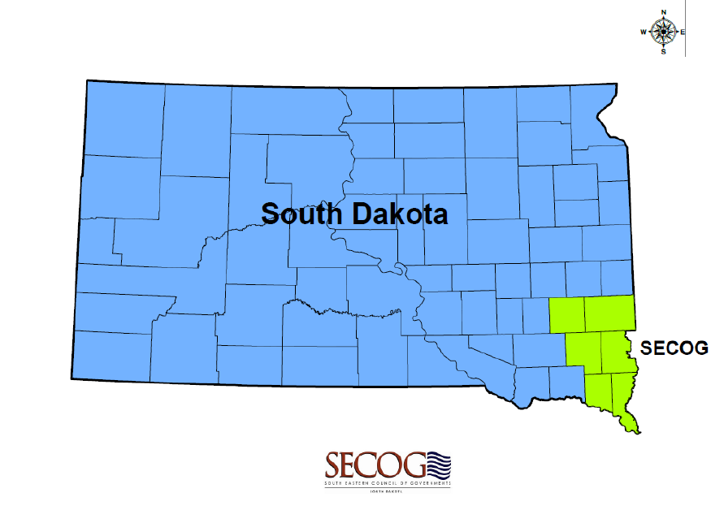
Discovering WealthWorks
Learned during previous NADO conference
Decided to implement during SECOG’s 2024-2028 CEDS

Slide 3
SECOG’s Region
6 Counties
40 Municipalities
Largest Municipality = Sioux Falls (>200,000 population)
All Others = 50 to 20,000 population
Diverse range of community identities, strengths, and challenges.

Slide 4
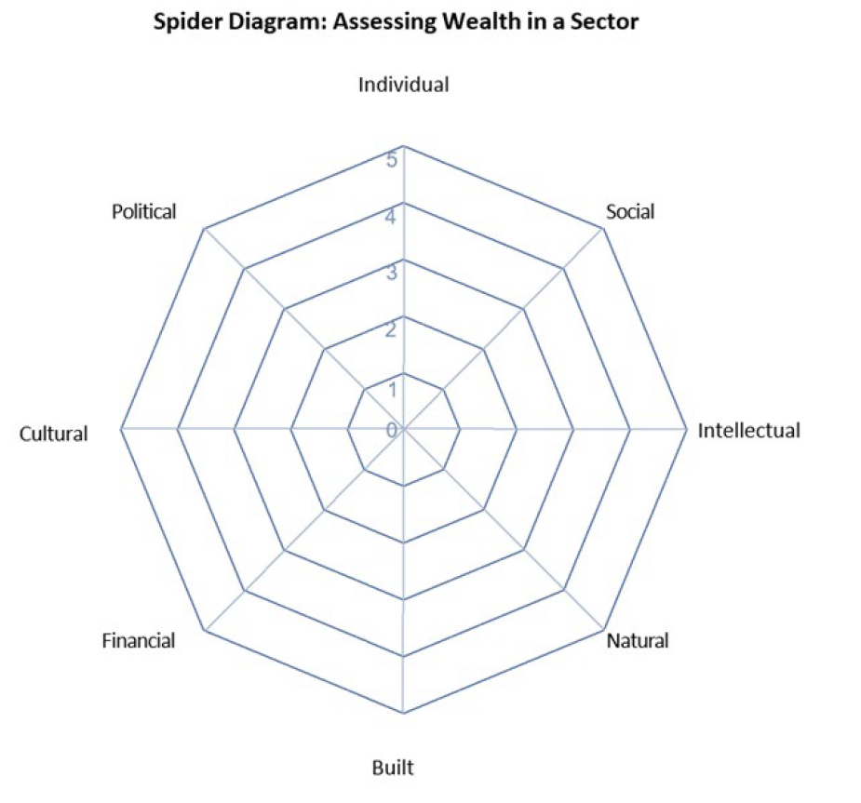
Implementing WealthWorks
Developed large survey to assess the 8 capitals of wealth
Distributed amongst the SECOG Region
Tracked responses to a specific county to assess wealth
Developed Action Plan to address the strengths and needs of each community.

Slide 5
SWOT Analysis - Strengths
Transportation System and Regional Airport
Water & Air Quality
Education System
Natural Environment

Slide 6
SWOT - Weaknesses
Economic Diversification
Housing
Workforce Shortage
Childcare Options
Low Wages
Workforce Well-Being

Slide 7
SWOT - Opportunities
Agri-tourism/Agri-business
Health Care Industry
Recreational Activities
History
Cultural Diversity

Slide 8
SWOT - Threats
Natural Disasters (floods and derechos)
Local support for economic development
Political presence (small towns)

Slide 9
Setting our Goals and Strategies for 2024-2028
Created a series of goals (community planning and development; workforce and business development; resiliency)
Established strategies to meet those goals
Connected the strategies to the capitals of wealth

Slide 10
What Comes Next?
CEDS was approved in August 2024
Utilize data from WealthWorks model for long range planning efforts
Assess progress on the 8 capitals of wealth over the upcoming years to determine progress

