Slide 1
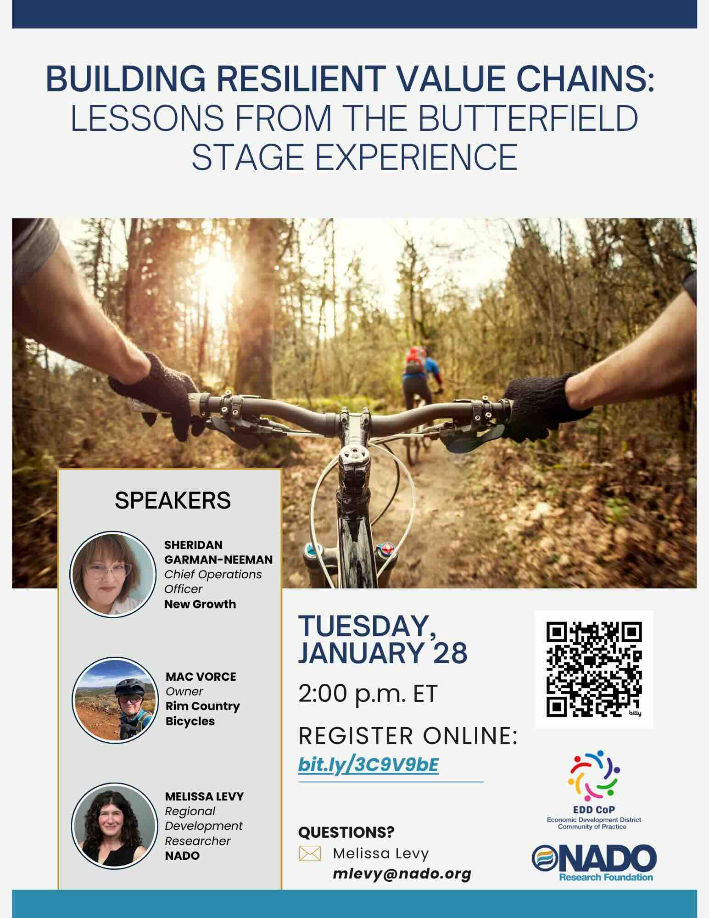

Slide 2
Thanks for Joining the Webinar!
Questions or comments can be submitted via the questions box on the right side of your screen in drop down menu
A recording of the webinar will be made available soon at www.nado.org
Please take a moment to complete the post-webinar survey to provide helpful feedback
Contact Melissa Levy at mlevy@nado.org with any questions about the webinar or wealth creation

Slide 3

Poll Questions

Slide 4


NADO provides advocacy, education, research, and training for the nation’s regional development organizations (RDOs). NADO and its members promote regional strategies, partnerships, and solutions to strengthen the economic competitiveness and quality of life across America’s local communities.
The NADO Research Foundation provides education, research, and training designed for RDO executive leadership, staff, and policy board members. It examines new and innovative practices in regional development and strives to improve the organizational and professional capacity of regional development organizations and their partners.
www.NADO.org

Slide 5

Melissa Levy
Regional Development Researcher/Wealth Creation Specialist
NADO Research Foundation
mlevy@nado.org
www.NADO.org

Slide 6
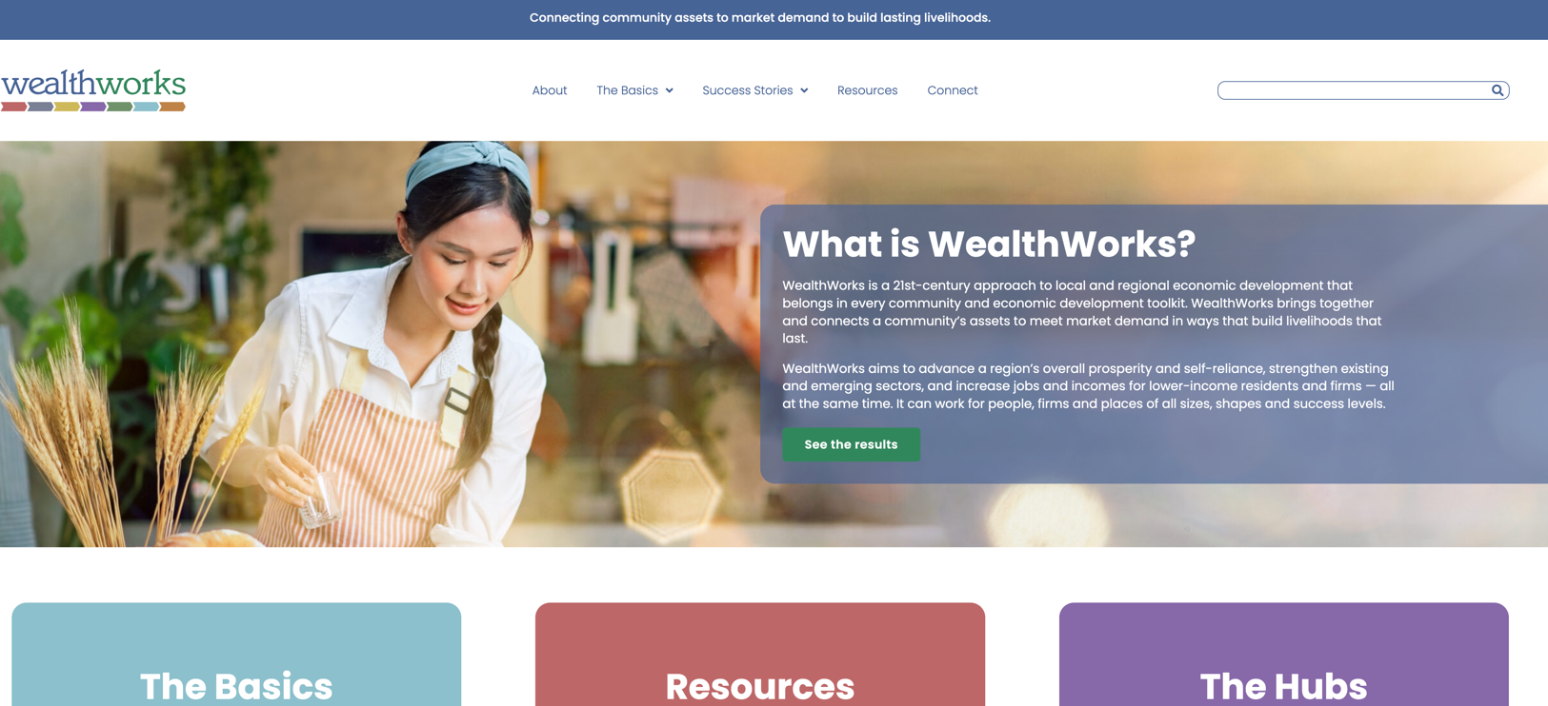
WealthWorks Website - www.wealthworks.org

Slide 7
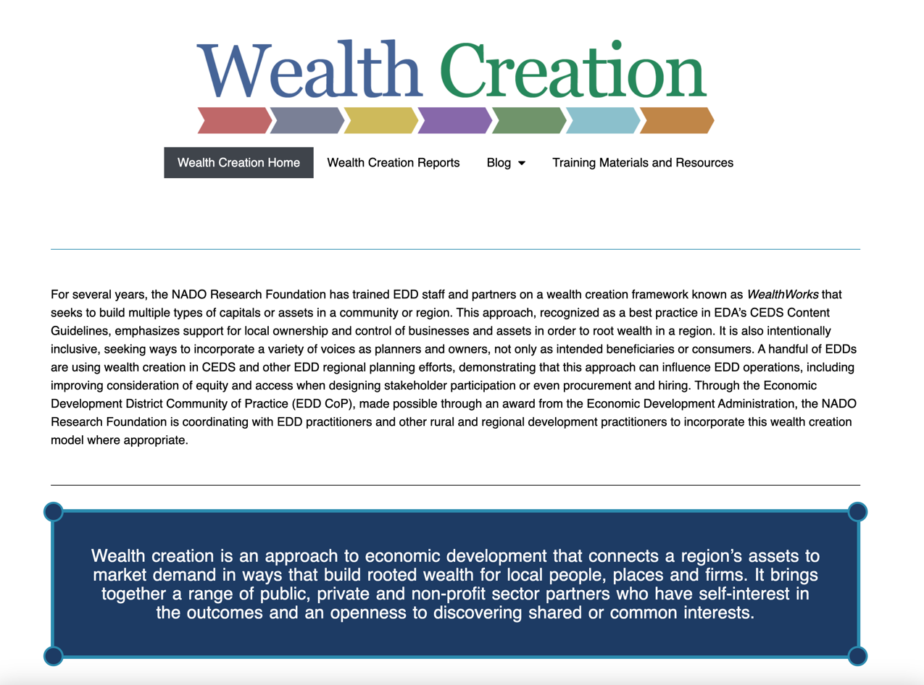
NADO Wealth Creation Website – www.nado.org/wealthcreation

Slide 8
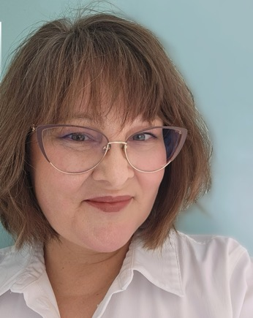
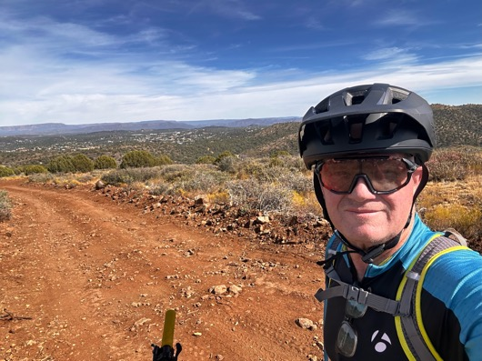

Today’s Presenters
Sheridan Garman-Neeman Mac Vorce
Chief Operations Officer
New Growth CDC
Owner
Rim Country Bicycles
(Moderator) Melissa Levy, Regional Development Researcher/Wealth Creation Specialist
NADO Research Foundation

Slide 9
WealthWorks…
an approach to economic development that connects a region’s assets to market demand in ways that build rooted wealth for local people, places and firms.
brings together a range of public, private and non-profit sector partners who have self-interest in the outcomes and an openness to discovering shared or common interests.
focuses on building a sector rather than individual and unrelated businesses.
Notes:
Goal: Advance a region’s prosperity by building wealth that sticks
WealthWorks is a bridge between community development (voice, empowerment, organizing) and economic development (attraction, retention, entrepreneurship).

Slide 10



Principles of Wealth Creation
#1 – Create wealth, broadly defined, and aspire to do no harm.
#2 – Root wealth in local people, places and firms through regional ownership, control and influence.
#3 – Build lasting livelihoods by intentionally including people and firms on the economic margins.
Notes:
Wealth building framework has three critical goals:
Create wealth broadly defined – includes 8 capitals. Aspire to do no harm to any.
Root wealth in place – pay attention to who owns, controls and influences the wealth that’s created. Root wealth in local peoploe, places and firms through local ownership, control and influence.
Build lasting livelihoods especially for people and firms on the margins – intentionally including economically-marginalized residents.
Use a systems approach – Wealth Creation Value Chains – to build value in existing and emerging sectors.

Slide 11
t
Wealth Components: Eight Capitals
Key Concept
Intellectual
  Knowledge and innovation
Assessment
Design
Measurement
Individual
  Skills, education, health
Social
  Trust and relationships
Natural
  Natural resources
Built
  Infrastructure
Political
  Influence on decision makers and shapers
Financial
  Savings and investment
Cultural
  Traditions, customs and ways of doing
Notes:
Realize that you all are familiar with the triple bottom line. This isn’t really different … just unpacks the three capitals into greater detail… The other addition is that this approach focuses on both inventory and then investing in building our “stocks” of these capitals/assets. We recognize that without active investment, resources will depreciate.

Slide 12
A Continuum for EDDs
CEDS
SWOT
Measuring outcomes
Sector-specific
Collaboration
Value chain development
Value chain mapping
Filling gaps in the chain
Coopetition
Notes:
It’s not one size fits all. The entry point is to use the discussion of capitals/assets in your CEDS planning.

Slide 13
#4: Tie wealth to place and connect regionally
Wealth Creation Value Chains connect local production to regional demand to bring fresh money into rural communities, defined as:
A network of people, businesses,
institutions, and non-profits
who collaborate to meet market demand
for specific products or services –
each advancing individual self-interest
while together creating greater local wealth.

Slide 14
Connecting a Value Chain
Demand: Final consumers/end market - Buyers
Functions: Those things that have to happen to deliver the product or service
Transactional partners: Those people, businesses, or organizations that play a direct role in sourcing, aggregating, distributing, processing, purchasing the product, etc.
Support partners: Those people, businesses, or organizations that provide the infrastructure, technical assistance and support that helps the transactional partners to produce
We are really talking about a Value Chain System!

Slide 15
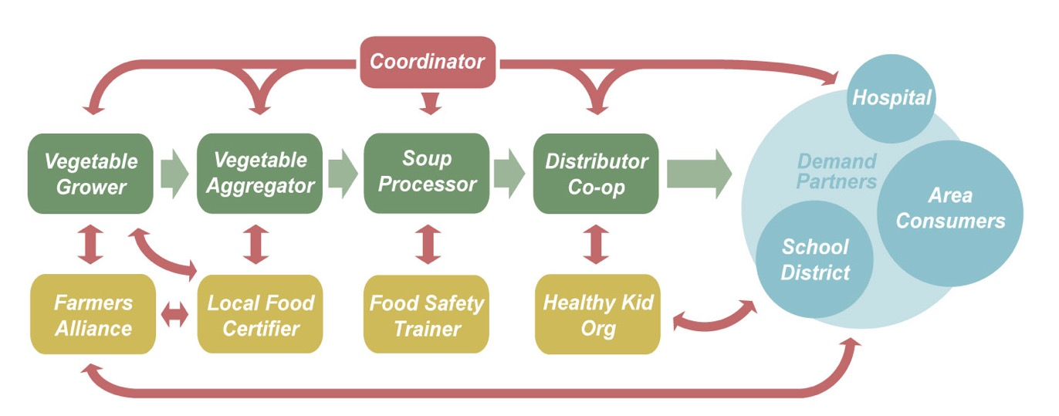
Value Chain Example

Slide 16
Notes:
Gaps are outlined. At a workshop, gaps were prioritized – these have red dots. Working groups were developed for these priorities.
Assets are identified.

Slide 17
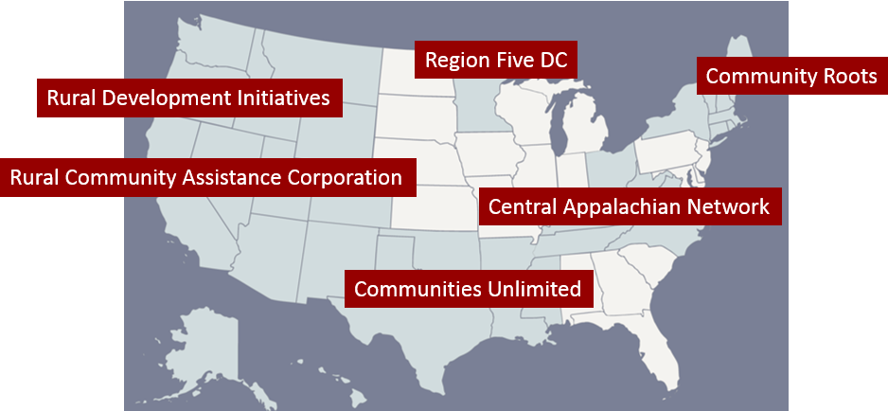
WealthWorks Regional Hubs
http://www.wealthworks.org/connect/hubs

Slide 18

Poll Question

Slide 19


Today’s Presenters
Sheridan Garman-Neeman Mac Vorce
Chief Operations Officer
New Growth CDC
Owner
Rim Country Bicycles

Slide 20
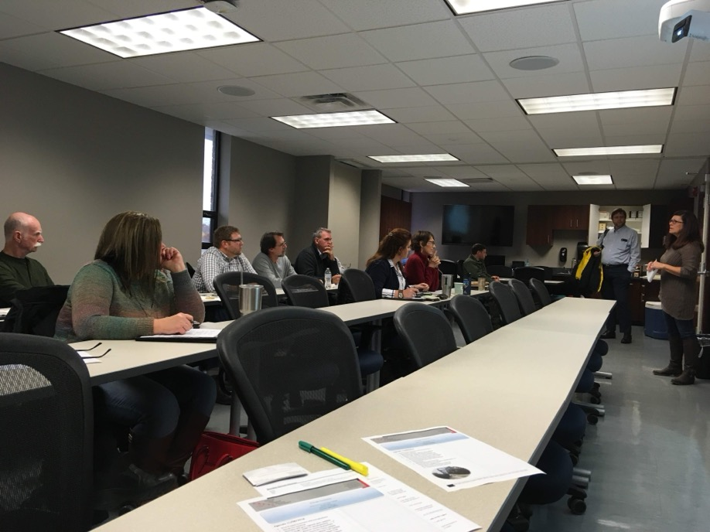
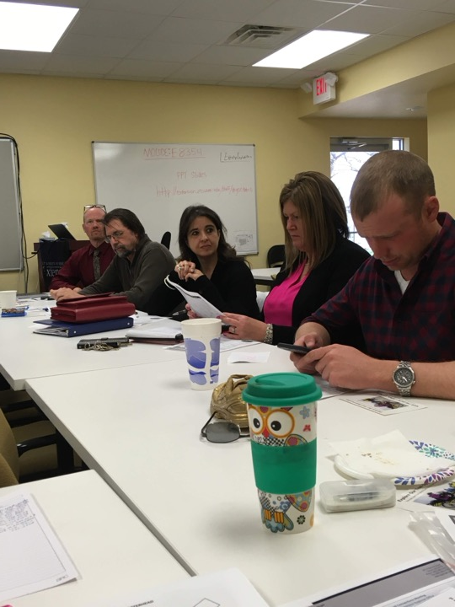

Slide 21
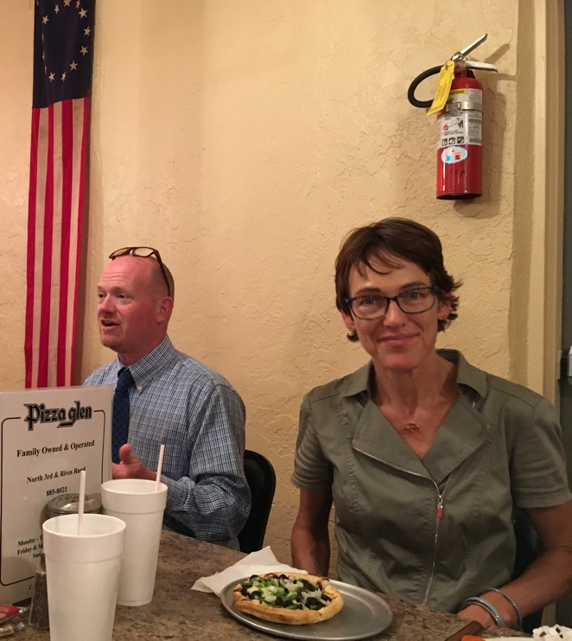
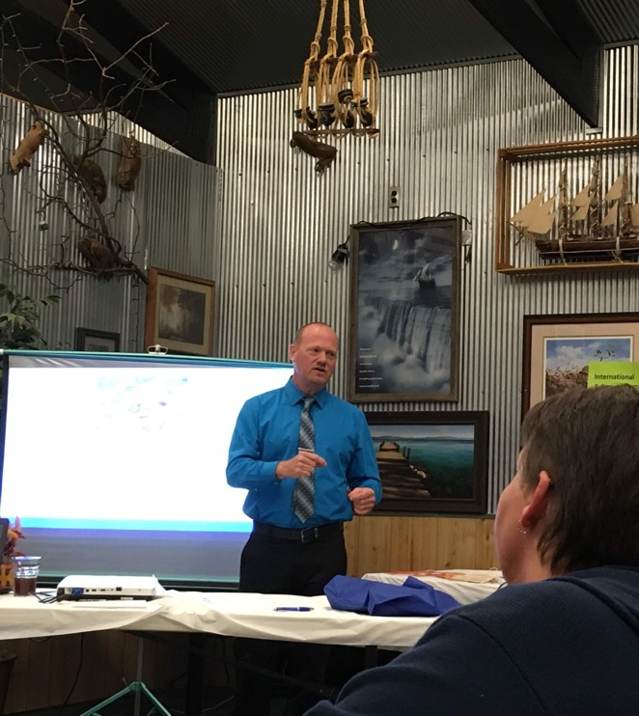

Slide 22
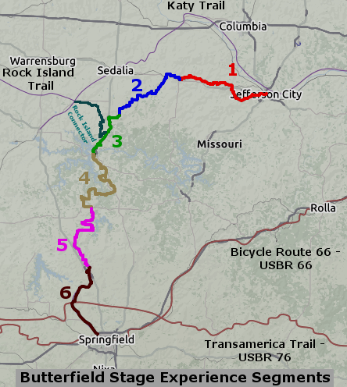

Slide 23

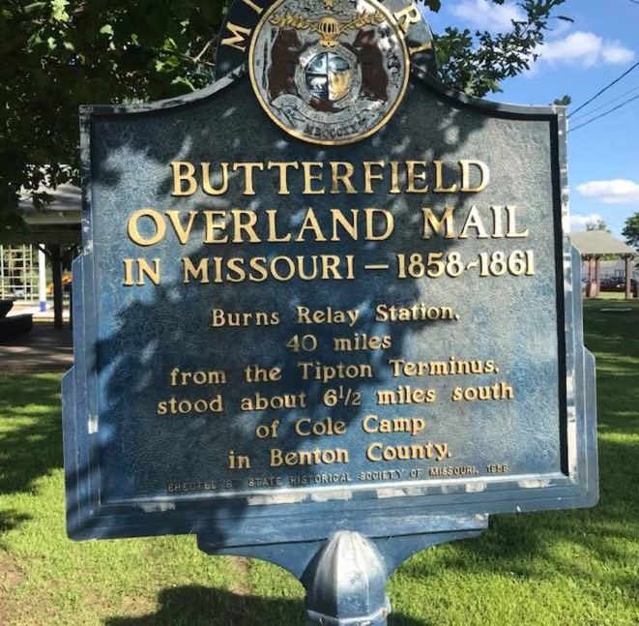

Slide 24
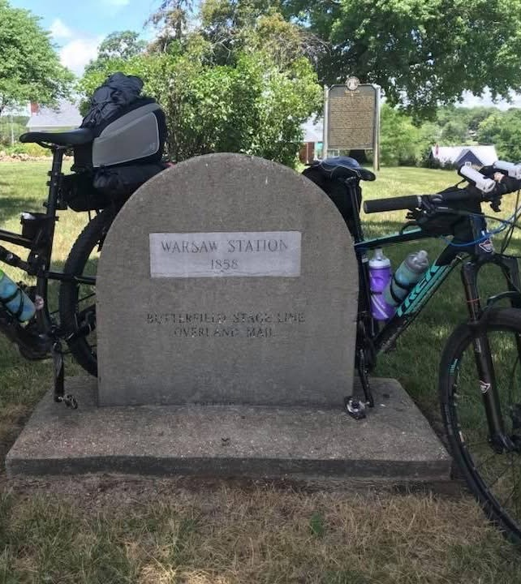
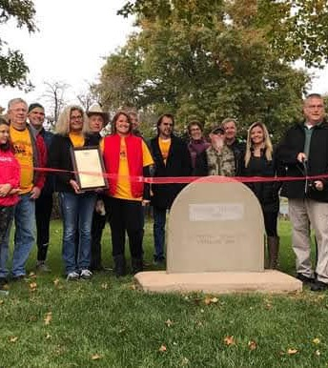

Slide 25
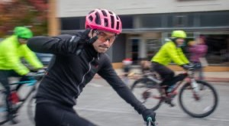

Slide 26
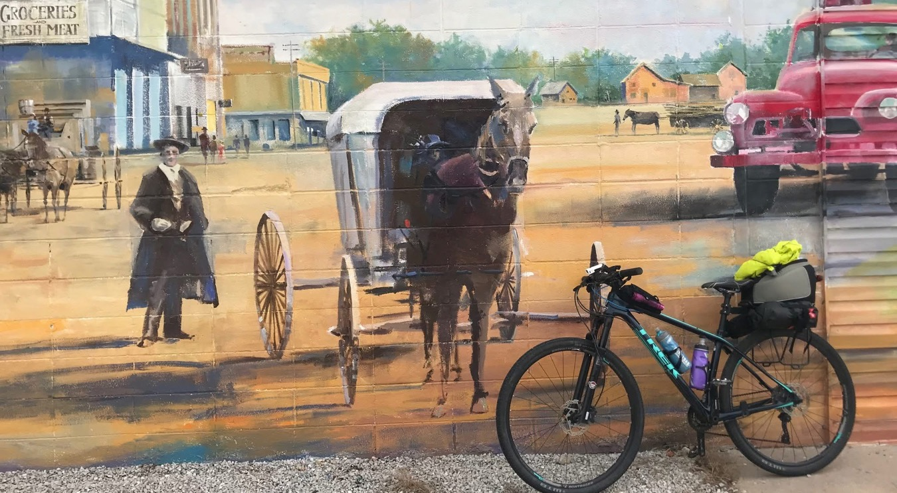

Slide 27
Discussion Questions
What underutilized resources in your region might be brought into productive use in a particular sector/value chain?
What would be most useful to you as you integrate wealth creation thinking into your work?
What do you most want to know about on future webinars or discussions?

Slide 28



More info at: www.nado.org/EDDCoP
The EDD CoP is made possible through an award from the U.S. Economic Development Administration, U.S. Department of Commerce (ED22HDQ3070106). The statements, findings, conclusions, and recommendations are those of the participants, trainers, and authors and do not necessarily reflect the views of the U.S. Economic Development Administration or the U.S. Department of Commerce.

Slide 29

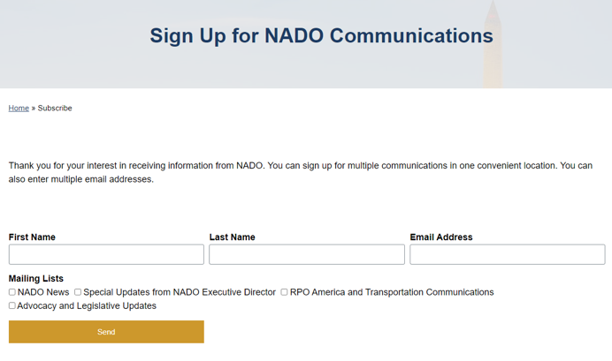
https://www.nado.org/subscribe/

Slide 30
Melissa Levy
Regional Development Researcher/Wealth Creation Specialist
NADO Research Foundation
mlevy@nado.org
www.NADO.org
www.CEDSCentral.com

