Slide 1
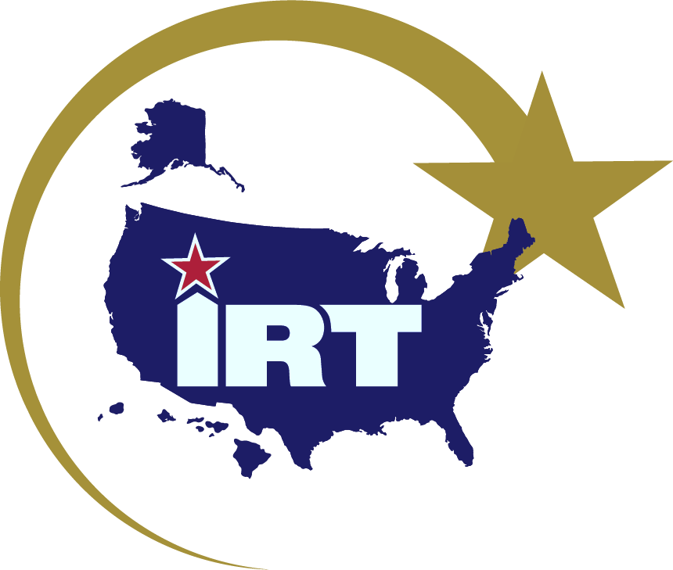
INNOVATIVE READINESS TRAINING The Premier Military Training Platform for a Secure and Prosperous America
FY25 IRT 101 Presentation
It’s all about… STRATEGIC ENGAGEMENT
Notes:
1. Program manager will introduce the SENIOR community representative and ask them to deliver the official welcome to the city/state. This individual will likely make brief comments about the value of the mission/civil-military partnership.
2. At the conclusion of welcome remarks, the program manager will EITHER: introduce the IRT video (slide #2) OR proceed to slide #3 and speak briefly on the value of the civil-military partnership. *All community partners offering remarks will speak at this time IF the IRT video will be played later in the presentation. If the video is to be played at slide #2, remaining community partners will speak at slide #3.

Slide 2
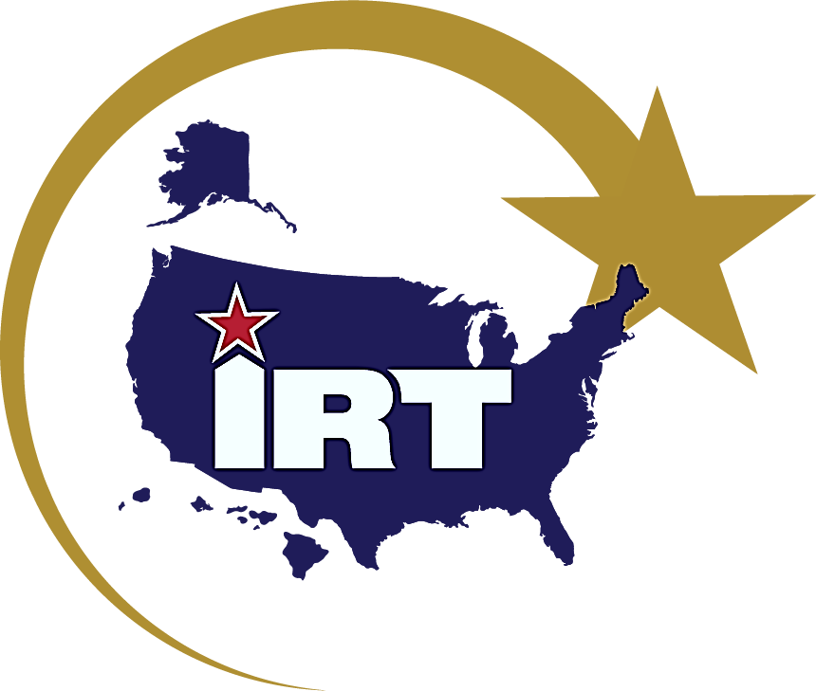
Capt Chris Park IRT ANG Deputy Program Manager

Slide 3
IRT 101
Notes:
1. Program manager will introduce the SENIOR community representative and ask them to deliver the official welcome to the city/state. This individual will likely make brief comments about the value of the mission/civil-military partnership.
2. At the conclusion of welcome remarks, the program manager will EITHER: introduce the IRT video (slide #2) OR proceed to slide #3 and speak briefly on the value of the civil-military partnership. *All community partners offering remarks will speak at this time IF the IRT video will be played later in the presentation. If the video is to be played at slide #2, remaining community partners will speak at slide #3.

Slide 4
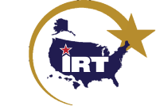
Innovative Readiness Training: Origin
What if the Best Military Training Led to Ready Forces and
Thriving American Communities?
Department of Defense Response to 1992 “Rebuild America” Initiative
Authorized Under Title 10 U.S. Code §2012
IRT is led by the Director, Civil-Military Engagement Policy, in the Office of the Deputy Assistant Secretary of Defense for Reserve Integration.
IRT includes opportunities for Active, Guard, and Reserve Service Members, (and multi-national partners) to integrate as a joint and whole-of-society team to train and serve American communities
“The American people have made an enormous investment in developing the skills, capabilities, and resources of the Armed Forces. These resources, if properly matched to local needs and coordinated with civilian efforts, can be a useful contribution to addressing the serious domestic needs of the United States." - 1993 Senate Armed Services Committee Report
The Premier Military Training Platform for a Secure and Prosperous America

Slide 5
Governing Authorities
10 U.S. Code § 2012 – Support and Services for Eligible Organizations and Activities Outside the DoD
Authorization to provide assistance that is incidental to military training
For a non-profit organization, the determination includes a review of the organizations:
IRS 501(c)3 determination letter
Bylaws
Articles of Incorporation
Department of Defense Directive (DoDD) 1100.20 - Support and Services for Eligible Organizations and Activities Outside the DoD (Innovative Readiness Training)
Establishes policy and procedures for civil-military IRT projects under authority of 10 U.S. Code § 2012
**UPDATED DoDI passed service component level, publish date: Feb 19**
Military Service instructions & policies
32 U.S. Code § 508 (ANG Only) – Assistance for
Certain Youth and Charitable Organizations
The Premier Military Training Platform for a Secure and Prosperous America

Slide 6
Legal Requirements
Must accomplish mission-essential military training
Must not compete with the private sector, non-competition clause
Military members will ONLY do tasks within their military occupational specialty
IRT authorities cannot be used to respond to natural or manmade disasters (though an IRT project may assist with long-term recovery)
Must result in incidental benefit to entities which address a valid/appropriate community need
Must not include commercial development (CE Only)
Military members cannot provide law enforcement during IRT projects

Slide 7
IRT Meets National Defense Priorities
SECDEF Priorities | IRT Strategic Outcomes
Restore Military Readiness | Conduct Successful Missions: IRT Provides hands-on, real-world training to improve readiness and survivability in complex contingency environments
Strengthen Alliances as we Attract New Partners | Community & Civic Needs Met: IRT strengthens and builds partnerships, while providing key services for American communities
Bring Business Reform to the Department of Defense | Optimized Mission Execution: IRT is a collaborative program that leverages military contributions and community resources to multiply value and cost savings for participants
The Premier Military Training Platform for a Secure and Prosperous America
Notes:
In conjunction with Secretary of Defense priorities:
IRT is authorized under Title 10 U.S. Code §2012.
IRT is led by the Director, Civil-Military Training Policy (Colonel Jay Scott), in the Office of the Deputy Assistant Secretary of Defense for Reserve Integration.
IRT includes opportunities for Active, Guard, and Reserve service members (as well as our multinational partners) to integrate as a joint and whole-of-society team to train and serve American communities.

Slide 8
IRT Program
OSD
Department Responsible Officer’s
AIR FORCE
NAVY
ARMY
RESERVE
GUARD
NAVY RESERVE
MARINE RESERVE
GUARD
RESERVE
ACTIVE
ACTIVE
ACTIVE
Service Responsible Officer’s & Program Manager
The Premier Military Training Platform for a Secure and Prosperous America

Slide 9
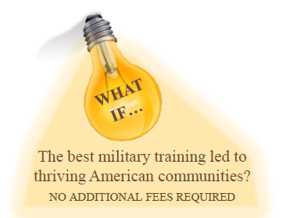
Bolstering Readiness
Hands-on training promotes mission readiness
Refine mission-essential skills in complex environments
REAL vs. simulated tasks in exercises and training events
Enhanced skills used in all phases of military effort
Junior officer/enlisted leadership opportunities in a joint environment
Military personnel double their public service satisfaction
Job satisfaction
Esprit de corps
The Premier Military Training Platform for a Secure and Prosperous America
Notes:
What they are about to see – Junior officer/enlisted leadership opportunity
Community Partnerships
Complex environment
REAL

Slide 10
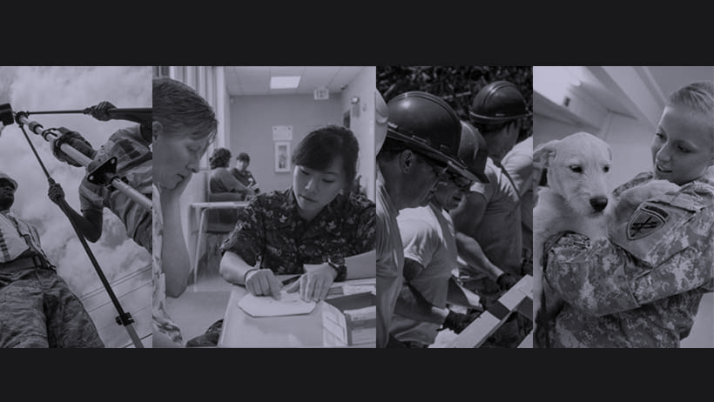
Extensive Training Opportunities
Civil Engineering
Medical
Cyber
Other
Vertical & Horizontal Construction
Electrical
HVAC
Utilities
Paving
Health Exams
Dental
Optometry
Veterinary
Education
Computer Network Defense (CND)
Cyber Resilience Reviews (CRR)
Risk & Vulnerability Assessments (RVA)
Force Support
Public Affairs
Chaplain
Transportation
Communications
Emergency Management
Notes:
IRT provides opportunities for units and individuals to train in a variety of military occupational specialties. While medical and civil engineering missions are the most commonly known, our training portfolio includes: public affairs, cross-country transportation services and even cyber training. As you can see, the training and service opportunities are only limited by your imagination!

Slide 11
Civil-Military Excellence
REQUIREMENTS
RESOURCES
RESULTS
Military
Personnel
Supplies & Equipment
TRAINING
READINESS
PARTNERSHIPS
INNOVATION
Community
SERVICES & SUPPORT
Volunteers Materials & Venue
The Premier Military Training Platform for a Secure and Prosperous America
Notes:
In conjunction with Secretary of Defense priorities:
IRT is authorized under Title 10 U.S. Code §2012.
IRT is led by the Director, Civil-Military Training Policy (Colonel Jay Scott), in the Office of the Deputy Assistant Secretary of Defense for Reserve Integration.
IRT includes opportunities for Active, Guard, and Reserve service members (as well as our multinational partners) to integrate as a joint and whole-of-society team to train and serve American communities.

Slide 12
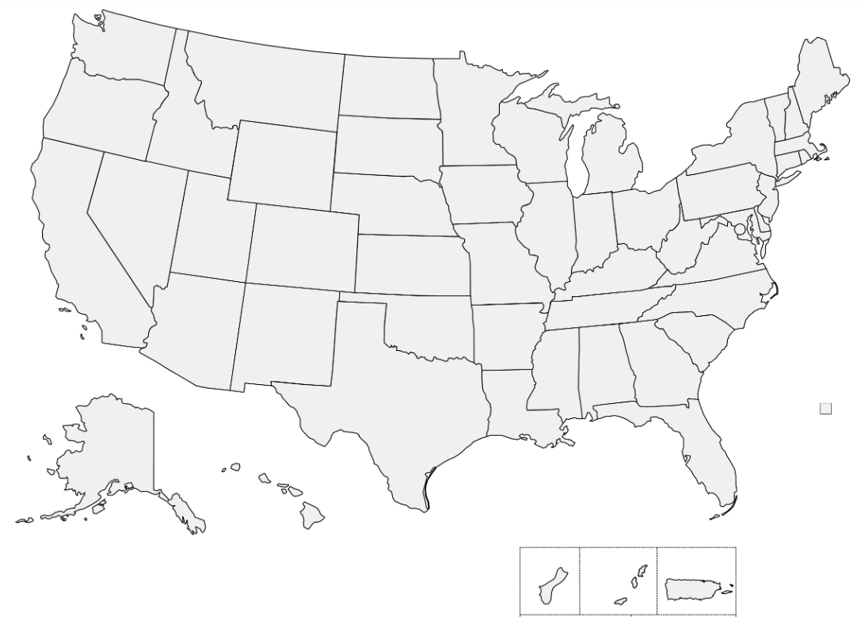
2024 IRT Snapshot
OSD Funded (Pre-Decisional)
38 Missions
26 States & Territories
14 Joint + 28 Non-Joint Missions
Mission Type Legend
Civil Engineering (13)
Medical (16)
Cybersecurity (5)
Transportation (3)
Civil Affairs (1)
Updated: 23 October 2023

Slide 13
FY24 IRT ANG Lead Mission Numbers
Location | ANG Airmen Trained | Joint Members Trained | Training Hours | Community Cost Savings*
Blackfeet Tribal Health (MO) | 61 | 204 | 33,791 | $1.4 mil
Green River Area Wellness (KY) | 82 | 171 | 18,158 | $1 mil
Greene County Guard Care (OH) | 104 | 205 | 5,448 | $604K
Kodiak Arctic Care (AK) | 165 | 289 | 44,572 | $1.4 mil
Totals | 412 | 869 | 101,969 | $4.4 million
The Premier Military Training Platform for a Secure and Prosperous America

Slide 14
IRT Value Participant Survey Results
The Best Military Training results in Ready Forces and Thriving American Communities
90%
reported having gained job satisfaction after being part of an IRT mission
82%
reported experiencing training that mimicked
deployment conditions
81%
reported feeling that they had training that they would have not otherwise had access to
85%
of participants reported increase in job satisfaction
The Premier Military Training Platform for a Secure and Prosperous America

