Slide 1


Leveraging Wealth Creation Strategies through the CEDS: Building Resilient Economies for the Future
March 10, 2025

Slide 2

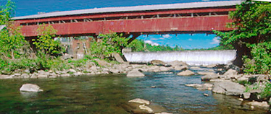
Wealth creation is an approach to economic development
connects a region’s assets to market demand in ways that build rooted wealth for local people, places and firms.
brings together a range of public, private and non-profit sector partners who have self-interest in the outcomes and an openness to discovering shared or common interests.
focuses on building a sector rather than individual and unrelated businesses.
Notes:
Goal: Advance a region’s prosperity by building wealth that sticks
WealthWorks is a bridge between community development (voice, empowerment, organizing) and economic development (attraction, retention, entrepreneurship).

Slide 3



Principles of Wealth Creation
#1 – Create wealth, broadly defined, and aspire to do no harm.
#2 – Root wealth in local people, places and firms through local ownership, control and influence.
#3 – Build lasting livelihoods by intentionally including people and firms on the economic margins.
Notes:
Wealth building framework has three critical goals:
Create wealth broadly defined – includes 8 capitals. Aspire to do no harm to any.
Root wealth in place – pay attention to who owns, controls and influences the wealth that’s created. Root wealth in local peoploe, places and firms through local ownership, control and influence.
Build lasting livelihoods especially for people and firms on the margins – intentionally including economically-marginalized residents.
Use a systems approach – Wealth Creation Value Chains – to build value in existing and emerging sectors.

Slide 4
t
Wealth Components: Eight Capitals
Key Concept
Intellectual
  Knowledge and innovation
Assessment
Design
Measurement
Individual
  Skills, education, health
Social
  Trust and relationships
Natural
  Natural resources
Built
  Infrastructure
Political
  Influence on decision makers and shapers
Financial
  Savings and investment
Cultural
  Traditions, customs and ways of doing
Notes:
Realize that you all are familiar with the triple bottom line. This isn’t really different … just unpacks the three capitals into greater detail… The other addition is that this approach focuses on both inventory and then investing in building our “stocks” of these capitals/assets. We recognize that without active investment, resources will depreciate.

Slide 5
A Continuum for Economic and Community Development
Comprehensive Planning
SWOT
Measuring outcomes
Sector-specific
Collaboration
Value chain development
Value chain mapping
Filling gaps in the chain
Coopetition
Notes:
It’s not one size fits all. The entry point is to use the discussion of capitals/assets in your CEDS planning.

Slide 6



Wealth Creation & the CEDS
NADO Washington Conference
March 10, 2025

Slide 7
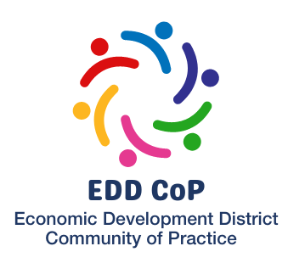


More info at: www.nado.org/EDDCoP

Slide 8

We are (Still) in a Golden Age for the CEDS
Rawpixels.com

Slide 9

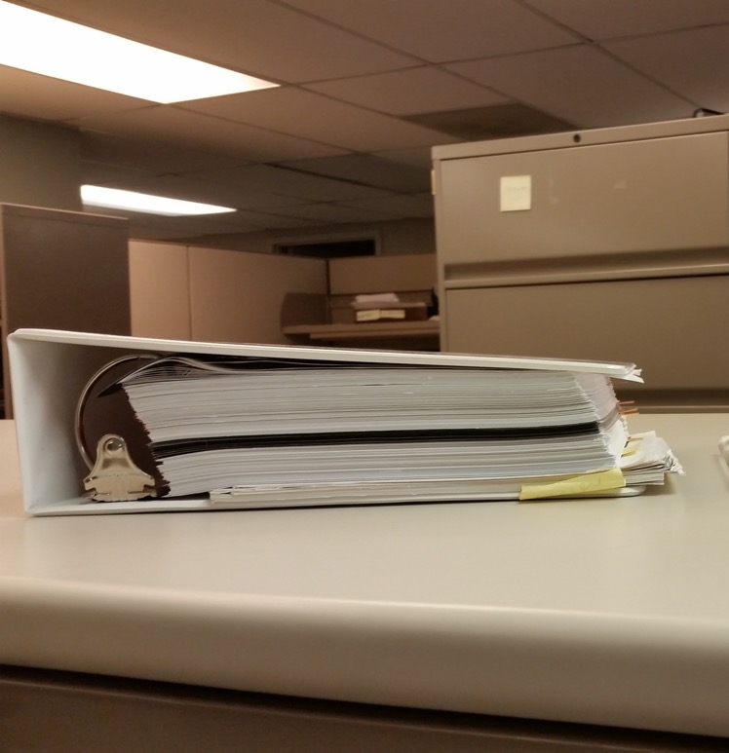

Slide 10
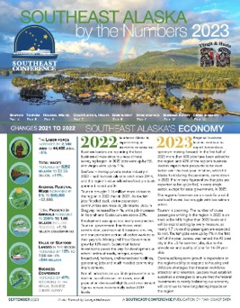
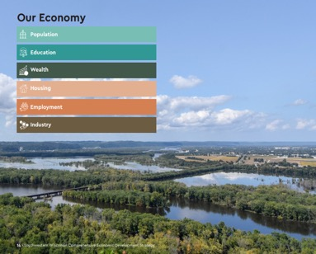
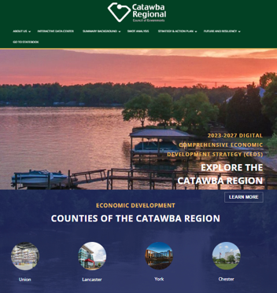
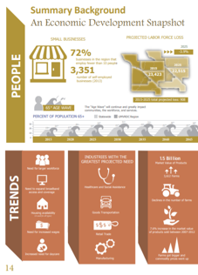
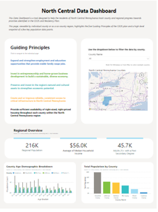


Slide 11
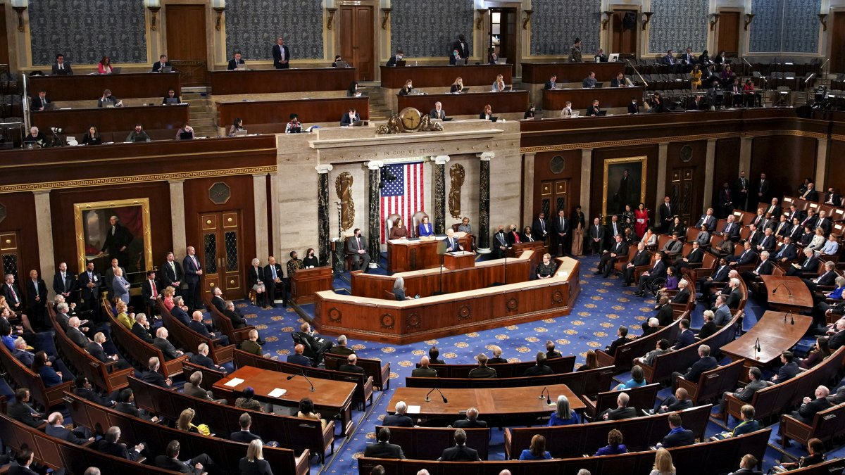
The CEDS as a Region’s “State of the Union”
NBC4 News

Slide 12

The CEDS as the Region’s Strategic Plan
Harvard Business School

Slide 13

The CEDS as a Roadmap for Regional Economic Development
Francesco Paggiaro

Slide 14

The CEDS as a Conduit of Resources to the Region

Slide 15
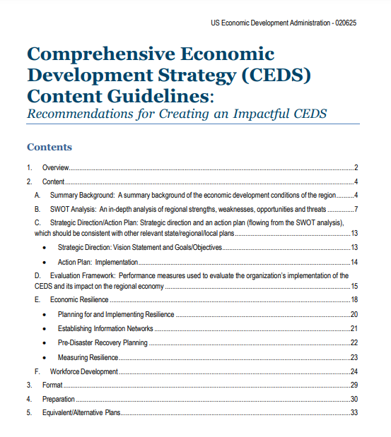
CEDS Content Guidelines
Intended to help regional planning organizations craft more impactful CEDS
Provides guidance on the required sections of the CEDS
  Summary Background
  SWOT
  Strategic Direction/Action Plan
  Evaluation Framework
  Economic Resilience
Focused on best practices, case studies, and links
Collection of suggestions and recommendations. . .not a list of additional requirements
https://www.eda.gov/CEDS

Slide 16



Slide 17
CEDS Content Guidelines
Intended to help regional planning organizations craft more impactful CEDS
Provides guidance on the required sections of the CEDS
  Summary Background
  SWOT
  Strategic Direction/Action Plan
  Evaluation Framework
  Economic Resilience
Focused on best practices, case studies, and links
Collection of suggestions and recommendations. . .not a list of additional requirements
https://www.eda.gov/CEDS

Slide 18
CEDS Evaluation Framework
The evaluation framework serves as a mechanism to gauge progress on the successful implementation of the overall CEDS…
The evaluation framework is an important element of the ongoing planning process and should answer the questions “How are we doing?” and “What can we do better?”
The evaluation framework, with its associated measures and timelines, should cascade from the strategic direction and action plan, which, in turn, flow from the SWOT analysis.
https://www.eda.gov/resources/comprehensive-economic-development-strategy/content/evaluation-framework

Slide 19
Wealth Creation as Part of the Evaluation Framework
[T]he concept of wealth is one that should be highlighted because of its natural alignment with asset-based strategies and approaches. More than just jobs and income, regional wealth is represented by intellectual, individual, social, natural, built environment, political, financial, and cultural assets. These assets, when invested in, nurtured, and leveraged appropriately, can reflect the true level of a region’s economic (and social) well-being.
Finding ways to better identify, foster, and measure these assets can help a region towards a more lasting prosperity since a focus on wealth creation and retention can build a region’s resiliency and long-term sustainability.
https://www.eda.gov/resources/comprehensive-economic-development-strategy/content/evaluation-framework

Slide 20
A wealth creation approach to the CEDS:
Is noted as a best practice by EDA in the CEDS Content Guidelines
Offers an asset-based approach to economic development
Provides a vocabulary to engage the stakeholders about regional issues
Can complement traditional metrics like job creation / GDP / etc
Is fun and inspiring!

Slide 21
More info at: www.nado.org/EDDCoP

Slide 22
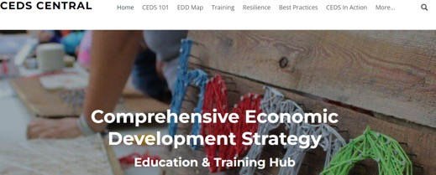
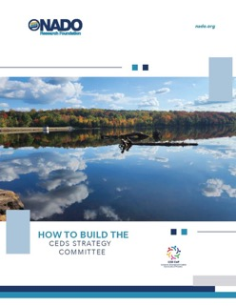

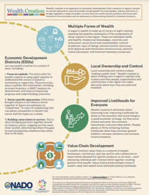

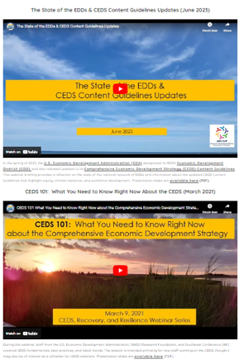
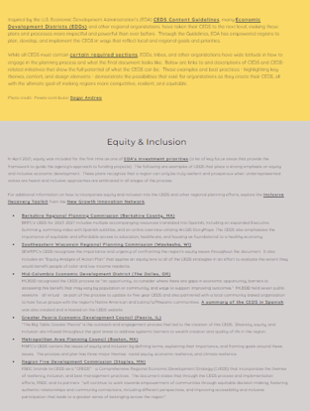
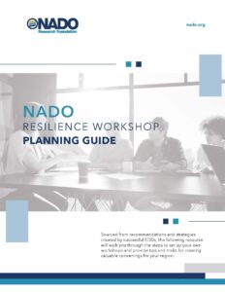
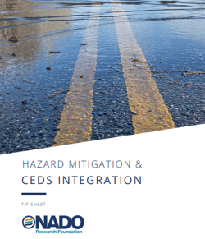
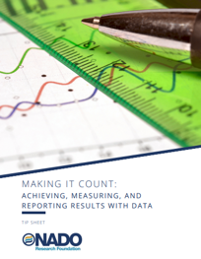
Visit: www.cedscentral.com & www.nado.org/eddcop

Slide 23
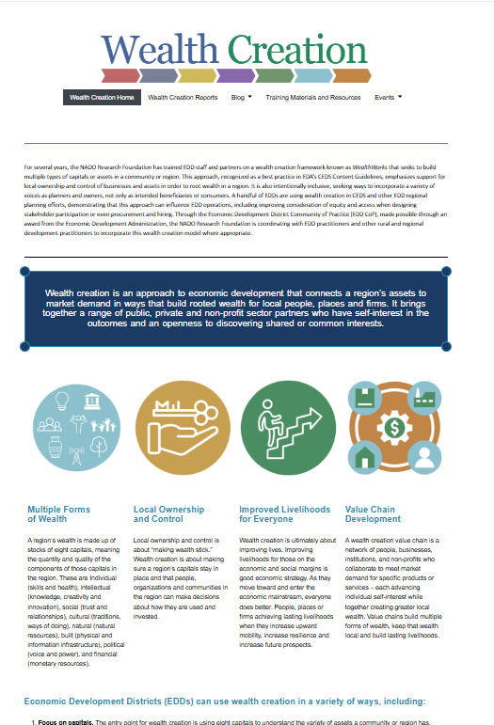
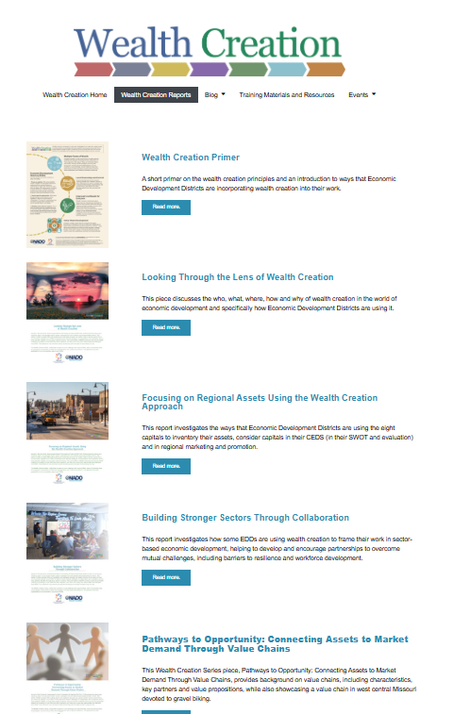
https://www.nado.org/wealthcreation/

Slide 24
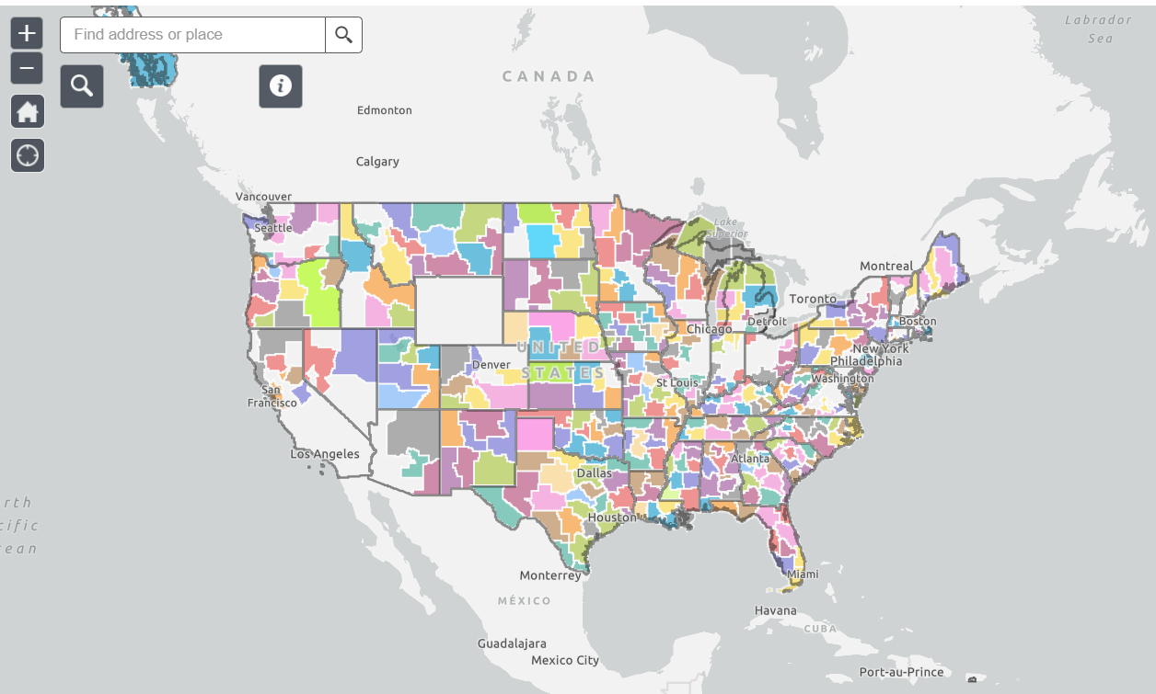
Interactive EDD Map available at: www.nado.org/EDDMap

Slide 25
Creative
Engaging
Driven by Data
Storytellers
The Most Impactful CEDS Are:

Slide 26


Stay in Touch!
Brett Schwartz
Associate Director
NADO Research Foundation
bschwartz@nado.org

Slide 27
Wealth Creation in the CEDS Process
Region 5 Development Commission (MN) engages CEDS stakeholders based on their strengths in building specific capitals.
Another resource to explore is NADO RF’s How to Build the CEDS Strategy Committee brief.
Notes:
Engagement through:
Multiple forms of wealth
Dignity and respect for all.

Slide 28
Opportunities to Build Partnerships
Community Capital | Current committee members (or other leadership) | Potential partners working to build these assets | Why would they be interested in participating in your work? How would you engage them?
Individual capital (health, wellness, workforce, education, other skills)
Intellectual capital (innovation partners)
Natural capital (businesses, organizations, or agencies focused on land, water, air, etc.)
Built capital (owners and operators of infrastructure, including private sector)

Slide 29
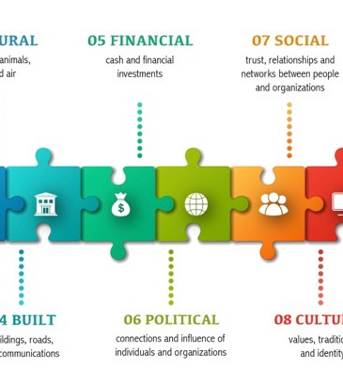
CEDS Content: Focus on Assets
Asset inventory and mapping
Consider capitals through the SWOT
Evaluate progress in plans.

Slide 30
Wealth Creation in CEDS Content
Summary Background
SWOT Analysis
Strategic Direction/Action Plan
Evaluation Framework

Slide 31
Summary Background
This is a summary background of the economic conditions of the region.
The question to be answered here is “What have we done?” and “What is going on in our region?”
The opportunity is to report the conditions of the region across the eight capitals. This might include the obvious ones: jobs and employment, educational attainment, revenues, income. But it may also include conditions of natural capital, cultural capital, intellectual capital, and more.

Slide 32
Asset Inventory
E
The Capitals | Definitions | What do we have?
Individual | Skills, understanding, physical health and mental wellness in a region’s people
Intellectual | Knowledge, resourcefulness, creativity and innovation in a region’s people, institutions, organizations and sectors.
Social | Trust, relationships and networks in a region’s population.
Cultural | Traditions, customs, ways of doing, and world views in a region’s population.
Natural | Natural resources—for example, water, land, air, plants and animals—in a region’s places.
Built | Constructed infrastructure—for example, buildings, sewer systems, broadband, roads—in a region’s places.
Political | Goodwill, influence and power that people, organizations and institutions in the region can exercise in decision-making.
Financial | Monetary resources available in the region for investment in the region.

Slide 33
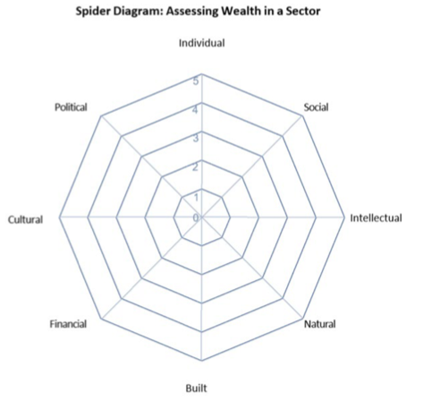
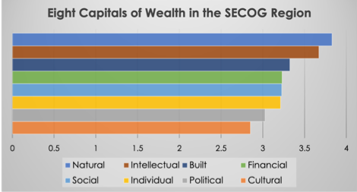
Spider Diagram as an Asset Inventory Tool

Slide 34
SWOT using community capitals
Strengths: Capitals we have, use, could use more Energy and enthusiasm Partnerships between business, government, and organizations | Weaknesses: Capitals we are missing, or are weak People, firms, and organizations on the economic margins Lack of partnerships between business, government, and organizations
Opportunities: Underutilized capitals we can invest in Upward mobility for all Emerging Markets/Demand Gaps in activities needed to meet demand for products and/or services in specific emerging markets where investment will have the greatest impact (leverage) Repurposed by-products or residuals Local, broad ownership Potential to go to scale | Threats: Policy barriers Ownership by those outside of the region Negative opinion shapers and parties unwilling to collaborate

Slide 35
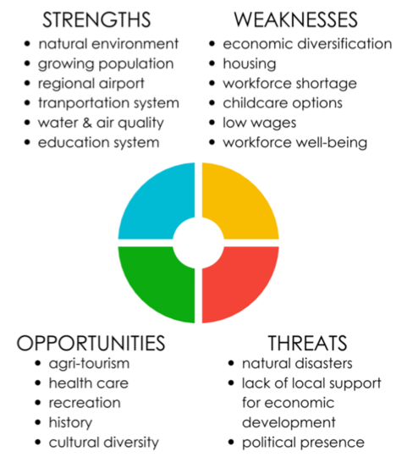
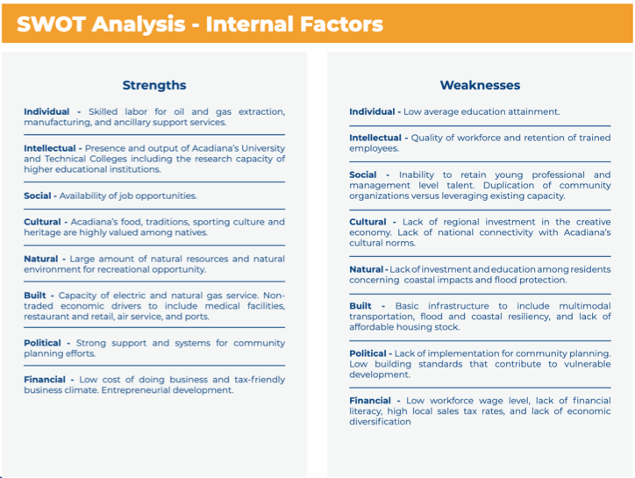
SWOT Examples
Buckeye Hills Regional Council identifies regional asset-based development as an opportunity in its SWOT analysis and calls out “expanding local ownership and control of assets as a wealth-building opportunity.”

Slide 36
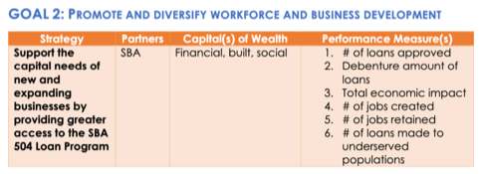
Strategic Direction/Action Plan
In the SECOG CEDS, there are three key goals in the action plan:
  Facilitate responsible community planning and development
  Promote and diversify workforce and business development
  Foster community vibrancy and resiliency.
Each goal has multiple strategies, each of which notes key partners, capitals affected, and measures.

Slide 37
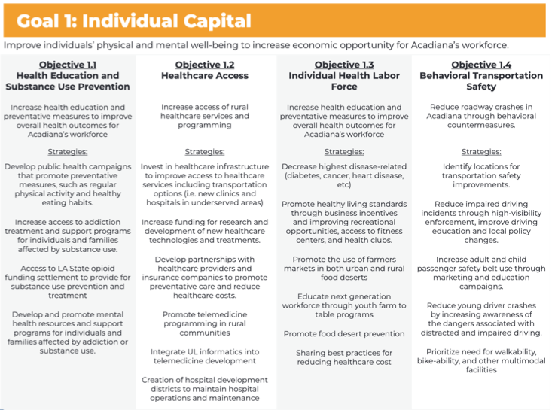
Acadiana Planning Commission Strategy – A Goal for Each Form of Wealth

Slide 38
Region Five Development Commission Strategy
“By considering the eight asset banks outlined in this model, goals and strategies cross typical boundaries by asking the question, ‘who else cares about this?’, in turn encouraging collaboration and efficiency in using available resources.”
Notes:
R5DC notes a few key strategies:
Industry and Innovation:
Share stories about the opportunity cost LOST if we did not build out all forms of wealth
Social Capital:
Develop intentional “efficiencies and effectiveness” programs and projects with multi -jurisdictional, multi -theme, multi -forms of wealth, multi - sectors/agencies/ departments involvement
Clearwater Economic Development Association (CEDA) in Idaho identifies in its Entrepreneurship, Business Development and Economic Empowerment Objective a task to “Execute WealthWorks Value Chain mapping to identify and address supply chain gaps and bottlenecks for regional businesses, artisans, and small producers.”\\Upper Coastal Plain Council of Governments (UCPCOG) identifies in its Action Plan a key vision that “Community wealth is generated throughout the Upper Coastal Plan Region,” with initiatives including to “improve the region’s ability to foster a diverse, thriving economy;” “Define and promote the region’s sense of place;” and “Build on the region’s competitive advantages and leverage the marketplace.”

Slide 39
Local Ownership in the CEDS
The Southern Tier 8 Regional Board in New York references in its CEDS the strategy to “Continue to build a regional local ownership entrepreneurial community,” also referencing local ownership and control of assets.
The Blackhawk Hills Regional Council in Illinois in its CEDS suggests the opportunity to “Discuss employee stock ownership plan (ESOP) and related models with proprietors.”
Buy Local Campaigns
Regional branding
Cooperatives
Resident Owned Communities

Slide 40
Evaluation Framework
Snowy Mountain Development Corporation, an EDD based in Lewistown, Montana, establishes in its Evaluation section: “The organization and communities increase in the eight forms of wealth including: individual, social, intellectual, natural, built, political, financial, and cultural capital.”
For R5DC, “the WealthWorks model plays an important role when evaluating the effectiveness of the [CEDS] goals and strategies, ensuring that eight asset banks, intellectual, individual, social, cultural, natural, build, political and financial, are all considered.”

Slide 41
Wealth Measurement Matrix
Name of Organization: |  |  | Date:
Type | Strategy (What actions will you take?) | Indicator (What is the change you’re seeking?) | Measure (How would you measure that change?) | Baseline (This is the first time you measure.) and Target (What are you working toward?) | Methodology (How will you measure and use the data?) | Partners (Are there any key partners needed?)
Individual
Social
Intellectual
Natural

Slide 42
EDDs incorporate wealth creation into the CEDS
Fostering asset-based development by leveraging local assets and community-owned wealth
Encouraging local and regional entrepreneurship through support for businesses, social enterprises and anchor institutions
Enhancing capital access through innovative financing tools and public infrastructure projects
Measuring wealth creation beyond jobs

Slide 43
Wealth Creation Initiatives in the CEDS
Northwest Michigan Council of Governments (Networks Northwest)
  Incorporates strategies to support local entrepreneurship, particularly in agriculture, tourism, and manufacturing.
  Includes programs that build regional value chains, such as linking local farmers to regional markets.
  Promotes workforce development initiatives to ensure local residents can access high-quality jobs.
Southeast Alaska Economic Development District (SEDA)
  Supports sustainable resource management, particularly in fisheries and forestry.
  Invests in local ownership of businesses and infrastructure to retain wealth within the region.
  Develops cultural tourism initiatives to preserve and leverage Indigenous heritage for economic growth.
Notes:
Southern Minnesota Initiative Foundation (SMIF) Emphasizes investments in local entrepreneurs and small businesses. Provides grants and loans to support community-driven projects. Focuses on building generational wealth through access to capital and business development programs.
Mid-Columbia Economic Development District (MCEDD), Oregon and Washington. Promotes renewable energy projects, including community-owned solar and wind energy initiatives. Strengthens local food systems by connecting farmers with regional distributors and consumers. Offers business financing programs to support small businesses and startups.
Southwest New Mexico Council of Governments (SWNMCOG)
Focuses on local capacity building by supporting small businesses and cooperatives.
Implements renewable energy projects to provide long-term community benefits.
Encourages value-added agriculture to increase profits for local producers.
East Central Iowa Council of Governments (ECICOG)
Develops business incubators and accelerators to support local entrepreneurs.
Encourages investment in affordable housing to create equity for residents.
Promotes downtown revitalization projects that stimulate local business activity and create wealth.
Even if wealth creation is not explicitly mentioned in the CEDS, there are elements of it (building wealth, keeping wealth local, building livelihoods) in many CEDS. In the Southern Colorado Economic Development District CEDS, one strategy mentions “Develop and share in the ownership of publicly owned broadband assets.”
The Central South Dakota Enhancement District CEDS references local ownership and control of assets when it lays out the strategy to “Encourage local leaders to invite youth to become involved in organizations, committees, and governing bodies in order to encourage "ownership" of a community.”

Slide 44
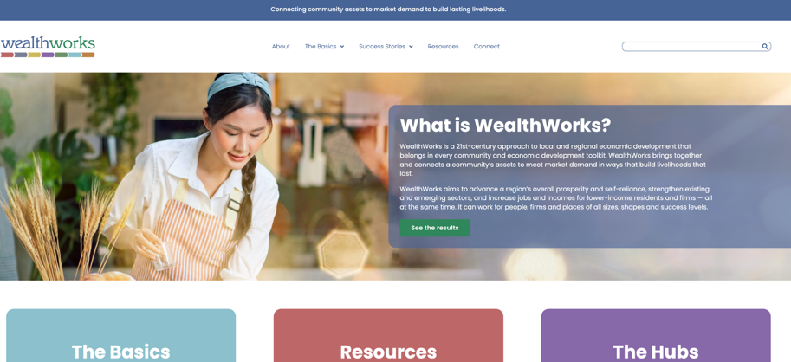
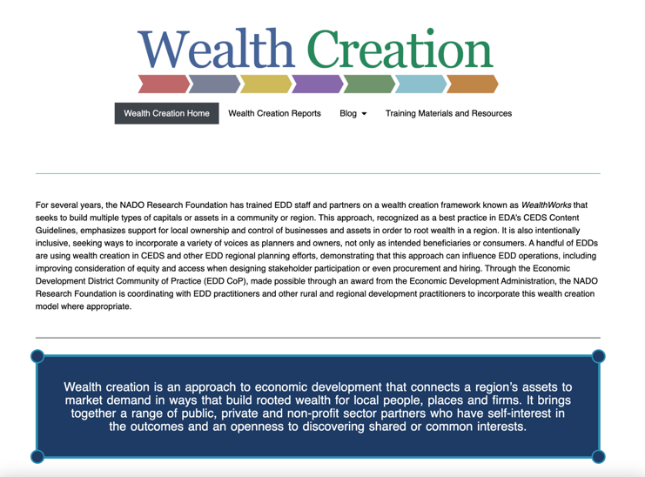
WealthWorks Website - www.wealthworks.org
NADO Wealth Creation Website – www.nado.org/wealthcreation

Slide 45
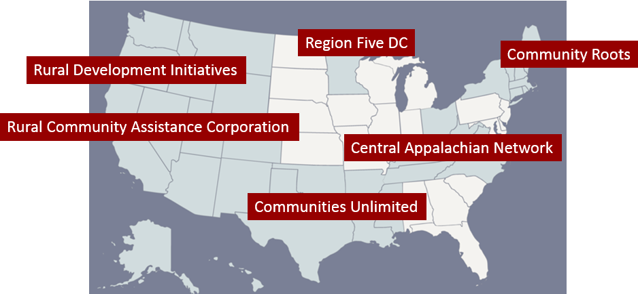
WealthWorks Regional Hubs
http://www.wealthworks.org/connect/hubs

Slide 46

For More Information
Melissa Levy
NADO
mlevy@nado.org
www.nado.org

