Slide 1
ARC Pathways: A Comprehensive Grant Management Platform for Success
March 11, 2025

Slide 2
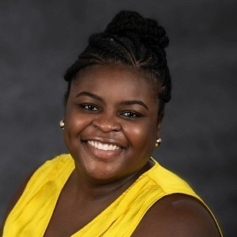
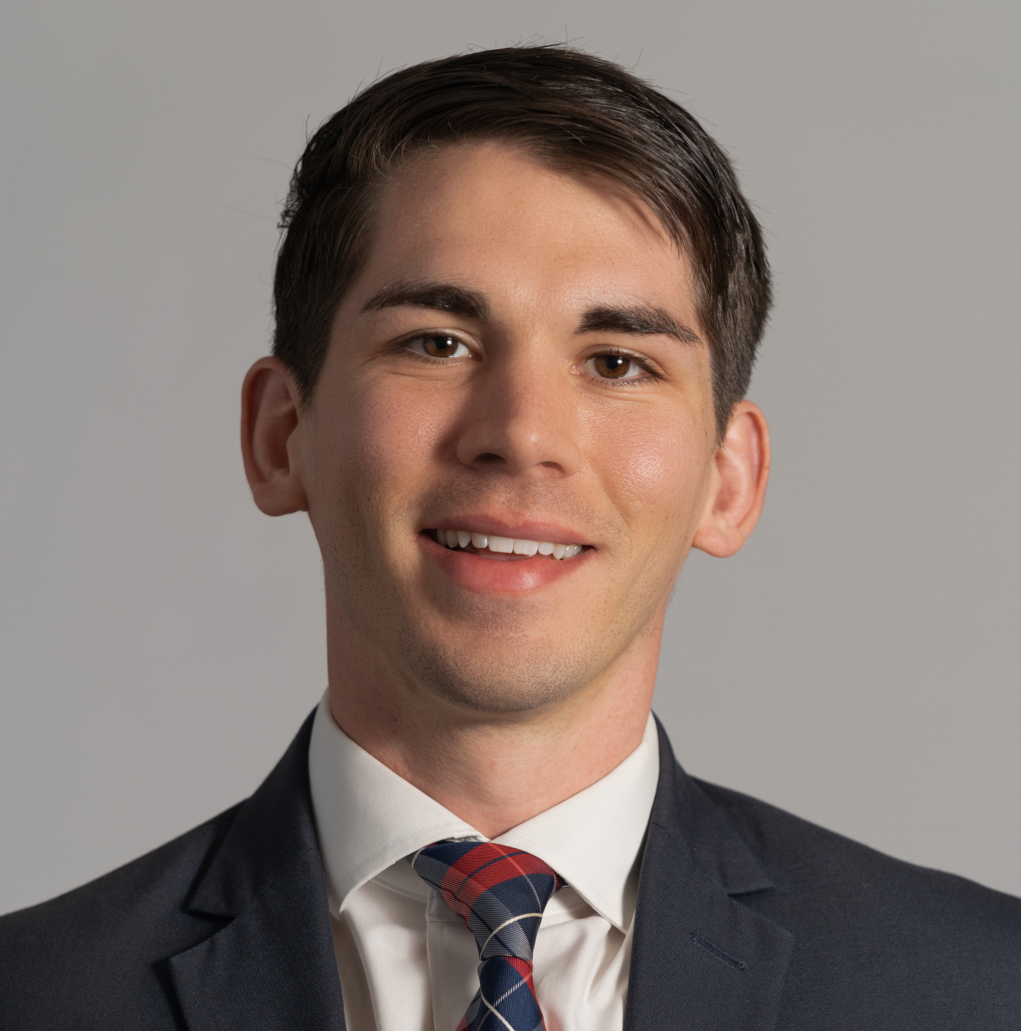
Welcome!
Krystal Rodney
Instructional Designer/Trainer
krodney@arc.gov
(insert pic)
Elijah Biggs
Business Analyst
ebiggs@arc.gov

Slide 3
Objectives:
Compare application creation and post-award activities in Pathways and ARCnet
Discuss what supports constituents may need
Practice creating an application and post award reports in Pathways
Notes:
Here are our objectives for the day. Frozen gesture, then read.

Slide 4
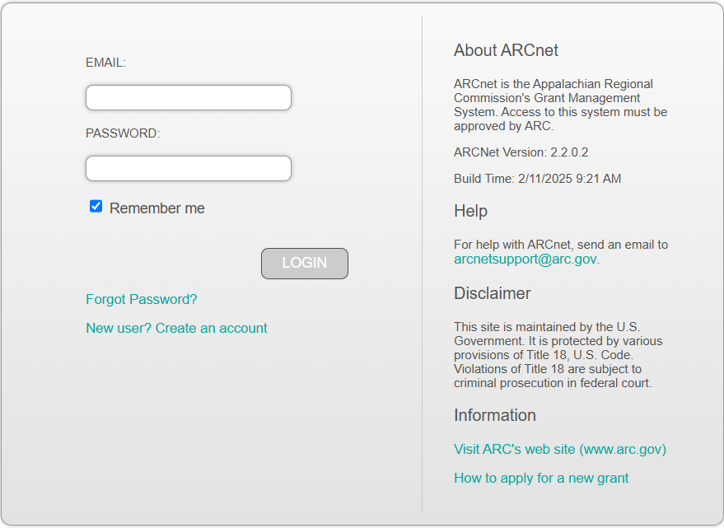
All About Pathways
Anticipated completion in Q2
For all grant management activities
Training opportunities and print materials will be available to all users through ARC
Notes:
If you have worked with ARC before, you may be familiar with ARCnet. Pathways is an all-inclusive grants management system. All activities in the grant life cycle will be housed here, from LOIs, to communication with your project coordinator, to payments and reports, all the way to closeout. We are very excited for a Q2 release this year, likely at the end of May. We will be providing lots of training opportunities ahead of the release, including virtual self-paced courses, and print materials.

Slide 5
Pathways Timeline
Quarter 2 -2025
Post Award activities
Signing new grant agreements
Training resources available
Early 2026
Create & submit applications
Notes:
The Pathways system rollout will happen in stages. As we previously said, we’ll start using the Pathways system in late Spring of this year. When we start using the system, it will be mostly for post award activities and the short process of signing grant agreements. At the beginning of next year, we’ll start using the system to create and submit applications. Keeping this timeline in mind, we’d like to explore two sections of the grant life cycle with you, since you’re likely deeply embedded in these processes with your constituents or give support to your constituents to complete these processes : post award reporting and creating applications. Our goal for our time together is for you to try out the processes with the lens of your work with constituents, and to share some feedback with us. To accomplish that, here’s the cadence for the rest of our time together.

Slide 6
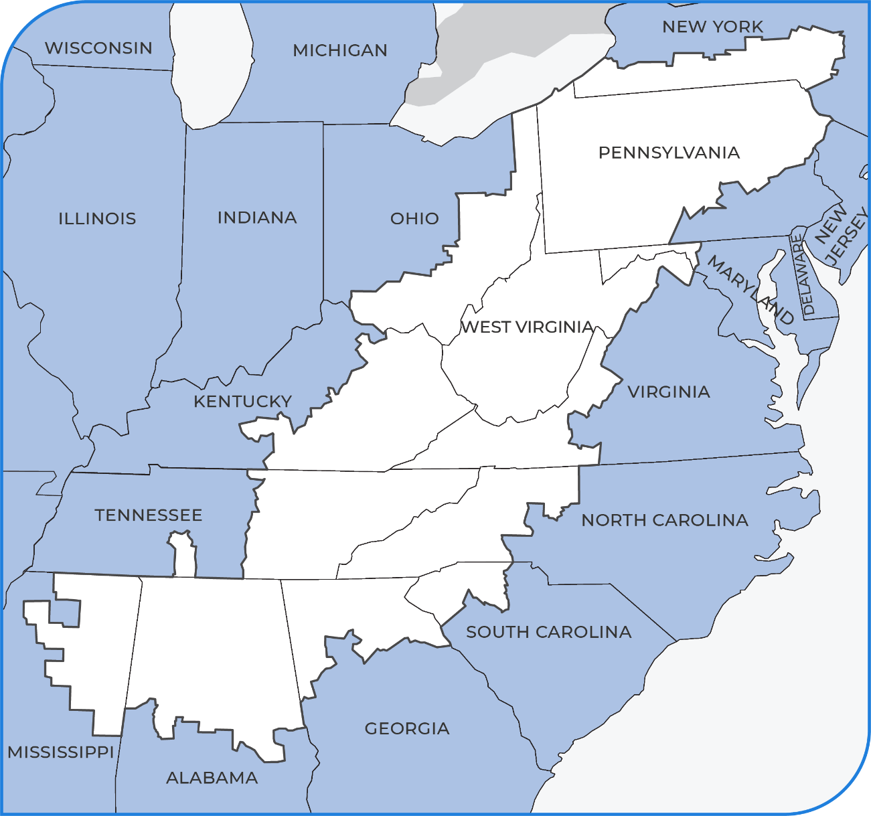
Appalachian Region
13 states
423 counties
206,000 square miles
26 million people
74 local development districts

Slide 7
What Does an Effective Grants Management System Need?
Notes:
So many of us in the room have worked with ARCnet, heard of ARCnet. Some of the states we work in have their own grants management systems. We’re going to start our time together really grounding ourselves in what we would want to see in a good grants management system. To do that, we’re going to…

Slide 8
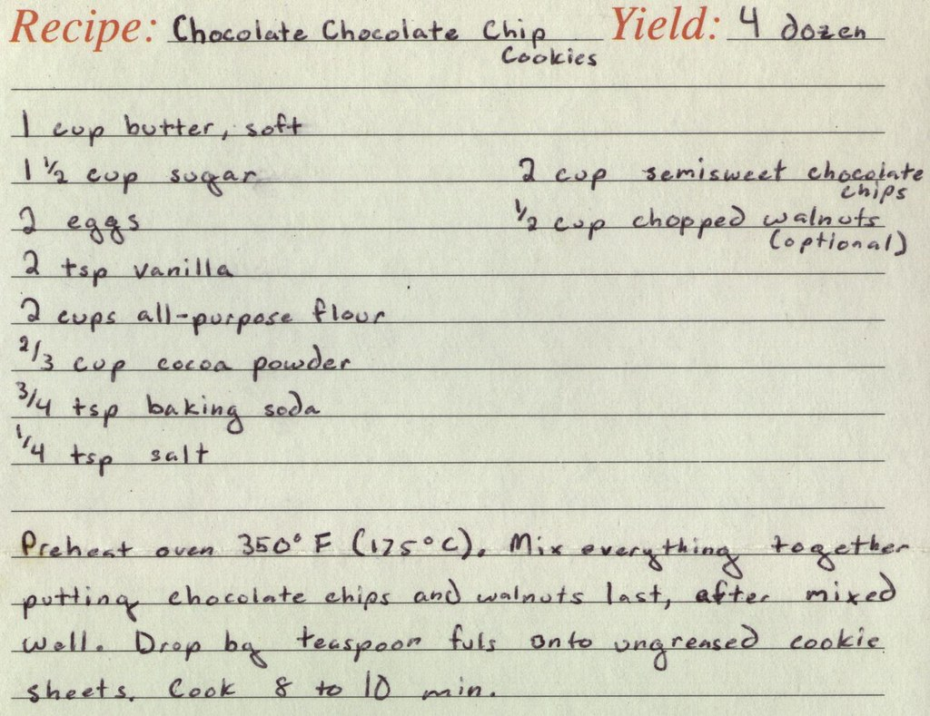
Create a Recipe
With your group, decide what ingredients are needed for a grants management system
Develop a recipe with your table group
Notes:
…create a recipe. So we’re going to create a recipe for an effective grants management system. Give example in the kitchen. Give example for grants management.
Image: Pip! Gold on Flickr: https://www.flickr.com/photos/phil_g/17283477, retrieved 3/4/2025

Slide 9
Create a Recipe
Word Bank
Ounce
Cup
Pint
Quart
Gallon
Teaspoon
Tablespoon
Pinch
Dash
Bake
Boil
Chill
Chop
Fold
Ladle
Mix
Sprinkle
Whisk
With your group, decide what ingredients are needed for a grants management system
Develop a recipe with your table group
Notes:
Here are some words that you might consider using in your recipe. Try to match your words with what you actually want, because we will be using this as feedback as we regroup as an ARC team. If you want a lot of something, we might use a larger measurement. What questions have I created before you get started?

Slide 10
Create a Recipe
Do a gallery walk with your group
Discuss: what similarities do you see?
Notes:
Now that we’ve finished, you’re going to a gallery walk with your group to look at what other groups wrote. Very similar to how we would move through an art gallery or museum. As you move about the room, discuss with the group what similarities you see across the charts or between what you wrote and what you’re observing.

Slide 11
Our Time Together
Demo Pathways
Try It Out
Discuss
ARCnet
Notes:
Explain the cadence of our time for the rest of the session.

Slide 12
Creating an Application

Slide 13
Creating an Application in ARCnet
Notes:
With ARCnet, you would send a PDF application to ARC, and ARC would enter it into the system for you.

Slide 14
Creating an Application in Pathways
Notes:
Demo of creating an application in Pathways. Showing the capabilities of the system. Current method of submission is still in use and available within Pathways. SPMs will be seeing this in 2 weeks. Opting to use any new capabilities to submit applications is a decision made by each individual state.

Slide 15
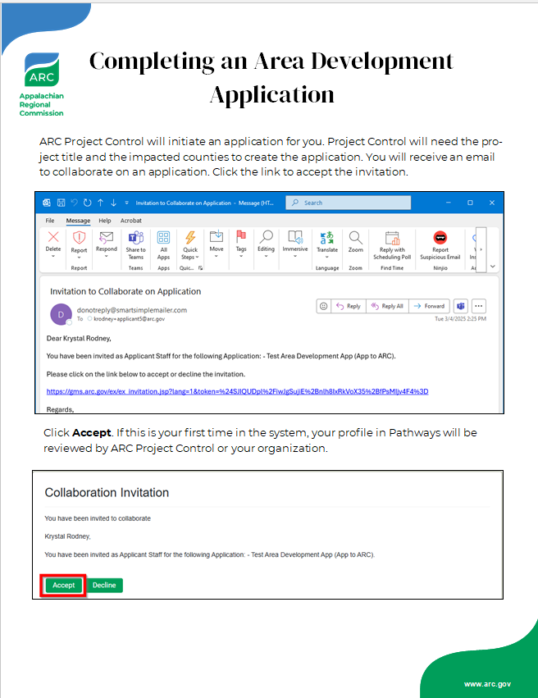
Let’s Try It Out!
Create groups of 2 or 3 at your table
Use the directions on the table to create an application
Notes:
Now you’ll have an opportunity to try this process out yourself. You have account information on your tables. Create groups of 2 or 3. Choose one account slip per group. Raise your hand if you don’t have at least 1 account slip for your group. You’ll also see some directions. These are the same steps you saw on the screen. You’ll use these steps to create an application in Pathways.

Slide 16
As You Work…
What might constituents need support with during these processes?
What might you or your LDD need support with during these processes?
What might this support look like?
Notes:
As you work, we’d like you to keep these 3 questions in mind (read questions with movement). We will also be circulating to support you as you work. What questions have I created before you get started?
Say Something? Or another Groups at Work structure? Would that be too much?
Or questions about supporting constituents here?

Slide 17
Let’s Discuss
What might constituents need support with during these processes?
What might you or your LDD need support with during these processes?
What might this support look like?
Notes:
What came to the surface for you as you discussed with your group?

Slide 18
Post Award Reports

Slide 19
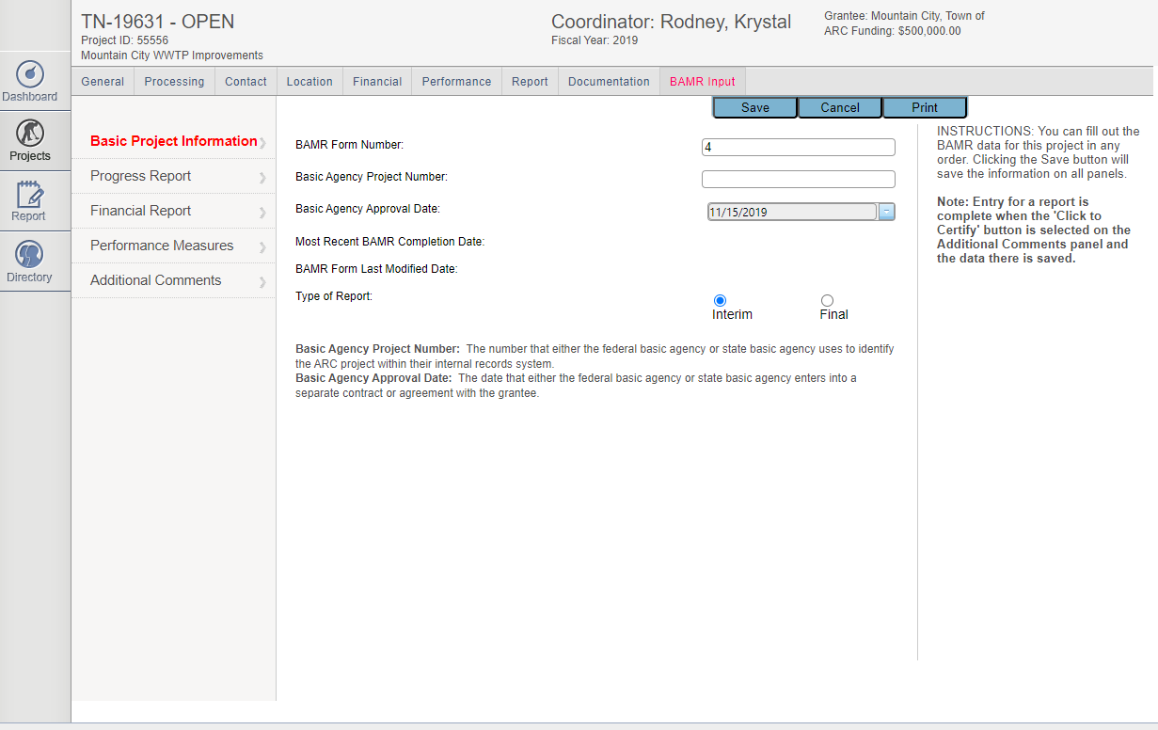
BAMR in ARCnet
Reporting tool for grantees
Notes:
No reporting tool for grantees

Slide 20
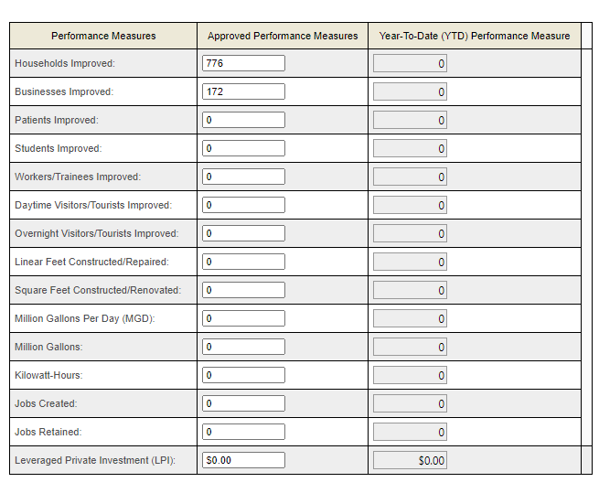
BAMR in ARCnet
Performance Measures reporting
Cumulative vs. Year-To-Date
Notes:
Currently asked for YTD performance measures, but they are actually cumulative
Currently, grey fields are where you type, white fields are locked.
You may need more info on performance measures from the grantee and not have an easy way to get it.

Slide 21
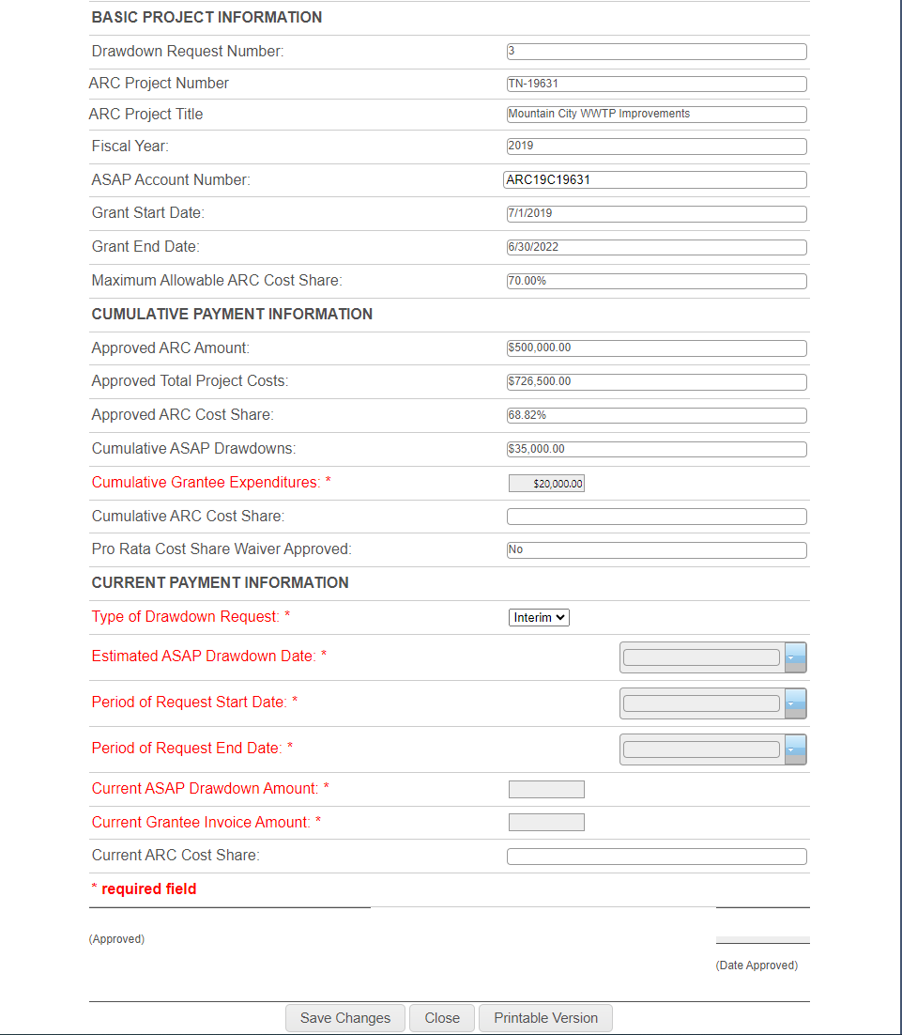
ASAP Drawdown in ARCnet
Where to enter text
What does this mean?
Order of the sections
Notes:
Based on helpdesk tickets, here are some issues we identified with ASAP drawdowns
Unclear where to enter text
Description of each field is unclear
Order of the sections may be confusing

Slide 22
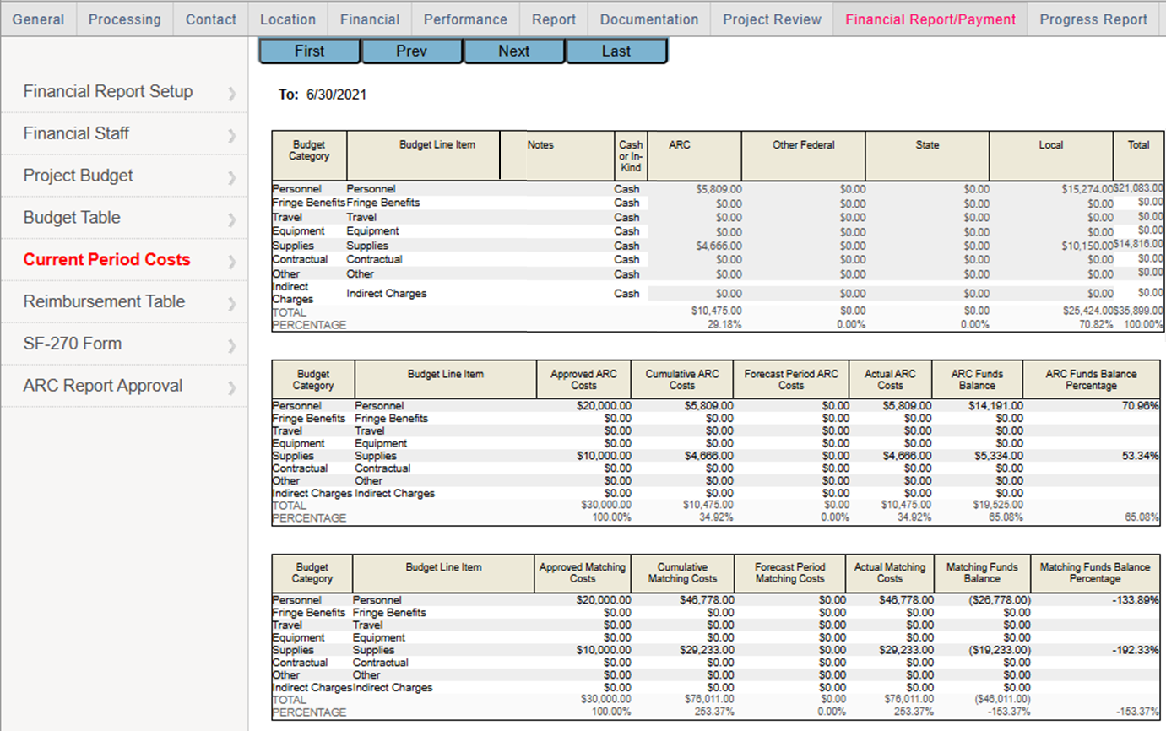
Payment Tool in ARCnet

Slide 23
Post-Award in Pathways
Notes:
Demo of completing a report in Pathways

Slide 24
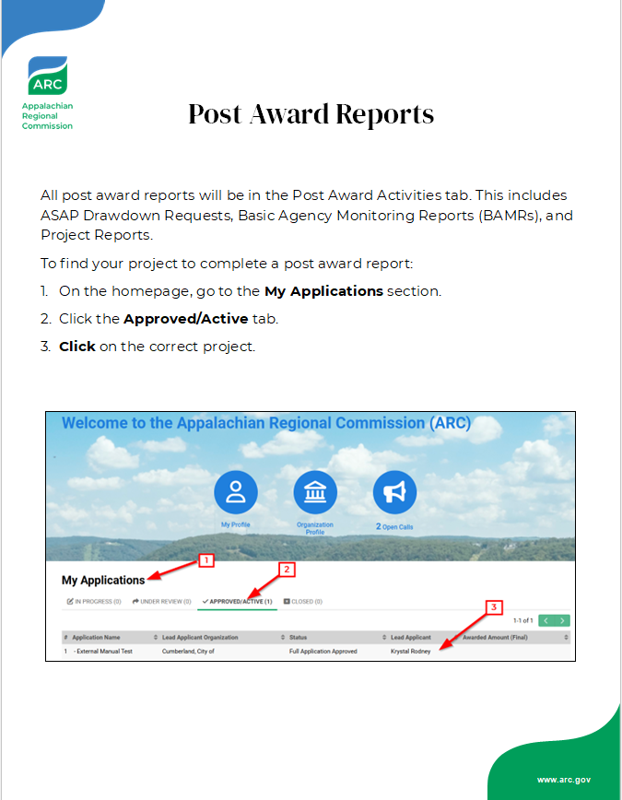
Let’s Try It Out!
With your pair or trio, try out one of the reports
Cover all 3 reports within your table
Construction vs. Non-construction
Use the directions on your table to complete the report
Notes:
Now you’ll have an opportunity to try this process out yourself. You’ll be in your same groups of 2 or 3 and will use the same account information. The applications you will use are already created for you. Choose one report to try out with your group. Be sure that within your table, every report is covered. (Give example). Please note that if you have a non-construction project, you will only see the project report. The directions for this are on the back page (modify once direction sheet is created). These are the same steps you saw on the screen. What questions have I created before you get started?

Slide 25
As You Work…
What might constituents need support with during these processes?
What might you or your LDD need support with during these processes?
What might this support look like?
Notes:
Just as last time, as you work, we’d like you to keep these 3 questions in mind (read questions with movement). We will also be circulating to support you as you work.

Slide 26
Let’s Discuss
What might constituents need support with during these processes?
What might your LDD need support with during these processes?
What might this support look like?
Notes:
What came to the surface for you as you discussed with your group?

Slide 27
As We Close…
Notes:
As we come close to end of our time together, we’d like to take another opportunity to gather some feedback. We’ll do that using a structure called…

Slide 28
Most Important Point
Individually, reflect on the session. What do you think is the most important idea or concept from today? Write the idea on a sticky note.
Share your idea at your table and why you chose it.
Share with the larger group
Notes:
On your own, think about today’s session. How would you capture or express the most important idea or concept from today? Something that really resonated with you. This could be around the content or a feeling
Example: It looks like this will be a large change, so I want to be proactive with sharing this info with my org.
With your table, share your word and why you chose it.
Example:
I chose proactive because I want to learn as much of the system as I can before my constituents have to use it.
I chose muscle memory because I know that once I’ve practiced working in the system, I’ll feel prepared.
I chose nervous because I know that change can be scary, and this is a big change.
Choose 1 person at your table to share their key word/term with the larger group.

Slide 29
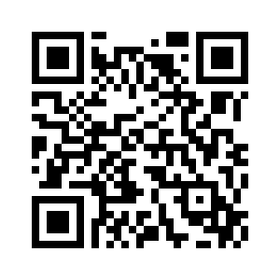
As We Close…
Thank You!
Please leave your Most Important Point on your table.
Accounts are available until March 21st
Connect with us!
Please share your thoughts!
https://forms.office.com/g/BHWUQGuRRx
Elijah Biggs
ebiggs@arc.gov
Krystal Rodney
krodney@arc.gov
Notes:
Please leave your MIP on your table, as we’ll use this feedback when we regroup as an ARC team.
The account you used today will be available until March 21st. Please keep trying it out, and share your thoughts with us!
Please connect with us! Our info will be coming onto the screen in a second. Please email us. If you’d like to talk more, please come grab a business card! Please stay tuned for more information about Pathways training opportunities and resources. Trainings will be scheduled and coordinated through TA.
Lastly, we’ve included a survey. Please share your thoughts with us about today’s session. We’d love to hear your thoughts so that we can make this system the best it can be and so that it really fits your needs and those with whom you work
Thank you so much for coming! We appreciate your time, attention, and thoughtful consideration.

Slide 30
Connect with ARC
x.com/ARCgov
facebook.com/ARC.gov
instagram.com/ARCgov
linkedin.com/company/appalachian-regional-commission
arc.gov/newsletter-signup

