Slide 1
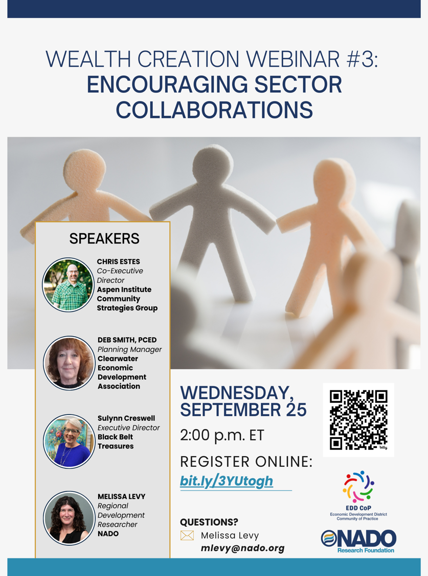

Slide 2
Thanks for Joining the Webinar!
Questions or comments can be submitted via the questions box on the right side of your screen in drop down menu
A recording of the webinar will be made available soon at www.nado.org
Please take a moment to complete the post-webinar survey to provide helpful feedback
Contact Melissa Levy at mlevy@nado.org with any questions about the webinar or wealth creation

Slide 3


NADO provides advocacy, education, research, and training for the nation’s regional development organizations (RDOs). NADO and its members promote regional strategies, partnerships, and solutions to strengthen the economic competitiveness and quality of life across America’s local communities.
The NADO Research Foundation provides education, research, and training designed for RDO executive leadership, staff, and policy board members. It examines new and innovative practices in regional development and strives to improve the organizational and professional capacity of regional development organizations and their partners.
www.NADO.org

Slide 4
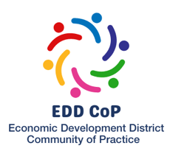
Melissa Levy
Regional Development Researcher/Wealth Creation Specialist
NADO Research Foundation
mlevy@nado.org
www.NADO.org
www.nado.org/wealthcreation

Slide 5

Poll Questions

Slide 6
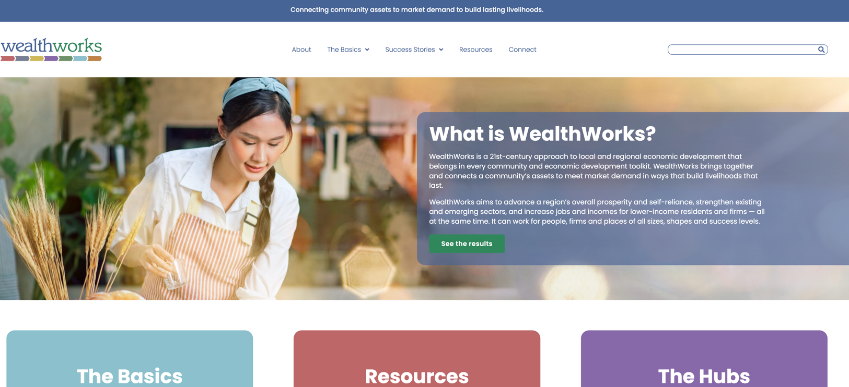
WealthWorks Website - www.wealthworks.org

Slide 7
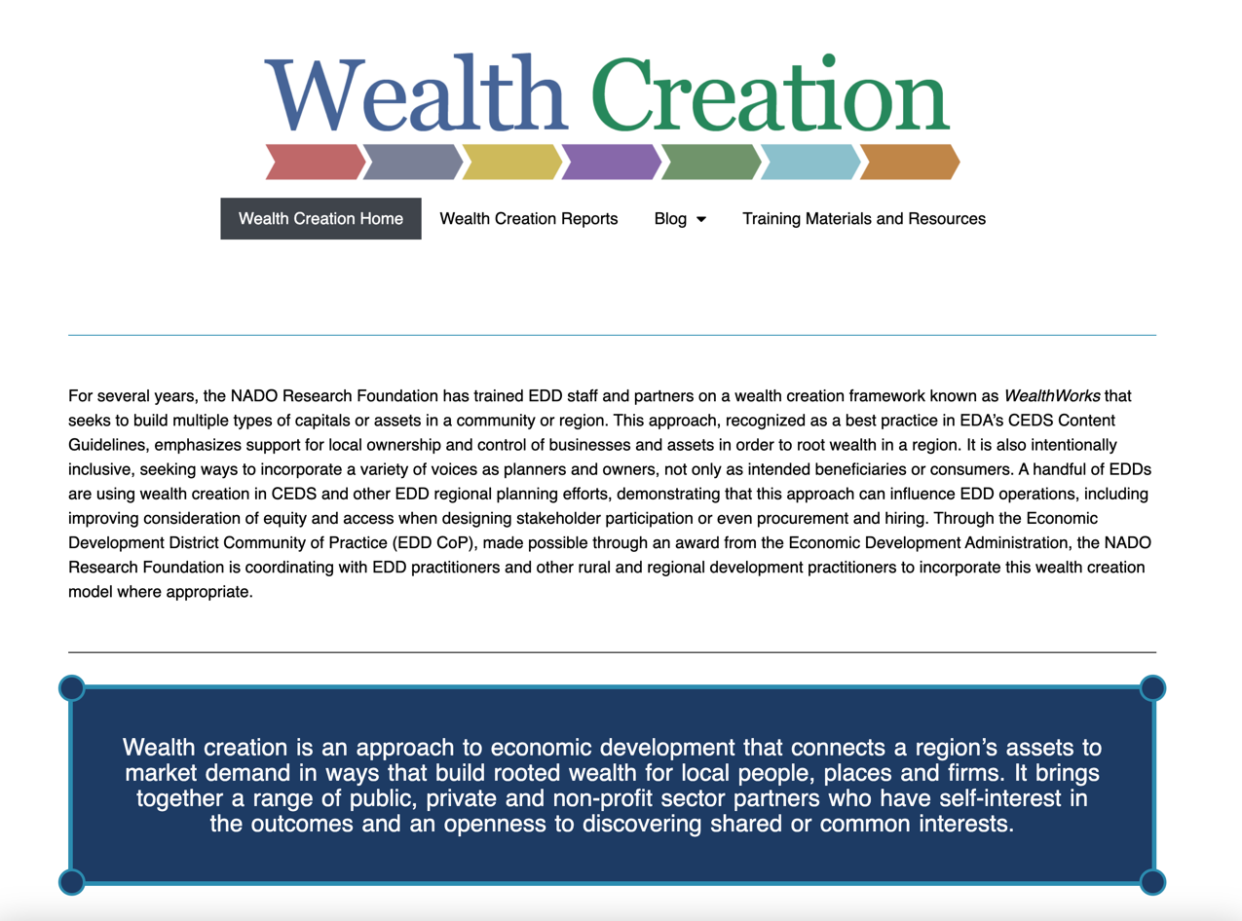
NADO Wealth Creation Website – www.nado.org/wealthcreation

Slide 8
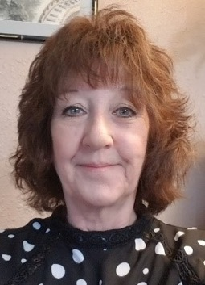
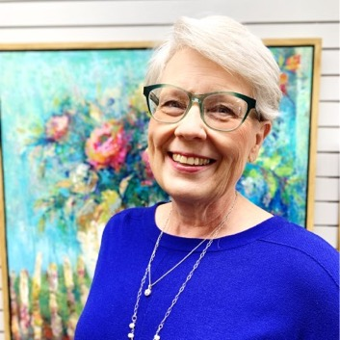
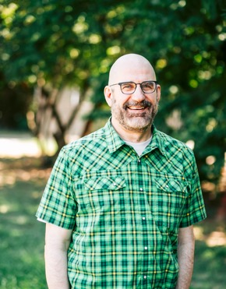


Today’s Presenters
Deb Smith Sulynn Creswell Chris Estes
Planning Manager
Clearwater Economic Development Association
Executive Director
Black Belt Treasures Cultural Arts Center
Co-Executive Director
Aspen Institute, Community Strategies Group
(Moderator) Melissa Levy, Regional Development Researcher/Wealth Creation Specialist
NADO Research Foundation

Slide 9
WealthWorks…
an approach to economic development that connects a region’s assets to market demand in ways that build rooted wealth for local people, places and firms.
brings together a range of public, private and non-profit sector partners who have self-interest in the outcomes and an openness to discovering shared or common interests.
focuses on building a sector rather than individual and unrelated businesses.
Notes:
Goal: Advance a region’s prosperity by building wealth that sticks
WealthWorks is a bridge between community development (voice, empowerment, organizing) and economic development (attraction, retention, entrepreneurship).

Slide 10



Principles of Wealth Creation
#1 – Create wealth, broadly defined, and aspire to do no harm.
#2 – Root wealth in local people, places and firms through regional ownership, control and influence.
#3 – Build lasting livelihoods by intentionally including people and firms on the economic margins.
Notes:
Wealth building framework has three critical goals:
Create wealth broadly defined – includes 8 capitals. Aspire to do no harm to any.
Root wealth in place – pay attention to who owns, controls and influences the wealth that’s created. Root wealth in local peoploe, places and firms through local ownership, control and influence.
Build lasting livelihoods especially for people and firms on the margins – intentionally including economically-marginalized residents.
Use a systems approach – Wealth Creation Value Chains – to build value in existing and emerging sectors.

Slide 11
t
Wealth Components: Eight Capitals
Key Concept
Intellectual
  Knowledge and innovation
Assessment
Design
Measurement
Individual
  Skills, education, health
Social
  Trust and relationships
Natural
  Natural resources
Built
  Infrastructure
Political
  Influence on decision makers and shapers
Financial
  Savings and investment
Cultural
  Traditions, customs and ways of doing
Notes:
Realize that you all are familiar with the triple bottom line. This isn’t really different … just unpacks the three capitals into greater detail… The other addition is that this approach focuses on both inventory and then investing in building our “stocks” of these capitals/assets. We recognize that without active investment, resources will depreciate.

Slide 12
A Continuum for EDDs
CEDS
SWOT
Measuring outcomes
Sector-specific
Collaboration
Value chain development
Value chain mapping
Filling gaps in the chain
Coopetition
Notes:
It’s not one size fits all. The entry point is to use the discussion of capitals/assets in your CEDS planning.

Slide 13
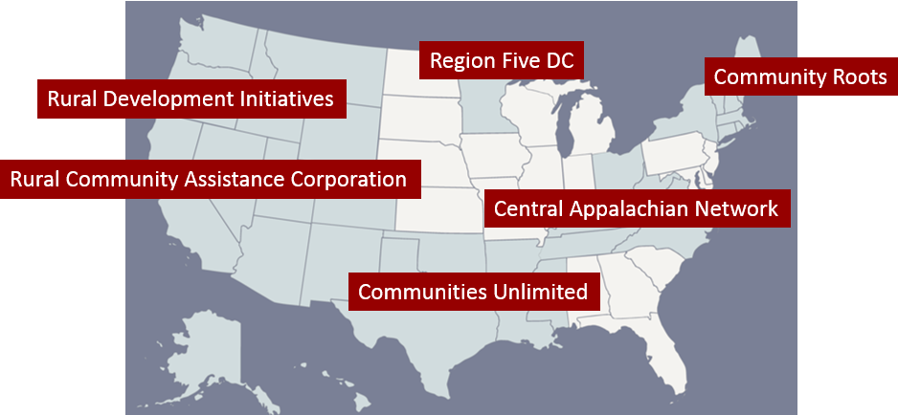
WealthWorks Regional Hubs
http://www.wealthworks.org/connect/hubs

Slide 14
What are the top 1-2 economic sectors in your region?
Share your answers in the chat box.

Slide 15
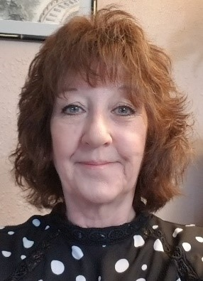
Deb Smith
Regional Planner
Clearwater Economic Development Association

Slide 16
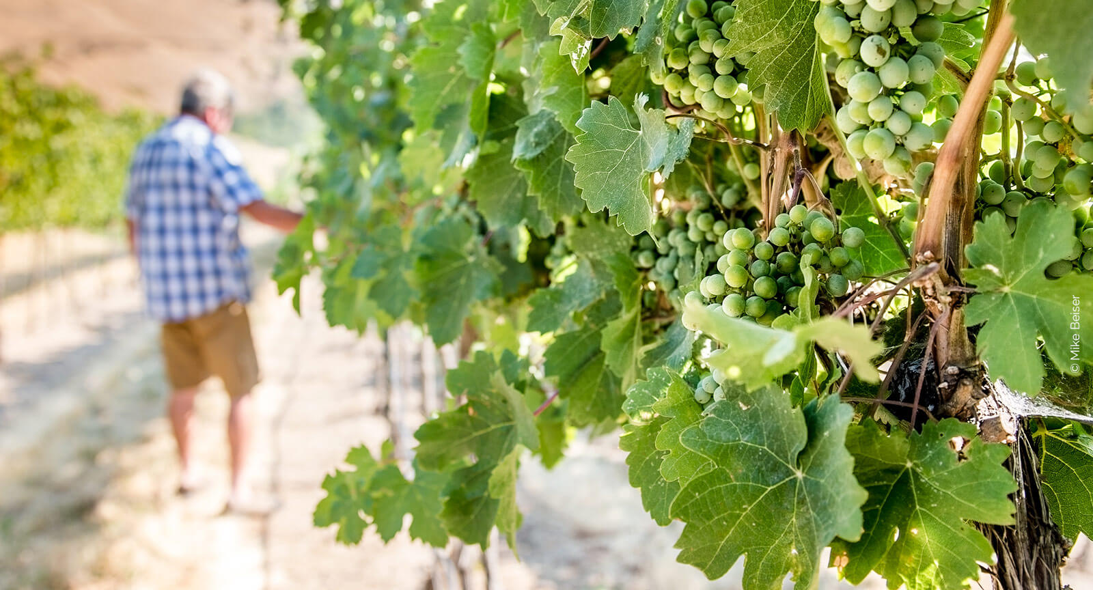

Slide 17
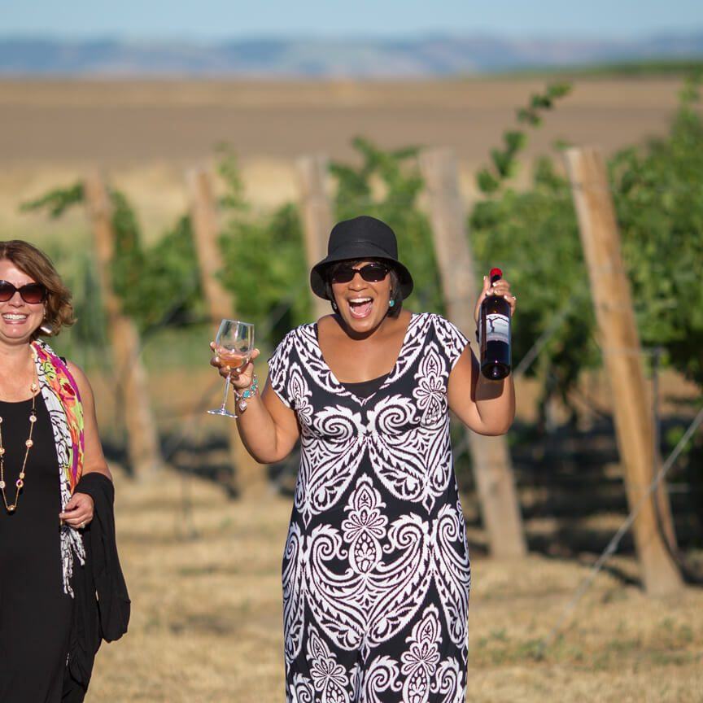

Slide 18
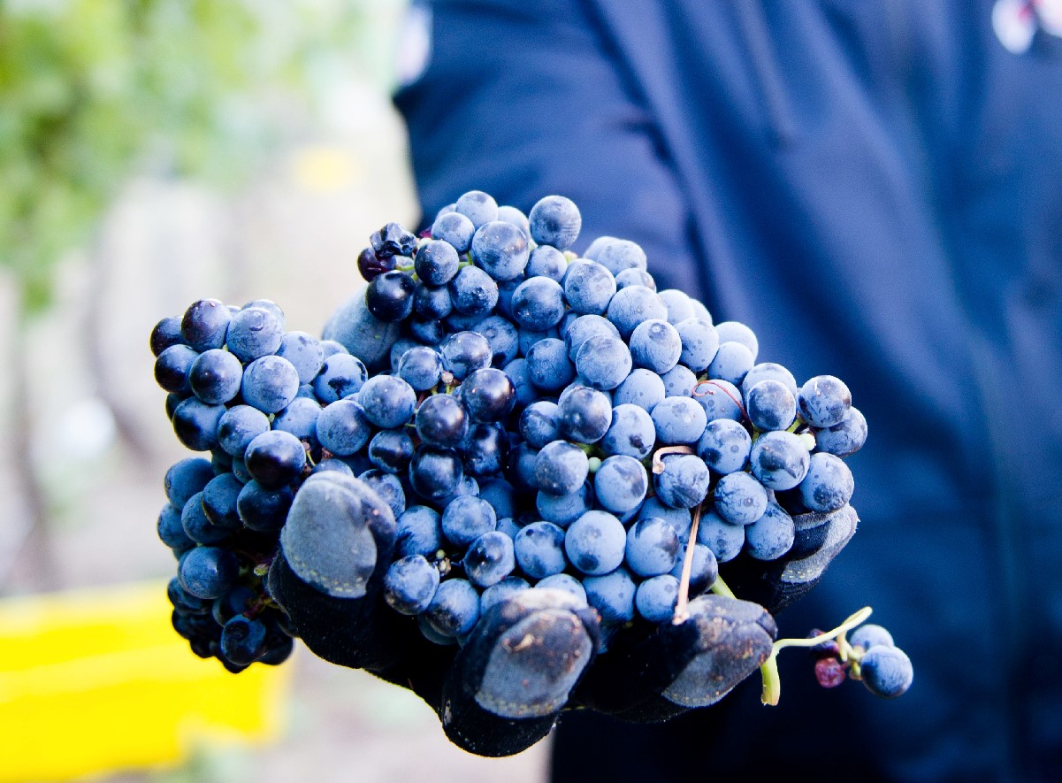

Slide 19

Sulynn Creswell
Executive Director
Black Belt Treasures Cultural Arts Center

Slide 20

Black Belt Treasures
Cultural Arts Center
Cultivating Art Across Alabama’s Black Belt
One Artist, One Work Of Art, One Story at a Time…

Slide 21
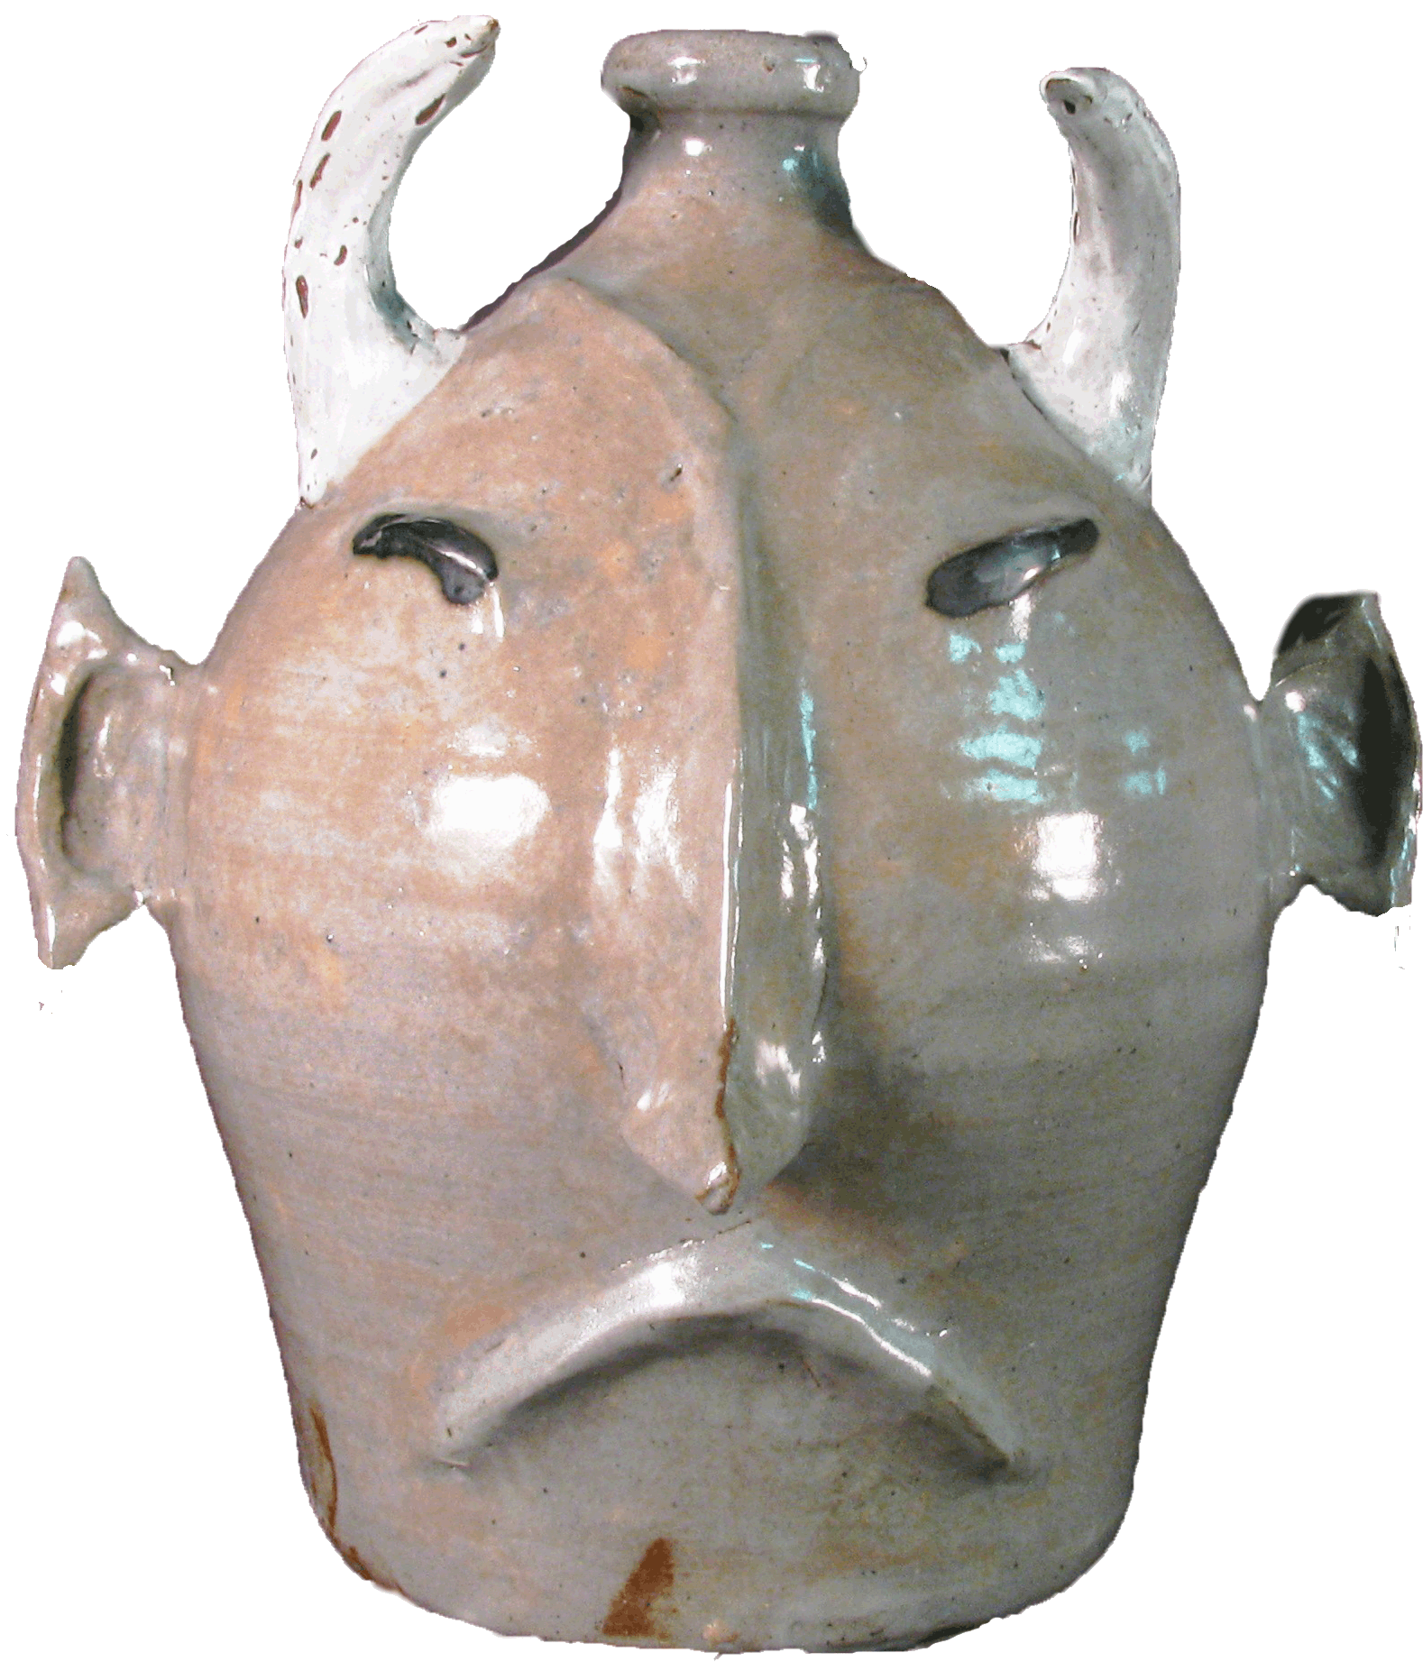
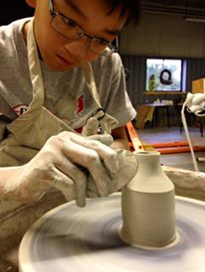
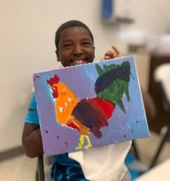
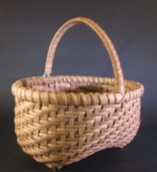
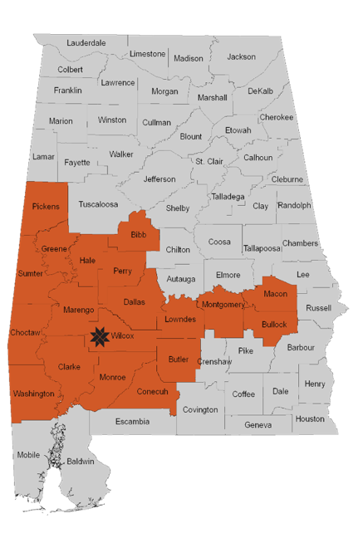
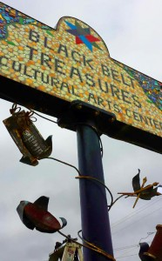
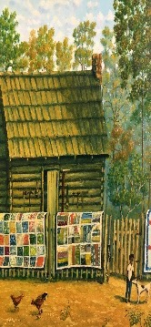
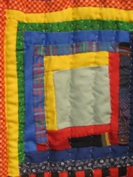
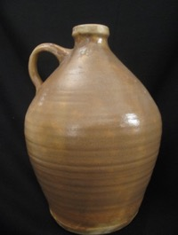
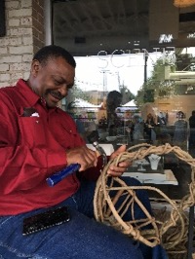
The Mission of Black Belt Treasures Cultural Art Center is to foster, develop, and promote economic development initiatives aimed at creating jobs and increasing the income of local residents through the marketing of arts, crafts, literature, food products, and other items unique to Alabama's Black Belt and to cultivate and provide arts education in the region.

Slide 22
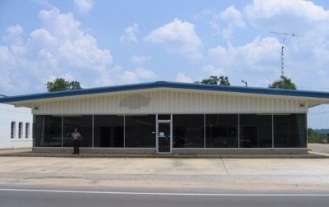
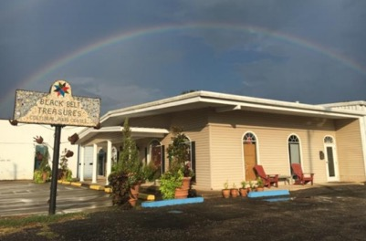
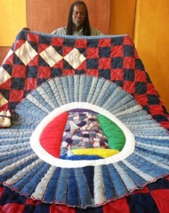
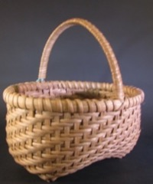
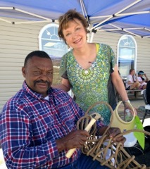
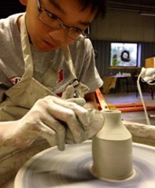
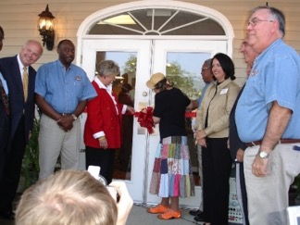
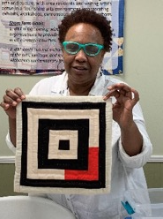
The What And Why...
Opened in 2005 following a regional tourism assessment.
Strategically located in center of Black Belt region with the intent of drawing
visitors off the interstate to experience the art & culture of the region.
A vacant auto dealership was renovated as the BBTCAC Gallery. ⇢ ⇢
6000 SqFt body shop partially renovation began in 2019 as the Black Belt
ART House –Pottery Classroom, Kiln Room, Art Classroom, Artist Studio.
Future Addition: changing gallery, textile classroom, artist incubator spaces,
large classroom workshop space, art supply storage.
Focus on painting a positive image of the region, in spite of years of negative press.
Black Belt Teaching Artist Program added in 2016 to meet growing need for arts enrichment in schools and continuing heritage arts traditions.

Slide 23
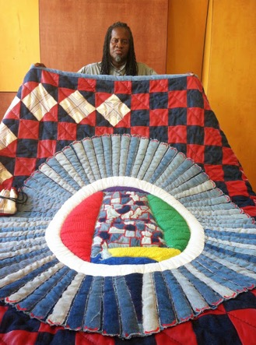
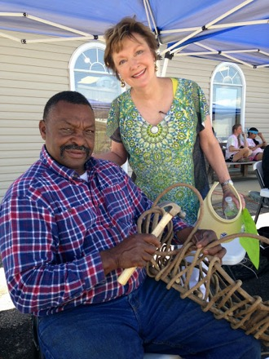
BBTCAC In Numbers
Artists
Tourism
Education
Began with 75
Have worked with over 530
Currently almost 350
To date $2,194,614 in Sales
$1,536,230 returned to Artists
Visitors from all 50 states and 35 other countries
Annually 12-14,000 visitors
Group tours from 4 to 75
2023-24– over 12,000 people reached
14 Teaching Artists presenting programs in-schools, and 20 Teaching Artists presenting at Community Programs
Workforce
Board = 11
Full Time Staff = 3
Part-Time/On Call = 6
Contract Staff = 2
Senior Aides = 1
Volunteers = 16
Teaching Artists = 20

Slide 24
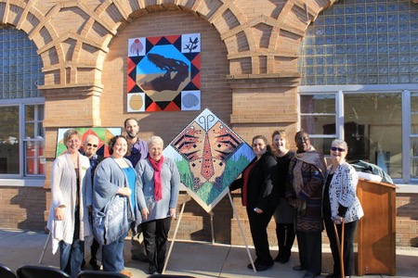
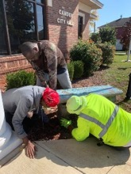
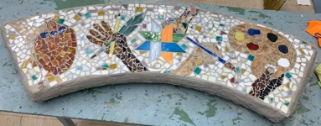
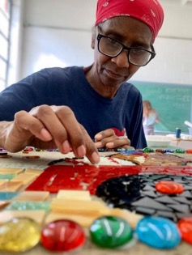
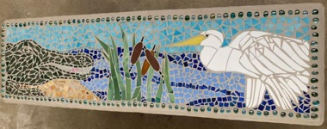
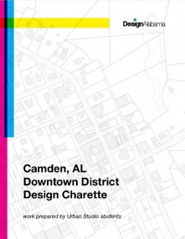
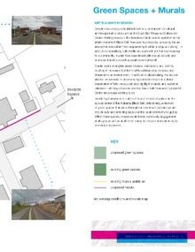
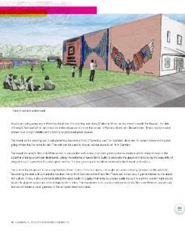
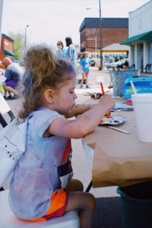
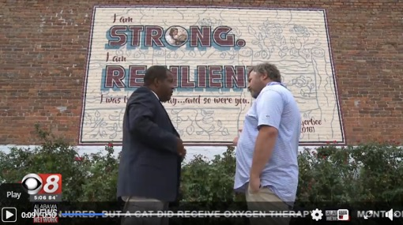
The Community Connection...
Located in a renovated former car dealership in historic downtown Camden…
BBTCAC continues to invest and participate directly in revitalization, tourism, and creative placemaking.
Downtown Revitalization Team
Creative Placemaking Projects: Murals, Mosaic Benches, Quilt Trail
Black Belt ART House & Artist Residency
Artist Demonstrations & Events
Public Art partnerships
Tourism Initiatives – partnering with downtown businesses, museums, and nonprofits for Events, Civil Rights & Cultural Tours, Weekend & Day Trips, Programs, and more…

Slide 25
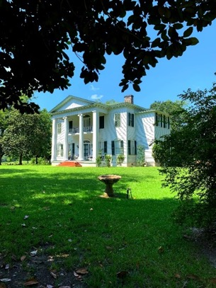
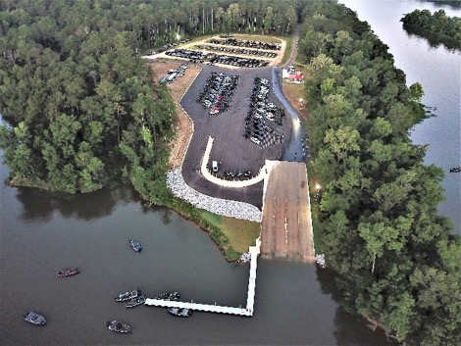
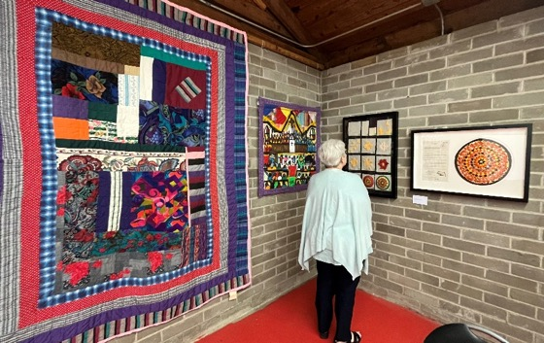
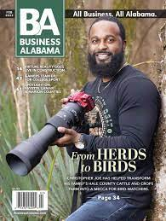
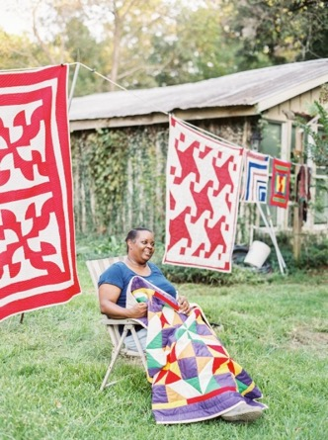
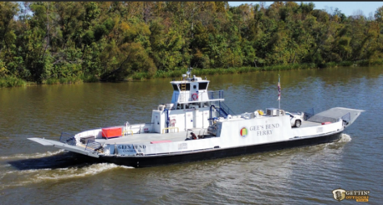
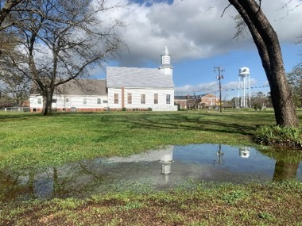
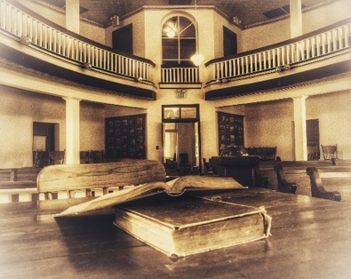


Tourism…Across the Black Belt

Slide 26








Arts Education Youth

Slide 27










Arts Education Adults

Slide 28

Through WealthWorks BBTCAC focuses on identifying opportunities in its service area while engaging partners to both build and capture wealth (i.e., intellectual, financial, natural, cultural, built, political, individual, and social).
BBTCAC’s planning complements and incorporates traditional economic development methods, while intentionally creating more value that is rooted in local people, places, and organizations.
While BBTCAC’s service area is impacted by poverty, unemployment, under-performing schools, and economic centers which have been abandoned or are in disrepair, BBTCAC has identified several “underutilized resources” through which the arts enhance the region’s wealth.
Learn more:
Education Amplifies Arts and Crafts Value Chain written by Carrie Kissel, the Associate Director of NADO (National Association of Development Associations). https://www.wealthworks.org/sites/default/files/resources/BlackBeltTreasures_final.pdf

Slide 29


Slide 30

The Wealthworks Inventory
The Community Capital assessment demonstrates the assets on which BBTCAC is built and how it is growing those capitals through its concerted effort.
Individual capital: The value chain is built on the individual capital in the form of artists’ technical skills in the medium with which they work. BBTCAC’s educational activities expands on individual capital for artists and creative entrepreneurs through the ArtsCultivate program and other ongoing programs and to develop art and business skills, and for other makers and individuals through networking, programs and educational events.
Intellectual capital: Regional artists hold significant creative intellectual capital and drive innovation culture through the pieces they produce. BBTCAC has partnered with intellectual capital assets such as museums, regional arts organizations, (i.e. Souls Grown Deep) and colleges and universities to access analysis and build opportunities.

Slide 31

Social capital: Groups that have a focus such as textiles, book discussion, and more bring together residents to celebrate the region’s heritage and connect over shared interests. The annual festival Hog Wild for Arts brings residents together to celebrate arts and food. BBTCAC builds social capital by bringing artists together and helping them learn from each other.
Natural capital: BBTCAC’s gallery space represents infill development in an established community. Several artists use reclaimed wood and other natural materials in their art, and natural capital represents a major source of inspiration for both longtime regional artists and new residents. In addition, partnering with Alabama’s Black Belt Adventures, Alabama’s Nature Journaling Club and Cornwallis 1828 are growing programs based on the region’s natural capital.

Slide 32



Built capital: Gallery and office space enable the value chain to exist, along with other built assets that facilitate tourism activity. Ongoing renovations will serve as an arts business incubator with shared studio space and equipment for creative entrepreneurs, classroom space for the adult and youth student, and community gathering/meeting space.
Political capital: A BBTCAC staff member was appointed to the Alabama Course of Study Committee for Visual Arts, providing a role in the state’s approach to primary education. State-level associations and connections may lead to opportunities. Presentations at local, regional, and state meetings such as ATRC events and the Alabama Association of Regional Councils annual conference ensure local government officials are aware of the breadth of BBTCAC’s work and impact. Staff members also serve on several state-wide arts and civic boards (i.e. ALVAN, Design Alabama, Alabama Folklife Association, among others).

Slide 33




Slide 34

Financial capital: BBTCAC has accessed funding for capital expenses and to develop and deliver programming from a variety of public and private funders. Guild memberships indicate that local individuals and businesses are willing to invest their own resources in the work of BBTCAC.
Cultural capital: The region is home to a rich cultural heritage related to the arts including literature, music, visual arts, fine crafts, and culinary arts. Arts festivals, workshops, and experiences visiting the gallery and speaking with artists celebrates and grows this cultural capital. BBTCAC refers visitors to other cultural assets in the region, such as the Gee’s Bend Quilt Collective, Gee’s Bend Ferry Terminal, and Camden Shoe Shop Museum. BBTCAC has been a supporting partner in the 20-year effort in recognizing the region as the Black Belt National Heritage Area (legislation 2023).

Slide 35


Slide 36


Contact Me...
Sulynn Creswell
  Executive Director
  sulynn@blackbelttreasures.com
  (334) 682-9878
  Find Black Belt Treasures Cultural Arts Center on...

Slide 37

209 Claiborne Street
Camden, Alabama 36726
334.682.9878
www.blackbelttreasures.com

Slide 38

Chris Estes
Co-Executive Director
Aspen Institute, Community Strategies Group

Slide 39
Breakout Discussion Questions
What economic sectors come to mind in your region that might be ready for a sector collaboration strategy?
How might you pursue a sector collaboration strategy?
Who would be good partners for a sector collaboration strategy?

Slide 40



More info at: www.nado.org/EDDCoP
The EDD CoP is made possible through an award from the U.S. Economic Development Administration, U.S. Department of Commerce (ED22HDQ3070106). The statements, findings, conclusions, and recommendations are those of the participants, trainers, and authors and do not necessarily reflect the views of the U.S. Economic Development Administration or the U.S. Department of Commerce.

Slide 41


https://www.nado.org/subscribe/

Slide 42
Melissa Levy
Regional Development Researcher/Wealth Creation Specialist
NADO Research Foundation
mlevy@nado.org
www.NADO.org
www.nado.org/wealthcreation

