Slide 1
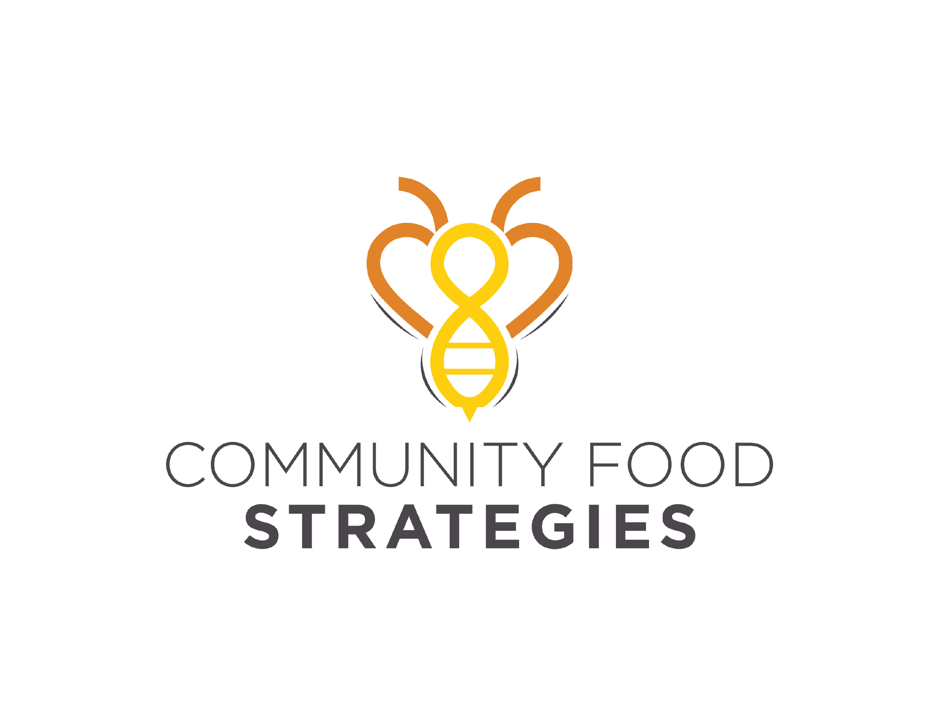
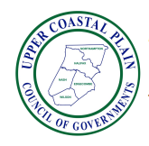
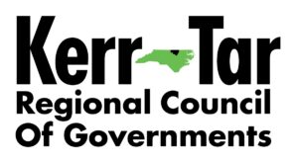
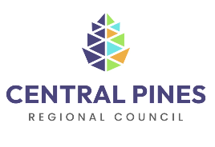
Tri-COG Food Ecosystem Economic Development Strategy (FEEDS): The Case for COGs & Local Government Investment in Food Systems Infrastructure

Slide 2
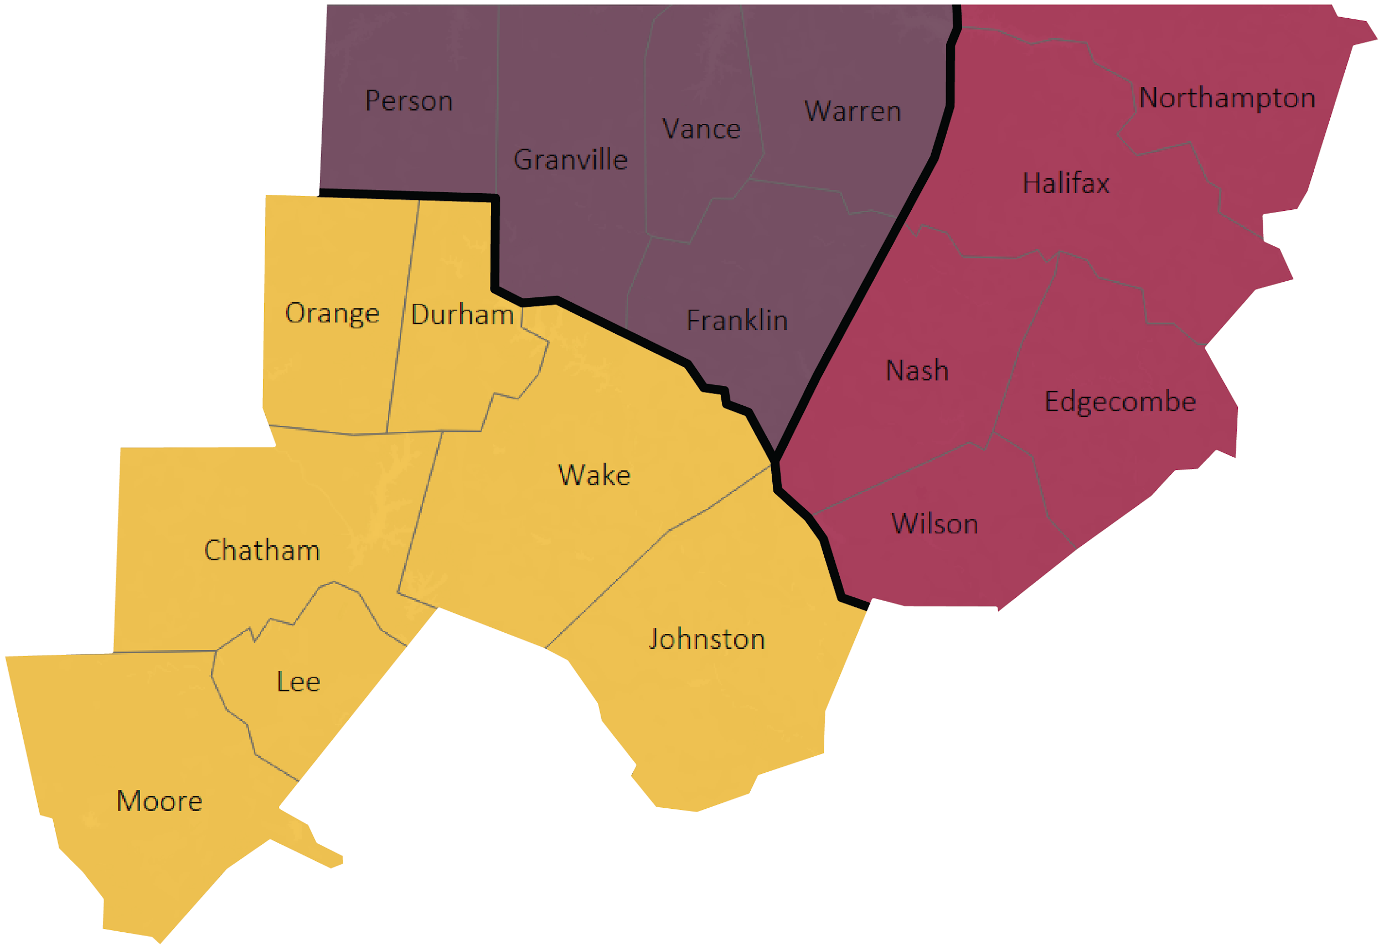
Tri-COG FEEDS Goals:
Identify the infrastructure needed to shorten food supply chains,
Drive economic development,
Enhance resilient practices,
Foster equity, and
Increase rural-urban connectivity in the region
Council of Government
Kerr-Tar
Central Pines
Upper Coastal Plain
Notes:
Talking Points:
Analysis of quantitative secondary data is coupled with qualitative data collected via interviews and focus groups by Tri-COG partners. The findings are meant to inform food systems infrastructure policy decisions made by local government officials.

Slide 3
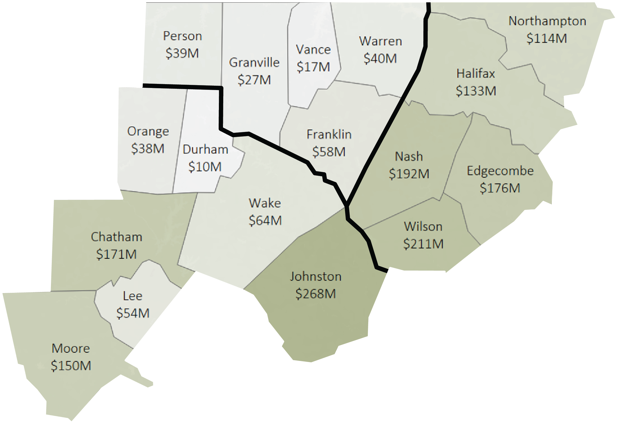
The Demand: $6.6 billion Potential in Local Food Spending
$10.2 billion spending on all food products in 2021 in the Tri-COG Region
Less than 1%, at $54 million, was direct-to-consumer sales
$6.6 billion local food spending potential, assuming 65% of total food spending could be satisfied with food products grown in the Tri-COG region
Reaching the $6.6 billion local food spending potential would require substantial public and private investments in regional food systems infrastructure.
$54 million
Current Sales
$10.7 billion
Potential economic impact for the
Tri-COG region
$6.6 billion
Potential Sales
*Note: The Census defines direct-to-consumer and intermediated sales as “sales of edible agricultural products that are both produced and sold by the operation directly to consumers (farmers markets, on farm stores or farm stand, roadside stands or stores, u-pick, CSA, online marketplaces, etc.) or retail markets, institutions, or food hubs for local or regionally branding. Retail and institutional establishments include supermarkets, supercenters, restaurants, caterers, independently owned grocery stores, food cooperatives, K-12 schools, colleges or universities, hospitals, workplace cafeterias, prisons, foodbanks, etc.”⁴
Notes:
Talking Points:
$54 Million represents current local food sales, although it is likely an underestimate.
The USDA Economic Research Service Thrifty Food Plan’s expenditure shares of vegetables, whole fruits, dairy, meats, and legumes average 65% for adults aged 19-50 years.¹³

Slide 4
Building Community Capital to support:
Food Systems-Driven Economic Development
Built
Social
Cultural
Natural
Financial
Human
Notes:
Talking Points:
Enhancing a traditional economic development approach with a community capital-based wealth creation approach
Local economic development has traditionally focused on bolstering local government tax dollars by attracting large business operations and development projects. Moving from a traditional economic development approach to a wealth creation approach requires recognizing and cultivating various types of community capital.²⁷
Investing in food systems-driven economic development is a way for local governments to support entrepreneurship, community wealth building, and more resilient economic development opportunities.
Many of the activities local governments already do, such as land use planning and workforce development, are relevant to food systems-driven economic development.

Slide 5
Different types of capital and infrastructure are needed to support a thriving regional food system.
Built Capital: (Buildings, Equipment, Storage) Plentiful in conventional supply chains, not necessarily in regional. Need to be intentional on utilizing the built capital we already have and coordinate.
Natural Capital: (Farmland, Clean Water, Soil Health) Preserving environmentally suitable farmland important and increasing access to it.
Financial Capital: (Cash, Loans, Credit) Allows business owners the freedom to make decisions that align with their goals and values, need to be creative.
Human Capital: (People, Knowledge, Expertise) Critical knowledge transfer intergenerationally, between practitioners and educational institutions
Social/Cultural Capital: (Trust, Tradition, Relationships) Encourages communication and coordination, a gateway to other types of capital

Slide 6
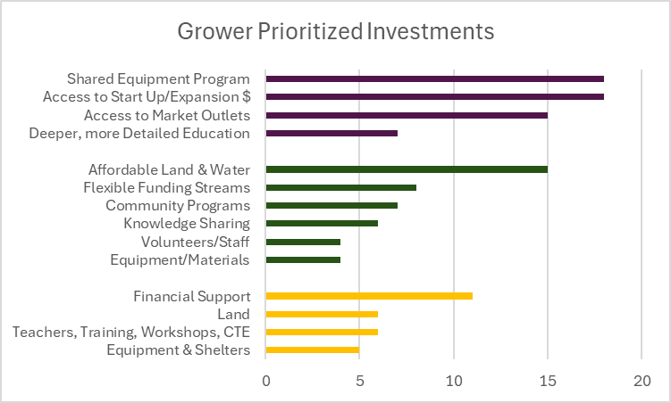
Grower Engagement:
Goal: Highlight needed infrastructure, using the community capital framework, to facilitate equitable food value chains and provide economic data to support infrastructural needs.
Growers are aware of the demand and opportunity in the region, however, need the infrastructural support to take advantage of it.
Rural
Urban
Youth

Slide 7
“Public policy” is an important tool local governments can use to transform food systems
Effective policies…⁴⁵
Are informed by input from the community and other affected stakeholders.
Balance progress and feasibility.
Set affected entities up for success.
Promote equity and ensure no group or community is unduly burdened.
Are evidence-based and reflect current best practices.
It is important to consider who benefits from economic development policies. Understanding the current state of ownership and decision-making power along the dimensions of race and ethnicity are a helpful starting point for improving equity outcomes.
Considerations for Selecting Policies
“The degree to which [alternative food networks] become potentially transformatory will partly depend upon the continued adjustments and actions of the dominant regulatory structures.”

Slide 8
Local Government Survey & Focus Group Results
Local government representatives surveyed in the Tri-COG region believe strengthening food systems is important but are either unaware of ways to support or have limited capacity to support.
Built, natural, human, and social were the four types of capital they felt local government was in the best place to support.
Agreed local government's capacity to provide traditional financial capital was constrained, although acknowledged that need for financial capital usually arises before the resources arrive.
There was a tension between feeling that local government could provide support in the areas listed above and challenges tied to a lack of social capital and equity: community distrust of government, communication, cooperation, and lack of community input into projects.
Notes:
Talking Points:
RTI invited local government officials who responded to the Tri-COG Government Official Survey to participate in working sessions about the feasibility of local government building various types of community capital. Examples of local government entities’ involvement in food system initiatives include zoning boards’ influence over built infrastructure placement, planning departments’ development of land use plans that drive local official decision-making, and economic development departments’ distribution of grant-funded infrastructure initiatives.

Slide 9
How Tri-COG region’s grower-recommended investments align with local government capacity:
Financial capital is a high-priority for grower-recommended investments, and yet local government officials feel constrained in their capacity to build that type of community capital.
Financial capital can be a bottleneck for accessing other types of capital (e.g., natural, built, human), so it is important for local governments to find ways to support the development of financial capital in Tri-COG.
Alignment Between Recommended Investments and Local Government Capacity
Rural Growers: Recommended Investments
Financial
Built
Social
Cultural
Human
Urban Growers: Recommended Investments
Natural
Financial
Human
Youth Growers: Recommended Investments
Financial
Natural
Human
Built
Local Government Officials: Government Capacity
Built
Natural
Human
Social
Notes:
Talking Points:
When there is strong alignment between recommended grower investments and the types of community capital local government is well-suited to support, local governments can lean into the areas of community capital cultivation.
When there is weak alignment between recommended grower investments and the types of community capital local government is well-suited to support, local governments can support organizations in their communities that do cultivate the recommended type of capital. They can play the role of convener and build social capital across the food system so other types of capital flow more freely.

Slide 10
COGs and local governments can use the following strategies to build food systems community capital
Social Capital: Lead with social capital. Serve as a convener: build relationships FIRST to leverage other capital types more effectively. Reach out to community members, particularly those who have had less of a public voice in the past, to meet them where they are and involve them in decision-making processes. Tailor communication strategies to specific groups.
Cultural Capital: Acknowledge that inequity exists in the food system and commit to adopting policies that move toward equity and investing in groups that historically have been underinvested in. Collectively examine how your community’s values show up in decisions about food systems.
Human Capital: Explore opportunities for joint funding of staffing positions. Dedicated staff who work on these issues across county boundaries are key. Ensure workforce development strategies support agriculture and food entrepreneurship endeavors. Connect well-matched organizations and individuals in this space.
Notes:
Talking Points:
Local governments can play a role in improving business-supporting infrastructure for food systems businesses in North Carolina.

Slide 11
COGs and local governments can use the following strategies to build food systems community capital (Continued)
Built Capital: Advocate for public financing of built infrastructure for food systems just as you would for roads and broadband. They are an important part of your government’s economic development strategy. Identify and support organizations already working to build infrastructure in your area. Focus on unlocking the full potential of existing and new built by ensuring they have the other types of capital they need.
Natural Capital: Integrate protection of farmland and water sources into your economic development strategy and land use plan.
Financial Capital: Familiarize yourself with creative financing mechanisms and connect organizations and individuals to appropriate options for their goals. Advocate for policies that enable easier direction of public funds, such as institutional procurement and emergency food dollars, toward regional and equitable food value chains in ways that put community-based organizations in control of decision-making.
Notes:
More example policies in a Policy Scan conducted by RTI that can be shared.

Slide 12
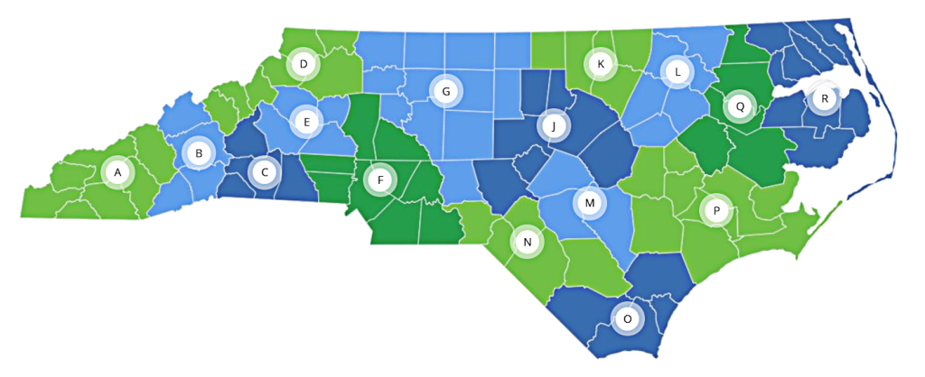
Potential Role of Councils of Governments in the Regional Food System
Consist of staff and departments who specialize in a multitude of areas that influence the food system, are consistent entities that can provide continuity to the work, supported by Local governments that would like to see COGs support food system efforts and can work with other regions when beneficial.
Have consistent contact with state and federal agencies to deliver programs - can drive investment from the EDA and other federal funding opportunities to the Tri-COG region and local organizations.
Facilitate relationships between local community organizations and funders and can partner on grants with local governments and community organizations if further capacity is needed.
Can tie Comprehensive Economic Development Strategy (CEDS) to food system objectives. The CEDS guides work throughout the year and gives capacity to work in partnership towards named strategies.
Notes:
Talking Points:
Councils of Governments (COGs) are regional entities that span across many counties and support local governments through cooperative planning, coordination, facilitation, and technical assistance on local and regional issues (16 total in NC).
Each COG is committed to continuing engagement on food system strategies after the closing of Tri-COG FEEDS in partnership with their community. COGs hope to do this by integrating strategies from this project into regional work plans and workforce development strategies in the following ways.

