Slide 1
Wealth Creation 101
Using the Eight Capitals
Notes:
Carrie

Slide 2
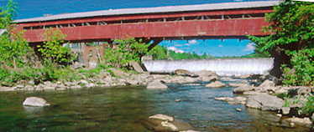
WealthWorks…
is an approach to economic development that connects a region’s assets to market demand in ways that build rooted wealth for local people, places and firms.
brings together a range of public, private and non-profit sector partners who have self-interest in the outcomes and an openness to discovering shared or common interests.
focuses on building a sector rather than individual and unrelated businesses.
Notes:
Carrie
Goal: Advance a region’s prosperity by building wealth that sticks
WealthWorks is a bridge between community development (voice, empowerment, organizing) and economic development (attraction, retention, entrepreneurship).

Slide 3
Principles of Wealth Creation
#1 – Create wealth, broadly defined, and aspire to do no harm.
#2 – Root wealth in local people, places and firms through local ownership, control and influence.
#3 – Build lasting livelihoods by intentionally including people and firms on the economic margins.
Notes:
Cariie
Wealth building framework has three critical goals:
Create wealth broadly defined – includes 8 capitals. Aspire to do no harm to any.
Root wealth in place – pay attention to who owns, controls and influences the wealth that’s created. Root wealth in local peoploe, places and firms through local ownership, control and influence.
Build lasting livelihoods especially for people and firms on the margins – intentionally including economically-marginalized residents.
Use a systems approach – Wealth Creation Value Chains – to build value in existing and emerging sectors.

Slide 4
#1: Investing in and Building 8 Capitals
Wealth is not just money.
Wealth is the reservoir of all assets that can contribute to the well-being of people, places or economies.
Every place has wealth.

Slide 5
t
Wealth Components: Eight Capitals
Key Concept
Intellectual
Knowledge and innovation
Assessment
Design
Measurement
Individual
Skills, education, health
Social
Trust and relationships
Natural
Natural resources
Built
Infrastructure
Political
Influence on decision makers and shapers
Financial
Savings and investment
Cultural
Traditions, customs and ways of doing
Notes:
Realize that you all are familiar with the triple bottom line. This isn’t really different … just unpacks the three capitals into greater detail… The other addition is that this approach focuses on both inventory and then investing in building our “stocks” of these capitals/assets. We recognize that without active investment, resources will depreciate.

Slide 6
#2: Wealth without Ownership isn’t Rooted
Capitals that are “owned” locally build wealth.
Ownership means you capture and control the flow of benefits from the capitals over time. It creates enduring, stable benefits.
Benefits – e.g., income, know-how, better technology – flowing from local ownership of capitals can be re-invested and re-circulated locally, enriching many.
Preserving local ownership or control over your capitals can increase the chances of preserving local jobs.
Local ownership is an anchor that helps wealth and change to stick.

Slide 7
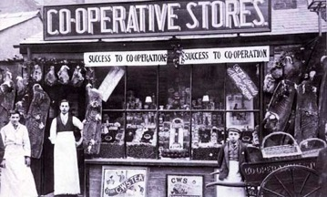
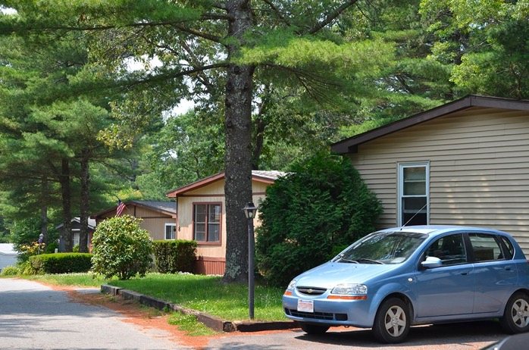
Making Wealth Stick: Local Ownership and Control
Cooperatives
Resident Owned Communities
Buy Local Campaigns
Regional branding
Notes:
Ownership and control looks like…
Many locally-owned businesses committed to the community
Local access to certificates or two-year degrees through the community college
Local endowment in the community foundation or affiliate
Other examples?

Slide 8
#3: Build Lasting Livelihoods
“Lasting livelihoods” means…
Ability to overcome vulnerability, maintain dignity and control, take risks to seize opportunities.
People at the margins are earning (and saving!) more.
They have improved skills to qualify for higher-paying jobs and to build their careers.
They are putting something aside for the future, e.g., building assets, so they are more resilient.
Notes:
Lasting livelihoods” means…
Low-income residents are doing better today, with improved skills to qualify for higher-paying jobs.
They are earning more and building careers.
They are putting something aside for the future, e.g., building assets, so they are more resilient.
They have better future prospects so they can give back their time, talent, and even treasure to the community.
Many places harbor underutilized assets ̶ people’s know-how and energy, natural resources, buildings, influence, connections… – that are not contributing to the broader economy.
Underutilized assets can be connected, developed, and linked to markets in ways that create wealth.
Economically-marginalized people and places are resources –and they (and everyone) will do better if they are connected to larger economies.
Need to include all, but too often economically-marginal are excluded

Slide 9
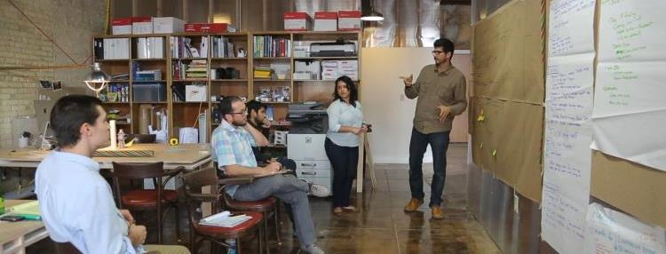
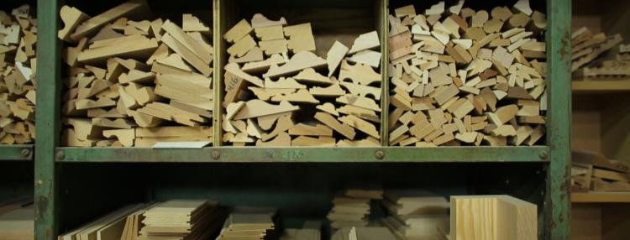
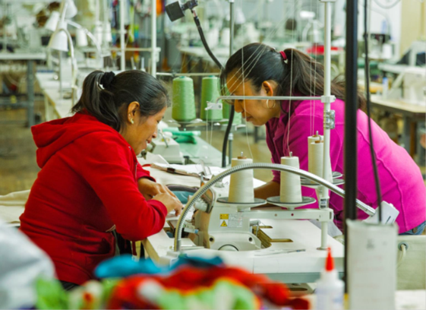
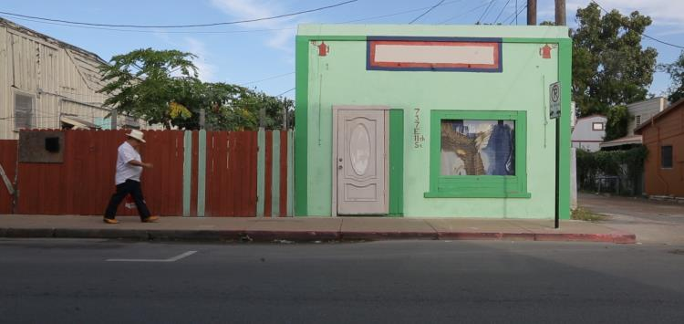
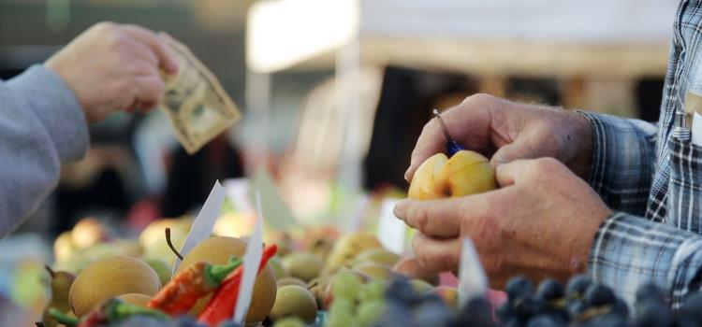
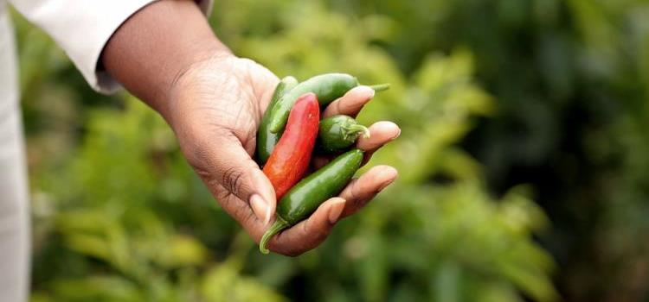
Inclusion—What Does it Mean?
Explorers and planners
Producers or suppliers
Employees
Owners of assets
Consumers
Beneficiaries
Notes:
As explorers helping to identify opportunity and demand
As producers/entrepreneurs adding value to a good or service connected to market demand, and increasing skill and ability in the process
As employees of businesses producing goods or services, or of organizations supporting WealthWorks value chains
As consumers of higher quality/lower cost goods or services produced by or leveraged by wealth creation value chains
As investors, owners, or co-owners, gaining, retaining and building wealth that sticks

Slide 10
Exercise: What Makes a Community Great?
E
What are the positive assets in your community? What would land your place on a “Top 10 Places to Live” list?
These are the assets you can build upon.
Take a few minutes to ponder this. Write 1-2 down on sticky notes.
Introduce yourselves at your tables and share those 1-2 assets that make your place special.

Slide 11
A Continuum for EDDs
Focus on Assets - CEDS
SWOT
Measuring outcomes
Sector-specific
Collaboration
Value chain development
Value chain mapping
Filling gaps in the chain
Coopetition
Notes:
It’s not one size fits all. The entry point is to use the discussion of capitals/assets in your CEDS planning.

Slide 12
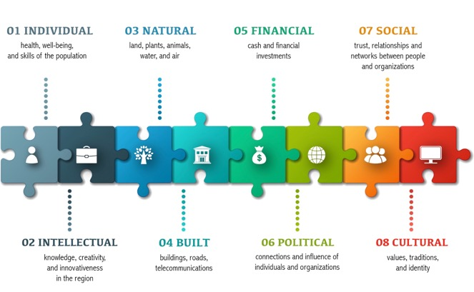
Focus on Assets – 4 ways
Asset inventory and mapping
Consider capitals in the CEDS through the SWOT/SOAR analysis
Evaluate progress in the CEDS
Area marketing and promotion.

Slide 13
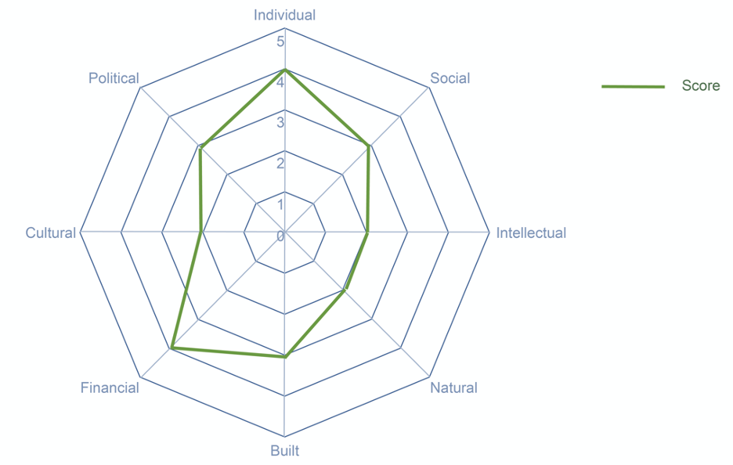
Asset Mapping Using the Spider Diagram
E

Slide 14
Acadiana Planning Commission (LA) – Strengths in the SWOT
Individual - Skilled labor for oil and gas extraction, manufacturing, and ancillary support services.
Intellectual - Presence and output of Acadiana’s University and Technical Colleges including the research capacity of higher educational institutions.
Social - Availability of job opportunities.
Cultural - Acadiana’s food, traditions, sporting culture and heritage are highly valued among natives.
Natural - Large amount of natural resources and natural environment for recreational opportunity.
Built - Capacity of electric and natural gas service. Non- traded economic drivers to include medical facilities, restaurant and retail, air service, and ports.
Political - Strong support and systems for community planning efforts.
Financial - Low cost of doing business and tax-friendly business climate. Entrepreneurial development.

Slide 15
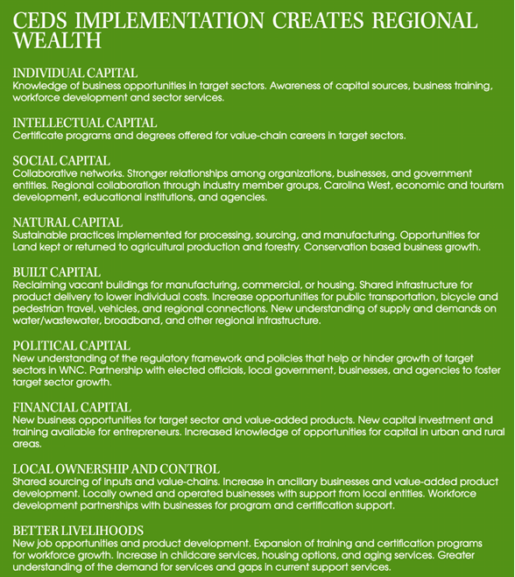
Land of Sky Regional Commission (NC) – Evaluating progress

Slide 16
SWOT using community capitals
Strengths: Capitals we have, use, could use more Energy and enthusiasm Partnerships between business, government, and organizations | Weaknesses: Capitals we are missing, or are weak People, firms, and organizations on the economic margins Lack of partnerships between business, government, and organizations
Opportunities: Underutilized capitals we can invest in Upward mobility for all Emerging Markets/Demand Gaps in activities needed to meet demand for products and/or services in specific emerging markets where investment will have the greatest impact (leverage) Repurposed by-products or residuals Local, broad ownership Potential to go to scale | Threats: Policy barriers Ownership by those outside of the region Negative opinion shapers and parties unwilling to collaborate

Slide 17
Committee Membership and Public Involvement
Notes:
Carrie
Wealth creation shows up in how organizations do the work that they do. These products on-screen were produced by the Land of Sky Regional Council in western North Carolina and the Region Five Development Commission in central Minnesota. In both cases, staff have mentioned how using the wealth creation framework leads them to recruit participation in study committees, plans, processes, and targeted public outreach. This helps them to ensure they coordinate with people and organizations building wealth in the community, such as engaging with health organizations around active transportation. It also ensures they stay focused on intentional inclusion, making sure that opportunities to participate in meaningful ways are promoted throughout the communities they serve. And it also keeps them focused on demand—are the people who are transportation users or potential users providing input into the planning of the transportation network?

Slide 18
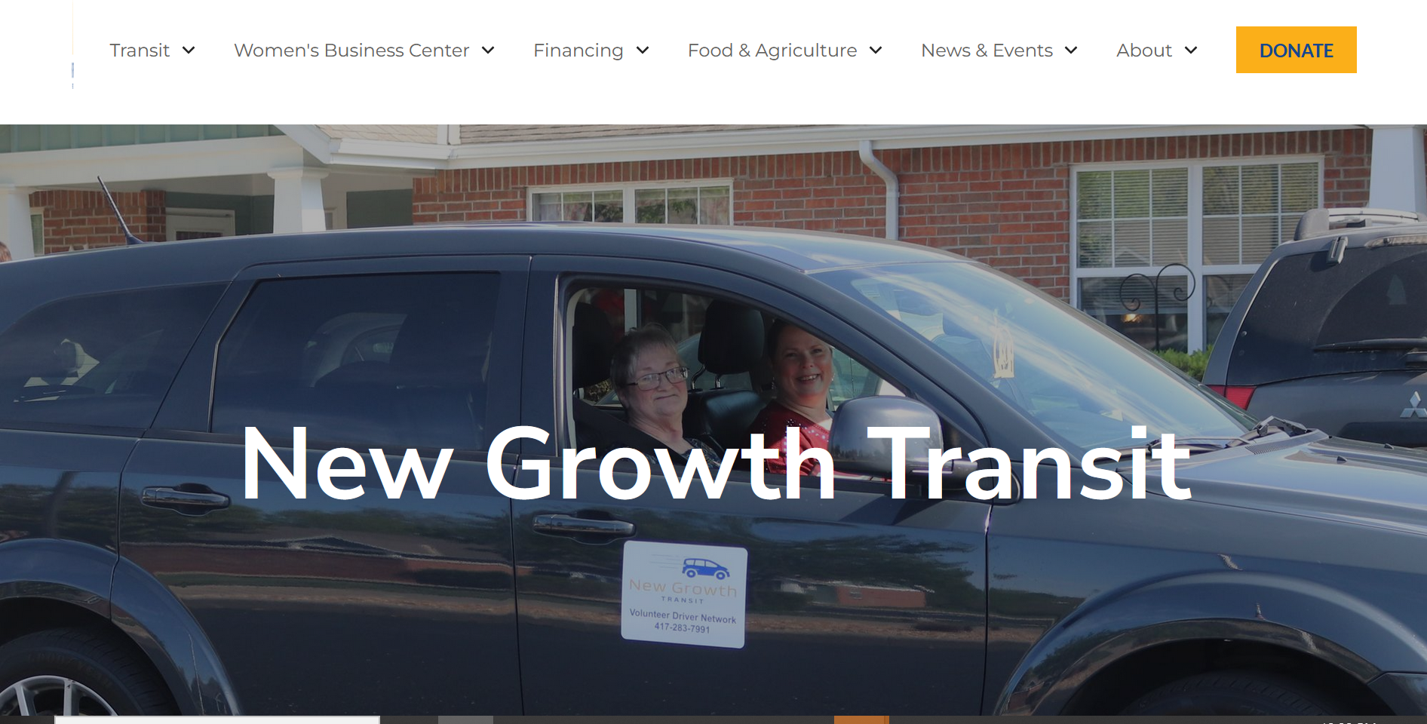
New Growth Transit
Notes:
Carrie
New Growth, a regional organization in Missouri that collaborates with the RPCs on regional transportation, business assistance, and economic development issues, has a regional volunteer driver program designed around building assets and understanding relationships between partners as a value chain.

Slide 19
Discussion
How might you use the capitals in your planning?
What do you need to make this happen?
E
Notes:
Carrie

Slide 20
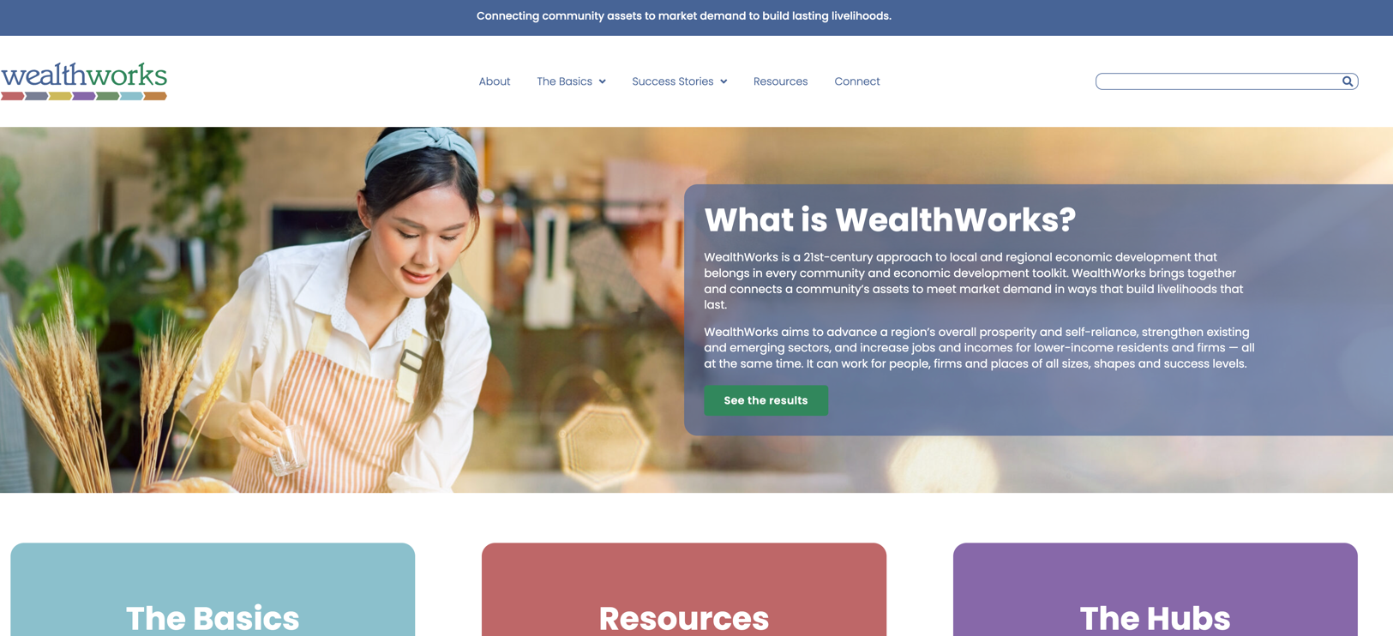
WealthWorks Website - www.wealthworks.org
Notes:
Carrie

Slide 21
NADO Wealth Creation Website – www.nado.org/wealthcreation
Notes:
Carrie

Slide 22
WealthWorks Regional Hubs
http://www.wealthworks.org/connect/hubs
Notes:
Carrie

Slide 23
For More Information
Melissa Levy
NADO
mlevy@nado.org
www.nado.org
Carrie Kissel
NADO
ckissel@nado.org
www.nado.org
Notes:
Carrie

