Slide 1
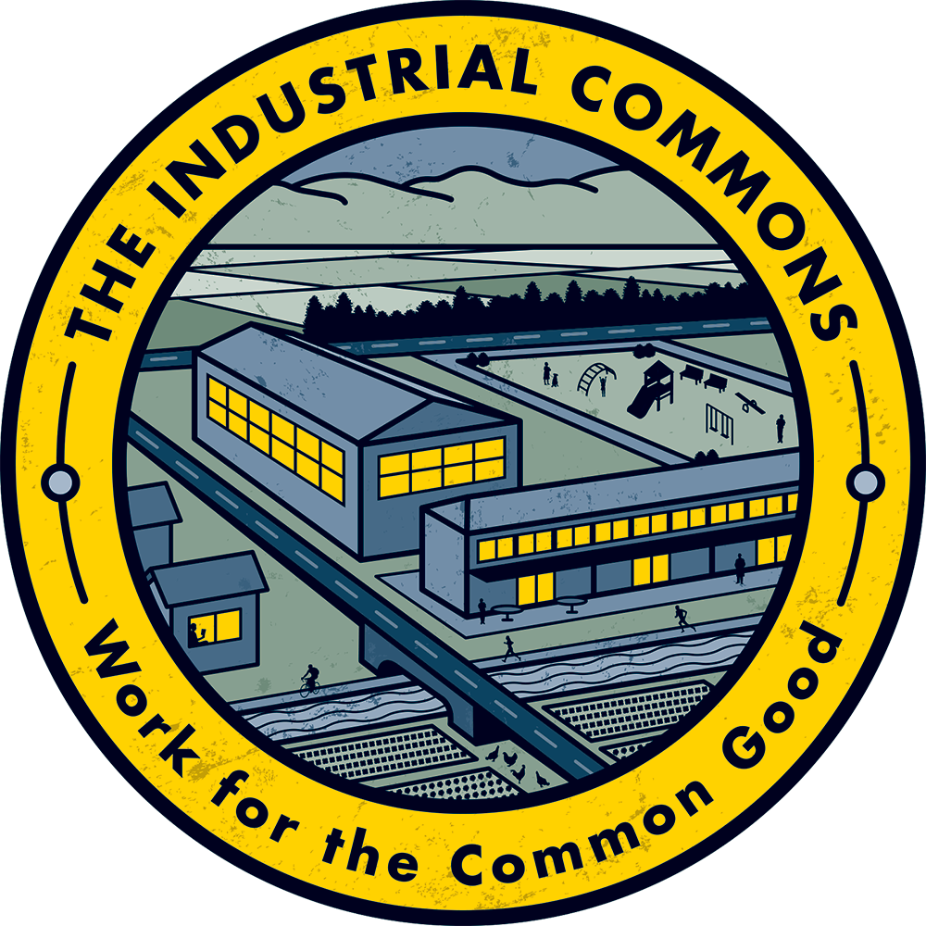

Slide 2
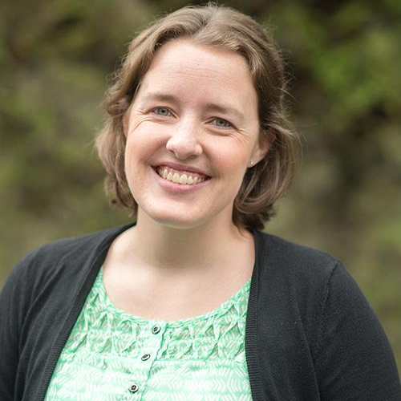
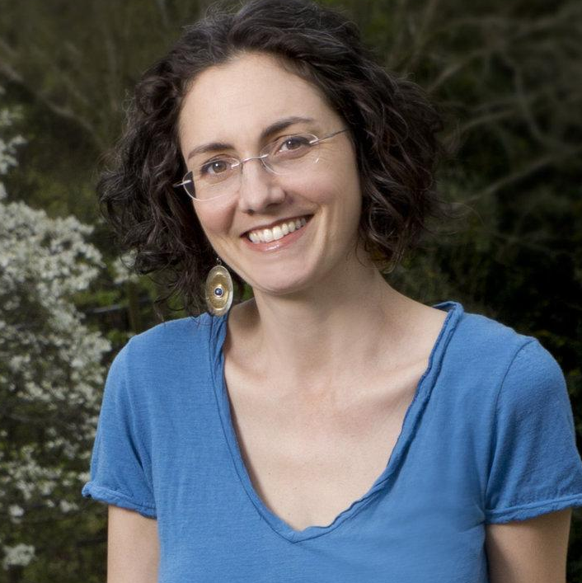
We work for the common good.
Both Sara and Molly are from Morganton, NC and bring their love of home and strength of strategy to lead The Industrial Commons.
Sara Chester
Co-Founder, Co-Executive Director
Background: Economic Development
Molly Hemstreet
Co-Founder, Co-Executive Director
Background: Business Development

Slide 3
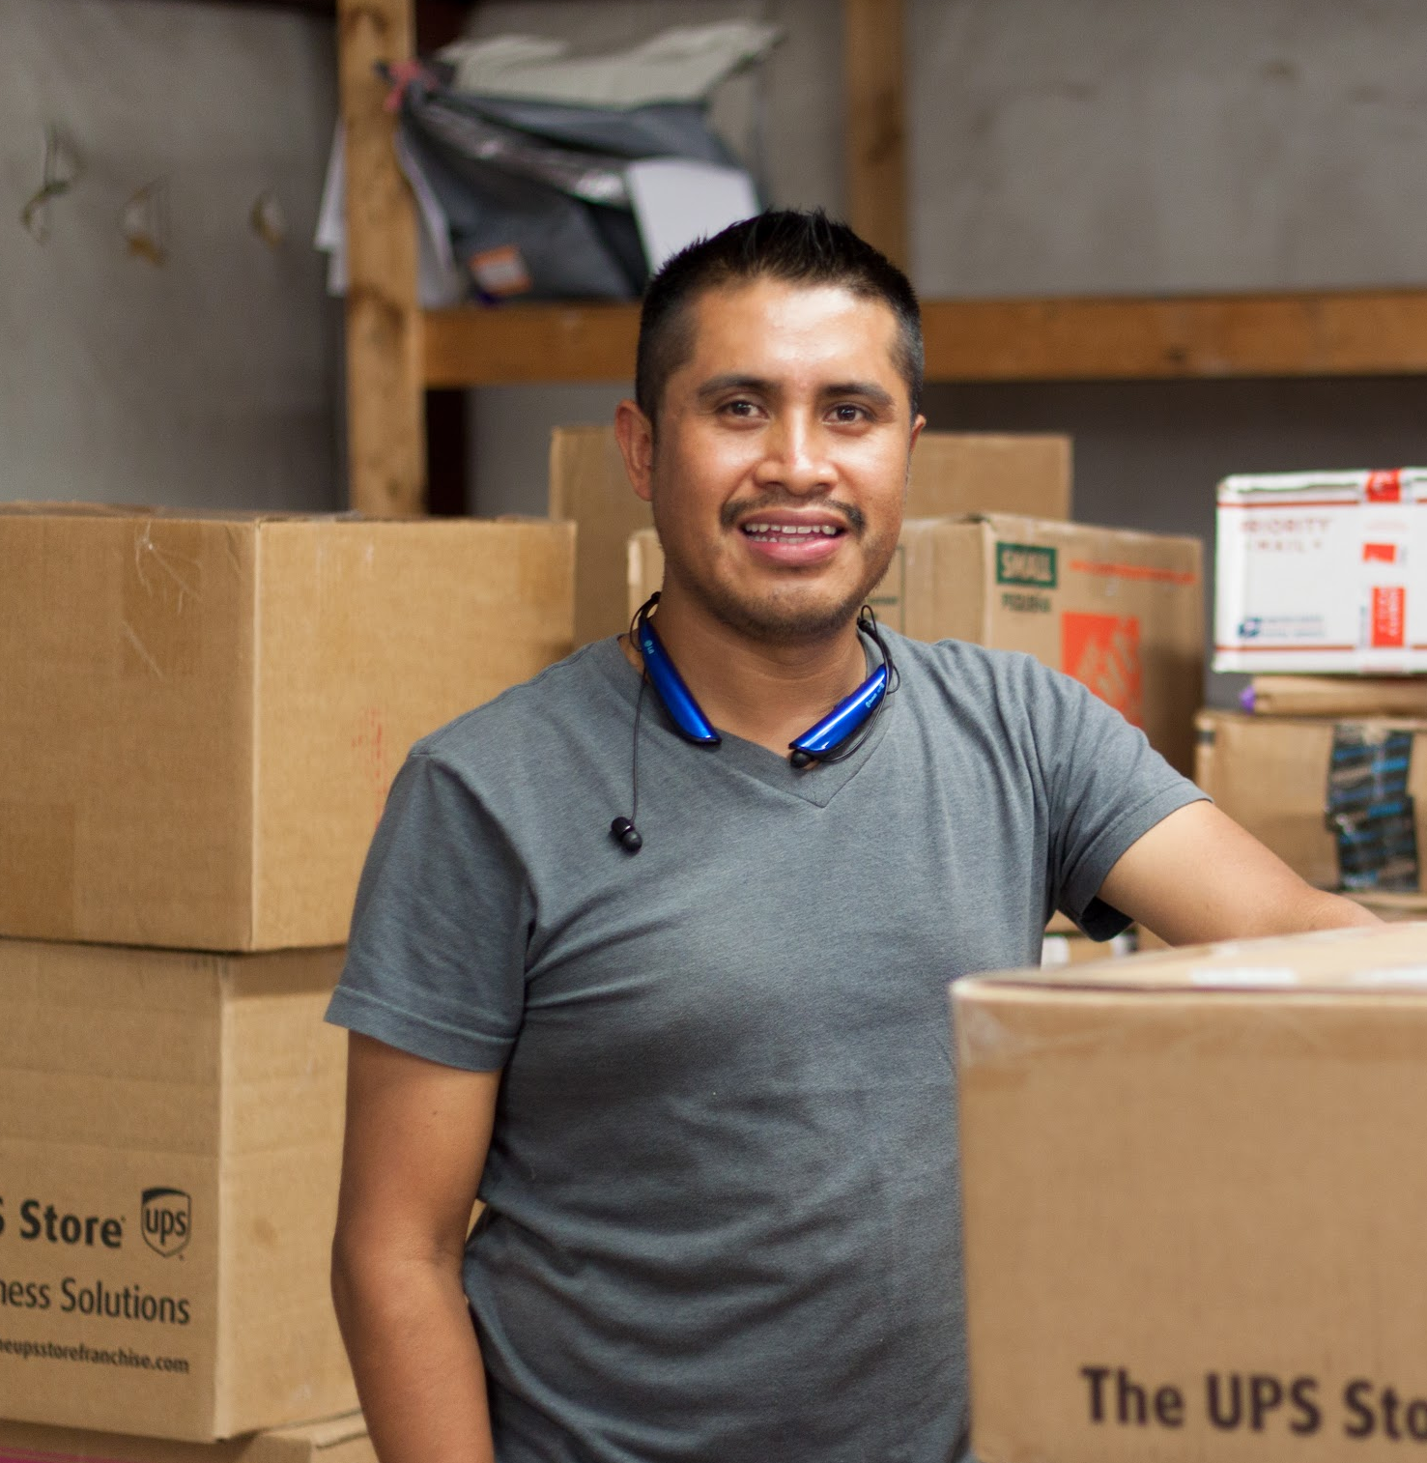
“
We build more inclusive and resilient rural economies.
60 million Americans in rural communities face intergenerational poverty.
In our rural community, wealth extraction has led to generational poverty.
Rural communities already have the assets to drive their own economic development.

Slide 4
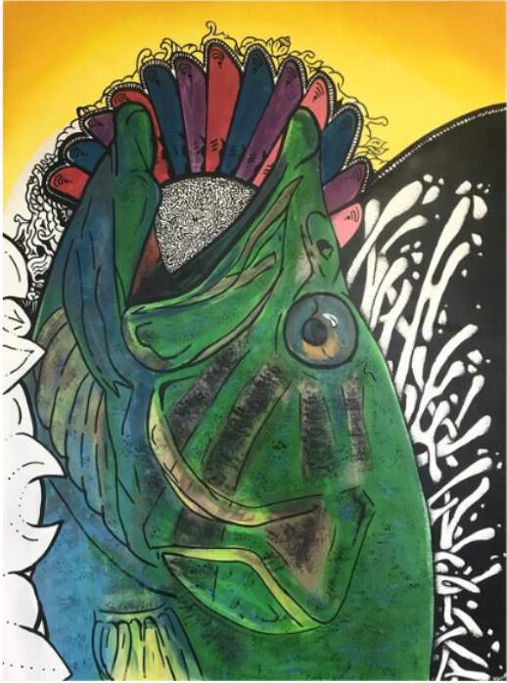
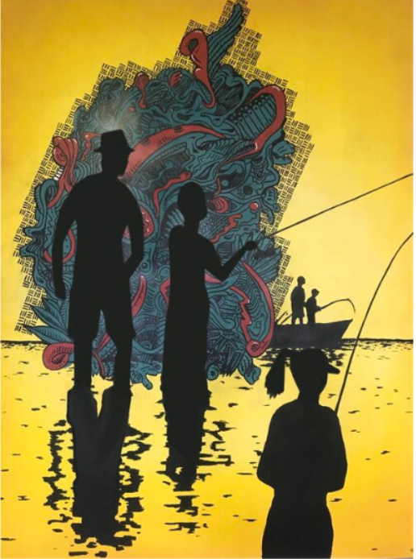
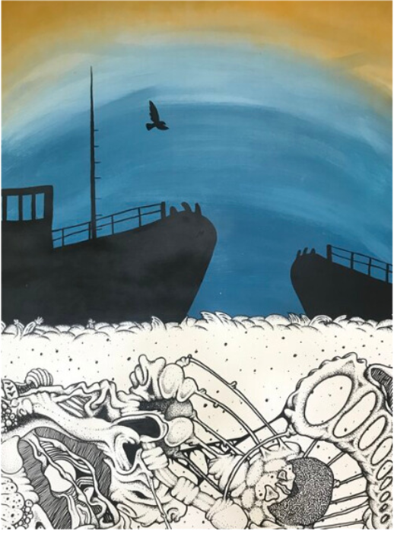
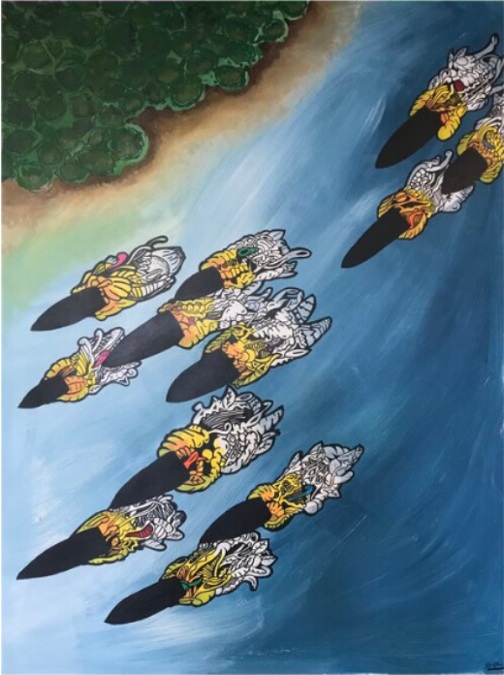
RURAL WEALTH BLUEPRINT
As an economic ecosystem we…
PROVIDE
TEACH
OWN
ORGANIZE

Slide 5
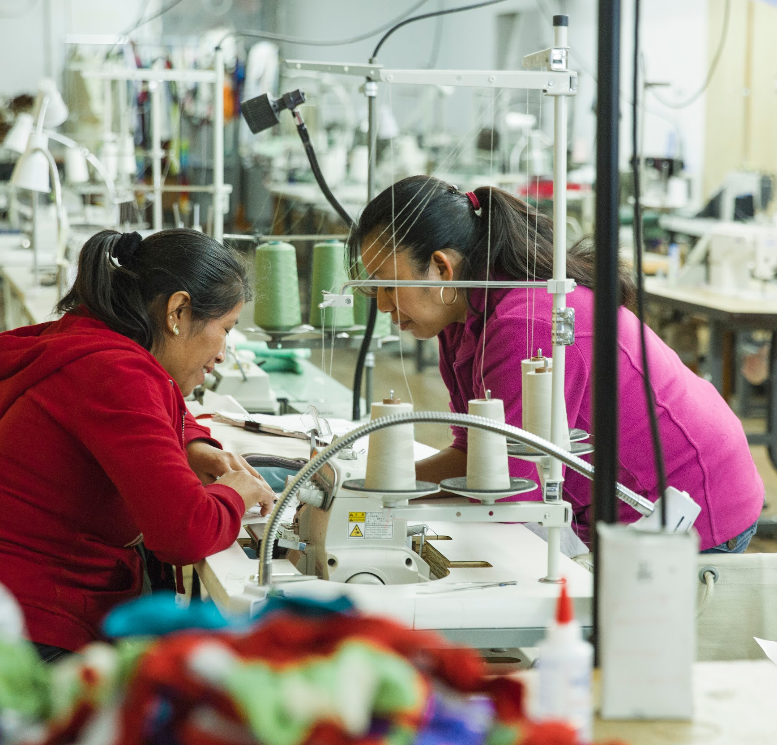
We build on successful models.
We base our model on well-established industrial cooperatives like Mondragon Corporation (started 65 years ago now with more than 81,000 employees and $14.5 billion in revenue in 2020) and Emilia Romagna (75 years old and generating about 35% of the region’s GDP).
We build on key principles of employee ownership, cooperative ecosystems, and a triple bottom line to bring hope and opportunity to rural America.
“
Be big by being small, together.

Slide 6
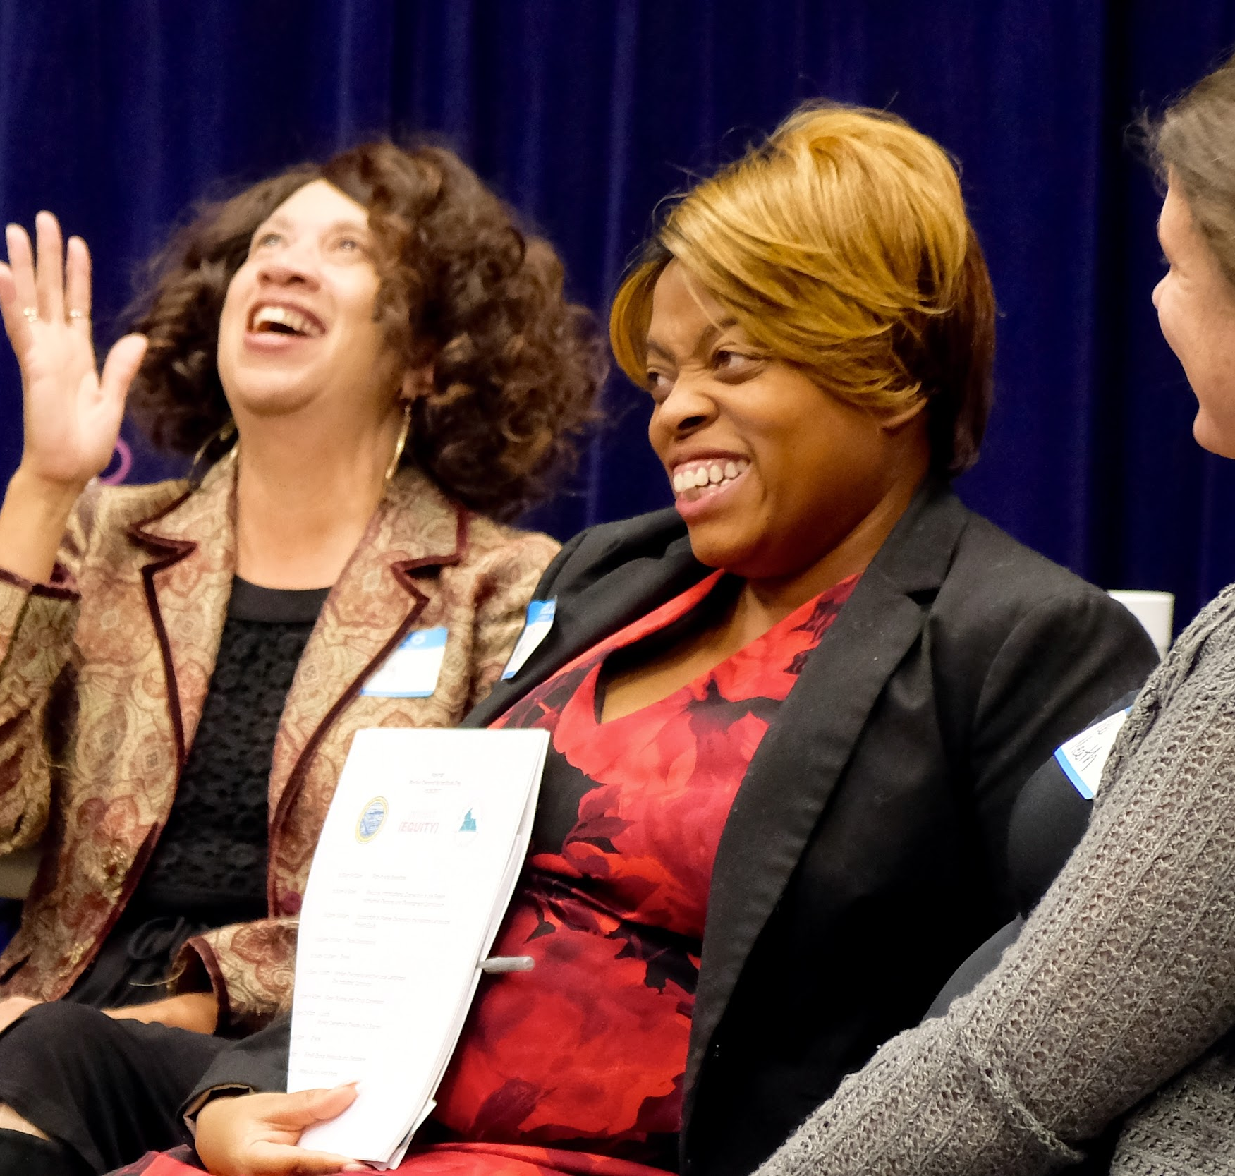
We believe.
Sustainability. Every project is underpinned with environmental and financial sustainability.
Racial Equity. Our work is done through a racial equity lens.
Participation. We believe in popular education and deeply engaging the communities we serve.
Place. We focus on our people and our assets.
Equity, Voice & Agency.
Everyone deserves to have a job that brings them dignity.

Slide 7
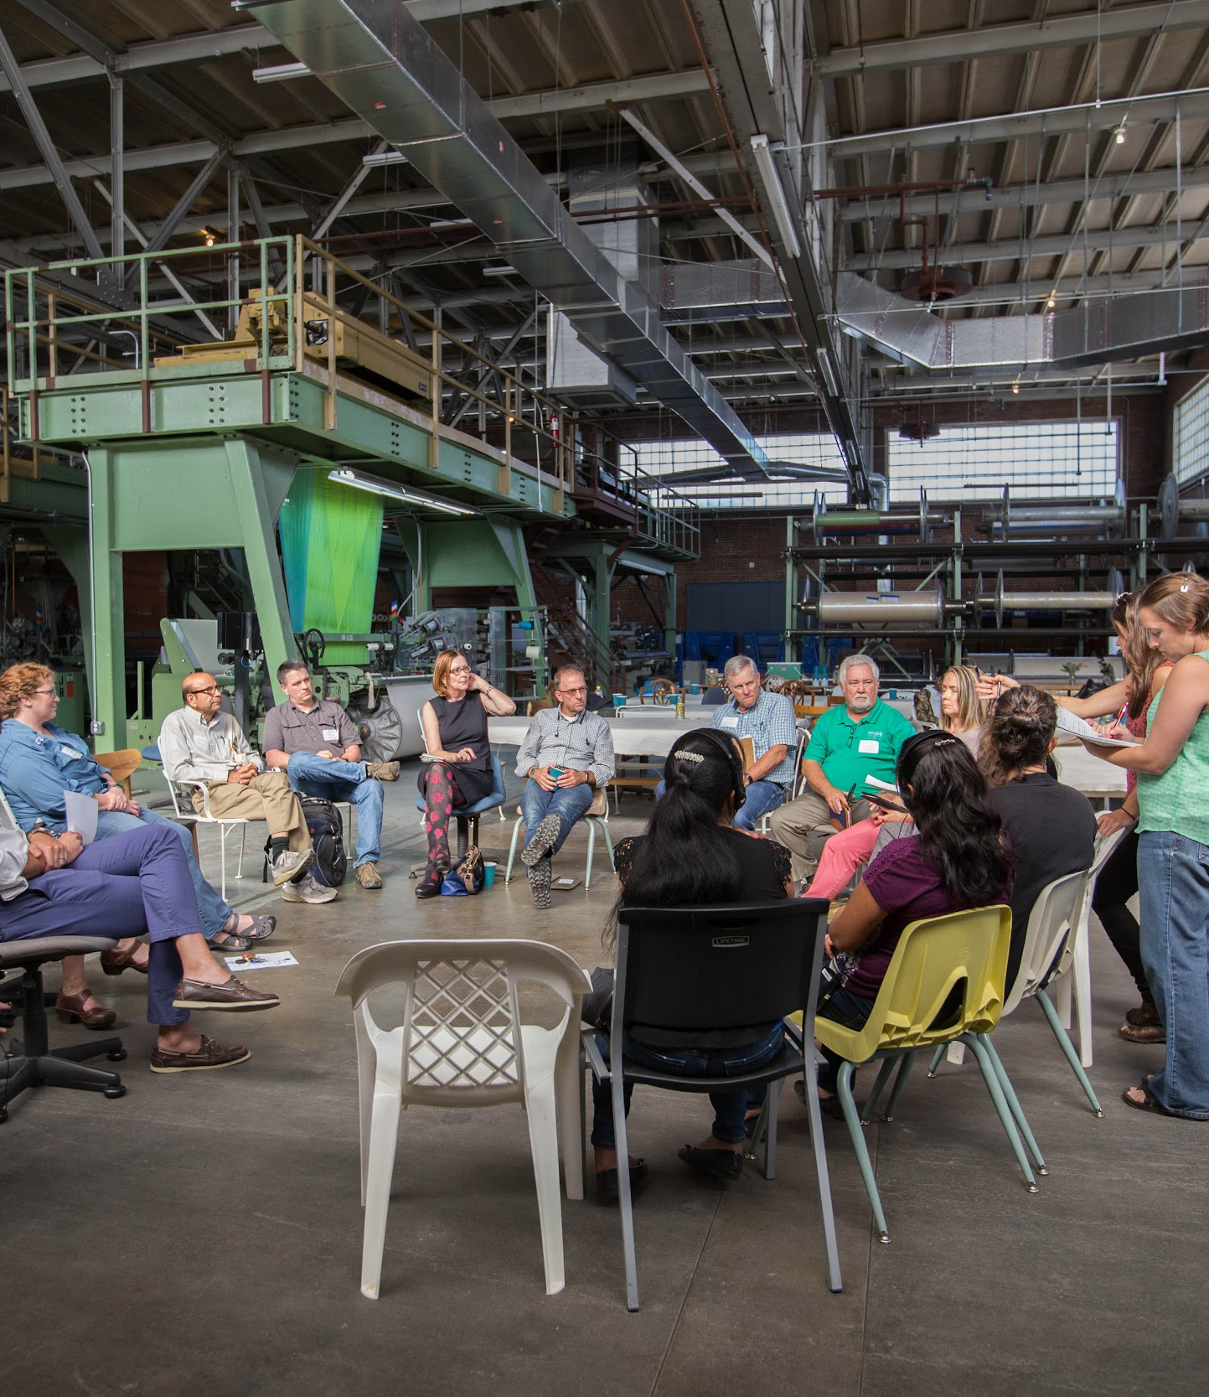
Effective strategies.
Industrial expertise. We leverage the region’s industrial infrastructure to de-risk new ventures.
Sector-wide collaboration. We organize small- and medium-sized businesses in the region to pursue larger opportunities and create resiliency.
Worker ownership. We create long-term opportunities for locally-rooted wealth to address intergenerational poverty.
Educating the next generation. We partner with community institutions like K-12 public education to engage the next generation in this new economy.

Slide 8
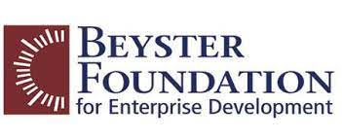
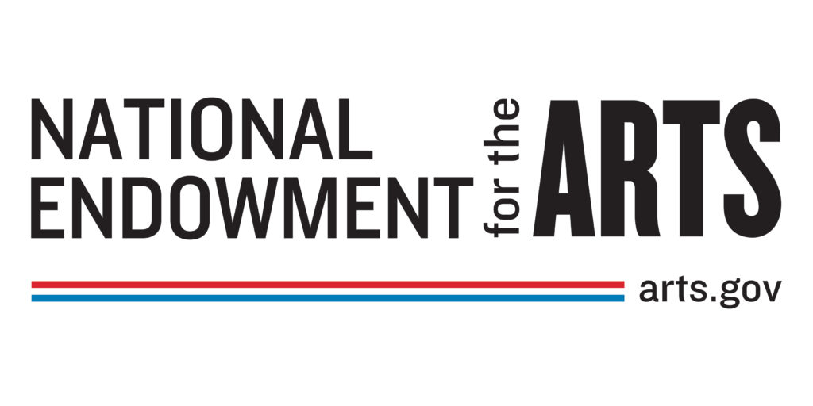
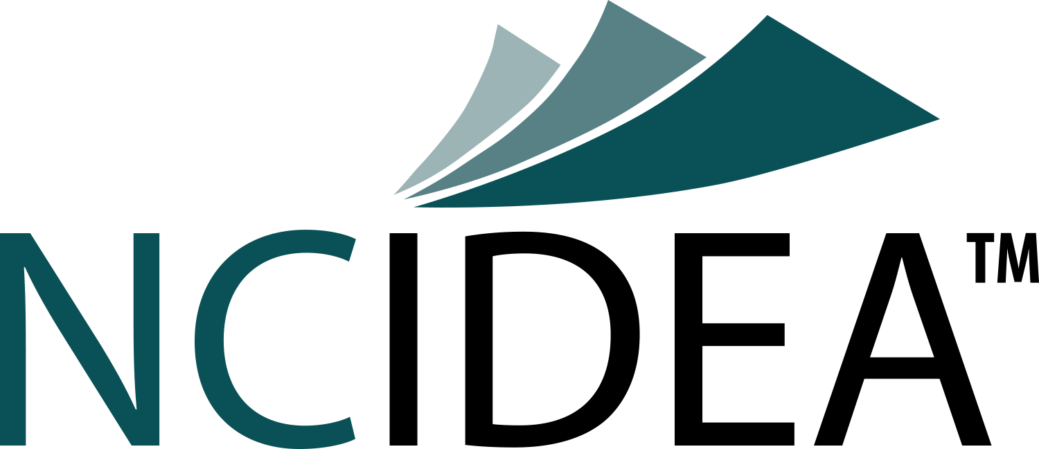
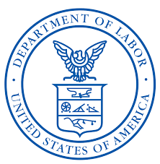
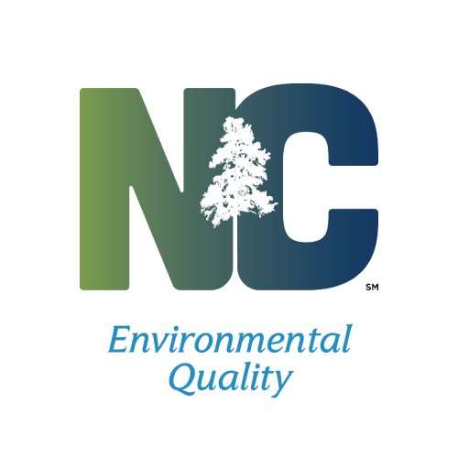
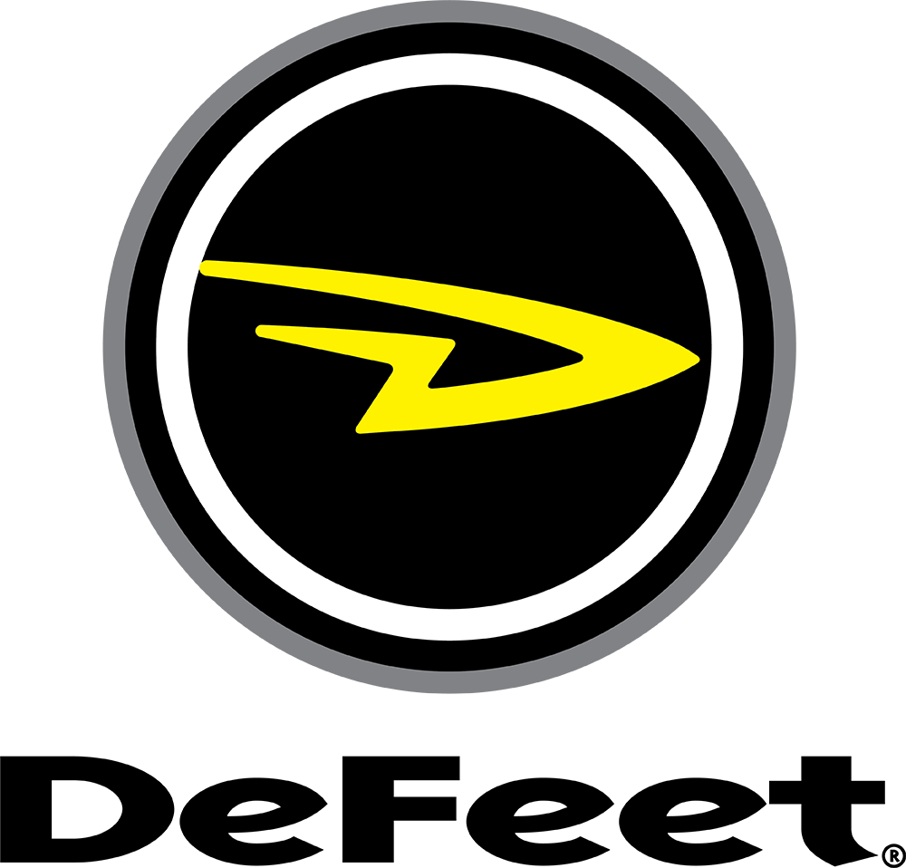
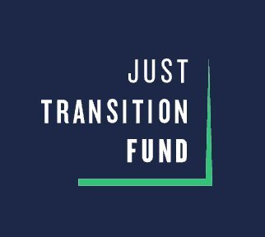
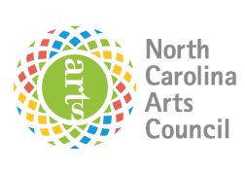
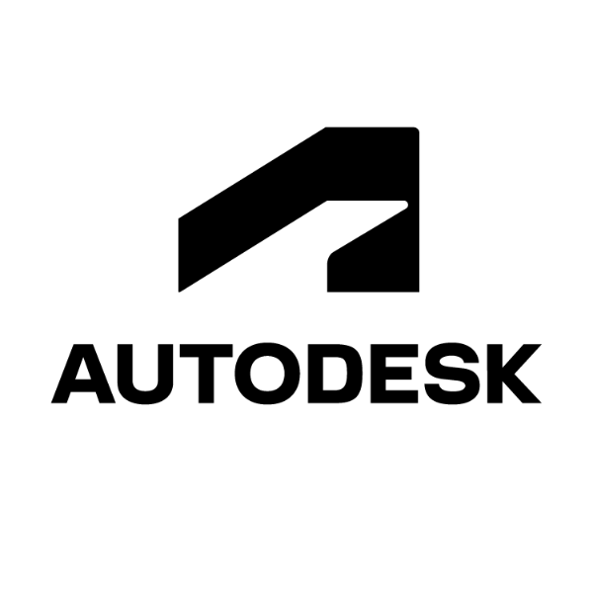
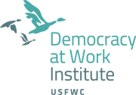
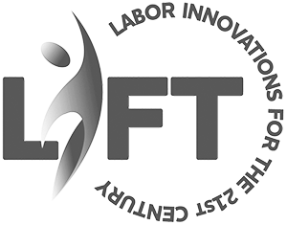
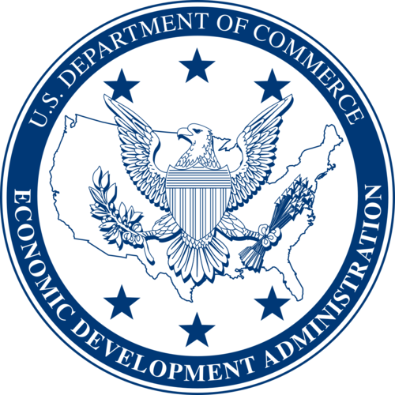
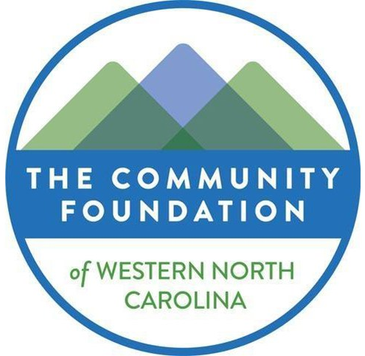
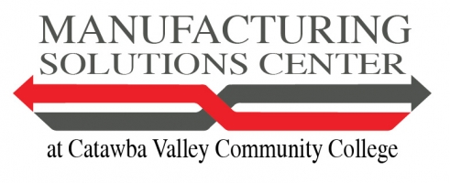
Some of Our
Industry Partners
Our Funding Partners

Slide 9
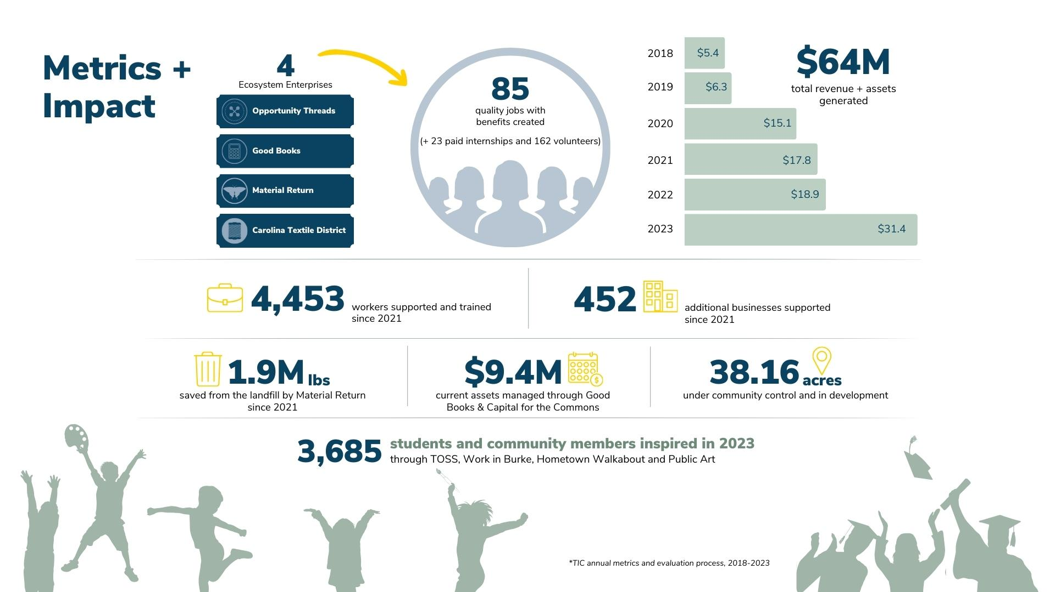

Slide 10
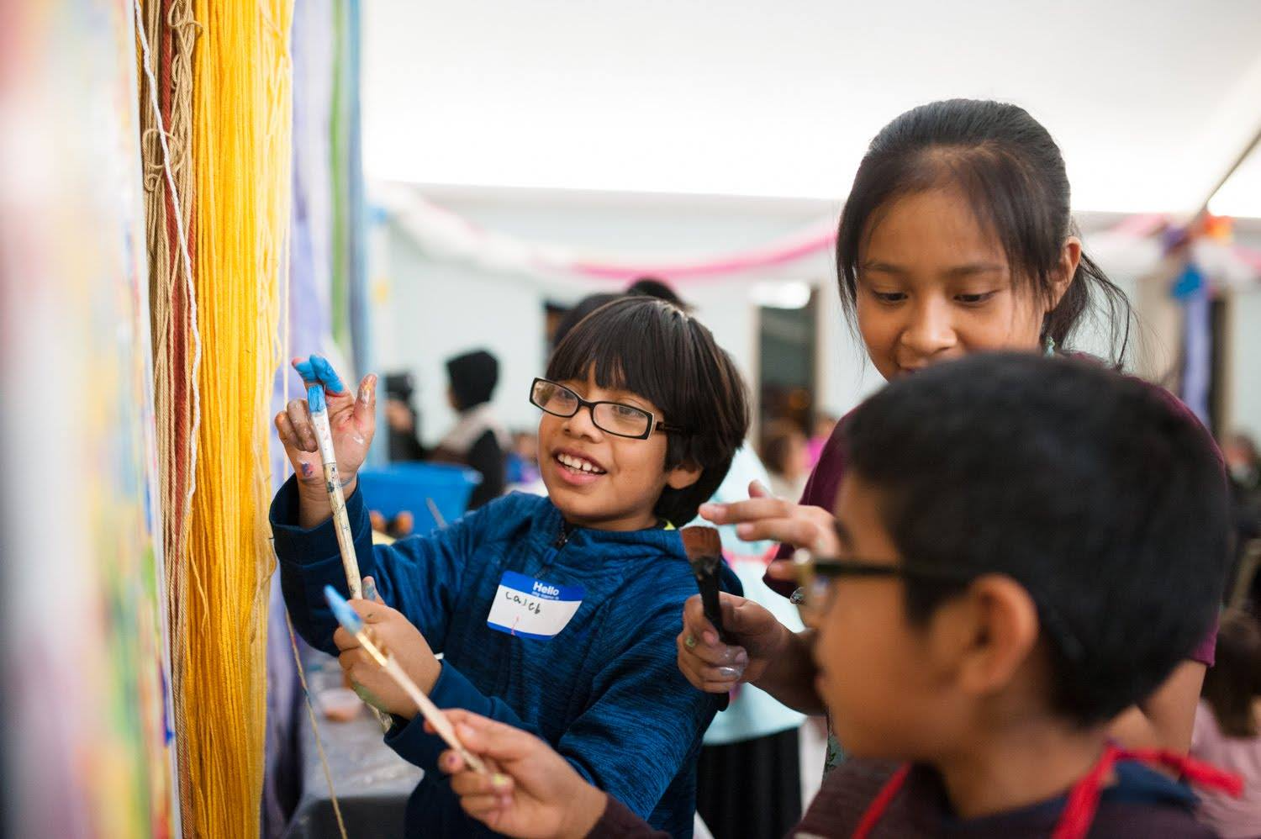
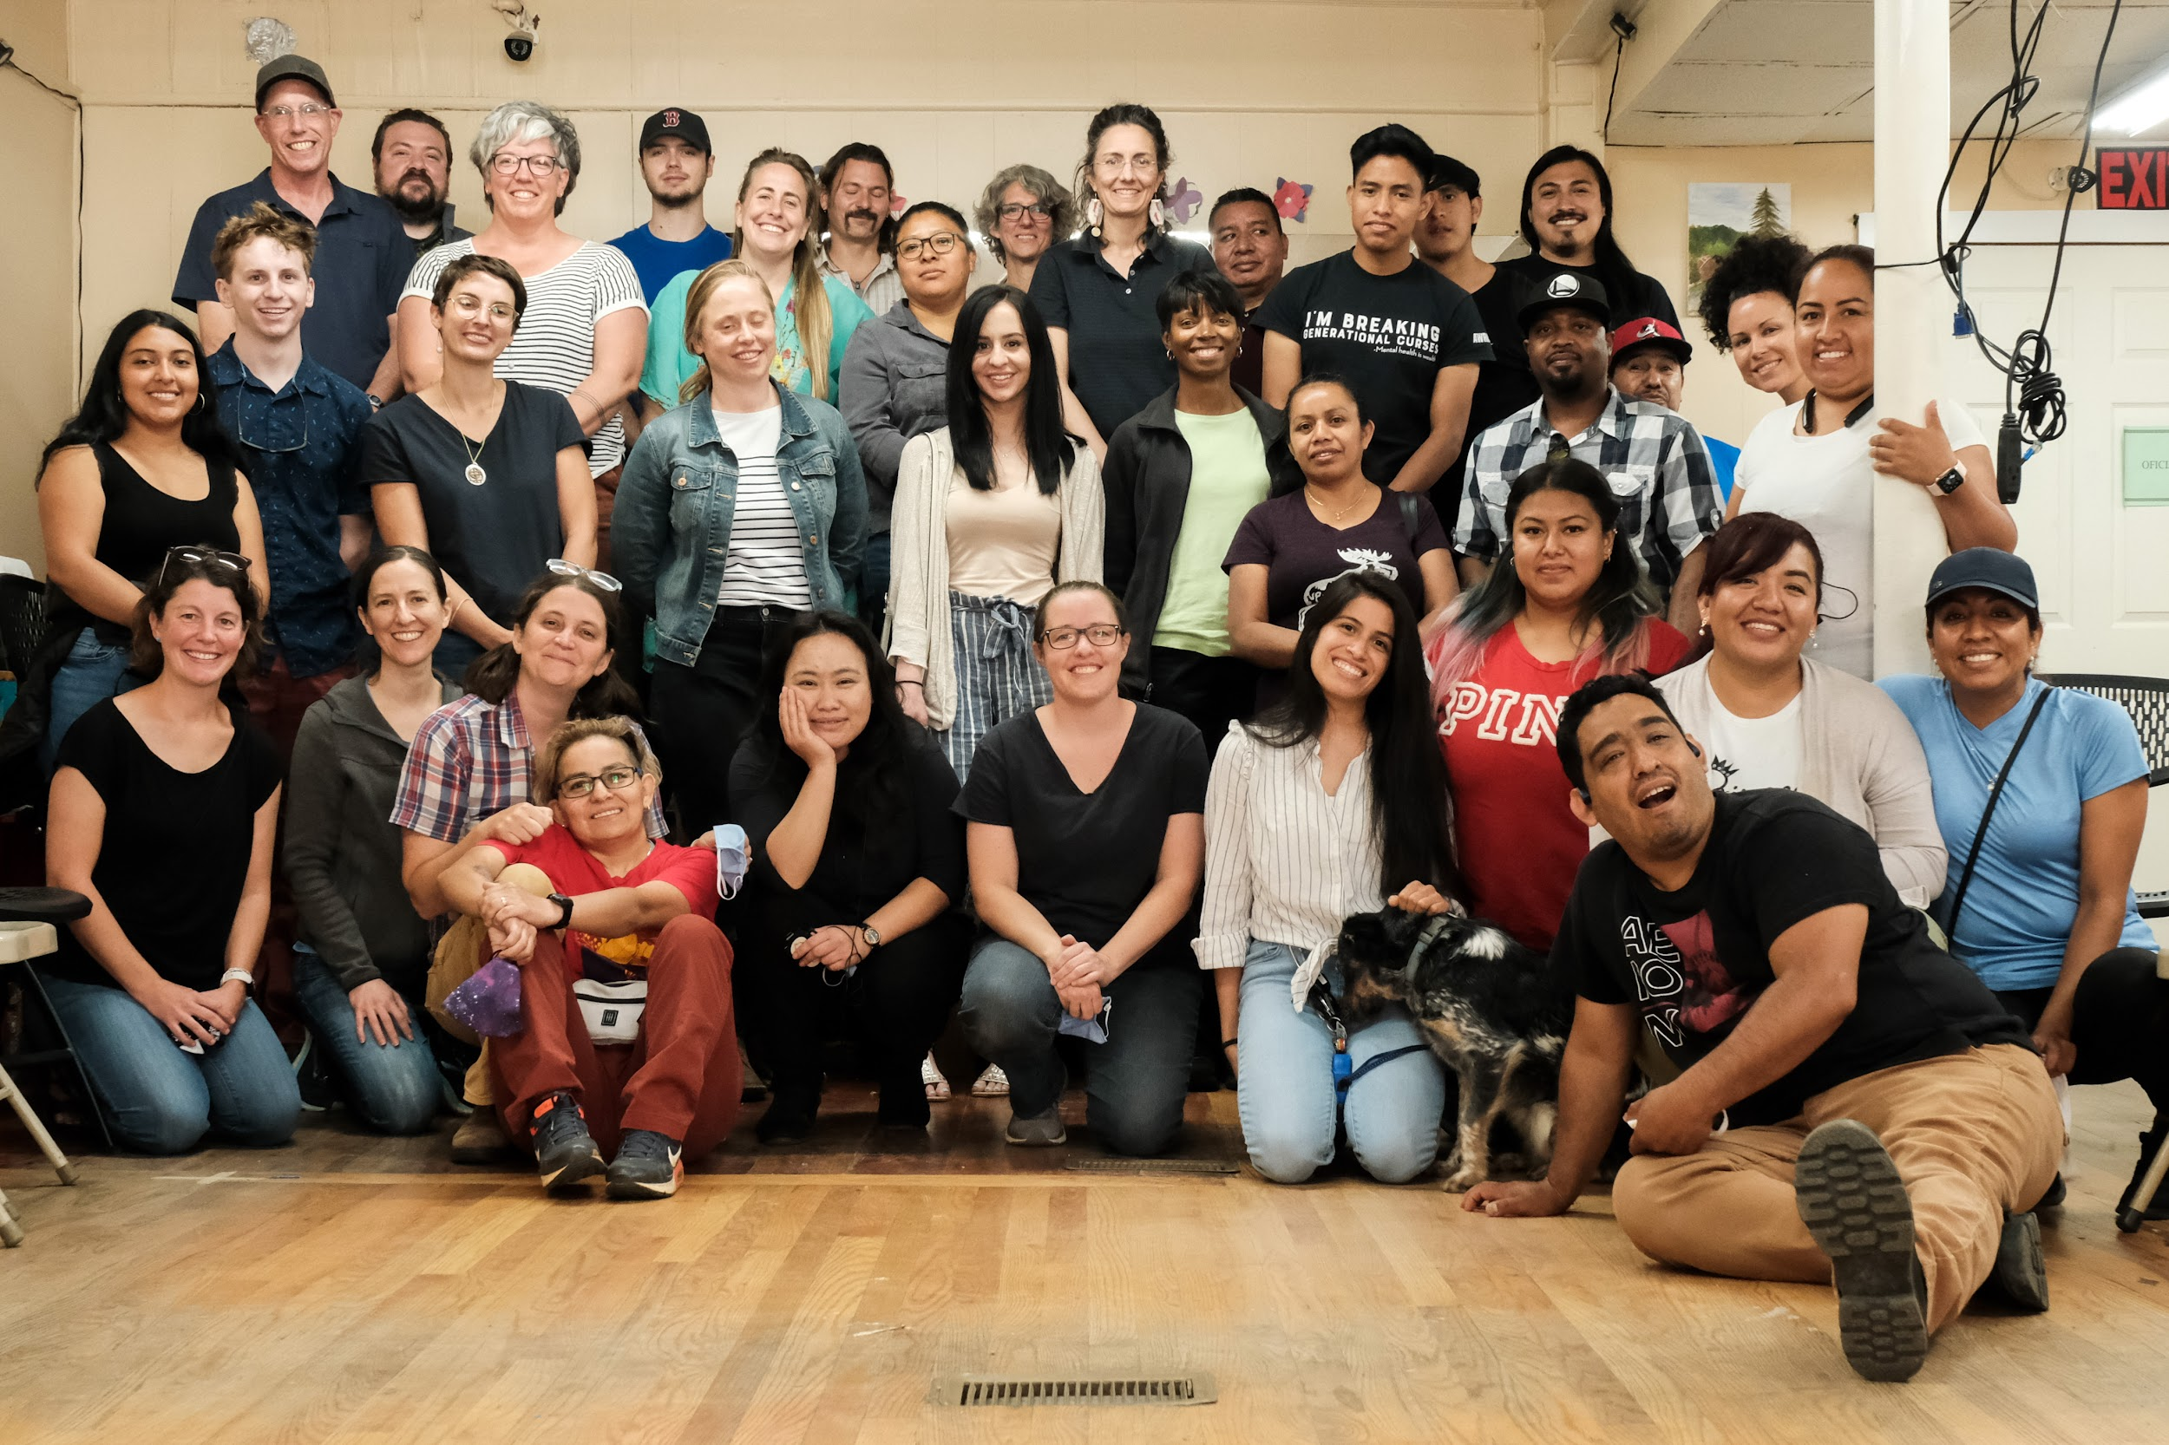
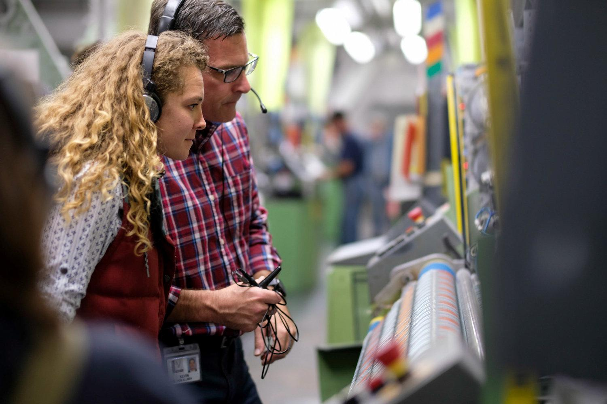
Here’s how we grow.
THRIVE
Organic
Growth
Regional expansion of our work within our own ecosystem and to contiguous communities.
Ecosystem Partnerships
Expansion of industry networks to partner cooperative ecosystems.
Model
Replication
Our ACE Institute provides shared experiences and coaching to other communities interested in replicating our model throughout the US.

Slide 11
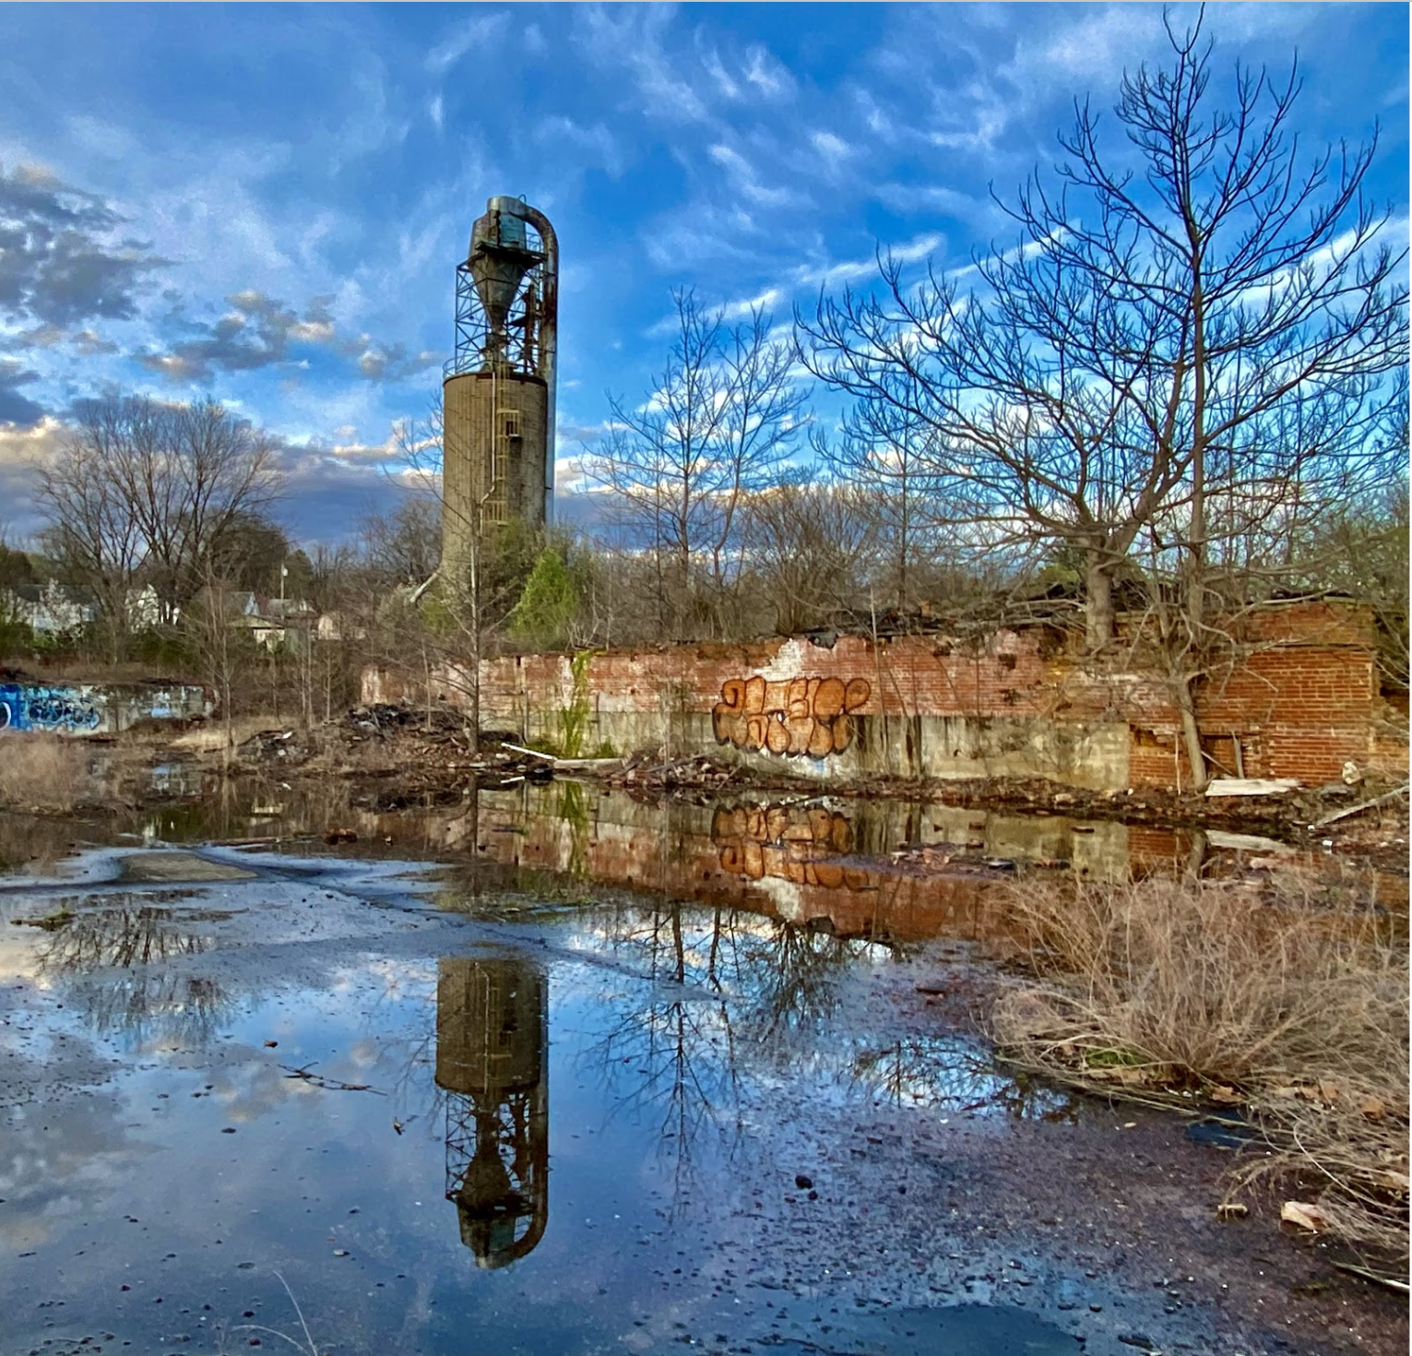
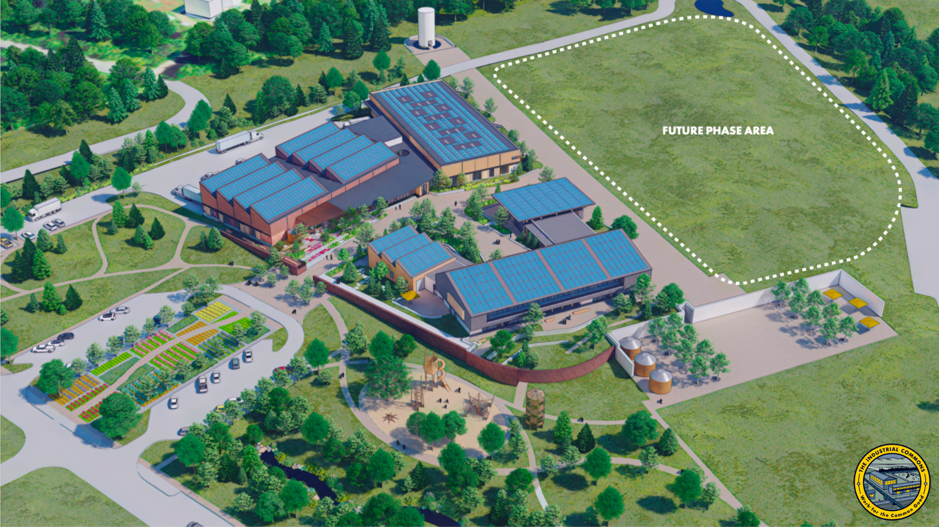
Plans for development.
The Innovation Campus & Adjacent Affordable Housing Parcel
Living Building Challenge
Limited Equity Housing Co-op + Land Trust

Slide 12
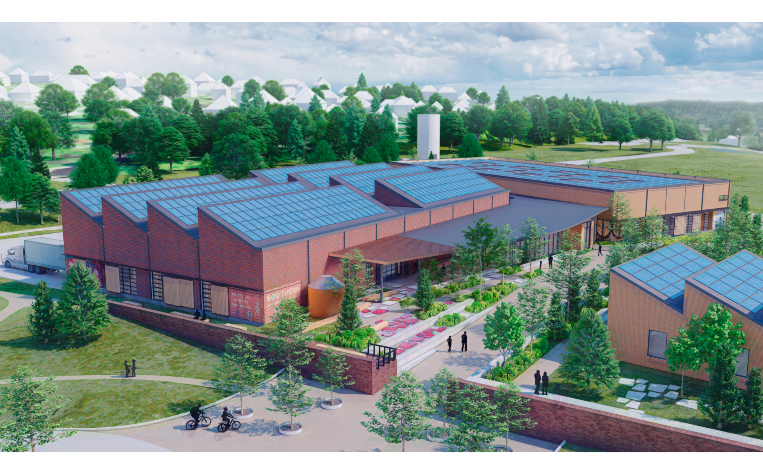

Slide 13
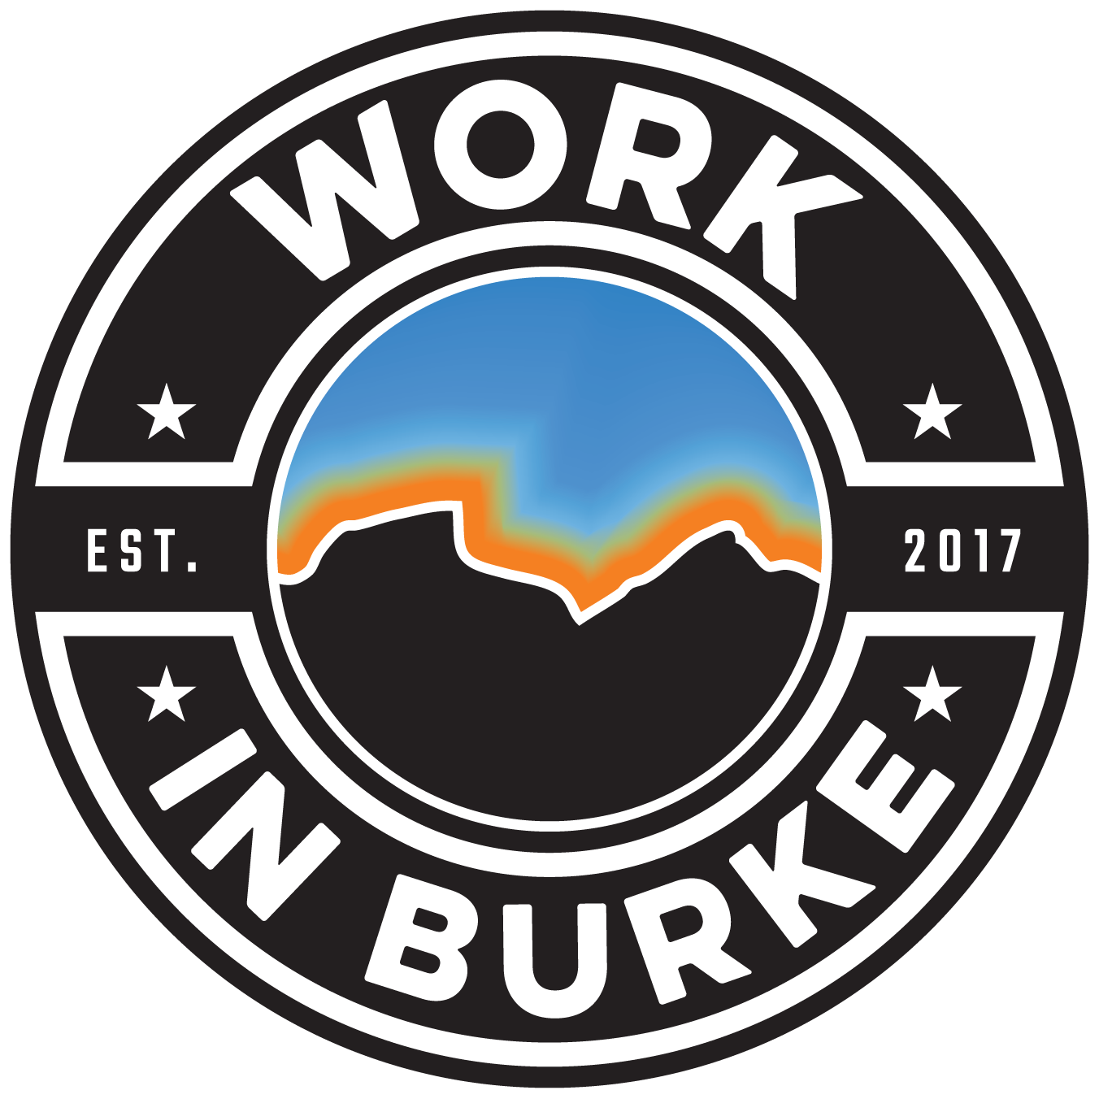
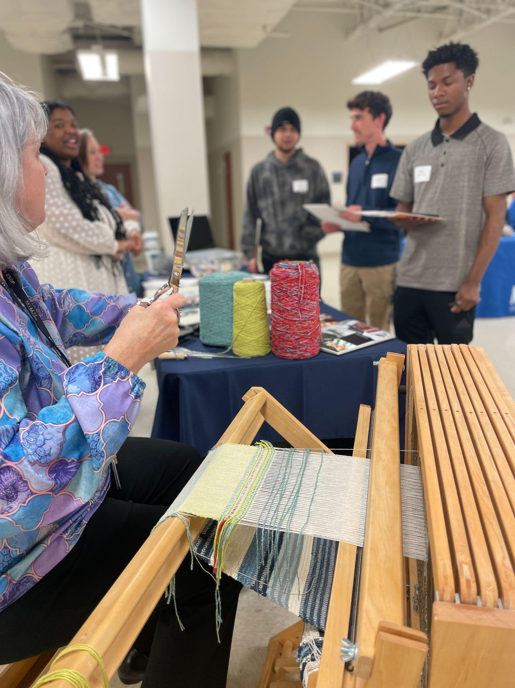
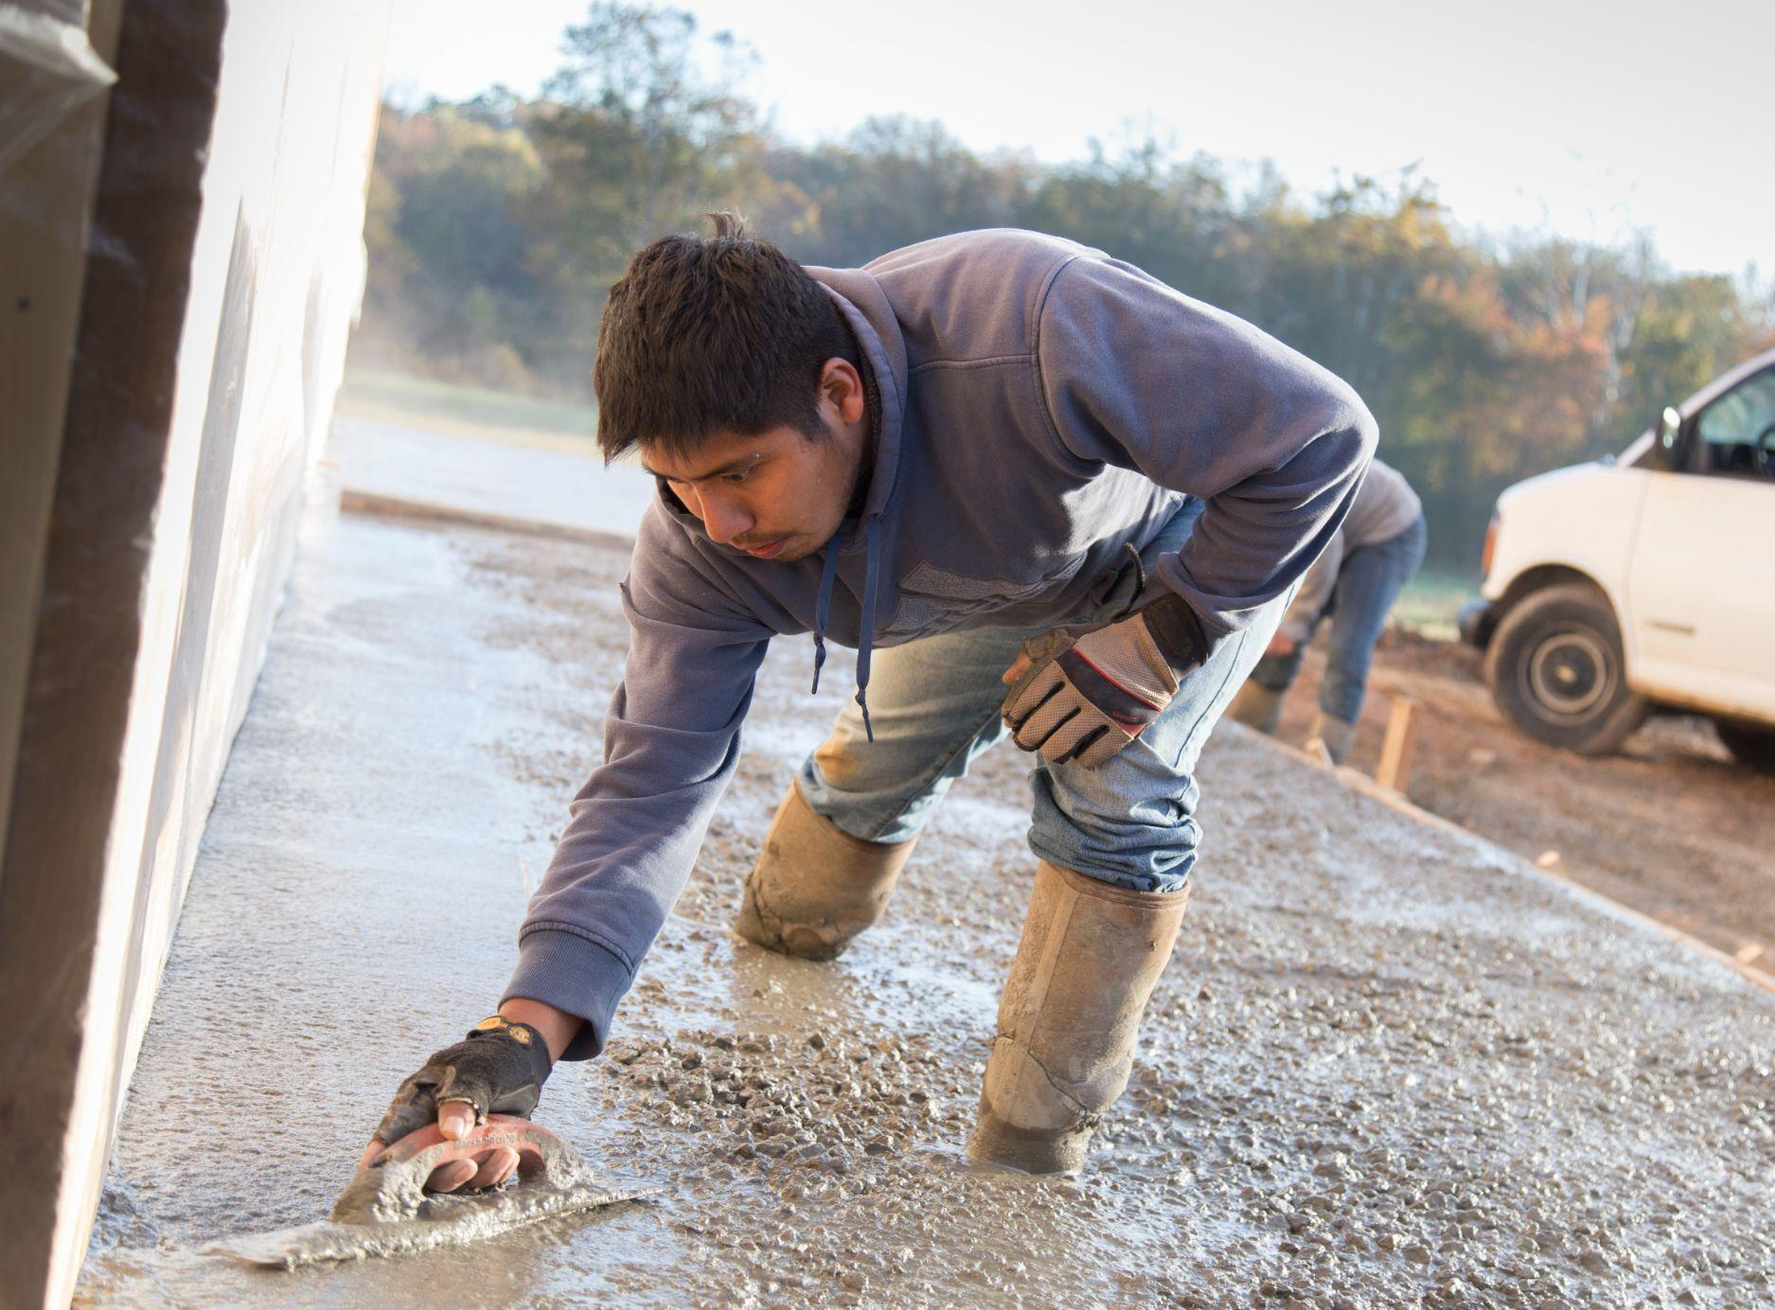
Partners:
Public School System
Community College
Economic Development
Workforce Development Board/Local Development District
Mission. Increase higher education rates for Burke County Students and build a skilled workforce by raising awareness of career and educational opportunities.
Outcome. 15% decrease in negative perceptions of local job opportunities. 15-20% increase in BCPS graduates that pursue post-secondary education.

Slide 14
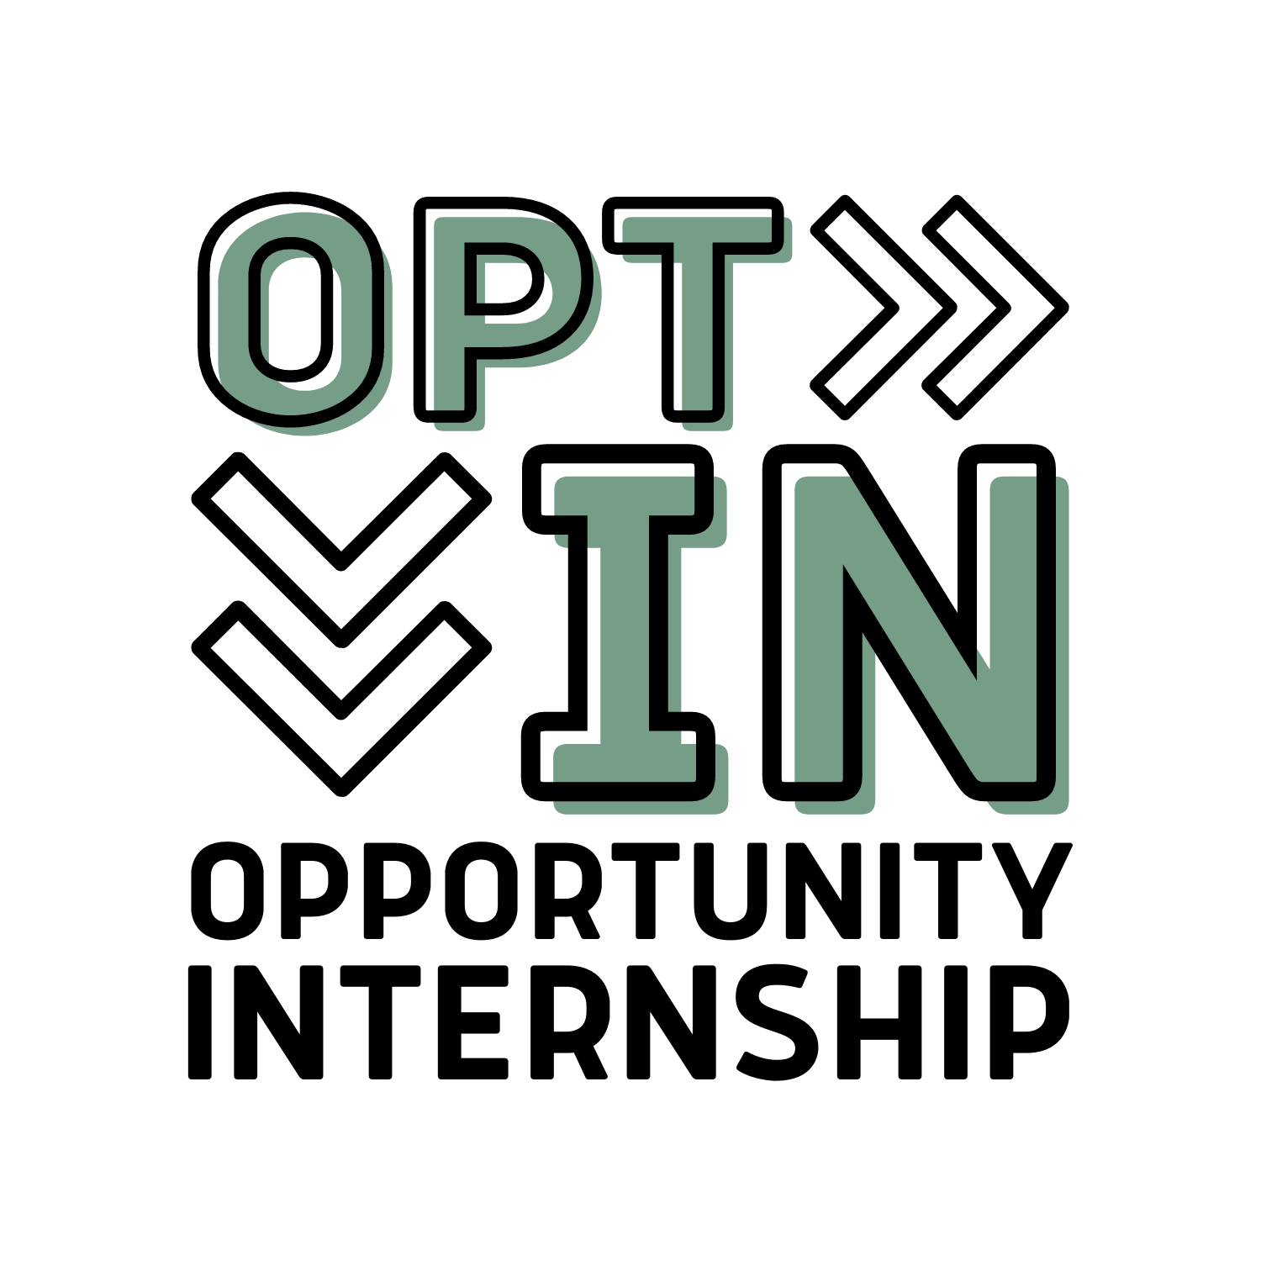
22% of 16-24 year olds were not working and not in school in 2022. We’ve seen a
4% decrease
in the “Opportunity Youth” rate over the past two years.

Slide 15
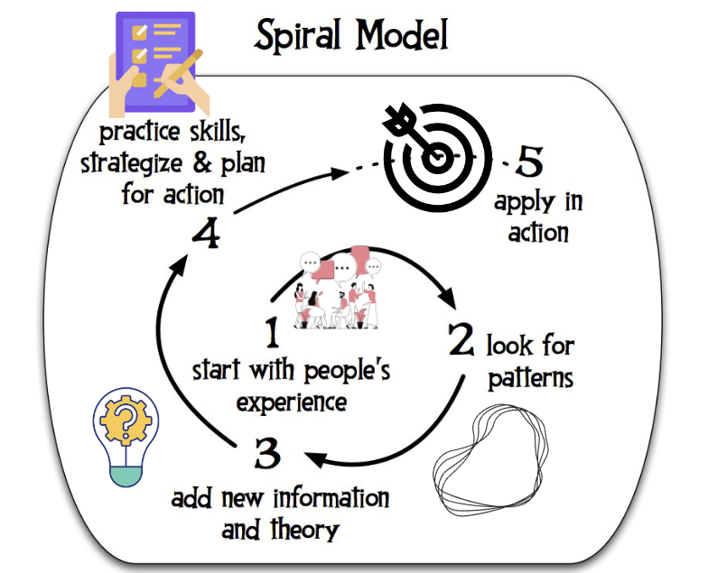
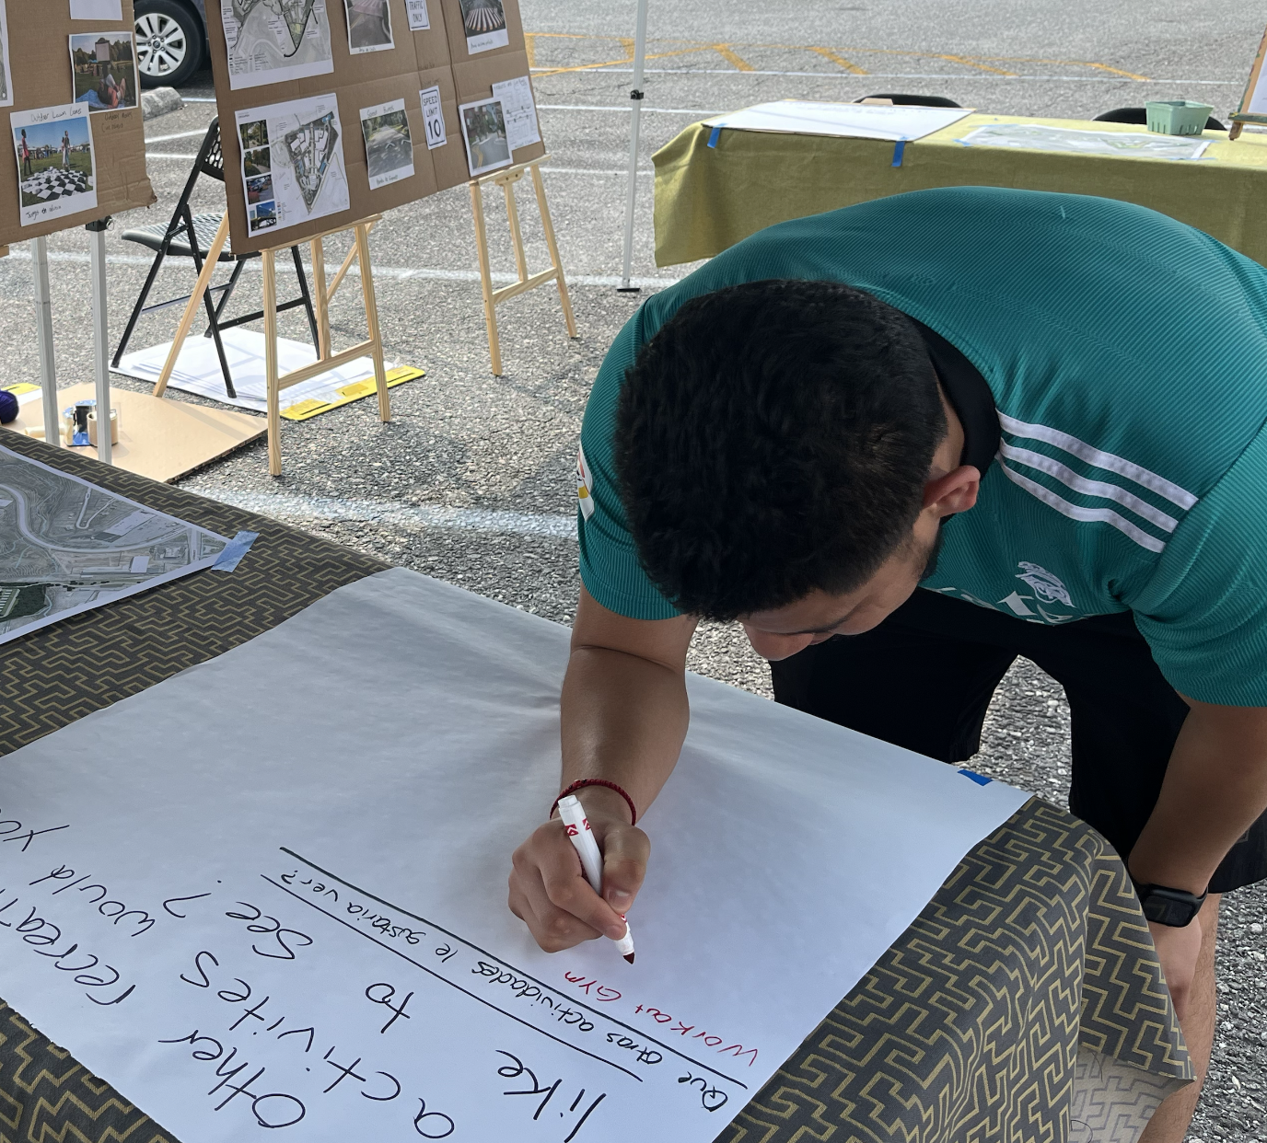
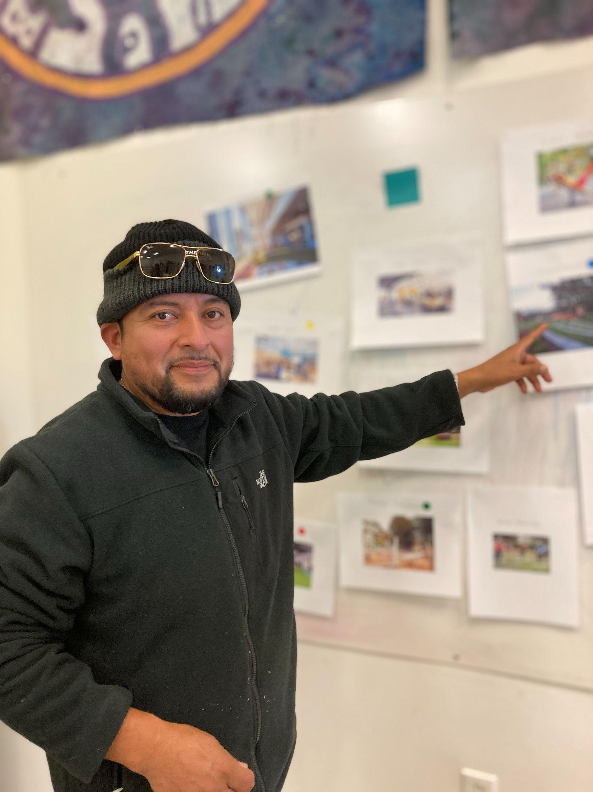
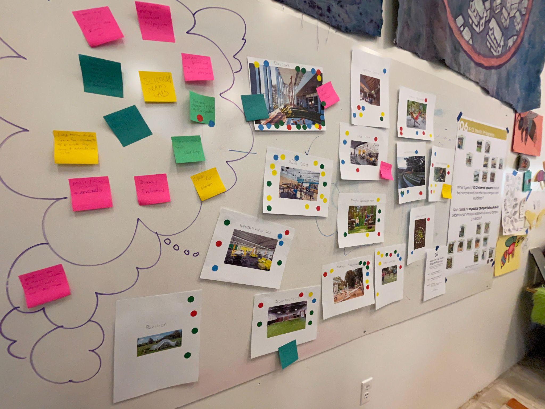
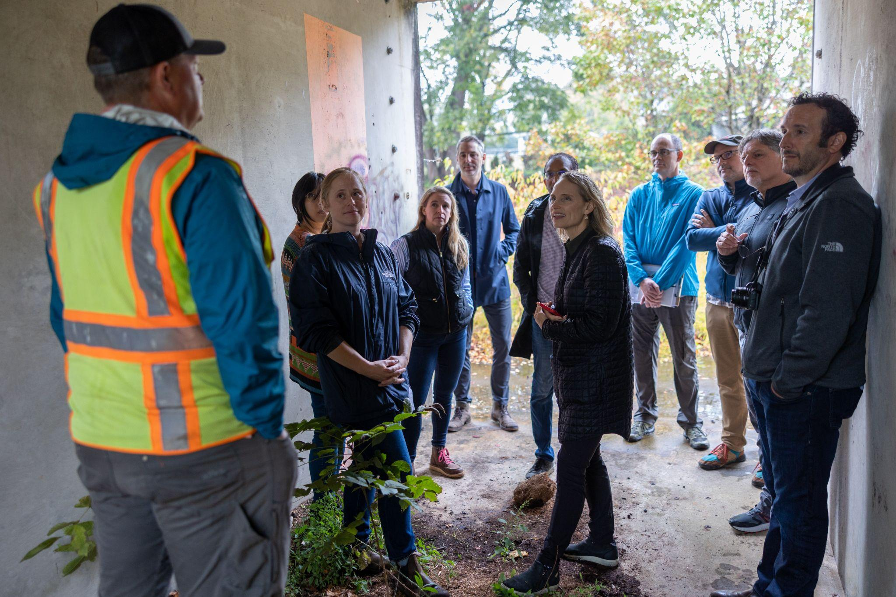
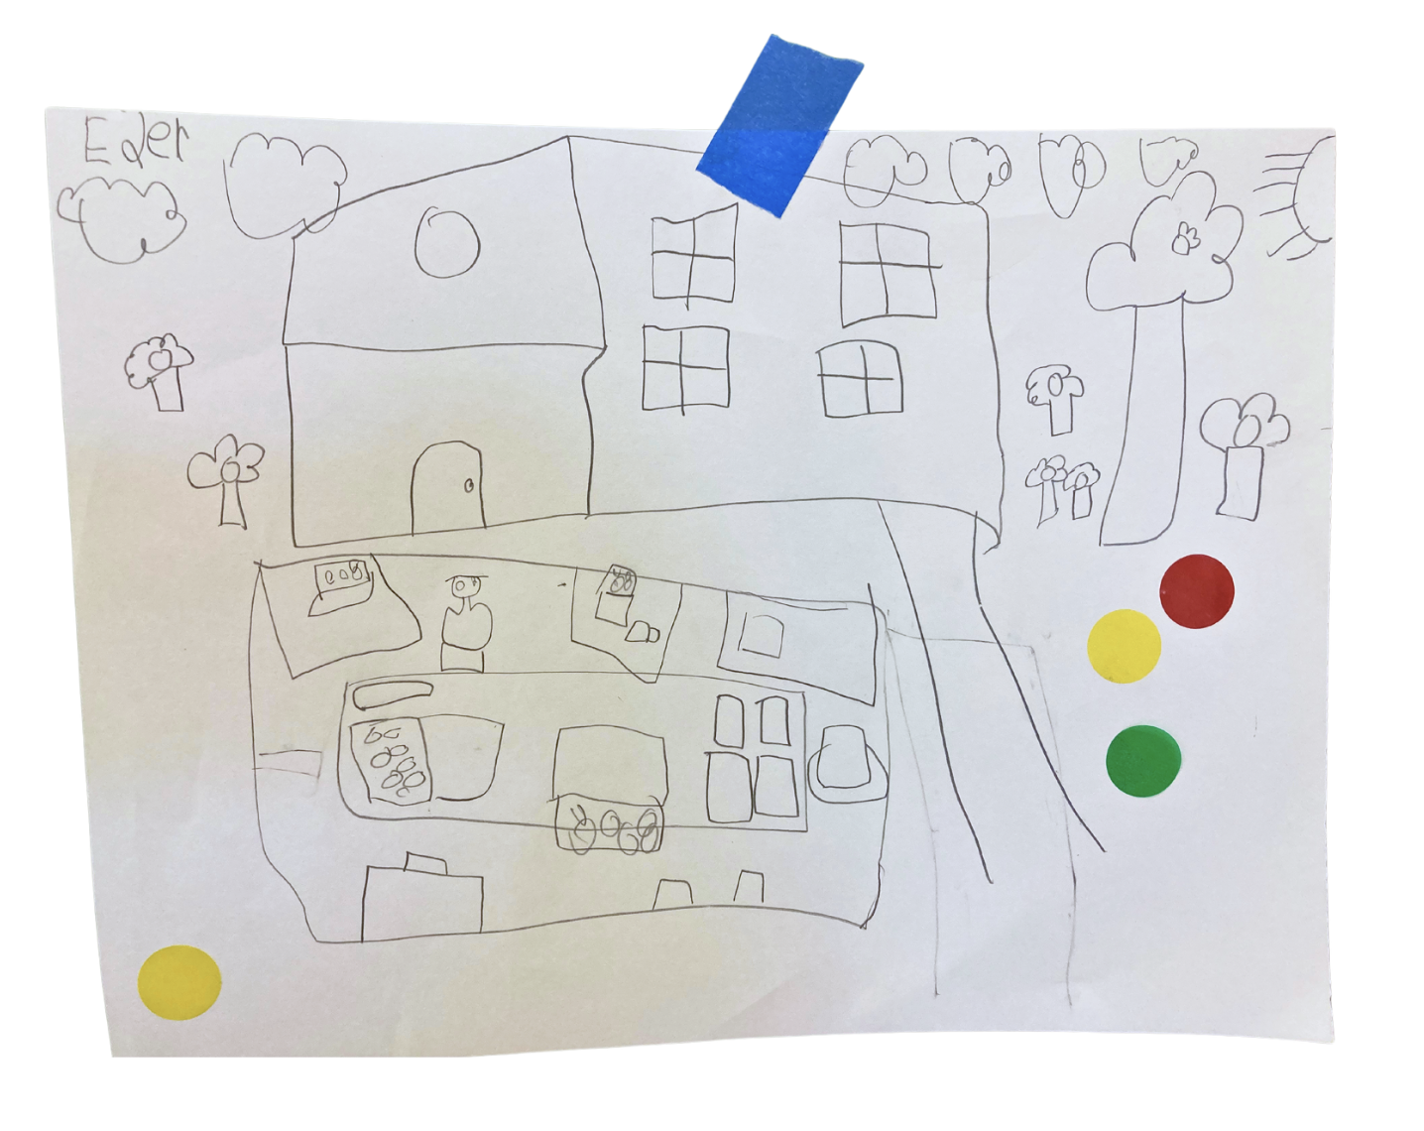
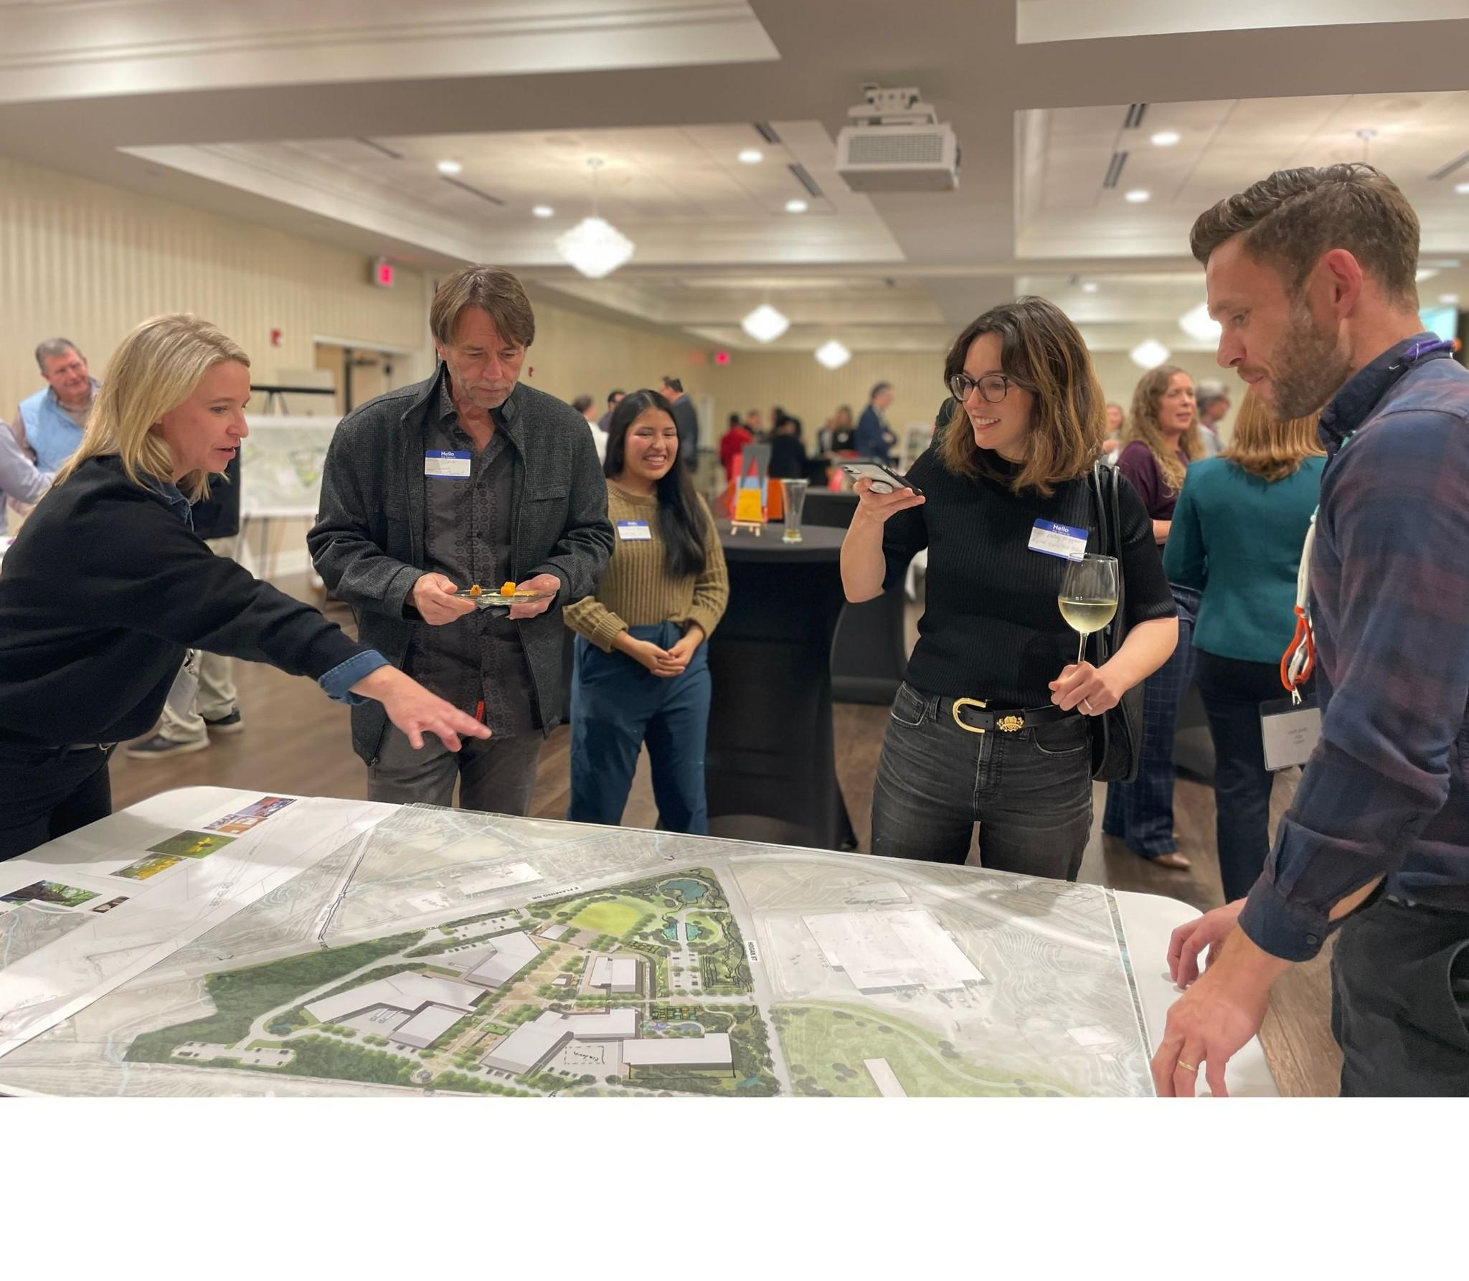
ACE Institute

Slide 16
Connect with us!
sara@theindustrialcommons.org
theindustrialcommons.org
@industrialcommons

