Slide 1

Thriving Communities Network
2024 National Regional Transportation Conference
Greenville, SC
July 30, 2024

Slide 2
What is the TCN?
The Thriving Communities Network (TCN) is a federal interagency effort that coordinates place-based technical assistance (TA) and capacity-building resources for urban, rural, and Tribal communities experiencing a history of economic distress and systemic disinvestment.
TCN was established in response to disadvantaged communities’ request for tools and resources to successfully compete and obtain funding that can address their economic, climate, and infrastructure needs.
These federal resources include grant and financial management support,
pre-development assistance, community engagement, planning, and project delivery support.
Notes:
TCN is a whole-of-government approach that coordinates TA and capacity building resources for urban, rural, and Tribal communities to help them identify, coordinate, and obtain TA to successfully compete and utilize the unprecedented and historic BIL and IRA investments that are helping address communities' economic, climate, and infrastructure needs.
This includes TA support in grant and financial management, pre-development assistance, community engagement, and overall planning and project delivery support.

Slide 3











TCN Agency Partners
Currently, TCN has 11 participating federal agencies.
TCN’s newest additions include the Department of Treasury and National Endowment for the Arts.
Notes:
Currently, we have 11 participating agencies as you can see here, and since our last meeting, we have added two more partners to TCN--Department of Treasury and National Endowment for the Arts.

Slide 4
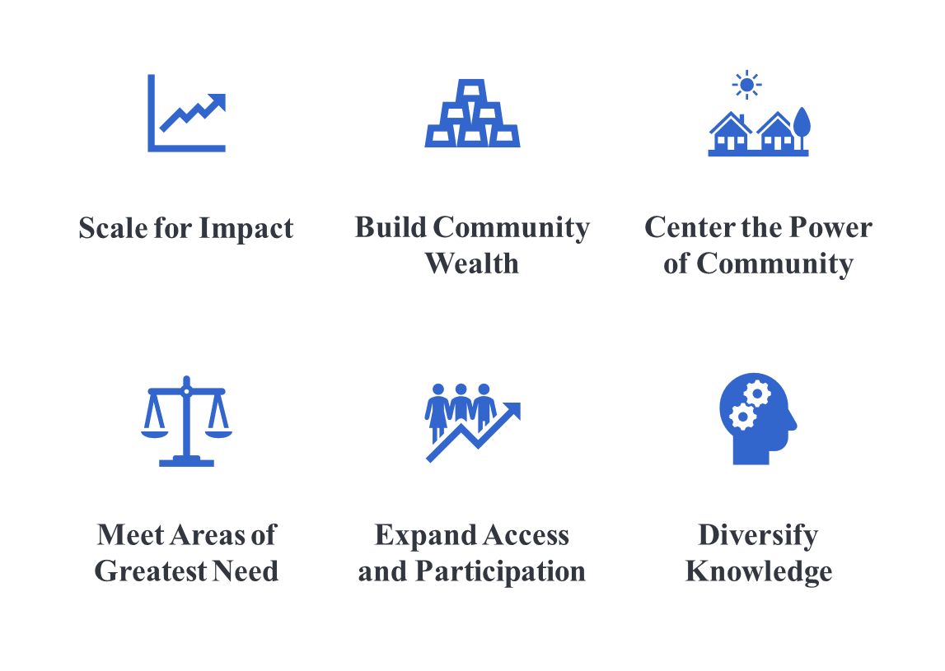
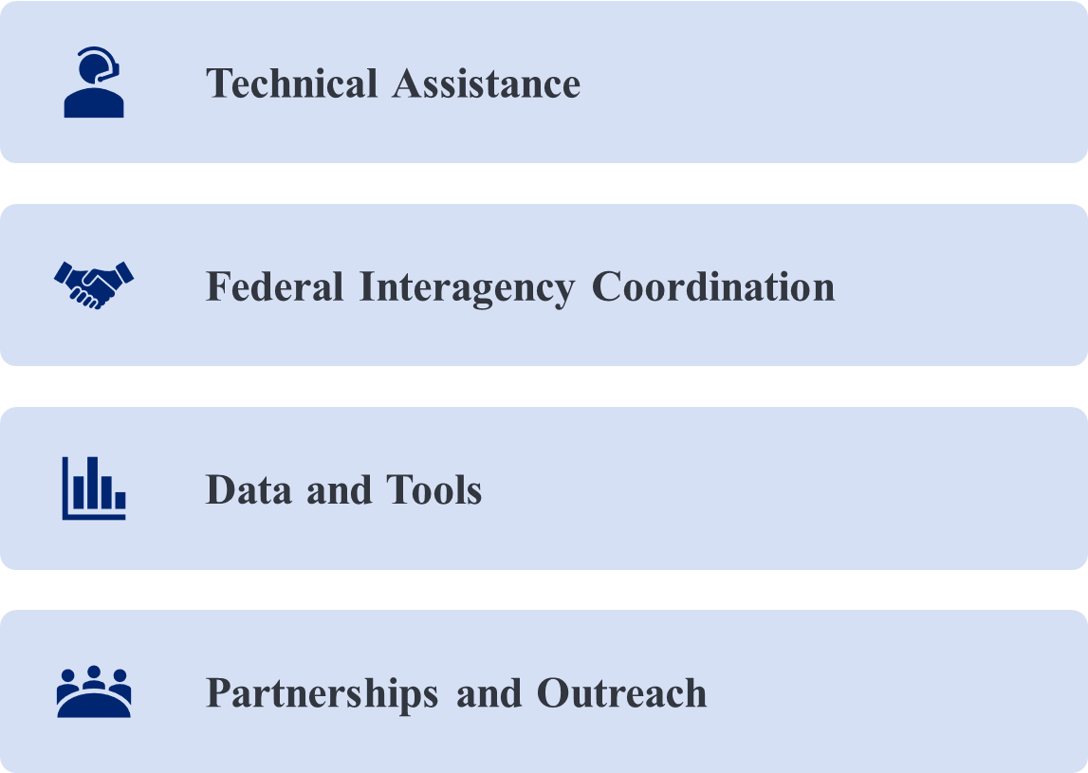
How does TCN work?
Theory of Change
Shared Principles
Four key strategies to support and connect communities:
TCN Partner Agencies commit to collectively supporting the following shared principles:

Slide 5
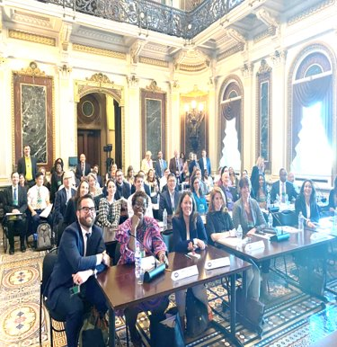
TCN White House
Capacity Builder Convening
Washington, D.C.
September 15, 2023
Full day event hosted by the White House for federally-funded TCN capacity builders, selected philanthropic organizations, and federal partners on September 15, 2023.
Senior White House leaders provided details about the Administration’s priorities and resources on climate, transportation, economic and environmental justice.
Participants had the opportunity to learn about the breadth of capacity building resources now available to communities and the historic investments now being deployed.
White House released a Fact Sheet highlighting a number of resources and programs from federal partners, states, and philanthropy and an updated Technical Assistance Resource Guide providing comprehensive information for more than 100 federal TA programs that can support efforts to win Federal funding and deploy it in communities across the nation.

Slide 6
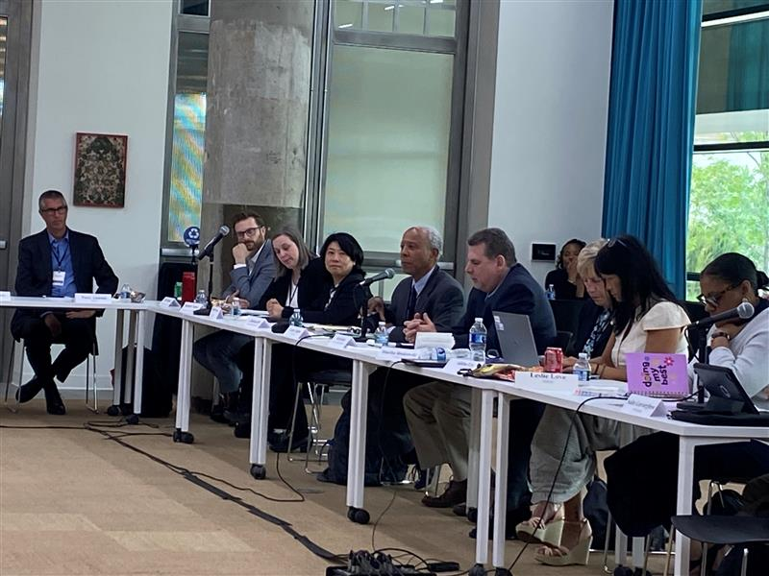
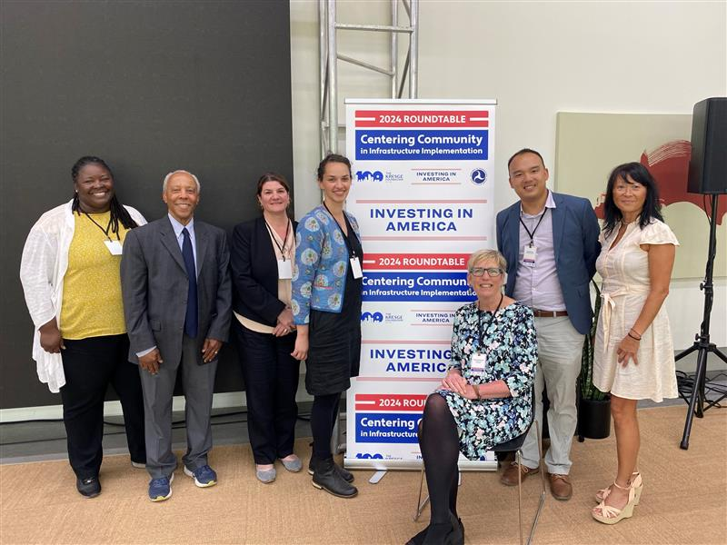
TCN Detroit/Kresge Convening
Detroit, MI
May 21 – 22, 2024
  Joint convening with DOT and the Kresge Foundation.
  Attendees included state and city partners, federal staff, and the Detroit community.
  Proactive engagement, brainstorming, and problem-solving with community members, federal staff, and state and city partners on project implementation .
  Community members felt hope and inspiration from conversations with federal staff; left feeling affirmed and seen.
  The convening sparked a renewed sense of commitment from all partners to center community voice and vision for projects implemented across Detroit.

Slide 7
TCN Regional Convenings
TCN New England Convening
  Date: July 29, 2024
  Location: St. Anselm College, New Hampshire
TCN Okanogan County Convening
  Date: September 11 – 12, 2024 (TBA)
  Location: Omak 12 Tribes Hotel, Washington
TCN & TCP FY 2023 TA Provider Convening
  Date: October 9 – 11, 2024 (TBA)
  Location: DOT Headquarters, Washington, D.C.
TCP FY 2022 TA Provider Convening
  Date: December 10 –11, 2024 (TBA)
  Location: DOT Headquarters, Washington D.C.

Slide 8
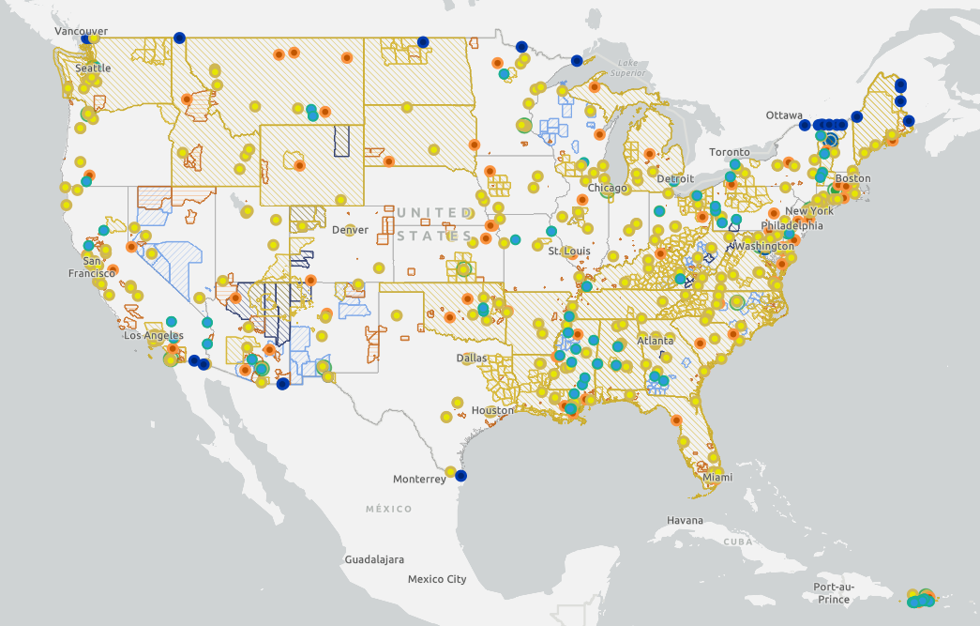
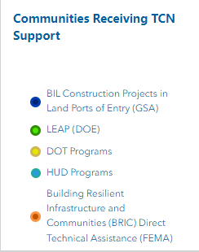
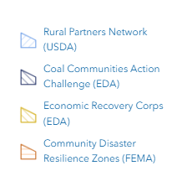
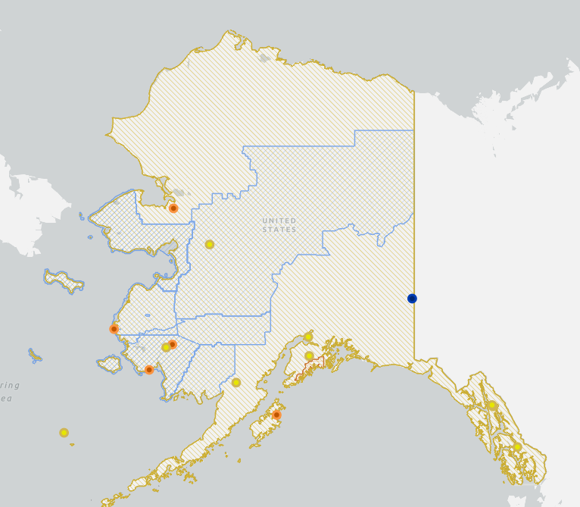
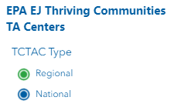
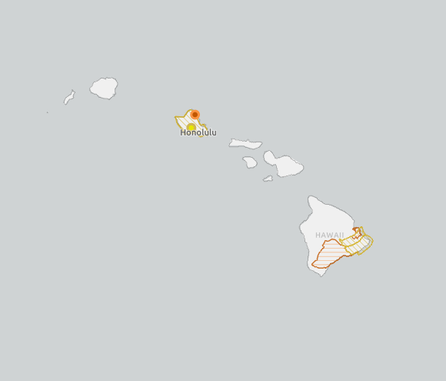
TCN Map
Map Link: https://experience.arcgis.com/experience/e690d86a246e49bdb8bad4f4dfe2ef70/page/TCN-Interagency-Coverage

Slide 9
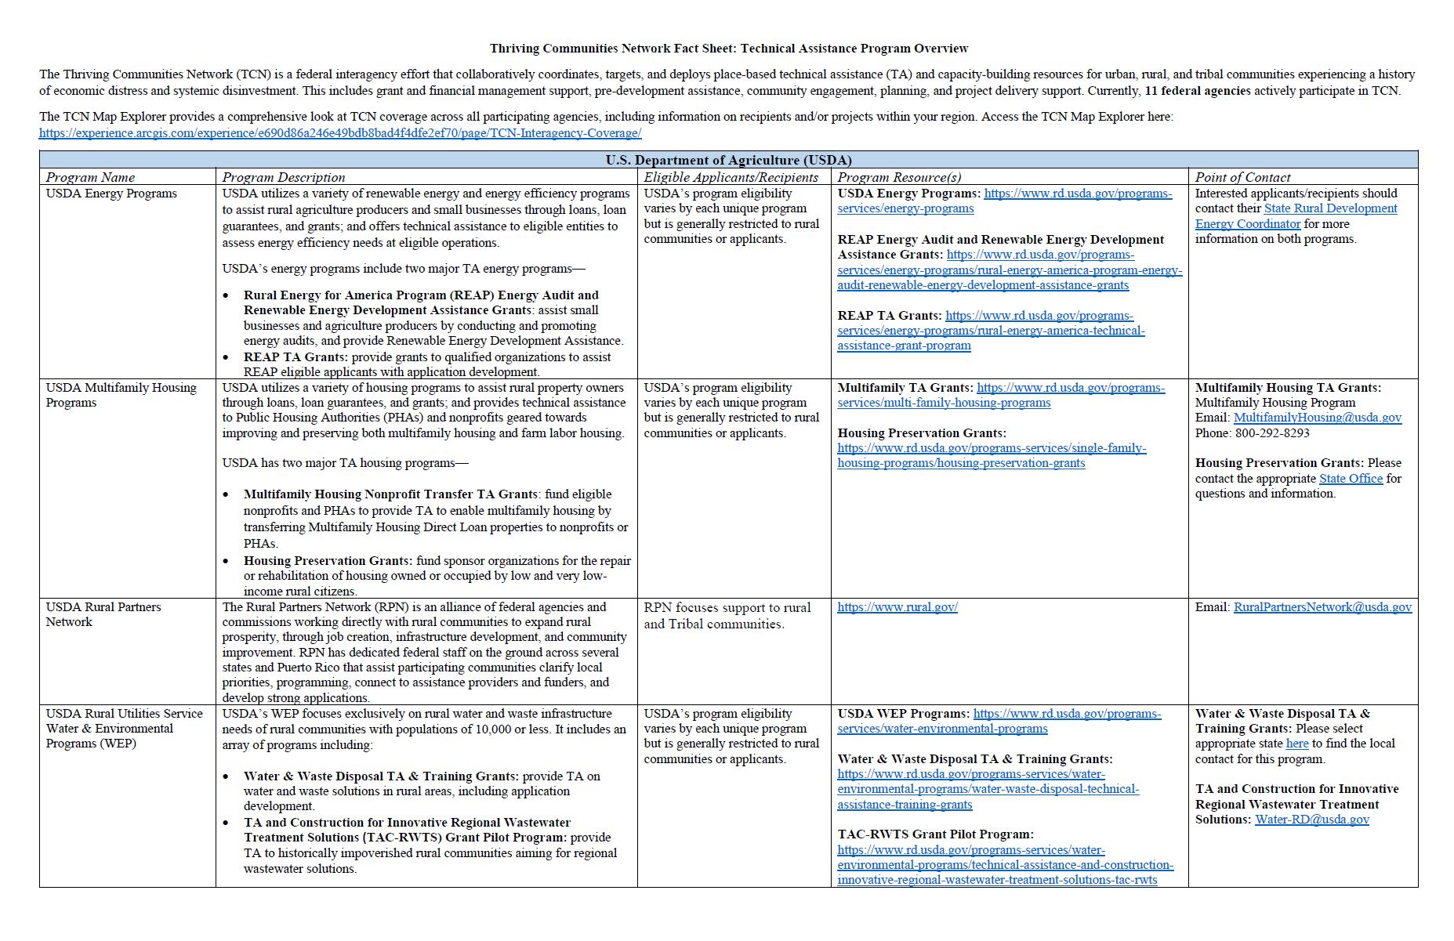
TCN Technical Assistance Programs

Slide 10
Stay Up to Date with the Thriving Communities Network!
Check out the TCN webpage for more information on TCN federal agencies, as well as TCN TA programs and resources: www.transportation.gov/thriving-communities-network-tcn
Stay up-to-date with TCN updates and events by subscribing to the TCN newsletter.
  To subscribe, please email ThrivingCommunitiesNetwork@dot.gov
TCN Community of Practice Learning Sessions: Monthly virtual series where TA providers, capacity builders, and federal staff convene to learn more about specific topics and discuss and share best practices and observations.
  If you're interested in attending these sessions, please email ThrivingCommunitiesNetwork@dot.gov

Slide 11
Questions?

Slide 12
Thank you!
Sharece Tyer
sharece.tyer@dot.gov

